Slide 1
Power Transformer
Erection , Commissioning and Maintenance
- Deshmukh Anand Rao

Slide 2
Topics Covered
Global View
Erection of T/F
Type tests
Routine Tests
Protection and protective Relays
Commissioning
Maintenance
Maintenance Check Lists Samples
Experiences sharing / Case studies.

Slide 3
Global View
Installed Capacities and Annual Consumption
Installed Capacity of
China-2355GW,USA-1176GW
Third Largest is India with 400GW.
Annual Consumption.
1. China-8.8PWh
2.USA-4.2 PWh
3.Third India with 1.5
4.Russia-1.08PWh
5.Japan-1PWh
Global Generation Growth Slower down from 5.7%to 2.3%.
India marked first with 9.7%, Indonasia-7.9%,China-3.7,US-3
 | Installed Capacity | Annual Consumption
World | 10,000 GW | 25 PWh
India | 400GW | 1.5 PWh
AP | 27GW | 65830 Million Units

Slide 4
Per Capita Consumption
Global Per Capita Consumption is 4500 Units
India -1500 Units (1/3 of World).
Max Dadar & Nagar Haveli - 10000Units.
Min Bihar - 311 Units.
AP -1400 Units.
Telangana- 2100 Units (70% increase from 2014)
Length of Transmission lines in AP 400KV-11KV-2,31,127KM(Excluding PGCL)
Max Day consumption - 251 MU ( on 28.05.23)
Highest grid demand in India - 223GW(09.06.23)
India’s population is 18% of world population but energy consumption is 6%.
Transmission and Distribution losses in India is 20% and AP <3%( 40% is given free without metering)

Slide 5
Transformer
An AC device used to change high voltage low current to low voltage high current without changing frequency on mutual induction principle

Slide 6
Power Transformer
Difference between Power and distribution Transformers
Power transformers are designed to step up or down voltage levels for transmission purposes, distribution transformers are made specifically to provide stepped-down voltages to consumers.
Why KVA not KW
As the copper losses depends on current and Iron losses on Voltage. Since total losses depend on Volt-Amp(VA) and not on load power factor the transformers rating is given in MVA/KVA
Dry Type T/F
Are of cast resin type or Vacuum Pressure Impregnated
Most suitable for moist atmosphere.
Less fire hazard
Low maintenance.
Easy erection.
Limitation is initial cost is more compared to oil immersed T/F.

Slide 7
Erection of T/F (IS Code -10028)
Precautions (Generally neglected but very Important)
Empty pockets.
Secure all tools with cotton tapes.
Oil being flammable no fire works to be take-up. If it is essential utmost carfare to be taken with first aid and fire extinguishers.
Minimize exposing the winding to atmosphere.
Foundation shall be level and strong.
No influence of external vibrations and ensure proper ventilation.
Suitable rail/road should be available and accessibility for suitable heavy vehicle movement.
TNP readiness and identify competent agency.
All factory reports and all formats are to be made ready.

Slide 8
Power T/F tests
Type Tests
To prove customer’s Specifications and design criteria are met.
It is conducted on sample unit.
Done at manufacturer’s premises.
Routine Tests
Done mainly to conform operational performance.
It is conducted on every unit.
Special Tests
To obtain useful information for operation and maintenance.
(Auchostic, Harmonics, Power consumption of pumps and fans, brought out items testing)

Slide 9
Tests on T/F
Winding resistance test of transformer
Transformer ratio test
Magnetic Balance Test.
Magnetizing Current Test.
Transformer vector group test
Measurement of impedance voltage/short circuit impedance (principal tap) and load loss (Short circuit test)
Measurement of no load loss and current (Open circuit test)
Measurement of insulation resistance
Dielectric tests of transformer.
Induced Voltage Test.
Tests on on-load tap-changer.
Temp rise test
Vacuum test on Tank and Radiators.
Oil pressure test on transformer to check against leakages past joints and gaskets

Slide 10
Tests on T/F
Winding Resistance Test
Is carried out as type test, routine and also field test.
Used to calculate Copper Losses (I2R)
Used in Calculation of WT as winding temp.can not be measured directly.
Used as intial reading for further analysis
For star connected T/F N-Phase, for Delta 1.5X Reading.
Ratio Test
Important to ensure design voltages.
During test voltages are applied on HV side to avoid unsafe voltages.
Should be done on all Tap positions.

Slide 11
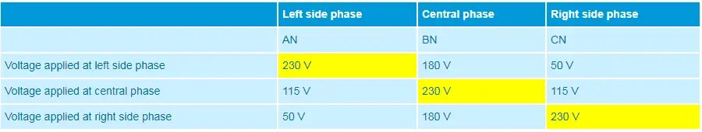
Tests on T/F
Magnetic Balance Test
Conducted on 3 phase T/F to check the imbalances in magnetic circuit.
Apply single phase voltage and measure the voltages on the other pages and record.Voltages depends on the respective limp position.
Eg:

Slide 12
Tests on T/F
Magnetising Current test
Mainly conducted to locate defects in magnetic core structure, shifting of winding, failure of insulation between turns or tap changer problems.
Keep tap at lowest position and open all HV,LV terminals.
Apply 3 Phase voltage and measure current and voltages I each phase.
Observation :- Higher readings on outer limb lower on center limb windings
Vector Group test
Very essential test for parallel operation
It is factory test on all T/F to ensure customer specifications.
Different Clock positions (0,5,6,11 O'clock) and different Star/Delta combinations can achieved by adopting different combinations of start and end winding connections (IS 2026 part -1)

Slide 13
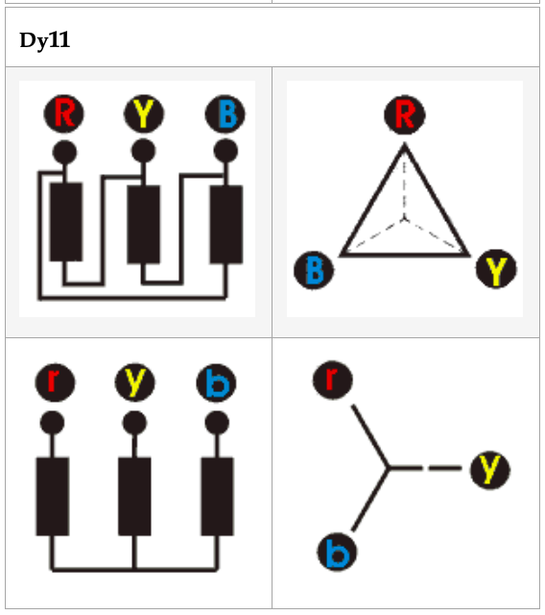
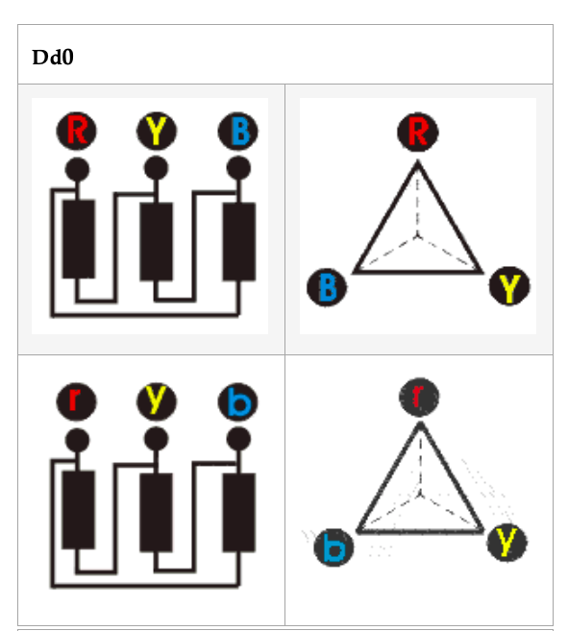
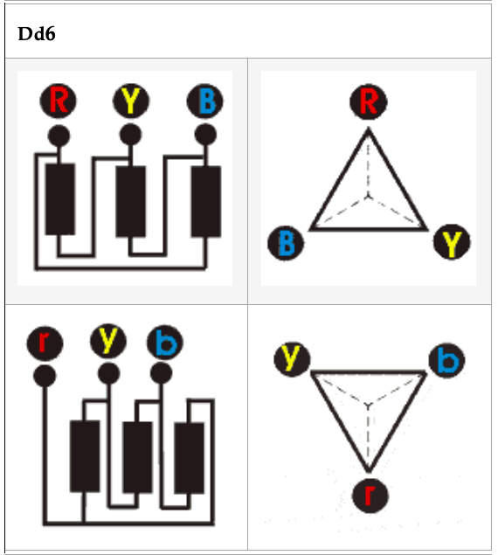

Slide 14
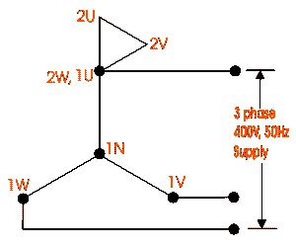
Finding the Vector Group (Sample for YNd11)
Let’s have a YNd11 transformer.
Connect neutral point of star connected winding with earth.
Join 1U of HV and 2W of LV together.
Apply 415 V, three phase supply to HV terminals.
Measure voltages between terminals 2U-1N, 2V-1N, 2W-1N, that means voltages between each LV terminal and HV neutral.
Also measure voltages between terminals 2V-1V, 2W-1W and 2V-1W.
For YNd11 transformer, we will find, 2U-1N > 2V-1N > 2W-1N 2V-1W > 2V-1V or 2W-1W . The vector group test of transformer for other group can also be done in similar way.

Slide 15
Tests on T/F
Short Circuit Test
Very low voltage (5-10%) is applied on HV side with secondary short circuited and slowly increase the voltage till rated HV current is reached.
Wattmeter shows Copper Losses and ammeter reads full load HV current. Then Impedance(Ze=Vsc/IL).
Open Circuit Test
Voltage is applied on LV side and measure voltage, current and power.
Ammeter reads No-Load Current. Wattmeter reads Core losses.

Slide 16
Tests on T/F
Insulation Resistance Test.
15 sec,1 minute and 10 minute values are taken
Increase in IR value indicates dryness of insulation.
Is the ratio of applied voltage across insulation to current through it.
The current has three components
1) Leakage current which is mainly due to moisture and dust etc.
2) Capacitive charging current because insulation materials are dielectric in nature. This will disappear in 1 minute.
3) Most important is conduction current. This remains steady throughout the test.
Absorption Coefficient (Dielectric Absorption Ratio)= 1 Minute value/15 Sec value. (1.4 best and<1 bad)
Polarization index=10 minute Value/1 minute value.( Value shall be > than 2)
Dielectric absorption Ratio(DAR) is incase PI is <2 than DAR >1.4 is acceptable.

Slide 17
Tests on T/F
Dielectric Test
Separate source voltage withstand test
All three line terminals are shorted and other winding is shorted and earthed.
Single phase supply is applied for 60 sec. Peak value X0.707 is applied.
Nominal Voltage | Highest system rated Voltage | Rated short duration withstand voyages
415V | 1.1KV | 3KV
11KV | 12KV | 28KV
33KV | 36KV | 70KV
400KV | 420KV | 630KV

Slide 18
Tests on T/F
Induced Voltage Test.
To check the inter turn and line end insulation as well as main insulation to each and between windings.
Apply twice the voltage and frequency of the secondary and keep the Primary (HV) winding open for 60 sec
Temperature Rise Test
LV side to be short circuited.
Low voltage is applied at HV side and increased to get wall meter reading equal to core plus copper losses.
Temperature is recorded on Hourly basis till it reaches study value or approximately 3 degrees raise in 1 hour.
Check whether the rise is within the temp. Rise mentioned on the name plate.
Oil Pressure Test. Is to ensure oil leakages from joints and gaskets.

Slide 19
Final Commissioning Checks
All test results are verified and compared with factory results.
Check for oil leakages and rectify.
All required points to be earthed as per commissioning chart.
Ensure all connections are tight and R-Y-B phase matching.
Check for desired oil levels in bushings and conservator.
Ensure all radiator and Bucholze valves are open.
Check operation of alarms and trips of Bucholze relay,OTI,WTI,MOG&PRV
Ensure proper operation of OLTC, Oil pumps, cooling fans.
Simulate all protection circuits
Fire fighting system and mulsifire system should be ready and tested.
Follow all commissioning protocols.

Slide 20
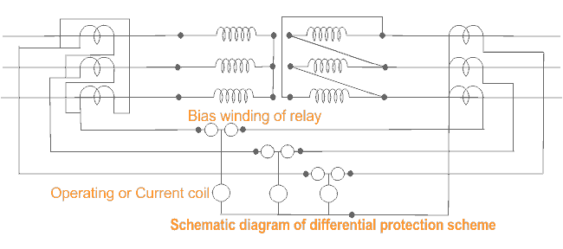
Protective relays (Differential Protection)
Operates for internal faults only.
Provided generally for T/F of >5 MVA
Though Bucholze relay can identify faults in the oil but it is slow and restricted to only oil and nor for bushings etc.
Detects faults in the deferential zone.
Compares the primary and secondary currents with help of CTs and any unbalance found, it will activate trip circuits of both primary and secondary circuit breakers.

Slide 21
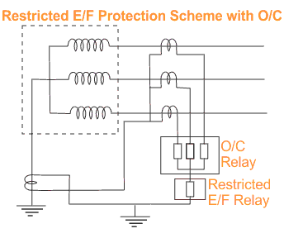
REF
For external faults, phase current is balanced by neutral CT. So no current flow in REF circuit.
For faults in restricted zone the current flows in neutral CT. that current will actuate REF relay.

Slide 22
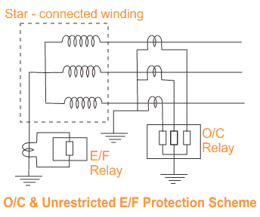
O/C and E/F protection
To protect the T/F damage due to heavy external fault currents.
IDMT(inverse definite min time), DMT when used as backup protection.

Slide 23
Over Fluxing
Flux in core is proportional to V/f and inversely proportional to number of turns on primary.
Max. Flux density of cold rolled grain oriented (CRGO)is 1.9 Tesla. If it is magnetized more ,core gets saturated leading to overheating.
May cause due to Over voltage due to sudden load rejection/Low frequency generation of power/Transmission line lightly loaded/Proper shunt compensation is not provided.
Instantaneous tripping is not desirable. Inverse time characteristics can be considered.

Slide 24
DGA(Dissolved Gas Analysis)
Whenever T/F undergoes abnormal thermal and electrical stress, certain gases are decomposed.
For major faults gas get collected in Buchholz relay. When stress is not significantly high, it is not possible to predict the condition of T/F with Buchholz relay.
It is analogy to our blood test.
Gases from oil is extracted by “Vacuum Gas Apparatus” and Gases are analysed by “Gas Chronograph”.
Temperature V/s Gas Generation
H2 and Methane(CH4) starts at 150 degrees temp.
Ethane (C2H6) starts at 250 degrees temp.
Ethylene (C2H4) starts at 350 degrees temp
Methane, Ethene and Ethylene after reaching their maximum points, their production goes down as the temp increases.
Acetylene (C2H2) begins between 500-700 degrees
Note:- thermal decomposition of cellulose material starts at 100 degrees are less and produces CO,CO2,O2 and H2. So OTI is set for alarm at 90 degrees.
Methods
Duval Triangle Method
Rogers Ratio Metod
Total Dissolved Combustible Gas Method
Doornenburg Ratio Method

Slide 25
DGA(Total Dissolved Combustible Gas Method- TDCG)
Gas | Chemical | Normal Value | Level Exceeded Normal | High Level of Decomposition | Very High
Hydrogen | H2 | 100 | 101-700 | 701-1800 | >1800 | Produced due to oil temp. rise up to 150-300 degrees
Methane | CH4 | 120 | 121-400 | 401-1000 | >1000 | due to abnormal thermal stress.
Ethane | C2H2 | 1 | 2-9 | 10-35 | >35 | It indicates Arcing.
Ethylene | C2H4 | 50 | 51-100 | 101-200 | >200 | If temp. goes>300 it indicates Very High temp hot spot.
Acetylene | C2H6 | 65 | 66-100 | 101-150 | >150 | Local Over heating.
Carbon Monoxide | CO | 350 | 351-570 | 571-1400 | >1400 | In large quantity indicates that there is decomposition of paper insulation.
Carbon Dioxide | CO2 | 2500 | 2501-4000 | 4001-10000 | >10000 | In large quantity indicates that there is decomposition of paper insulation.
TDCG | Total Gas | 720 | 721-1920 | 1921-4630 | >4630

Slide 26
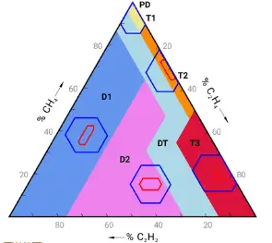
DGA(Duval DGA Interpretation)
Partial Discharge(PD) | The corona occurs, which can result in deposits of “X-Wax”on paper insulation or the sparking type occurs which can induce pin holes in paper (Carbonized punctures) in paper that may be difficult to find
Low energy Partial Discharge(D1) | Discharges of low energy occures in oil and/or paper , as indicated by large carbonised punctures in paper, carbonisation of the papersurface(tracking) or carbon particles in iol(as in an OTC)
High Energy Partial discharge(D2). | Occurs in oil and/or paper, as indicated by extensive destruction and carbonisation of paper or metal fusion at the discharge extremes, extensive carbonisation of oil
Thermal Fault (T1) | Occurs in oil and/or paper below 300 degrees temperature turning the paper “brownish”
Thermal Fault (T2) | Occurs in oil and/or paper 300-700 degrees temperature carbonising the paper
Thermal Fault (T3) | Occurs in oil and/or paper above 700 degrees temperature with strong evidence of carbonisation of oil, metal coloration (at 800 degrees) and metal fusion (at 1000 degrees)
% CH4 = 32/(32+129+85)*100 = 13%
% C2H4 = 52%
% C2H2 = 35%

Slide 27
DGA(Doernenburg Ratio Interpretation)
Fault Diagnosis | (R1) CH4/H2 | (R2) - C2H2/C2H4 | (R3)- C2H2/CH4 | (R4)- C2H6/C2H2
Thermal Decomposition | >1 | <0.75 | <0.3 | >0.4
Partial Discharge | < 0.1 | - | <0.3 | >0.4
Arcing | > 0.1 - <1 | >0.75 | >0.3 | <0.4
CO2/CO>11(Indicates poor insulation and 4-11 is normal value)
Furan Analysis is done on insulation to know the paper life and considered the best.
H2 and C2H4 released in large quantities for temp>700 degrees

Slide 28
DGA (Roger’s Ratio Method)
Case | (R2) - C2H2/C2H4 | (R1) CH4/H2 | (R5)- C2H4/C2H6 | Fault
0 | <0.1 | >0.1-<1 | <1 | Unit Normal
1 | < 0.1 | <0.1 | <1 | Low energy arcing-PD
2 | <0.1-3 | >0.1-<1 | >3 | Arcing -High energy discharge
3 | <0.1 | >0.1-<1 | 1 - 3 | Low thermal
4 | <0.1 | >1 | 1 - 3 | Thermal<700 degrees
5 | <0.1 | >1 | >3 | Thermal>700 degrees
CO2/CO>11(Indicates poor insulation and 4-11 is normal value)
Furan Analysis is done on insulation to know the paper life and considered the best.
H2 and C2H4 released in large quantities for temp>700 degrees
Case Study
R1=0.65
R2=0.65
R5=1.55

Slide 29
Bushings
Most important function is to insulate the high voltage terminals from the body of T/F
Based on construction there are two types of bushings Solid – Type and condenser – type.
Solid type consists of an insulator with central conductor surrounded by oil
In capacitance –graded bushing several conducting layers are inserted at predetermined radial intervals within the insulation separating the central conductor. These conducting layers cause a capacitive effect.
Solid Porcelain Bushings
Oil Impregnated Paper Bushings(OIP)
Silicon Rubber Insulator Bushings
Resin Impregnated Paper Bushings(RIP)

Slide 30
Bushing Failures
Because of OLTC – 40%
Because of Winding -35%
Because of Bushing -14% (it occupies 3rh position in T/F failures)
They are mainly due to
Ingress of moisture
Short circuiting of capacitance graded layers
Lightening surges
Mishandling of bushing

Slide 31
Diagnosis
Tan delta- for power factor measurement, dissipation
factor and capacitance to access the condition of the insulation
VFPF test(Variable Frequency Power Factor Test)- to determine conductive contaminants , top terminal looseness , potential discharges
Hot collar Test to determine detoriation ,low liquid levels and contaminations

Slide 32
OIP V/s RIP
OIP | RIP
Susceptible for oil leakages | Superior thermal and electrical performance
Moisture ingress can trigger explosive failure
Oil impregnated liquid phase throughout its life | Forms a solid condenser
Partial discharge level is low 2Pc | Higher 5Pc
Tan delta 0.35% | 0.45%
Insulating class E (120 degrees) | A (105)
Weight double RIP | 50% of OIP
Transportation and installation tough | Easy
Mechanical Srength less | More
High Maint | Low Maint.
More fire hazard | Low fire hazard

Slide 33
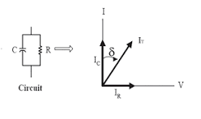
Tan Delta Test
To determine condition of bushing healthiness
Test is conducted at different voltages 2KV,5KV and 10KV,
A healthy bushing will have low Tan Delta value and an unhealthy bushing will have high Tan value

Slide 34
Lighting arrestors
It’s main function is to discharge over voltages to ground. Lightning voltages are in the range of 5-20 Million Volts
The average strokes of the globe – 100 strokes per second
Currents will be in the range of 10K – 90K
Over voltages can cause due to external or internal reasons
External
Direct lightning strokes
Over voltages due to lightning discharges near by (Side stroke)
Over voltage due to atmospheric changes along the length of the line
External statically induced due to clouds, dust, dry snow and due to high altitudes
Internal
Switching surges
Insulation failure
Arching
Resonance

Slide 35
Auto Transformer
In Auto T/F apart from primary and secondary windings there will be Tertiary winding so it is also called as three winding T/F.
Advantages
Load at different voltage can be taken
It reduces the flow of fault current
It reduces the unbalanceing in the primary due to unbalancing in three phase load
Allows third harmonics
Disadvantages
Due to extra winding accuracy is less in positioning the coils so electrical and performance may be affected
More maintenance
Extra safety required.

Slide 36
Evolution of maintenance practices
Reliability centred maintenance (RCM)
Corrective Maintenance
Maintenance after failure
Costly and time consuming hence not desirable
Preventive Maintenance
Many failures almost have a regular pattern failing after an average period therefore maintenance is planned before it fails
Predictive Maintenance
Modern instruments and Technologies were used to identify failure symptoms.

Slide 37
Maintenance
Regular walk down checks will help in identifying abnormalities.
Checklists are to be prepared and monitored regularly.
PM jobs are to be done at regular intervals.
Oil Samples are to be monitored at regularly and depending on the recommendations.
All relays are to be calibrated on regular basis and settings are to be checked for proper grading.
Any abnormality is to be attended on top priority.
All spares shall be sufficiently available and are to be stored as per the instructions of manual or as per IS.
Spares are to be checked for healthiness at regular intervals.
Working personnel shall have sufficient knowledge and skills. Regular trainings are to be organized to up grade their knowledge.
Modern maintenance practices are to be adopted.

Slide 38
Maintenance (Online Monitoring)
It is increasingly widespread practice
The objective is to detect faults in the initial stage and alert the operator
As far as possible estimate the tolerable time to become severe problem
Can be used to estimate useful life.
Monitoring DGA , Partial discharge and thermal scanning are most widely used
It improves the reliability and availability
Online testings can be used for alerting only but for accurate reliable results offline testing are preferred

Slide 39
Most used online testing techniques
Test | Method | Degree of reliability | Features
Partial Discharge(PD) | Online | Medium | Lack of confidence and robustness (interferences), although it is possible to make precise and traceable measurements
 | Offline | High | Greater sensitivity than online measurements. It can be measured directly inside the transformer tank with liquid insulation using ultra high frequency sensors (UHF)
Insulation Resistance (IR) | Online | Medium | Incorporated in current monitoring systems. It is not traceable with offline measurements
 | Offline | Medium | It detects defects on the insulation, such as deterioration or contamination and faults between windings or windings to earth in extreme cases. PI or DRA test are recommended as complementary tests
Infrared thermography | Online | Medium | Easy interpretation

Slide 40
Most used online testing techniques
Test | Method | Degree of reliability | Features
Dissolved gases analysis (DGA) | Online | High | Good detection and diagnostic capacity. A similar, but more economical alternative, is the equivalent hydrogen method
 | Offline | High | Very good detection and diagnostic capacity based on laboratory chromatography
Transformation ratio (TTR) | Online | High | The accuracy of current and voltage transformers make possible to detect very small changes in the properties of the transformer, being comparable to the tolerance limits established for the off-line
 | Offline | High | Open circuits and short-circuited turns can be detected by measuring the ratio and phase angle of one winding to another
Differential protection | Online | High | Primary protection for its reliability, certainty, and operation speed Disadvantage: False operations caused by the magnetization current
Vibrations and acoustic analysis | Online | High | Suitable for mechanical faults in transformers and OLTC

Slide 41
Sample PM Checklist
Transformer Details: DATE:
PTW No:-
HT&LT side bushings cleaned and ensured healthiness of bushings and studs
HT and LT side termination healthiness ensured and tightness checked using torque wrench
Plugged all holes/openings with Suitable putty/Aluminum foil tape.
Discharge rod removed and IR Values Recorded:-HV side. R-E____.Y-E.____ B-E.____
Ensured healthiness of gasket and HT&LT covers closed
Checked for healthiness of OTI, WTI, MOG and Gauge Glass. TBs cleaned and tightened
Simulated all protections
Protocol made and PTW cancelled
Confirmed isolation of I/C (Upstream and Downstream breakers both), locking as mentioned in PTW and verified personally including control supply isolations
Discharged incoming cables and bus. (Keep the earth rod connected till the work is completed)
Protective relays cleaned and calibration ensured
Oil filtration done based on earlier oil BDV values if required
Attended all oil leakages (replaced gaskets & oil seals wherever required)
Oil level ensured
Cleaned transformer and marshaling box thoroughly using suitable cleaning agent.
Any observations for improvement
Spares Consumed

Slide 42
DGA Format Sample
Oil test reports for CHP - 1,2,3&4 transformers for 2018
 |  |  |  |  |  |  |  |  |  |  |  |  | Prepared By - Shivang Deep
Sl. | Transformer description | Location | KVA Rating | Pri Vol (KV) | Sec Vol (KV) | Serial no. | Moisture (PPM) | Acidity (mg KOG/gm) | DGA |  |  |  |  |  |  |  |  |  |  |  | BDV | Date of Testing
 |  |  |  |  |  |  |  |  | H2 (PPM) | CO (Ppm) | CH4 (Ppm) | CO2 (Ppm) | C2H4 (Ppm) | C2H6 (Ppm) | C2H2 (Ppm) | C3H8 | C3H6 | O2 (%) | N2 (%) | TDG (% by Vol)
 |  |  | Safe Limit |  |  |  | 35 | 0,03 | 100 | 300 | 120 | 2500 | 50 | 65 | 1 | - | - |  |  | 10 | 40

Slide 43
THANK YOU

