Slide 1
Power Transformer
Erection , Commissioning , Testing and Maintenance
- Deshmukh Anand Rao

Slide 2
Objective of this class is
To make you to understand what is Transformer and other associated equipment in sub station like CTs & PTs etc
How to understand the name plates of T/F, CTs & PTs
How to prepare specifications and its importance
Purpose of different tests and how they are conducted
Interpretation of test results
Different types of important protective relays ,their basic operating principles and connection drawings
Basics Control Drawings and how to study drawings.
Case studies and experience sharing for better understanding
Importance of checklists and how to prepare them and use them in erection ,commissioning and maintenance

Slide 3
Topics Covered
Global View
Erection of T/F
Type tests
Routine Tests
Protection and protective Relays
Commissioning
Maintenance
Maintenance Check Lists Samples
Control Circuits
Experiences sharing / Case studies.

Slide 4
Global View
Installed Capacities and Annual Consumption
Installed Capacity of
China-2355GW,USA-1176GW
Third Largest is India with 400GW.
Annual Consumption.
1. China-8.8PWh
2.USA-4.2 PWh
3.Third India with 1.5
4.Russia-1.08PWh
5.Japan-1PWh
Global Generation Growth Slower down from 5.7%to 2.3%.
India marked first with 9.7%, Indonasia-7.9%,China-3.7,US-3
 | Installed Capacity | Annual Consumption
World | 10,000 GW | 25 PWh
India | 400GW | 1.5 PWh
AP | 27GW | 65830 Million Units

Slide 5
Per Capita Consumption
Global Per Capita Consumption is 4500 Units
India -1500 Units (1/3 of World).
Max Dadar & Nagar Haveli - 10000Units.
Min Bihar - 311 Units.
AP -1400 Units.
Length of Transmission lines in AP 400KV-11KV-2,31,127KM(Excluding PGCL)
Max Day consumption - 251 MU ( on 28.05.23)
Highest grid demand in India - 223GW(09.06.23)
India’s population is 18% of world population but energy consumption is 6%.

Slide 6
Transformer
An AC device used to change high voltage low current to low voltage high current or Low Voltage high current to high voltage low current without changing frequency on mutual induction principle
Overall, a transformer carries out the following operations:
1.Transfer of electrical energy from one circuit to another
2.Transfer of electrical power through electromagnetic induction
3.Electric power transfer without any change in frequency
4.Two circuits are linked with mutual induction

Slide 7
Types of Transformers
1. Based on Voltage Levels
Step-Up Transformer
Step- Down Transformer.
Isolation Transformer.
2. Based on Usage/application
Power Transformer
Distribution Transformer
Instrument Transformer
3. Based on cooling medium
Oil Immersed Transformer
Dry Type Transformer
4.Based on construction
Shell Type
Core type

Slide 8
Power Transformer
Difference between Power and distribution Transformers
  Power transformers are designed to step up or down voltage levels for transmission purposes, distribution transformers are made specifically to provide stepped-down voltages to consumers.
Why KVA not KW
  As the copper losses depends on current and Iron losses on Voltage. Since total losses depend on Volt-Amp(VA) and not on load power factor the transformers rating is given in MVA/KVA
  Dry Type T/F
  Are of cast resin type or Vacuum Pressure Impregnated
  Most suitable for moist atmosphere.
  Less fire hazard
  Low maintenance.
  Easy erection.
  Limitation is initial cost is more compared to oil immersed T/F. So it is limited to 36KV

Slide 9
Erection of T/F (IS Code -10028)
Precautions (Generally neglected but very Important)
Empty pockets.
Secure all tools with cotton tapes.
Oil being flammable no fire works to be take-up. If it is essential utmost carfare to be taken with first aid and fire extinguishers.
Minimize exposing the winding to atmosphere.
Foundation shall be level and strong.
Suitable rail/road should be available and accessibility for suitable heavy vehicle movement.
TNP readiness and identify competent agency.
All factory reports and all formats are to be made ready.

Slide 10
Tests on Power Transformer
Type Tests
Purpose
To prove customer’s Specifications and design criteria are met.
It is conducted on sample unit.
Done at manufacturer’s premises.
Type Tests are
Transformation ratio test
Winding resistance test of transformer
Measurement of core losses and no-load current through open-circuit test
Measurement of short circuit impedance and copper losses through short-circuit test
Transformer vector group test
Measurement of insulation resistance
Dielectric test of transformer
On-load tap-changer test
Temperature rise test
Vacuum test of tank and radiators

Slide 11
Routine Tests
Purpose
Done mainly to conform operational performance.
It is conducted on every unit.
Routine Tests are
Winding resistance test of transformer
Transformation ratio test
Measurement of core losses and no-load current through open-circuit test
Measurement of short circuit impedance and copper losses through short-circuit test
Transformer vector group test
Dielectric test of transformer
On-load tap-changer test
Oil pressure to check against the leakages of joints and gaskets.
Special Tests
To obtain useful information for operation and maintenance.
(Auchostic, Harmonics, Power consumption of pumps and fans, brought out items testing)

Slide 12
Tests on T/F
    Winding resistance test of transformer
    Transformer ratio test
    Magnetic Balance Test.
    Magnetizing Current Test.
    Transformer vector group test
    Measurement of impedance voltage/short circuit impedance (principal tap) and load loss (Short circuit test)
    Measurement of no load loss and current (Open circuit test)
    Measurement of insulation resistance
    Dielectric tests of transformer.
    Induced Voltage Test.
    Tests on on-load tap-changer.
    Temp rise test
    Vacuum test on Tank and Radiators.
    Oil pressure test on transformer to check against leakages joints and gaskets

Slide 13
Tests on T/F
  Winding Resistance Test (It is carried out as type test, routine and also field test).
  Purpose
  Used to calculate Copper Losses (I2R)
  Used in Calculation of WT as winding temp.can not be measured directly.
  Used as intial reading for further analysis
  Important diagnostic tool for assessing possible defects due to poor design , assembly , handling , overloading and maintenance
  To ensure all connections are proper and tight
  To ensure Tap changer healthiness
  Procedure
  Known DC current is passed through the winding under test and voltage drop is measured across the terminals and apply Ohm's Law (V/I)
  Modern kits are using Kelvin Bridge method
  For star connected T/F N-Phase
  for Delta 1.5X Reading.

Slide 14
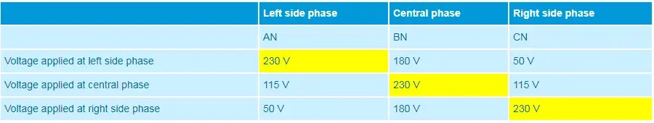
Tests on T/F
Magnetic Balance Test
Purpose
  Conducted on 3 phase T/F.
  To detect the faults in the core to verify the imbalances in the magnetic circuit
  To identify inter-turn faults at early stage of manufacturing
  Procedure
  Apply single phase voltage and measure the voltages on the other phases and record.Voltages depends on the respective limp position.
  Eg:

Slide 15
Ratio Test
Ratio Test
  Important to ensure design voltages.
  During test voltages are applied on HV side to avoid unsafe voltages.
  Should be done on all Tap positions.

Slide 16
Tests on T/F
Magnetising Current test
Mainly conducted to locate defects in magnetic core structure, shifting of winding, failure of insulation between turns or tap changer problems.
Keep tap at lowest position and open all HV,LV terminals.
Apply 3 Phase voltage and measure current and voltages I each phase.
Observation :- Higher readings on outer limb lower on center limb windings
Vector Group test
Very essential test for parallel operation
It is factory test on all T/F to ensure customer specifications.
Different Clock positions (0,5,6,11 O'clock) and different Star/Delta combinations can achieved by adopting different combinations of start and end winding connections (IS 2026 part -1)

Slide 17
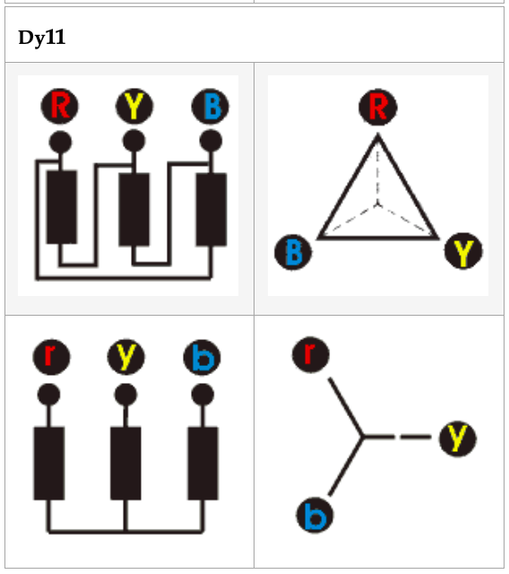
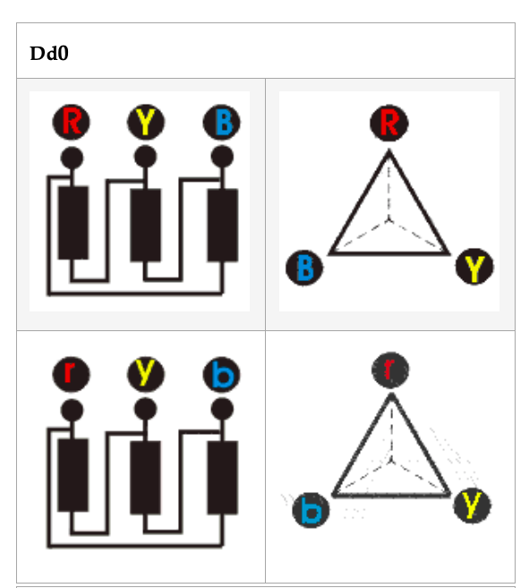
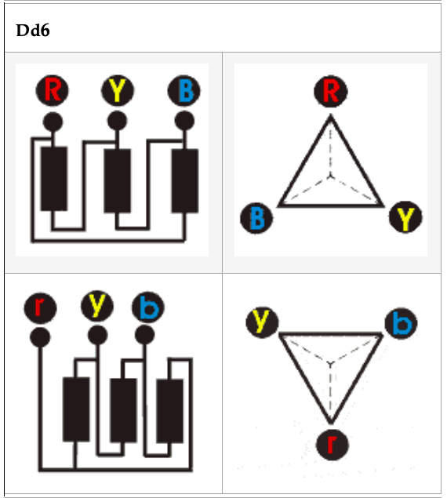

Slide 18
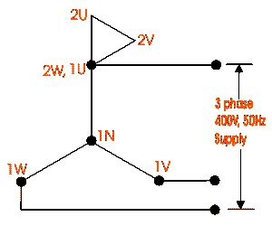
Finding the Vector Group (Sample for YNd11)
Let’s have a YNd11 transformer.
Connect neutral point of star connected winding with earth.
Join 1U of HV and 2W of LV together.
Apply 415 V, three phase supply to HV terminals.
Measure voltages between terminals 2U-1N, 2V-1N, 2W-1N, that means voltages between each LV terminal and HV neutral.
Also measure voltages between terminals 2V-1V, 2W-1W and 2V-1W.
For YNd11 transformer, we will find,
2U-1N > 2V-1N > 2W-1N
2V-1W > 2V-1V or 2W-1W .
The vector group test of transformer for other group can also be done in similar way.

Slide 19
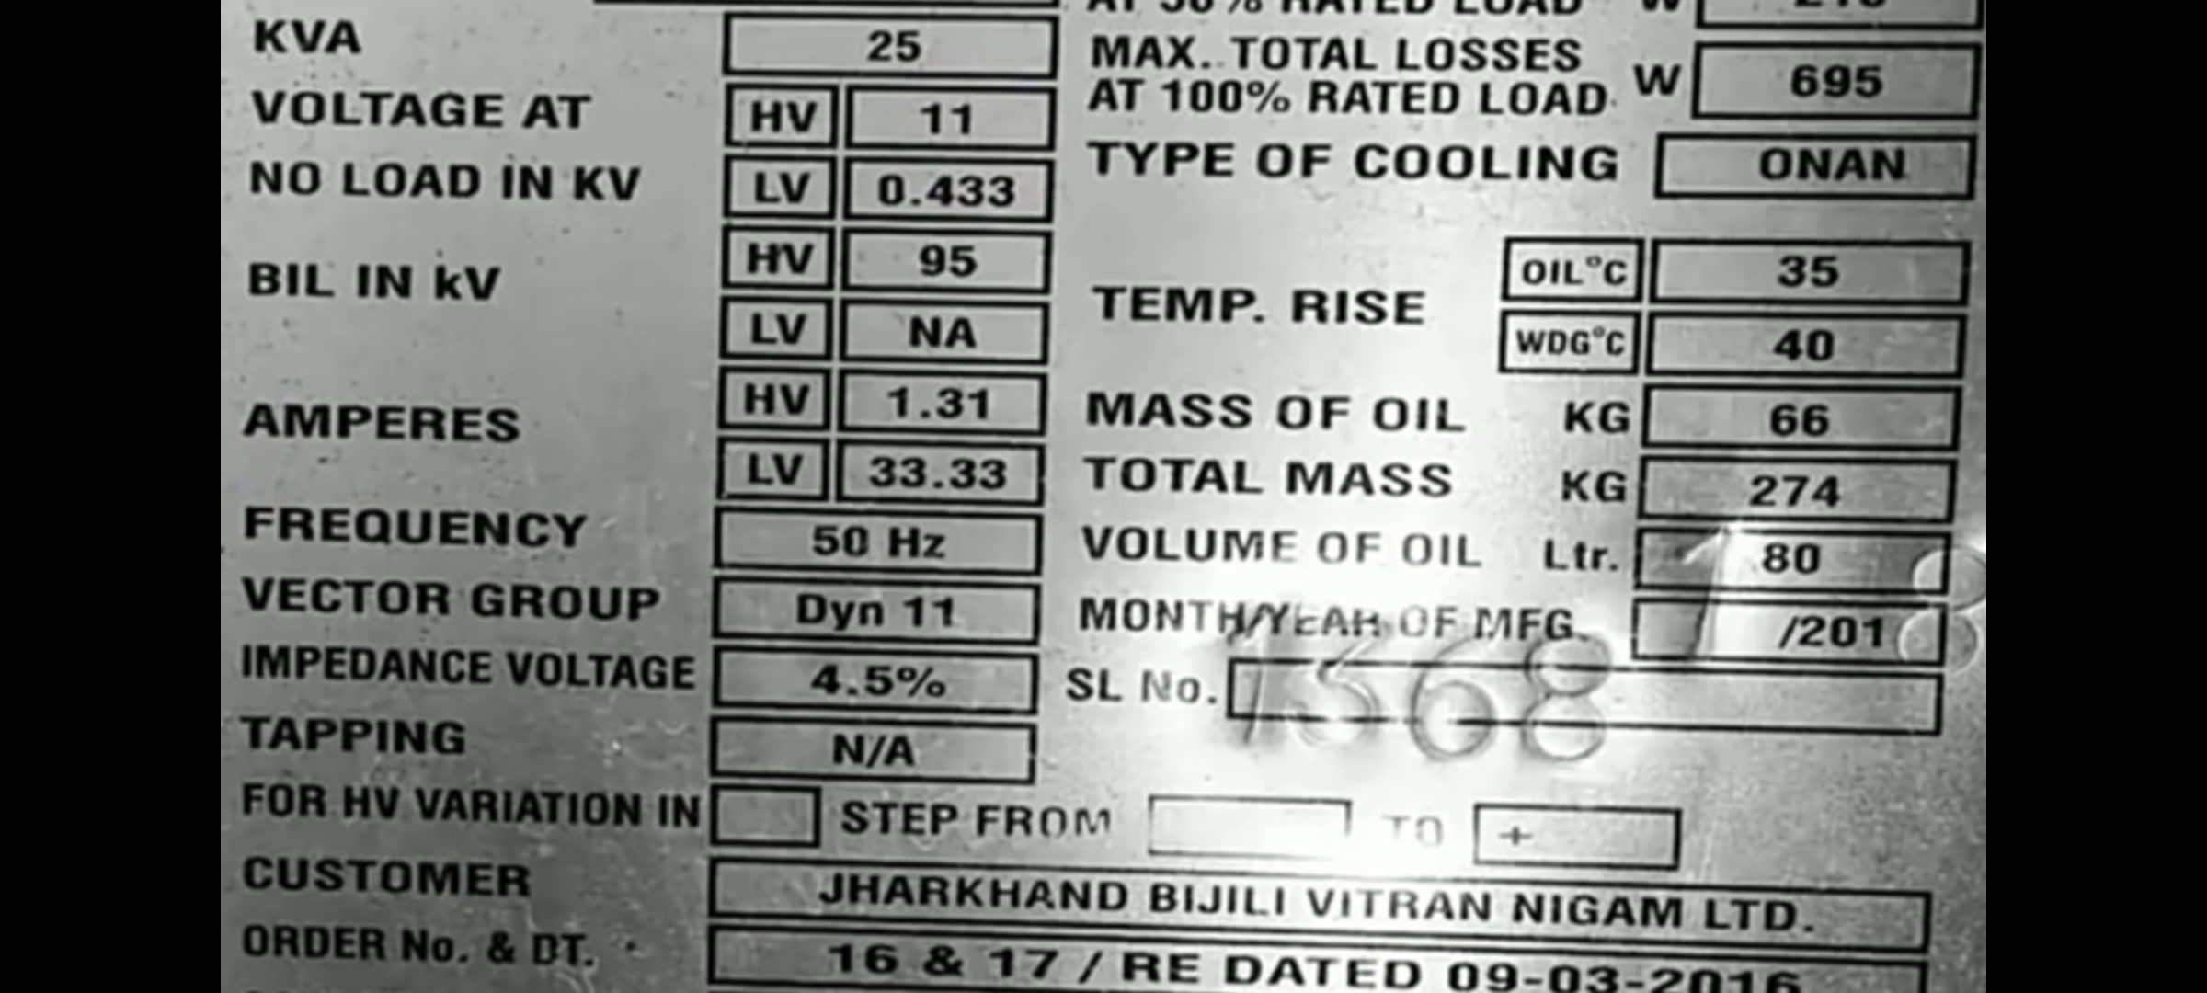
Tests on T/F
Short Circuit Test or Impedance Test

Slide 20
Tests on T/F
Short Circuit Test or Impedance Test
Percentage Impedance is the voltage drop in the T/F windings when the full load current flowing through the T/F
Purpose
Is used in determining copper losses
Required while designing protective relays, fuses, Circuit breakers and switchgears
Used in calculating maximum level of fault current
For parallel operation of T/Fs the impedances shall be equal otherwise they will not be loaded equally. The T/F with less %Impedance(%Z) will take more load and get overloaded
Advantage of having more %Z is it can handle fault currents easily but dis advantage is it will have more voltage drop
Less %Z will result in more currents and more heating which may result in early failure of insulation, hence as per IEC minimum level of %Z is mentioned.

Slide 21
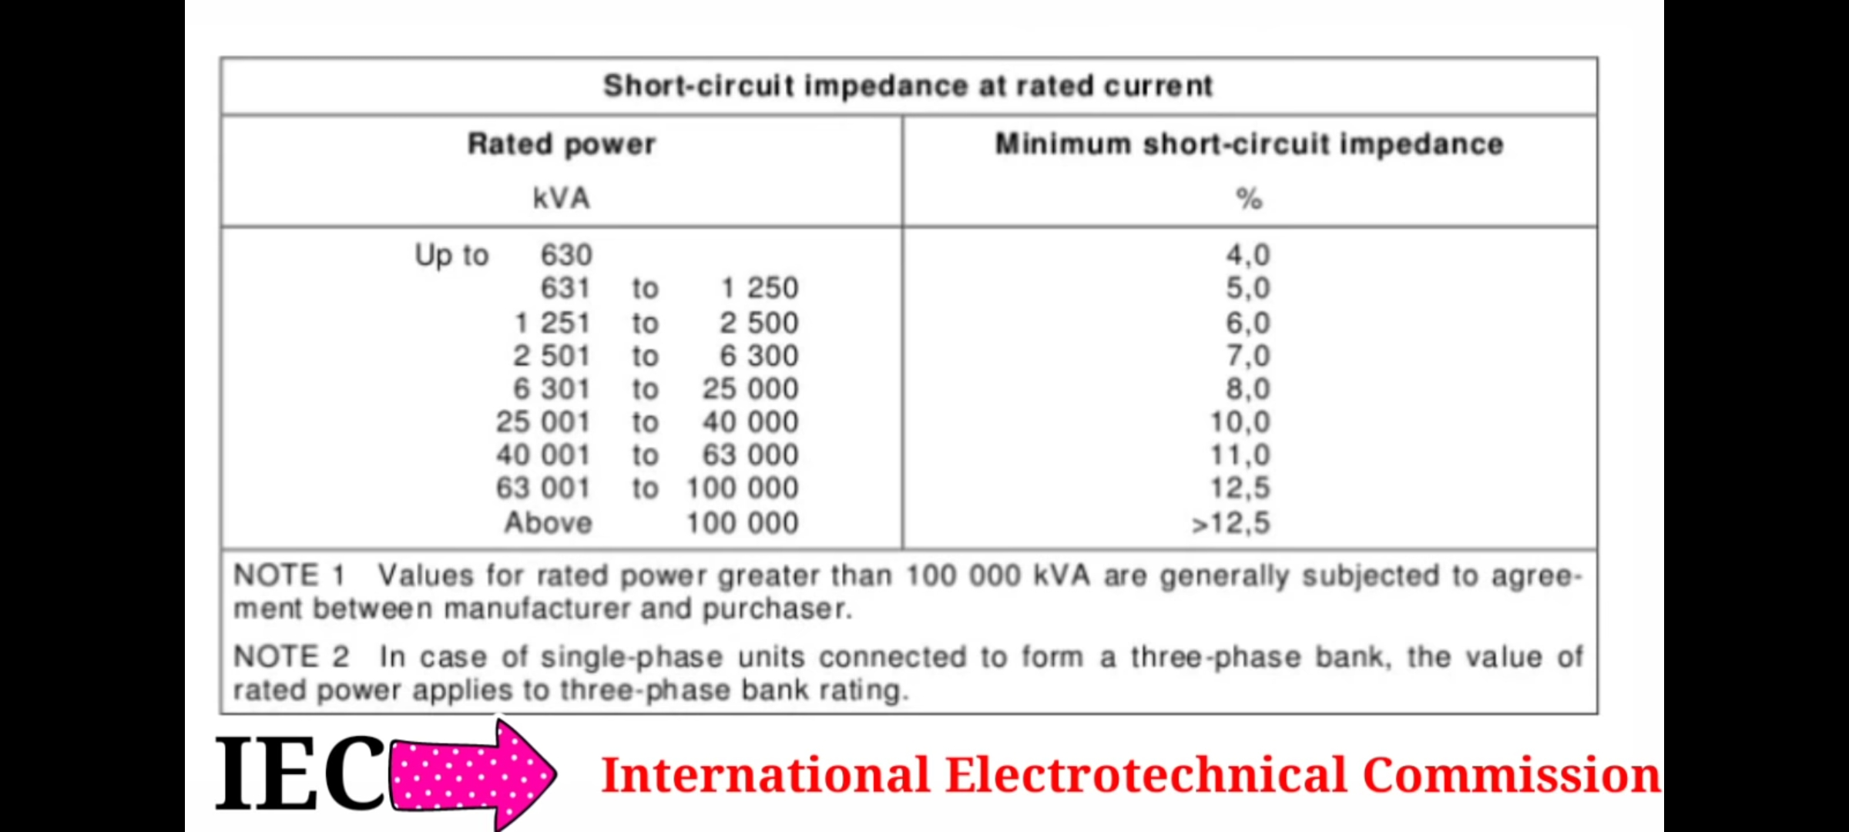
Minimum Percentage Impedance as per IEC

Slide 22
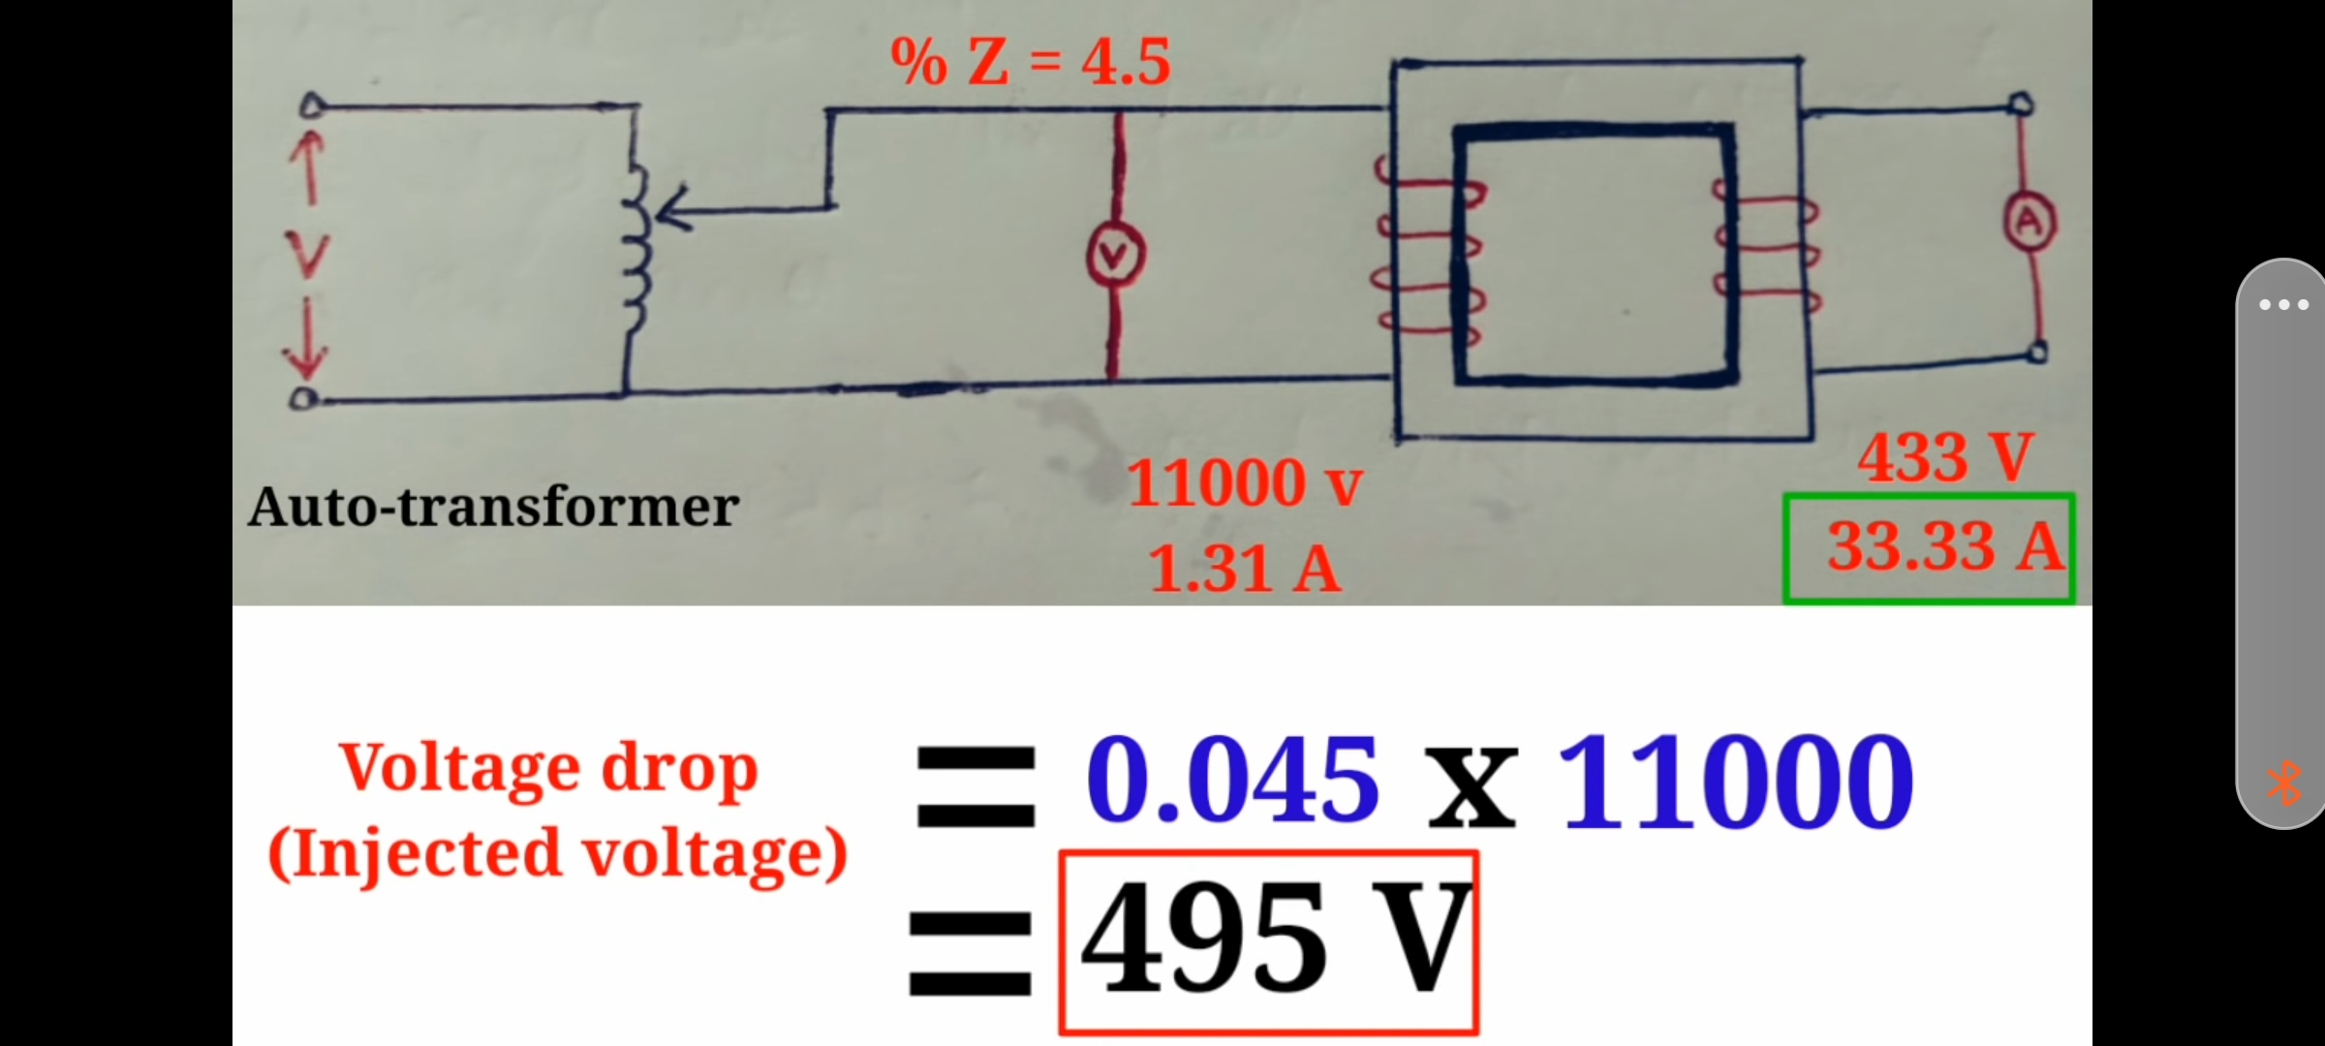
% Impedance Test Procedure

Slide 23
Tests on T/F
Short Circuit Test or Impedance Test
Procedure
Very low voltage (5-10%) is applied on HV side with secondary short circuited and slowly increase the voltage till rated HV current is reached.
Wattmeter shows Copper Losses and ammeter reads full load HV current. Then Impedance(Ze=Vsc/IL).
% Impedance =Injected Voltage X 100/Primary Voltage
Example case =495X100/11000=4.5%

Slide 24
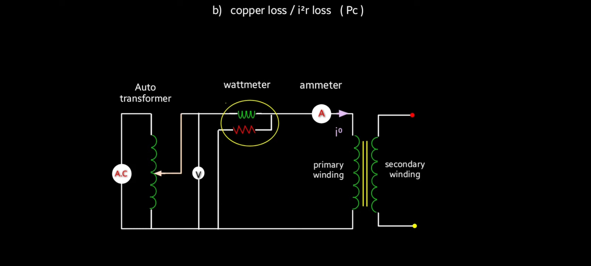
Open Circuit Test
Purpose
To determine core losses
To determine No-Load current
Voltage is applied on LV side and measure voltage, current and power.
Ammeter reads No-Load Current. Wattmeter reads Core losses.

Slide 25
Tests on T/F
Insulation Resistance Test.
15 sec,1 minute and 10 minute values are taken
Increase in IR value indicates dryness of insulation.
Is the ratio of applied voltage across insulation to current through it.
The current has three components
1) Leakage current which is mainly due to moisture and dust etc.
2) Capacitive charging current because insulation materials are dielectric in nature. This will disappear in 1 minute.
3) Most important is conduction current. This remains steady throughout the test.
Absorption Coefficient (Dielectric Absorption Ratio)= 1 Minute value/15 Sec value. (1.4 best and<1 bad)
Polarization index=10 minute Value/1 minute value.( Value shall be > than 2)
Dielectric absorption Ratio(DAR) is incase PI is <2 than DAR >1.4 is acceptable.

Slide 26
Tests on T/F
Induced Voltage Test.
To check the inter turn and line end insulation as well as main insulation to each and between windings.
Apply twice the voltage and frequency of the secondary and keep the Primary (HV) winding open for 60 sec
Temperature Rise Test
LV side to be short circuited.
Low voltage is applied at HV side and increased to get wall meter reading equal to core plus copper losses.
Temperature is recorded on Hourly basis till it reaches study value or approximately 3 degrees raise in 1 hour.
Check whether the rise is within the temp. Rise mentioned on the name plate.
Oil Pressure Test. Is to ensure oil leakages from joints and gaskets.

Slide 27
Tests on T/F
Dielectric Test
Separate source voltage withstand test
All three line terminals are shorted and other winding is shorted and earthed.
Single phase supply is applied for 60 sec. Peak value X0.707 is applied.
Nominal Voltage | Highest system rated Voltage | Rated short duration withstand voyages
415V | 1.1KV | 3KV
11KV | 12KV | 28KV
33KV | 36KV | 70KV
400KV | 420KV | 630KV

Slide 28
Final Commissioning Checks
All test results are verified and compared with factory results.
Check for oil leakages and rectify.
All required points to be earthed as per commissioning chart.
Ensure all connections are tight and R-Y-B phase matching.
Check for desired oil levels in bushings and conservator.
Ensure all radiator and Bucholze valves are open.
Check operation of alarms and trips of Bucholze relay,OTI,WTI,MOG&PRV
Ensure proper operation of OLTC, Oil pumps, cooling fans.
Simulate all protection circuits
Fire fighting system and mulsifire system should be ready and tested.
Follow all commissioning protocols.

Slide 29
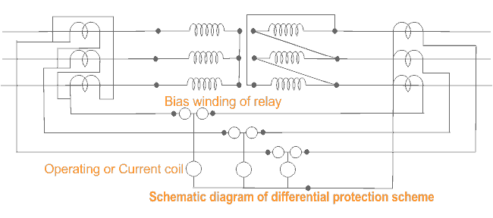
Protective relays (Differential Protection)
Operates for internal faults only.
Provided generally for T/F of >5 MVA
Though Bucholze relay can identify faults in the oil but it is slow and restricted to only oil and nor for bushings etc.
Detects faults in the deferential zone.
Compares the primary and secondary currents with help of CTs and any unbalance found, it will activate trip circuits of both primary and secondary circuit breakers.

Slide 30
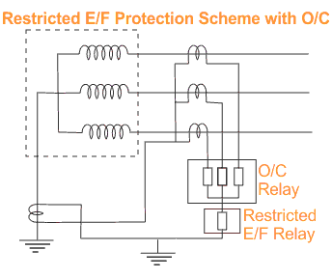
REF
For external faults, phase current is balanced by neutral CT. So no current flow in REF circuit.
For faults in restricted zone the current flows in neutral CT. that current will actuate REF relay.

Slide 31
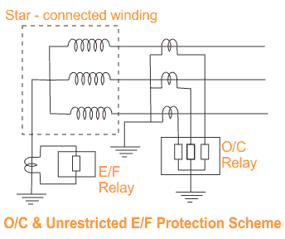
O/C and E/F protection
To protect the T/F damage due to heavy external fault currents.
IDMT(inverse definite min time), DMT when used as backup protection.

Slide 32
Over Fluxing
Flux in core is proportional to V/f and inversely proportional to number of turns on primary.
Max. Flux density of cold rolled grain oriented (CRGO)is 1.9 Tesla. If it is magnetized more ,core gets saturated leading to overheating.
May cause due to Over voltage due to sudden load rejection/Low frequency generation of power/Transmission line lightly loaded/Proper shunt compensation is not provided.
Instantaneous tripping is not desirable. Inverse time characteristics can be considered.

Slide 33
DGA(Dissolved Gas Analysis)
Whenever T/F undergoes abnormal thermal and electrical stress, certain gases are decomposed.
For major faults gas get collected in Buchholz relay. When stress is not significantly high, it is not possible to predict the condition of T/F with Buchholz relay.
It is analogy to our blood test.
Gases from oil is extracted by “Vacuum Gas Apparatus” and Gases are analysed by “Gas Chronograph”.
Temperature V/s Gas Generation
H2 and Methane(CH4) starts at 150 degrees temp.
Ethane (C2H6) starts at 250 degrees temp.
Ethylene (C2H4) starts at 350 degrees temp
Methane, Ethene and Ethylene after reaching their maximum points, their production goes down as the temp increases.
Acetylene (C2H2) begins between 500-700 degrees
Note:- thermal decomposition of cellulose material starts at 100 degrees are less and produces CO,CO2,O2 and H2. So OTI is set for alarm at 90 degrees.
Methods
Duval Triangle Method
Rogers Ratio Metod
Total Dissolved Combustible Gas Method
Doornenburg Ratio Method

Slide 34
DGA(Total Dissolved Combustible Gas Method- TDCG)
Gas | Chemical | Normal Value | Level Exceeded Normal | High Level of Decomposition | Very High
Hydrogen | H2 | 100 | 101-700 | 701-1800 | >1800 | Produced due to oil temp. rise up to 150-300 degrees
Methane | CH4 | 120 | 121-400 | 401-1000 | >1000 | due to abnormal thermal stress.
Ethane | C2H2 | 1 | 2-9 | 10-35 | >35 | It indicates Arcing.
Ethylene | C2H4 | 50 | 51-100 | 101-200 | >200 | If temp. goes>300 it indicates Very High temp hot spot.
Acetylene | C2H6 | 65 | 66-100 | 101-150 | >150 | Local Over heating.
Carbon Monoxide | CO | 350 | 351-570 | 571-1400 | >1400 | In large quantity indicates that there is decomposition of paper insulation.
Carbon Dioxide | CO2 | 2500 | 2501-4000 | 4001-10000 | >10000 | In large quantity indicates that there is decomposition of paper insulation.
TDCG | Total Gas | 720 | 721-1920 | 1921-4630 | >4630

Slide 35
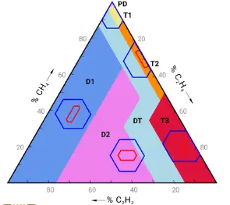
DGA(Duval DGA Interpretation)
Partial Discharge(PD) | The corona occurs, which can result in deposits of “X-Wax”on paper insulation or the sparking type occurs which can induce pin holes in paper (Carbonized punctures) in paper that may be difficult to find
Low energy Partial Discharge(D1) | Discharges of low energy occures in oil and/or paper , as indicated by large carbonised punctures in paper, carbonisation of the papersurface(tracking) or carbon particles in iol(as in an OTC)
High Energy Partial discharge(D2). | Occurs in oil and/or paper, as indicated by extensive destruction and carbonisation of paper or metal fusion at the discharge extremes, extensive carbonisation of oil
Thermal Fault (T1) | Occurs in oil and/or paper below 300 degrees temperature turning the paper “brownish”
Thermal Fault (T2) | Occurs in oil and/or paper 300-700 degrees temperature carbonising the paper
Thermal Fault (T3) | Occurs in oil and/or paper above 700 degrees temperature with strong evidence of carbonisation of oil, metal coloration (at 800 degrees) and metal fusion (at 1000 degrees)
% CH4 = 32/(32+129+85)*100 = 13%
% C2H4 = 52%
% C2H2 = 35%

Slide 36
DGA(Doernenburg Ratio Interpretation)
Fault Diagnosis | (R1) CH4/H2 | (R2) - C2H2/C2H4 | (R3)- C2H2/CH4 | (R4)- C2H6/C2H2
Thermal Decomposition | >1 | <0.75 | <0.3 | >0.4
Partial Discharge | < 0.1 | - | <0.3 | >0.4
Arcing | > 0.1 - <1 | >0.75 | >0.3 | <0.4
CO2/CO>11(Indicates poor insulation and 4-11 is normal value)
Furan Analysis is done on insulation to know the paper life and considered the best.
H2 and C2H4 released in large quantities for temp>700 degrees

Slide 37
DGA (Roger’s Ratio Method)
Case | (R2) - C2H2/C2H4 | (R1) CH4/H2 | (R5)- C2H4/C2H6 | Fault
0 | <0.1 | >0.1-<1 | <1 | Unit Normal
1 | < 0.1 | <0.1 | <1 | Low energy arcing-PD
2 | <0.1-3 | >0.1-<1 | >3 | Arcing -High energy discharge
3 | <0.1 | >0.1-<1 | 1 - 3 | Low thermal
4 | <0.1 | >1 | 1 - 3 | Thermal<700 degrees
5 | <0.1 | >1 | >3 | Thermal>700 degrees
CO2/CO>11(Indicates poor insulation and 4-11 is normal value)
Furan Analysis is done on insulation to know the paper life and considered the best.
H2 and C2H4 released in large quantities for temp>700 degrees
Case Study
R1=0.65
R2=0.65
R5=1.55

Slide 38
Bushings
Most important function is to insulate the high voltage terminals from the body of T/F
Based on construction there are two types of bushings Solid – Type and condenser – type.
Solid type consists of an insulator with central conductor surrounded by oil
In capacitance –graded bushing several conducting layers are inserted at predetermined radial intervals within the insulation separating the central conductor. These conducting layers cause a capacitive effect.
Solid Porcelain Bushings
Oil Impregnated Paper Bushings(OIP)
Silicon Rubber Insulator Bushings
Resin Impregnated Paper Bushings(RIP)

Slide 39
Bushing Failures
Because of OLTC – 40%
Because of Winding -35%
Because of Bushing -14% (it occupies 3rh position in T/F failures)
They are mainly due to
Ingress of moisture
Short circuiting of capacitance graded layers
Lightening surges
Mishandling of bushing

Slide 40
Diagnosis
Tan delta- for power factor measurement, dissipation
factor and capacitance to access the condition of the insulation
VFPF test(Variable Frequency Power Factor Test)- to determine conductive contaminants , top terminal looseness , potential discharges
Hot collar Test to determine detoriation ,low liquid levels and contaminations

Slide 41
OIP V/s RIP
OIP | RIP
Susceptible for oil leakages | Superior thermal and electrical performance
Moisture ingress can trigger explosive failure
Oil impregnated liquid phase throughout its life | Forms a solid condenser
Partial discharge level is low 2Pc | Higher 5Pc
Tan delta 0.35% | 0.45%
Insulating class E (120 degrees) | A (105)
Weight double RIP | 50% of OIP
Transportation and installation tough | Easy
Mechanical Srength less | More
High Maint | Low Maint.
More fire hazard | Low fire hazard

Slide 42
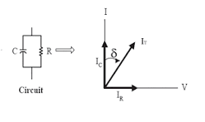
Tan Delta Test
To determine condition of bushing healthiness
Test is conducted at different voltages 2KV,5KV and 10KV,
A healthy bushing will have low Tan Delta value and an unhealthy bushing will have high Tan value

Slide 43
Lighting arrestors
It’s main function is to discharge over voltages to ground. Lightning voltages are in the range of 5-20 Million Volts
The average strokes of the globe – 100 strokes per second
Currents will be in the range of 10K – 90K
Over voltages can cause due to external or internal reasons
External
  Direct lightning strokes
  Over voltages due to lightning discharges near by (Side stroke)
  Over voltage due to atmospheric changes along the length of the line
  External statically induced due to clouds, dust, dry snow and due to high altitudes
Internal
  Switching surges
  Insulation failure
  Arching
  Resonance

Slide 44
Auto Transformer
In Auto T/F apart from primary and secondary windings there will be Tertiary winding so it is also called as three winding T/F.
Advantages
Load at different voltage can be taken
It reduces the flow of fault current
It reduces the unbalanceing in the primary due to unbalancing in three phase load
Allows third harmonics
Disadvantages
Due to extra winding accuracy is less in positioning the coils so electrical and performance may be affected
More maintenance
Extra safety required.

Slide 45
Evolution of maintenance practices
Reliability centred maintenance (RCM)
Corrective Maintenance
Maintenance after failure
Costly and time consuming hence not desirable
Preventive Maintenance
Many failures almost have a regular pattern failing after an average period therefore maintenance is planned before it fails
Predictive Maintenance
Modern instruments and Technologies were used to identify failure symptoms.

Slide 46
Maintenance
Regular walk down checks will help in identifying abnormalities.
Checklists are to be prepared and monitored regularly.
PM jobs are to be done at regular intervals.
Oil Samples are to be monitored at regularly and depending on the recommendations.
All relays are to be calibrated on regular basis and settings are to be checked for proper grading.
Any abnormality is to be attended on top priority.
All spares shall be sufficiently available and are to be stored as per the instructions of manual or as per IS.
Spares are to be checked for healthiness at regular intervals.
Working personnel shall have sufficient knowledge and skills. Regular trainings are to be organized to up grade their knowledge.
Modern maintenance practices are to be adopted.

Slide 47
Maintenance (Online Monitoring)
It is increasingly widespread practice
The objective is to detect faults in the initial stage and alert the operator
As far as possible estimate the tolerable time to become severe problem
Can be used to estimate useful life.
Monitoring DGA , Partial discharge and thermal scanning are most widely used
It improves the reliability and availability
Online testings can be used for alerting only but for accurate reliable results offline testing are preferred

Slide 48
Most used online testing techniques
Test | Method | Degree of reliability | Features
Partial Discharge(PD) | Online | Medium | Lack of confidence and robustness (interferences), although it is possible to make precise and traceable measurements
 | Offline | High | Greater sensitivity than online measurements. It can be measured directly inside the transformer tank with liquid insulation using ultra high frequency sensors (UHF)
Insulation Resistance (IR) | Online | Medium | Incorporated in current monitoring systems. It is not traceable with offline measurements
 | Offline | Medium | It detects defects on the insulation, such as deterioration or contamination and faults between windings or windings to earth in extreme cases. PI or DRA test are recommended as complementary tests
Infrared thermography | Online | Medium | Easy interpretation

Slide 49
Most used online testing techniques
Test | Method | Degree of reliability | Features
Dissolved gases analysis (DGA) | Online | High | Good detection and diagnostic capacity. A similar, but more economical alternative, is the equivalent hydrogen method
 | Offline | High | Very good detection and diagnostic capacity based on laboratory chromatography
Transformation ratio (TTR) | Online | High | The accuracy of current and voltage transformers make possible to detect very small changes in the properties of the transformer, being comparable to the tolerance limits established for the off-line
 | Offline | High | Open circuits and short-circuited turns can be detected by measuring the ratio and phase angle of one winding to another
Differential protection | Online | High | Primary protection for its reliability, certainty, and operation speed Disadvantage: False operations caused by the magnetization current
Vibrations and acoustic analysis | Online | High | Suitable for mechanical faults in transformers and OLTC

Slide 50
Sample PM Checklist
Transformer Details: DATE:
PTW No:-
HT&LT side bushings cleaned and ensured healthiness of bushings and studs
HT and LT side termination healthiness ensured and tightness checked using torque wrench
Plugged all holes/openings with Suitable putty/Aluminum foil tape.
Discharge rod removed and IR Values Recorded:-HV side. R-E____.Y-E.____ B-E.____
Ensured healthiness of gasket and HT&LT covers closed
Checked for healthiness of OTI, WTI, MOG and Gauge Glass. TBs cleaned and tightened
Simulated all protections
Protocol made and PTW cancelled
Confirmed isolation of I/C (Upstream and Downstream breakers both), locking as mentioned in PTW and verified personally including control supply isolations
Discharged incoming cables and bus. (Keep the earth rod connected till the work is completed)
Protective relays cleaned and calibration ensured
Oil filtration done based on earlier oil BDV values if required
Attended all oil leakages (replaced gaskets & oil seals wherever required)
Oil level ensured
Cleaned transformer and marshaling box thoroughly using suitable cleaning agent.
Any observations for improvement
Spares Consumed

Slide 51
DGA Format Sample
Oil test reports for CHP - 1,2,3&4 transformers for 2018
 |  |  |  |  |  |  |  |  |  |  |  |  | Prepared By - Shivang Deep
Sl. | Transformer description | Location | KVA Rating | Pri Vol (KV) | Sec Vol (KV) | Serial no. | Moisture (PPM) | Acidity (mg KOG/gm) | DGA |  |  |  |  |  |  |  |  |  |  |  | BDV | Date of Testing
 |  |  |  |  |  |  |  |  | H2 (PPM) | CO (Ppm) | CH4 (Ppm) | CO2 (Ppm) | C2H4 (Ppm) | C2H6 (Ppm) | C2H2 (Ppm) | C3H8 | C3H6 | O2 (%) | N2 (%) | TDG (% by Vol)
 |  |  | Safe Limit |  |  |  | 35 | 0,03 | 100 | 300 | 120 | 2500 | 50 | 65 | 1 | - | - |  |  | 10 | 40

Slide 52
Electrical Circuits are mainly
Power Circuits
Control Circuits

Slide 53
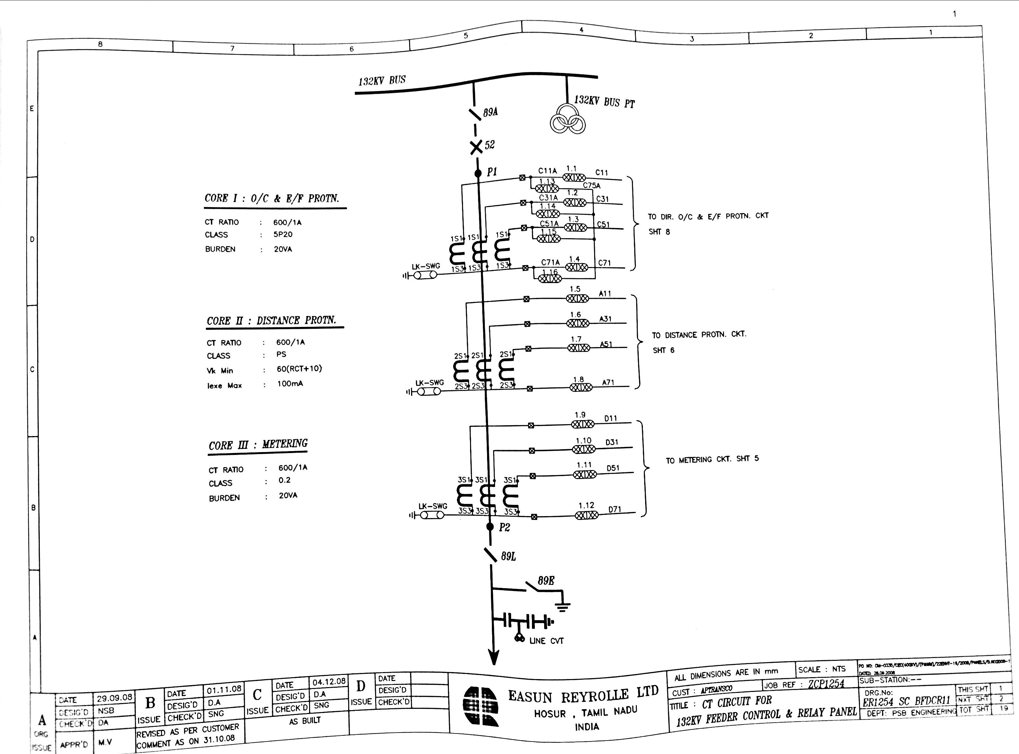
CT Circuit for 132 KV feeder Control Sheet 1

Slide 54
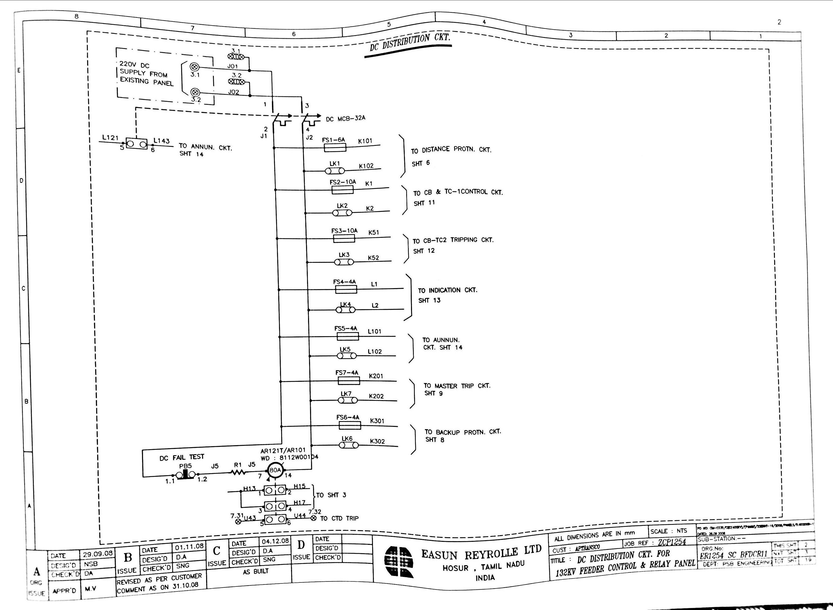
DC Distribution Sheet 2

Slide 55
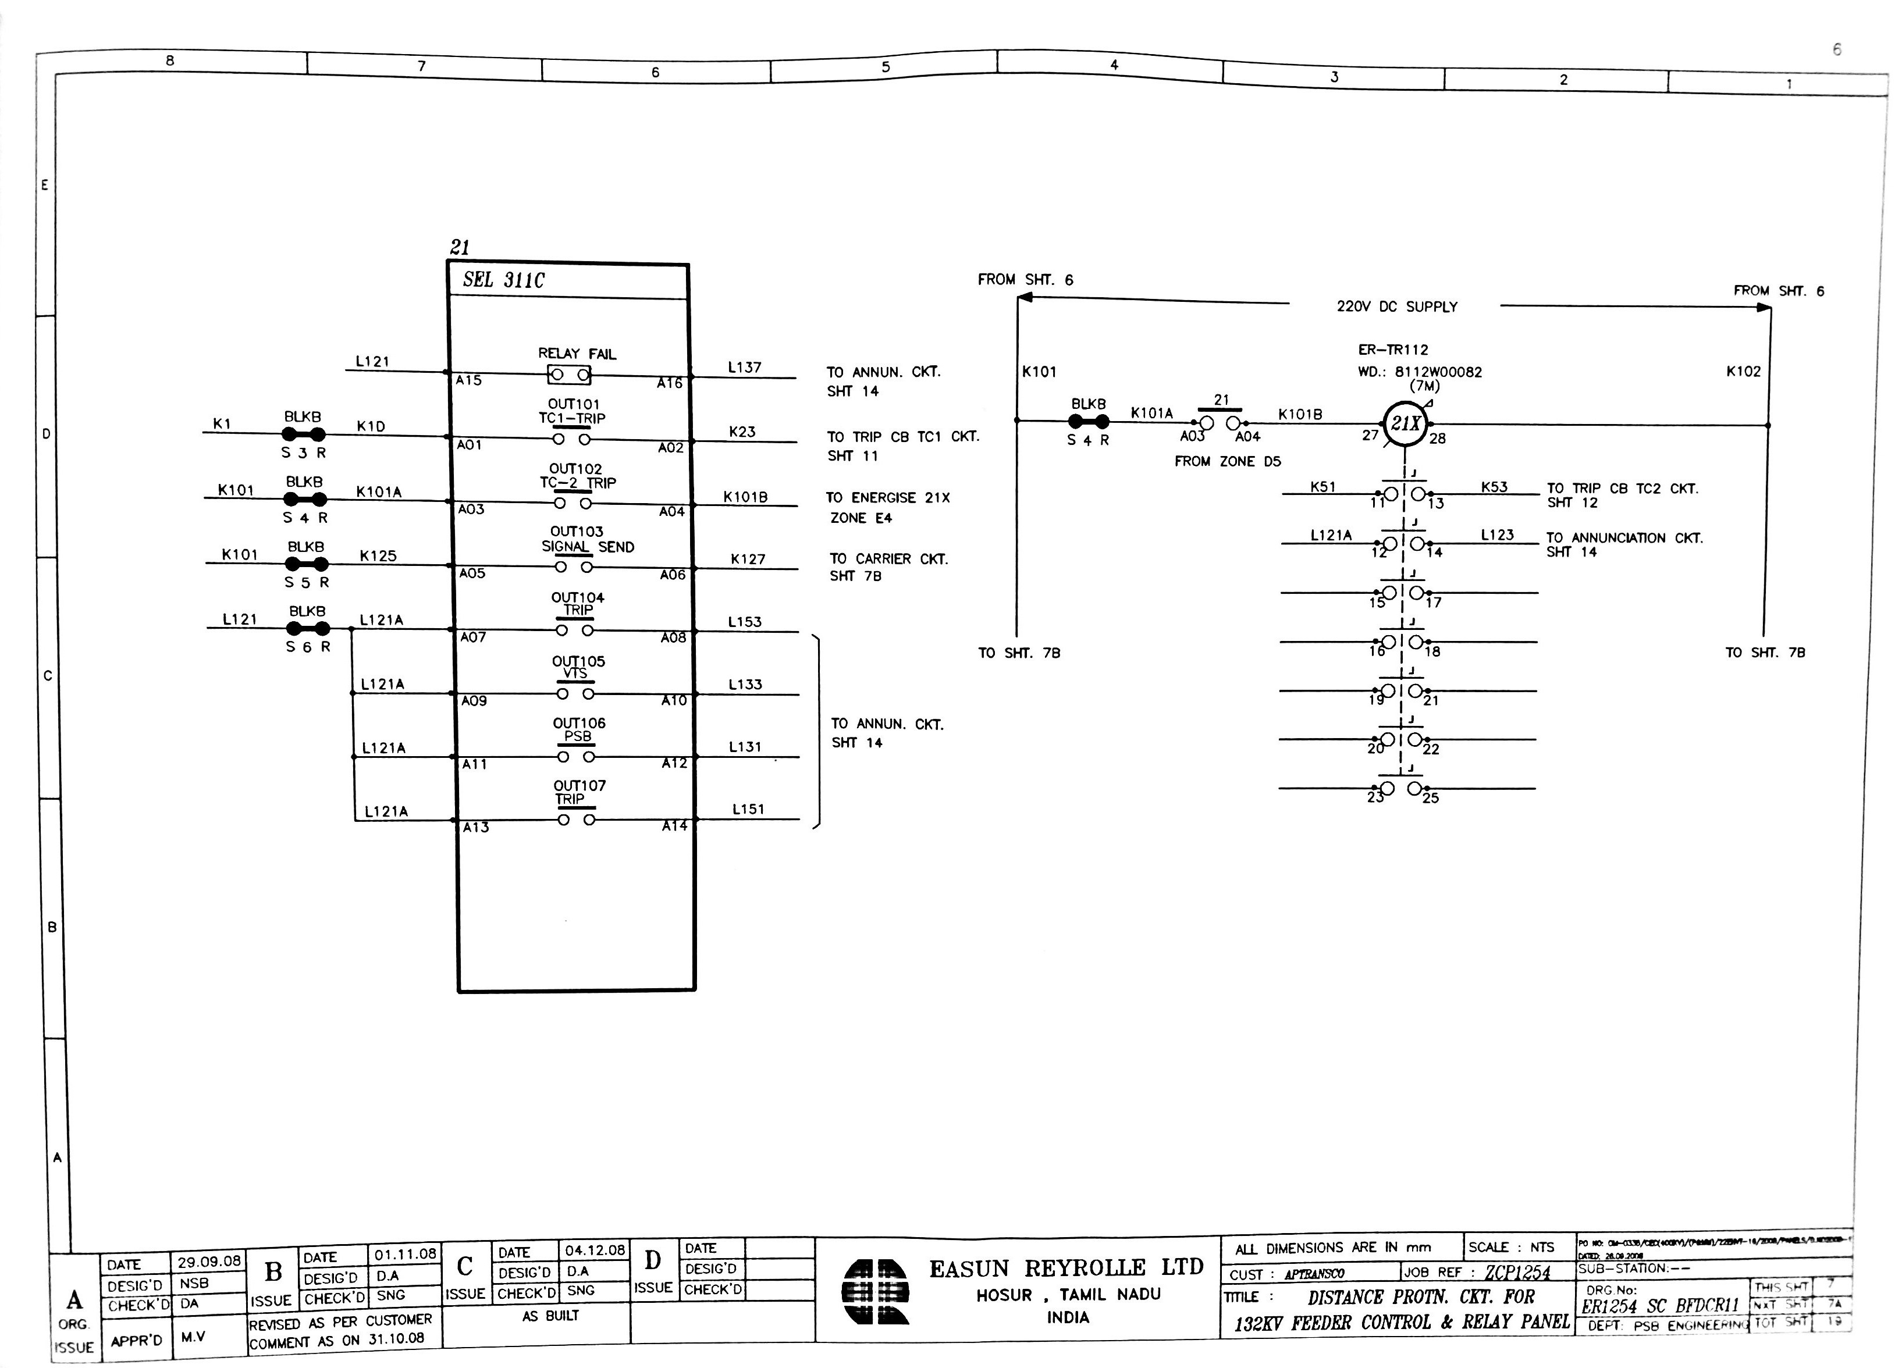
Sheet 7

Slide 56
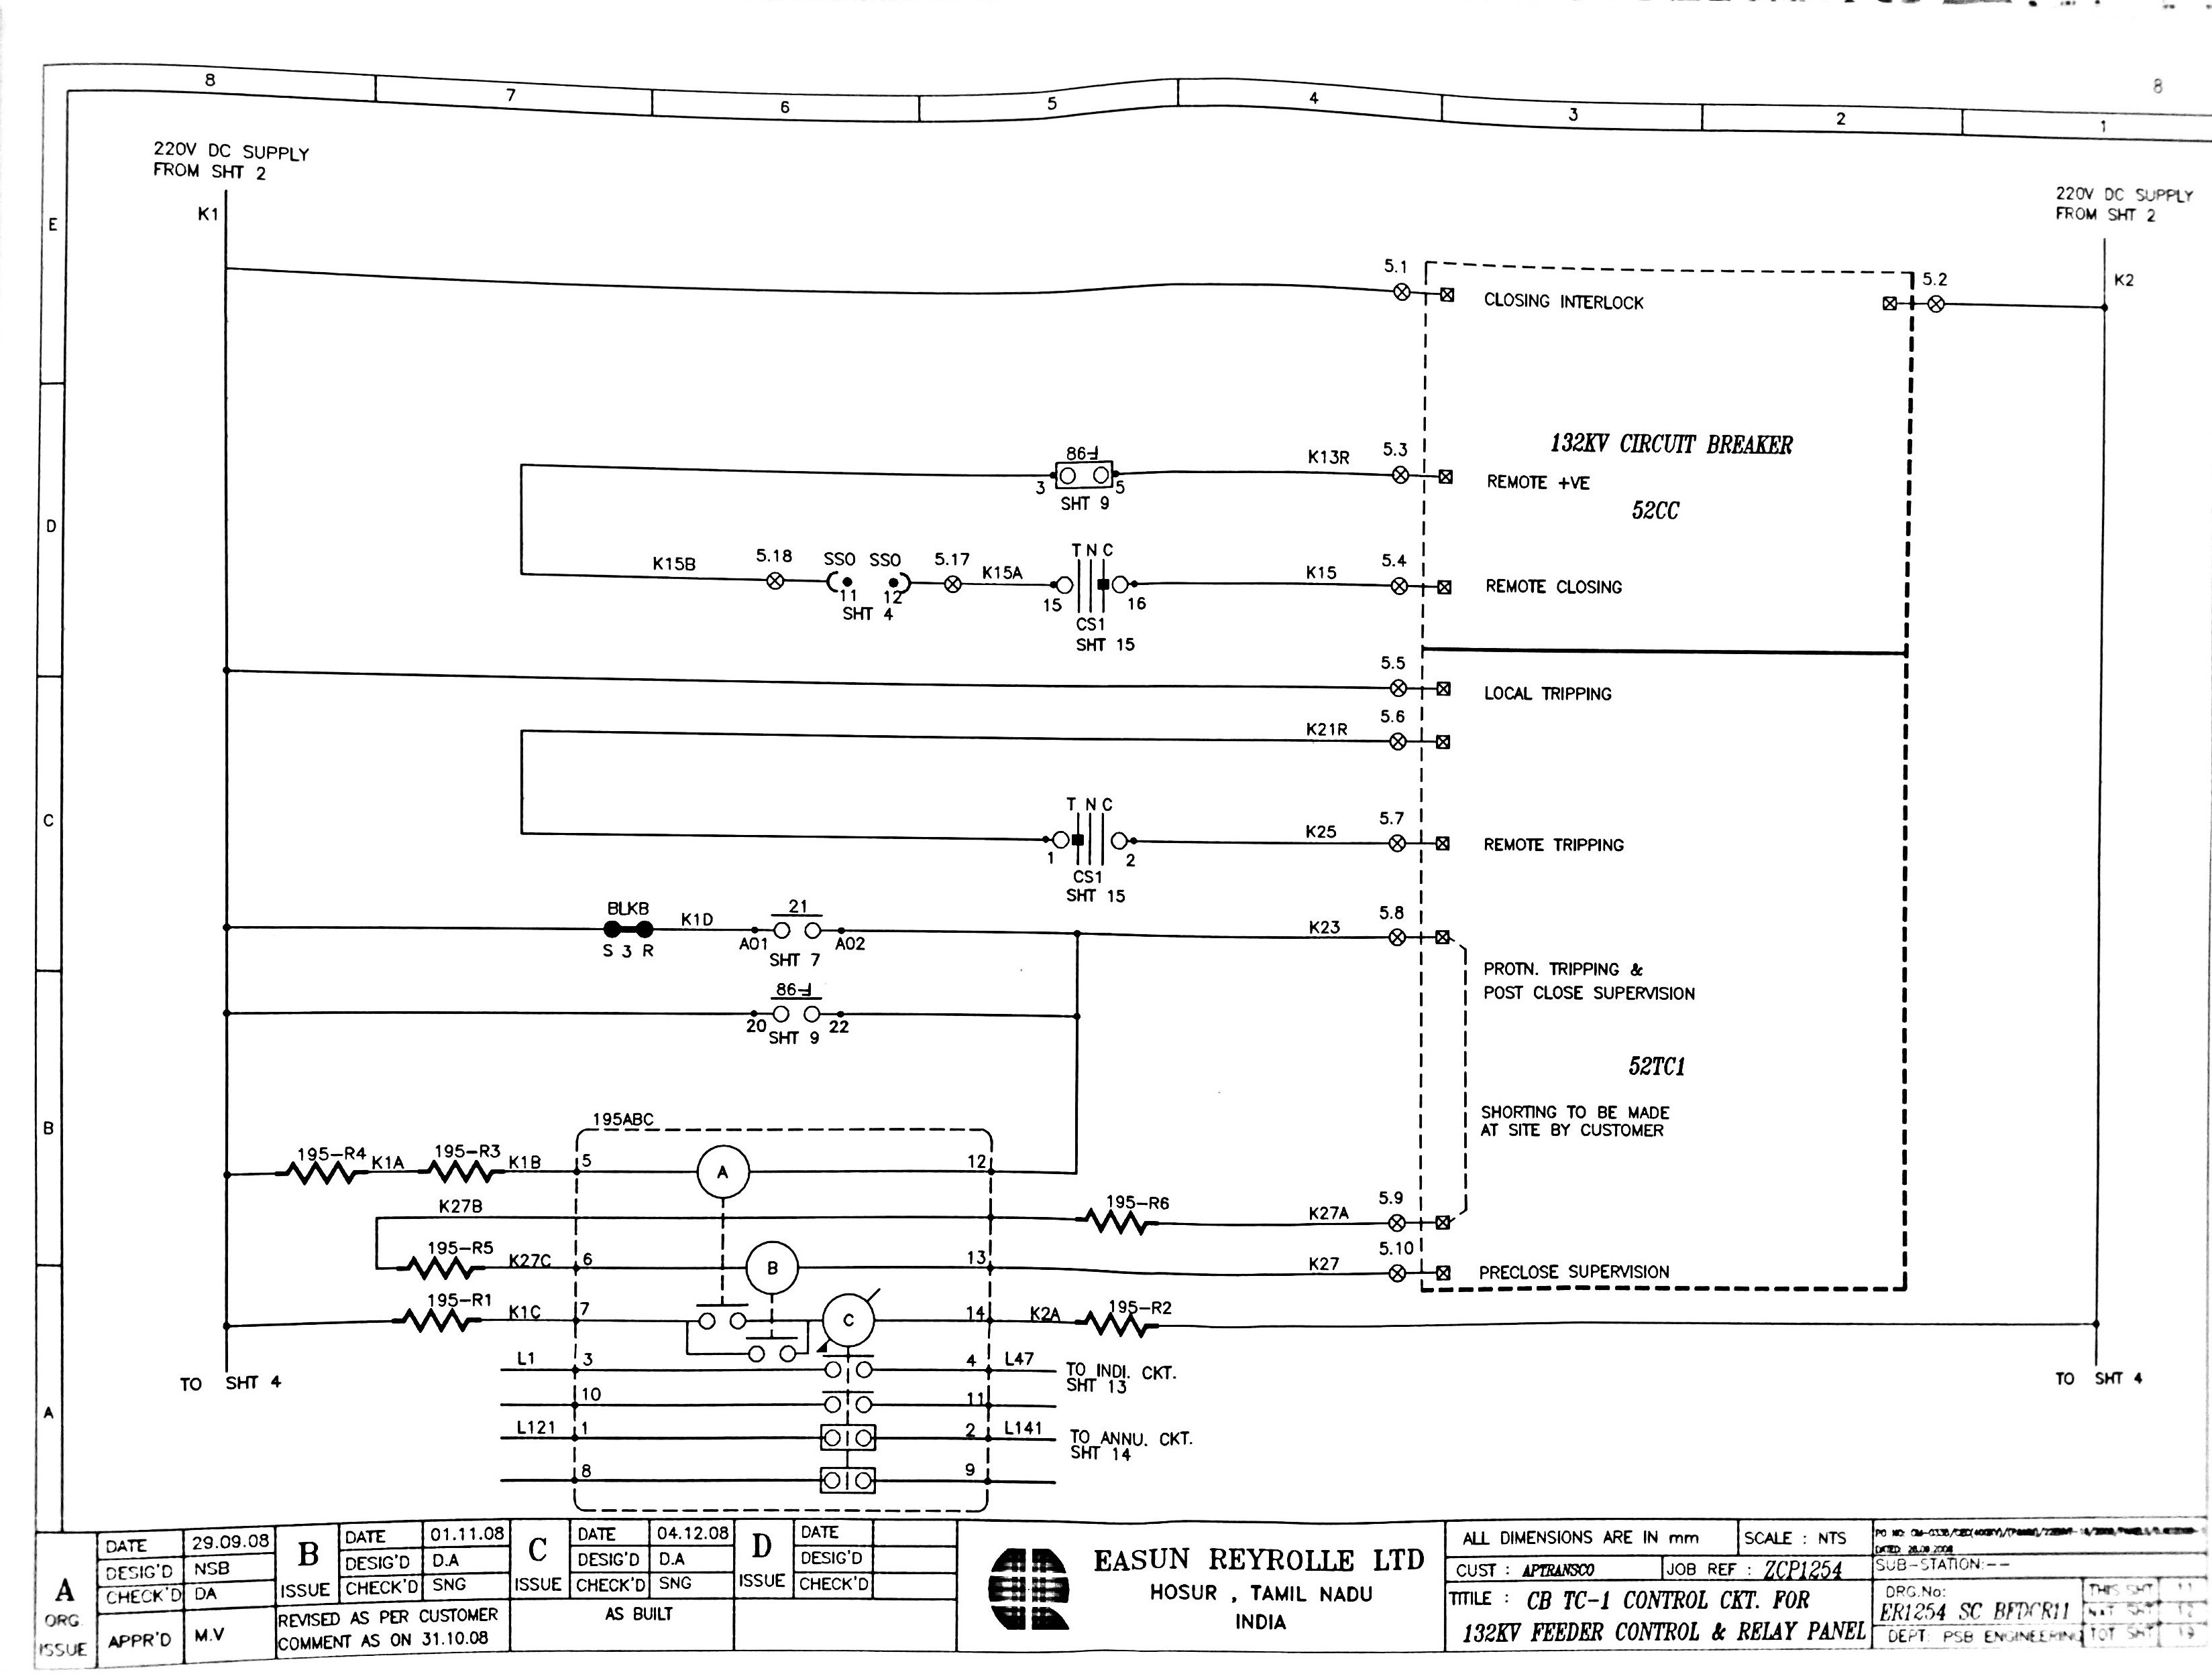
CB TC-1 Control CKT Sheet 11

Slide 57
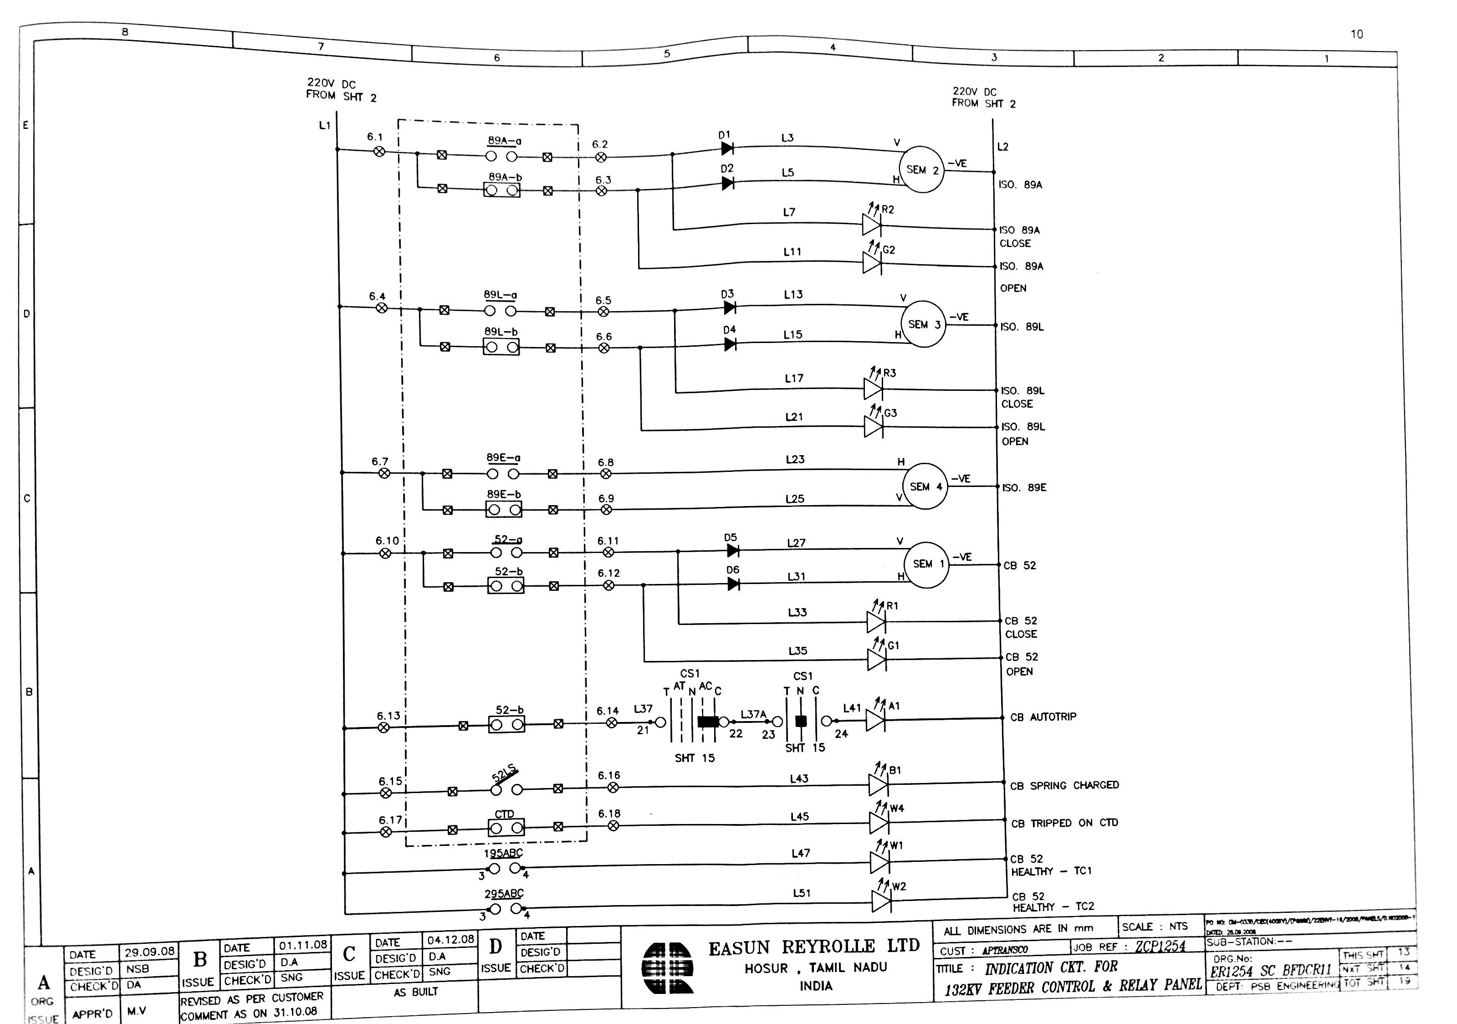
Indication CKT Sheet 13

Slide 58
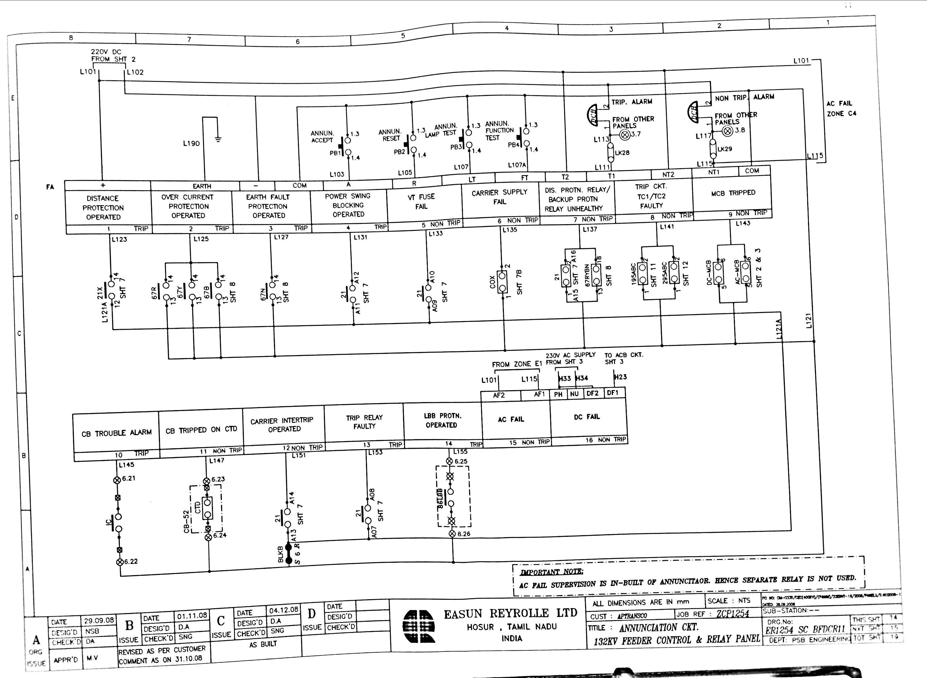
Annunciation CKT Sheet 14

Slide 59
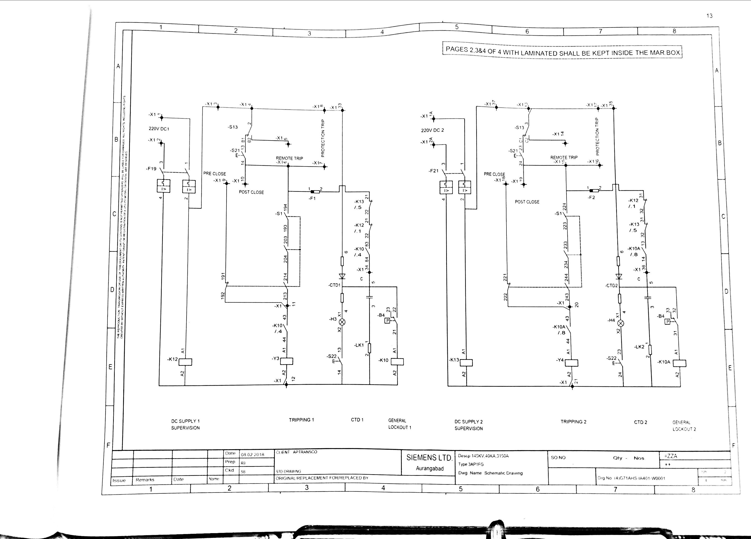
Schematic Drawing Sheet 2

Slide 60
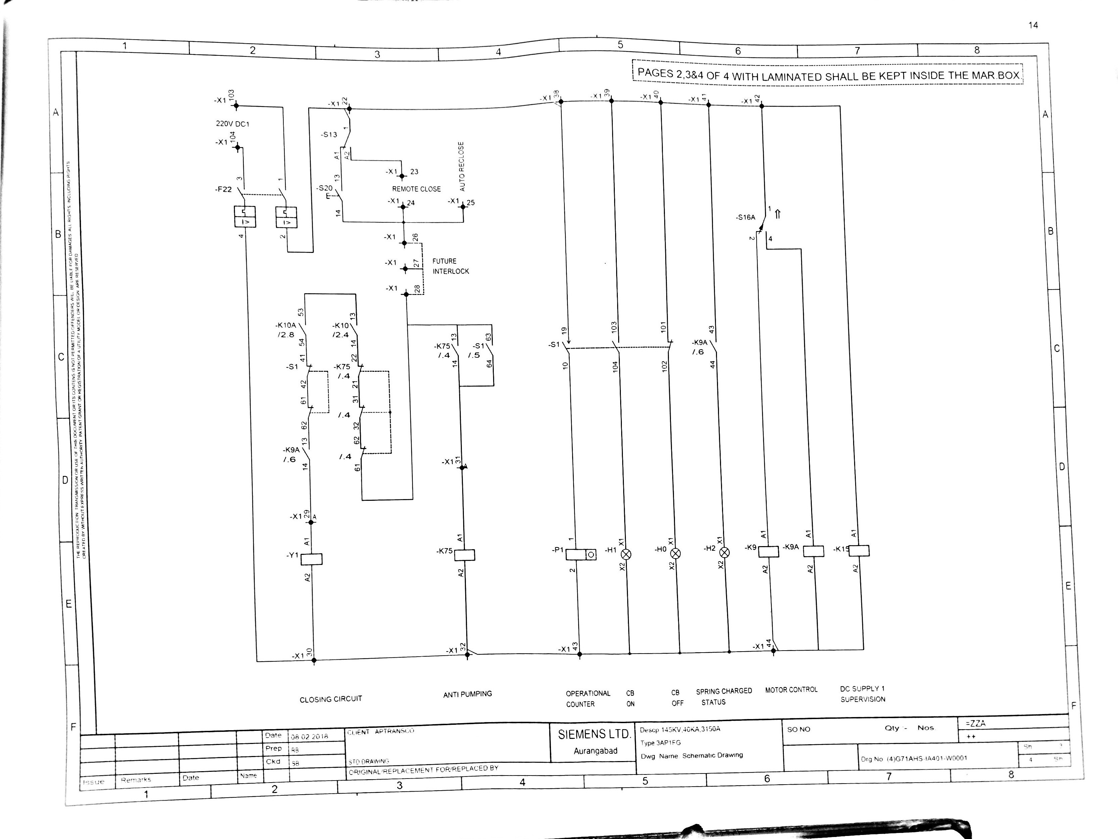
Schematic Drawing Sheet 3

Slide 61
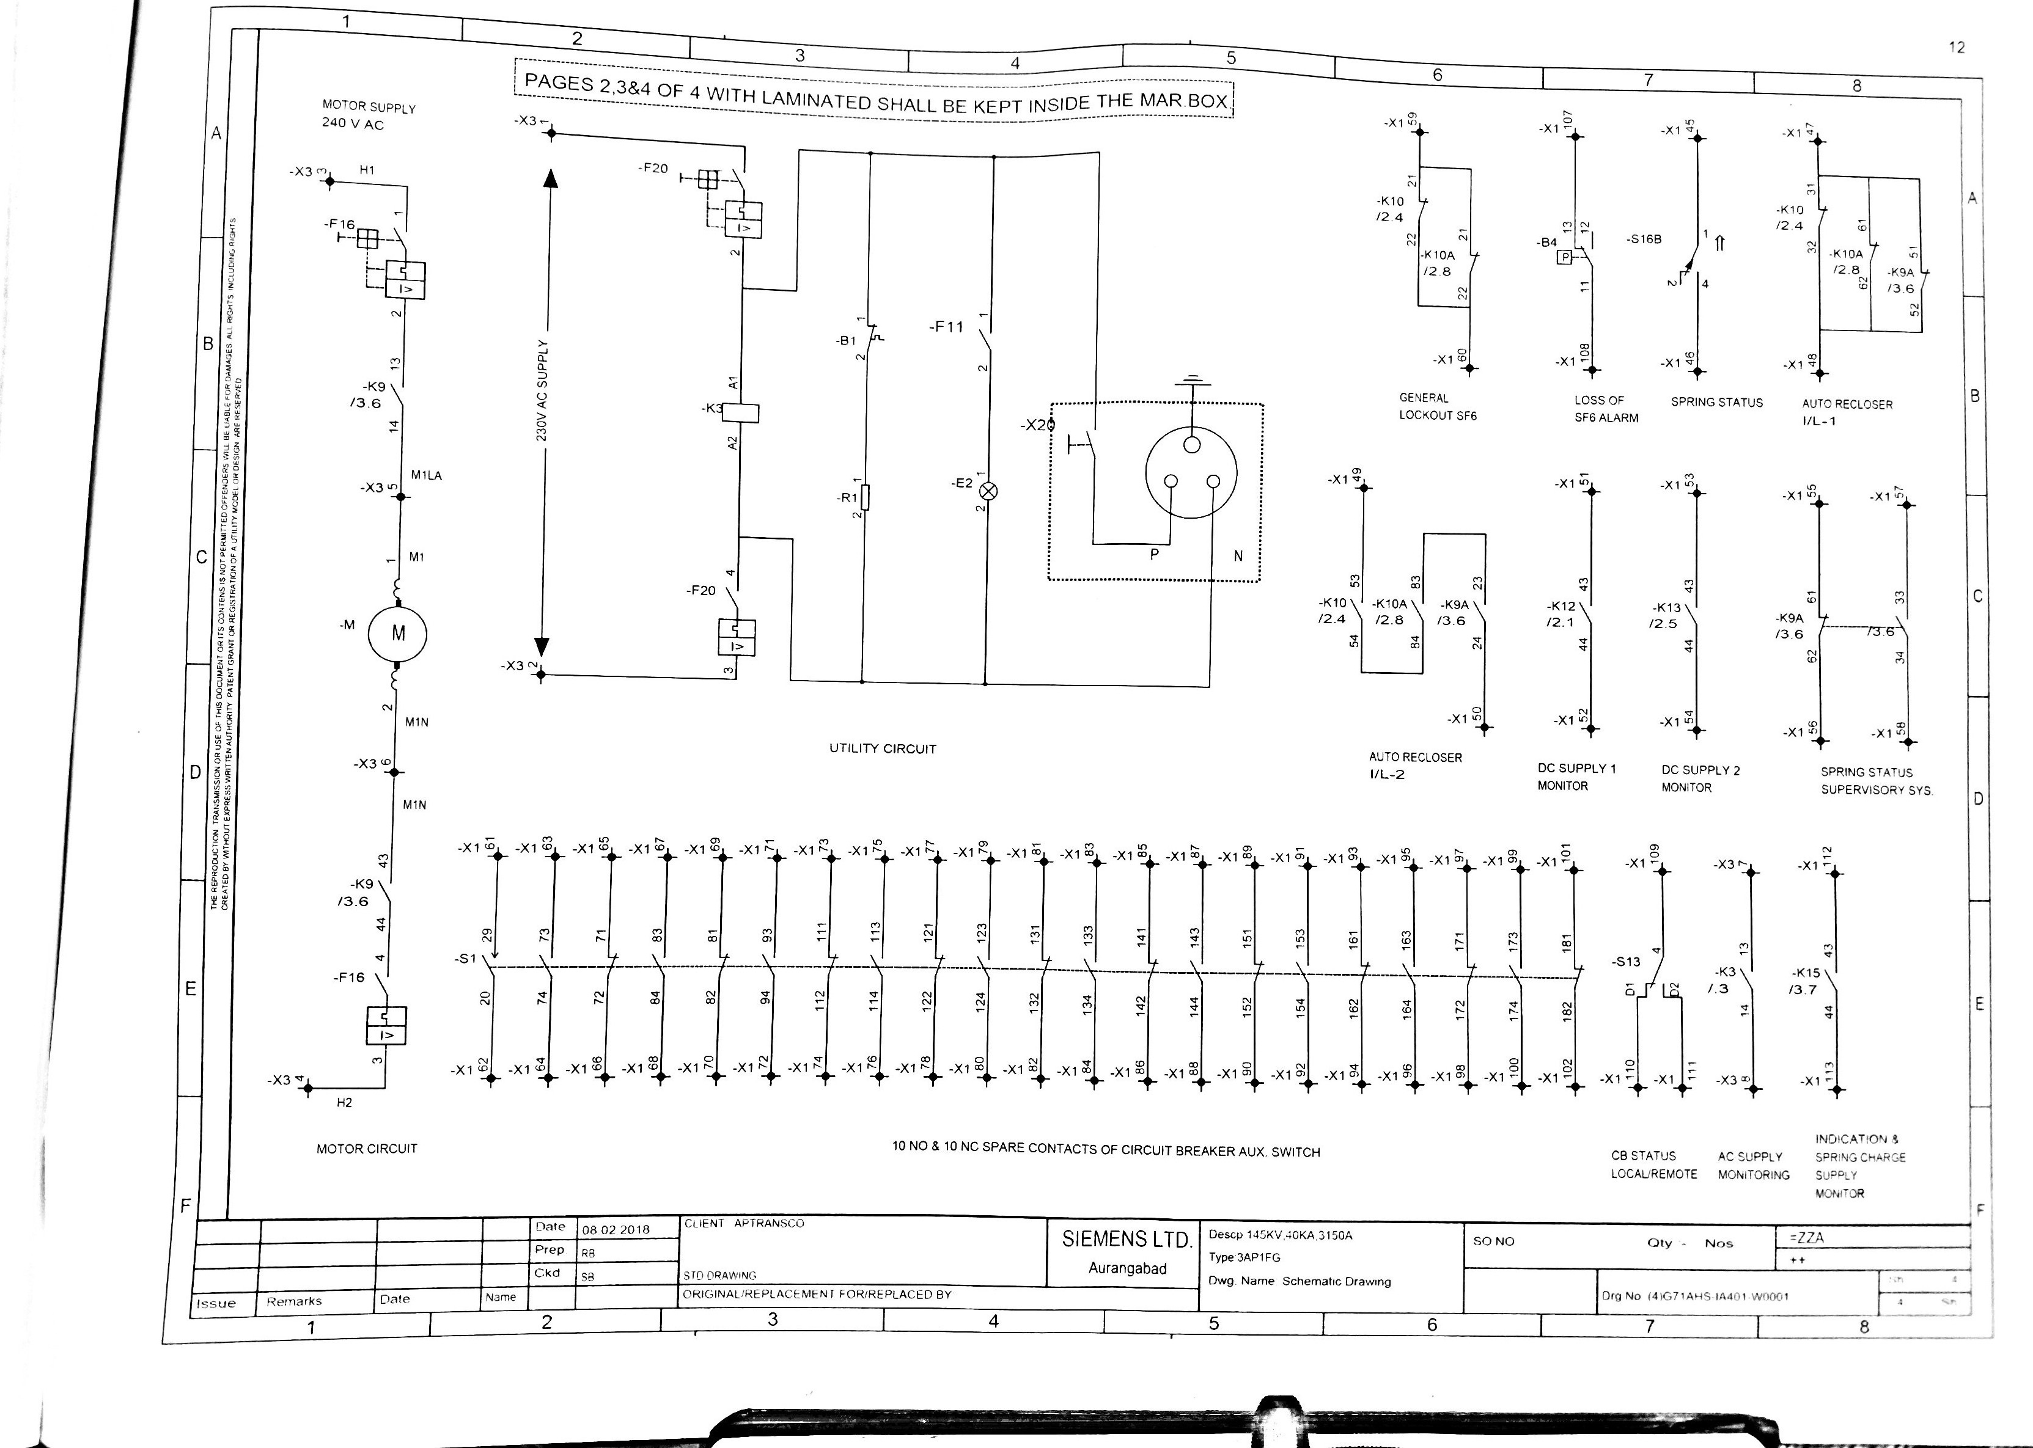
Schematic Drawing Sheet 4

Slide 62
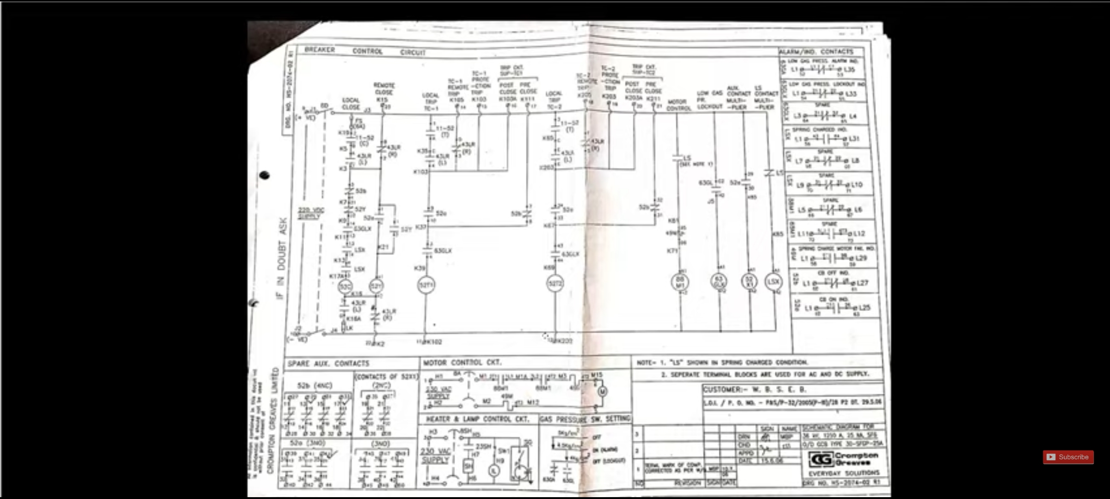

Slide 63
THANK YOU

