Slide 1
Transmission Line Towers
B.SRINIVASA RAO
B.Tech., (EEE) & MBA (HR)
DEPUTY EXECUTIVE ENGINEER / DESIGNS TRANSMISSION CORPORATION OF ANDHRA PRADESH LTD Vidyut Soudha, VIJAYAWADA-520 004
e-mail: aptranscodesigns@gmail.com
Mobile (O): 87126 13226, Mobile (P): 96766 59759

Slide 2
BRIEF TRAINING ON SURVEY, TOWER SPOTTING, DESIGN ASPECTS, CONSTRUCTION AND SUBSTATIONS

Slide 3
SURVEY OF TRANSMISSION LINE
Preliminary survey
Detailed Survey
Check Survey
Profiling
Tower spotting

Slide 4
PRELIMINARY SURVEY
BEE LINE
EXPLORING THE DIFFERENT ROUTES ALONG THE BEE LINE
NOTING THE ALL THE DETAILS ON ROUTE MAPS BY PLOTTNG THE ROUTES

Slide 5
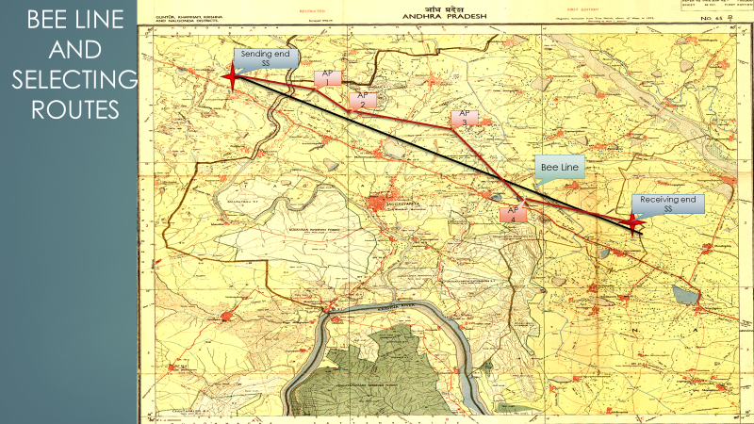
TOPO SHEETS
MAPS ARE USED IN EARLIER DAYS
NO UPDATES
TOPO SHEETS SCALE 1:50000(1CM =0.5KM)

Slide 6
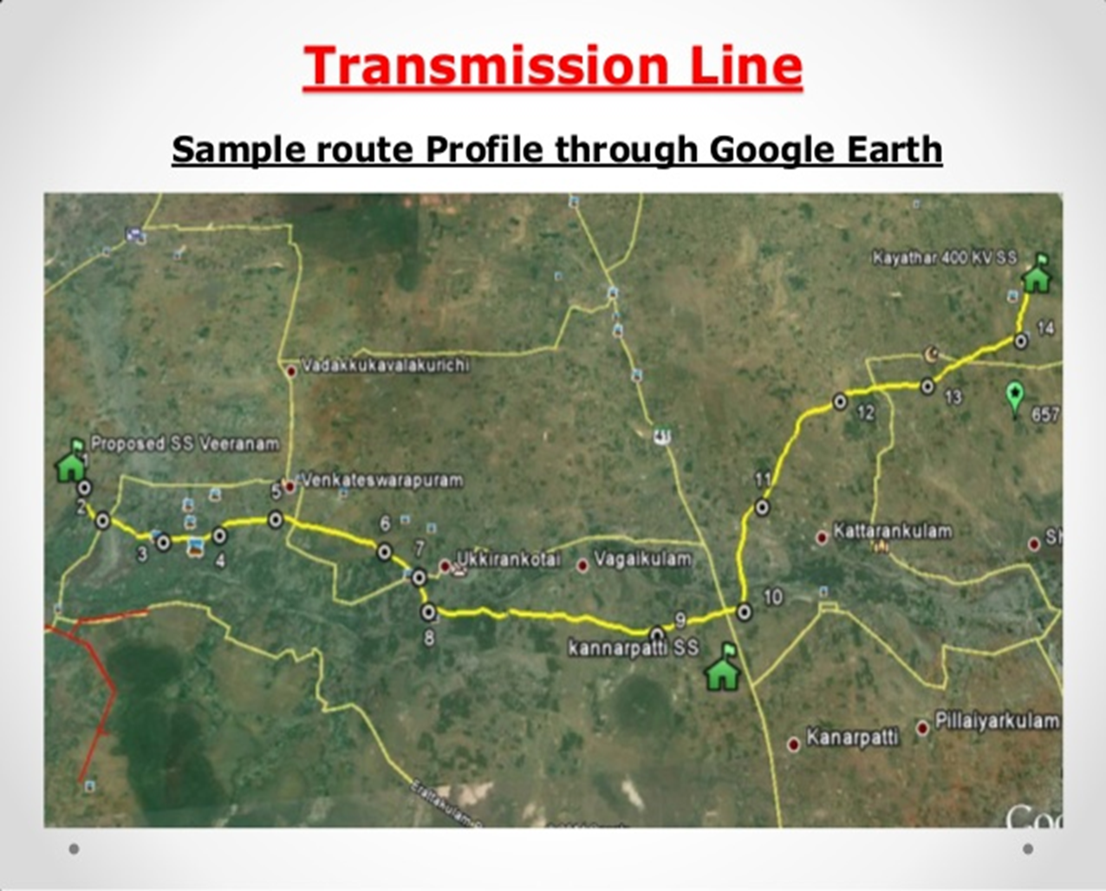
GOOGLE EARTH
MAPS ARE USED IN PRESENT
UPDATED FEATURES

Slide 7
RECONNAISSANCE SURVEY
FIX UP THE ANGLE POINTS TENTATIVELY
SHORT ROUTE, APPROACHABLE
ALONG THE ROAD SIDE
MINIMISE THE ROW
AVOID NOTIFIED AREAS

Slide 8
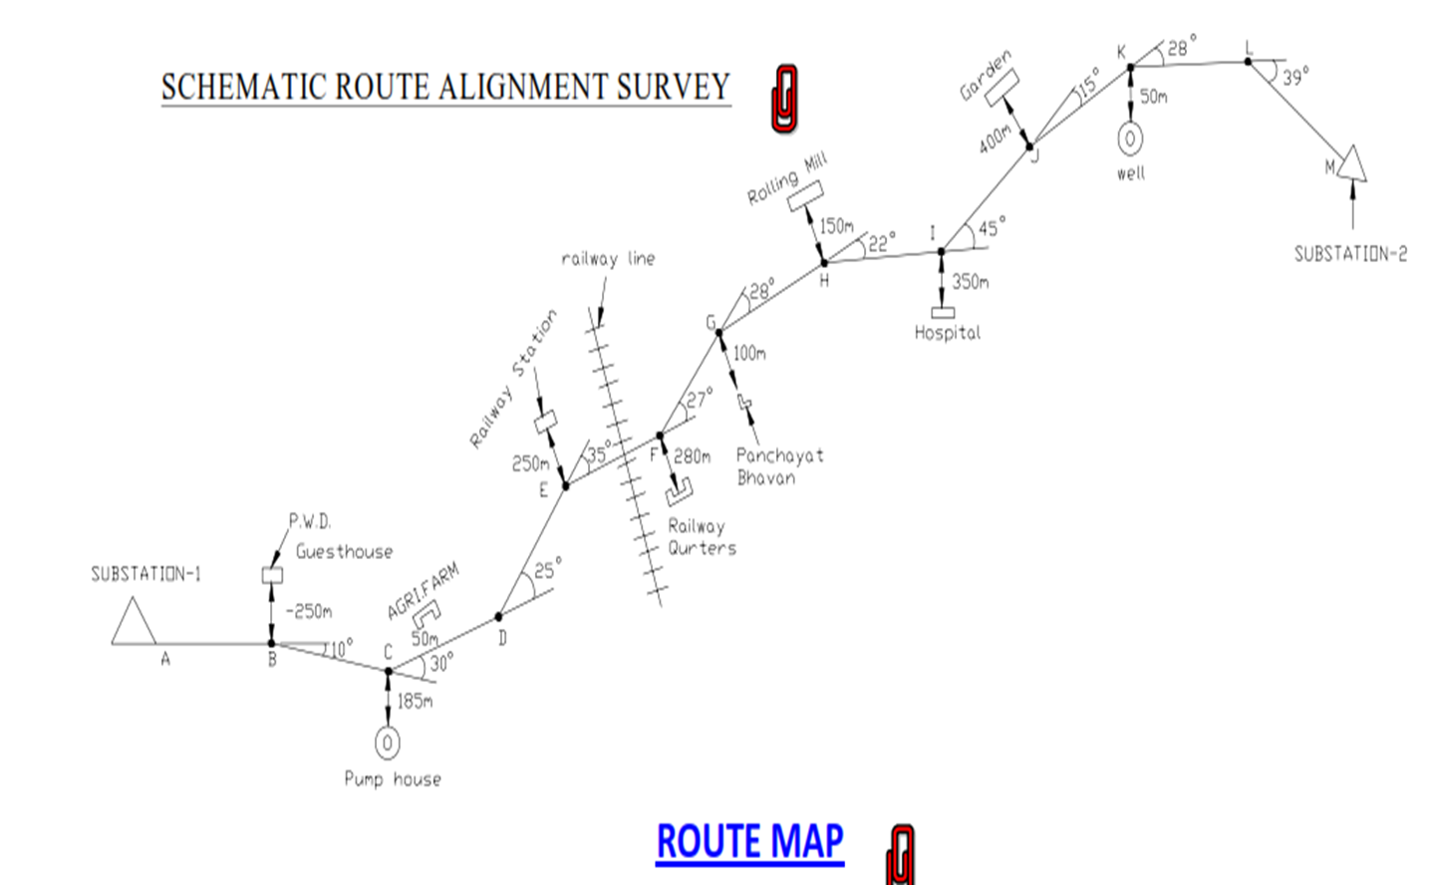
ROUTE ALIGNMENT

Slide 9
DETAILED SURVEY
FIRST INFORMATION DOCUMENT CONTAINING ALL DETAILS
PREPARING THE LONGITUDINAL CROSS SECTIOIN OF APPROVED ROUTE
ROUTE PROFILE 1:2 VERTICAL, 1:20 IN HORIZONTAL
LEVELS SHALL BE TAKEN @ 30 MTR INTERVAL or 30cm CHANGE IN HEIGHT OF GROUND

Slide 10
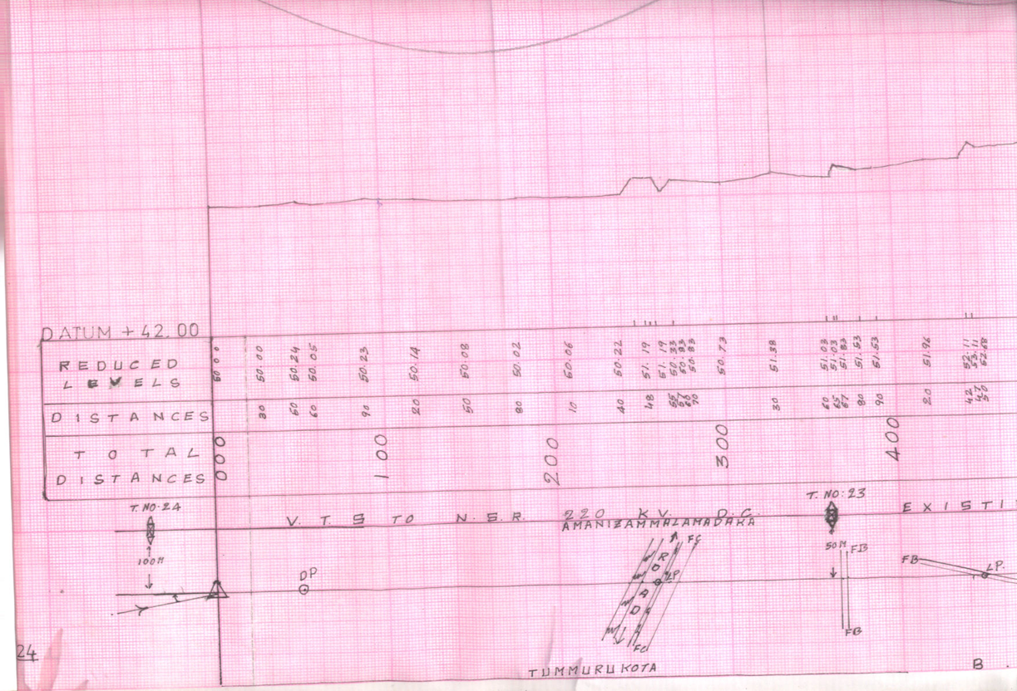
SAMPLE PROFILE

Slide 11
Introduction
A Transmission line is a device for the transfer of electrical energy. It can transfer the energy over long or short distances, and at different voltages.
The EHV (Extra High Voltages) transmission lines of 132 kV, 220 kV & 400 kV are available in APTRANSCO grid.
In the planning and design of transmission line, a number of requirements have to be met.
From the electrical point of view, the most important requirement is insulation and safe clearances to earthed parts.
These, together with the cross-section of conductors, the spacing between conductors, and the relative location of ground wires with respect to the conductors, influence the design of pylons and foundations.

Slide 12
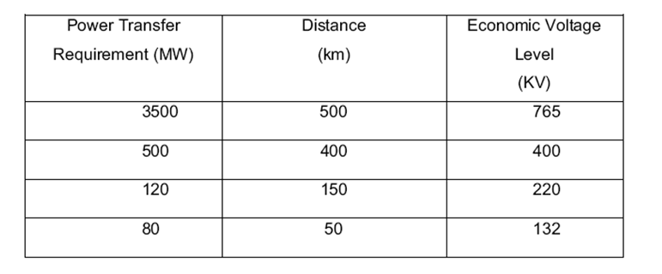
Economic Voltage of Transmission of Power
E = Transmission voltage (KV) (L-L).
L = Distance of transmission line in KM
KVA=Power to be transferred
Standard Voltage - 66,110,132, 220, 400 KV

Slide 13
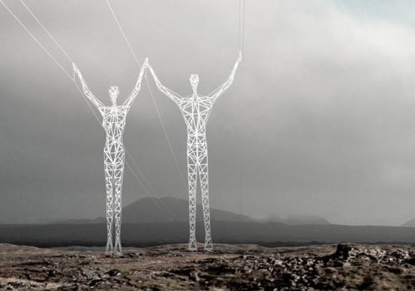
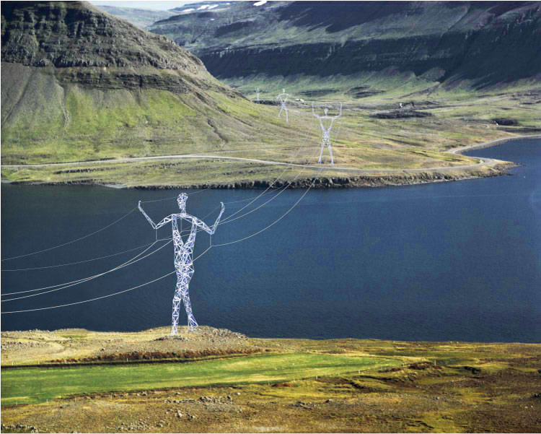
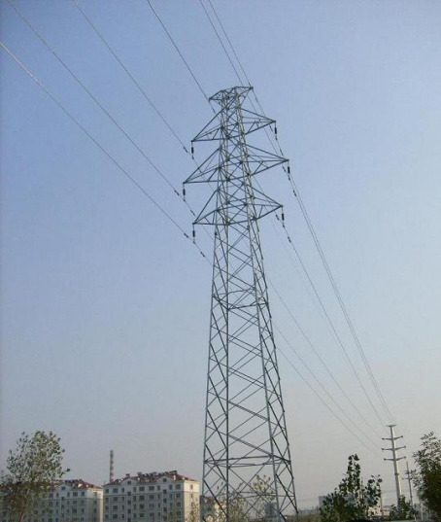
What is Transmission tower..?
Tall structure is a Steel lattice tower, used to support an overhead power line
Electricity pylon
Ironman
Hydro tower

Slide 14
VARIOUS SPANS IN TL SURVEY
DESIGN SPAN / RULING SPAN
WIND SPAN
WEIGHT SPAN

Slide 15
DESIGN SPAN
Basic spans in general:
400 KV – 400 Meter
220 KV – 350 Meter
132 KV – 320 Meter

Slide 16
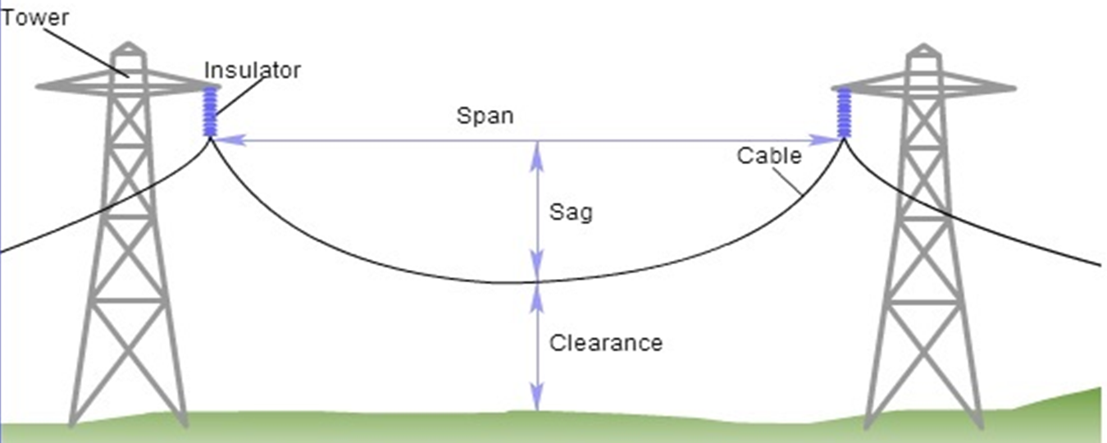
DESIGN SPAN/RULING SPAN

Slide 17
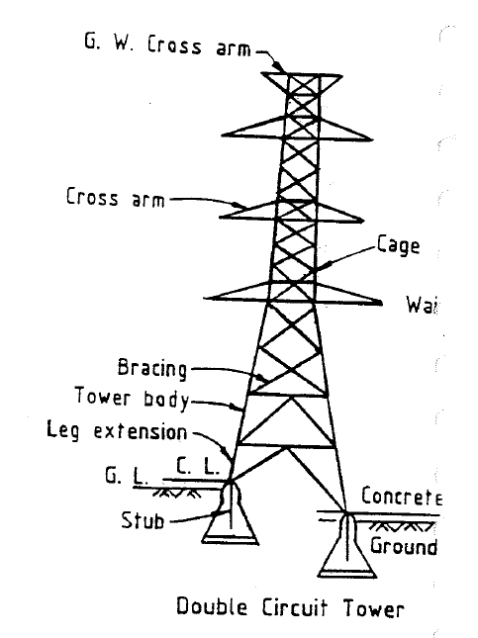
Tower Anatomy
Peak - supports G.W
CAGE - b/w peak & tower body
Cross Arm - Support Conductor/G.W
Boom – supports power conductors (horizontal)
Tower body – main portion, connects cage/boom to foundation/(leg/body ) extensions

Slide 18
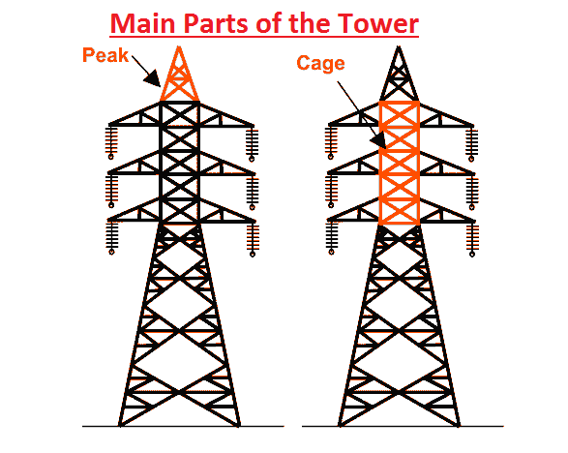

Slide 19
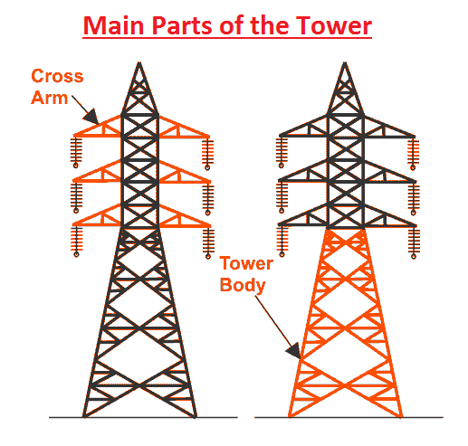

Slide 20
Parameter for Design of Transmission Line Towers
Strength / Load Considerations
Material
Self weight
Wind load on
Members
Conductors
Earth wire
Insulators & Fittings
Line Deviation
Construction & Maintenance loads
Height Considerations
Transmission Voltage for clearances
Number of Circuits
Climatic Conditions
Environmental Conditions
Type of Conductor
Type of Earth Wire
Insulators
Span & Sag
(Sag depends on the above 3 to 8 items)

Slide 21
The following points are to be considered in designing a transmission tower a) The minimum ground clearance required from the lowest conductor point above the ground level. b) The length of the insulator string. c) The minimum clearance to be maintained between conductors and between the conductor and tower. d) The location of ground wire with respect to outermost conductors. e) The mid-span clearance required from considerations of the dynamic behavior of the conductor and lightning protection of the line. All the above points depend on the line voltage.

Slide 22
To determine the required tower height by considering the above points, we can divide the total height of the tower in four parts. a) Minimum permissible ground clearance (H1) b) Maximum sag of the conductor (H2) c) Vertical spacing between top and bottom conductors (H3) d) Vertical clearance between the ground wire and top conductor (H4).
FACTORS GOVERNING TOWER HEIGHT

Slide 23
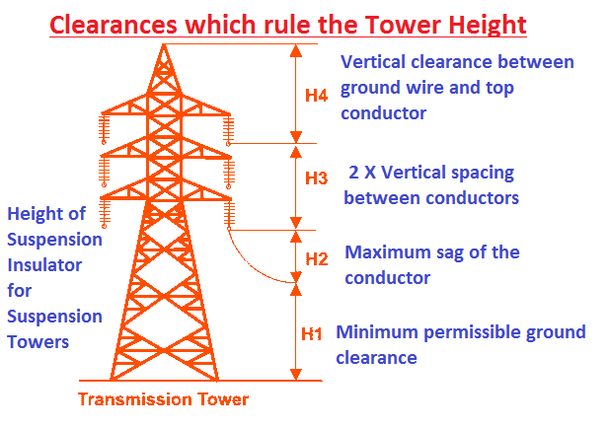

Slide 24
Tower Extension
Body Extension
Leg Extension
Body Extension
Used to Increase the height of tower to obtain the required min Ground clearance & over road crossings, river crossings, Railway crossings and ground obstacles.
Body extensions up to 9 meters height in steps 3.0 meters can be used thus form a part of the standard tower
For Special Extensions having greater heights (+12m, +18m, +25 m, +30 m) the suitability is checked by reducing span length and angle of deviation. Practice in tower industry is also to specify negative body extension (portion of tower body is truncated)

Slide 25
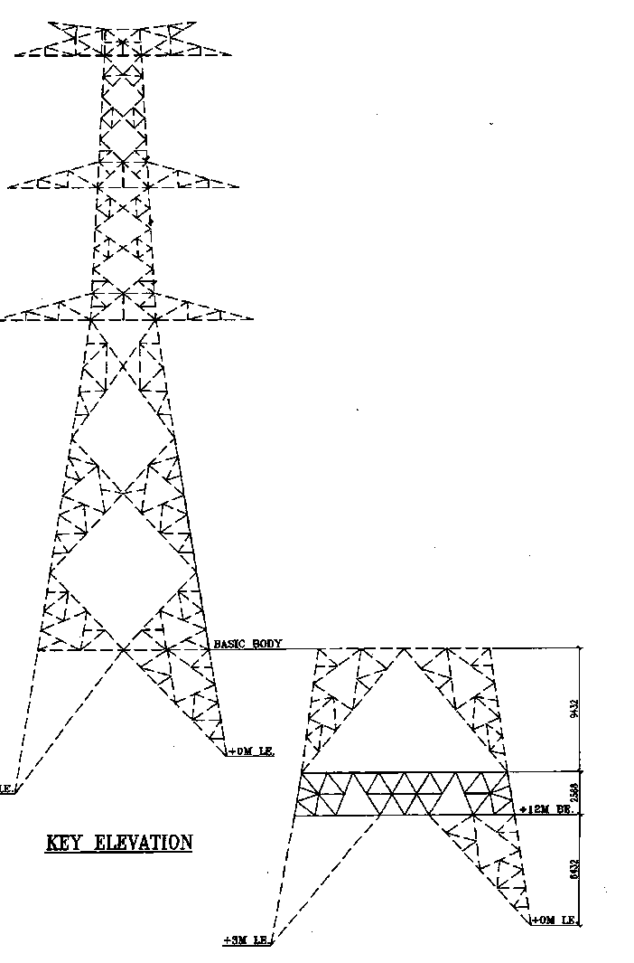
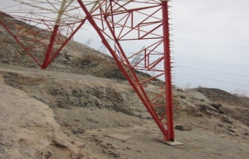
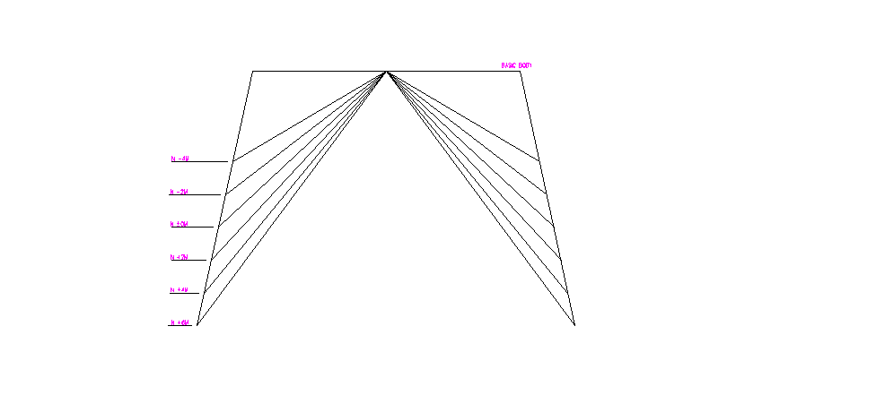
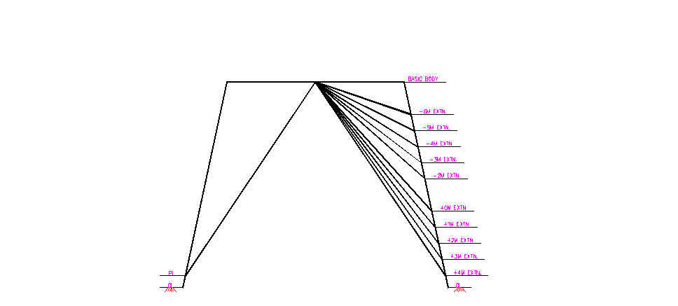
Leg Extension
Tower Leg extensions are required when the tower was spotted in an undulated surface / Hilly terrain.
While spotting the tower locations in hilly areas requires more benching or revetment or both are involved , but suitable hill side (leg extensions) can be used to minimize benching or revetment or both.
Two types of Leg extension :
i) Universal leg extension
ii) Individual leg extension

Slide 26
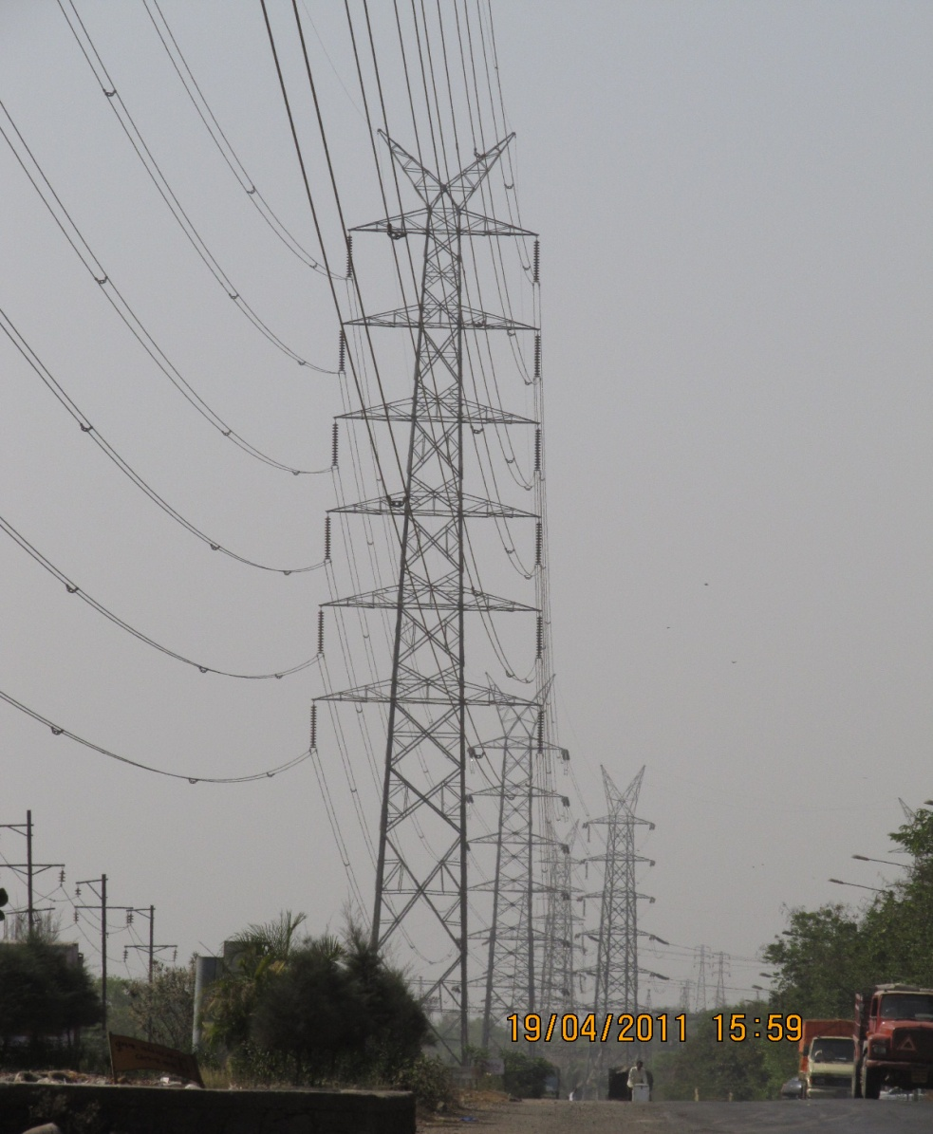
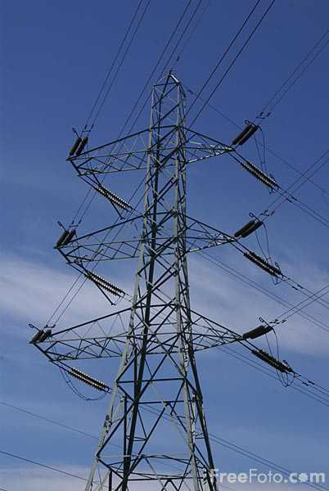
Tension Tower
Multi Circuit
Suspension Tower

Slide 27
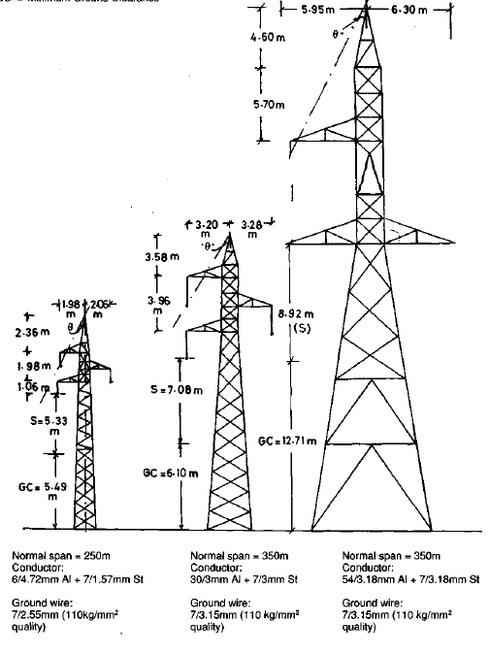
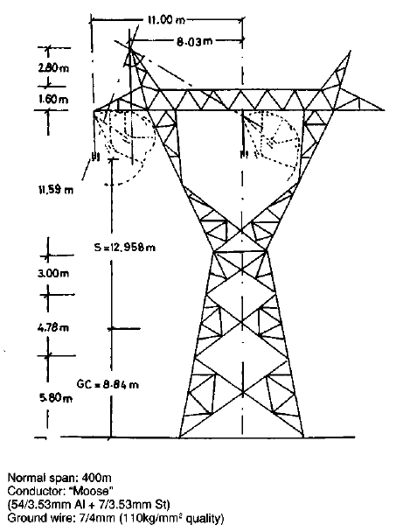
66 kv
132 kv
220 kv
400 kv

Slide 28
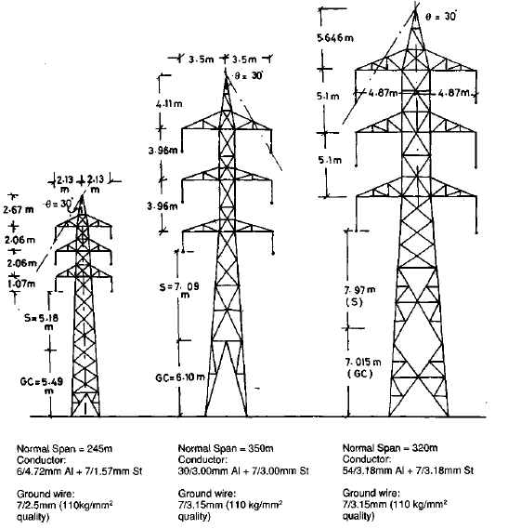
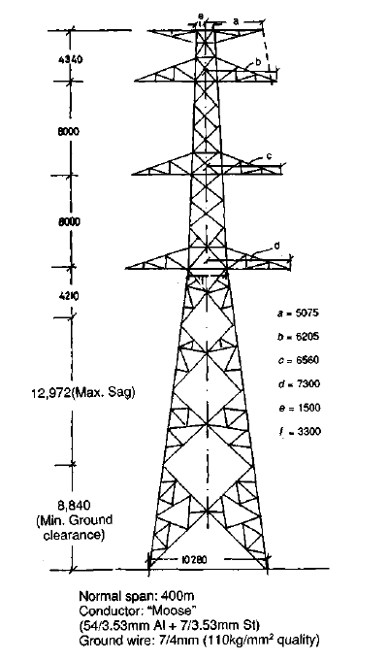
66 kv
132 kv
220 kv
400 kv

Slide 29
Shielding Angle
Shielding Angle
400kV lines=20degrees
Notes:
29

Slide 30
Electrical Clearances which rule the Tower Height
(Based on IE Rules & CEA Regulations 2010 & IS & CBIP manuals)
(All clearances in meters)
Sl. No | Description | Nominal System Voltage / Line Voltage
 |  | 400KV | 220KV | 132KV
1) | Minimum Ground Clearance from the bottom most conductor | 8.84 | 7.00 | 6.10
2) | Minimum Phase to Phase vertical distance | 8 | 5.1 | 4
3) | Minimum mid span vertical distance between top conductor and earth wire | 9.00 | 8.50 | 6.10
4) | Shielding angles and no. of earth wires | 20 deg / 2 nos. | 30 deg / 1 no. | 30 deg / 1 no.
5) | Minimum Electrical clearance from Live conductor to Earthed metal part for string and for jumpers. | Nil - 3.05 20deg -3.05 40deg - 1.86 | Nil - 2.13 | Nil - 1.53
6) | Minimum Electrical clearance from Live conductor to Earthed metal part, for suspension strings at each swing angle | Nil - 3.05 22 deg - 3.05 44deg - 1.86 | Nil - 2.13 15 deg - 1.98 30deg - 1.83 45 deg - 1.675 | Nil - 1.53 15 deg - 1.53 30deg - 1.37 45 deg - 1.22 60deg - 1.07

Slide 31
The other points to be kept in mind in designing of Towers is a) to add 150mm or up to 4% of Sag to Ground clearance towards errors while deciding the height of Tower. b) To consider Double Tension string length while fixing the bottom cross arm height from ground and Single suspension string for calculating Peak Height.

Slide 32
After finalizing the height of the Tower we have to decide width of Tower at Bottom and at Hamper. A) While fixing the base width of Tower at Concrete level the Right of Way / Corridor shall also to be kept in mind. B) The width at Hamper (Bottom cross arm- base) and width of the cage will be generally depends on the horizontal spacing between the conductors

Slide 33


Determination of Base Width
The base width(at the concrete level) is the distance between the center of gravity at one corner leg and the centre of gravity of the adjacent corner leg.
A particular base width which gives the minimum total cost of the tower and foundations.
The ratio of base width to total tower height for most towers is generally about one-fifth to one-tenth.
Ryle
Formula

Slide 34
A wide taper in the tower base reduces the foundation loading and foundation costs but it increases the cost of the tower and the area of the site required.
A minimum cost which occurs with a tower width, is greater with bad soil than with good soil.
So optimization is to be done with different base widths and costs of the Tower & Foundation while designing of the Towers.
The ROW issues shall also be kept in mind while arriving at the Base width of the Tower.

Slide 35
Hamper width / Cage width
The Horizontal spacing between the Conductor shall decide the hamper width and as well as Cross arm length between the centre of the Tower.
Horizontal spacing between conductors based on the mid-span flashover between the power conductor under the severest wind and galloping conditions and the electrical clearance of the line conductor (live part) to the tower body (metal part).

Slide 36
Phase-to-Phase Air Clearances
Horizontal Clearance between conductors
= 0.62* (fmax + Lk)^0.5+(V/150)
where
fmax is the maximum sag in metres
Lk is the vertical length of the Suspension String in mtrs
V is the line voltage in kV

Slide 37
Cage Height
The Cage width depends on the Vertical spacing between the Conductor
Phase to Phase Vertical Clearance
= 0.75* (fmax + Lk)^0.5+(V/150)
where
fmax is the maximum sag in metres
Lk is the vertical length of the Suspension String in mtrs
V is the line voltage in kV

Slide 38
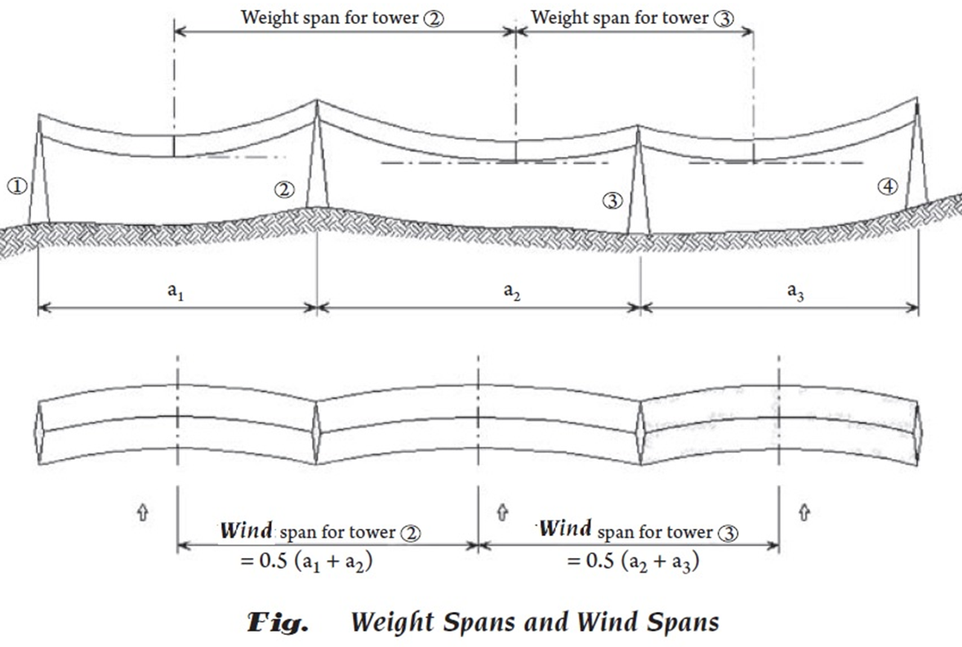
WEIGHT SPAN /WIND SPAN

Slide 39
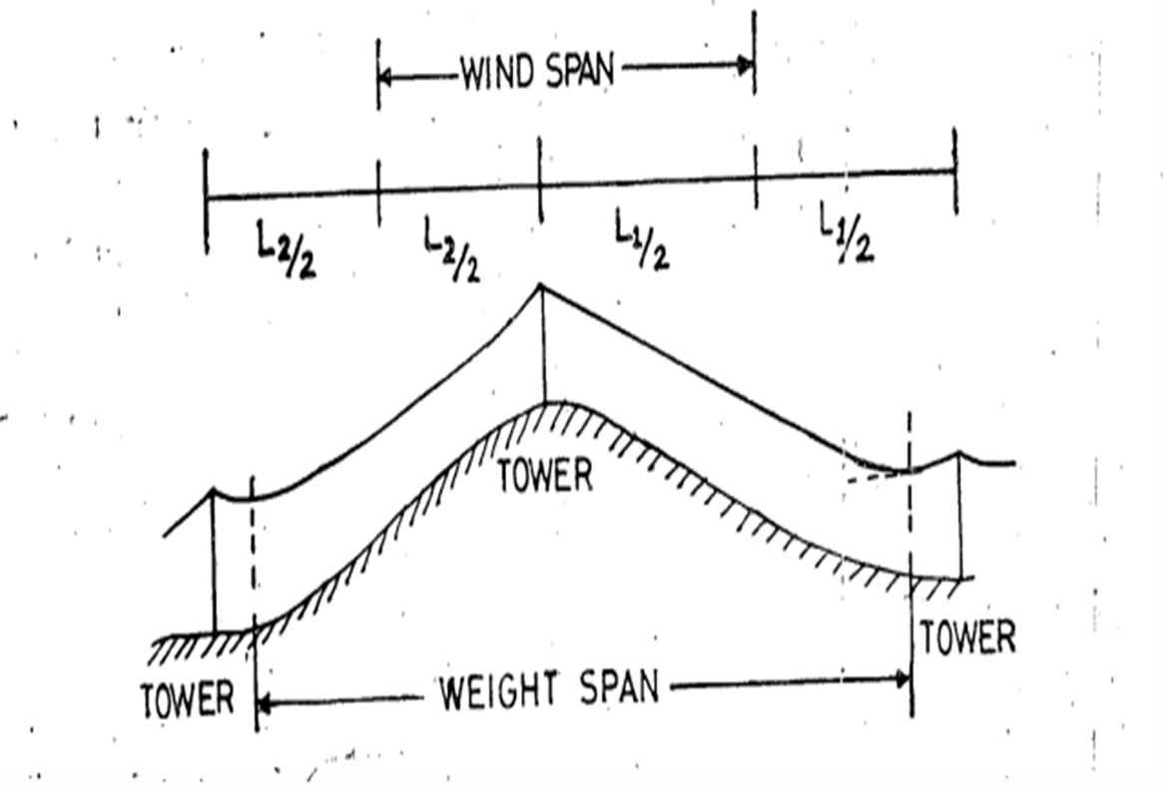
WEIGHT SPAN / WIND SPAN

Slide 40
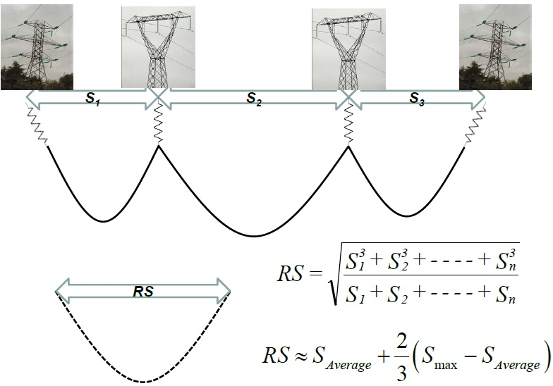
What is a ruling span?

Slide 41
CONDUCTORS used IN APTRANSCO
PANTHER ACSR/AAAC FOR 132KV (DOG,WOLF,LYNX)
ZEBRA/MOOSE ACSR FOR 220KV
TWIN/QUAD MOOSE ACSR FOR 400KV

Slide 42
MAX ALLOWABLE TEMPERATURE OF ACSR CONDUCTOR AS PER IS 802
BEFORE 1995 - MAX TEMP 60 DEG
AFTER 1995 REVISION - MAX TEMP 75 DEG
AFTER 2015 REVISION - MAX TEMP 85 DEG
Ordinary Hard drawn Aluminium used in conventional ACSR conductor starts annealing and losing strength at above 93⁰C and not suitable for long term use at temperatures beyond 93⁰C and hence limited to use upto 85⁰C only.

Slide 43
Thermal Loading Limits for ACSR Panther Conductor:
ACSR Panther (212.5Sq.mm) Dia:21.00mm
Ambient Temperature in deg.C | Ampacity for Maximum Conductor temperature
 | 65 | 75 | 85 | 90
40 | 312 | 413 | NA | NA
45 | 244 | 366 | NA | NA
48 | 199 | 334 | NA | NA
50 | NA | 311 | NA | NA

Slide 44
Thermal Loading Limits for ACSR Zebra Conductor:
ACSR Zebra (484 Sq.mm) Dia:28.62mm
Ambient Temperature in deg.C | Ampacity for Maximum Conductor temperature
 | 65 | 75 | 85 | 90
40 | 473 | 643 | 769 | NA
45 | 346 | 560 | 703 | NA
48 | 240 | 503 | 663 | NA
50 | 128 | 462 | 631 | NA

Slide 45
Thermal Loading Limits for ACSR Moose Conductor:
ACSR Moose (597 Sq.mm) Dia:31.77mm
Ambient Temperature in deg.C | Ampacity for Maximum Conductor temperature
 | 65 | 75 | 85 | 90
40 | 528 | 728 | 874 | NA
45 | 378 | 631 | 798 | NA
48 | 247 | 565 | 749 | NA
50 | 83 | 516 | 714 | NA

Slide 46
SUBSTATION PLANNING CRITERIA
The capacity of any single sub-station at different voltage levels shall not normally exceed as given in column (C) in the following table:
Voltage Level | Transformer Capacity
(A) | Existing Capacity (B) | Maximum Capacity (C)
765 kV | 6000 MVA | 9000 MVA
400 kV | 1260 MVA | 2000 MVA
220 kV | 320 MVA | 500 MVA
132 kV | 150 MVA | 250 MVA

Slide 47
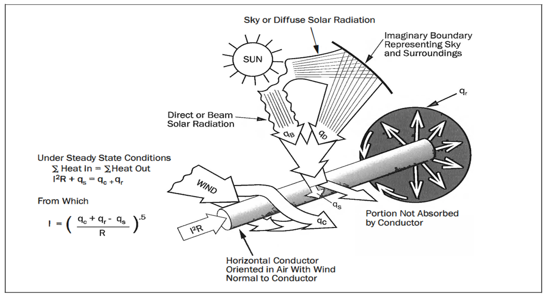
MAX TEMP WRT THERMAL CAPACITY OF CONDUCTORS

Slide 48
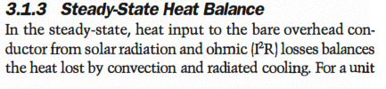
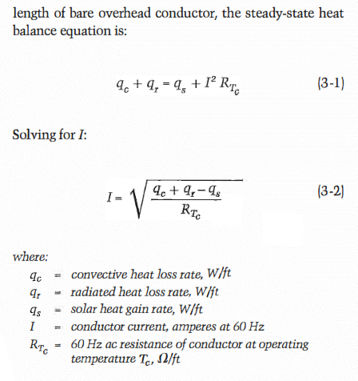

Slide 49
Comparision of Sag & Ampacity
For ACSR Panther conductor
At 60 deg, Sag - 6.5 Mtr & Ampacity-252A (55MW)
At 75 deg, Sag – 7.056 Mtr & Ampacity-429A (93MW)
At 85 deg, Sag – 7.420 Mtr & Ampacity-510A (111MW)

Slide 50
The loadings have to be worked out for Normal condition & broken wire condition.
The I.S. 802‐1995 covers various combinations of broken wire conditions.
Thus, there will be different sets of loadings and the loading trees.

Slide 51
Types of Transmission Tower
Towers are classified according to their use independent of the number of conductors they support.
The transmission line goes as per available corridors and hence it cannot be along with the BEE line.
So the transmission line has to deviate from its straight way when obstruction comes.
A tower has to withstand loadings ranging from straight runs up to varying angles and dead ends.

Slide 52
To simplify the designs and ensure an overall economy in cost and maintenance, tower designs are generally confined to a few standard types as follows.
A – type tower – angle of deviation 0º to 2º. B – type tower – angle of deviation 2º to 15º. C – type tower – angle of deviation 15º to 30º. D – type tower – angle of deviation 30º to 60º &
Dead end.

Slide 53
As per the force applied by the conductor on the cross arms, the transmission towers can be categorized in another way:
1. Tangent or Suspension tower and is generally
A - type tower.
2. Angle tower or Tension tower or Dead end tower or some time it is called Section tower. All B, C and D types of transmission towers come under this category.

Slide 54
Apart from the above customized type of tower, the tower is designed to meet special usages listed below,
These are called special type towers
1. River crossing towers
2. Anchor Towers
3. Transposition towers
4. Power Line Underneath crossing Towers

Slide 55
ORIENTATION OF TOWER w.r.t CROSS ARM
A. Suspension Tower
Longitudinal view of line
Line alignment
Suspension tower positions
Longitudinal direction
Transverse direction
Line alignment
Cross arm orientation (plan)

Slide 56
ORIENTATION OF TOWER w.r.t CROSS ARM
B. Angle Tower
Angle of deviation
Angle of deviation
Angle Tower Positions
Bisected
Cross Arm Orientation of Angle tower (plan)

Slide 57
TRANSVERSE LOAD ON SUSPENSION TOWER
On account of wind pressure on tower body
On account of wind pressure on conductor, earth wire & insulator string
On account of conductor / earth wire pull
Conductor
Wind load on tower = wind pressure x projected area
Wind load on conductor/earth wire = wind pressure x projected area

Slide 58
TRANSVERSE LOAD ON TENSION TOWER ON ACCOUNT OF CONDUCTOR / EARTH WIRE PULL
Θ = angle of Deviation
T
T
Tcos θ /2
Tcos θ /2
Longitudinal Load due to Pull
T
T
2T sin θ /2
TRANSVERSE LOAD DUE TO DEVIATION

Slide 59
DEAD END LOAD ON TOWER
Switch yard gantry
Connection to Switch yard gantry is done at a later stage and with slack span only
Dead End Tower

Slide 60
Loads on Tower
Normal Condition
Broken Wire Condition

Slide 61
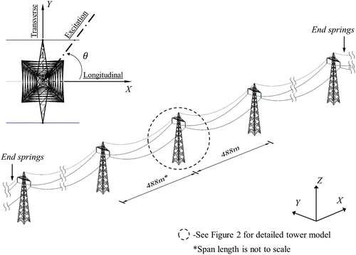
LOADS
Notes:
Refer auto cad

Slide 62
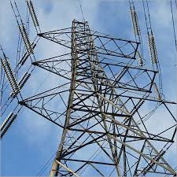
TRANSVERSE LOAD DUE TO DEVIATION
Notes:
Refer auto cad

Slide 63
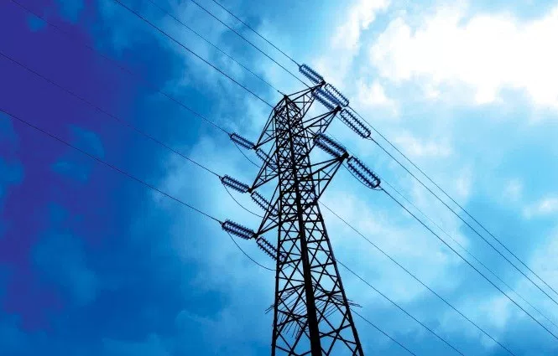
DEVIATION LOADS NIL
Notes:
Refer auto cad

Slide 64
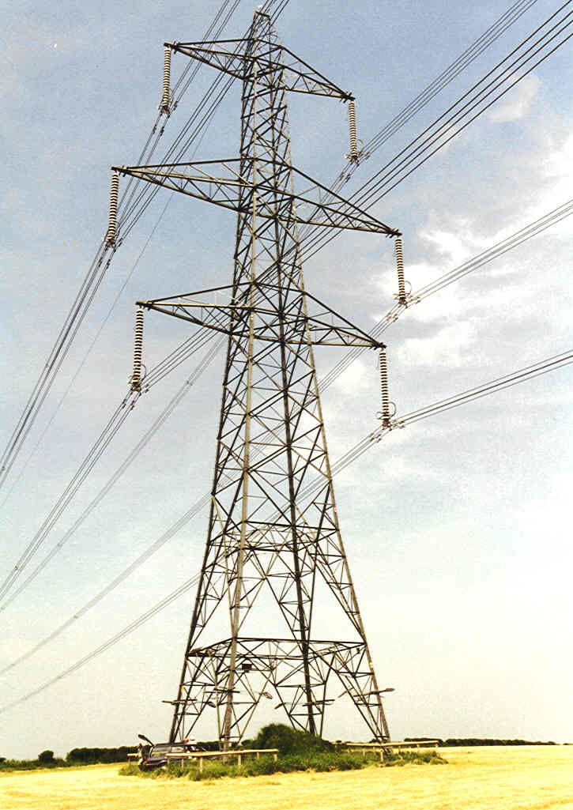
Suspension Tower
Tension Tower

Slide 65
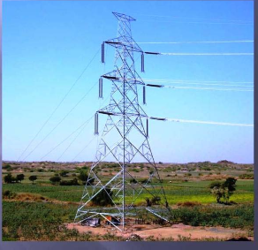
BROKEN WIRE/DEAD END
Notes:
Refer auto cad

Slide 66
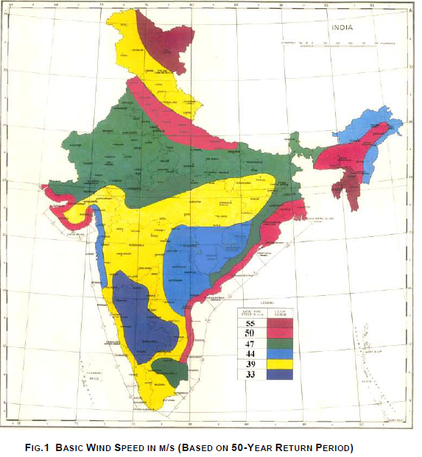
WIND MAP OF INDIA

Slide 67
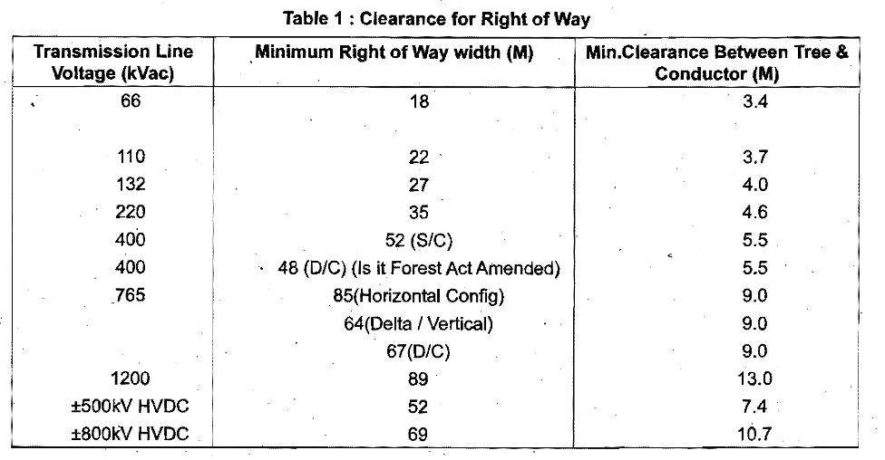
ROW WIDTH

Slide 68
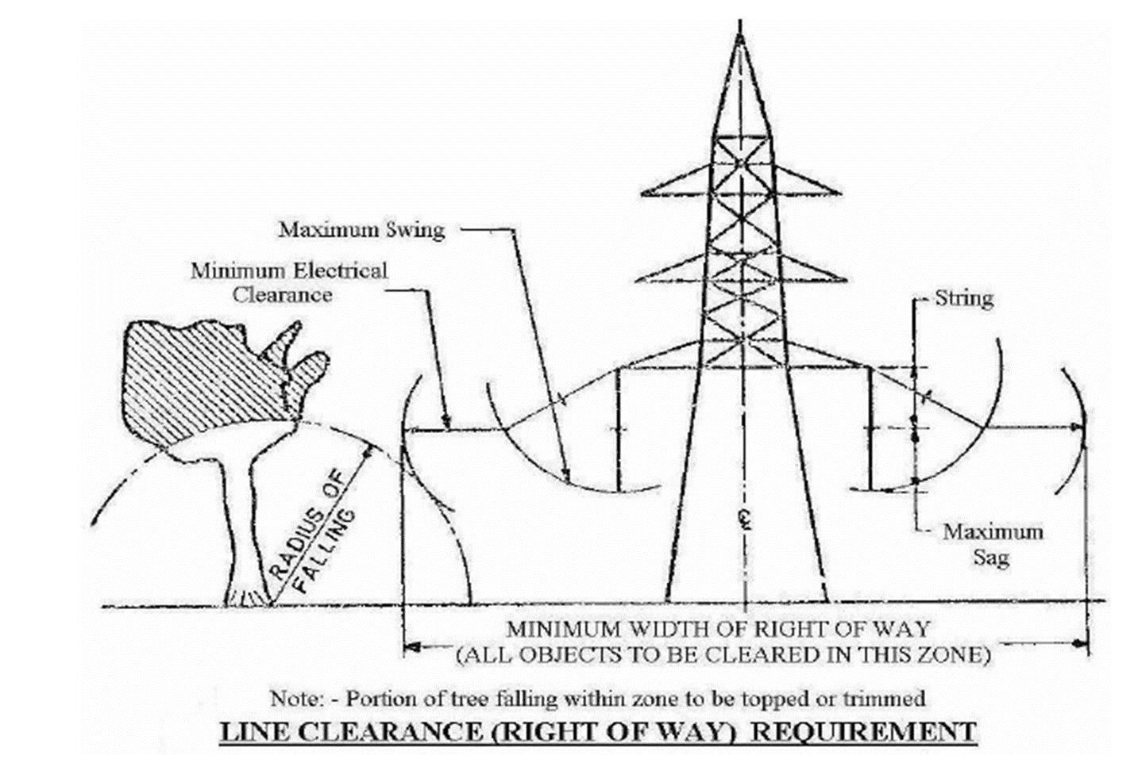
RIGHT OF WAY
Sr. No | Type of Clearance | 132 kV | 220 kV | 400 kV | 765 kV
1 | ROW width | 27 m | 35 m | 52 m | 85 m

Slide 69
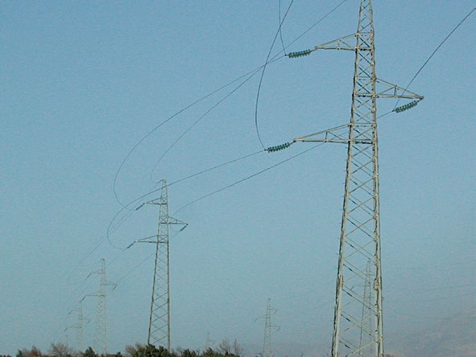
ROW WIDTH

Slide 70
ROW WIDTH CALCULATION
 |  | for 400kV |  |  | for 132kV |  | for 220kV
Min length of Insulator string = |  | 4.2 | mtrs |  | 1.92 |  | 2.64
Max Sag of Moose ACSR Conductor for = span of 400 mtrs at 75⁰ |  | 12.867 | mtrs |  | 6.5 |  | 9.235
Conductor Shifts When it swings at 44⁰= |  | (4.2+12.867)x Sin 44⁰ |  |  | (1.92+6.5)x Sin 44⁰ |  | (2.64+9.235)x Sin 44⁰
 | = | 11.86 |  |  | 5.85 |  | 8.25
 |  | say | 12.00 | mtrs | 6.00 |  | 8.25
Minimum clearance required after swing |  |  | 6.00 | mtrs | 4.00 |  | 4.00
Length of cross arm |  | say | 6.00 | mtrs | 2.67 |  | 3.35
Half of the tower width at Xarm level |  |  | 2.00 | mtrs | 0.85 |  | 1.75
i.e; hamper width/2
*The Clearance required from centre of tower body
 |  | = 12+6+6+2 | 26.00 | mtrs | 13.52 |  | 17.35
Taking both sides of tower |  | 2x26 | 52.00 | mtrs | 27.04 |  | 34.70

Slide 71
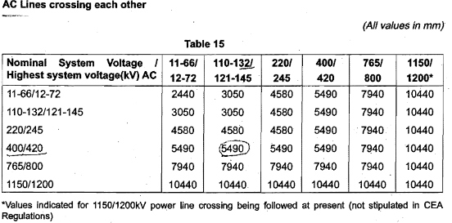
CLEARANCE OVER POWER LINES
The tower of the power line to be crossed should be kept away from the proposed line shall be 1.5 times to the tower height.

Slide 72
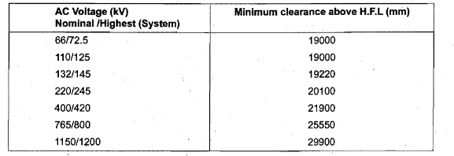
RIVER CROSSING CLEARANCES (in case of navigable rivers)

Slide 73
Minimum Clearance of Power Conductor over the Highest Flood Level in Case of Non- Navigable Rivers
System Voltage (kV) Nominal/Highest | Minimum clearance above highest flood level (mm)
66/72.5 | 3650
110/125 | 4300
132/145 | 5100
220/245 | 6400
400/420 | 9400
765/800 | 11000

Slide 74
CLEARANCE FROM BUILDINGS
Vertical clearance from EHV lines :3.7 meters up to 33kv +0.3 meters for every additional 33kv or part thereof.
Horizontal clearance from EHV lines :2.0 meters up to 33kv +0.3 meters for every additional 33kv or part thereof.

Slide 75
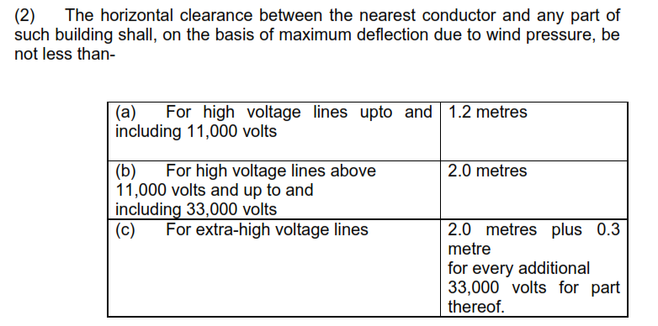

Slide 76
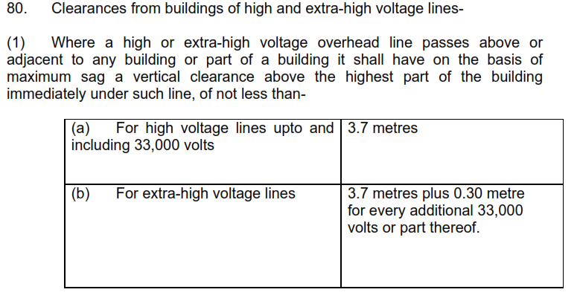

Slide 77
CLEARANCE OVER RAILWAY TRACKS
Over Head crossing voltage | Clearance over the track | Min Clearance over the highest traction conductor to bottom of transmission line conductor
132kv | 16480 mm | 3050
220 kV | 18260mm | 4580
400kv | 19160 mm | 7940
765 kv | 21860 mm | 7940
The angle of crossing should preferably be 90 degrees, but an angle of up to 60 degrees may be permitted in special cases

Slide 78
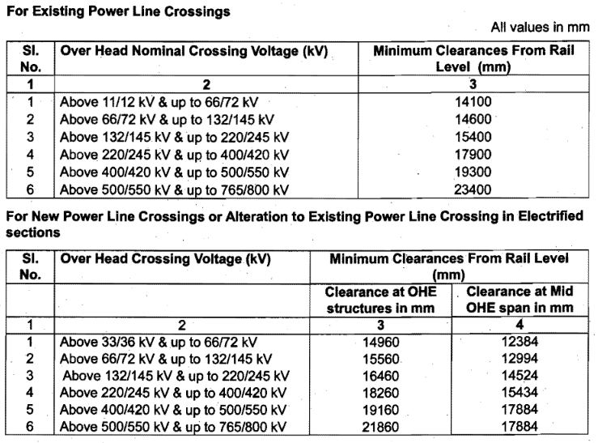

Slide 79
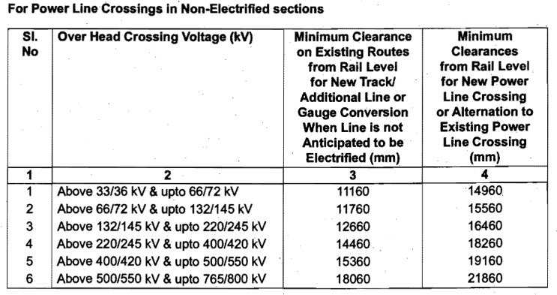

Slide 80

 | 33 | 36 | 5.2
 | 132 | 145
 | 220 | 245
 | 400 | 420
 | For 132kV, | 5.2+ (( 145- 33) / 33) x 0.3 = |  | 6.10
 | For 220kV, | 5.2+ (( 245- 33) / 33) x 0.3 = |  | 7.00
 | For 400kV, | 5.2+ (( 420- 33) / 33) x 0.3 = |  | 8.80

Slide 81
CLEARANCE OVER RAILWAY TRACKS
The crossing span shall be restricted to 300 meters or to 80% of the basic span of the towers of the relevant voltage class, whichever is less. Angle towers are to be provided on both sides.
The minimum distance of the towers of the crossing span from the center of the nearest railway track shall be equal to the height of the tower in meters above normal ground level plus 6 metres.

Slide 82
CLEARANCE OVER HIGHWAYS
Transmission line crossings across National Highways and major roads shall preferably be at right angles or as near to 90 degrees as possible. Minimum Clearance over road shall be 12.5meters
Avoid parallelism with communication lines
If continuous parallelism for long stretches with EHV Power lines minimum separation of 300 meter shall be maintained

Slide 83
AVIATION CLEARANCES
Aviation Clearance: Transmission towers of height more than 30 mtrs are not allowed with in 3.05 km (10000 ft)
Beyond 3.05km to 15.24 km(50000ft) erection of towers with height of 35 mtrs is allowed and should be painted red and white bands of 5 mtr height and with night aviation of signalling lights
Hence it is better to avoid in 15.24 km if possible

Slide 84
Sag & Tension
So by this time you would have understood that the Transverse loads on the Tower are due to Wind on Tower, Wind on the Conductor, Wind on the Earth wire, Wind on Insulators, Hard Ware and Accessories.
Further the loads due to line deviation the Conductor & Earth wire Tensions will result to the Transverse loads.
Except for dead-end towers the longitudinal loads are considered as zero by ignoring the height differences and span differences between adjacent towers.

Slide 85
Loads on Transmission Lines
Overhead transmission lines are subjected to various loads during their life span which are classified into three distinct categories:‐
a) Climatic loads related to reliability requirements (This is considered to be a Normal condition).
b) Failure containment loads related to security requirements (This is considered to be a broken wire condition).
c) Construction and maintenance loads related to safety requirements.

Slide 86
Loads on towers (Brief)
Loads are applied in all three directions namely Transverse ( FX ),
Vertical ( FY) and Longitudinal (FZ) direction.
Transverse loads consists of –
Wind on Conductor
Wind on Insulator
Component of Wire Tension in Transverse Direction (Deviation Load)
Wind on Tower Body
Vertical Load consists of –
Weight of Wire
Weight of Insulator
Weight of Line man & Tools
Self Weight of Tower
Longitudinal Load Consist of –
Component of Unbalanced pull of the wire in the longitudinal direction.

Slide 87
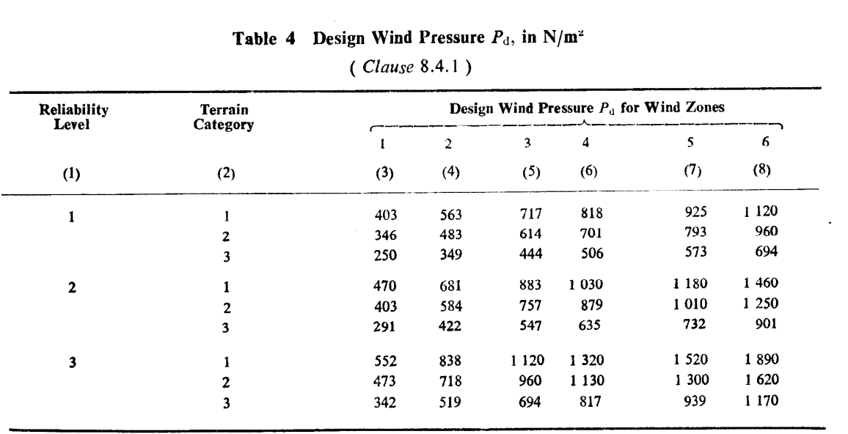
WIND PRESSURE IN VARIOUS WIND ZONES

Slide 88

Reliability Consideration
Sl. No | Description | Reliability levels
 |  | 1 Up to 400kV | 2 Above 400kV & Triple / quad up to 400kV | 3 River crossing & Special towers
i) | Return period of design loads in Years, T | 50 | 150 | 500
ii) | Yearly reliability Ps | 1-10⁻² | 1-10^{-2.5} | 1-10⁻³
Transmission lines shall be designed for the reliability levels given below. These levels are expressed in terms of return periods in years of climatic ( wind ) loads.
The minimum yearly reliability Ps, corresponding to the return period, T is expressed as P =(1-1/2T )

Slide 89
Wind Zones

Slide 90
Wind Load
Basic Wind Speed, VB
The above slide shows basic wind speed map of India as applicable at 10 m height above mean ground level for the six wind zones of the country.
Basic wind speed VB is based on peak gust velocity averaged over a short time interval of about 3 seconds, corresponds to mean heights above ground level in an open terrain ( Category 2 ) and have been worked out for a 50 years return period [refer IS 875 (Part 3 )].

Slide 91
Wind Load
Basic wind speeds for the six wind zones as per IS-802
Wind Zone Basic Wind Speed, Vb in m/s
Wind Zone | V_{b} | Vr=V_{b}/K_{o}
1 | 33 | 24.000
2 | 39 | 28.364
3 | 44 | 32.000
4 | 47 | 34.182
5 | 50 | 36.364
6 | 55 | 40.000
Meteorological Reference Wind Speed, VR: It is the extreme value of wind speed over an averaging period of 10 minutes duration and is to be calculated from basic wind speed, VB by the following relationship: VR = VB / K0, Where,K0 is a factor to convert 3 seconds peak gust speed into average speed of wind during 10 minutes period at a level of 10 metres above ground. K0 may be taken as 1.375.
Note:
1 Reference may be made to IS 875(Part 3) for basic wind zone maps.
2 In case the line travels on the border of different wind zones, the higher wind speed may be considered.

Slide 92
Wind Load
Design Wind Speed, Vd
Reference wind speed obtained above shall be modified to include the following effects to get the design wind speed:
a) Risk coefficient, K1, and
b) Terrain roughness coefficient, K2.
It may be expressed as follows:
Vd = Vr.K1.K2.

Slide 93
Wind Load
Risk coefficient, K1 for different wind zones for the
three reliability levels as per IS-802.
Sl. No | Wind Zone | Risk coefficient K1 for different wind zones
 |  | 1 | 2 | 3 | 4 | 5 | 6
 | Reliability level
1 | 1 | 1.00 | 1.00 | 1.00 | 1.00 | 1.00 | 1.00
2 | 2 | 1.08 | 1.10 | 1.11 | 1.12 | 1.13 | 1.14
3 | 3 | 1.17 | 1.22 | 1.25 | 1.27 | 1.28 | 1.30

Slide 94
Wind Load
Terrain roughness coefficient, K2 as per IS-802.
Sl. No | Terrain category | Terrain Roughness coefficient, K₂ | APPLICABILITY
1 | 1 | 1.08 | Exposed open terrain with few or no obstruction and in which the average height of any object surrounding the structure is less than 1.5 mtrs. (Sea coasts, large water bodies, large treeless plains)
2 | 2 | 1.00 | 0 is for open terrain with well scattered obstructions having objects of height between 1.5 mtrs to 10 mtrs. (Normal country lines with few obstacles)
3 | 3 | 0.85 | 1 is for Terrain with numerous closely spaced obstructions. (Built up areas like cities and thick forests)

Slide 95
Wind Load
Design Wind Pressure, Pd
The design wind pressure on towers, conductors and insulators shall be obtained by the following relationship:
Pd= 0.6 (Vd ) ^ 2 where
Pd = design wind pressure in N/m², and
Vd = design wind speed in m/s.
Design wind pressures, Pd for the three reliability levels and pertaining to six wind zones and the three terrain categories have been worked out and
given below

Slide 96
Wind Load
Reliability level | Zones | Design Wind Pressure Pd for wind zones
 |  | 1 | 2 | 3 | 4 | 5 | 6
 | Terrain category
1 | 1 | 403 | 563 | 717 | 818 | 925 | 1120
 | 2 | 346 | 483 | 614 | 701 | 793 | 960
 | 3 | 250 | 349 | 444 | 506 | 573 | 694
2 | 1 | 470 | 681 | 883 | 1030 | 1180 | 1460
 | 2 | 403 | 584 | 757 | 879 | 1010 | 1250
 | 3 | 291 | 422 | 547 | 635 | 732 | 901
3 | 1 | 552 | 838 | 1120 | 1320 | 1520 | 1890
 | 2 | 473 | 718 | 960 | 1130 | 1300 | 1620
 | 3 | 342 | 519 | 694 | 817 | 939 | 1170

Slide 97
Wind Load on Tower
For a lattice tower of square cross-section, the resultant wind load, Fwt in N, for wind normal to the longitudinal face of tower on a panel height, h applied at the centre of gravity of this panel is:
Fwt =Pd X Cdt X Ae X Gt where
Pd = design wind pressure, in N/m²
Cdt = drag coefficient for panel
Ae = total net surface area of the legs, bracings, cross arms and secondary members of the panel projected normal to the face in m².
GT = gust response factor

Slide 98
Wind Load on Towers
Drag Coefficient C_{dt} for Towers
Solidity Ratio up to | Drag Coefficient
0.05 | 3.6
0.1 | 3.4
0.2 | 2.9
0.3 | 2.5
0.4 | 2.2
0.5 | 2
Values of Gust response factor Gt for Towers and Gi for Insulators
Height above ground up to | Terrain Category
 | 1 | 2 | 3
10 | 1.70 | 1.92 | 2.55
20 | 1.85 | 2.20 | 2.82
30 | 1.96 | 2.30 | 2.98
40 | 2.07 | 2.40 | 3.12
50 | 2.13 | 2.48 | 3.24
60 | 2.20 | 2.55 | 3.34
70 | 2.26 | 2.63 | 3.45
80 | 2.31 | 2.69 | 3.58
Solidity ratio is equal to the effective area (projected
area of all the individual elements) of a frame normal to the wind direction divided by the area enclosed by the boundary of the frame normal to the wind direction;

Slide 99
Wind Load on Conductor
The load due to wind on each conductor and ground wire,
Fwc in Newtons shall be determined by :
Fwc = Pd X Cdc X L X d X Gc
Where,
Pd = design wind pressure, in N/m²;
Cdc= drag coefficient, 1 . 0 for conductor and 1.2 for EW.
L = Wind span, being half of the sum of adjacent Spans
d = diameter of Conductor or EW in metres; and
Gc = Gust response factor
NOTE — The average height of conductor/ground wire shall be taken up to clamping point of top conductor/ground wire on tower less two-third the sag at minimum temperature and no wind. The total effect of wind on bundle conductors shall be taken equal to the sum of the wind load on sub-conductors without accounting for a possible masking effect of one of the sub-conductors on another.

Slide 100
Wind Load on Conductor
Terrain Category | Height in meters |  | Values of Gc for ruling span of in meters
 |  |  | up to 200 | 300 | 400 | 500 | 600 | 700 | 800 and above
1 | Up to | 10 | 1.7 | 1.65 | 1.6 | 1.56 | 1.53 | 1.5 | 1.47
 |  | 20 | 1.9 | 1.87 | 1.83 | 1.79 | 1.75 | 1.7 | 1.66
 |  | 40 | 2.1 | 2.04 | 2 | 1.95 | 1.9 | 1.85 | 1.8
 |  | 60 | 2.24 | 2.18 | 2.12 | 2.07 | 2.02 | 1.96 | 1.9
 |  | 80 | 2.35 | 2.25 | 2.18 | 2.13 | 2.1 | 2.06 | 2.03
2 | Up to | 10 | 1.83 | 1.78 | 1.73 | 1.69 | 1.65 | 1.6 | 1.55
 |  | 20 | 2.12 | 2.04 | 1.95 | 1.88 | 1.84 | 1.8 | 1.8
 |  | 40 | 2.34 | 2.27 | 2.2 | 2.13 | 2.08 | 2.05 | 2.02
 |  | 60 | 2.55 | 2.46 | 2.37 | 2.28 | 2.23 | 2.2 | 2.17
 |  | 80 | 2.69 | 2.56 | 2.48 | 2.41 | 2.36 | 2.32 | 2.28
3 | Up to | 10 | 2.05 | 1.98 | 1.93 | 1.88 | 1.83 | 1.77 | 1.73
 |  | 20 | 2.44 | 2.35 | 2.25 | 2.15 | 2.1 | 2.06 | 2.03
 |  | 40 | 2.76 | 2.67 | 2.58 | 2.49 | 2.42 | 2.38 | 2.34
 |  | 60 | 2.97 | 2.87 | 2.77 | 2.67 | 2.6 | 2.56 | 2.52
 |  | 80 | 3.19 | 3.04 | 2.93 | 2.85 | 2.78 | 2.73 | 2.69

Slide 101
Loads of Towers
SALIENT DESIGN CONDITIONS
RELIABILITY REQUIREMENTS CLIMATIC LOADS UNDER
NORMAL CONDITION
SECURITY REQUIREMENTS FAILURE CONTAINMENT
LOADS UNDER BROKEN
WIRE CONDITION
SAFETY REQUIREMENTS LOADS DURING CONSTRUCTION
AND MAINTENANCE LOAD

Slide 102
Computation of Loads
i). Transverse Load
a). Due to Conductor & Earth wire.
Pd . Cdc. L . Gc. d
b). Due to insulator string. Where,
Cdi. Pd. Ai . Gi Pd = Design wind pressure
c). Deviation loads Cdc, Cdi = Drag coefficients
2T. Sin(D/2) L = Wind span
Gc, Gi = Gust response factors
ii). Vertical Load d = Dia of cable
T = Design tension
iii). Longitudinal Load D = Deviation angle
Loading Combinations as per Clause 13

Slide 103
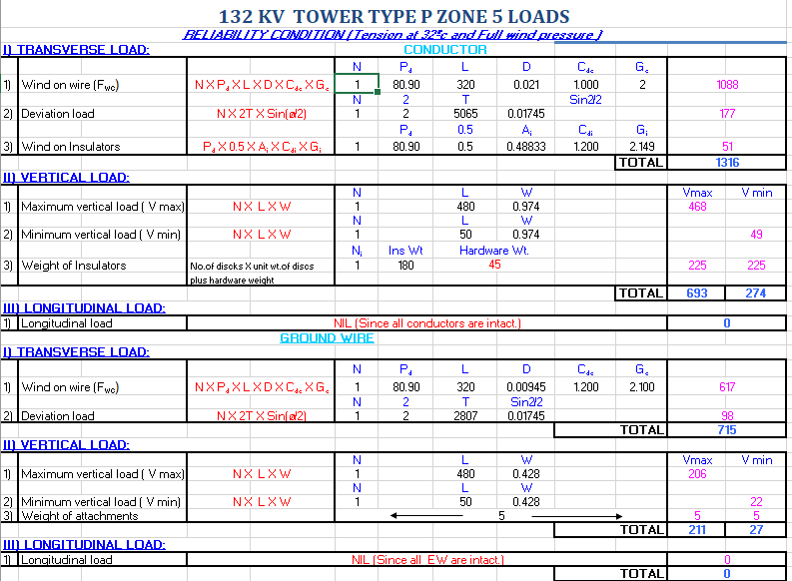
Sample Load calculations

Slide 104
Sag & Tension
So Sag and Tensions are the Most Important factors in designing of a Transmission Tower.
Sag is defined as “The distance measured vertically from a conductor to the straight line joining its two points of support.” In other words, sag is usually the lowest point on a Conductor or wire between two points.
Tension is defined as “The longitudinal force exerted on a wire during installation”. Tension is the force pulling the wires at either end by what they are attached to or the weight of the cable itself.

Slide 105
Sag & Tension
Sag Template: The tower designs are developed based on the minimum ground clearance considerations for a normal span on a flat terrain. The terrain on which the lines are constructed are seldom flat and hence a device is necessary to locate the tower maintaining the required ground clearance on any terrain on profile sheet. For this purpose a sag template is developed.
The location of structure on the profile with sag template is essential for both correct design of line and also economic / optimization of no. of towers / Steel required for the line.

Slide 106
Sag & Tension
Care should be taken that the weight span and wind spans of each location does not exceed the designed figures under the maximum permissible angle of deviation of the line at the tower for which the tower is designed.
However higher wind spans are permissible with lesser angles of deviation and the corresponding limits should be obtained from the tower spotting data issued by the design wing / tower manufacturer.

Slide 107
Uplift
On steep inclined spans the low point may fall beyond the lower support and this indicates the conductor in the uphill span exerts a negative or upward pull on the lower tower. The amount of this upward pull is equal to the weight of the conductor from the lower tower to the low point in the sag.

Slide 108
Uplift
For an easy check whether a tower is under uplift or not the template is applied horizontally until the tops of alternative supports coincide with the cold template curve. If the curve is above the intermediate support, the support is under uplift and has to be extended till it touches the cold template and so culminates uplift. If +3 mtrs or + 6mtrs extensions for tangent towers do not satisfies the condition, section towers designed for uplift shall be used.

Slide 109
Uplift
When the upward pull is greater than the downward load in the next adjacent span and uplift occurs and the conductor will swing clear off the tower upward during stringing. Hence this type of locations necessitates an section /angle tower even though there is no deviation. These positions shall also be checked for uplifts with +3 mtrs or +6 mtrs extensions for tangent towers.

Slide 110
Sag & Tension
Sag & Tension behaviour of conductors are very important to practising engineers because it rules the design, erection, maintenance and operation of any Transmission Line and its components.
There are two main types of tensions.
Initial Tension.
Final Tension.

Slide 111
Sag & Tension
Initial Tension: Initial Tension is defined as “ The longitudinal tension in the conductor prior to the application of any external load”. In other words the characteristics of the conductor before time, temperature, weight etc. of the conductor stretch or shrink the wire.
Final Tension: Final Tension is defined as “The longitudinal tension in a conductor after it has been subjected for an appreciable period of the loading prescribed, in which it is situated, or equivalent loading, and the loading removed. In other words what the characteristics of the conductor are expected to be after time, temperature, weight and other factors have effected it.

Slide 112
Sag & Tension
Sag-tension Calculations???
Why Bother with Sag-Tension???
Sag determines electrical clearances, right-of-way width (blowout), uplift (weights & strain), and thermal rating.
Sag is a factor in electric & magnetic fields, Aeolian vibration (H/w), ice galloping.
Tension determines structure deviation angle/dead-end/broken wire loads.
Initial & Final Tension limits of Conductor, determine conductor system safety factor, vibration, & structure cost.

Slide 113
Sag & Tension
In the Design Maximum Sag and Maximum Tension will be considered.
Maximum Sag will give minimum clearance to ground. Due to over loading of lines and high ambient Temperatures in our state, conductors are usually at high temp.
Maximum tension:- So that structures can be designed to withstand it.
Minimum sag - To check the structure uplift problems & requirement of Accessories during “coldest month” to limit Aeolian vibrations.

Slide 114
Sag & Tension
Tension equalization between suspension spans allows use of the ruling span
Initial and final conditions occur at sagging and after high loads and multiple years
For large conductors, max tension is typically below 60% in order to limit wind vibration & uplift

Slide 115
SAG TEMPLATE CURVE
The sag templates have the following curves itched on them.
‘Cold or Uplift Curve’-Showing sag of conductor at specified minimum temperature and zero wind.
‘Hot’ or ‘Maximum Sag Curve’-Showing maximum sag of conductor under zero wind and maximum temperature and sag tolerances are also allowed to take care of stringing error, conductor creep or snow incidences.
Ground clearance Curve-Drawn parallel to curve (b) and at a distance equal to specified minimum ground clearance.
Tower footing Curve-For normal tower drawn parallel to curve under (c) above and separated by a distance equal to maximum sag at design span.
A typical ‘Sag Template’ drawing is shown

Slide 116
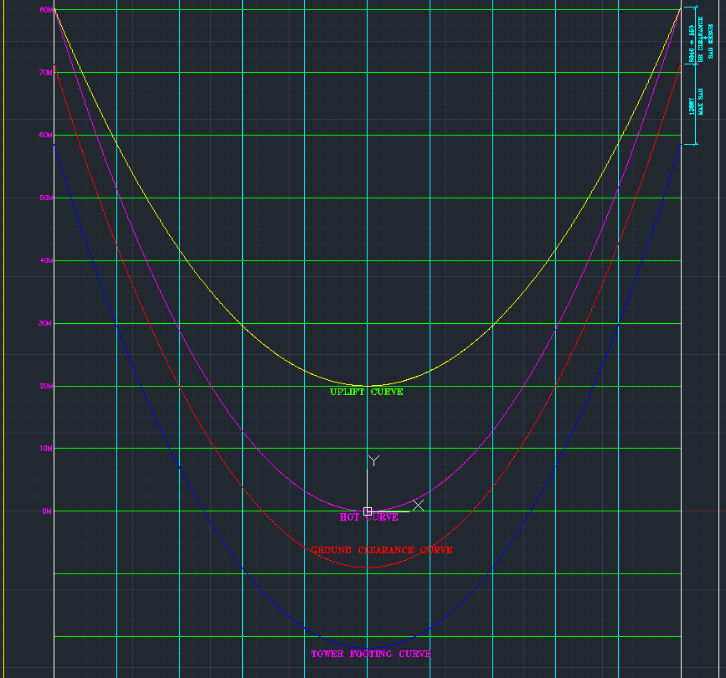
SAG TEMPLATE CURVE

Slide 117
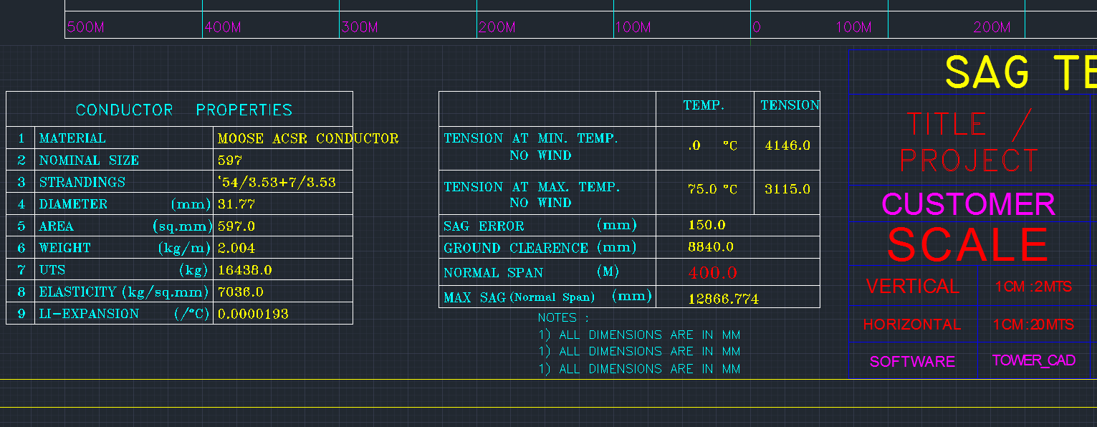
Sag & Tension
Observe the Conductor Technical Particulars and Design span considered in the Sag template curve used by your surveyor.

Slide 118
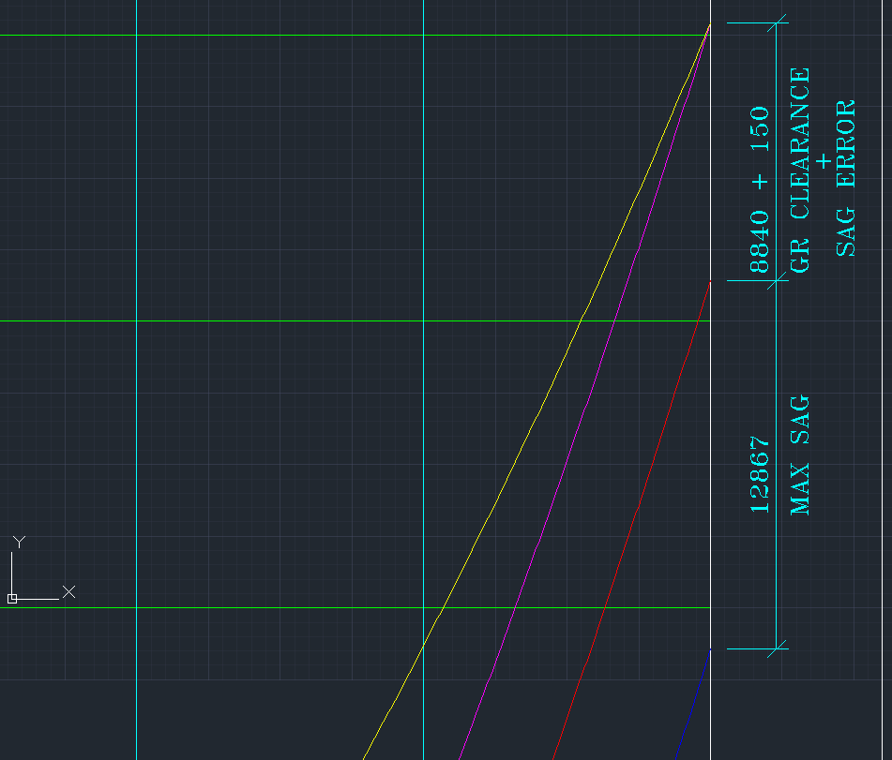
Sag & Tension
Observe the Sag, Ground Clearance & Sag error consideration in the Sag template curve used by your surveyor.

Slide 119
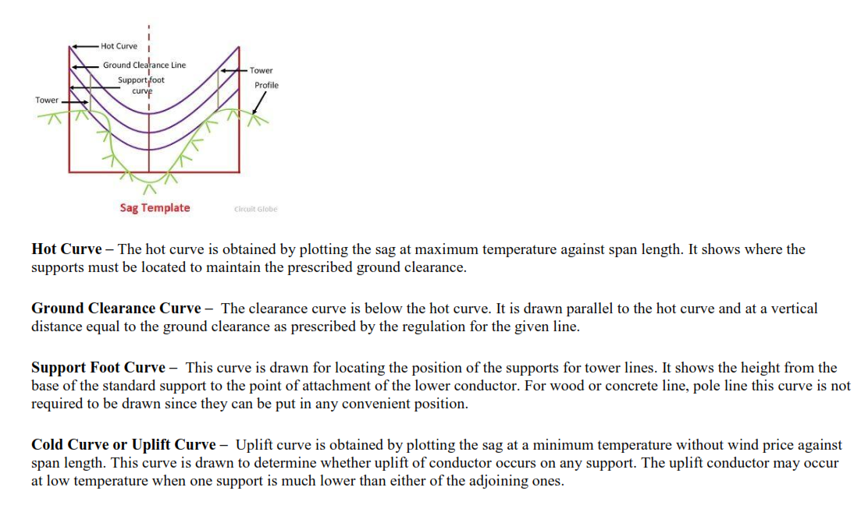

Slide 120


Slide 121

Sag Template Curve Data

Slide 122


Slide 123


Slide 124


Slide 125


Slide 126
TRUE LENGTH CALCULATIONS
Rated Voltage = |  |  |  | 220 | kV
No. of circuits = |  |  |  | Double
Type of Conductor = |  |  |  | Single Moose
Type of Line = |  |  | 220 kV Single Moose Double Circuit Line
Designed Ruling Span = |  |  |  | 350 | mtrs
Max. Sag obtained for Design span = |  |  |  | 9.235 | mtr
Now Span for which sag is required = |  |  |  | 300 | mtr
Sample calculation
Max. Sag of 350 mtrs Ruling Span at 32 deg FW is |  |  |  | 9.235 | mtr
Sag calculated for 300 mtr span will be
 | =9.235 x ( 300/350)^2 |  |  | 6.78 | mtr
True Length Of Conductor in strung span = |  |  |  | L + 8D²/3L
where L is span in mtrs, D is Sag in mtrs
Then True length of conductor in 300 mtr span is
 |  | =300+(8x6.78489795918367^2/3x300) |  | 300.41 | mtr

Slide 127
Maximum Sag and Conductor Creep
The conductor sag is determined by the size of the conductor (AAC, ACSR, AAAC, ACAR, AACSR), climatic conditions (wind, temp. snow) and span length.
The maximum sag of a conductor occurs under maximum temperature and still wind condition
The maximum sag is considered in fixing the height of line support. In snowy region, the maximum sag may occur at 0° and nil wind for ice-coated conductors.
Appropriate provision for sagging error (generally 150 mm) is also to be considered.
Creep in a conductor is defined as a permanent set in the conductor. It is a continuous process and takes place throughout its life. The. rate of creep is higher initially but decreases with time.

Slide 128
CREEP COMPENSATION
Creep compensation is provided by one of the following methods:-
(i) Pre-tensioning of the conductor before stringing
(ii) Over-tensioning of the conductor in the form of temperature correction
(iii) By providing extra ground clearance
(iv) By a combination of partly over-tensioning of the conductor and partly providing extra Ground clearance.
For transmission lines of 400 kV and above, the creep is compensated by adopting negative temperature compensation of 26°C considered at the time of preparing stringing charts.
For transmission lines of 132kV & 220kV, the creep is compensated by adopting negative temperature compensation of 20°C considered at the time of preparing stringing charts.

Slide 129
Maximum Sag of Ground wire /Minimum Mid Span Clearances/Angle of Shield:
The function of ground wire/OPGW is to provide protection to the power conductors against direct lightning stroke and to conduct the lightning current to the nearest earthed point when contacted by a lightning stroke.
The above functions are performed by the ground wire(s) based on the selection of angle of shield, mid span clearance and coordination of ground wire / OPGW sag with that of conductor.
The effect of creep in galvanized stranded steel ground wire/OPGW being negligible is not taken in account while deciding the sag.
The location of ground wire/OPGW determines the height of ground wire peak

Slide 130
CLEARANCE BETWEEN CONDUCTOR & GROUND/SHIELD WIRE/OPGW at Tower
The height and location of ground wires shall be such that the line joining the ground wire to the outermost conductor shall make an angle with the vertical equal to desired shield angle.
The angle of the shield adopted for various voltage transmission lines in India is given as under:
AC Voltage (kV) Nominal/Highest (System) | Angle of Shield of Ground wire (°)
66/72.5 | 30
110/125 &132/145 | 30
220/245 | 30
400/420 | 20
765/800 | 20 (10 for Double ckt)
1150/1200 | 10

Slide 131
TOWER SPOTTING DATA
Once the technical parameters like angle of deviation, weight span, wind span, body extensions, etc are tabulated, the next step is to choose the correct type of towers at various locations after comparing the field parameters with the design parameters.
In the case of hilly terrains, towers with unequal leg extension are also used. This is mainly adopted to reduce benching work in a particular location. The design parameters are contained in a document called Tower- spotting Data.
Proposal of Chimney raisings, Proposal of protection work such as revetment etc

Slide 132
NEGATIVE WEIGHT SPAN
Total weight span of tower A = L_{A} – R_{A}
Total weight span of tower B = L_{B} + R_{B}
L_{A}
B
A
(-)R_{A}
L_{B}
R_{B}

Slide 133

Negative Wt span
Refer profile

Slide 134
Tower Spotting Data – Pg.1/2
Tower Spotting Requirements of 220KV Double Circuit LA,LB,LC,LD,LD-DE type Towers with single MOOSE ACSR Conductor IN ZONE -5
 | Description | Type of Tower
 |  |  | LA |  | LB |  | LC |  | LD |  | LD-DE
 | Deviation not to exceed in degrees |  | 2 |  | 15 |  | 30 |  | 60 |  | 90
 | Normal WIND SPAN (m) |  | 350 |  | 350 |  | 350 |  | 350 |  | 350
 | Indvidual Span not greater than From vertical separation consideration
 |  |  | 540 |  | 550 |  | 550 |  | 550 |  | 550
 | Max. Wt Span (m)
 |  |  | Down |  | Down |  | Down |  | Down |  | Down
 | Vertical load limitation
 | Conductor
 | Effect of both spans(m) NC |  | 525 |  | 525 |  | 525 |  | 525 |  | 525
 | Effect of one span(m) BWC |  | 315 |  | 315 |  | 315 |  | 315 |  | --
 | Earth Wire
 | Effect of both spans(m) NC |  | 525 |  | 525 |  | 525 |  | 525 |  | 525
 | Effect of one span(m) BWC |  | 315 |  | 315 |  | 315 |  | 315 |  | --

Slide 135
Tower Spotting Data – Pg.2/2
Description | Type of Tower
 |  | LA |  | LB |  | LC |  | LD |  | LD-DE
Min. Wt Span(m) |  | Down |  | Up |  | Up |  | Up |  | Up
Conductor
Effect of both spans(m) NC MIN |  | 150 |  | 0 |  | 0 |  | 0 |  | 0
Effect of one span(m) BWC MIN |  | 100 |  | -100 |  | -100 |  | -200 |  | -200
Earth Wire
Effect of both spans(m) NC MIN |  | 150 |  | 0 |  | 0 |  | 0 |  | 0
Effect of one span(m) BWC MIN |  | 100 |  | -100 |  | -100 |  | -200 |  | -200
 |  | DEG |  | DEG |  | DEG |  | DEG |  | DEG
Permissible sum of adjacent spans |  | 2 | 700 | 15 | 700 | 30 | 700 | 60 | 700 | 90 | -613
in meters for various deviation angles |  | 1 | 756 | 12 | 865 | 28 | 807 | 58 | 796 | 88 | -534
Based on the condition that required |  | 0 | 811 | 10 | 975 | 26 | 915 | 56 | 894 | 86 | -454
minimum ground clearance is available |  |  |  | 8 | 1085 | 24 | 1023 | 54 | 992 | 84 | -373
Limiting to max sum of adjacent span |  |  |  | 6 | 1100 | 22 | 1100 | 52 | 1091 | 82 | -290
from vertical separation consideration |  |  |  | 4 | 1100 | 20 | 1100 | 50 | 1100 | 80 | -205
 |  |  |  | 2 | 1100 | 18 | 1100 | 48 | 1100 | 78 | -120
Note: Permissible one span for various angles should not exceed 50% of values shown for sum of adjacent spans
Broken wire conditions considered in |  | Any |  | Any |  | Any |  | Any |  | Any
Design |  | one |  | Two |  | Two |  | three |  | three
 |  | wire |  | wires |  | wires |  | wires |  | wires
 |  | (one side) |  | (one side) |  | (one side) |  | (one side) |  | (one side)

Slide 136


Slide 137


Slide 138


Slide 139
PIT MARKING CALCULATIONS
Type of Tower |  |  |  | Tape reading at point
 | M | N | Pit size | A | B | C | D | E
DRY
K+0 | 8797.7 | 12441.8 | 1600 | 5198.85 | 8797.70 | 10397.70 | 12660.44 | 17749.98
K+3 | 9734.2 | 13766.2 | 1600 | 5667.10 | 9734.20 | 11334.20 | 13596.94 | 19348.69
K+6 | 10670.8 | 15090.8 | 1600 | 6135.40 | 10670.80 | 12270.80 | 14533.54 | 20947.57
WET
K+0 | 8858.66 | 12528 | 2350 | 5604.33 | 8858.66 | 11208.66 | 14532.06 | 19134.38
K+3 | 9795.16 | 13852.4 | 2350 | 6072.58 | 9795.16 | 12145.16 | 15468.56 | 20733.08
K+6 | 10731.7 | 15176.9 | 2350 | 6540.83 | 10731.66 | 13081.66 | 16405.06 | 22331.79

Slide 140


Slide 141

PLS CADD ROUTE PLAN

Slide 142

PLS CADD 3D ROUTE MAP

Slide 143

PLS CADD PROFILE

Slide 144

PLS CADD PROFILE

Slide 145

PLS CADD PROFILE

Slide 146

PLS CADD PROFILE

Slide 147
TYPES OF 132kV TOWERS IN APTRANSCO
132KV–KEC Design
Double Circuit(DC) P type (0 - 2°)
R type (2 - 30°) &
S type (30 - 60°)
Multi-Circuit(SAE)
K type (Upto 2°)
L type (Upto 30°) &
M type (Upto 60°)
Narrow Based DC NA,NB,NC,ND 1.2 MTR
Narrow Based DC (60°) NB (3.74m BW)
NARROW BASED MCKT 3.2 MTRS MCA,MCD
Narrow Base Multi circuit Tower NMS (3.536m BW)

Slide 148

TYPES OF TOWERS IN APTRANSCO

Slide 149
TYPES OF 220kV TOWERS IN APTRANSCO
L&T Design (Moose/Zebra) - LA type (Upto 2°), LB type (Upto 15°)
LC type (Upto 30°) & LD type (Upto 60°)
EMC (Twin Moose Design) - AA type (Upto 2°), AB type (Upto 15°)
AC type (Upto 30°),AD type (Upto 60°)
TSP Design - AV (Upto 2°), BS (Upto 30°) & CS (Upto 60°)
- Narrow Based DC (60°) CN (3.825m BW)
- Narrow Based DC - NA,NB,NC,ND 2.2 MTR
- Broad Based Multi-Circuit (SAE) – X, Y & Z
- Narrow Based Multi-Circuit (KRR) – NMA, NMB, NMC & NMD
- JC (MPEB) – Suspension - 88M
- JCM (Truncated) – Suspension - 74M

Slide 150
TYPES OF 400kV TOWERS IN APTRANSCO
Single Circuit SA,SB,SC & SD TOWERS (for Twin Moose)
Extensions +0, +3M, +6M, +9M, +12M, +18M, +30M
Double Circuit DA,DB,DC & DD TOWERS (for Twin Moose) –Zone3
Double Circuit DA,DB,DC & DD TOWERS (for Twin Moose) –Zone5
Double Circuit DA,DB,DC & DD TOWERS (for Quad Moose)- Zone3
Double Circuit DA,DB,DC & DD TOWERS (for Quad Moose)- Zone5
with Extensions +0, +3M, +6M, +9M, +12M, +18M, +25M
Multi Circuit MCA,MCC & MCD TOWERS (for Twin Moose) –Zone3
Multi Circuit QA,QB,QC & QD TOWERS (for Twin Moose) –Zone5
Multi Circuit QA,QC & QD TOWERS (for Quad Moose)- Zone5
Narrow base Multi Circuit QA & QD TOWERS (for Twin Moose)- Zone5
Narrow base Double Circuit NDD TOWER 7.0mBW (for Twin Moose)- 200m span

