Slide 1
Transmission Lines and Maintenance
BY
T.Sreemannarayana Murthy
Assistant Divisional Engineer
APSLDC

Slide 2
what is our generation voltage? Why high voltage transmission is required?

Slide 3
What is distribution voltage?
Why high voltage transmission is preferred?

Slide 4
At What voltage Indian STUs and powergrid transmitting now

Slide 5
Transmission System in Andhra Pradesh &Telangana i) 400KV ii) 220KV iii)132KV

Slide 6
Main Discussion areas of Tr. Lines
Survey
Construction
Major faults
Maintenance system

Slide 7
SURVEY

Slide 8
Survey
Wall over survey : The proposed line between Substations drawn as straight line on Topo sheet. Along this line wall over survey is conducted. Observations recorded as report.
Now Google Maps used for the purpose

Slide 9
ii)Detailed Survey
:Based on the WOS report detailed verification of route is carried out. The following characteristics verified
a) Soils in the route
b) NH ways crossing in the route
c) Existing power line crossings
d)Railway crossings
e)Airport area
f)Water logged areas
.

Slide 10
g) Major river crossings
h) Tanks
i) Reserve forest
j) Telephone line crossings
k) Hills
l) Dams /reservoirs
m) temples/public areas
With minimum angle points report prepared

Slide 11
Survey Euipment & chainage, terrain profile
Theodolite
Total station
After completion of survey, levels of terrain and chainage, report prepared for tower spotting

Slide 12
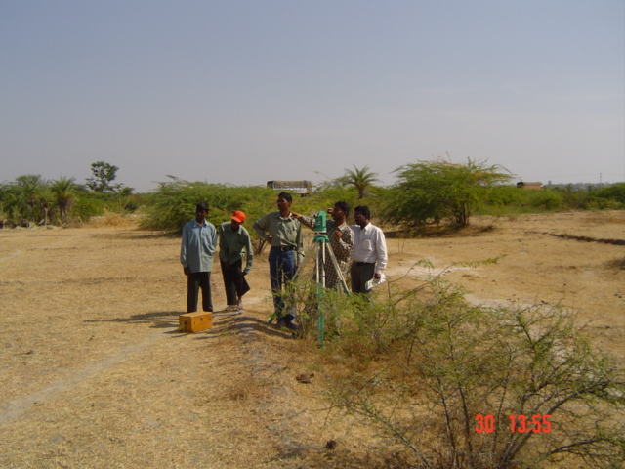
Survey team in the field

Slide 13
Check survey
The detailed survey report is thoroughly checked and tower spotting is done on profile.
B,C,D Angle points and suspension tower quantity is finalised.

Slide 14
Construction of Transmission Lines
Main discussion areas of Construction
Soil Classification:
i)Dry
ii)wet
iii)PS
iv)FS
v)MDFR
vi)BC
vii)sandy
Viii)rocky etc.,

Slide 15
Casting of Foundations
After soil classification, depending on the type of foundation ,angle point, the casting is done with template of tower type.
Survey team should follow the casting team for laying in line of the foundations as per survey
After perfect curing released for tower erection

Slide 16
Tower Erection
Tower types
A : 0 TO 2 degrees
B : 2 TO 15 degrees
C : 15 TO 30 degrees
D : 30 to 60degrees
Dead end towers >60degrees
Transposition towers (4 cross arms)
Special towers river crossing towers
A-Suspension
B,C&D tension towers

Slide 17
Tower heights
132kv 23mts
220kv 33mts
400Kv 45mts

Slide 18
Tower extensions
Available in following
+3m
+6m
+9M
+12m
+18m
+25m
+30M
Generally the extensions added at the bottom of the tower

Slide 19
Insulators
Suspension Tension
132KV 9 10
220KV 13 14
400Kv 23 24

Slide 20
iv)Fixing hardware
Vibration dampers
suspension hardware
Tension hardware
Line spacers
MSCJ ( Midspan compressor joint)
Earthwire suspension and tension hardware and copper jumper
Deadend cone with jumper clamp

Slide 21
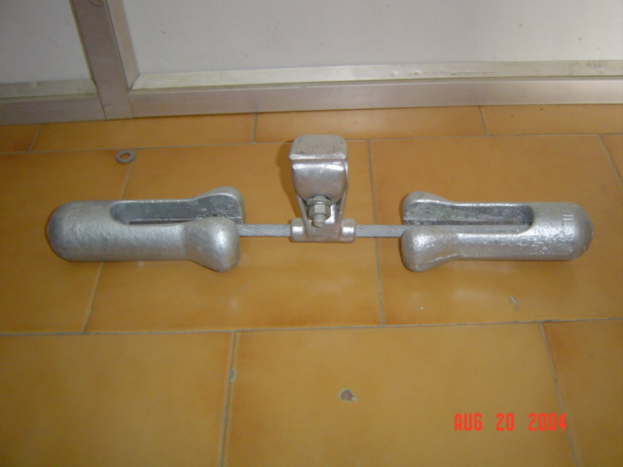
Hardware of Transmission lines
Vibration Damper

Slide 22
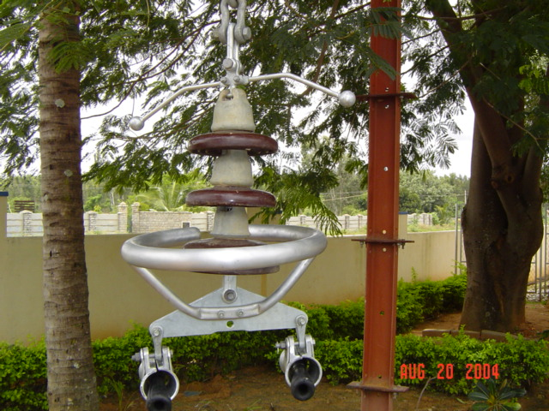
400KV suspension hardware (twin Moose)

Slide 23
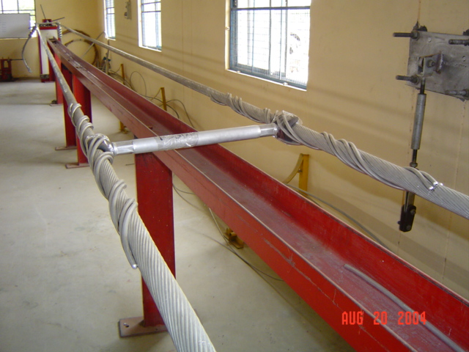
Spacer between two moose conductors

Slide 24
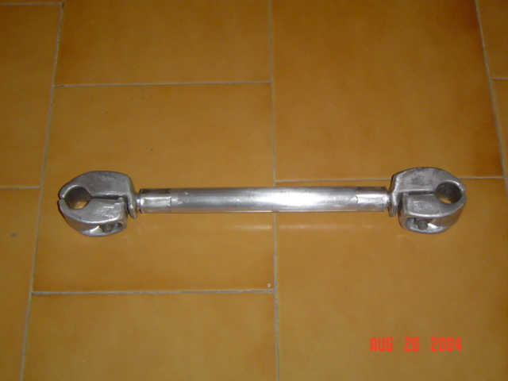
Spacer between two moose conductors

Slide 25
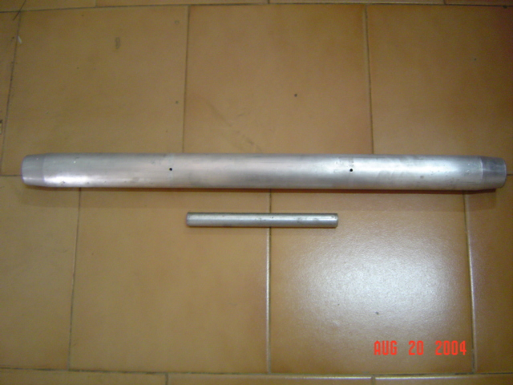
MSCJ: Midspan compressor joint

Slide 26
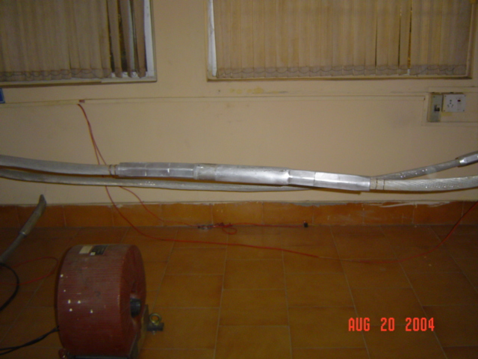
MSCJ after jointing

Slide 27
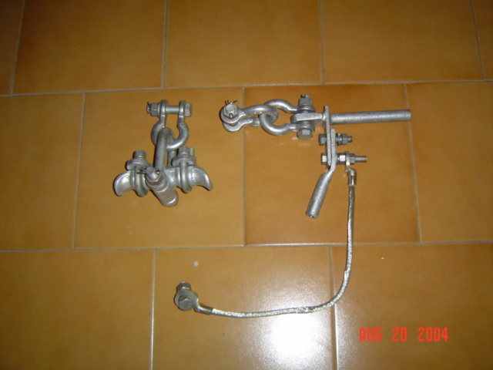
Earthwire suspension and tension hardware

Slide 28
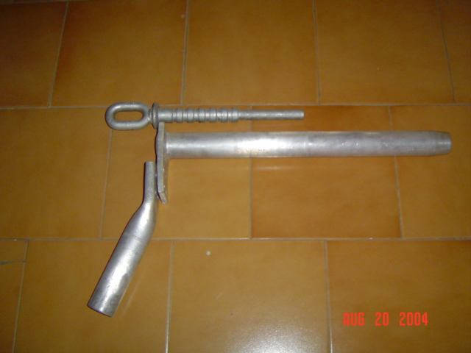
Tension dead end cone with jumper clamp

Slide 29
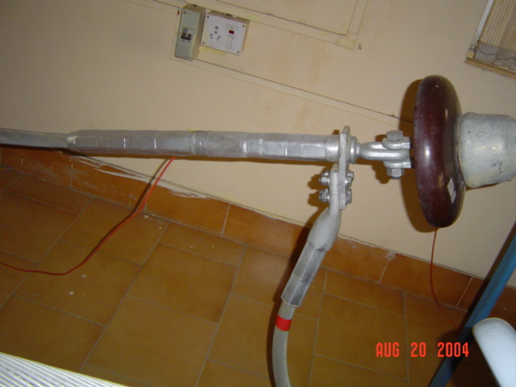
Previous one after erection

Slide 30
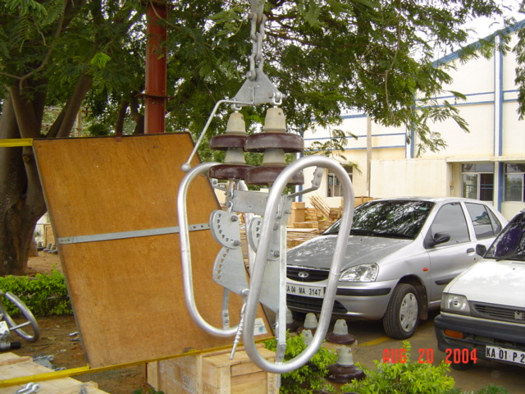
Tension hardware

Slide 31
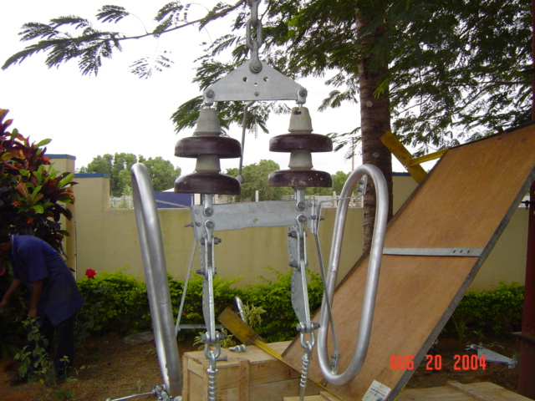
Tension hardware

Slide 32
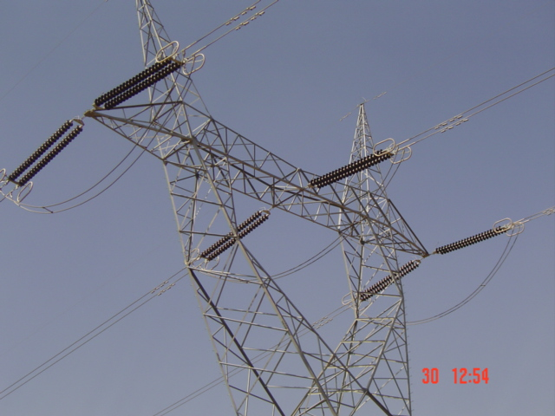
Tension hardware on a charged line

Slide 33
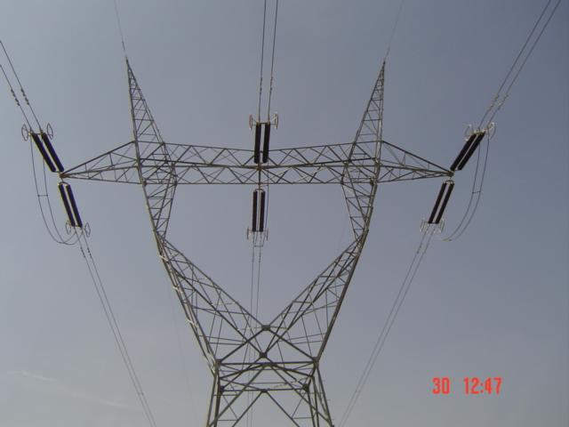

Slide 34
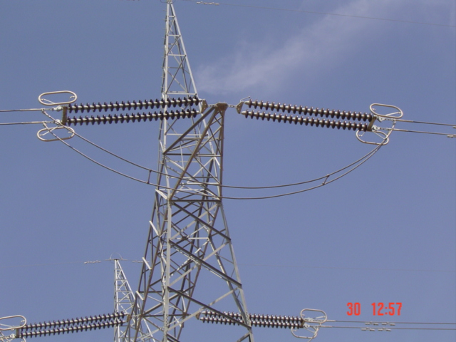

Slide 35
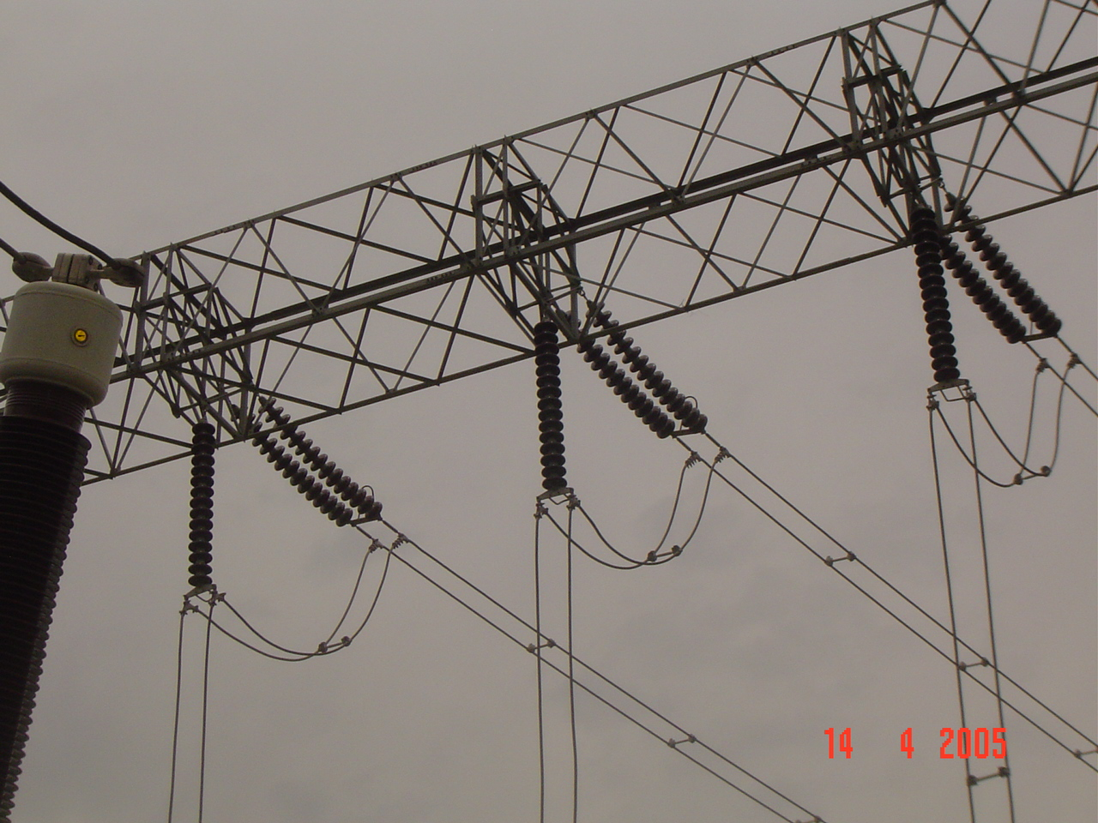

Slide 36
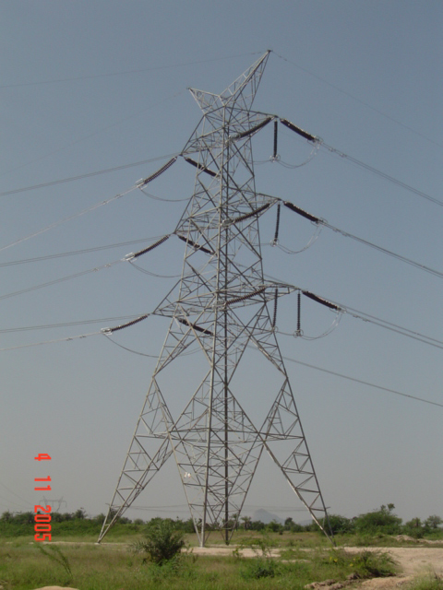
400Kv DC line tower

Slide 37
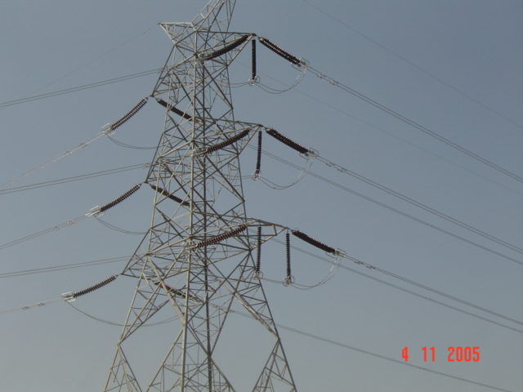

Slide 38
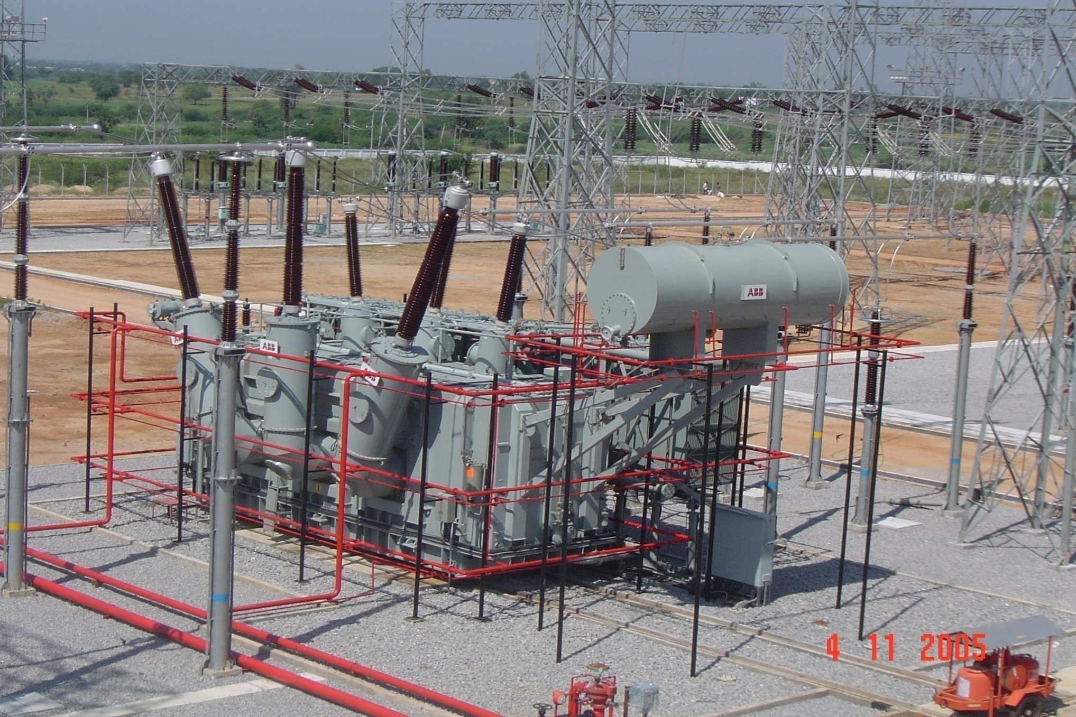
315MVA PTR at 400KV SS Mahaboob Nagar

Slide 39
Tower Earthing
Every tower earthed at D Leg
Two earths provided for Railway crossing towers
Pipe earthing and counter poise earthing methods followed generally depending upon the tower foot resistance.
<15 Ohm Pipe earthing
15 -30 Ohm counter poise earthing

Slide 40
stringing
Paving out conductor
Rough sag
Final tension/stringing

Slide 41
Stringing of conductors
Normal spans for panther(320M), zebra (350m), moose(400m)
132KV,220KV stringing will be manually done
Panther for 132 kv lines and zebra& moose for 220Kv lines
Tractors,chain pully blocks, winches, leg wiches used for pulling the conductor
10t Hydraulic jointing compressor machines used for jointing conductor

Slide 42
beyond 220KV Machine stringing is mandatory
Generally pilot wire stinging is done
Cutpoint to cutpoint stringing is done
Tools used for stinging
Tensioner
puller
Turn table
Joining machines
Walkie takies
Joint protector
Conductor sacks, arial rollers, wooden ballies,leg wiches,tractors, dynamo metersetc.,

Slide 43
Ground Clearance
132 Kv :6.1 mts
220KV :7.0Mts
400KV :8.84Mts

Slide 44
Jumpering
All angle points connected through jumpers
flexible copper jumper for earth wire continuation

Slide 45
ACD
Anti climbing device is fixed for every tower to avoid climbing of tower

Slide 46
Statutory inspection
check Questionnaire available for inspection
Inspectors check every tower and submit report
Checks include
Number plate
Type of tower
Danger plate
ACD
Missing bolts
Loose members

Slide 47
Statutory inspection
Coping
Welding of bolts
Copper jumper of earth wire
Step bolts
Insulators
Ground clearance
Earthing
Arcing horns
Vibration dampers
Tree clearance etc.,

Slide 48
PTCC approval
Power telecommunication coordination committe
duly verifying line crossing through any telecommunication lines
Calculate induced voltage on their lines
Whether the voltage is with in limits or not
Insist to put GD tubes

Slide 49
Commissioning line
After attending remarks of Statutory inspection report
PTCC approval
The Transmission line is ready for commissioning

Slide 50
Major faults
Line to Ground & double line to Ground
Line to Line
Three phase short
Tower collapse
Open jumper
Over load
Insulator flashover due to lightning, saline weather, pollution
Bird fault
Hot spots& red hot

Slide 51
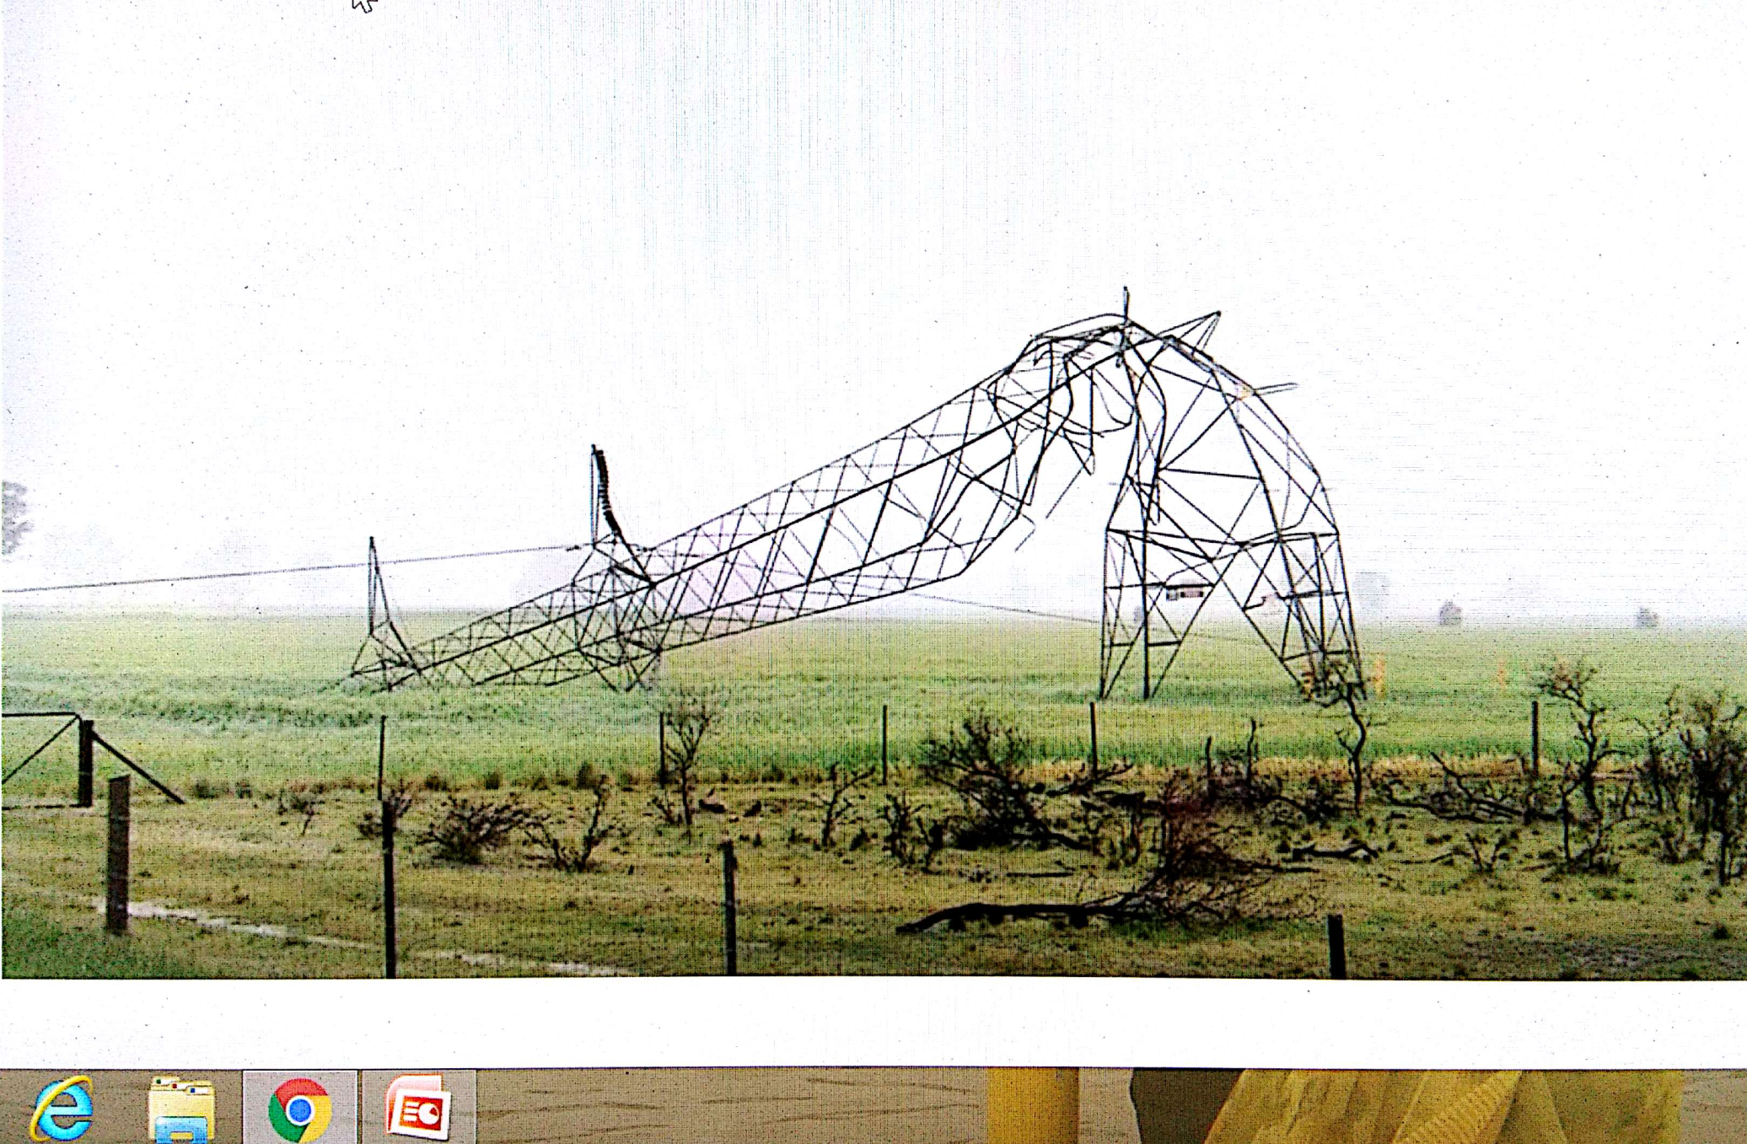
Tower collapse

Slide 52
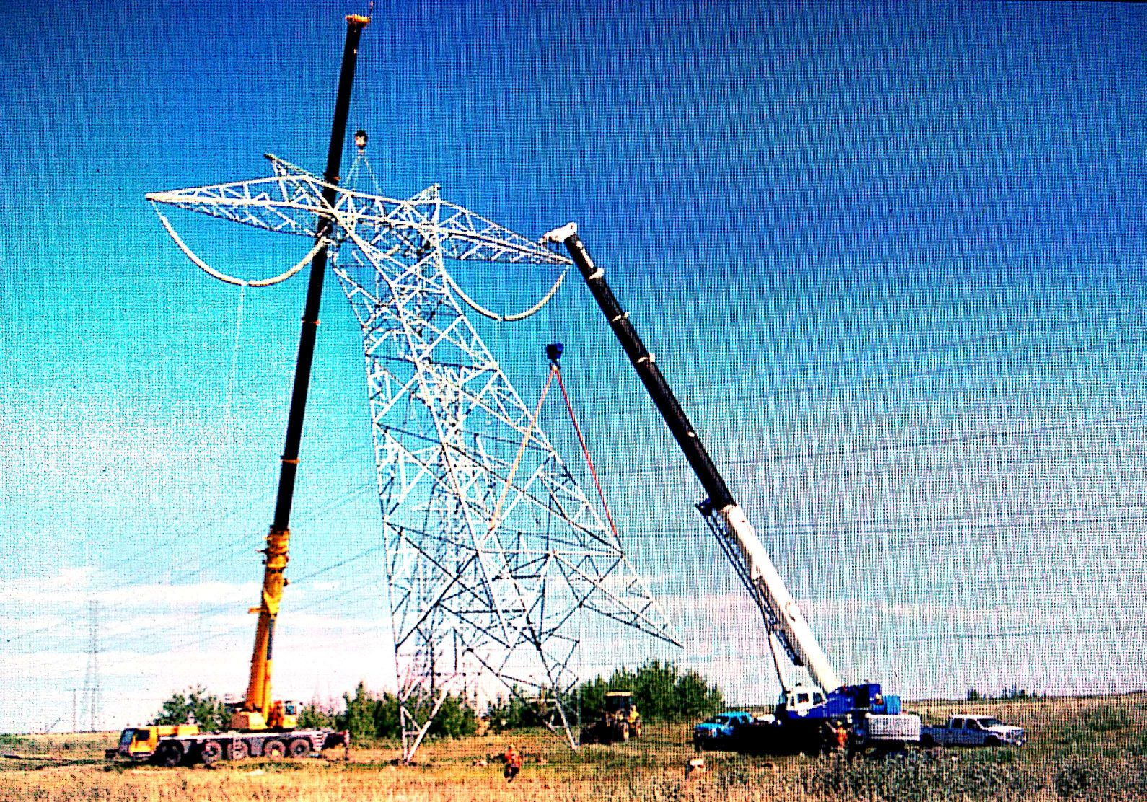

Slide 53
Transmission Line Maintenance

Slide 54
Maintenance staff

Slide 55
Tree cutting

Slide 56
Taurus kits

Slide 57
Thermo vision scanning cameras

Slide 58
Fire fighting equipment

Slide 59
Communication facilities

Slide 60
PMI: Pre monsoon Inspection

Slide 61
Failure analysis team

Slide 62
Disaster management staff to be trained

Slide 63
Maintenance Audit Maintenance of records

Slide 64
Residual life assessment(RLA)

Slide 65
Log books Remedial measures

Slide 66
Contingency Maintenance
ERS : Emergency restoration system
Minimum three(3) ERS towers of different voltages should keep as contingency to minimise the outage time of supply .
In Every Tr line work
TR utility keeps 5 no suspension and
1no each angle towers as spare
5 to 10 % of line accessories as spare
For 400Kv system the spares available in SS itself
For 220kv and 132kv system the spares available in stores

Slide 67
Any Questions

Slide 68
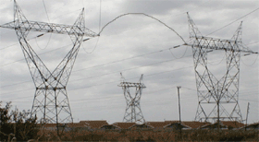
Thank You

Slide 69
Thank You

