Slide 1
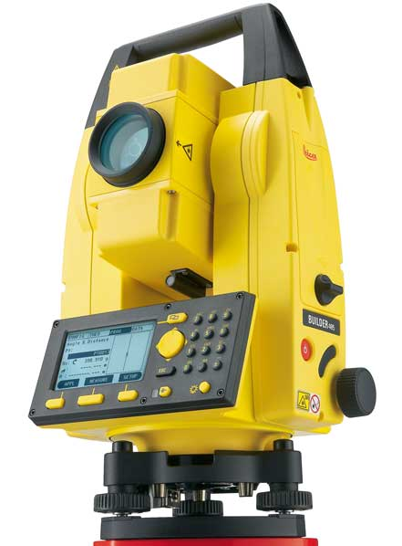
Total Station And Its Applications In Surveying
By:
MD NIZAMUDDIN

Slide 2
Introduction
A total station is an electronic/optical
instrument used in modern surveying
The instrument can be used to measure horizontal and vertical angles as well as sloping distance of object to the instrument.

Slide 3
Introduction
TOTAL STATION is a combination of
Electromagnetic Distance Measuring Instrument (EDM)
Electronic Theodolite and
A simple Microprocessor

Slide 4
Introduction
It also has a memory card to store the data. It also consists of battery socket which houses the battery.
A fully charged battery works for about 3 to 8 hrs continuously

Slide 5
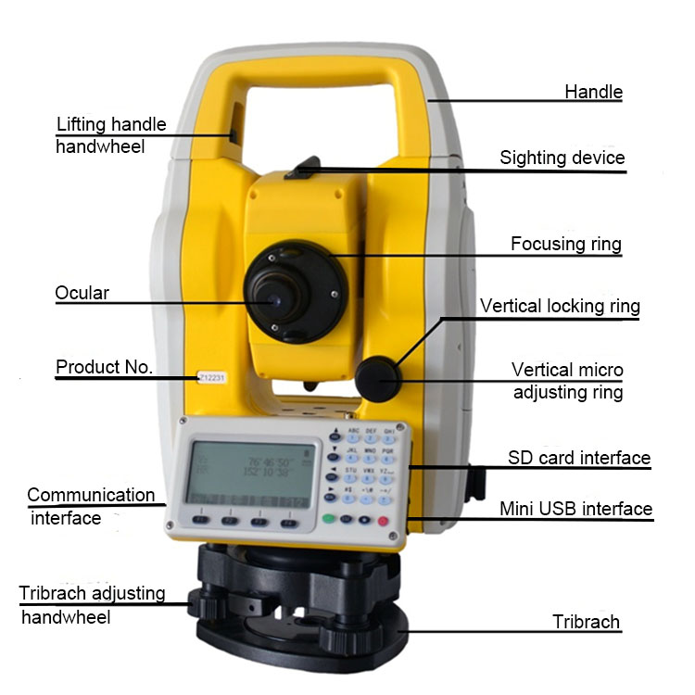
Different Parts of Total Station

Slide 6
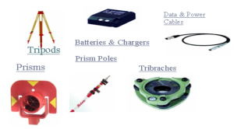
ACCESSORIES FOR TOTAL STATION

Slide 7
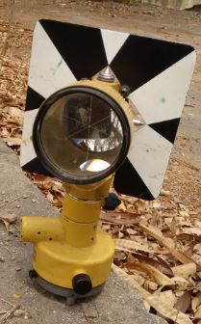
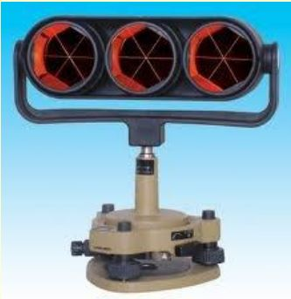
ACCESSORIES FOR TOTAL STATION
Depending upon the prism measuring distance vary Lengths up to about 2 km can be measured with a single prism, and up to about 6 to 7 km with triple prism. single prism triple prism

Slide 8
FUNCTIONS PERFORMED BY TOTAL STATIONS
Total Stations, with their micro processors, can perform a variety of functions and computations, depending on how they are programmed. The capabilities vary with different instruments, but some standard computations include:
Averaging multiple angle and distance measurements.
Correcting electronically measured distances from prism constant, atmospheric pressure, and temperature.

Slide 9
FUNCTIONS PERFORMED BY TOTAL STATIONS
Making curvature and refraction corrections to elevations determine by trigonometric levelling.
Reducing slope distances to their horizontal and vertical components.
Calculating point elevations from the vertical distance components (supplemented with keyboard input of instrument and reflector heights).
Computing coordinates of survey points from horizontal angle and horizontal distance

Slide 10
ACCURACY OF A TOTAL STATION:
Accuracy depending upon the instrument and varies from instrument to instrument
The angular accuracy varies from1″ to 20 ″.
Distance accuracy depends upon two factors.
Instrumental error which ranges from
+ / – 10mm to + / – 2mm.

Slide 11
ACCURACY OF A TOTAL STATION:
Error due to the length of measurement.
It can be from + / – 10mm to + / – 2mm per kilometer.
1 prism, 2.5–2.7 km2 prisms
5-7 km3 prisms

Slide 12
ACCURACY OF A TOTAL STATION:
The accuracy achieved with total station is mainly depends on operator procedure of Careful centering and leveling of the instrument
Accurate pointing at targets.
Taking averages of multiple angle measurements made in both direct and reverse positions
Peripheral equipment that can affect accuracy includes
Tribrachs
Optical plummets
Prism and
Prism poles
Tribrachs must provide a snug fit without slippage

Slide 13
OPERATION OF TOTAL STATION
Because the Total Station contains delicate electronic components they are not as rugged as ordinary Theodolite. They must be packed and transported carefully, handled gently and carefully removed form their cases.
The setting of Total Station over the station mark is similar to an ordinary Theodolite. This includes
Centering
Leveling
Removal of parallax

Slide 14
Applications of Total Station in surveying
There are many other facilities available, the total station can be used for the following purposes
Remote elevation measurement- (REM)
Fixing of missing pillars (or) Setting out (or) Stake out.
Resection.
Area calculations, etc.
Remote distance measurement (RDM) or Missing line measurement (MLM)

Slide 15
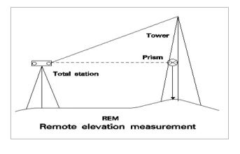
Applications of Total Station in surveying (REMOTE ELEVATION MEASUREMENT (REM))
The process of finding the height of objects without actually going to the top of the object is known as Remote Elevation Measuring (REM) i.e., a total station placed remotely (faraway) from the object is used to measure the heights

Slide 16
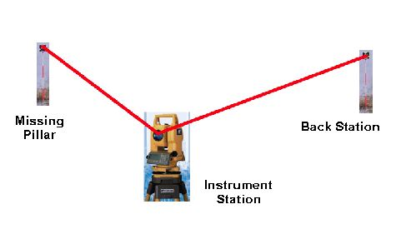
Applications of Total Station in surveying FIXING OF MISSING PILLARS (OR) SETTING OUT (OR) STAKE OUT:
The process of fixing missing pillars on the ground using its theoretical coordinates is known as STAKE OUT. Here two other known coordinates are required.
Process of finding the positions of known coordinates points e.g. missing boundary pillars.

Slide 17
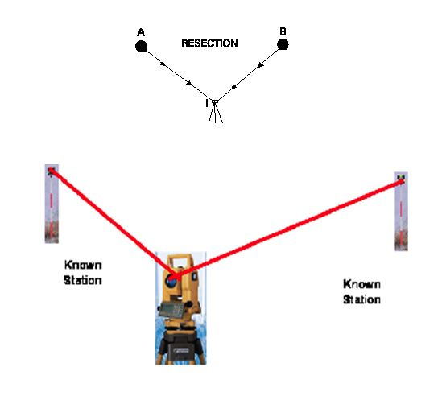
Applications of Total Station in surveying RESECTION:
The process of finding the coordinate of the instrument position making use of other control points (points whose coordinates are known) is known as RESECTION

Slide 18
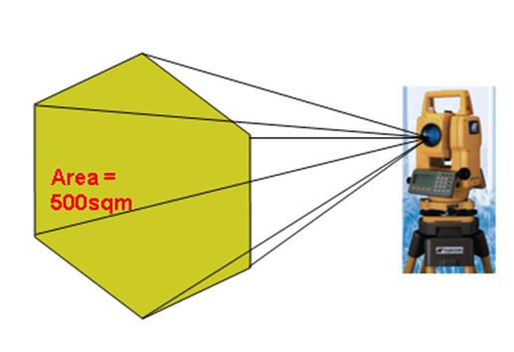
Applications of Total Station in surveying AREA CALCULATION:
Area can be computed of any figure just by giving the coordinates of the corner of the figure.
Area Calculation.
Process of finding the area of a closed figure.

Slide 19
USES OF TOTAL STATION
The uses of Total Station are as follows:
Mine Survey
Engineering Survey
Large Scale Survey
Road / Rail / Canal Survey

Slide 20
ADVANTAGES OF TOTAL STATION SURVEYING
Great accuracy in area computation
Quick setting of instrument on tripod using laser plummet
Multiple surveys can be performed at one set-up location
Relatively quick collection of data
On-board display of mesurents of co-ordinates areas etc..

Slide 21
THANK YOU

