Slide 1
EHV Sub-stations
B. SRINIVASA RAO, B.Tech.,
Dy.Executive Engineer/DESIGNS
Vidyut Soudha/VIJAYAWADA
8712613226 / 9676659759

Slide 2
Important considerations
Safety of personnel and equipment
Reliability and Security
Design
Quality
Manufacturing
Construction
Adherence to
Statutory obligations
– I.E. rules, Environmental aspects
Electrical design considerations
Structural design considerations
Ease of maintenance
Possibility to Expand

Slide 3
System parameters
Sr. | Description | 400kV | 220kV | 132kV
1. | Nominal system voltage | 400kV | 220kV | 132kV
2. | Max. operating voltage | 420kV | 245kV | 145kV
3. | Rated frequency | 50Hz | 50Hz | 50Hz
4. | Number of phases | 3 | 3 | 3
5. | System neutral earthing | Effectively earthed | Effectively earthed | Effectively earthed
6. | Corona Extinction voltage | 320kV | 156kV | 105kV
7. | Min. Creepage distance | 25mm/kV | 25mm/kV | 25mm/kV
8. | Rated short ckt. Current for 1 sec. | 40kA | 40kA | 31.5kA
10. | Radio interference voltage for freq. bet. 0.5 MHz and 2 MHz (for phase to earth voltage) | 1000 μV (320kV) | 1000 μV (156kV) | 500 μV (92kV)

Slide 4
System parameters Contd..
Sr. | Description | 400kV | 220kV | 132kV
11. | Rated insulation levels i) Full wave impulse withstand voltage -- for lines -- for reactor/ X’mer -- for other equipments | 1550kVp 1300kVp 1425kVp | 1050kVp 950kVp 1050kVp | 650kVp 550kVp 650kVp
 | ii) Switching impulse withstand voltage (dry/wet) | 1050kVp | --- | ---
 | iii) One min. power freq. withstand voltage (dry/wet) -- for lines -- for CB / Isolator (L –G) (Across open terminal) -- for other equipments | 680kV 520kV 610kV 630kV | 460kV 460kV 530kV 460kV | 275kV 275kV 315kV 275kV

Slide 5
Functions of substation equipments
Equipment | Function
1. Bus-Bar | Incoming & outgoing ckts. Connected to bus-bar
2. Circuit Breaker | Automatic/Manual switching during normal or abnormal conditions
3. Isolators | Disconnection under no-load condition for safety, isolation and maintenance.
4. Earthing switch | To discharge the charge on dead lines to earth
5. Current Transformer | To step-down currents for measurement, control & protection
6. Voltage Transformer | To step-down voltages for measurement, control & protection
7. Lightning Arrester | To discharge lightning surges and switching surges to earth

Slide 6
Functions of substation equipments Contd…
8. Shunt reactor | To control over voltages by providing reactive power compensation
9. Neutral Grounding Reactor | To discharge trapped charge on the line
10. Coupling capacitor | To filter HF signals from high voltage line & feed to PLCC equipment
11. Line –Trap | To prevent high-frequency signals from entering the other equipment.
12. Shunt capacitors | To provide compensations to reactive loads of lagging power factors
13. Power Transformer | To step-up or step-down the voltage and transfer power from one a.c. voltage to another a.c. voltage at the same frequency.
14. Series Capacitor | To improve transmission capability.

Slide 7
Functions of Associated system in substation
System | Function
1. Substation Earthing system -- Earthmat -- Earthing rod / pipe -- Earthing risers | To provide an earthmat for connecting neutral points, equipment body, support structures to earth. For safety of personnel and for enabling earth fault protection. To provide the path for discharging the earth currents from neutrals, faults, Surge Arresters, overheads shielding wires etc. with safe step-potential and touch potential.
2. Overhead shielding earth wire or Lightning masts. | To protect the outdoor substation equipment from lightning strokes.
3. Illumination system (lighting) -- for switchyard -- buildings -- roads etc.

Slide 8
Contd..
4. Protection system -- CTs, VTs -- control cables -- protection relay panels -- circuit breakers etc. | To provide alarm and/or automatic tripping of faulty part from healthy part and also to minimize damage to faulty equipment and associated system.
5. Power cable | To provide supply to various auxiliary equipment and machines.
6. Power Line Carrier Communication system -- line trap -- coupling capacitor -- PLCC panels | For speech communication, telemetry, tele-control, Tele protection etc.

Slide 9
Contd…
7. Fire Fighting system -- Sensors, detection system -- HV water spray system -- fire prot. panels, alarm system -- watertank and pumps | To sense the occurrence of fire by sensors and to initiate water spray, to disconnect power supply to affected region to pin-point location of fire by indication in control room.
8. Auxiliary AC/DC power system -- Battery & Battery Charger -- diesel generator sets -- switchgear -- distribution system | For supplying starting power, power for auxiliaries, emergency power supply
9. Telephone, telex, microwave, OPF | For internal and external communication
10. SCADA | Monitoring, Remote operation

Slide 10
Basic Requirements for design/construction
Single Line Diagram
General Arrangement Drawing
Electrical Plan and Section
Control Room Architectural layout
---------------------------------------------------------------------------
Soil Investigation
Civil
Electrical

Slide 11
SUBSTATION PLANNING CRITERIA
The capacity of any single sub-station at different voltage levels shall not normally exceed as given in column (C) in the following table:
Voltage Level | Transformer Capacity
(A) | Existing capacity (B) | Maximum Capacity (C)
765 kV | 6000 MVA | 9000 MVA
400 kV | 1260 MVA | 2000 MVA
220 kV | 320 MVA | 500 MVA
132 kV | 150 MVA | 250 MVA

Slide 12
The maximum short-circuit level on any new substation bus should not exceed 80% of the rated short circuit capacity of the substation. The 20% margin is intended to take care of the increase in short-circuit levels as the system grows.
The rated breaking current capability of switchgear at different voltage levels may be taken as given below:
Voltage Level Rated Breaking Capacity
132 kV - 25 kA / 31.5 Ka
220 kV - 31.5 kA / 40 kA
400 kV - 50 kA / 63 kA
765 kV - 40 kA / 50 kA

Slide 13
Supporting drawings
Structural layout
Earthmat layout
Civil layout
Erection Key Diagram
Lighting Layout
Schematics & cable schedule
LT Switchgear
Special Structures

Slide 14
Single Line Diagram

Slide 15
General arrangement layout

Slide 16
Electrical layout

Slide 17
Electrical Section

Slide 18
Control room layout

Slide 19
Structural layout

Slide 20
Earthmat Layout

Slide 21
Earth Electrode
Rod Electrode
Pipe Electrode

Slide 22
Civil layout

Slide 23
Erection Key Diagram

Slide 24
Lighting Design
Adequate lighting is necessary for safety of working personnel and O&M activities
Recommended value of Illumination level
Control & Relay panel area - 350 Lux (at floor level)
Test laboratory - 300 Lux
Battery room - 100 Lux
Other indoor area - 150 Lux
Switchyard - 50 Lux (main equipment)
- 20 Lux (balance Area / road @ ground level)

Slide 25
LT Switchgear

Slide 26
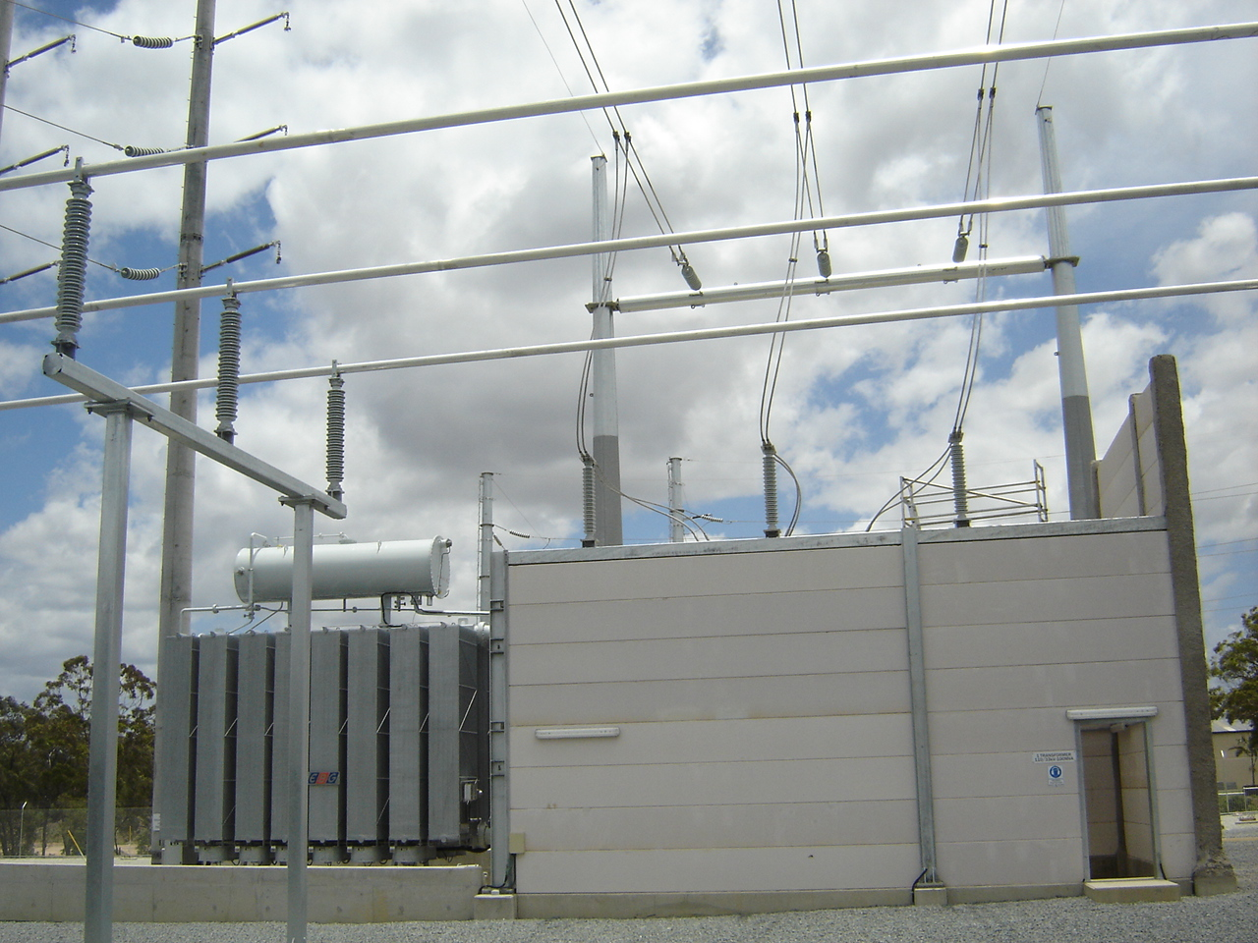
Special Structure – Noise Wall

Slide 27
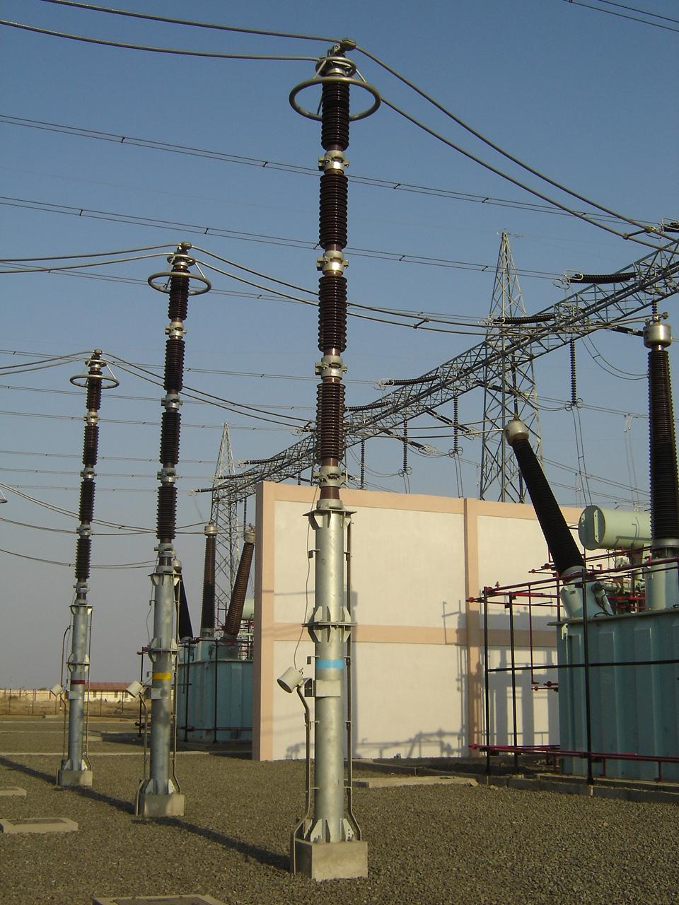
Special Structure – Fire Wall

Slide 28
Clearance between Transformers
Oil capacity in Ltrs | Clear separating distance in Mtrs. (As per TAC)
upto 5000 | 6
5,000 - 10,000 | 8
10,001 - 20,000 | 10
20,000 - 30,000 | 12.5
Above 30,000 | 15

Slide 29
Single Bus arrangement

Slide 30
Single Bus with bus sectionaliser

Slide 31
Main & Transfer Bus

Slide 32
Double Busbar arrangement

Slide 33
Double Busbar with Double breaker

Slide 34
Double main & transfer

Slide 35
One & half breaker scheme

Slide 36
Minimum Clearances
 | 400kV | 220kV
1. Phase to Earth | 3500 mm | 2100 mm
2. Phase to phase | 4200 mm (Rod-conductor configuration) 4000 mm (Conductor-conductor configuration) | 2100 mm
3. Sectional clearance | 6400 mm | 4300 mm

Slide 37
Power System Overvoltages

Slide 38
Ground & Sectional Clearances
As per clause 64, 2 (a) (i) of Indian Electricity Rules,
(i) Clearances shall be provided for electrical apparatus so that sufficient space is available for easy operation and maintenance without any hazard to the operating and maintenance personnel working near the equipment and for ensuring adequate ventilation.
(ii) The following minimum clearances shall be maintained for bare conductors or live parts of any apparatus in out-door substations, excluding overhead lines, of HV and EHV installations
Voltage Class (in KV) | Ground Clearance (mtrs) | Sectional Clearance (mtrs)
Upto 11kV | 2.75 | 2.6
Upto 33kV | 3.7 | 2.8
Upto 66kV | 4.0 | 3.0
Upto 132kV | 4.6 | 3.5
Upto 220kV | 5.5 | 4.3
Upto 400kV | 8.0 | 6.5

Slide 39
Insulation Level - Min. P-E, P-P Clearance (CIGRE SC 23)
Insulation Level (kV) - Rated Switching impulse withstand voltage - Rated lightning impulse withstand voltage | 1050 1425
Minimum Phase – Ground Air Clearance (mm) - Rod to Rod - Rod to structure | 2600 3360 (3500)
Minimum Phase – Phase Air Clearance (mm) - Ring to Ring - Rod to Rod | 3400 (4000) 4200 (4200)

Slide 42
Clearance Diagram

Slide 43
Clearances at High Altitude
Normal clearances are valid for altitude upto 1000 mtr above MSL
At altitude > 1000 mtr above MSL, reduction of dielectric strength of air
From 1000 mtr to 3000 mtr clearance to be increased by 1.25% per 100 mtr

Slide 44
Creepage Distance
Degree of Contamination | Examples | Min. creepage dist. Mm/kV
Slight | Predominantly rural areas without industry and far from sea air | 16
Moderate | Areas in which little severe pollution is expected | 20
Severe | Industrial areas with relatively severe pollution, sea air etc | 25
Very severe | Areas with heavy industry and much dust, fog, sea air | 31

Slide 45
Bus Bar Design
Continuous current rating. Ampacity calculation as per IEEE:738
Short time current rating (40kA for 1 Sec.) IEC-865
Stresses in Tubular Busbar
Natural frequency of Tubular Busbar
Deflection of Tube
Cantilever strength of Post Insulator
Aeolian Vibrations

Slide 46
Considerations for Eqpt. Clamps
Conforming to IS - 5561
Type of terminal – Pad, Bar Type
Conductor Type – Tube, ACSR, AAC
Rated current
Peak Short circuit current
Contact area
Ultimate temperature
Mechanical strength
Shall be corona controlled
Min. Contact resistance.

Slide 47
Gantry Structure Design
Sag / Tension calculation : as per IS: 802 1995
 | Sr. | Temp | Wind Pressure | Limits
 | 1. | Min. | No wind
 | 2. | Min. | 36%
 | 3. | Every Day | No wind | T <= 22% of UTS
 | 4. | Every Day | 100% | T <= 70% of UTS
 | 5. | Max. (ACSR 75⁰C/ AAAC 85⁰C) | No wind | Clearances

Slide 48
Contd..
Short Circuit Forces calculation
As per IEC : 865
Short circuit forces during short circuit
Short circuit forces after short circuit
Short circuit forces due to “Pinch” effect for Bundled conductor
Spacer span calculation
The forces acting on the conductors cause a rapid acceleration of the conductors towards each other until they clash together. The fast conductors sticking begin in the middle of the subspain and propagate toward spacers resulting in rapid increase of the conductors stresses called pinch effect (Fpi)
Factor of safety of 2.0 under normal condition and 1.5 under short circuit condition

Slide 49
Earthing Design
Guiding standards – IEEE 80, IS:3043, CBIP-223.
400kV & 220kV system are designed for 40kA.
Basic Objectives:
Step potential within tolerable
Touch Potential limit
Ground Resistance
Adequacy of Ground conductor for fault current (considering corrosion)

Slide 50
33kV Structures (for all wind pressures)
BD | 4.23M boom suitable for twin moose conductor on both sides
TB | 33kV tower suitable to connect BD boom on both sides @ 6.35m and 9.15m level
TC | 33kV tower suitable to connect BD boom on both sides @ 3.63m and 6.35m level
TD | 33kV tower suitable to connect BD boom on both sides @ 3.63m level
BP

Slide 51
132kV Structures (for all wind pressures)
TNS | With BNC/BNS Boom @ 9.2m level on one side
TND | With BNS/BN Boom @ 9.2m level on both sides
BNC | 11.0M boom suitable for Single Moose conductor @ 9.2m level
BNS | 12.2M boom suitable for Single Moose conductor @ 9.2m level
BN | 12.2M boom suitable for Twin Moose conductor @ 9.2m level
BP
All boom distances indicated are from centre to centre of adjacent structures on whom they will be erected

Slide 52
220kV Structures (@ 130 kg/mm2 wind pressure)
TA | With BP Boom @ 16m level on both sides
TB | With BQ Boom @ 11m level on one side
TC | With BP/BQ Boom @ 11m level on both sides and @ 16m level on both sides in perpendicular direction
TD | With BQ Boom @ 16m level on one side
TE | With BS Boom @ 11m level on one side
TF | With BR Boom @ 11m level on one side
TG | With BR/BS Boom @ 11m level on both sides and with BP/BQ @ 16m level on both sides in perpendicular direction
TH | With BS Boom @ 16m level on one side

Slide 53
220kV Structures (@ 260 kg/mm2 wind pressure)
TAV | With BPV Boom @ 16m level on both sides
TBV | With BQV Boom @ 11m level on one side
TEV | With BSV Boom @ 11m level on one side
TFV | With BRV Boom @ 11m level on one side
TGV | With BSV/BRV Boom @ 11m level on both sides and with BPV @ 16m level on both sides in perpendicular direction
THV | With BSV Boom @ 16m level on one side

Slide 54
220kV Beams (for different wind pressures)
BP | Suitable for Single Moose conductor @ 16m level | BPV
BQ | Suitable for Twin Moose conductor @ 16m level | BQV
BR | Suitable for Quad Moose conductor @ 16m level on both sides strung | BRV
BS | Suitable for Quad Moose conductor @ 16m level on one side strung | BSV
All 220kV beams are of 17.0 mtrs width
All boom distances indicated are from centre to centre of adjacent structures on whom they will be erected

Slide 55
220kV Columns & Beams in 400kV Sub-station (Zone-3)
 | @11.0 m | @16.0 m | @21.0 m
Tower-C1 | 1-H2 | 1-H2 | --- | (2 levels) | 11.0m + 5m + 5m Peak
Tower-C2 | 1-H2 | 2-H2 | --- | (2 levels) | 11.0m + 5m without Peak
Tower-C2P | 1-H2 | 2-H2 | --- | (2 levels) | 11.0m + 5m + 5m Peak
Tower-C3 | 1-H1 or 1-H2 | --- | --- | (1 level) | 11.0m without Peak
Tower-C4 | 1-H1 or 1-H2 | 2-H2 | 2-H2 | (3 levels) | 11.0m + 5m + 5m without Peak
Tower-C5 | 1-H1 | 2-H2 | --- | (2 levels) | 11.0m + 5m without Peak
Tower-C6 | 2-H1 | 2-H2 | --- | (2 levels) | 11.0m + 5m without Peak
Tower-C7 | 1-H2 | 1-H1 | 1-H2 | (3 levels) | 11.0m + 5m + 5m without Peak
Tower-C9 | --- | 1-H1 &1-H2 | --- | (1 level) | 11.0m + 5m without Peak
Tower-C10 | 2-H1 | 1-H1 &1-H2 | --- | (2 levels) | 11.0m + 5m without Peak
Beam-H1 | 18m beam with Quad Moose | =16.5+0.75+0.75
Beam-H2 | 17m beam with Twin Moose | =15.5+0.75+0.75

Slide 56
220kV Columns & Beams in 400kV Sub-station (Zone-3) with Peaks
Tower-C2P | 11.0m + 5m + 5m Peak |  | 16+Peak
Tower-C4M | 11.0m + 5m + 5m Peak (Truncated C4) |  | 16+Peak
Tower-C5M | 11.0m + 5m Peak (Truncated C5) |  | 11+Peak
Tower-C6P | 11.0m + 5m + 5m Peak |  | 16+Peak
Tower-C4P | 11.0m + 5m + 5m + 5m Peak |  | 21+Peak
Tower-C5P | 11.0m + 5m + 5m Peak |  | 16+Peak
Tower-C9P | 11.0m + 5m + 5m Peak |  | 16+Peak
Tower-C10P | 11.0m + 5m + 5m Peak |  | 16+Peak

Slide 57
220kV Columns & Beams in 400kV Sub-station (Zone-5) with Peaks
 |  |  | @ 11.0 m | @ 16.0 m | @ 21.0 m
5T1P | 1 | 1G1#11M | 1-G1 | 2-G2
 |  | 2G2#16M
5T2P | 1 | 1G1+1G2#16M |  | 1-G1+1-G2
5T3P | 1 | 1G1#11M | 1-G1
5T4P |  | 2G1#11M | 2-G1 | 1-G1+1-G2
 | 1
 |  | 1G1#16M+1G2#16M
5T5P | 1 | 1G1#11M+1G1#16+1G2#21M | 1-G1 | 1-G1 | 1-G2
 | 2 | 2G2#21 |  |  | 2-G2
 | 3 | 1G1#11M+1G2#21M | 1-G1 |  | 1-G2
Beam-5G1 | 18m beam with Quad Moose | =16.5+0.75+0.75
Beam-5G2 | 17m beam with Twin Moose | =15.5+0.75+0.75

Slide 58
400kV Columns & Beams in 400kV Sub-station (Zone-5)
 |  |  |  |  | @15.5m level | @23.0m level
Tower-QA1 | 15.5m + 7.5m + 8.5m Peak |  |  | (2 levels) | 1-QF2 | 2-QF1 or 1-QF2+1-QF1
Tower-QA2 | 23.0m + 8.5m Peak |  |  | (1 level) | --- | 2-QF1
Tower-QA3 | 15.5m + 7.5m without Peak |  |  | (2 levels) | 1-QF2 | 2-QF2
Tower-QA4 | 15.5m without Peak |  |  | (1 level) | 1-QF2 | ---
Tower-QA5 | 23.0m without Peak |  |  | (1 level) | --- | 2-QF2
Beam-QF1 | 27m beam with Quad Moose at 23.0m level (with deviation)
Beam-QF2 | 27m beam with Quad Moose at 15.5m level (without deviation)
Beam-QF2* | 27m beam with Quad Moose at 23.0m level (without deviation)

Slide 59
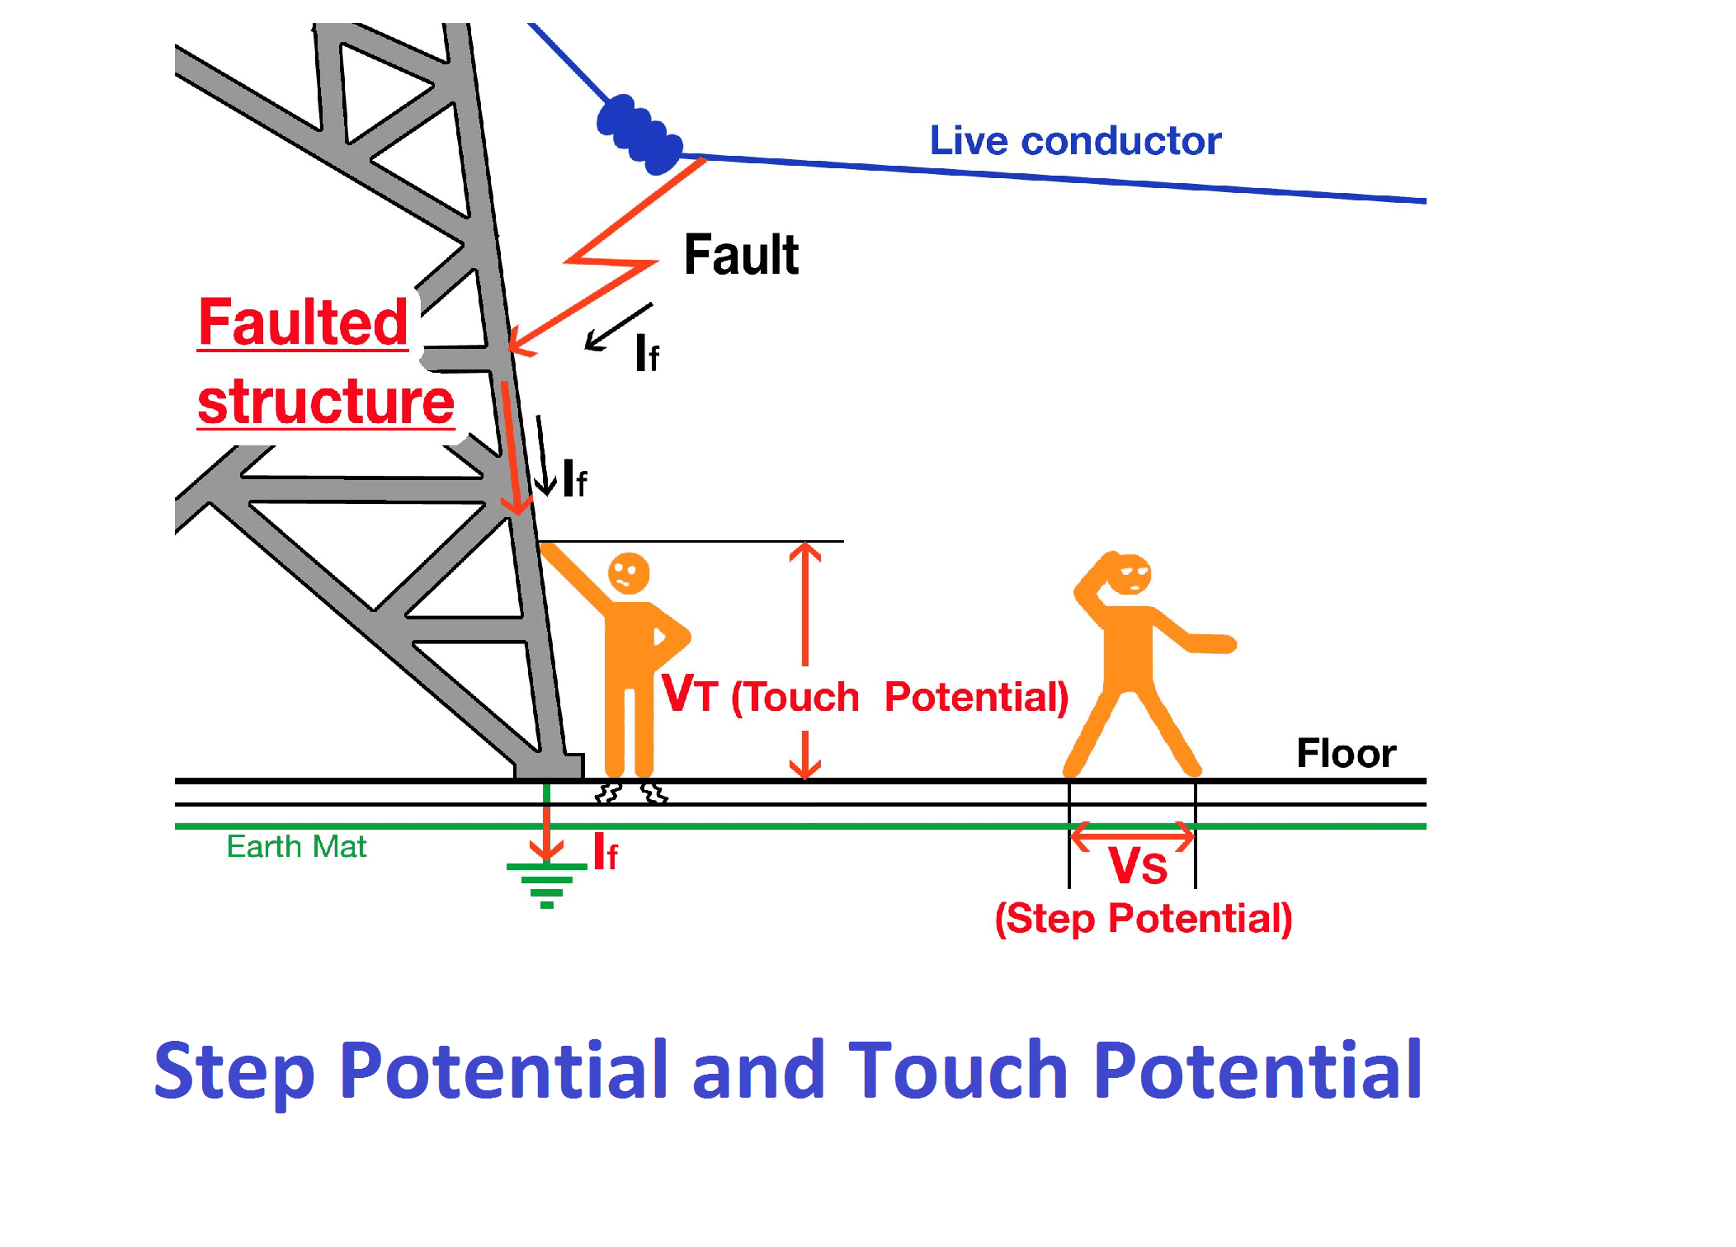
STEP AND TOUCH POTENTIAL

Slide 60
DEFINITIONS
Step Potential When current is flowing from an overhead conductor through a chain-link fence to the earth, a high-voltage condition is created and a voltage gradient will occur based on the resistivity of the soil, resulting in a voltage difference – also known as a potential difference – between two points on the ground. This is called a step potential as it can cause a voltage difference between a person’s feet.
Touch Potential Touch potential is the voltage between any two points on a person’s body – hand to hand, shoulder to back, elbow to hip, hand to foot and so on. For example, if an overhead conductor falls on a car, and a person touches that car, current could pass from the energized car through the person to the ground.

Slide 61
Tolerable current for human body
I_{B} = 0.116 / SQRT(Ts) ( for 50Kg)
I_{B} = 0.157 / SQRT(Ts) ( for 70Kg)
Sr. | Ts | I_{B} (50Kg) | I_{B} (70Kg)
1. | 0.2 Sec | 259 mA | 351 mA
2. | 0.5 Sec | 164 mA | 222 mA
3. | 1.0 Sec | 116 mA | 157 mA

Slide 62
Resistance of Rod Electrode

Slide 63
Resistance to Earth Electrode

Slide 64
Lightning Protection – Ground Wire

Slide 65
Lightning Protection – Lightning Mast

Slide 66
THANKS for attention!
Questions / Answers

