Slide 1
Table of contents
Substation Automation - Overview
Substation Automation - Functions
Substation Automation - IEC61850
Substation Automation - Ethernet Topology
Substation Automation – System Design
Substation Automation – System Products
Substation Automation - Checklist
1

Slide 2
Substation Automation
Overview
Automation is the use of technology to perform tasks with where human input is minimized.
2

Slide 3
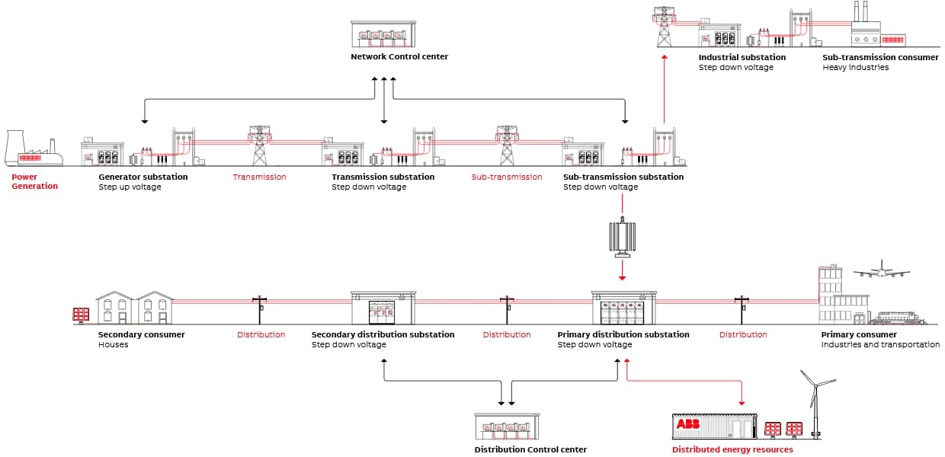
Power System
3

Slide 4
Substation Automation - Overview
What is meant by Substation Automation System (SAS) ?
Substation Automation System (SAS) provides protection, control, monitoring and communication capabilities as a part of a comprehensive substation control and monitoring solution.
Substation automation refers to using data from Intelligent electronic devices (IED), control and automation capabilities within the substation and control commands from remote users to control power-system devices. It collects the historical data of the substation and generates the alarms in the event of electrical accidents or faults.
Why do we need a Substation Automation System?
To Manage
Repetitive Operation
Complex Operation
To Have
Accurate, Timely information about all power system components
Faster Response
Quicker Decisions
Faster Restoration after breakdown
Less or nil human interference
Lower Operational cost
4

Slide 5
TRADITIONAL SYSTEM ARCHITECTURE
Control
Center
HMI
Engineering
Router
Station Bus
Bay Controller
Relay A
Relay B
Bay Controller
Relay A
Relay B
Conventional Switchgear
Conventional CT / VT's
Conventional Switchgear
Conventional CT / VT's

Slide 6
Substation Automation System – Expectation
Data Exchange
Monitored Information:
Control Information:
Single Bit indications (alarms, events)
Double Bit indications (on/off status of devices)
Step position indication (Transformer tap position)
Analog measurements (voltages, currents, power, etc.,)
Pulse counter data (kWH, kVARH, etc.,)
Protection Events,
Sequence of event records,
Disturbance records,
IED configuration data.
Close or trip commands
Set point (analog output) commands
Regulating step command
Time synchronization
Parameter setting commands
Exchange of Information between devices via GOOSE
6

Slide 7
Advantages of Automation
LOCAL & REMOTE GRAPHICAL VISUALISATION OF ELECTRICAL DIAGRAMS OF BAY & SYSTEM VIEWS.
ALARM PAGES & SOE ARE DISPLAYED AND PRINTABLE.
TREND WINDOWS: SEVERAL CURVES CAN BE FULLY CUSTOMISED BY THE OPERATOR.
CONTROL WITH THE “SELECT-BEFORE OPERATE” SECURITY COMMANDS.
SAVING OF HISTORICAL FILES.
SYSTEM CONFIGUARATION SCREEN.
TIME SYNCHRONISATION
MONITORING OF CIRCUIT BREAKER.
MONITORING OF TRANSFORMER.
MONITORING OF CTs, PTs, & CVTs.
MONITORING OF RELAYS, ENERGY METERS & PANEL METERS.
CONFIGUARATION OF RELAYS
DISTURBANCE RECORD VIEW.

Slide 8
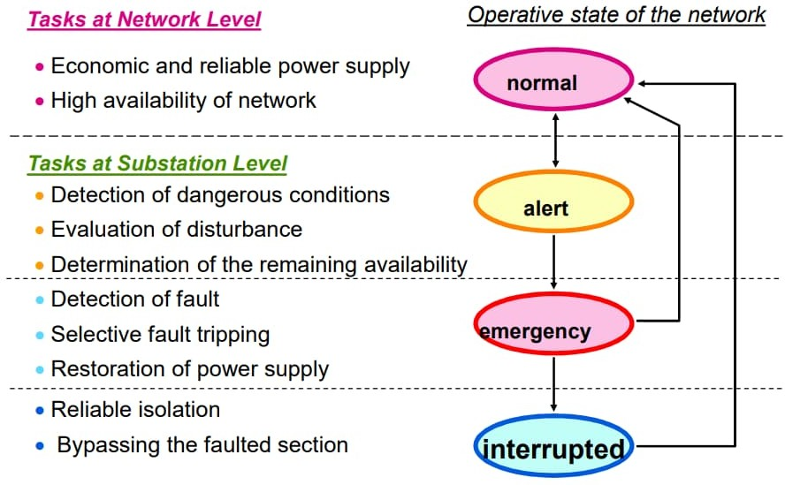
Substation Automation – Overview
Network States & Automation Tasks
normal
alert
emergency
interrupted
8

Slide 9
Substation Automation System – Communication Protocol
Definition
Communication protocol
Set of rules that determines the behavior of functional units in achieving and performing communication
Open protocol
A communication protocol whose stack is either standardized or publicly available. Normally follows the ISO OSI Seven Layer Reference Model
Proprietary protocol
A communication protocol owned by a single organization or individual
9

Slide 10
OSI Layer Reference Model Protocol Stack
7
6
Application
Presentation
Session
Transport
Network
Data Link
Physical
The OSI Model
OSI is a well-known hierarchical framework for implementing communications protocols. It serves as the worldwide foundation for
interoperability between networking products.
5
4
The OSI architecture consists of seven functional sections known as layers. Each layer is cleverly defined to hand off control over data to the layer directly above and the layer directly below.
3
2
1
OSI is really a reference model that manufacturers work from. Compliance is voluntary, but most vendors’ products provide some subset of OSI functionality.
10

Slide 11
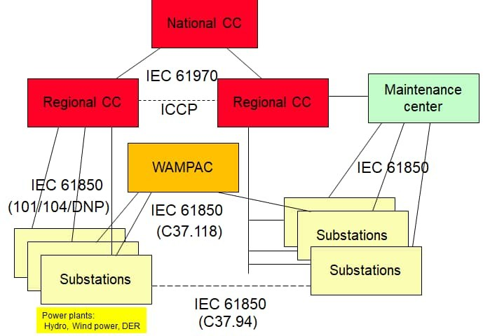
Substation Automation System – Communication Protocols
Communication within Substations
IEC 61850
IEC 60870-5-103
MODBUS
DNP3.0
OPC
Communication outside Substation
IEC 60870-5-101
IEC 60870-5-104
IEC 61850
DNP3.0
IEC 60870-6 (TASE2/ICCP)
C37.94
Operation architecture schematic
11

Slide 12
Protocols
IEC 60870-5
The IEC Technical Committee 57 has also generated companion standards:
IEC 60870-5-101 Transmission Protocols - companion standards especially for basic telecontrol tasks
IEC 60870-5-102 Transmission Protocols - Companion standard for the transmission of integrated totals in electric power systems (this standard is not widely used)
IEC 60870-5-103 Transmission Protocols - Companion standard for the informative interface of protection equipment
IEC 60870-5-104 Transmission Protocols - Network access for IEC 60870-5-101 using standard transport profiles
MODBUS
Modbus is a data communications protocol originally published by Modicon (now Schneider Electric) in 1979 for use with
its programmable logic controllers (PLCs). Modbus has become a de
facto standard communication protocol and is now a commonly available means of connecting industrial electronic devices.^{[1]}
Modbus is popular in industrial environments because it is openly published and royalty-free. It was developed for industrial applications, is relatively easy to deploy and maintain compared to other standards, and places few restrictions - other than the datagram (packet) size - on the format of the data to be transmitted.
The Modbus protocol uses character serial communication lines, Ethernet, or the Internet protocol suite as a transport layer.
Modbus supports communication to and from multiple devices connected to the same cable or Ethernet network. For example, there can be a device that measures temperature and another device to measure humidity connected to the same cable, both communicating measurements to the same computer.
IEC 60870-5-101/102/103/104 are companion standards generated for basic telecontrol tasks, transmission of integrated totals, data exchange from protection equipment & network access of IEC101 respectively.
12

Slide 13
Protocols
DNP3.0
Distributed Network Protocol 3 (DNP3) is a set of communications protocols used between components in process automation systems. Its main use is in utilities such as electric and water companies. Usage in other industries is not common. It was developed for communications between various types of data acquisition and control equipment. It plays a crucial role in SCADA systems, where it is used by SCADA Master Stations (a.k.a. Control Centers), Remote Terminal
Units (RTUs), and Intelligent Electronic Devices (IEDs). It is primarily
used for communications between a master station and RTUs or IEDs. ICCP, the Inter-Control Center Communications Protocol (a part of IEC 60870-6), is used for inter-master station communications.
While IEC 60870-5 was still under development and had not been standardized, there was a need to create a standard that would allow interoperability between various vendors' SCADA components for the electrical grid. Thus, in 1993, GE-Harris Canada (formerly known as Westronic) used the partially completed IEC 60870-5 protocol specifications as the basis for an open and immediately implementable protocol that specifically catered to North American requirements. The protocol is designed to allow reliable communications in the adverse environments that electric utility automation systems are subjected to, being specifically designed to overcome distortion induced
by electro magnetic interference (EMI), aging components and poor transmission media.
OPC
Open Platform Communications (OPC) is a series of standards and specifications for industrial telecommunication. An industrial automation task force developed the original standard in 1996 under the name OLE for Process Control (Object Linking and
Embedding for process control). OPC specifies the communication
of real-time plant data between control devices from different manufacturers.
For any new development, given the choice, OPC-UA should be used. The only reason to use OPC-DA at this point in time is if you're connecting to a legacy product that only supports OPC-DA and cannot be replaced or upgraded. OPC UA is not only for OPC-DA, but for
all OPC Classic (DA, AE, HDA, etc).
OPC DA allows to access only the current data and is incapable to generate alarms, historical events whereas OPC UA supports features like historical events, multiple hierarchies and provides methods and programs (that are called commands).

Slide 14
PROFIBUS
Profibus (usually styled as PROFIBUS, as
a portmanteau for Process Field Bus) is a standard
for fieldbus communication in automation technology and was first
promoted in 1989 by BMBF (German department of education and research) and then used by Siemens. It should not be confused with the Profinet standard for Industrial Ethernet. Profibus is openly published as part of IEC 61158.
There are two variations of PROFIBUS in use today; the most commonly used PROFIBUS DP, and the lesser used, application specific, PROFIBUS PA:
PROFIBUS DP (Decentralised Peripherals) is used to operate sensors and actuators via a centralised controller in production (factory) automation applications. The many standard diagnostic options, in particular, are focused on here.
PROFIBUS PA (Process Automation) is used to monitor measuring equipment via a process control system in process automation applications. This variant is designed for use in explosion/hazardous areas (Ex-zone 0 and 1). The Physical Layer (i.e. the cable) conforms to IEC 61158-2, which allows power to be delivered over the bus to field instruments, while limiting current flows so that explosive conditions are not created, even if a malfunction occurs. The number of devices attached to a PA segment is limited by this feature.
C37.94 / C37.118
The IEEE C37. 94 Standard for N Times 64 Kilobit Per Second Optical Fiber Interfaces Between Teleprotection and Multiplexer Equipment (2002) provides plug-and-play transparent communications between different manufacturers' teleprotection and multiplexer devices using multimode optical fiber.
The C37. 118 standard defines a method for exchange of synchronized phasor measurement data between power system equipment. It specifies messaging including types, use, contents, and data formats for real-time communication between Phasor Measurement Units (PMU), Phasor Data Concentrators (PDC), and other applications.
LonWorks (local operating network) is a networking platform specifically created to address the needs of control applications. The platform is built on a protocol created by Echelon Corporation for networking devices over media such as twisted pair, powerlines, fiber optics, and RF
The SPA-Bus protocol was designed for use as a field bus by the ABB company. It enables the coupling of devices such as protection relays, bay control units etc. to a central device. SPA-Busoperates with asynchronous serial interfaces and baud rates of up to 9600 Baud.
ASCII format is used for data encoding

Slide 15
Substation Automation System – Communication Protocols
Comparison of Functionality
Protocol feature | IEC 61850 | IEC 60870-5- 101/104 | IEC 60870-5- 103 | IEC 61970
Read / Write | X, Clients – servers | X, Master – slaves | X, Master - slaves | X
Commands | X | X | - | X
Spontaneous events | Reports | Polled / balanced | polled | X
Realtime events | GOOSE | - | - | -
Analog samples | SAV | - | - | -
Directory services | X | - | - | X
File services | X | X | Dist.Record | -
Application semantics | X | - | Protection | X
Engineering support | SCL | - | - | CIM
CIM: Common Information Model
SCL: Substation Configuration Language SAV: Sampled Analog Values
GOOSE: Generic Object Oriented Substation Event

Slide 16
Substation Automation
Ethernet Topology

Slide 17
Ethernet for Substation
The geographical layout together with EMI environment and availability requirements influence the communication system costs quite strongly (glass versus wire, lengths, ring versus star)
Inside cubicles Cu wires may be used (screening by cubicle)
Outside/between cubicles Fiber Optic cables are a must
Switches must be “SA proof” (IEC 61850-3)
Environmental conditions same as for protection IEDs (EMC, Temperature etc.)
Power supply from Station battery (110 – 220 V DC)
Managed switches (Priorities tag, VLAN, more)
The Ethernet LAN is a subpart of the station and needs engineering, configuration and supervision as any other subpart
A network management system is appropriate
The topology depends on a number of constraints:
Operational requirements for the substation
Size of the substation
Reliability and availability

Slide 18



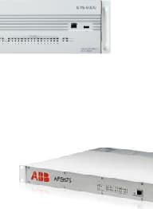





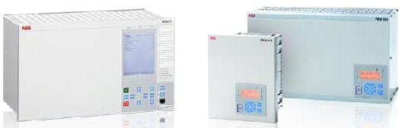
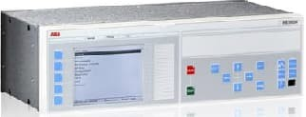
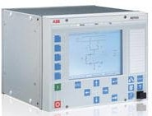
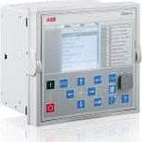
Ethernet for Substation – Star Topology
HMI
SNTP Time Master
Hierarchical structure using un- or managed Ethernet switches
LAN
100 or 1’000 Mbps
100 Mbps
100 Mbps
100 Mbps

Slide 19


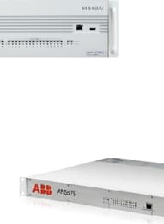





Ethernet for Substation – Bus Topology
HMI
SNTP Time Master
Bus structure using un- or managed Ethernet switches
LAN
100 Mbps
100 Mbps
100 Mbps
100 Mbps

Slide 20


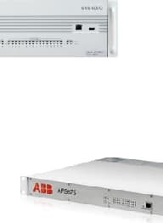

Ethernet for Substation – Ring Topology
HMI
SNTP Time Master
Network recovery using RSTP (recovery time 100ms with 20 switches)
LAN
#1
100 or 1’000 Mbps
#2
#3
…
#20
100 Mbps
100 Mbps
100 Mbps

Slide 21
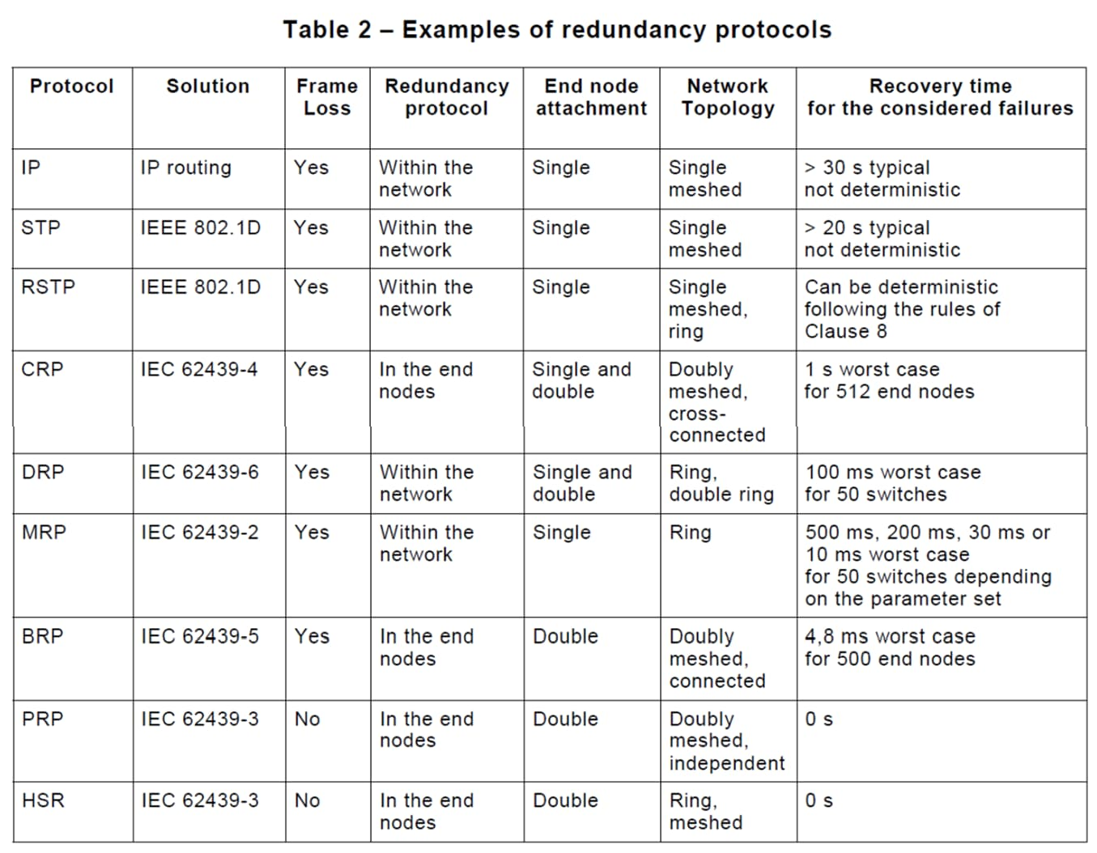
Ethernet for Substation – Redundancy Protocols
for SAS
networks
for SAS IEC 61850 IEDs
21
Reference: IEC 62439-1

Slide 22



Ethernet for Substation – RSTP
Rapid Spanning Tree Protocol
Station HMI 1 |  |  | Station Gateway
Station switch |  |  | Station switch
RSTP mechanism keeps communication ring logically open to avoid circulating packages
Station
HMI 1
Station
Gateway
1
Packet path is not through logical opening
Station
switch
Station
switch
In case of a fault in the communication ring, the logical opening is closed
Bay switch
Bay switch
Bay switch
Bay
switch
Bay
switch
Bay
switch
IED
IED
IED
This re-configuration of the network requires time
IED
IED
IED
IED
IED
IED
Packet path is now through alternate path
IED
IED
IED
2

Slide 23
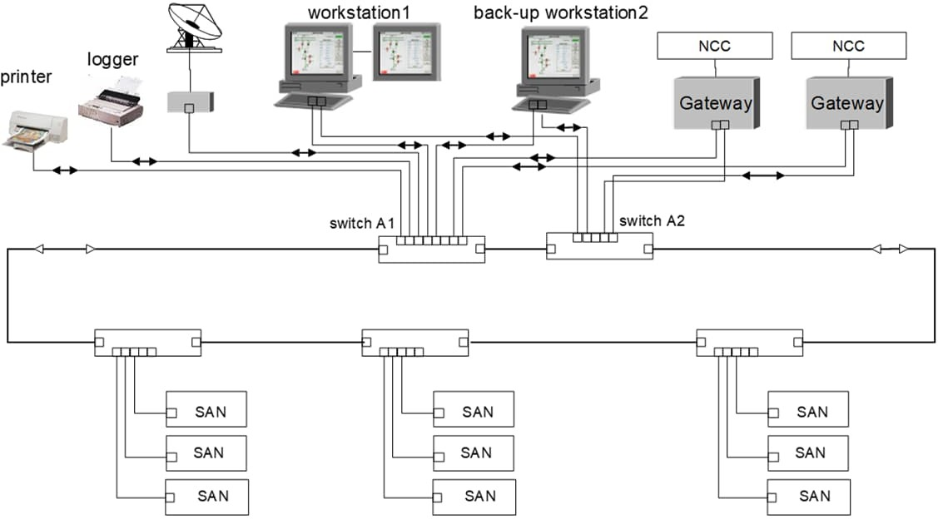
RSTP – Advantages/Disadvantages
Any topology supported: Tree, Star, Ring, meshed Network is autonomous, independent of IEDs Standard Ethernet components, no special devices
☺
~5ms per switch failure recovery time
😐
Flexible network speed (100MBit/s, 1GBit/s) and media Full bandwidth can be used, no double frames
RSTP
Failure or power-off of 2 or more IEDs has no impact to the network
☺
Any fully Interoperable IEC61850 3rd party IED can be
connected to the network
☺
Moderate costs for switches and network cabling
😐

Slide 24


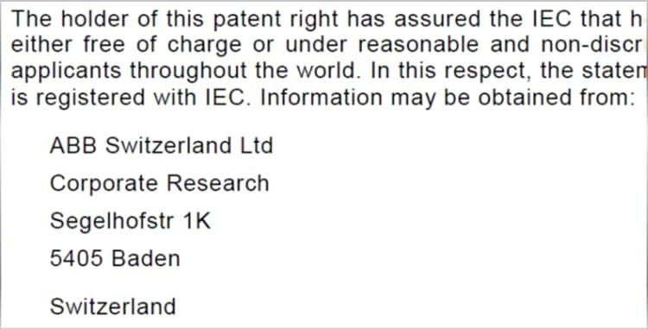




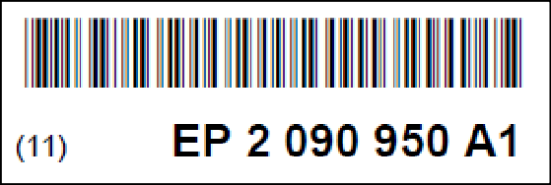

Ethernet for Substation – PRP/HSR
Link Redundancy-IEC61850-3 PRP/HSR patented by ABB
IEC 62439-3
PRP
Parallel Redundancy Protocol
HSR
High-availability Seamless Redundancy
PRP/HSR is a patent of ABB Corporate Research
ABB has assured the IEC to provide licenses throughout the world free of charge or under reasonable and non-discriminatory terms

Slide 25
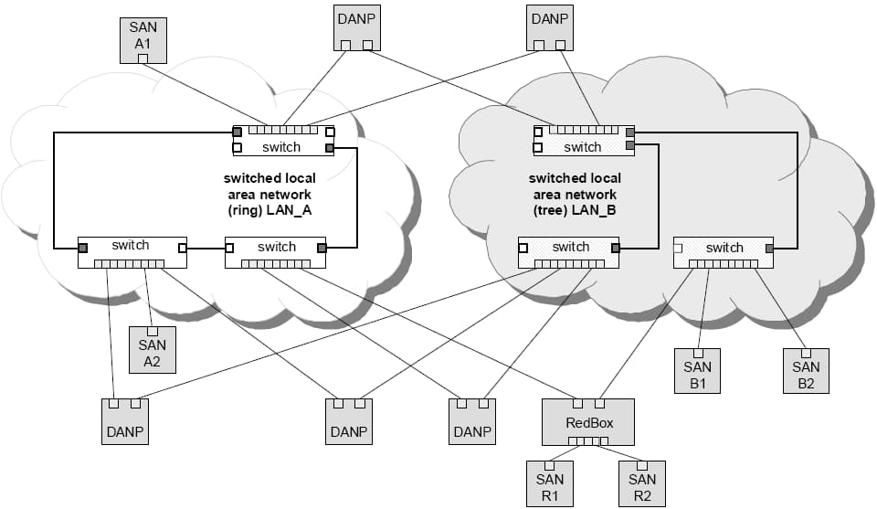

Ethernet for Substation – PRP
Parallel Redundancy Protocol
receiver
Operation principle
DANP (Double Attached Node implementing PRP) are attached to 2 independent LANs
Source DANP sends same frame over both LANs
sender
Destination DANP receives frame from both LANs, consumes 1st frame, discards the duplicated

Slide 26
PRP – Advantages/Disadvantages
Any topology supported: Tree, Star, Ring, meshed Network is autonomous, independent of IEDs Standard Ethernet components, no special devices Flexible network speed (100MBit/s, 1GBit/s) and media
☺
0ms failure recovery time No frame loss
☺
Full bandwidth can be used, frames run on separate LANs
Failure or power-off of IEDs has no impact to the network
☺
Connecting single port IEDs directly to one network
High costs for switches and network cabling
☹
Fully Interoperable with non redundant IEDs
☺

Slide 27
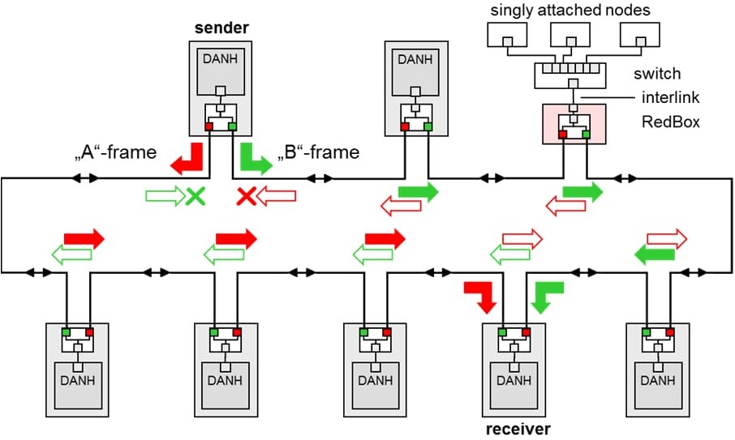
Ethernet for Substation – HSR
High-availability Seamless Redundancy
Operation principle
DANH (Double Attached Node implementing HSR) has 2 ports operated in parallel
Source DANH sends a frame over each port (“A”-frame and “B”-frame)
Destination DANH receives frame from each port, consumes 1st frame, discards the duplicated
DANH support bridge functionality and forward frames from one port to the other (not frames that it injected)

Slide 28







HSR – Advantages/Disadvantages
Only ring or ring of ring topologies IEDs are integral part of network
Standard Ethernet components cannot be used Fix network speed (100MBit/s)
☹
No direct connection of single port IEDs possible (only via RedBox)
Not interoperable with non redundant IEDs
☹
singly attached nodes
end node
end node
switch
interlink RedBox
A
B
A
B
A
B
B
A
B
A
B
A
B
A
B
A
end node
end node
end node
end node
end node
Failure or power-off of more than 2 IEDs has impact to the network
☹
0ms failure recovery time No frame loss
☺
Low cost (no switches and few network cables)
☺

Slide 29
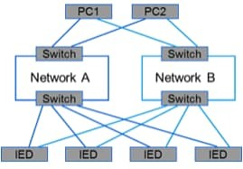
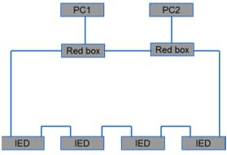
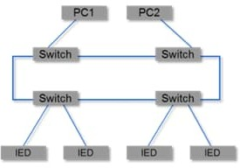
Ethernet for Substation – Summary of Redundancy methods
 | IEC 61850 |  | Architecture |  | Performance
Method | 8-1 | 9-2 | Redundant Network | Connect 1 port IED | Frame loss | Recovery time | Network | Latency
PRP IEC 62439-3 | Yes | yes | yes | yes | No | 0 ms | Full bandwith, flexible speed | No latency in IEDs
HSR IEC 62439-3 | Yes | yes | no | no Redbox required | No | 0 ms | Limited bandwith, fixed speed 100Mbps | Latency in each IED
RSTP with external Ethernet switches | Yes | no | no | yes | Yes | typ. 100ms (ring with 20 nodes) | Full bandwith, flexible speed | No latency in IEDs

Slide 30
Substation Automation
Functions

Slide 31
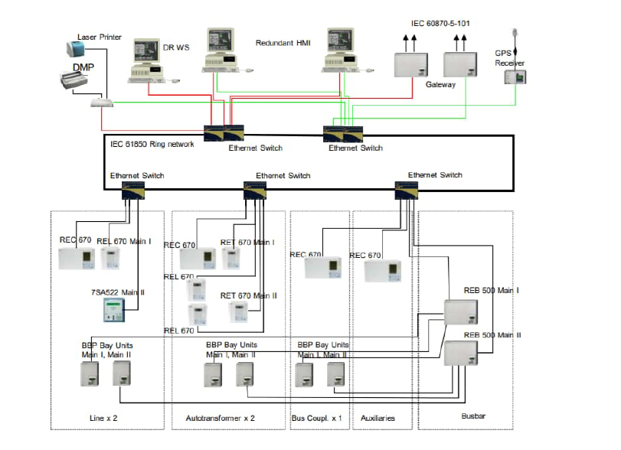
SUBSTATION AUTOMATION SYSTEM
SAS Components
Hardware Software
- Servers - Relay Software
- HMI - System Software
- Printers - HMI Software
- Ethernet switches - DR analysis software
- Modem
- Cables
- Inverter

Slide 32
COMPONENTS
COMPONENTS AT STATION LEVEL
Station Computer
HMI Workstation
Engineering Workstation
Station Switch
GPS Receiver
COMPONENTS AT BAY LEVEL
Control Unit (BCU)
Protection Unit (BPU)
Monitoring Unit (BMU)
Bay Switch
THE COMPONENTS AT STATION AND BAY LEVEL ARE
INTERCONNECTED BY THE STATION LAN

Slide 33
The SAS comprises of Station level, Bay level and Field level components and are integrated as depicted in the system Architecture.
BAY CONTROL UNIT (BCU) is fully self sufficient control and monitoring system with non-volatile storage of all Bay unit parameters.
• BCU comprise of I/O cards for field equipments and LCD screen for
Mimics
• BCU in conjunction with numerical relays of each bay form integrated system for control, protection and monitoring.
AC KIOSK CONCEPT:
• BCU with associated numerical protection relays housed in AC
Kiosk.
• Installed at field level
• Reduction in control cable.

Slide 34
PROCESS INTERFACING
The Bay Units are interfaced directly to the HV equipment by
traditional I/O cards
STATION/BAY INTERFACING
The station level and the BU are interconnected by the station
LAN
BAY/BAY(Goose) INTERFACING
Interlocking functions
Start-up & signalling functions
REMOTE CENTRE INTERFACING
Through Gateway function in the Station Computer and the
protocols IEC60870-5-104 and IEC60870-5-101

Slide 35
IEC 61850 Protocol
IEC 61850 is an international standard defining communication protocols for intelligent electronic devices(IEDs) at electrical substations.
Further it is a part of the International Electrotechnical Commission's (IEC) Technical Committee 57 reference architecture for electric power systems.

Slide 36
BAY CONTROL UNIT ( BCU )

Slide 37
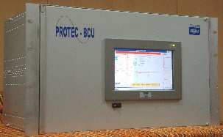
BCPU ( Bay Control Protection Unit)
COMMUNICATION INTERFACES
METERING
MONITORING
CONTROL
PROTECTION
RMS (V&I)
EVENTS
AUTO-RECLOSE
OVER-CURRENT
FRONT END
POWER (ACTIVE, REACTIVE, TOTAL)
CHECK SYNCHRONISM
EARTH FAULT
GRAPHIC TERMINAL
FAULTS
STATUS
INTERLOCKING
OVER VOLTAGE
POWER FACTOR
ALARMS
PROGRAMMING TOOL (IEC 61131)
UNDER VOLTAGE
IEC 61850
FREQUENCY
APPARATUS CONTROL
CLIENT-SERVER
GOOSE(PUBLISHING)
PHASE
GOOSE(SUBSRIBING)
TAP POSITION (4-20 ma)
BREAKER
SAMPLE VALUES
(SUBSCRIBING)
WINDING,OIL TEMP
(4-20 ma)
ISOLATOR

Slide 38
BCU FUNCTIONS
Metering of the following parameters
RMS values of voltages & Currents
Power ( Active, Reactive & Total)
Power facor
Frequency
Angle
Tap position
Winding / Oil temperatures
Monitoring
Events
Faults
Status
Alarms
Control
Autorecloser with/without check synchronism
Apparatus (Breaker & Isolator) control with following modes
Direct operate with / without enhanced security
SBO with / without enhanced security
Interlocking
Protection
Over_current / Earth_fault
Over_voltage / Under_voltage

Slide 39
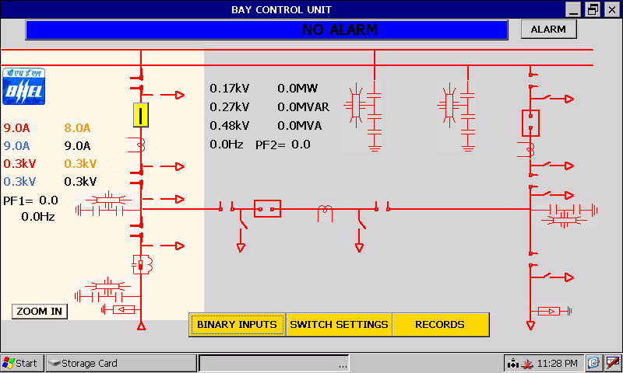
COMMUNICATION INTERFACE
THE MONITORING PERFORMANCES USUALLY DEVELOPED BY THE BMU, CAN BE INTEGRATED IN THE BCU EQUIPMENT
7” LCD GRAPHIC TERMINAL WITH A TOUCH SCREEN FOR FOLLOWING OPERATIONS
SINGLE LINE DIAGRAM DISPLAYING ONE & HALF BREAKER ZONE
DISPLAY OF PHASE VOLTAGES & CURRENTS, ACTIVE & REACTIVE POWER, PHASE,
FREQUENCY AND PF.
STATUS OF BREAKERS & ISOLATORS
EVENTS / FAULTS RECORDS WITH TIME STAMPING
SWITCH SETTINGS
SBO / DIRECT CONTROL WITH NORMAL / ENHANCED SECURITY
TIME ACTIVATED CONTROL
DIGTAL I/O CONFIGURATION
BCU LOCAL HMI

Slide 40
IEC 61850 COMMUNICATION INTERFACE
CLIENT-SERVER COMMUNICATION BETWEEN BCU & HMI
METERING
SWITCH SETTINGS
STATUS INDICATIONS
CONTROL (DIRECT / SBO CONTROL WITH NORMAL / ENHANCED SECURITY)
REPORT & LOG CONTROL BLOCK
FILE TRANSFER
DYNAMIC DATA SETS
EVENTS / FAULTS BEING SENT TO THE CLIENT IN THE FORM OF ASCII FILE
GOOSE PUBLISHER/SUBSCRIBER COMMUNICATION
PUBLISHING
SUBSCRIPTION
SAMPLED VALUE SUBSCRIBER
ACQUIRING DIGITIZED ANALOG VALUES FROM THE PROCESS BUS

Slide 41
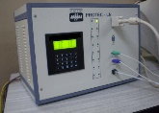
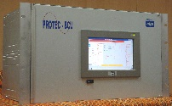

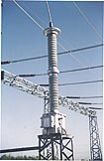
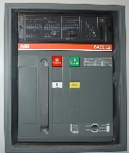
BCU INTERFACING IN CLIENT-SERVER
Operator workplace
Engineering / Monitoring
CONTROL CENTER
Station level
CLIENT
CLIENT
Server supports connections with
several clients simultaneously
STATION
A bay unit can be a server and a client at the same time
SERVERS
Process level
BCU
PROCESS
CT
PT
CB

Slide 42
Client-Server Communication
All IEDs will act as server and report to Station HMI and Gateway
Maximum no of Clients association is IED implementation dependant
Reports from server to client triggered by changes

Slide 43
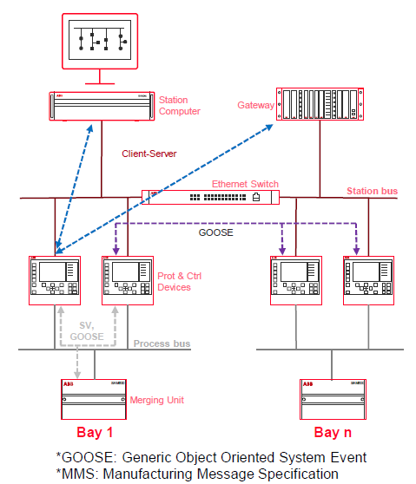
Goose Communication

Slide 44
IEC 61850 – GOOSE Principle
GOOSE (Generic Object Oriented Substation Event)
G
O
O
S
E
M
E
S
S
A
G
E
GOOSE RECEIVER DEVICE Y
GOOSE TRANSMITTERDEVICE X
SUBSCRIBER
GOOSE
RECEIVER
DEVICE Z
NOT A SUBSCRIBER
PUBLISHER
A device sends information by multicasting
Only devices which are subscribers receive this message
In the example, Receiver Z receives the message
Receiver Y is not a subscriber
GOOSE message

Slide 45
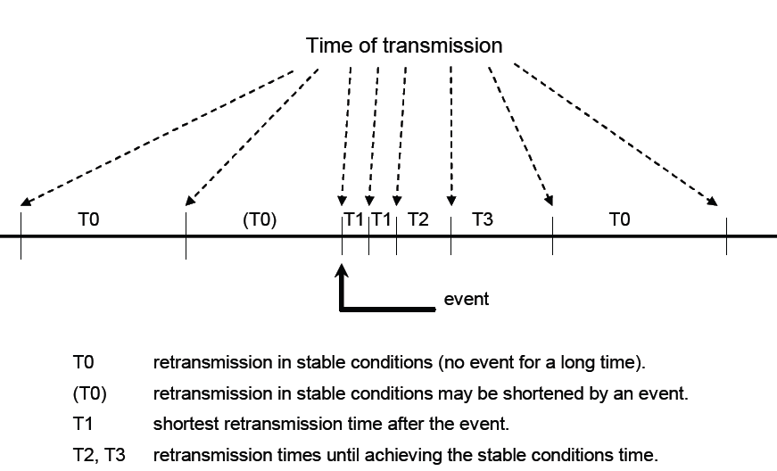
GOOSE RETRANSMISSION INTERVALS

Slide 46
INTEROPERABILITY
ABILITY OF TWO OR MORE IEDS FROM THE SAME VENDOR, OR
DIFFERENT VENDORS,TO EXCHANGE INFORMATION AND USES
THAT INFORMATION FOR CORRECT CO-OPERATION.
INTERCHANGEABILITY
ABILITY TO REPLACE A DEVICE SUPPLIED BY ONE MANUFACTURER
WITH A DEVICE SUPPLIED BY ANOTHER MANUFACTURER, WITHOUT
MAKING CHANGE TO THE OTHER ELEMENTS IN THE SYSTEM
INTERCHANGEABILITY IS BEYOND IEC 61850

Slide 47
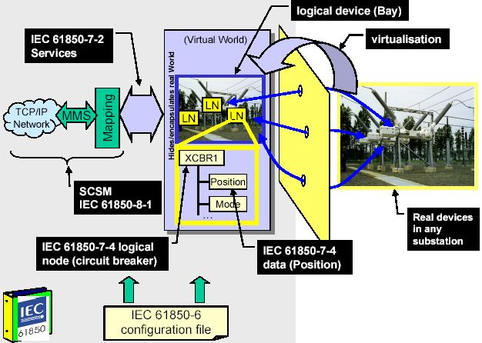
IEC 61850 – Modeling Approach

Slide 48
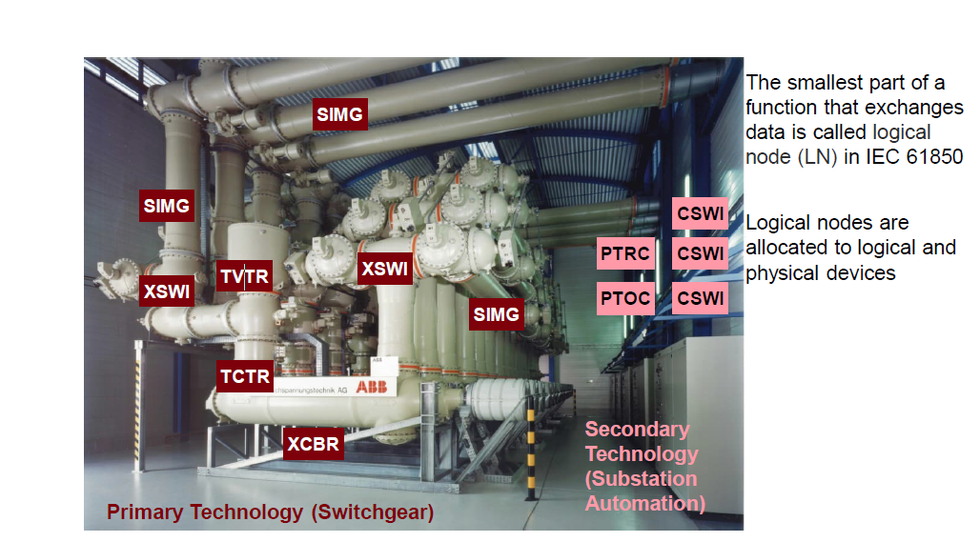
Data Modeling in IEC 61850

Slide 49
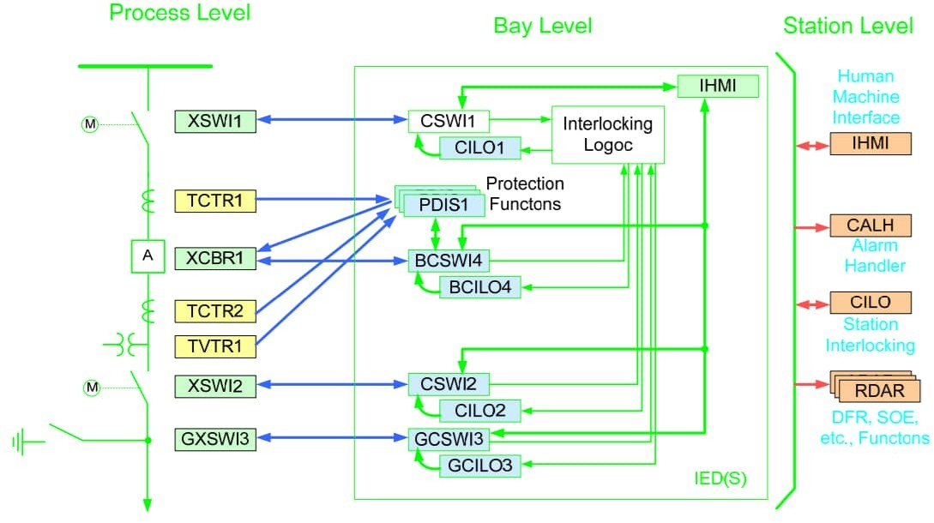
Substation Automation – Data Modeling in IEC61850
Basic Principle

Slide 50
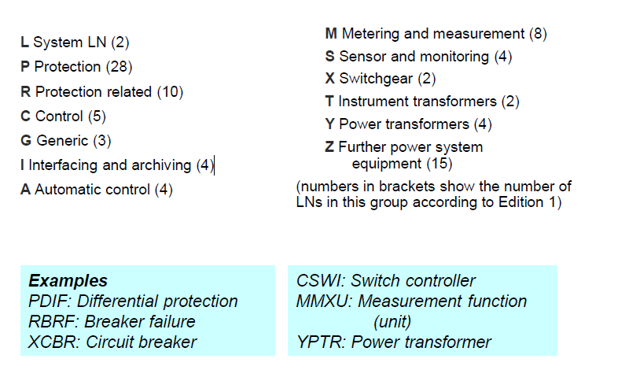
Naming and Groups of data modeling

Slide 51
APPROACH OF IEC 61850
LOGICAL NODES, LN
SMALLEST ENTITIES IN A SUBSTATION PERFORMING FUNCTIONS
CONTAIN FUNCTION RELATED DATA & THEIR ATTRIBUTES TO BE
COMMUNICATED
COMMUNICATE WITH EACH OTHER
HAVE A STANDARDIZED MNEMONIC NAME OF FOUR LETTERS
LOGICAL DEVICE, LD
LOGICAL NODES FOR COMMON APPLICATION ARE GROUPED INTO
LOGICAL DEVICE

Slide 52
PHYSICAL DEVICE, PD
A SET OF LOGICAL DEVICES GROUPED TO DEFINE A FUNCTION
MODEL
EACH IED IS A PHYSICAL DEVICE
ALL LOGICAL NODES MUST RESIDE IN SOME LOGICAL DEVICE
LLN0 CONTAINS COMMON DATA FOR ALL LOGICAL NODES OF A
LOGICAL DEVICE
ATTRIBUTES OF PHYSICAL DEVICE LIKE COMMUNICATION
RELATED DATA SETS, CONTROL BLOCKS STORED IN LD0
THE SYSTEM INCLUDING THE CONFIGURATION IS DESCRIBED BY THE SUBSTATION CONFIGURATION DESCRIPTION LANGUAGE (SCL)

Slide 54
SAMPLED MEASURED VALUES
A METHOD FOR TRANSMITTING SAMPLED
MEASUREMENTS FROM TRANSDUCERS SUCH AS CTS,
VTS, AND DIGITAL I/O.
ENABLES SHARING OF I/O SIGNALS AMONG IEDS
SUPPORTS 2 TRANSMISSION METHODS:
- MULTICAST SERVICE (MSVC) OVER ETHERNET
- UNICAST (POINT-TO-POINT) SERVICE (USVC)
OVER SERIAL LINKS.

Slide 55
IEC61850 CONTROLS
4 CONTROL MODELS:
DIRECT CONTROL WITH NORMAL SECURITY
SBO CONTROL WITH NORMAL SECURITY
DIRECT CONTROL WITH ENHANCED SECURITY
SBO CONTROL WITH ENHANCED SECURITY
ENHANCED SECURITY PROVIDES VALIDATION AND
SUPERVISION OF THE CONTROL ACTION AND
REPORTING OF STATUS.

Slide 56
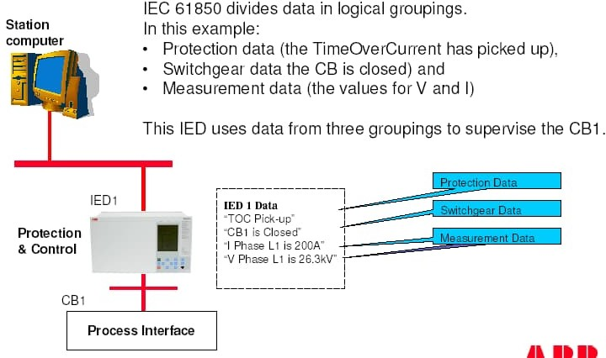
Substation Automation – Data Communication using IEC61850

Slide 57
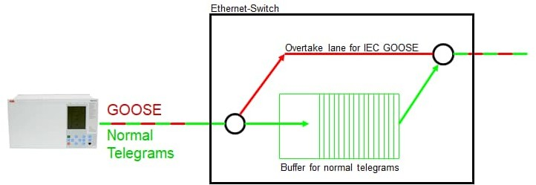
Substation Automation – GOOSE communication
Horizontal Communication
GOOSE: Is a mechanism for fast transmission of substation events such as commands, alarms, indications as messages.
A GOOSE message sent by one IED can be received and used by several other IEDs.

Slide 58
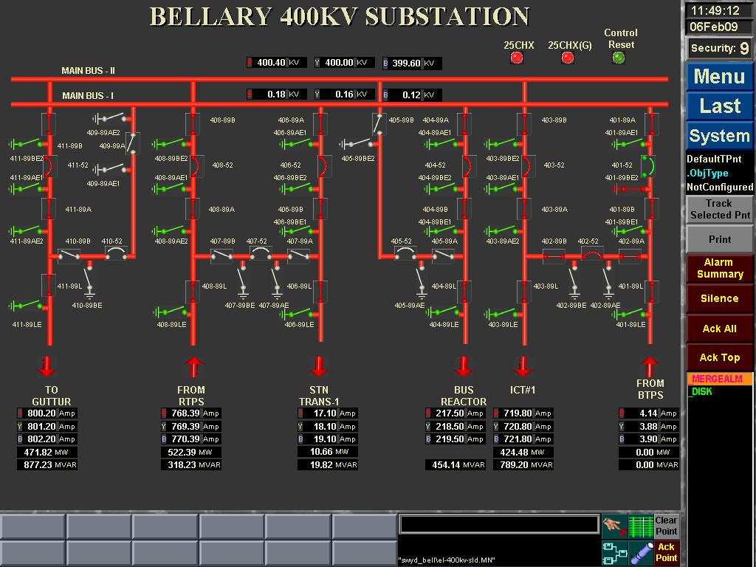
Typical Graphical Display (STATION LEVEL)
Date and Time Display
Single Line Diagrams
Measurement Display
Alarm Navigation

Slide 59
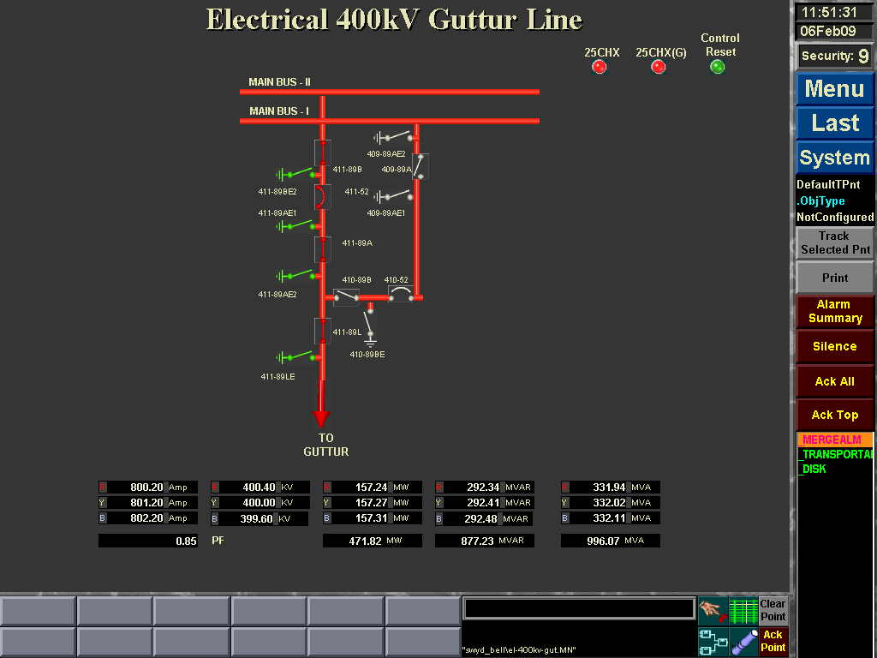
Typical Graphical Display (BAY LEVEL)

Slide 60
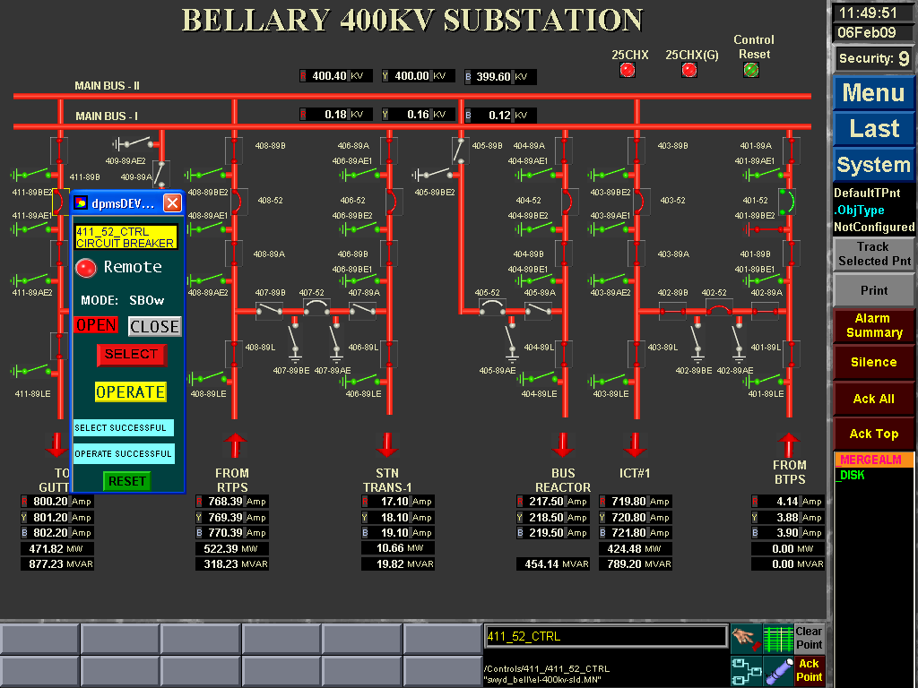
Graphical Display with Control Pop-Ups
Control Pop-Up
Track Select Point

Slide 61
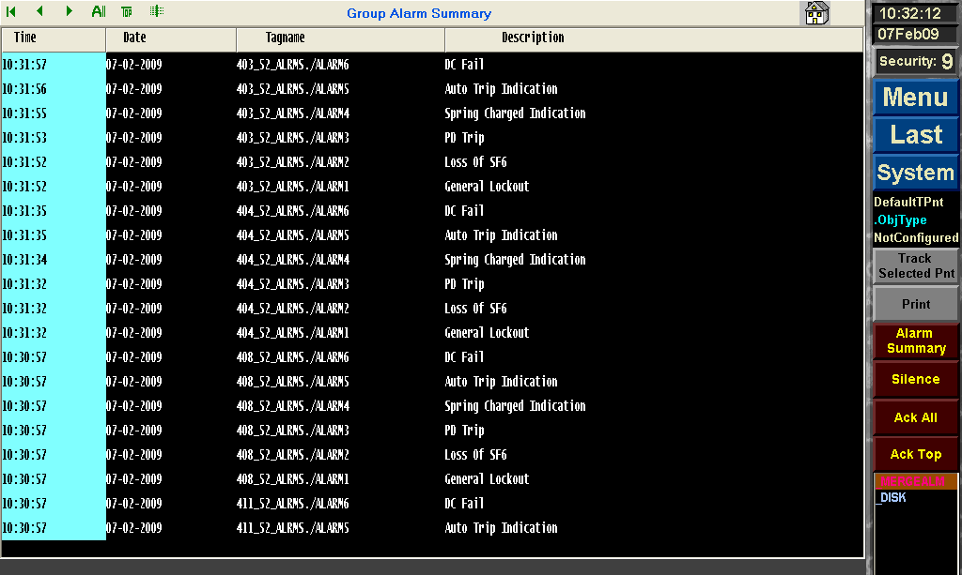
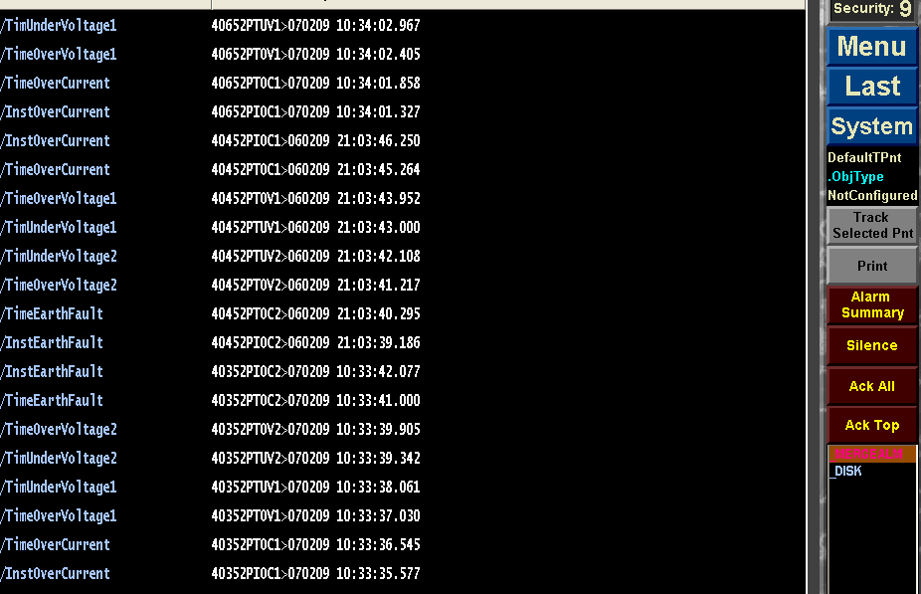
ALARMS
Reason for Circuit Breaker
Trip for necessary Action
EVENTS
Protection Events
Circuit Breaker Open/Close
Update Rate upto msec

Slide 62
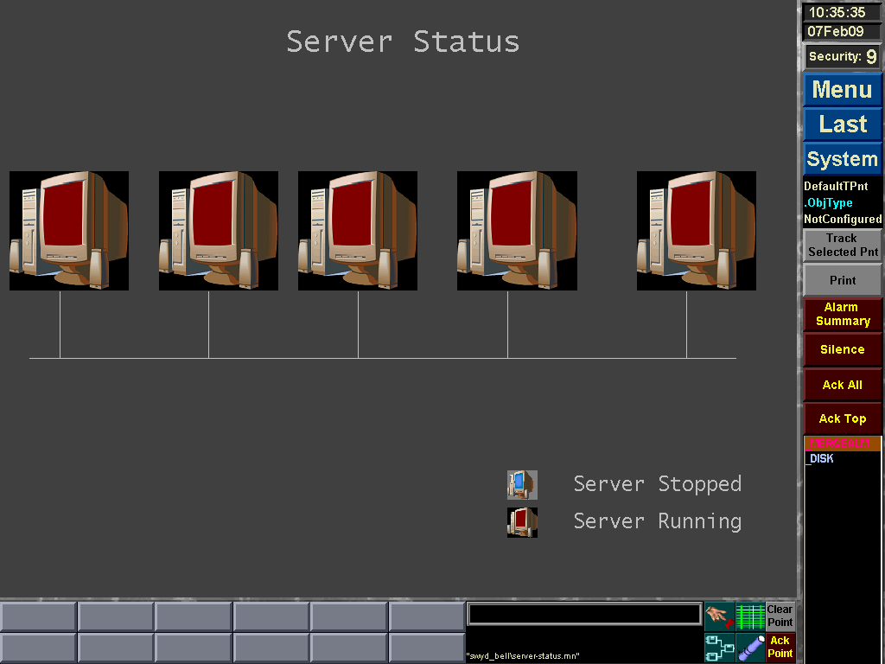
BCU Server Communication Status

Slide 63
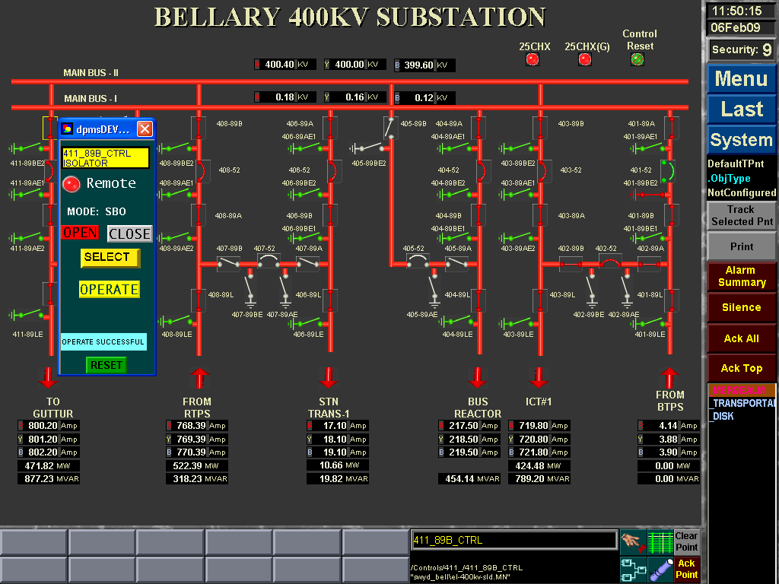
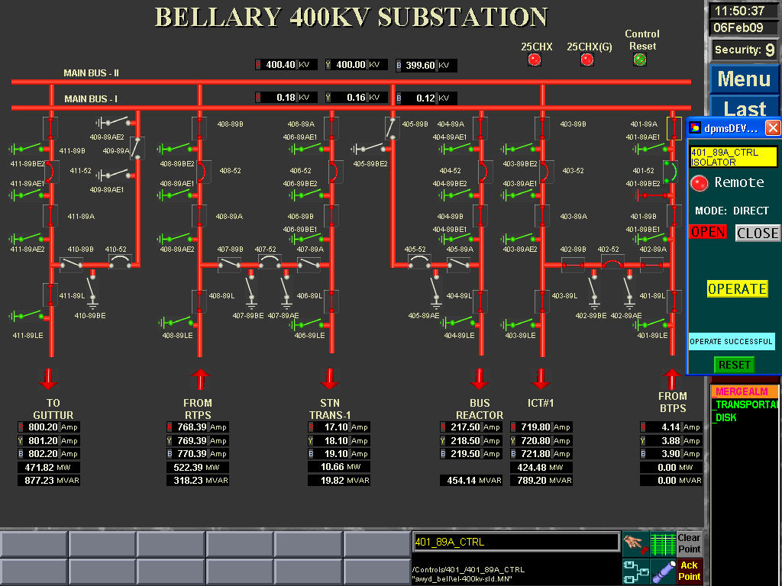
Control Modes of Operation
Direct
Select-Before-Operate (SBO)
Direct with Enhanced Security
Select-Before-Operate with Enhanced Security (SBOw)

Slide 64
SCADA features of IEC61850
Control Modes of Operation
Scalability
Extensibility
Interoperability

Slide 65
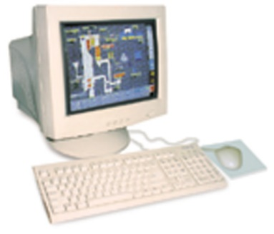
FEATURES OF HMI STATION AND STORIAN
LOCAL AREA NETWORK
HISTORIAN
HMI Station
Hot-stand by
Redundant
HMI Station
Trends
Reports
Disturbance Records
Alarm Logging
Event Logging
SCADA
4 control Modes
of operation
SLDs
(Station Level &
Bay Level)
Alarm List
Event List
File Transfer
Same as HMI Station

Slide 66
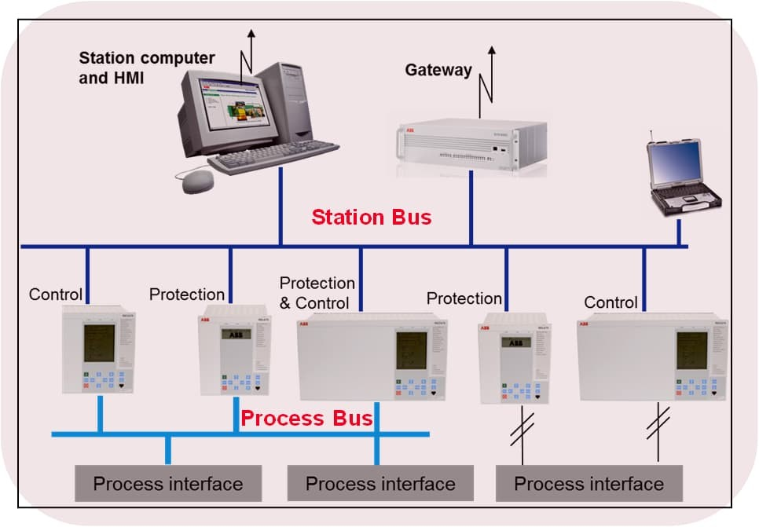
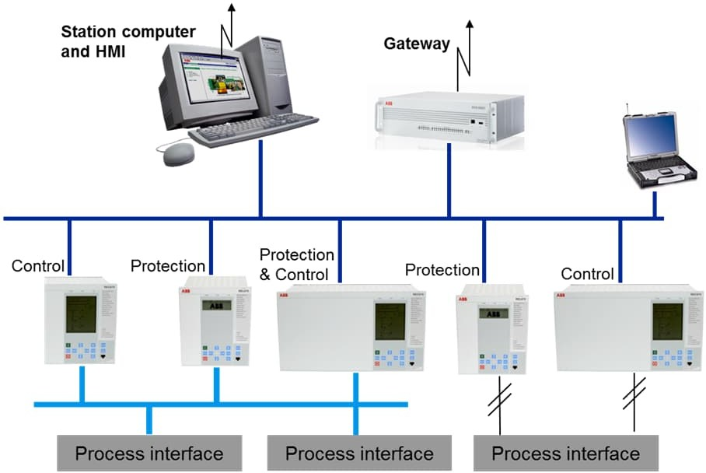

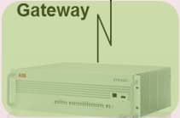

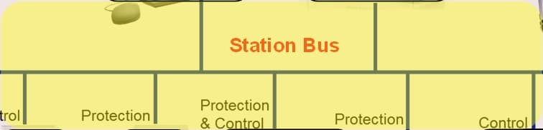







Substation Automation – IEC61850 Standard
Scope mapped to System Architecture
Published standard documents related to the substation
General parts (Part 1-4)
Comms. functions / models (part 5)
Configuration, Engineering (Part 6)
Data modelling (Part 7)
Communication services (Part 8, 9)
Conformance testing (Part 10)
Station Bus
Process Bus
Communication networks and systems in substations

Slide 67
Substation Automation
System Design

Slide 68
Substation Automation – System Design
Availability
MTTR (mean time to repair) is influenced by
Time to locate failed module
Time to exchange module
MTTF
MTTR
MTTF
MTTR
MTTF
…
Time to put system back into operation
start
operation
repair
operation
repair operation
MTTF MTTF + MTTR
MTTF (meant time to failure) is influenced by
Component selection
Environment
Redundancy
A =
Availability (A)= Probability that an item will be in operable condition at any point of time along its life cycle.

Slide 69


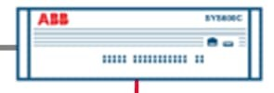
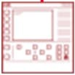
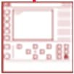



Substation Automation – System Design
Single computer system
MHMI/SHMI/GATEWAY
HMI cum Gateway
All functions in one computer
Local HMI in substation
Substation gateway
Solution is especially suitable for e.g.
Small substations

Slide 70








Substation Automation – System Design
Distributed system (1/3)
Functions are distributed two computers
Local HMI in substation
Substation gateway
Solution is especially suitable for e.g.
Large substations
Separation of responsibility between organizations
Gateway
HMI

Slide 71









Substation Automation – System Design
Distributed system (2/3)
MicroSCADA Pro
Functions are distributed two computers
Local HMI in substation -Hot standby
Substation gateway
Solution is especially suitable for e.g.
Large substations
Separation of responsibility between organizations
High availability
Gateway
HMI

Slide 72








Substation Automation – System Design
Distributed system (3/3)
MicroSCADA Pro
HMI cum Gateway
Functions are distributed two computers
Local HMI in substation-Hot standby
Substation gateway –Hot standby
Solution is especially suitable for e.g.
Large substations
High availability

Slide 73

Substation Automation – System Design
Types of SCL files
IED Capability Description (ICD) file: It defines complete capability of an IED. This file needs to be supplied by each manufacturer to make the complete system configuration. The file contains a single IED section, an optional communication section and an optional substation part which denotes the physical entities corresponding to the IED.
System Specification Description (SSD) file: This file contains complete specification of a substation automation system including single line diagram for the substation and its functionalities (logical nodes). This will have Substation part, Data type templates and logical node type definitions but need not have IED section.

Slide 74
Substation Automation – System Design
Types of SCL files
Substation Configuration Description (SCD) file: This is the file describing complete substation detail. It contains substation, communication, IED and Data type template sections. An .SSD file and different .ICD files contribute in making an SCD file.
Configured IED Description (CID) file: It is a file used to have communication between an IED configuration tool to an IED. It can be considered as an SCD file stripped down to what the concerned IED need to know and contains a mandatory communication section of the addressed IED.

