Slide 1

DESIGN OF STUB FOR
TRANSMISSION LINE TOWERS
BY
DEBJYOTI DAS,
C.Eng., AMIE, MISWE, MBA, M.Tech

Slide 2
What is Stub?
The anchoring arrangement of transmission tower legs consisting of inclined angle (in the same slope as that of the tower leg) with bearing cleats at the end, all embedded in the concrete foundation, is called Stub-cleat arrangement or simply “STUB”.

Slide 3
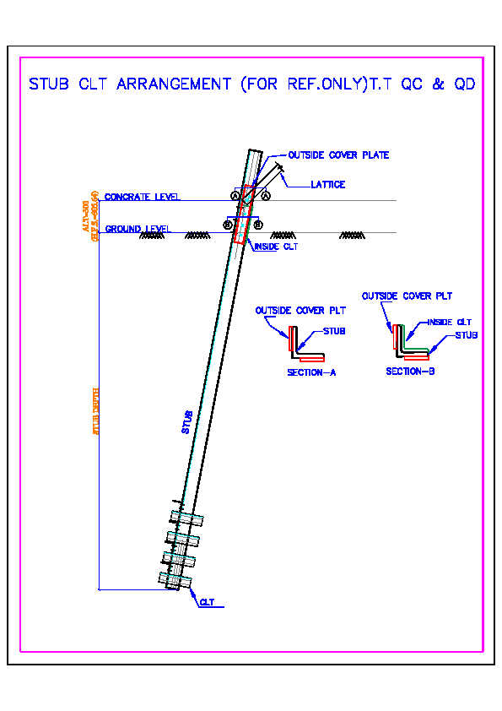
Different Parts of Stub
Stub consists of the following parts:
1. Stub Angle,
2. Bearing Cleats,
3. Cleats at the unsupported portion of stub angle.

Slide 4
Stub setting / Template fixing
Stub should be set in the manner so that distance between stubs, their alignment and slope are as per design and drawing. To achieve the following methods are generally followed:
1. A combined stub setting template.
2. Prop setting template.

Slide 5
COMBINED STUB SETTING TEMPLATE ARRANGEMENT
PLUMB BOB
GL
GL
STUB
ELEVATION
JACK
CENTRE LINE
90º LINE
PLUMB BOB
STUB SETTING
TEMPLATE
PLAN

Slide 6
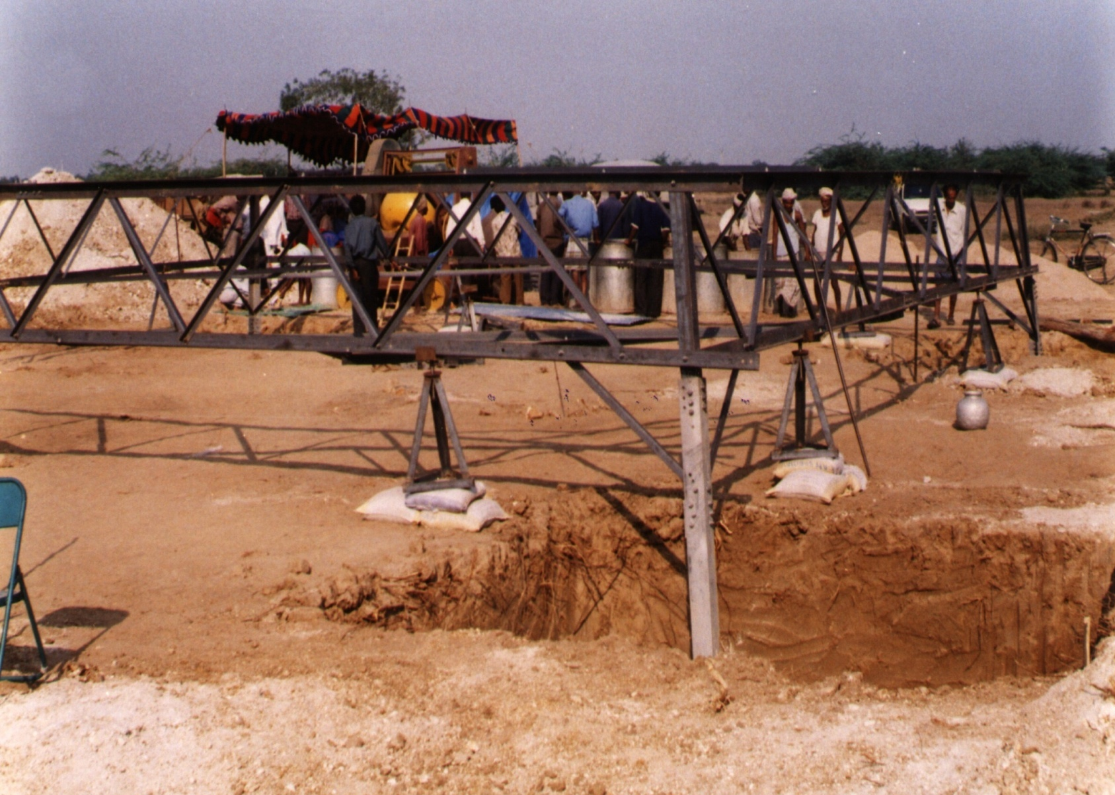
STUB SETTING TEMPLATE ARRANGEMENT

Slide 7
Stub setting by Prop
90mm Ø WITH INSIDE THREADING
STUB
12mm TH. PLATE
GL
GL
ANCHOR BOLT 600mm LONG
SUPPORTING ARRANGEMENT
ELEVATION
90mm Ø WITH INSIDE THREADING
FOUNDATION PIT
12mm TH. PLATE
STUB
PLAN

Slide 8
Procedure for Stub Setting
1. Assemble the templates four sides as per drawing.
2. Place the four sides of the assembled template on the stub setting jacks.
3. Mark center point of the each side of the template.
4. Tie thread on the line center pegs and on pegs at 90º to line direction pegs in case suspension tower
5. In case of angle tower, tie thread on the angle bifurcation pegs and on the peg at 90º to angle bifurcation pegs.
6. Fix 4 Nos Plumb bobs (generally 0.9Kg) to the four center marks on four sides of the template.

Slide 9
7. Orient template to the alignment of the line and center it over center pegs of the location.
8. Fix up the stubs to the template corners with the help of Water level or Dumpy level, with reference to the point considered as reference point for excavation (generally the center peg).
9. Check both the diagonals of the template.
10. Ensure that all four sides are at the same level.
11. Check the alignment, centering and diagonals of template again.

Slide 10
Safety measures in Stub setting
1. Position of template supporting jack should be selected properly .
2. Template supporting jack should be away from the edge of the excavated pit.
Supporting jack should be on firm ground.
Careful handling of template should be done while aligning with axis of the foundation.
5. Keep constant watch on collapsing soil of the pits or the arrangements made to resist collapsing.
6 Use personal protective equipment while at work.

Slide 11
Template Arrangement in Loose Soils
CENTRE LINE
SUPPORTING
OF JACK
STUB SETTING
TEMPLATE
CENTRE LINE
STUB
THE SUPPORTING JACK OF TEMPLATE SHOULD BE AWAY FROM THE PIT EDGE SPECIALLY IN CASE WBC, SAND PREDOMINANT, SOFT OR SLUSHY SOIL. BRIEFLY WHEREVER THE SOIL IS COLLAPSING THIS ARRANGEMENT

Slide 12
Template Arrangement in Hard Soils
CENTRE LINE
SUPPORTING
OF JACK
CENTRE LINE
STUB
THE SUPPORTING JACK OF TEMPLATE SHOULD BE AWAY FROM THE PIT EDGE SPECIALLY IN CASE NORMAL SOILS, MOORUM, GRAVELL ETC.

Slide 13
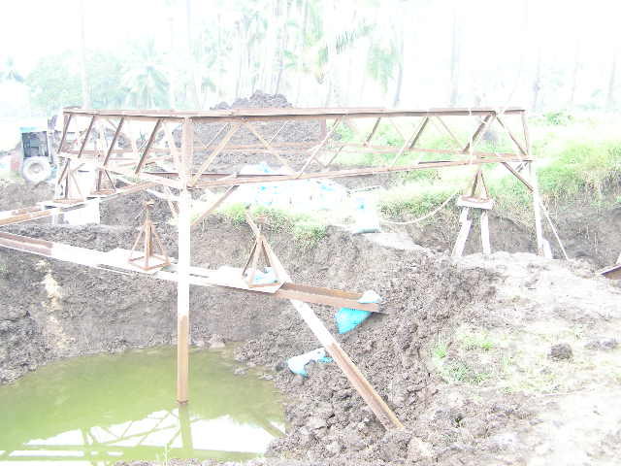
Photos of Stub & Stub Setting Template

Slide 14
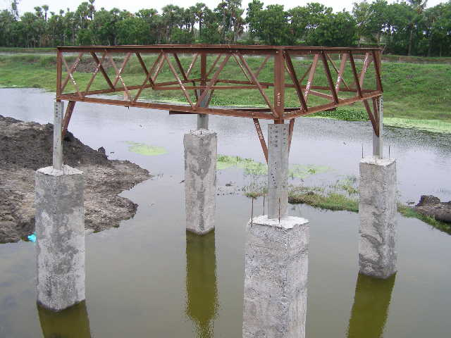
Photos of Stub & Stub Setting Template

Slide 15
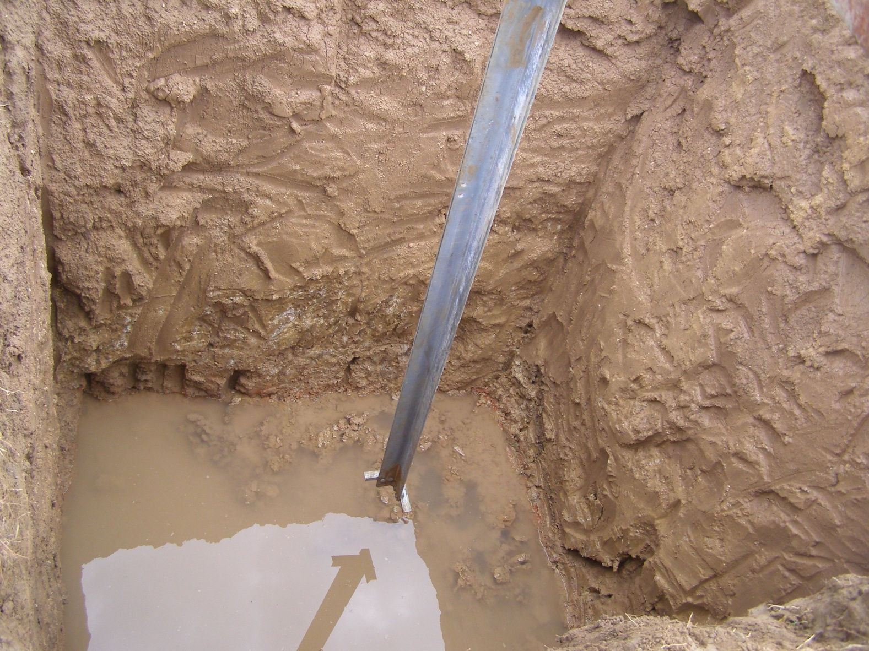
Photos of Stub & Stub Setting Template

Slide 16
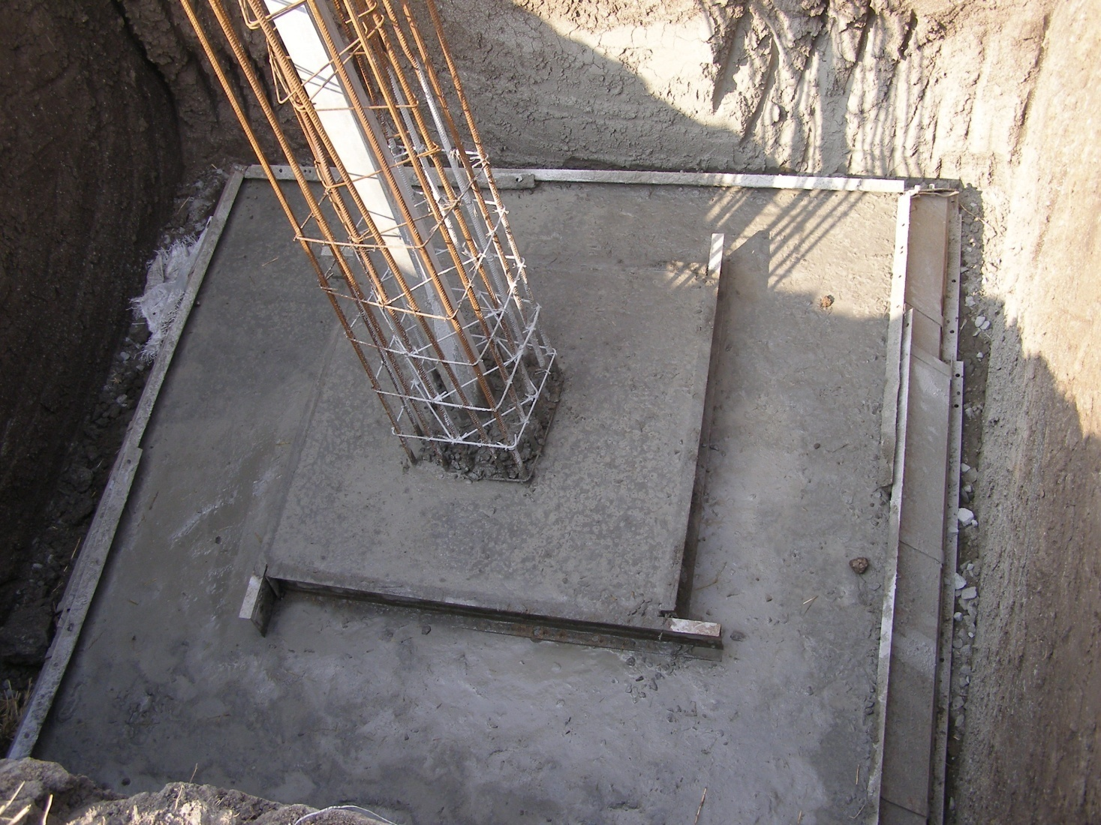
Photos of Stub & Stub Setting Template

Slide 17
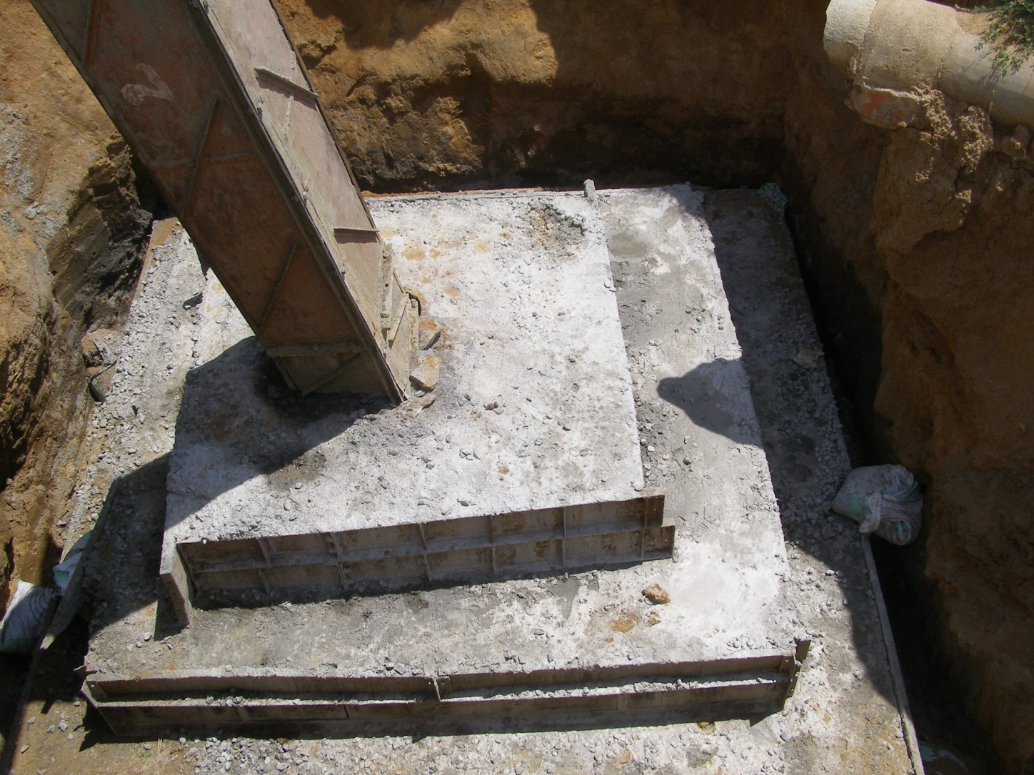
Photos of Stub & Stub Setting Template

Slide 18
Design of Stub
Structural Drawing of Stub.pdf
Structural Drawing of Stub Setting Template.pdf
DESIGN REFERENCES:
CBIP Manual for Transmission Line Tower
IS:456-2000: Plain & Reinforced Concrete Code of Practice
ASCE 52: Guide for Design of Steel Transmission Towers

Slide 19
Design of Stub…Contd…
The design of stub is presented step-by-step with descriptions of methods and illustrative example.
INPUT DESIGN LOAD: Ultimate foundation loads as obtained from PLS Tower output are required for the design of stub. Two cases shall be considered:
Maximum compression with corresponding transverse as well as longitudinal thrust.
Maximum tension with corresponding transverse as well as longitudinal thrust.

Slide 20
Design of Stub…Contd…
Ultimate Foundation Load:
Compression = 86551 kG
TR Side TH = 3867 kG
LG Side TH = 88 kG
Tension = 65068 kG
TR Side TH = 3867 kG
LG Side TH = 88 kG
INPUT Structural Data: Initially, stub and cleat sizes are taken based on experience and the sections are checked for sufficiency as per appropriate design methodology.
Stub Detail:
Stub Section: 120*120*12 - HT

Slide 21
Design of Stub…Contd…
Cleat Detail:
Cleat Arrangement: Single angle in one layer
No. of Cleats/Stub: 4
Cleat Section: 90*90*7 – HT
Cleat Length: 300 mm
Bolt Detail:
Bolt Property Class: 5.6
Dia. Of Bolt: 16 mm
No. of Bolts/Cleat: 3
Total No. of Bolts/Stub: 4*3 = 12 nos.
Concrete Grade: fck = 20 N/mm2

Slide 22
Design of Stub…Contd…
DESIGN: The total compression or tension shall be resisted by the bond between stub and concrete and bearing of cleat on concrete.
Design of stub consists of following steps:
Determination of bond strength between stub and concrete;
Check for Bearing Stress of Concrete due to bearing of cleat;
Bolt Capacity Check;
Check for Stub angle area;
Strength of Bearing Cleat;
Combined axial & Bending Check for Cleat at the unsupported portion.

Slide 23
Design of Stub…Contd…
Determination of bond strength between stub and concrete:
The bond strength is given by:
F_{b} = A_{p} x f_{b} where A_{p} = peripheral area of stub in mat portion, and f_{b} = bond stress between stub & concrete.
Load Resisted by Bond Strength:
As per CBIP Manual, f_{b} = 1 N/mm₂ for M20 concrete.
Length of stub in mat portion = 500 mm
A_{p} = ((120x2)+(120-12)x2)}x500 = 228000 mm2 (Approx.)
Hence, load resisted by bond between stub and concrete
F_{b} = A_{p}xf_{b} = (228000x1) = 23241.6 kG ≈ 25% of max. compression.
So, in this case, it can be ascertained that 75% of the stub force is carried by cleat.

Slide 24
Design of Stub…Contd…
Check for Bearing/Crashing Capacity of Concrete :
The load resisted by the cleats due to bearing on concrete shall be greater than the load carried by cleats (stub force in excess of bond strength of stub).
The bearing/crushing of concrete is given by:
F_{br} = 0.45 x f_{ck} x A_{br} [IS: 456-2000, Cl. 34.4]
Where, bearing area of cleat A_{br} = L_{cleat} x (w-t) x N
Bearing Capacity of Concrete:
Compression force for cleat design = 0.75 x 86551 = 64913 kG
Tension force for cleat design = 0.75 x 65068 = 48801 kG
Total bearing area of 4 nos. of cleats
A_{br} = L_{cleat} x (w-t) x N = [30 x (9-0.7)x4] cm2 = 996 cm2
Hence, bearing capacity of concrete = 0.45 x fck x Abr = (0.45 x 204 x 996)
= 91433 kG > Compression/tension force for cleat design, hence OK.
.

Slide 25
Design of Stub…Contd…
Cleat Strength Check: [ ASCE 52, Cl. 9.9.2]
To mobilize the stub force to concrete, the cleat should be strong enough,i.e., cleat strength shall be greater than stub force to be carried by bearing cleat.
The cleat strength is given by:
x = t x [EQ. 9.9 – 2, ASCE 52]
P = 1.19 x f_{ck} x b x (t + r + x/2) [EQ. 9.9 – 3, ASCE 52]
Where, b = length of cleat, r = root radius of the cleat section, t = thickness of cleat.

Slide 26
Design of Stub…Contd…
Cleat Strength Check:
Compression force for cleat design = 0.75 x 86551 = 64913 kG
Tension force for cleat design = 0.75 x 65068 = 48801 kG
Cleat thickness t = 0.7 cm Cleat length b = 30 cm.
Root radius r = 0.85 cm.
Yield stress of HT cleat f_{y} = 3569 kG/cm².
f_{ck} = 204 kG/cm²
x = t x = 0.7 x = 2.685 cm
Cleat strength for single cleat
P = 1.19 x fck x b x (t + r + x/2) = [1.19 x 204 x 30 x (0.7 + 0.85 + 2.685/2)] kG
= 21052 kG
Total cleat strength for 4 nos. of cleats = 21052 x 4 = 84208 kG > Compression/tension force for cleat design, hence OK.
.
.

