Slide 1


Stress Management &Work-Life Integration
-Prof.Dr.Alapati Srinagesh

Slide 2

Do you experience Stress?
When (What times?)
Where(Which areas of life?)
Types of Stress

Slide 3
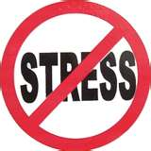
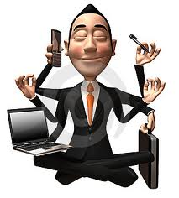
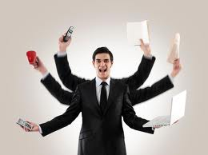

STRESS MANAGEMENT
Stress is the feeling we have when under pressure, while stressors are the things we respond to in our environment.
Stressor - a stressor is an agent or stimulus that causes stress.

Slide 4

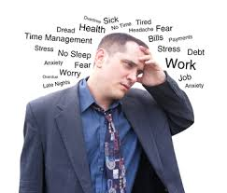
Immune system goes down
Muscles become tense
We do not sleep (heightened state of alertness)
Digestive system slows down
Feeling anxious, irritable, or depressed
Apathy
Loss of interest in work
Fatigue
Using alcohol or drugs to cope
Muscle tension or Headaches
Stomach problems
Social withdrawal

Slide 5
History of stress
Hans Selye: Hungarian-Canadian Endocrinologist
Father of Stress Research
Borrowed the term STRESS from the field of Physics to Medical field and began using this since 1920.
He conducted important scientific work on the hypothetical non-specific response of an organism
to stressors

Slide 6
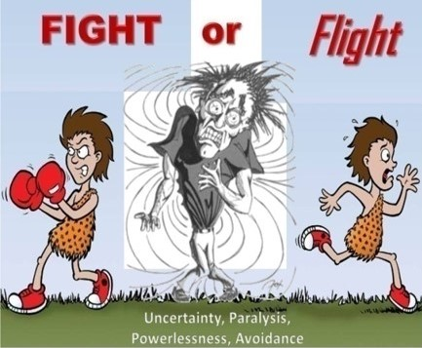
General Adaptation Syndrome
In Hans Selye’s theory, G.A.S. had 3 stages.
Stage 1 : Alarm reaction
This is the immediate reaction to a stressor.
In the initial phase of stress,
humans exhibit a “fight or flight” response.
This stage takes energy away from other systems (e.g. immune system) increasing our vulnerability to illness.

Slide 7
Stage 2 : Resistance
If alarm reactions continue, the body begins getting used to being stressed
But this adaptation is not good for your health, since energy is concentrated on stress reactions.
Stage 3 : Exhaustion
This is the final stage after long-term exposure to a stressor.
The body’s resistance to stress is gradually reduced and collapses as the immune system becomes ineffective.
In Selye’s view, patients who experience long-term stress could succumb to heart attacks or severe infection due to their reduced resistance to illness.

Slide 8
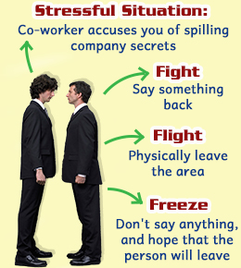
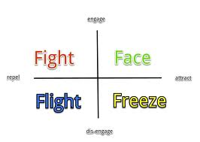
Responses 4Fs
Ex: Snake, Fire

Slide 9
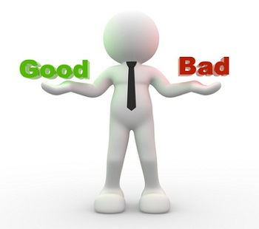
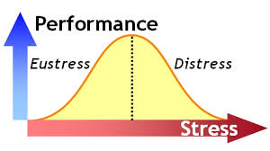
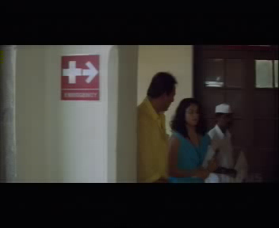
2 Kinds OF STRESS ( According to Dr. HANS SELYE )
DISTRESS : Comes from HATING the WORK
and FEELING like a VICTIM
EUSTRESS: Positive Tension Between
WHERE WE ARE NOW and WHERE WE WANT TO GO

Slide 10
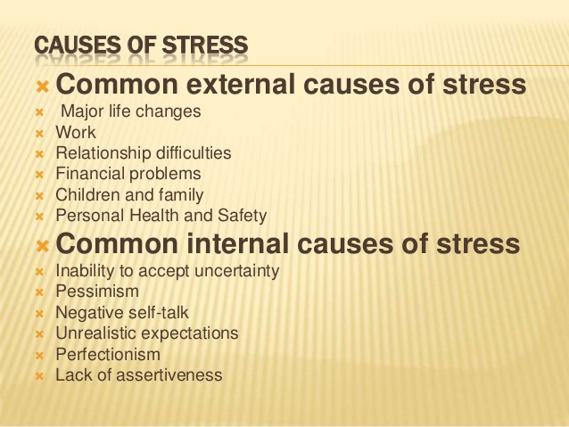

Slide 11
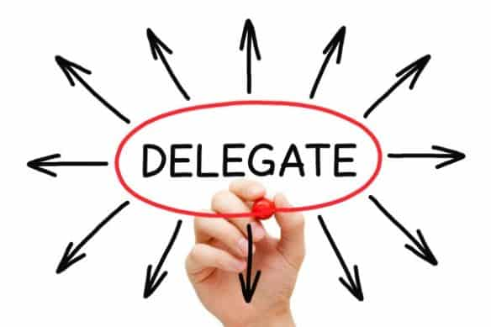

Unimportant and Urgent things
Assigning it to Third Parties: ATMs & Courier

Slide 12

Causative Factors for Stress
Ability vs. Expectations ( Supply vs. Demand)
Railway Reservation:
Solution: Learn K&S

Slide 13
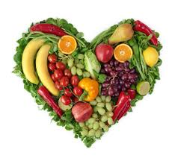
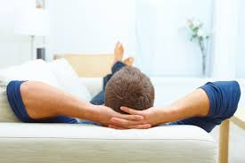
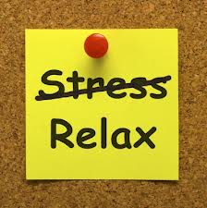

RELIEVING STRESS
Physical- Rest, Relaxation, Sleep/Nap,
Food & Nutrition

Slide 14
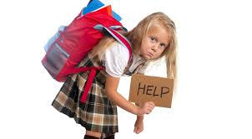


Slide 15
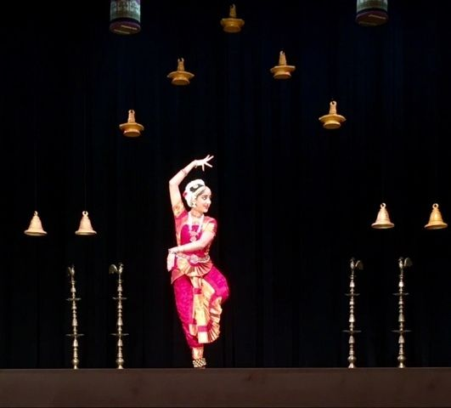

Stress is proportional to Load and Time

Slide 16
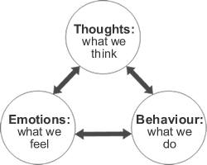
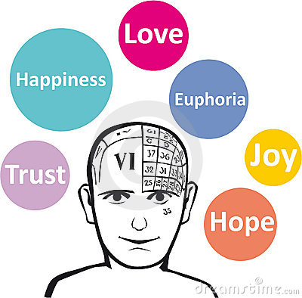



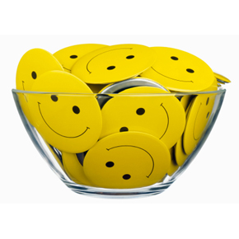
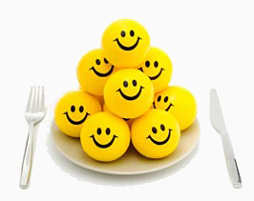
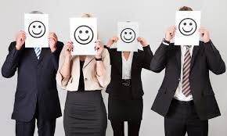
EMOTIONAL- EQ, EI By increasing POSITIVE EMOTIONS
HAPPINESS – Absolute Vs Relative Locus of Control –
External and Internal
Happiness is along the way, not at the end of the road
COURAGE,OPTIMISM,CONTENTMENT

Slide 17
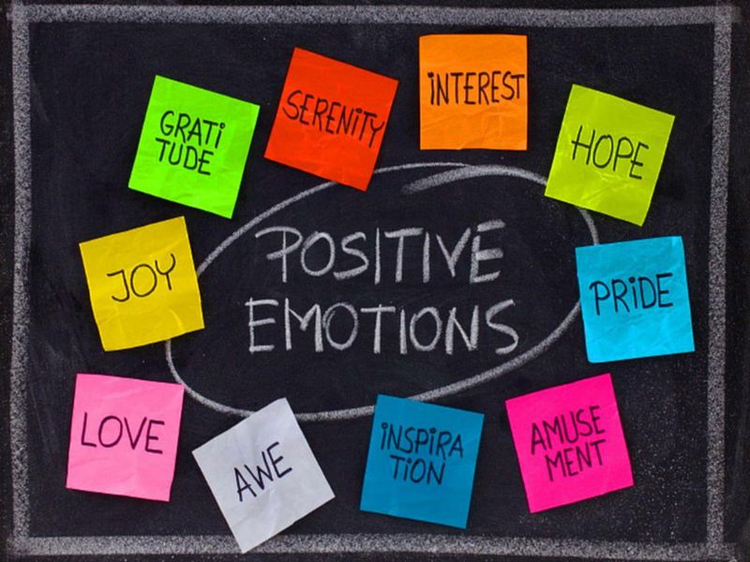


Slide 18
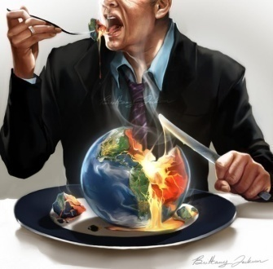
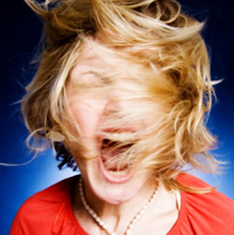

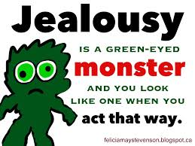
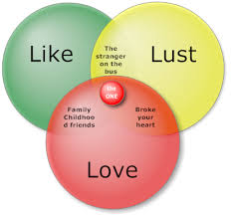
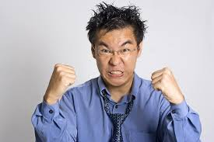
EMOTIONAL- EQ, EI
By REDUCING NEGATIVE EMOTIONS OF KKLMMM
KAMA-LUST
KRODHA- RAGE
LOBHA- GREED
MOHA- MANIA ( EXCESSIVE & UNDESIRABLE LIKING)
MADA- EGOISM
MATSARYA- JEALOUSY/ENVY
FEARS & PHOBIAS, DEPRESSION, SHYNESS,INFERIORITY….

Slide 19
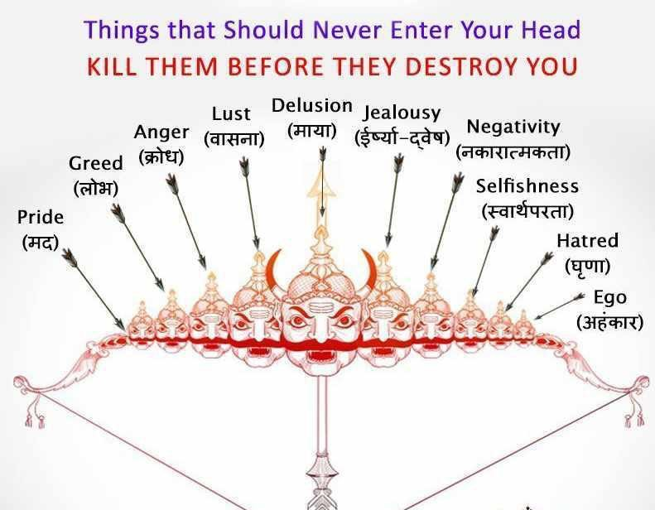

Slide 20
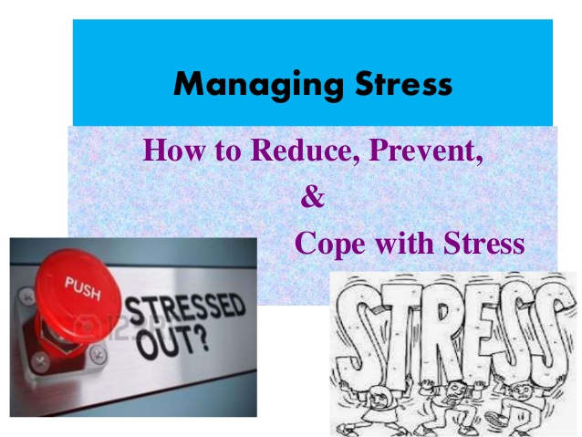

Slide 21
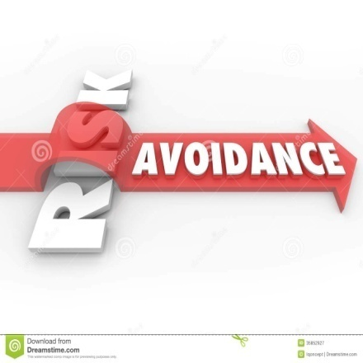

Avoidance of Stressors
Ex: Target oriented jobs
Traffic – Eleventh Hour- 3 Fish story
Elimination of Stressors
Management of Stress by Change in Perception,
i.e. ATTITUDE CHANGE towards Problems & Stress as
Challenges & opportunities for Growth / Development/
Increase in Abilities/ Personality Improvement
Ex : Smooth Roads

Slide 22
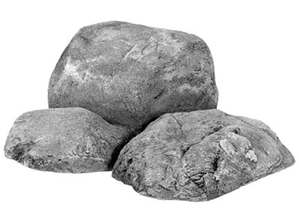
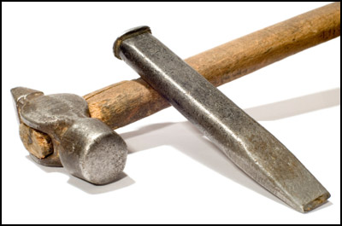
Sculptor-Strain-Stones

Slide 23
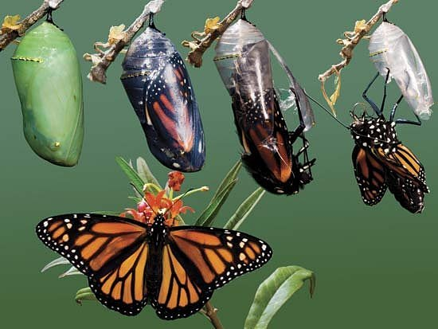
Struggle- Cocoon

Slide 24
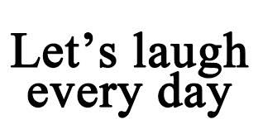

HUMOUR,LEARNING,CHANGING,ETHICS
Humour - Jokes, Fun, Comedy Books, Channels, Movies, Laugh
Increasing Abilities to meet demands- LEARN
Adapting CHANGE
Retaining VALUES,MORALS,ETHICS - Trikarana Suddhi

Slide 25
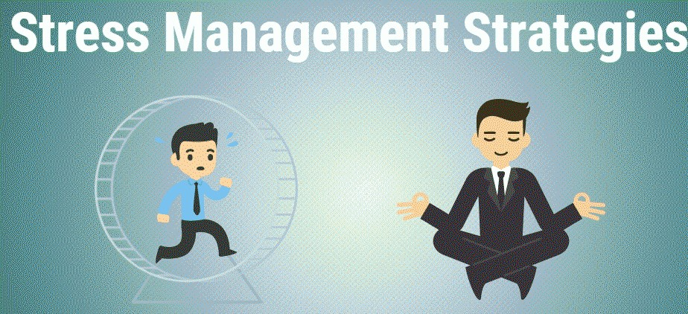

Slide 26
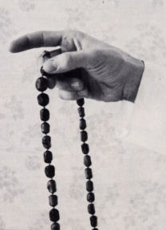



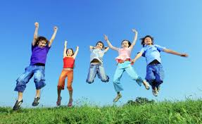
COPING UP WITH STRESS
Planning
Timely Decision-Making
Prioritizing, Preparation
SQ- Spirituality Quotient
For Theists:
Prayer, Worship, Piety, Pilgrimages, Chanting
For Atheists :
Philanthropic Activities
Service to humanity is service to God,
Helping Hands are holier than praying lips
Pleasure Trips, Tours
1/7 Exclude- Day out - week-end
Recliner/Easy chair/ Swing
Funny GAMES/SPORTS- Out-door
HOBBIES, Extra – Curricular Activities, Activities, Interests- Gardening

Slide 27



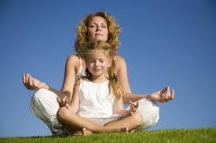
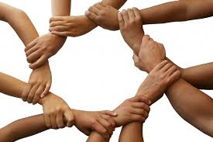
THERAPIES,TECHNIQUES TO COMBAT STRESS
Music- therapy
Aroma-Therapy
Cognitive Behavioral therapy
Helio-Therapy
Play Therapy
Animal Assisted Therapy
Pleasant Environment-
Office, Personal, Greenery, Scenery
Physical Activities
Dance, Swimming, Skipping…..
Water as stress buster
Meditation, Chanting, Mouna-Vrat,
Occasional Fasting for cleansing
Sharing- Team working

Slide 28
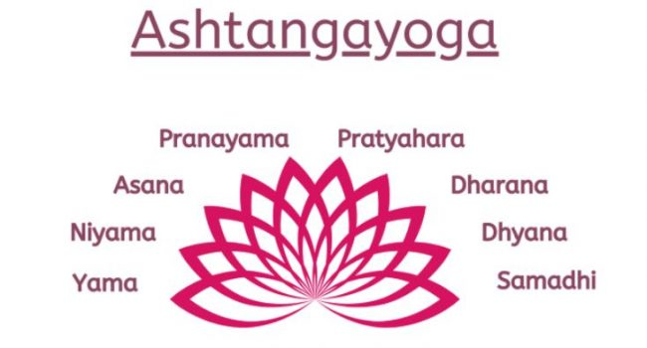
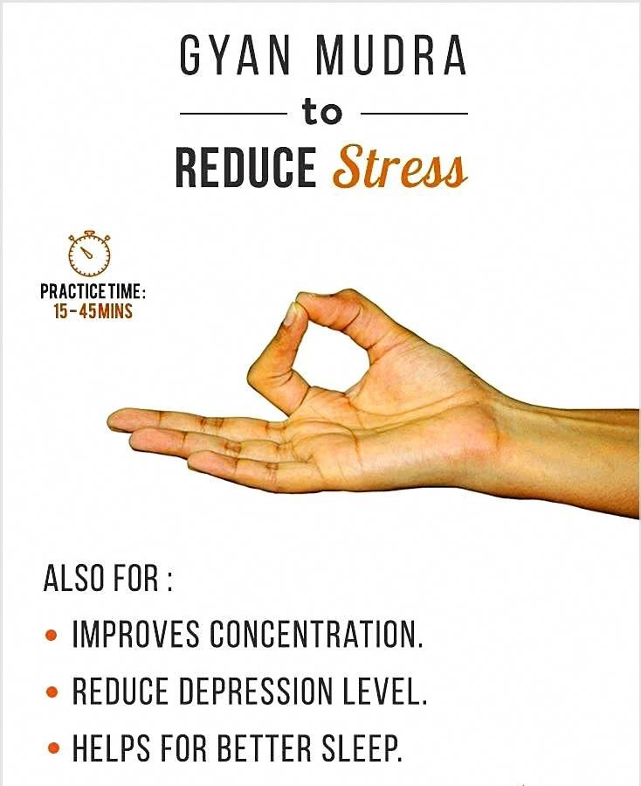
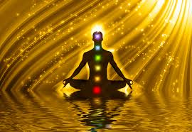
ASHTANGA YOGA FOR STRESS RELIEF

Slide 29
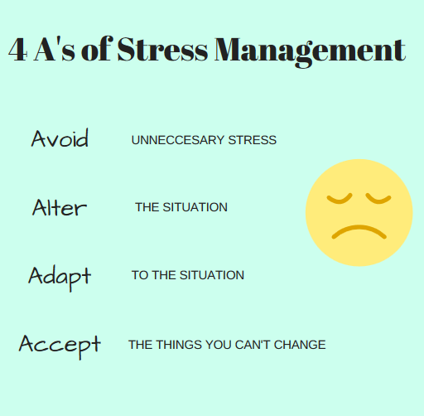

Slide 30
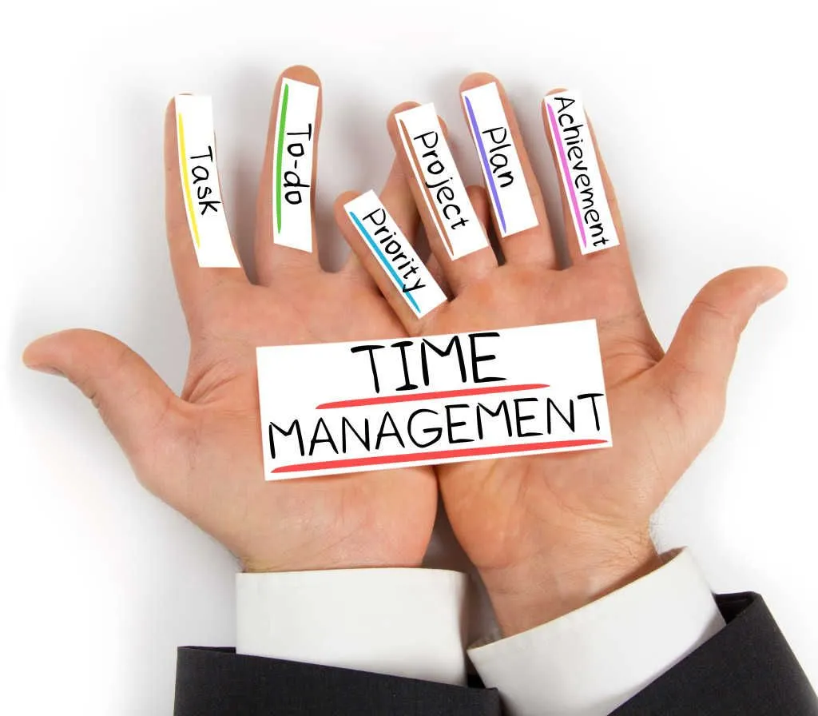

TIME MANAGEMENT
By Prof.Dr.Alapati Srinagesh

Slide 31
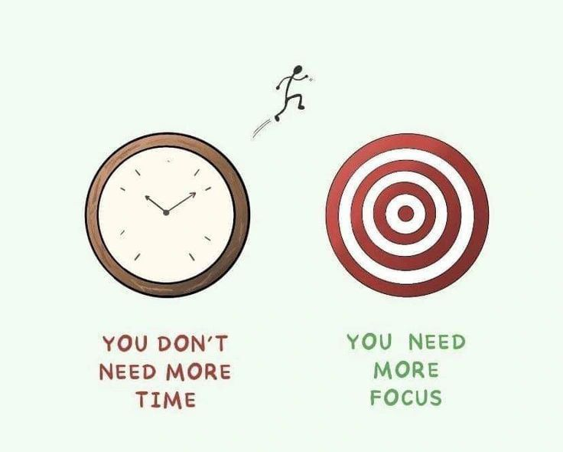

Slide 32
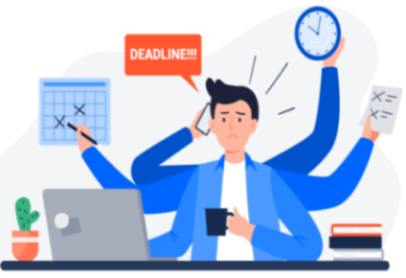

Slide 33
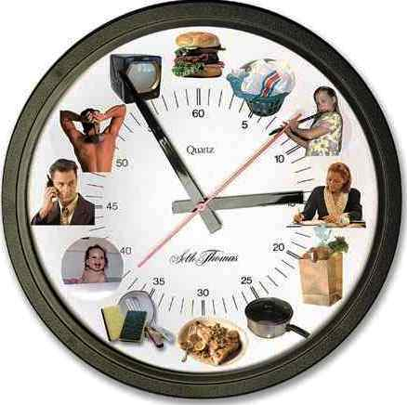
Quote of the Day
To get what you want, stop doing what isn’t working
Live as if there were no tomorrow and
Learn as if you were going to live forever.

Slide 34
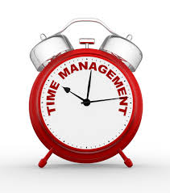
Quotations
“Time is a great healer, but a poor beautician.”
– Lucille S. Harper
“You will never find time for anything. If you want time you must make it.”
– Charles Buxton
“Those who make the worst of their time most complain about its shortness.”
– La Bruyere
“Time is money.”
– Benjamin Franklin
“Know the true value of time; snatch, seize, and enjoy every moment of it. No idleness, no laziness, no procrastination; Never put off till tomorrow what you can do today.”
– Lord Chesterfield

Slide 35
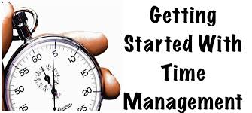
* “The bad news is time flies. The good news is you’re the pilot.”
– Michael Altshuler
“Ordinary people think merely how they will spend their time, a man of intellect tries to use it.”
– Schopenhauer
“The worst days of those who enjoy what they do are better than the best days of those who don’t.”
– Jim Rohn
“It is better to have lived one day as a tiger than a thousand years as a sheep.”
– Tibetan saying
“A stitch in time saves nine.”
– popularized by Benjamin Franklin in his “Poor Richard’s Almanac”

Slide 36


Slide 37
STEPHEN COVEY’S 3 CIRLCES CONCEPT
In the book The 7 Habits of Highly Effective People, Stephen R. Covey talked about the concept of Circle of Concern and Circle of Influence.
Proactive people focus their efforts on their Circle of Influence. They work on the things they can do something about: health, children, or problems at work.
Reactive people focus their efforts in the Circle of Concern--things over which they have little or no control: the national debt, terrorism, or the weather.

Slide 38


Slide 39


Slide 40


Proactive & Reactive Behavior Story of 3 FISHES “Buddimathi”,“Kalamathi” and “Mandamathi”.

Slide 41

We can stop the clock Can we stop the time?

Slide 42
The Time Bank
Imagine there is a bank
that credits your account
each morning with Rs.86,400.

Slide 43

It carries over no balance from day to day.
Every evening the bank deletes
whatever part of the balance
you failed to use during the day.

Slide 44

What would you do? Draw out every Rupee, of course!!!!

Slide 45

Each of us has such a bank. Its name is TIME. Every morning, it credits you with 86,400 seconds.

Slide 46

Every night it writes off, as lost,
whatever of this you have failed
to invest for good purpose

Slide 47

It carries over no balance.
It allows no overdraft. Each day it opens a new account for you. Each night it burns the remains of the day.

Slide 48

If you fail to use the day's deposits,
the loss is yours.
There is no going back.
There is no drawing against the "tomorrow".

Slide 49

You must live in the present on today's deposits. Invest it so as to get from it the utmost in health, happiness, and success!

Slide 50

The clock is running.
Make the most of today.

Slide 51

To realize the value of ONE YEAR,
ask a student who failed a grade.

Slide 52

To realize the value of ONE MONTH,
ask a mother
who gave birth to a premature baby.

Slide 53


Slide 54


To realize the value of ONE WEEK,
ask the editor of a weekly newspaper.

Slide 55

To realize the value of ONE DAY, ask the daily wage worker

Slide 56

To realize the value of ONE HOUR,
ask the friends who are waiting to meet.

Slide 57

To realize the value of ONE MINUTE,
ask a person who missed the train.

Slide 58

To realize the value of ONE SECOND,
ask a person who just avoided an accident.

Slide 59

Treasure every moment that you have!
And reassure it more because you shared it with someone special, special enough to spend your time.

Slide 60

Remember that time waits for no one. Yesterday is history. Tomorrow is mystery. Today is a gift. That's why it's called the PRESENT!

Slide 61
LIFE = TIME ONE TIME OPPORTUNITY

Slide 62

WORK HARD and SMART
Working smart means organizing yourself so that you invest your time only In value added activities, contributing towards achieving your goals and objectives.
3 types of demand on your time :
Your time - planning, doing, interacting
Manage interruptions, Have “ To do” list

Slide 63



PARETO PRINCIPLE

Slide 64

Eisenhower's Urgent/Important Principle helps you quickly identify the activities that you should focus on, as well as the ones you should ignore.
When you use this tool to prioritize your time, you can deal with truly urgent issues, at the same time as you work towards important, longer-term goals.
To use the tool, list all of your tasks and activities, and put each into one of the following categories:
Important and urgent.
Important but not urgent.
Not important but urgent.
Not important and not urgent.
Then schedule tasks and activities based on their importance and urgency.

Slide 65

TIME MATRIX- Eisenhower's Urgent/Important Principle

Slide 66

ABCD analysis of Time Management
A – Tasks that are perceived as being urgent and important,
B – Tasks that are important but not urgent,
C – Tasks that are unimportant but urgent,
D – Tasks that are unimportant and not urgent.

Slide 67

4 Ds of time management

Slide 68


TIPS
Know to REJUNEVATE,RECREATE,REVITALIZE,REFRESH,RELAX
CHRONEMICS- Non-Verbal Communication
Punctuality, Regularity, Official Meetings, Prompt and timely response, replies to others’ problems and queries
Value others’ Time also, Don’t make somebody to wait
MEMO BOARD, 4 Ds – Do, Delay, Delegate, Delete
5 S Kaizen movement
– Standardize, Sustain, Set in order, Straighten up, Shine
Avoid unnecessary talk *Keep your watch ahead of time

Slide 69
Kaizen
Now, lets move onto Kaizen. Kaizen is method and a word that was created in Japan after World War II. The word Kaizen means “continuous improvement.”
It comes from the Japanese words 改 (“kai”) which means “change” or “to correct” and 善 (“zen”) which means “good.” It is pronounced “k-eye-zen.”
The method and the word have become part of the Toyota Production System (TPS), where it means “small, continuous improvements on everyone’s part.
Kaizen is a system that involves all employees – from senior management to the janitorial crew. Everyone is encouraged to come up with small improvement ideas and recommendations on a regular and continuing basis.
In Japanese companies, such as Toyota and Canon, employees typically make 60 to 70 suggestions per year, which are written down, shared and implemented.
In most cases these are not ideas for major changes. Kaizen is based on making little changes on a regular basis: always improving productivity, safety and effectiveness while reducing waste.
Kaizen suggestions are not limited to a specific area such as production or marketing. Kaizen is based on making changes anywhere that improvements can be made.
Western philosophy may be summarized as, “if it isn't broke, don’t fix it.” The Kaizen philosophy is to “do it better, make it better, improve it, even if it isn’t broken, because if we don’t, we can’t compete with those who do.”
Kaizen encompasses many of the well-known Japanese process improvement methods.

Slide 70


Slide 71
5S is a productivity method whose name is derived from the five first letters of Japanese words: Seiri, Seiton, Seiso, Seiketsu and Shitsuke.
The method was originally intended to organize a workspace for efficiency.
Let’s examine each ‘S’ and determine what it means.
Seiri – Sorting. Keep the necessary in work area, dispose or keep in a distant storage area less frequently used items, discard unneeded items.
Seiton – Systematic Arrangement for the most efficient and effective retrieval. There should be a place for everything and everything should be in its place. The place for each item should be clearly labelled or demarcated. Items should be arranged in a manner that promotes efficient workflow, with equipment used most often being the most easily accessible. Workers should not have to bend repetitively to access materials.
Seiso – Shining. Clean the workspace and all equipment, and keep it clean, tidy and organized. After the first thorough cleaning when implementing 5S, daily follow-up cleaning is necessary in order to sustain this improvement. A “Shining” work environment will lead to great efficiency gains.
Seiketsu – Standardizing. Work practices should be consistent and standardized. Work stations for a particular job should be identical. All employees doing the same job should be able to work in any station with the same tools that are in the same location in every station. Everyone should know exactly their responsibilities.
Shitsuke – Sustaining. Once the previous 4 S’s have been established, they become the new way to operate. Maintain focus on this new way and do not allow a gradual decline back to the old ways. The effect of continuous improvement (Kaizen) leads to less waste, better quality and faster lead times.

Slide 72

Efficiency is defined as the ability to accomplish something with the least amount of wasted time, money, and effort or competency in performance.
Efficacy is the ability of something like a drug or a medical treatment to bring about the results that are wanted
Effectiveness is defined as the degree to which something is successful in producing a desired result; success.

Slide 73


TIPS
ABC ANALYSIS, EFFECTIVE Vs EFFICIENT
Maintain DIARY- Long Term and Short Term-Day’s Planning
BUSY doesn’t mean INACCESSIBLE/UNAPPROACHABLE
PHONE CALLS :Call back, Cell Phone ( Vibrate/Silent)
Allot SPECIFIC TIME for making and receiving phone calls
WORK LIFE BALANCE-
Don’t be workaholic,
Cut off work mood at home.
Balu, Raymonds.
Life is one-time opportunity.
Notes:
The story of three fishes from Panchtantra

Slide 74






Slide 75

The last wishes of Alexander the Great:
On his death bed, Alexander summoned his generals and told them his three ultimate wishes: 1. The best doctors should carry his coffin; 2. The wealth he has accumulated (money, gold, precious stones…) should be scattered along the procession to the cemetery, and 3. His hands should be let loose, hanging outside the coffin for all to see!! One of his general who was surprised by these unusual requests asked Alexander to explain. Here is what Alexander the Great had to say:

Slide 76

The last wishes of Alexander the Great:
1. I want the best doctors to carry my coffin to demonstrate that, in the face
of death, even the best doctors in the world have no power to heal;
2. I want the road to be covered with my treasure so that everybody sees
that material wealth acquired on earth, stays on earth...
3. I want my hands to swing in the wind, so that people understand that we
come to this world empty handed and we leave this world empty handed
after the most precious treasure of all is exhausted, and that is TIME!

Slide 77

The last wishes of Alexander the Great
We do not take to our grave any material wealth, although our good deeds can be our travelers’ checks. TIME is our most precious treasure because it is LIMITED. We can produce more wealth, but we cannot produce more time. When we give someone our time, we actually give a portion of our life that we will never take back. Our time is our life!
So my dear friends, the best present that you can give to your family and friends, is your TIME!

Slide 78




Slide 79



The Ashoka Chakra has twenty-four spokes that represent each hour of the time and indicates the passage of time. The Ashoka Chakra is said to be a representation of the Buddhist Dharma Chakra.

Slide 80


Slide 81


