Slide 1
Strategic Thinking

Slide 2
What is in it for me?
A strategic mind encourages you to determine the best use of resources and align them to achieve your goals.

Slide 3
Building Blocks: Strategic Thinking
What is Strategic Thinking
Creative Thinking
Critical Thinking
Business Analysis Tools

Slide 4
Understanding
Strategic Thinking
Relevance and use of strategic thinking in day-to-day life

Slide 5

What is Strategy?
The word “strategy” is derived from the Greek word “Stratagos”; strat (meaning army) and “ago” (meaning leading/moving)
Strategy bridges the gap between…
…where we are…
…where we want to be.
Notes:
Highlight the definition of strategy. Explain that strategy bridges the gap in between where you/your business currently is and what is you aim? Where you want to be?

Slide 6
Definitions of Strategy
Chandler (1962)
Strategy is the determinator of the basic long-term goals of an enterprise, and the adoption of courses of action and the allocation of resources necessary for carrying out these goals.
Mintzberg (1979)
Strategy is a mediating force between the organization and its environment: consistent patterns in streams of organizational decisions to deal with the environment.
Porter (1996)
Strategy is about being different. It means deliberately choosing a different set of activities to deliver a unique mix of value.
Notes:
Highlight the different definitions given by Chandler, Mintzberg and Porter.
For Chandler it’s determination of long term goals. For Mintzberg it bridges the gap in between company and external environment and for Porter it’s being choosing a unique path to deliver exceptional and extraordinary results.

Slide 7
Mintzberg’s Five P’s Of Strategy
Plan
Ploy
Pattern
Planning is an essential part of the strategy formulation process.
“how do I get there?”
A manoeuvre intended to outwit a competitor. Getting the better of competitor
In consistent actions over time. Sometimes, however, strategy emerges from past organizational behaviour
Position
Perspective
It reflects the decision of the firm to offer particular products or services in particular markets
A vision and direction, a view of what the company or organization is to become.
Notes:
According to Mintzberg the Five P’s of strategy is explained as
1) Plan: Before you start execution, planning is an essential part of strategy to understand where we are heading toward and what is our goal to achieve?
2) Ploy: a superior strategy always analysed the external environment and pay close attention to competitors to stay relevant in competitive business environment.
3) Pattern: One can always analyse the past behaviours and success pattern to repeat the same actions over time to reap the same benefits and achieve success.
4) Position: The positioning of your product/services is an essential of strategy. Where you position your product/service according to the need and requirement of particular target market to stay relevant.
5) Perspective: A clear vision is necessary to form a strategy which will give you long term benefits and which is aligned with your companies long term goals

Slide 8
Example: Apple’s Strategy
Today Apple epitomizes a capabilities-driven innovation strategy, but it wasn't always so. In the early 1990s the company squandered enormous resources and billions of dollars on a series of failed consumer products like the Newton PDA. Its efforts to do everything itself, building capabilities as varied as cutting-edge hardware development and volume manufacturing, led to huge losses and massive layoffs.
But in 1997 Apple began to focus its portfolio and its capabilities. In fact, the company concentrated first on the capabilities at which it excelled, and which differentiated it clearly from peers:
An exceptional consumer experience
Intuitive user interfaces
Sleek product design
Iconic branding
Notes:
Explain how Apple epitomised on capabilities driven strategy

Slide 9

Example: HDFC Bank’s Digital Strategy
HDFC Bank is giving shape to its digital vision in a number of ways. Consider the bank’s humanoid IRA (Intelligent Robotic Assistant) and the chat bot EVA (Electronic Virtual Assistant). While IRA can “guide” people at a branch to find the relevant counter for them, EVA can answer common queries of users who log on to the bank’s website.
The bank has also launched a Facebook Messenger bot that allows users to do transactions such as bill payments, mobile recharges and even booking Ola or Uber cabs.
Notes:
Explain how HDFC used digital strategy

Slide 10

Example: Reliance Jio’s Growth Hacking Strategy
Reliance smartly worked on Growth Hacking for Reliance Jio that clearly defines the pathway to start and implement a new strategy in the form of data-driven marketing. The algorithm revolved around 5 basic stages: Acquisition, Activation, Retention, Referral and Revenue.
1st & 2nd Stage - Acquisition & Activation: Initially Jio offered a completely free package to its users.
3rd Stage - Retention: Then they extended the free package plan till March 2017 to retain their existing users.
4th Stage - Referral: Non-Jio also started converting based on referrals and offers of free services.
5th Stage - Revenue: As Jio managed to cross 100 million Subscribers, they now plan to recover the cost of the marketing strategy within 5 years
Notes:
Explain how Reliance Jio captured the telecom sector with growth hacking strategy

Slide 11
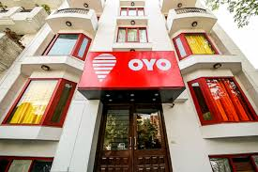
Example: OYO Room’s Branding Business Strategy
Oyo Rooms is an online hotel booking platform which has standardized requirements for listing hotels onto their platform. Oyo Rooms have brought 4500+ non-branded hotels under one brand with over 40,000 rooms on the platform.
Oyo Rooms use branding as a business strategy. Oyo Rooms focuses on three key areas:
Affordability
Technology
Standardization
The approach is a very efficient and lean way to expand the brand.
Notes:
Explain how Oyo rooms is using branding business as its strategy to position themselves in the market

Slide 12

Example: Uber’s Disruptive Innovative Strategy
While experts debated whether self-driving cars would be commercially available in 5 or 10 years, Uber raced ahead and put vehicles on the road. Last August, it launched a program in Pittsburgh that allowed people to summon a self-driving car from their phones.
Last summer, Uber signed a $300 million deal with Volvo, which provides the company’s current fleet of human-assisted self-driving cars. The partners intend to debut a fully autonomous one by 2021.
Notes:
Explain how Uber benefited with its destructive innovative strategy to stay relevant in such a competitive market sector

Slide 13
Can you give some examples of strategy based on products or services you use daily?
Notes:
Ask for examples of companies/CA firms using unique strategy or used unique and innovate strategy for its product or services.

Slide 14
Are you ready to analyze strategies used by the different company’s?
Notes:
Ask for examples of companies/CA firms using unique strategy or used unique and innovate strategy for its product or services.

Slide 15







Slide 16
Strategic thinking is a forward-thinking and innovative process in which we consider ‘what’ we are doing and ‘why’ we are doing it.
Notes:
Explain the meaning as Strategic thinking is nothing but forward thinking

Slide 17
What is Strategic Thinking
Strategic Objective
Problem Definition
Problem Statement
Creative Thinking
Generating Options
Options
What is the problem?
What might happen?
Actions
Decisions
Strategic Planning
Taking Action
Critical Thinking
Evaluating & Making Choices
How will we do it?
What will we do?
Notes:
The framework of strategic thinking is
Define problem: Get to the root cause of your problem. What were the factors responsible, why did that happened? Ask question till you get to the root of it
Creative Thinking: after defining the problem, think creatively and out of the box to generate a many solutions/suggestions/ideas as possible to solve the issue without evaluating it at this stage.
Critical Thinking: Now critically evaluate the ideas generated in the last stage and decide which suggestion/idea will best solve the problem. Which idea can be practically implemented?
Take Decision and action planning: After deciding which idea to execute, plan your each and every action step. Which should include who will be responsible to complete the task, prioritise the tasks properly Deadline of execution of task, resources available and needed etc.

Slide 18
Strategic versus Conventional Thinkers
Conventional | Strategic
Reactive | Proactive
Short-term focus | Long-term focus
Unconcerned | Inquisitive
Unimaginative | Creative
Cautious | Willing to Take Risks
Rigid | Flexible
Content with capabilities | Life-Long Learner
Notes:
The difference between conventional and strategic thinking is strategic thinkers are proactive. They plan in advance whereas conventional thinker react to the problematic situations rather than planning in advance. Strategic thinkers have long term focus whereas conventional thinkers are concerned about short term benefits and they take wrong decisions. Strategic thinkers are curious to learn new things, are very creative when it comes to solving problems and that’s why they are better in taking risk to implement their ideas and flexible enough if doesn't work. Whereas conventional thinkers are not curious to learn new things, they prefer to use conventional methods to solve problems and not much imaginative that’s why they are very cautious to take any risk to implement any creative idea and very rigid to adapt to any unforeseen circumstances.

Slide 19
Benefits of Strategic Thinking
Creates clarity about the goals and pathways
Boosts performance
Aligns the team towards the goals
Helps identify other opportunities
Provides motivation and inspiration
Encourages learning through research
Notes:
Highlight the benefits of improving strategic thinking
It clarifies goals, where you want to reach?
It aligns the team to achieve one targeted goal
It provides motivation to achieve that goal
It encourages learning through research
It also helps in identifying the existence of other opportunities
And that’s why it boosts the performance of not only the team but also the Organisation

Slide 20
Let’s look at the two core pieces of Strategic Thinking in greater detail…
Creative Thinking
Critical Thinking

Slide 21
Creative Thinking
Thinking about new things or thinking in new ways.

Slide 22
“The important aspect of creativity is seeing the same thing as everyone else, but thinking of something different.”
- Dr. APJ Abdul Kalam

Slide 23
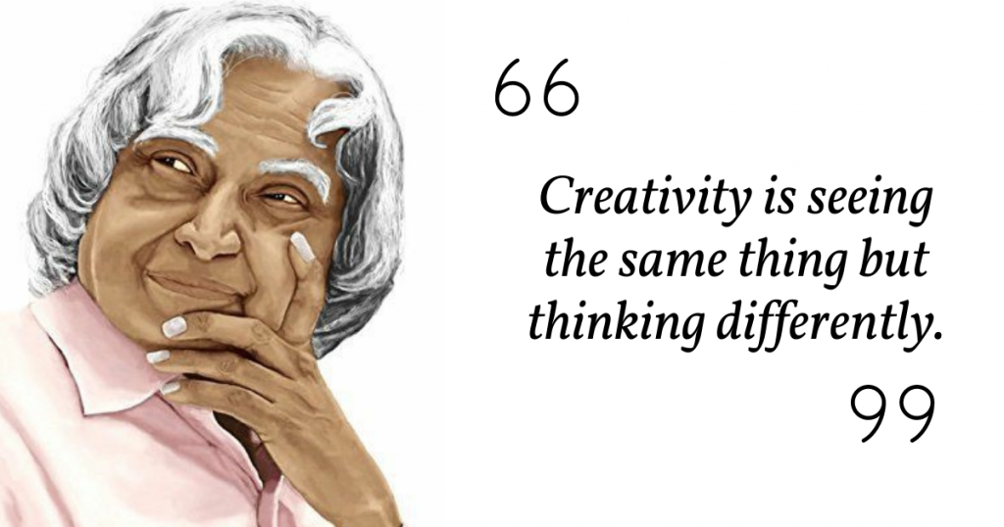

Slide 24
Some Examples of Creative Thinking
Brainstorming ways to cut electricity use
Coming up with new procedures to improve reporting quality
Increasing staff productivity by devising performance incentives
Devising a computer program to automate the billing process
Devising a more efficient way to process travel reimbursements
Restructuring a filing system to facilitate easier retrieval of information
Suggesting a way to improve customer service
Notes:
Creative thinking is nothing but finding a unique solution to a problem which others can not imagine of. Give examples.

Slide 25
How to Improve Your Creative Thinking Skills
Notes:
https://youtu.be/zO2LdDpx-Tc
Debrief: Ask questions such as
What other ways you learned to improve you creative thinking?
How will you apply creative thinking in your daily life?

Slide 26
For a really creative idea to develop,
it needs to go through some thinking process in a structured manner.

Slide 27
For a really creative idea to develop,
it needs to go through some thinking process in a structured manner.

Slide 28
Effective Creative Thinking Process
1
2
3
4
5
Preparation
Incubation
Insight
Evaluation
Elaboration
Becoming immersed in problems & issues that are interesting & that arouse curiosity
Allowing ideas to bounce around in your mind without consciously focusing on it
Experiencing the moment when the problem makes sense and the idea clicks
Taking time to make sure that the insight provides sufficient value to outweigh the various costs involved in implementation
Creating a plan to implement the solution, and following through
Based on the well-researched book "Creativity“ by Mihaly Csikszentmihalyi
Notes:
Explain the 5 step process of thinking creatively

Slide 29
Cut The Cake
Group Activity
Cut this cake into 8 equal pieces with the condition that you cannot make more than 3 cuts.
Notes:
Solution: The answer is to cut the cake twice on top (once in either direction) and once horizontally through the middle.

Slide 30

Individual
Activity
Toothpick Challenge
You get 6 toothpicks each.
Create 4 triangles with the toothpicks.
Notes:
The trick is to think in 3 dimensions! You can use the 6 matches to form a tetrahedron which has 4 faces, each of which is an equilateral triangle.

Slide 31
Individual
Activity
9 Dots Challenge
Join all nine dots by drawing no more than 4 straight lines. The straight lines must be continuous – i.e. you must not lift your pen /pencil from the paper once you start drawing.
Notes:
Ask question to students:
Think back to how you were solving the puzzle. Did you solve it by trial and error or did you think through a strategy? Spend 30 seconds thinking about how you solved it and what changes in your thoughts you needed have to get you there.
The beauty of this nine-dot puzzle is that you literally have to "think out of the box" to solve the puzzle. Your pencil or mouse must go outside the box of the dots to be able to solve it.
The most frequent difficulty people have with this puzzle is that they try to draw all the lines within the dots and they do not initially want to draw lines outside it because: There is nothing outside the set of dots to associate to. There are no dots to join a line to outside the puzzle so they assume a boundary exists.
It is assumed that doing this is outside the scope of the problem, even though the problem definition does not say you are not allowed to.
You are so close to doing it that you keep trying the same way but harder.
The solution to this problem requires that you "think out of the box" in order to solve it.

Slide 32
Simple Ways to Improve Creative Thinking Skills
Try to come up with new ideas everyday
Ask a lot of questions
Take breaks to find creative inspirations
Build a network of friends from different backgrounds
Do things you have never done before
Play games like Chess, Sudoku, Crossword
Notes:
Explain the simple ways to improve creative thinking. For example, playing Sudoku, chess, asking questions are some tricks which you can use in your daily life.

Slide 33
Two Useful Creative Thinking Techniques
Brainstorming
Parallel Thinking

Slide 34

Brainstorming is the process of generating many different and creative ideas.
Brainstorming
It encourages people to come up with thoughts and ideas that can, at first, seem a bit crazy.
Notes:
Explain the concept of brainstorming. That is encouraging people to come up with different and creative ideas

Slide 35
 | Brainstorming- Group Activity

Slide 36
How To Brainstorm
Have a clear objective
Encourage sharing of ideas without any judgement
Make sure everyone is heard
Encourage developing each other’s ideas
Don’t spend too much time on any one idea
Be creative - encourage crazy even impractical ideas wherever possible
Notes:
There is a structure process while doing brainstorming which you should follow that is:
Before you start a brainstorming, first have a clear agenda what you want to discuss to be on track
One should encourage everyone to share their ideas freely without any criticism
One need to make sure that everyone is participating
One should encourage developing each other’s shared ideas
One should not spend too much time on discussing only one idea

Slide 37
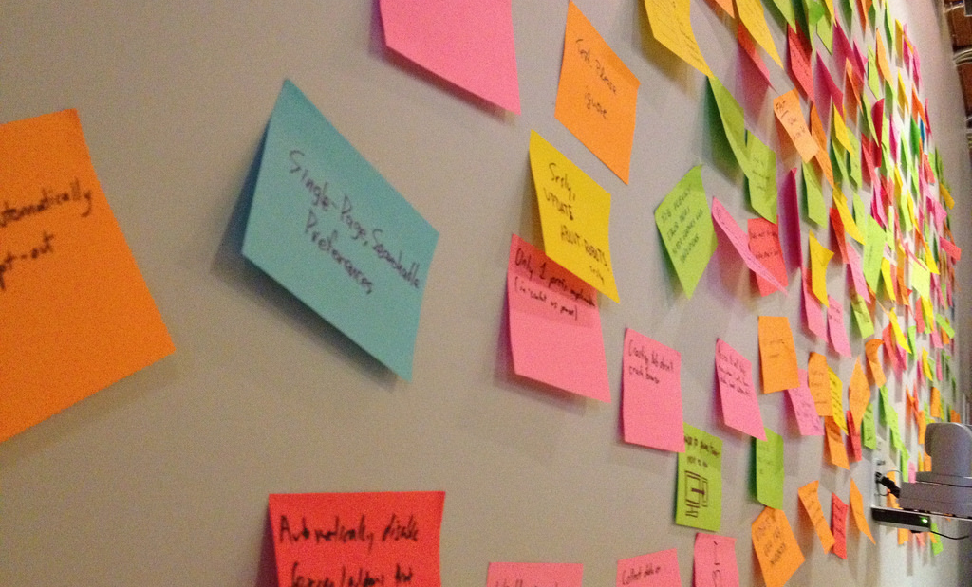
Brainstorming
Activity

Slide 38
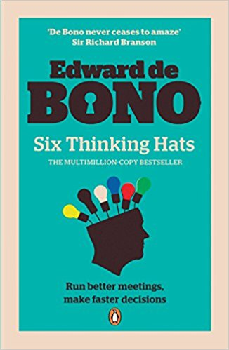
Parallel Thinking
Edward de Bono developed a simple parallel thinking tool called Six Thinking Hats®. It helps people look at a decision from all points of view.
The process involves separating thinking into six clear functions and roles. Each thinking role is identified with a colored symbolic "thinking hat."
By mentally wearing and switching "hats," you can easily focus on different perspectives and have a holistic view of the situation.
Notes:
Explain the concept of Six Thinking Hats

Slide 39






Colors & Their Significance
White Hat
Red Hat
Yellow Hat
Black Hat
Green Hat
Blue Hat
Data & Information – what is available and what may be needed
Feelings, intuition & emotion – share feelings without justification or prejudice
Benefits & positive view, encourages looking at situation positively
Caution & critical judgement – encourages recognizing what can go wrong
Creative thinking & generating new ideas – encourages out of the box thinking
Process control – requires summaries, conclusions and decisions
Notes:
Six Thinking Hats is a powerful technique for creative thinking introduced by Dr. Edward de Bono. In this technique, as a person wears different coloured hats, he/she is required to think from the particular perspective that is associated with that hat.
This parallel thinking approach forces each of the participants in a team meeting or focus group to adopt the particular thinking style represented by each coloured hat.
For example, • When wearing the RED hat a person will state what he or she feels about a particular situation. When wearing the YELLOW hat a person is compelled to think about the positive aspects of a topic or situation • The GREEN hat compels people to adopt a creative thinking focus. WIGHT represent factual information, BLACK represents the things which can go wrong, BLUE hat manages the process and ask for conclusions and decision.

Slide 40
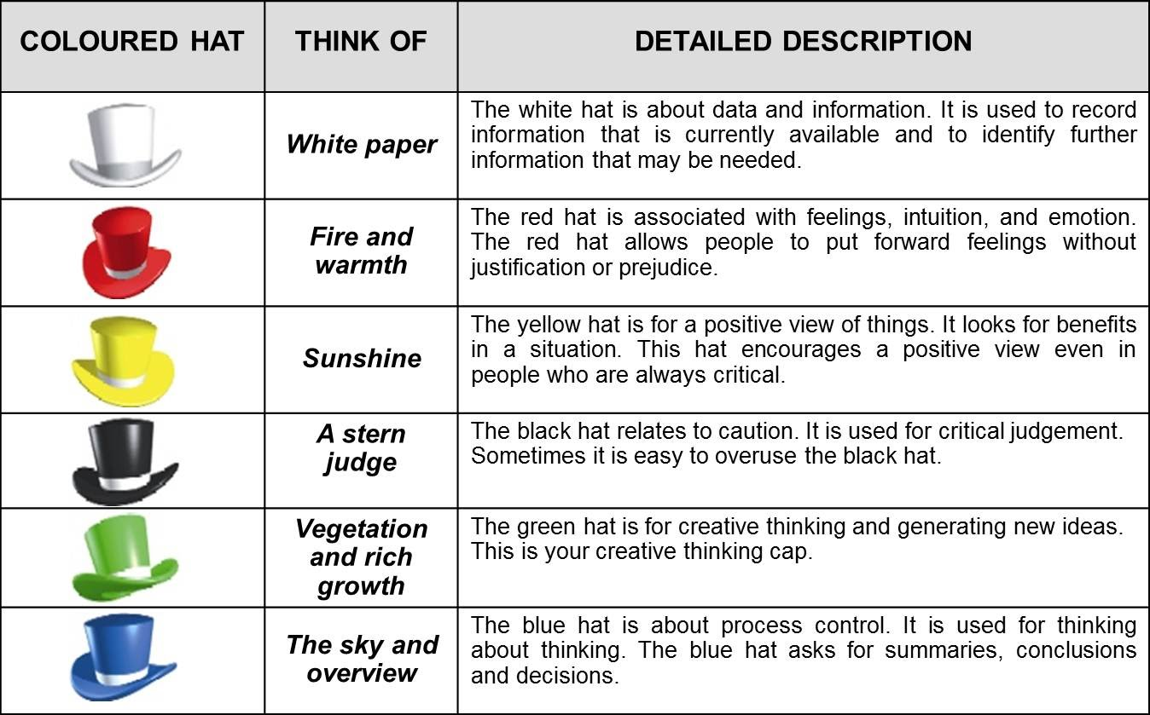

Slide 41
Where can you use Parallel Thinking?
Notes:
Every problem can be analysed by viewing it from many different perspectives.

Slide 42
As fast-paced innovation increases rapidly and procedural thinking fades, the demand for creative thinking is growing exponentially.
Creative ideas and innovations are disrupting businesses.
Notes:
Importance of creative thinking

Slide 43
Video
Understanding Disruptive Innovation
Breakthrough Ideas

Slide 44
Critical Thinking
It requires questioning ideas and assumptions rather than accepting them at face value.

Slide 45
Definitions of Critical Thinking
“The careful application of reason in the determination of whether a claim is true.”
- Moore & Parker
“Judicious reasoning about what to believe, and therefore what to do.”
- Tittle
Notes:
Explain the two definitions. Critical thinking is objective analysis of facts

Slide 46
Critical Thinking involves…
Careful, Intentional Thinking
Use of Reason or Logic
Judgment about Beliefs
Application to Real World Problems
Notes:
What exactly is critical thinking?

Slide 47
Critical Thinking Requires Higher Order Thinking
Creating
Higher Order
Thinking
Evaluating
Analysing
Applying
Understanding
Remembering
Notes:
Critical Thinking is higher order thinking that means Analysing, evaluating and creating.
Remembering: recalling information, recognising, listing, describing, retrieving, naming, finding information
Understanding: Explaining ideas or concept, interpreting, summarising, paraphrasing, classifying, explaining
Applying: using information in other familiar situation, implementing, carry out, executing
Analysing: Breaking information into parts to explore relationships, organising, deconstructing,
Evaluating: Justifying a decision, Critiquing, experimenting, judging
Creating: generating new ideas or products, or ways of viewing things, designing, planning, inventing

Slide 48
Questions Critical Thinkers Ask
When presented with a new piece of new information, critical thinkers may ask questions such as:
“What information supports that?”
“How was this information obtained?”
“Who obtained the information?”
“How do we know the information is valid?”
“Why is it that way?”
“What makes it do that?”
“How do we know that?”
“Are there other possibilities?”
Notes:
Good thinkers routinely ask questions, in order to understand and effectively deal with the world around them. They question the status quo. They know that things are different from the way they are presented.

Slide 49
Developing Critical Thinking
1
2
Interpretation
Analysis
3
4
Conclusion
Evaluation
5
6
Explanation
Self Regulation
Notes:
Critical thinking is developed by asking the right set of open ended questions.

Slide 50
Let’s take the example of taking the decision about how many

Slide 51
Developing Critical Thinking…
1
Questions to ask:
What happened?
What does this mean?
Who all were involved and who should we ask about this situation?
What is the best way to categorize/classify this situation?
Interpretation
This involves understanding the significance or meaning of information

Slide 52
Developing Critical Thinking…
Questions to ask:
What was the intention of the persons involved?
What sense can we make out of this?
What is the basis for saying something?
What assumptions have been made while arriving at a conclusion?
What are the arguments -pros and cons?
2
Analysis
This involves identifying assumptions and reasons, examining how they interact in the formation of the arguments.

Slide 53
Developing Critical Thinking…
3
Inference
Questions to ask:
What conclusions can we draw from what we know so far?
What can we rule out, given what we know so far?
What does this evidence imply?
What additional information do we need to resolve this question?
What are some alternatives we haven’t yet explored?
This involves drawing conclusions from reasons and evidence.

Slide 54
Developing Critical Thinking…
4
Evaluation
Questions to ask:
Do we have our facts right?
How strong are those arguments?
How confident can we be in our conclusion, given what we now know?
Why do we think we can trust what this person says?
This involves assessing the credibility of sources of information and determining the strength or weakness of arguments.

Slide 55
Developing Critical Thinking…
5
Explanation
Questions to ask:
How did you come to that interpretation?
Please take us through your reasoning one again.
Why do you think that was the right solution?
How would you explain why this particular decision was made?
This involves supporting evaluation by explaining the evidence, methods, criteria, or assumptions and the conclusions reached.

Slide 56
Developing Critical Thinking…
6
Self Regulation
Questions to ask:
Did we have a good methodology, and did we follow it well?
Can we be more precise as our position currently seems to be too vague?
Is there a way we can reconcile these two apparently conflicting conclusions?
How good is our evidence?
Some of our definitions seem to be a little confusing; can we revisit what we meant by certain things before we make any final decisions?
This involves questioning the process, methodology, quality to information and approach to refine it further.

Slide 57
Failing To Think Critically…
Can lead to:
Bad decisions
Business failures
Job loss
Financial mis-management
Distorted communication
Notes:
The consequences of not thinking critically

Slide 58
Disposition for Critical Thinking
Inquisitiveness
Alertness to opportunities
Self confidence
Being well informed
Open mindedness
Flexibility
Fair-mindedness
Accepting one’s own biases
Good critical thinkers are willing to change their thinking when they discover better thinking.
They can be moved by reason.
Notes:
The key disposition of critical thinking are:
Inquisitiveness: An inclination to be curious; desire to fully understand something, discover the answer to a problem and accept that the full answer may not yet be known; a desire to understand a task and its associated requirements, available options and limits.
Alertness to opportunities: Willingness to focus and concentrate; to be aware of surroundings, context, consequences and potential obstacles; to have the ‘full picture’.
Self Confidence: The tendency to be confident and trust in one’s own reasoned judgments; acknowledging one’s sense of self while considering problems and arguments
Being well informed: to seek and offer both reasons and objections in an effort to inform and to be well-informed; a willingness to challenge popular beliefs and social norms by asking questions
Open Mindedness: open to divergent or conflicting views; detaching from one’s own beliefs to consider diverse points of view without bias or self-interest; to be open to feedback, accepting positive feedback, criticism
Flexibility: flexible in accepting the changes
Fair Mindedness: A fair-minded person always tries to be fair and reasonable, and always listens to other people's opinions.
Accepting One’s own biases: you have to at least recognize that you have your own biases, just like everyone else.

Slide 59
Quiz Time
1
2
3
A bat and ball costs Rs. 110. The bat costs Rs. 100 more than the ball. How much does the ball cost?
Divide 30 by ½ and add 10. What answer do you get?
What is pronounced like a single letter, written with 3 letters and most animals have 2 of them?
Notes:
Answer 1 – Ball costs Rs.5 (Rs.5 for ball + Rs.105 for bat = Rs.110)
Answer 2 – 70
Answer 3 – Eye

Slide 60
3
4
5
Here are three answers:
Answer A
Answer A or B
Answer B or C
There is only one correct answer to this question. Which is it?
Looking at a portrait of a man, Harsh said, “His mother is the wife of my father’s son. Brothers and sisters I have none.” At whose portrait was Harsh looking?
Divide 110 into two parts so that one will be 150 percent of the other. What are the 2 numbers?
Notes:
3. If answer A would be correct, then answer B ("Answer A or B") would also be correct. If answer B would be correct, then answer C ("Answer B or C") would also be correct. This leads to the conclusion that if either answer A or answer B would be the correct answer, there are at least two correct answers. This contradicts with the statement "there is only one correct answer to this question". If answer C would be correct, then there are no contradictions.
Therefore, the solution is answer C.
4. His Son
5. Answer is 44 and 66

Slide 61
Critical thinking can be seen as an exercise in problem solving.

Slide 62
5-Step Problem Solving Process
I
D
E
A
S
Identify
Determine
Enumerate
Assess
Scrutinize
This is a simple 5-step critical thinking general problem solving process that can be used to come up with better solutions to problems.
Notes:
This is a simple 5-step critical thinking general problem solving process that can be used to come up with better solutions to problems

Slide 63
IDEAS – Step #1
Defining the problem is a crucial step
It involves digging deeper to identify what it is that needs to be solved.
The more clearly a problem is defined, the easier it is to complete subsequent steps.
It's common to mistake symptoms for problems themselves.
Compare your current state to the future state you want to be in, to identify the gaps between them and hence the problem.
I
Identify
Notes:
Identify the problem and set priorities

Slide 64
IDEAS – Step #2
D
Determine relevant information and deepen understanding
Dig to the root causes of the problem
The five-why analysis is a tool that'll help you get to the heart of the problem. Ask "Why?" a number of times to dig through each layer of symptoms and so to arrive at the problem's root cause.
Determine
Notes:
Determine relevant information and deepen understanding

Slide 65
IDEAS – Step #3
E
Enumerate
Identify as many potential solutions as you can
Brainstorm creatively – ask lots of questions about the who, what, where, when, and how of the causes to point to various possibilities.
Don't limit yourself by considering practicalities at this stage; simply record your ideas.
Notes:
Identify as many potential solutions as you can

Slide 66
IDEAS – Step #4
A
Evaluate various options to choose the best solution
In evaluating your ideas, more options could present themselves.
You could do this by rating each possible solution you came up with according to criteria such as
  how effective it will be
  how much time or effort it will take
  its cost
  how likely it is to satisfy stakeholders
Assess
Notes:
Evaluate various options to choose the best solution

Slide 67
IDEAS – Step #5
S
Scrutinize the process and self correct as needed
Plan and implement a pilot test of the chosen alternative
Gather feedback from all affected parties
Seek acceptance or consensus by all those affected
Establish ongoing measures and monitoring
Evaluate long-term results based on final solution
Scrutinize

Slide 68

Case Study
IDEAS

Slide 69
Various kinds of biases or faulty thinking can impair our ability to think critically.
It is essential for leaders to have a healthy sense of professional skepticism and avoid biases.

Slide 70
Factors Affecting Critical Thinking
Association Bias
Overconfidence
Effect
Confirmation Bias
Example Text
Fundamental
Attribution Error
Availability
Heuristic
Anchoring Effect
Neglect
Of Probability
Framing Effect
Notes:
Association bias: Our life and memory revolve around associations. The smell of a good lunch makes our stomach growl, the songs we hear remind us about the special times that we have had and horror movies leave us with goose bumps. When taking decisions we associate something positive or negative to them
Availability Heuristic: The availability heuristic is a mental shortcut that relies on immediate examples that come to a given person's mind when evaluating a specific topic, concept, method or decision. Some events are easier to recall than others, not because they are more common but because they stand out in our minds.
Anchoring effect: The tendency to jump to conclusions. This may occur if you feel under pressure to make a quick decision or if you have a general tendency to act hastily.
Confirmation bias: which may lead us to errors. An example of confirmation bias is the way it plays out in schooling. Teachers often expect little of students when they think of them low in ability. The students then give the teachers little. The teacher’s original beliefs are thereby “confirmed”.
Fundamental Attribution error: Tendency to blame others when things go wrong, instead of looking objectively at the situation. You may blame or judge someone based on a stereotype or a perceived personality flaw. Our biases often comes from subconscious thinking and hence are hard to spot.
Overconfidence effect: There tends to be a difference between what people really know and what they think they know. This overconfidence can especially creep in for experts because they believe that they know a lot about their field. The best way to handle such people is to take their predictions with a pinch of salt and try to judge the situation more realistically.
Neglect of probability: A lot of people don’t bother to look at the probability of potential outcomes in uncertain situations. This type of cognitive bias leads to people take decisions with complete disregard to the probability and hence flounder in decision-making.
Framing effect: This is type of cognitive bias in which people react to a particular choice depending on how it is presented to them. What is heavier, a kilo of rocks or a kilo of sponge? Obviously both weight the same (1 Kilo), but most people would think of the rocks being heavier. This framing effect is used extensively by advertising agencies and politicians. They try to present things in a positive frame or highlight only the positive factors to make their audience accept it.

Slide 71
Activity - #1
Mr. Patel was running late for work and happened to catch a red light. When it happens, Mr. Patel says, “See, I told you that I always catch a red light when I’m in a hurry!” Of course Mr. Patel is talking to himself, but it makes him feel better. Which bias is Mr. Patel experiencing?
Confirmation bias
Framing Effect
Overconfidence Effect
Association Bias

Slide 72
Activity - #1
Mr. Patel was running late for work and happened to catch a red light. When it happens, Mr. Patel says, “See, I told you that I always catch a red light when I’m in a hurry!” Of course Mr. Patel is talking to himself, but it makes him feel better. Which bias is Mr. Patel experiencing?
Mr. Patel is just confirming his own assumption/ belief that he always catches a red light and it is okay to do so. However, unintentionally he is taking a wrong decision.
Confirmation bias
Framing Effect
Overconfidence Effect
Association Bias

Slide 73
Activity - #2
Would you rather have a situation where 137 people die out of 416 total, or 279 people live out of 416 total?
Most people prefer the case where 279 people live, despite both outcomes being equivalent. What kind of bias is this?
Confirmation bias
Framing Effect
Overconfidence Effect
Anchoring Effect

Slide 74
Activity - #2
Would you rather have a situation where 137 people die out of 416 total, or 279 people live out of 416 total?
Most people prefer the case where 279 people live, despite both outcomes being equivalent. What kind of bias is this?
Confirmation bias
Framing Effect
Overconfidence Effect
Anchoring Effect

Slide 75
Activity - #3
You are told to give a speech in favour of the death penalty. After the speech, the class is informed that you were told to present only that side (in favour) of the issue. Even so, the class overwhelmingly believes that you believe in the death penalty. This illustrates:
Confirmation bias
Fundamental Attribution Error
Overconfidence Effect
Association Bias

Slide 76
Activity - #3
You are told to give a speech in favour of the death penalty. After the speech, the class is informed that you were told to present only that side (in favour) of the issue. Even so, the class overwhelmingly believes that you believe in the death penalty. This illustrates
Even though class was aware that the your behaviour is constrained by situational factors, you were told to do so, still the class prefers to believe that you are strongly in favour of the death penalty
Confirmation bias
Fundamental Attribution Error
Overconfidence Effect
Association Bias

Slide 77
Activity - #4
After the movie Jaws came out, and again in the early 1990s after Summer of the Shark, many people were afraid to go in the ocean. This is due to
Confirmation bias
Fundamental Attribution Error
Overconfidence Effect
Availability Heuristic

Slide 78
Activity - #4
After the movie Jaws came out, and again in the early 1990s after Shark Attack, many people were afraid to go in the ocean. This is due to
This is because people make judgments easily on the basis of available information. Here the information collected was on the basis of movie where shark attacks people.
Confirmation bias
Fundamental Attribution Error
Overconfidence Effect
Availability Heuristic

Slide 79
Activity - #5
Mr. Kumar buys a laptop which was available on 30% discount. An equivalent laptop, which was not on sale, was actually 10% cheaper than the one he bought.
What type of bias is this?
Availability Heuristic
Fundamental Attribution Error
Anchoring Effect
Neglect Of Probability

Slide 80
Activity - #5
Mr. Kumar buys a laptop which was available on 30% discount. An equivalent laptop, which was not on sale, was actually 10% cheaper than the one he bought.
What type of bias is this?
Mr. Kumar believed the first information he encountered that is a 30% discount on a laptop. This created the anchoring effect and he took a wrong decision based on the discount available.
Availability Heuristic
Fundamental Attribution Error
Anchoring Effect
Neglect Of Probability

Slide 81
Activity - #6
Rajesh believes that he has a great voice and decides to try out in Indian Idol. When he submits his audition tape, he could end up being laughed at or ridiculed as his voice is actually quite untrained. What type of bias is he experiencing?
Overconfidence Effect
Anchoring Effect
Framing Effect
Neglect Of Probability

Slide 82
Activity - #6
Rajesh believes that he has a great voice and decides to try out in Indian Idol. When he submits his audition tape, he could end up being laughed at or ridiculed as his voice is actually quite terrible. What type of bias is he experiencing?
Rajesh was overconfident about his ability and instead of polishing his voice, he directly participated in the reality show.
Overconfidence Effect
Anchoring Effect
Framing Effect
Neglect Of Probability

Slide 83
Activity - #7
A person managing a project promises that it will be delivered on a certain date after planning for all tasks but without including any contingency for risks and unexpected issues.
Overconfidence Effect
Anchoring Effect
Framing Effect
Neglect Of Probability

Slide 84
Activity - #7
A person managing a project promises that it will be delivered on a certain date after planning for all tasks but without including any contingency for risks and unexpected issues.
That person completely neglected the probability of changes in the project conditions and external factors.
Overconfidence Effect
Anchoring Effect
Framing Effect
Neglect Of Probability

Slide 85
4.
Business Analysis Tools
Various tools used for business analysis and planning

Slide 86
Some Strategic Thinking Tools
PEST Analysis
Porter’s Five Forces
This is a structured approach to analysing the external macro-environment that affects all firms
Many of these external factors are usually beyond the firm’s control
Porter’s Five Forces is named after Harvard Business School Professor Michael E. Porter.
This model takes into account the five market forces that play out in any given company or industry.
Cost-Benefit Analysis
SWOT Analysis
Is best for making quick and simple financial decisions
Useful for deciding whether to pursue a project
The concept was first introduced in 1930’s by Jules Dupuit, a French Engineer
It can be used in a variety of situations
It can be a useful tool in conducting situation analysis
The internal environment is covered in terms of the strengths and weaknesses of a company
The external environment is covered in terms of opportunities and threats within the market
Notes:
There are many tools and techniques that can be applied to the strategic analysis

Slide 87
Let’s look at each of these tools in greater detail…

Slide 88

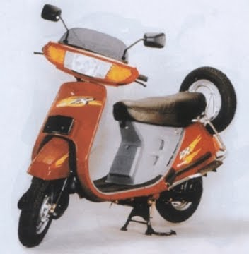

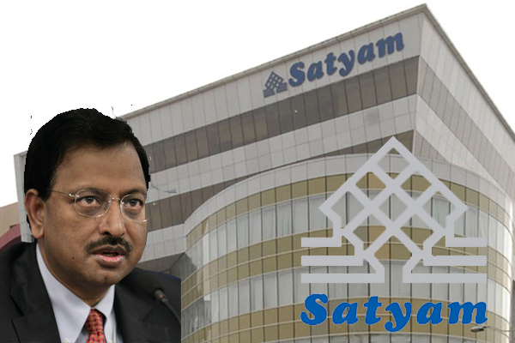


Case Study

Slide 89
PEST Analysis
Political Political stability, pricing regulations, taxation-tax rates and tax incentives, minimum wage and overtime, mandatory employee benefits, product labelling requirements, industrial safety regulations, favoured trading partners | Economical Type of economic system in countries of operation, government intervention in free market, efficiency of financial markets, infrastructure quality, skill level of workforce, Labour costs, unemployment rate, inflation rate, interest rate
Social Demographics, class structure, education, culture, leisure interests, entrepreneurial spirit, attitudes | Technological Recent technological developments, technology’s product impact on product offering, impact on cost structure and value chain structure, rate of technological diffusion
Notes:
This is a structured approach to analysing the external macro-environment that affects all firms • Many of these external factors are usually beyond the firm’s control and sometimes present themselves as threats • It assesses a market from the standpoint of a particular proposition or a business.
PEST is an acronym for Political, Economic, Social and Technological. This analysis is used to assess these four external factors in relation to your business situation.
Political – Here government regulations and legal factors are assessed in terms of their ability to affect the business environment and trade markets. The main issues addressed in this section include political stability, tax guidelines, trade regulations, safety regulations, and employment laws.
Economic – Through this factor, businesses examine the economic issues that are bound to have an impact on the company. This would include factors like inflation, interest rates, economic growth, the unemployment rate and policies, and the business cycle followed in the country.
Social – With the social factor, a business can analyze the socio-economic environment of its market via elements like customer demographics, cultural limitations, lifestyle attitude, and education. With these, a business can understand how consumer needs are shaped and what brings them to the market for a purchase.
Technological – How technology can either positively or negatively impact the introduction of a product or service into a marketplace is assessed here. These factors include technological advancements, lifecycle of technologies, the role of the Internet, and the spending on technology research by the government.

Slide 90
Porter’s Five Forces of Competitive Position
Threat of Substitutes
The power of customers to purchase alternatives
Rivalry amongst Existing Competitors
The power of competitors
Supplier Power
The power of suppliers to drive up prices
Buyer Power
The power of customers to drive down prices
Threat of New Entrants
The power of competitors to enter a market
Notes:
Porter’s Five forces is named after Harvard Business School Professor Michael E. Porter. This model takes into account the five market forces that play out in any given company or industry. This model examines these forces thereby helping to determine a given company’s strengths and weaknesses.
It is also a way to view the potential risks to which any given company may be exposed. Porter’s is a valuable yet somewhat subjective tool. It is a starting point meant to encourage further discussion.
The five forces are:
1. Supplier power. An assessment of how easy it is for suppliers to drive up prices. This is driven by the: number of suppliers of each essential input; uniqueness of their product or service; relative size and strength of the supplier; and cost of switching from one supplier to another.
2. Buyer power. An assessment of how easy it is for buyers to drive prices down. This is driven by the: number of buyers in the market; importance of each individual buyer to the organisation; and cost to the buyer of switching from one supplier to another. If a business has just a few powerful buyers, they are often able to dictate terms.
3. Competitive rivalry. The main driver is the number and capability of competitors in the market. Many competitors, offering undifferentiated products and services, will reduce market attractiveness.
4. Threat of substitution. Where close substitute products exist in a market, it increases the likelihood of customers switching to alternatives in response to price increases. This reduces both the power of suppliers and the attractiveness of the market.
5. Threat of new entry. Profitable markets attract new entrants, which erodes profitability. Unless incumbents have strong and durable barriers to entry, for example, patents, economies of scale, capital requirements or government policies, then profitability will decline to a competitive rate.
What benefits does Porter’s Five Forces analysis provide?
Five forces analysis helps organisations to understand the factors affecting profitability in a specific industry, and can help to inform decisions relating to: whether to enter a specific industry; whether to increase capacity in a specific industry; and developing competitive strategies.

Slide 91
Case Study
Kodak using PEST and Porter’s Five Force

Slide 92
Topic | Kodak's downfall | Case study # 2
Objective | While working on the case study, the student will be able to understand and implement the external environment analysis tools. Understand needs of today's businesses to keep track of their performance and strategy grow using PEST and Porter’s Five Forces.
Tools and Kits | Case Study
Debrief | Ask them to read thoroughly and come up with their findings after applying PEST and Porter’s Five Forces Ask them to share their findings and the analysis done How Kodak could have retained in business if it could have foresight of doing the analysis of external environment affecting the organisation? Have a discussion on how Porter's Five Forces would have provided them a vision needed to adapt to the new technologies and then lead the world market.

Slide 93
Kodak Case Study
In 1888, with the launch of the 'Kodak' camera with a 100-picture film for US$25, Eastman revolutionized photography. To market this product, the company used the slogan 'You press the button, we do the rest'. This invention reinforced the company's commitment to bringing photography to the common man at the lowest possible price. The camera proved to be a commercial success. Eastman trademarked the 'Kodak' brand name and the word Kodak was incorporated into the company name.
Right from the 1950s, Kodak faced tough competition from Japanese manufacturers like Fuji in the film business and Olympus Corporation (Olympus), Nikon Corporation (Nikon), Canon Inc. (Canon), and others in the camera market. Kodak, however, continued to develop new products. In 1975, the company invented the world's first digital camera which could take black and white photos with a resolution of 10,000 pixels (.01 megapixels) . In 1979, the company developed the world's first viable Organic Light-Emitting Diode (OLED) material. Kodak kicked off the OLED industry with its reports of the first working OLED devices in 1987...

Slide 94
Kodak, which ruled the imaging industry through innovation for more than a century, found itself facing tough times in the early 2000s. The company lost focus by diversifying into many products and also failed to keep in touch with the changing needs of the consumers. Though a pioneer in the digital space, the company failed to take the initiative and capitalize on the digital business due to fear of cannibalizing the existing product lines. The company slowly started moving into the digital space but found that it was too late and the competition had become formidable. The company realigned its business model and brought in top executives from outside in a bid to recapture lost ground.
(source: http://www.icmrindia.org/)

Slide 95
Cost Benefit Analysis
Cost
Benefit
Higher Income
All make or buy decisions
New Equipment
Faster Operations
Training
Lower Wastage
Notes:
A cost-benefit analysis is a process by which business decisions are analyzed. The benefits of a given situation or business-related action are summed, and then the costs associated with taking that action are subtracted.
The first step in the process is to compile a comprehensive list of all the costs and benefits associated with the project or decision. Costs should include direct and indirect costs, intangible costs, opportunity costs and the cost of potential risks. Benefits should include all direct and indirect revenues and intangible benefits, such as increased production from improved employee safety and morale, or increased sales from customer goodwill. A common unit of monetary measurement should then be applied to all items on the list. Care should be taken to not underestimate costs or overestimate benefits. A conservative approach with a conscious effort to avoid any subjective tendencies when calculating estimates is best suited when assigning value to both costs and benefits for the purpose of a cost-benefit analysis.
The final step is to quantitatively compare the results of the aggregate costs and benefits to determine if the benefits outweigh the costs. If so, then the rational decision is to go forward with project. In not, a review of the project is warranted to see if adjustments can be made to either increase benefits and/or decrease costs to make the project viable. If not, the project may be abandoned.

Slide 96
SWOT Analysis
Notes:
A SWOT analysis is a strategic planning tool that helps a business owner identify his or her own strengths and weaknesses, as well as any opportunities and threats that may exist in a specific business situation.
Strengths: For this quadrant, think about the attributes of yourself and your business that will help you achieve your objective. Questions to consider:
What do you do well?
What are your unique skills?
What expert or specialized knowledge do you have?
What experience do you have?
What do you do better than your competitors?
Where are you most profitable in your business?
Weaknesses: For this quadrant, think about the attributes of yourself and your business that could hurt your progress in achieving your objective. Questions to consider:
In what areas do you need to improve?
What resources do you lack?
What parts of your business are not very profitable?
Where do you need further education and/or experience?
What costs you time and/or money?
Opportunities: For this quadrant, think about the external conditions that will help you achieve your objective. Questions to consider:
What are the business goals you are currently working towards?
How can you do more for your existing customers or clients?
How can you use technology to enhance your business?
Are there new target audiences you have the potential to reach?
Are there related products and services that provide an opportunity for your business?
Threats: For this quadrant, think about the external conditions that could damage your business's performance. Questions to consider:
What obstacles do you face?
What are the strengths of your biggest competitors?
What are your competitors doing that you're not?
What's going on in the economy?
What's going on in the industry?

Slide 97
Personal SWOT
Strengths: What do I do better than anyone else? What is my Unique Selling Point (USP)? | Weaknesses: What should I avoid? What would people see as my likely weakness?
Opportunities: What good opportunities can I spot? What interesting trends am I aware of? | Threats: What obstacles do I face? What are my competitors doing?
Notes:
Ask students to do their own SWOT analysis
Ask them :
Create a plan to build up your strengths even more
List ways you can work on building up your weaknesses
Set SMART goals for each of the opportunities you identified
Devise a plan to use your strengths to decrease the threats you identified

Slide 98
Activity
S
W
O
T
Do your Personal SWOT

Slide 99
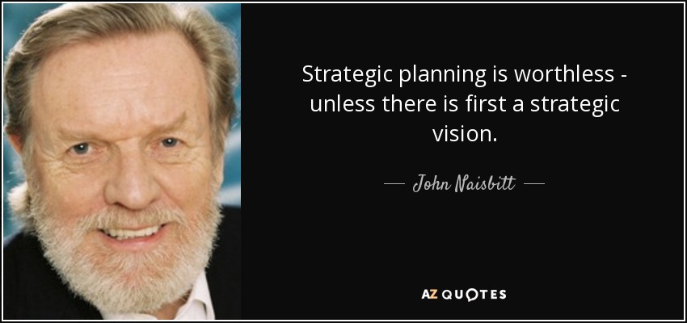

Slide 100
Group Activity
Present an innovative business idea

Slide 101


Jagadish Upadhya
98856 57080
jagadishpu@yahoo.com

