Slide 1
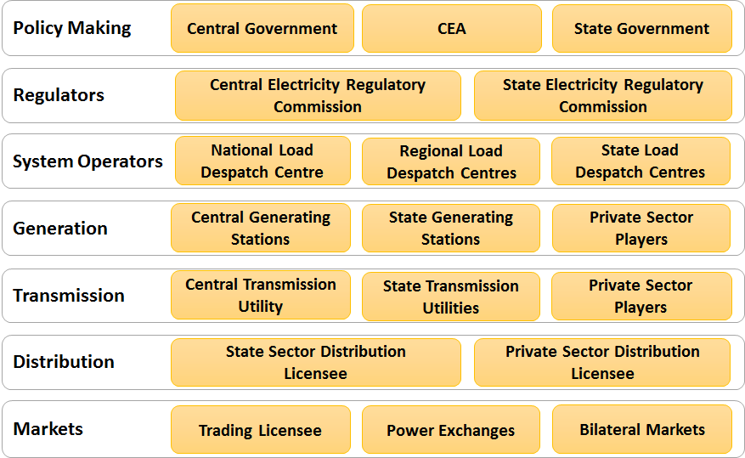
Structure of Indian Electricity Sector

Slide 2

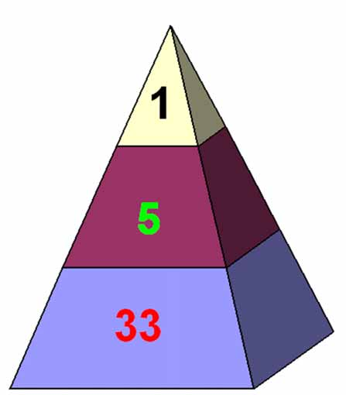
Hierarchy of Grid Management
National Level
Regional Level
State Utilities Level

Slide 3
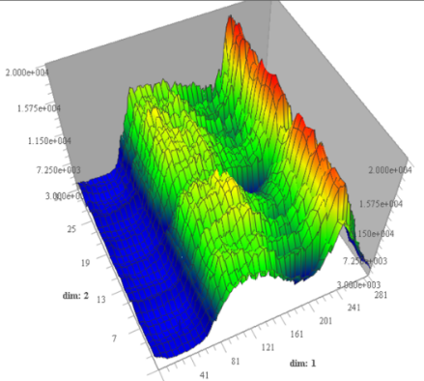
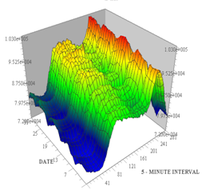
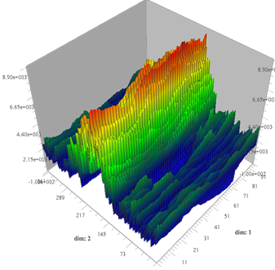
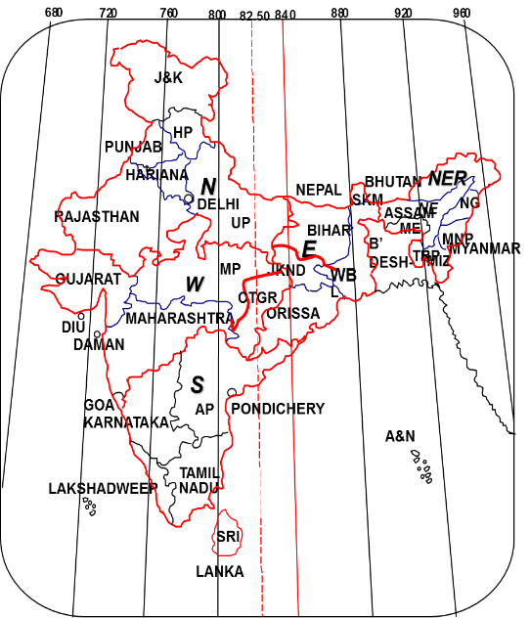
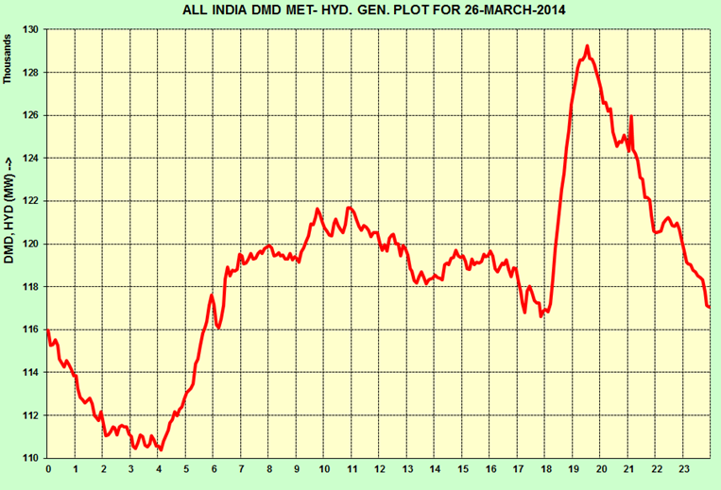
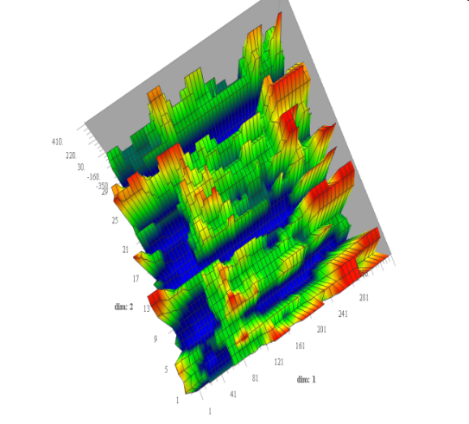
Harnessing Diversity - Regional Grids
Solar
Wind
Hydro
All India
Diurnal Variation
Seasonal Variation
Morning Peak @ 140 MW/min for 40 minutes
Evening Peak @ 200 MW/min for 40 minutes
Pumped Hydro

Slide 4
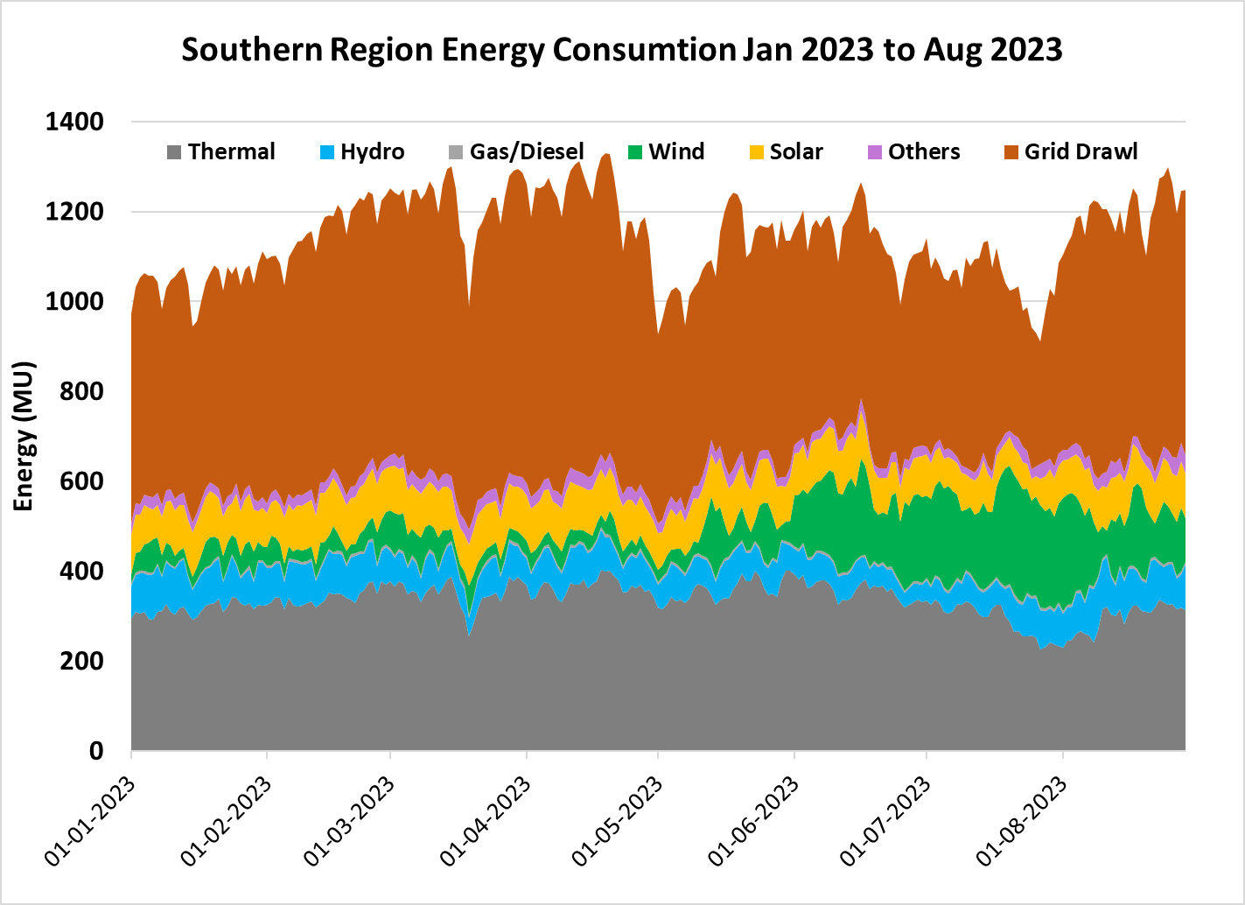
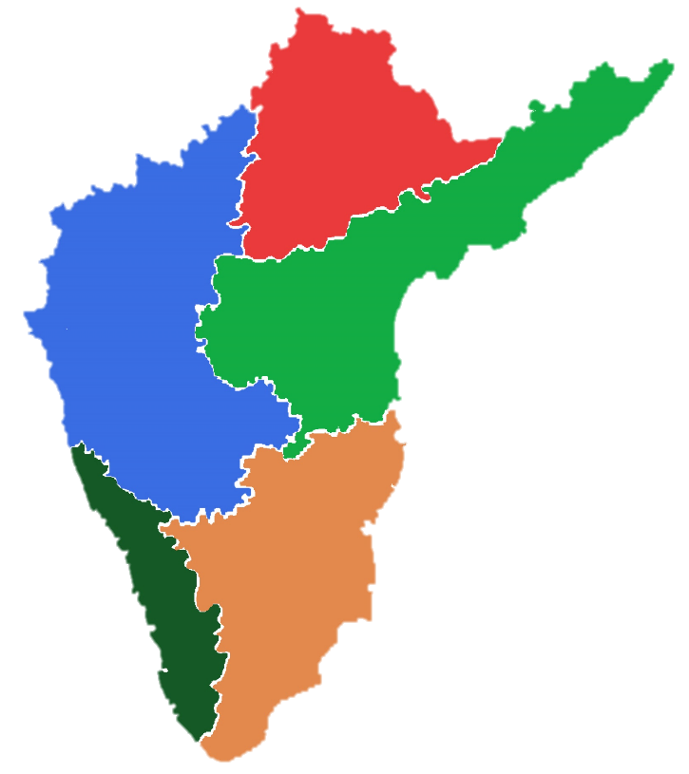
SR Energy Particulars
Southern Region
IC | 118 GW
PD | 64337 MW
ME | 1329 MU
Transmission
400 kV : 452 Nos ~ 45779 Ckm
765 kV : 22 Nos ~ 8315 Ckm
Transformation Capacity
400 kV : 330 Nos ~ 118442 MVA
765 kV : 20 Nos ~ 30000 MVA
TELANGANA
IC | 12117 MW
PD | 15497 MW
ME | 303 MU
DA | 185 MU
KARNATAKA
IC | 24337 MW
PD | 16950 MW
ME | 309 MU
DA | 190 MU
ANDHRA PRADESH
IC | 18389 MW
PD | 12900 MW
ME | 264 MU
DA | 170 MU
IC – Installed Capacity
PD – Peak Demand
ME – Maximum Energy
DA – Daily Avg Consumption
PUDUCHERRY
IC | 32.5 MW
PD | 512 MW
ME | 11 MU
DA | 7 MU
KERALA
IC | 3405 MW
PD | 5024 MW
ME | 103 MU
DA | 69 MU
TAMIL NADU
IC | 23375 MW
PD | 19387 MW
ME | 415 MU
DA | 282 MU

Slide 5
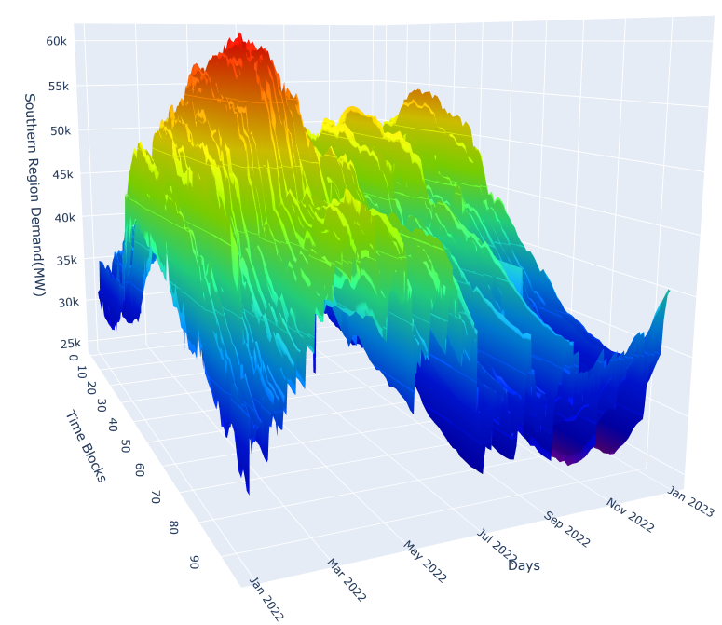
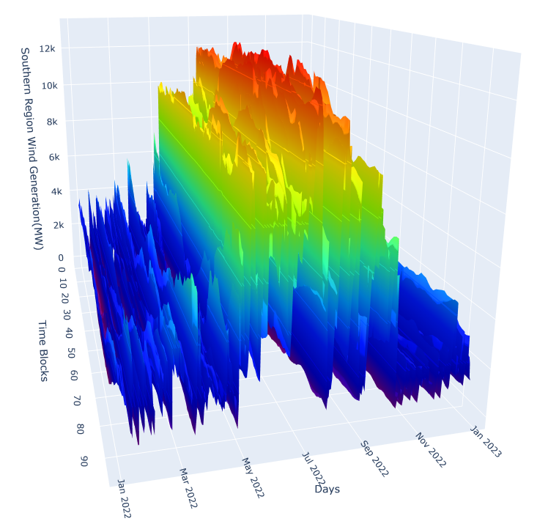
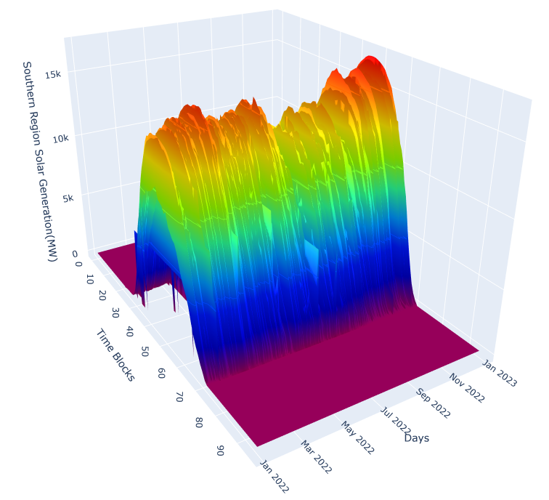
Southern Region Demand/Generation Characteristic
SR Max Demand – 64337 MW on 15th March 2023
SR Max Wind Generation – 13.2 GW MW on 12th July 2022
SR Max Solar Generation – 18.5 GW MW on 13th Feb 2023
Demand vs RE

Slide 6
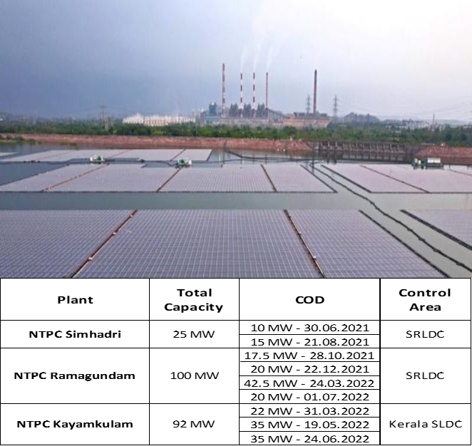
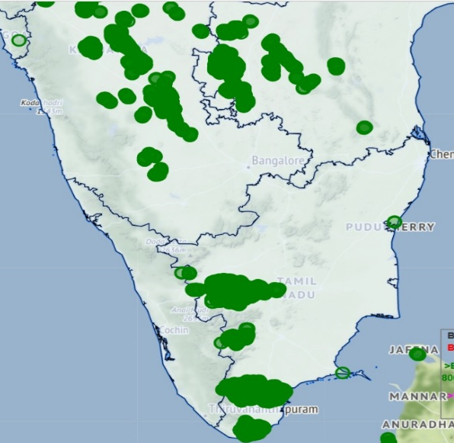
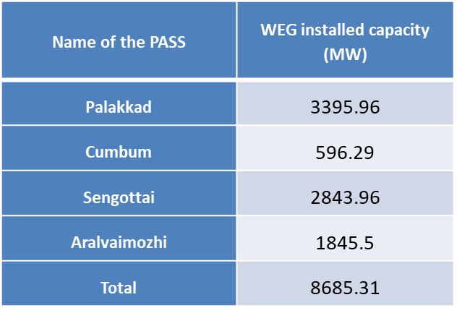
Renewable Energy in Southern Region
S.No | State | Date | Thermal | Hydro | Gas/ Diesel | Wind | Solar | Net RE | Grid Drawl | Consumption | Penetration (%)
1 | AP | 12-07-2022 | 70 | 4 | 3 | 78 | 9 | 86 | -6 | 159 | 59%
2 | KA | 22-05-2022 | 27 | 26 | 0 | 59 | 27 | 86 | 3 | 150 | 65%
3 | TN | 07-08-2022 | 21 | 23 | 5 | 110 | 23 | 133 | 81 | 269 | 49%
4 | TS | 23-05-2022 | 98 | 1 | 0 | 2 | 25 | 27 | 48 | 175 | 15%
5 | SR | 14-07-2022 | 168 | 117 | 8 | 263 | 61 | 323 | 236 | 874 | 37%
1986: 55kW, 90 kW - First RE Plant Commissioned at Muppandal, Iyanaruthu - TN
Annual CUF
RE– 19.82 %
Solar – 20.31
Wind – 19.31
Maximum CUF
Girel (Wind) – 33.25 %
SB Energy (Solar) – 25.89
ISTS Wind – 23.8% to 33 %
ISTS Solar – 19.31 % to 20.31%
WTG installation in SR

Slide 7
Peak RE Generation Comparison 2022 vs. 2023
Solar Max
23.12.2022 – 17019 MW
13.02.2023 – 18500 MW
Wind Max
12.07.2022 – 13208 MW
19.07.2023 – 13427 MW
4.1 GW Addition in RE Capacity

Slide 8
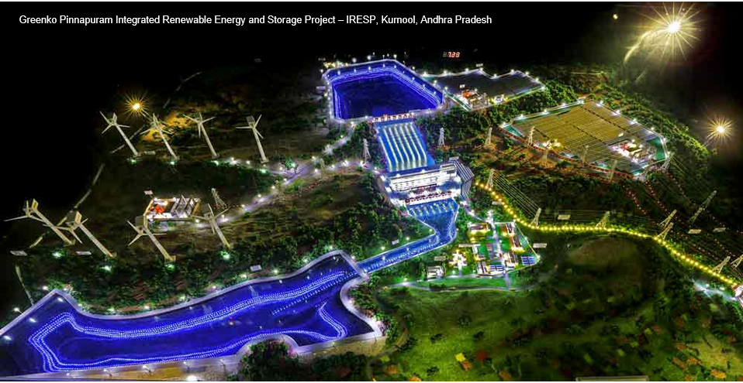
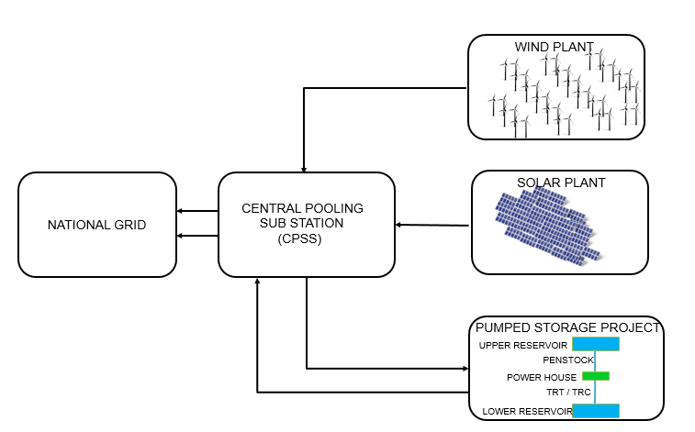
Hybrid Plants in SR (Wind, Solar & Pumped Storage)
Andhra Pradesh – 3675 MW(IC) – Under Construction
Pumped Storage Hydro – 1200 MW
Solar – 2175 MW
Wind – 300 MW
AMGPEL
989 MW
Similar Plants in SR
1. Karnataka - Soundati – 4860 MW
2. Telangana - Adilabad – 2000 MW

Slide 9
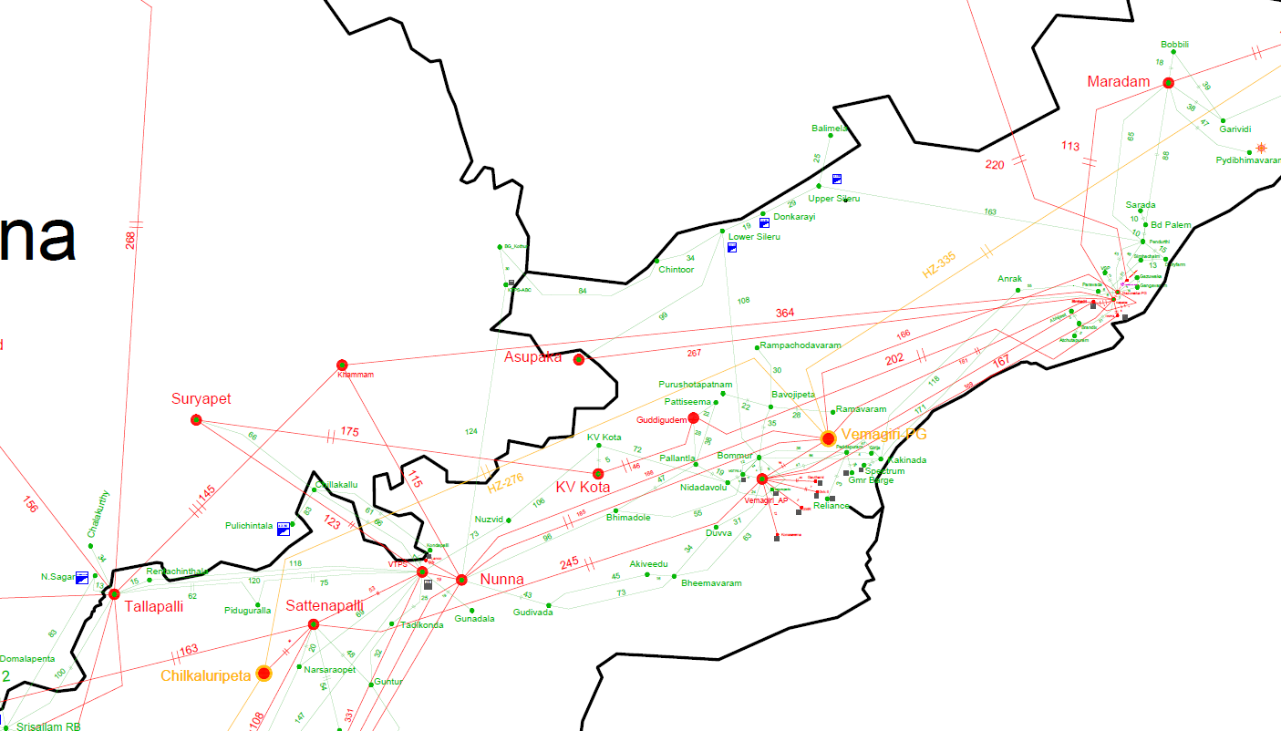
Transmission constraints in Andhra Pradesh system:
Over loading of ICTs at
400/220kV Vemagiri:
400KV Ainavalli SS Planned, one ICT replacement with 500 MVA
400/220kV Maradam :
4th ICT is planned
400/220kV KV Kota:
3rd ICT augmentation at Guddigudem will relieve to certain extent
400/220kV Talapalli SS (3x315 MVA):
Replacement with 500 MVA ICTs

Slide 10
220kV Line issues
The following lines are heavily loaded
220kV Kalpakka-Brandix D/C
220kV KVKota (400/220kV SS)- KV Kota D/C
220 kV Nunna- Gudivada D/C
220 kV Vemagiri-Bommuru 1,2 &3
220kV Lower Sileru –Bommuru S/C
220kV Maradam-Bobbili D/C
220kV Podili(400/220kV)-Podili_AP D/C
220kV VTS-Kondapalli D/C
220kV Nagarjuna Sagar-Talapalli 1,2&3
220kV Chittor(400/220kV)-Chittor_AP D/C
220kV Narnoor-AP Carbides D/C
220kV Ghani-Somayajulapalli D/C
220kV Somayajulapalli-Done D/C
220kV Anantapur- Gooty S/C
220kV Anantapur- Kalayanadurgam D/C
220kV Chinakampalli-RYTPP 1,2,3 &4
220kV Rachagunneri-Renigunta D/C

Slide 11
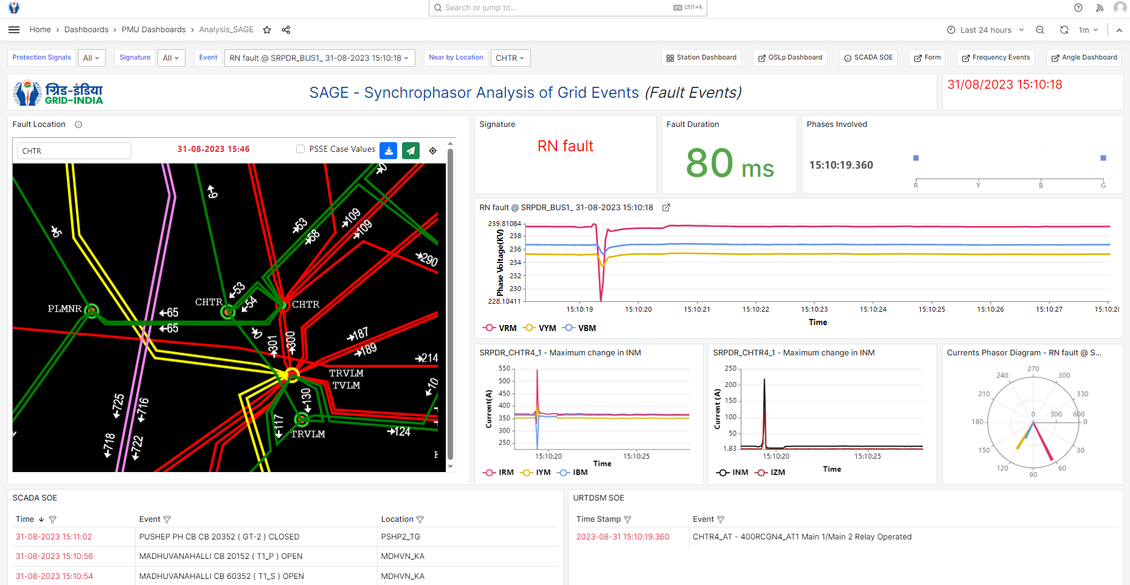
Grid Monitoring tools

Slide 12
AUFR and Df/dt defense Mechanisms
AUFR present settings
 | settings
Stage-1 | 49.2 Hz
Stage-2 | 49.0 Hz
Stage-3 | 48.8 Hz
Stage-4 | 48.6 Hz
 | AP | TG | KAR | KER | TN | PONDY | Total
Stage-1: | 392 | 417 | 576 | 204 | 740 | 21 | 2350
Stage-2: | 393 | 419 | 578 | 205 | 744 | 21 | 2360
Stage-3: | 398 | 424 | 586 | 208 | 753 | 21 | 2390
Stage-4 | 399 | 426 | 588 | 209 | 756 | 22 | 2400
Quantum of Load Relief:
DF/Dt settings
Stage-1: | 49.5 Hz 0.2 Hz/sec fall of frequency
Statge-2: | 49.3 Hz 0.3 Hz/sec fall of frequency
CONSTITUENT | STAGE-1 | STAGE-2
ANDHRA PRADESH | 345 | 367
TELANGANA | 855 | 912
KARNATAKA | 474 | 485-1036
KERALA | 172 | 121-175
TAMIL NADU | 624 | 559
PONDY | 18 | 0
TOTAL | 2000 | 2932-3537
Quantum of Load Relief:

Slide 13
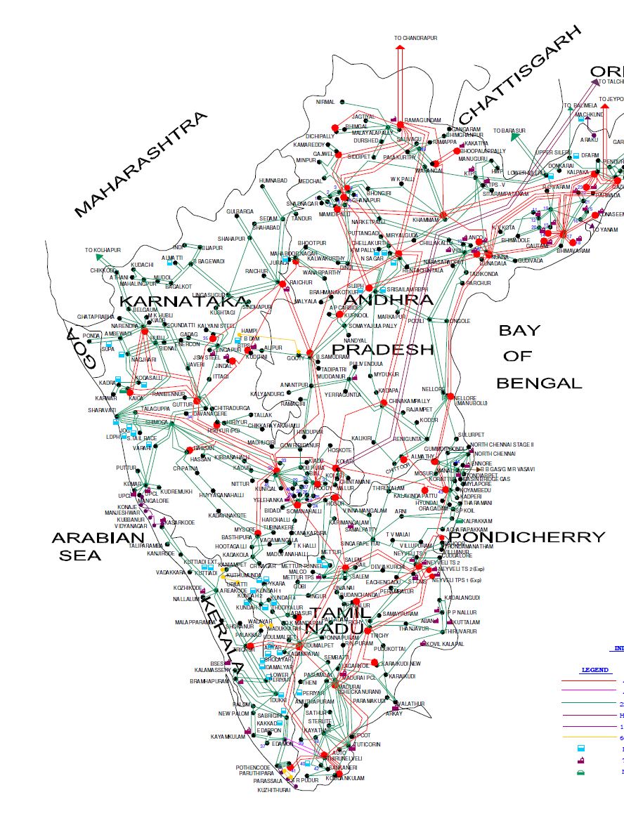
Special Protection Schemes in SR
NTPC Talcher SPS
Hyderabad ICTs
Raichur-Sholapur SPS
Vijayawada-Nellore SPS
Nagjheri SPS
Muddanur SPS
VARAHI SPS
Nellore-Almathi SPS
Chittur-Tiruvalam and Sulurpet-Gummidipoondi SPS
UPCL SPS
Kolar SPS
Peenya SPS
Hosur ICTSPS
Water works SPS
S1-S2 SPS
Commissioned
Hiriyur- Nelamngala
Gooty-Nelamangala SPS
Madakathara SPS
Madhurai wind SPS
Tirunelvelli wind SPS
Kudankulam SPS

Slide 14

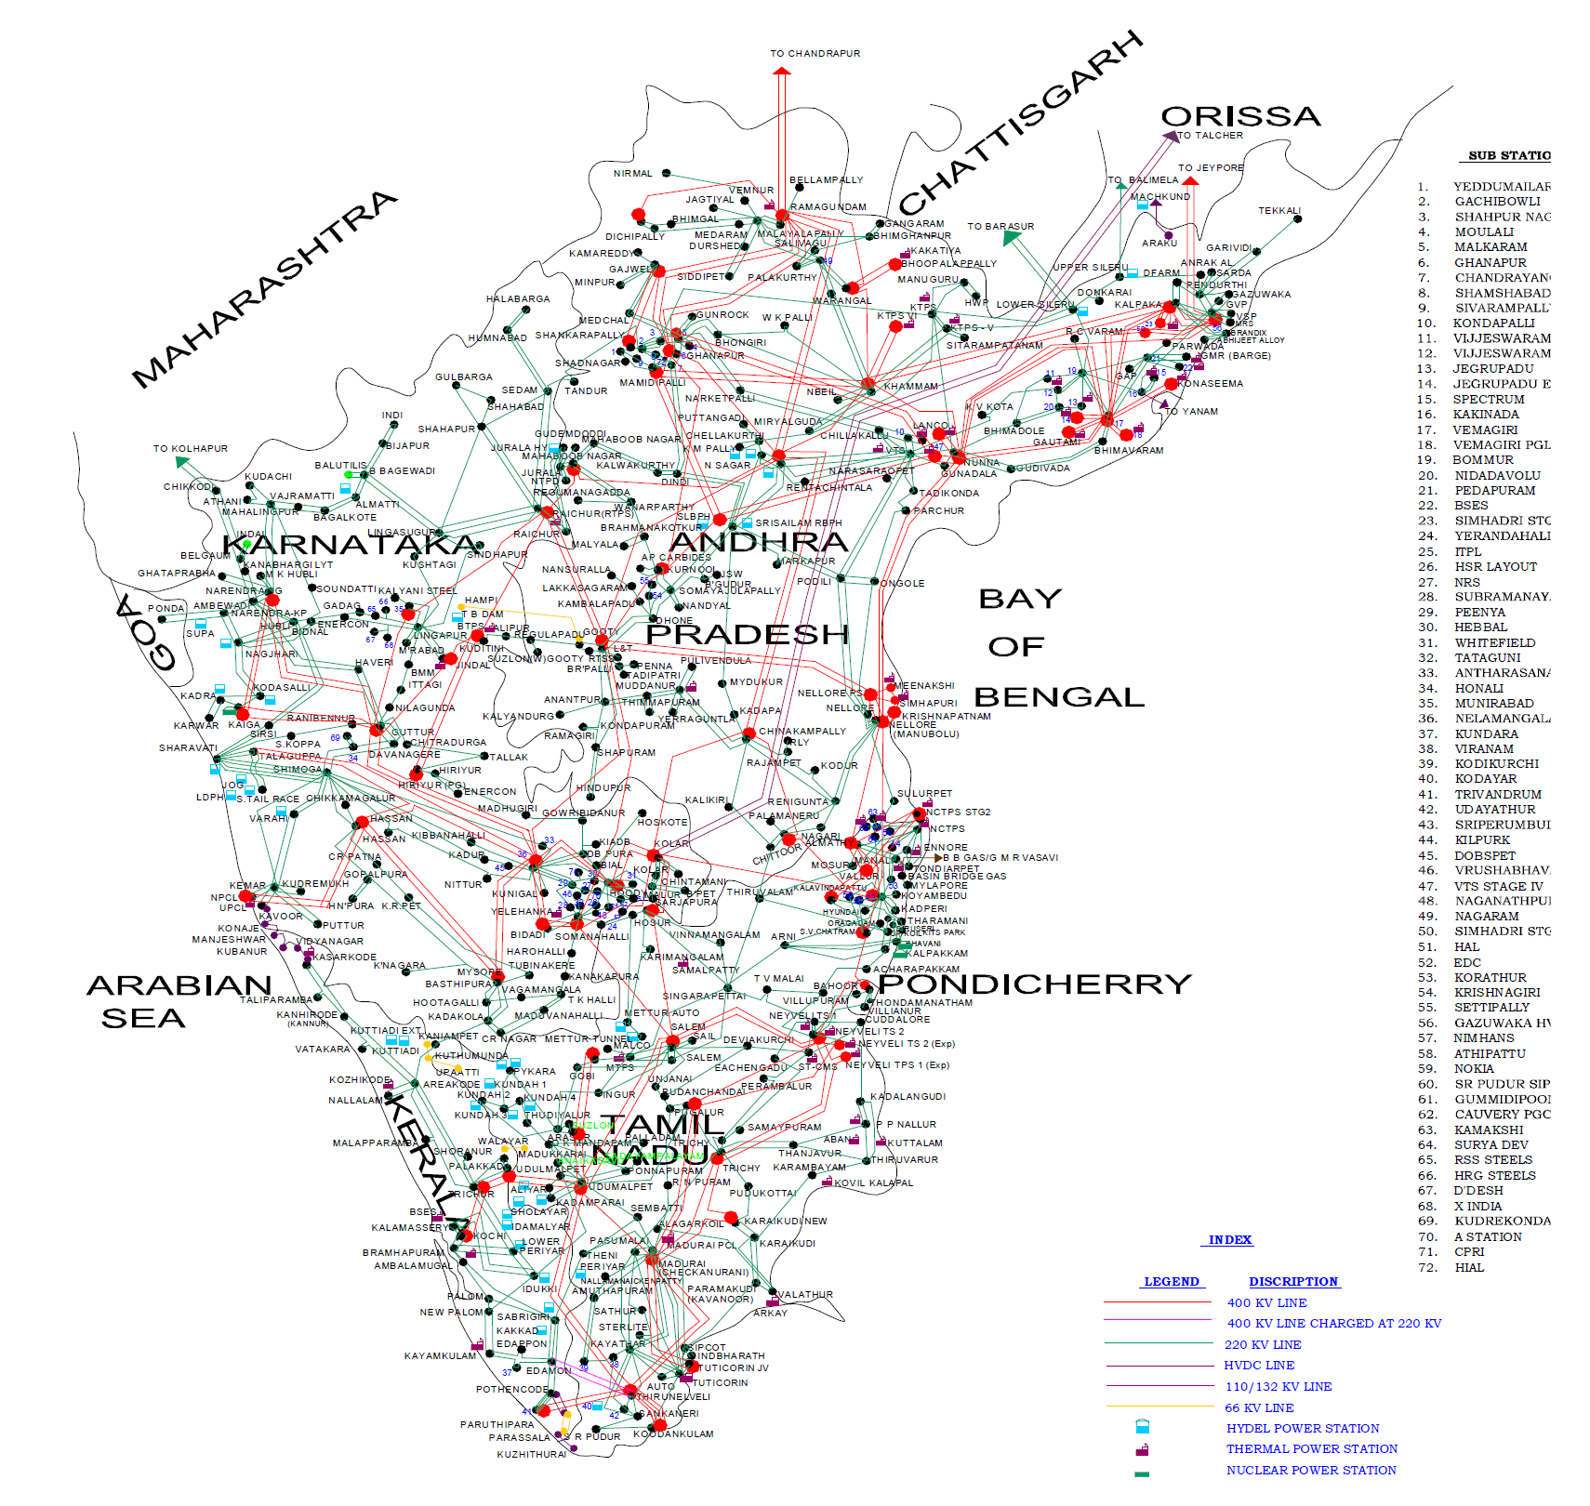
Islands in SR
Ramagundam-Hyderabad island
47.9Hz - commissioned
Chennai Island 47.9Hz
Neyveli-MTPS-Kundah-Erode-Coimbatore-Palakkad Island
47.9Hz
Koodankulam-Tuticorin-Trivendrum Island
47.9Hz

