Slide 1

System studies and Load Flow Studies
19-09-2023

Slide 2
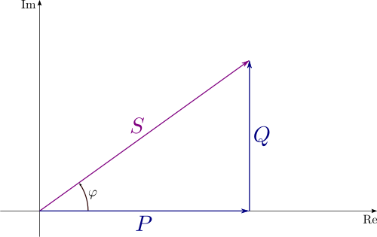
Introduction
To analyze the power system performance under steady state conditions.
The analysis in normal steady-state operation is called a power-flow study (load-flow study) and it targets on determining the Voltages, Currents, and Real and Reactive Power Flows in a system under specified generation and load conditions.
At each bus, We make an assumption about either
a Voltage at a bus or
the Power being supplied to the bus
Then determine
Bus voltage magnitude and phase angles
Line currents, etc. that would result

Slide 3
Steps in Load flow studies:
Step 1 – Represent the system by its single-line diagram.
Step 2 – Convert all quantities to per unit
Step 3 – Draw the impedance diagram.
Step 4 – Obtain the Ybus matrix.
Step 5 – Classify the buses (swing bus, or generator bus, or load buses)
Step 6 – Start answering the missing variables, by assumptions (unless it is specified otherwise).
Step 7 – Find approximations for the real and reactive power that we are given, using the assumed and given values for voltage/angles/admittance.
Step 8 – Write the Jacobian Matrix for the first iteration of the Newton Raphson Method.
Step 9 – Solve for the unknown differences, use Cramers Rule.
Step 10 – Repeat step 7 – 9 iteratively until we obtain an accurate value.

Slide 4
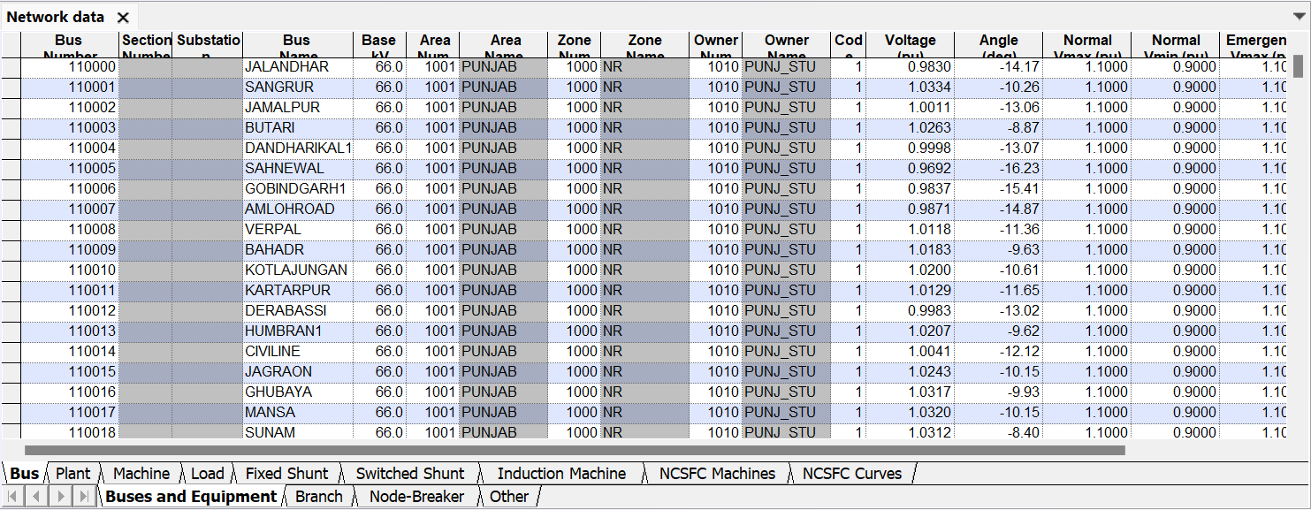
Modelling of network elements in Soft ware:

Slide 5
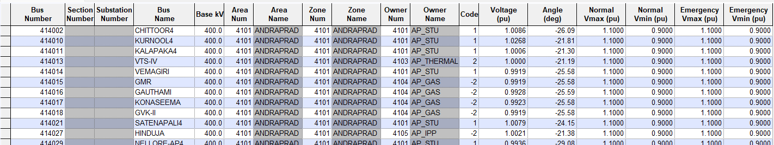
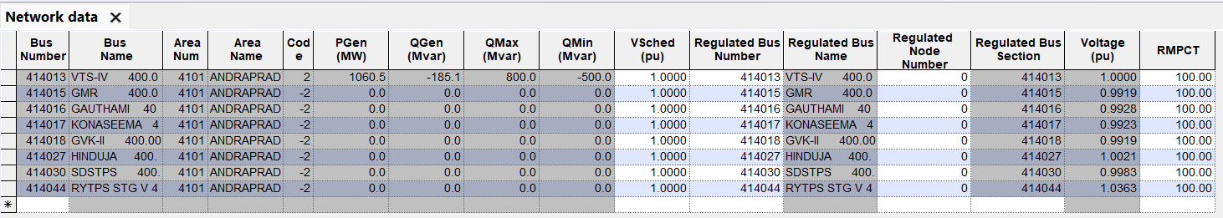
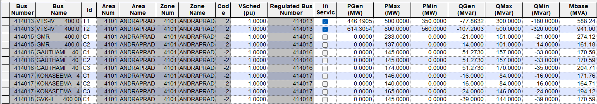
BUS DATA:
PLANT DATA:
MACHINE DATA:

Slide 6
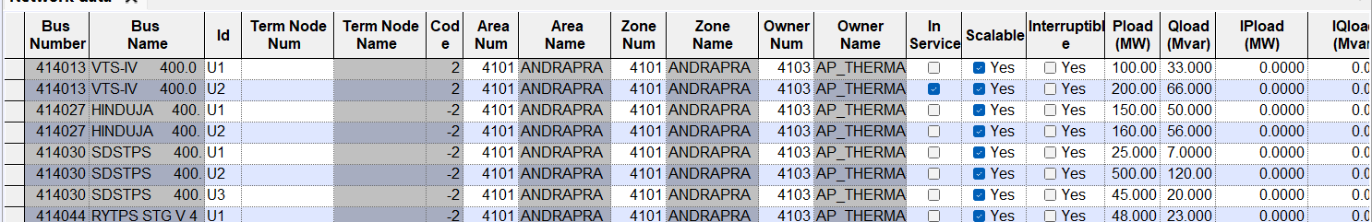
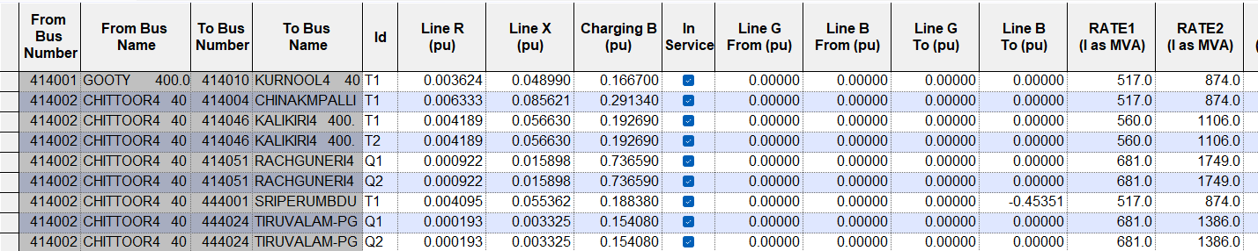
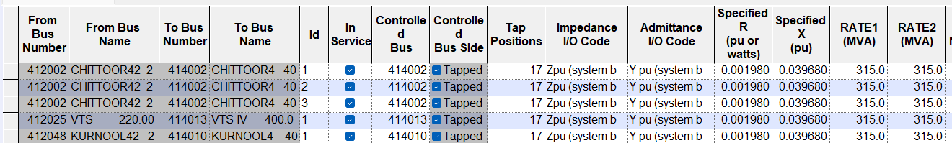
LOAD DATA:
LINE DATA:
Transformer DATA:

Slide 7
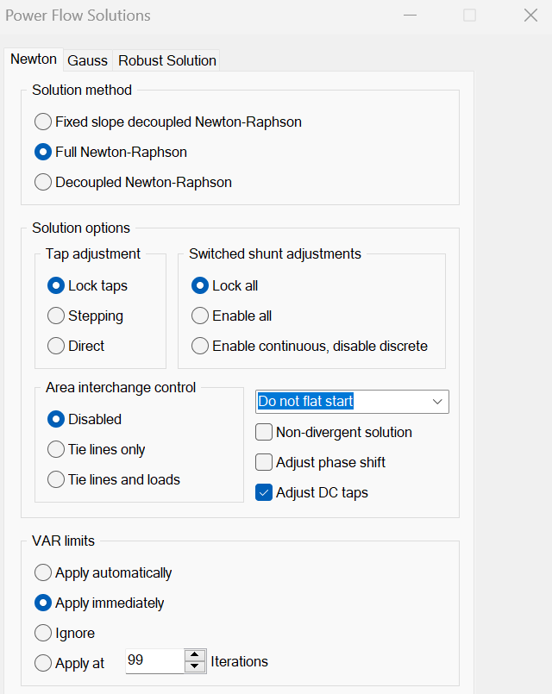
POWER FLOW SOLUTION

Slide 8
Types of Buses:
Generation Bus
Also called the P-V bus or voltage-controlled buses
Voltage magnitude |Vi| and real power Pi are specified
Able to specify (and therefore to know) the voltage magnitude of this bus.
Most generator buses fall into this category, independent of whether it also has load
When Q calculated is more than Q max or Q calculated is less than Q min then that bus acts as load bus.

Slide 9
Types of Buses:
Slack or Swing Bus
Known as reference bus
Voltage magnitude |Vi| and phase angle di are specified, else they are assumed to be equal to 1.0 and at angle 0 deg.
p.u. and 00 , as per flat-start procedure of iterative
The slack or swing bus is usually a PV-bus with the largest capacity generator of the given system connected to it.
This generator “swings” to compensate for the network losses, or, one may say that it “takes up the slack.”
Compensates the mismatch in the generator despatch and total load in the system.

Slide 10
Types of Buses:
Load Bus
Also called the P-Q bus
Real power Pi and Qi are specified
All load buses fall into this category, including buses that have not either load or generation.

Slide 11
The Bus Admittance Matrix
The majority of load flow programs employ methods using the bus admittance matrix, as this method is found to be more economical.
In the YBUS matrix, Yij = 0, if an incident element is not present in the system connecting the buses “I” and “j”. Sparsity.
The percentage sparsity of YBUS, in practice, could be as high as 80-90%, especially for very large, practical power systems.
While YBUS is thus highly sparse, it‟s inverse, ZBUS, the bus impedance matrix is not so. It is a FULL matrix, unless the optimal bus ordering schemes are followed before proceeding for load flow analysis

Slide 12
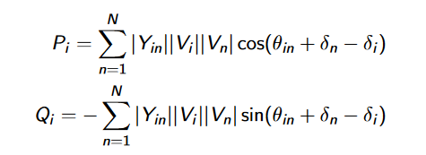
Load Flow

Slide 13
Reasons for carrying out Power flow studies
Finding out line flows
The bus voltages and system voltage profile
The effect of change in configuration and incorporating new circuits on system loading
Contingency analysis
The effect of temporary loss of transmission capacity and (or) generation on system loading and accompanied effects.
Transformer tap setting for economic operation
Possible improvements to an existing system by change of conductor sizes and system voltages
System loss minimization

Slide 14

Transmission Line Parameters/Models
Source: CEA Transmission Planning Criteria 2013

Slide 15
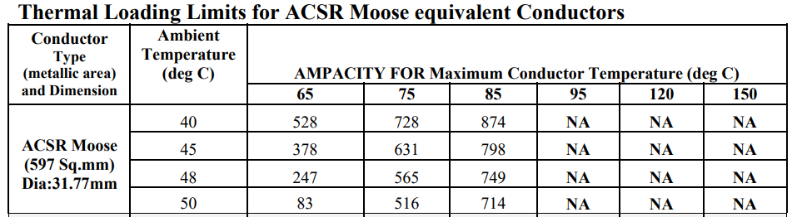
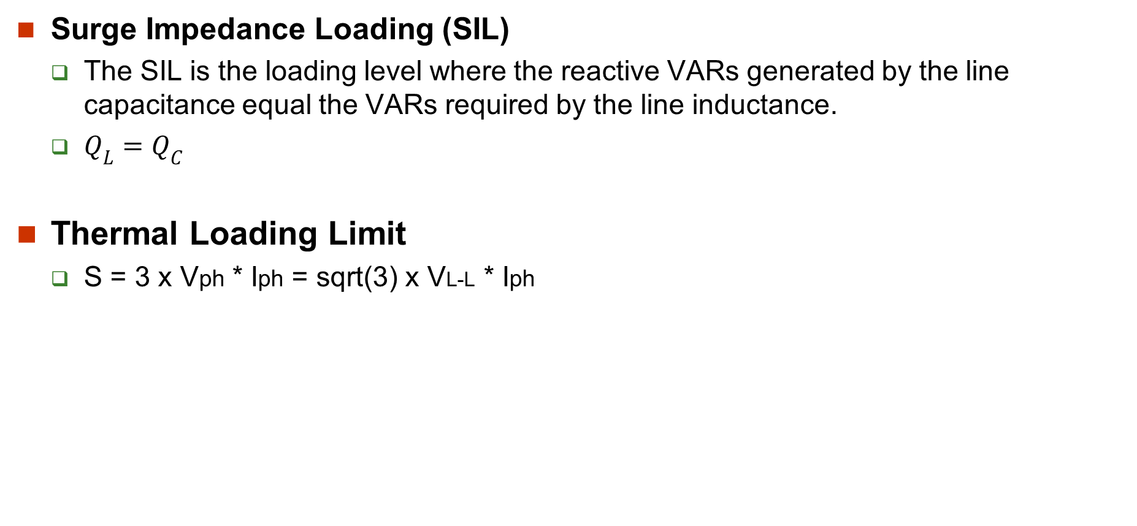
Transmission Line Loading Limitis
Surge Impedance Loading (SIL)
The SIL is the loading level where the reactive VARs generated by the line capacitance equal the VARs required by the line inductance.
$Q_{L}=Q_{C}$
Thermal Loading Limit
S = 3 x Vph * Iph = sqrt(3) x VL-L * Iph

Slide 16
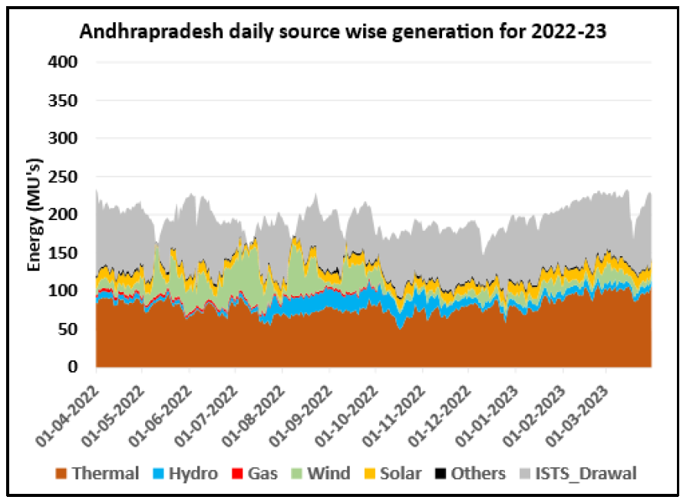
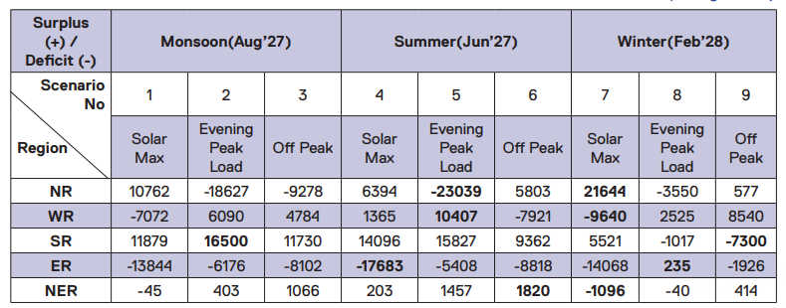
Selecting Load generation balance:
The generation despatch is considered based on the month under study by analysing historical trends.
In the planning horizon following cases are considered for All India

Slide 17
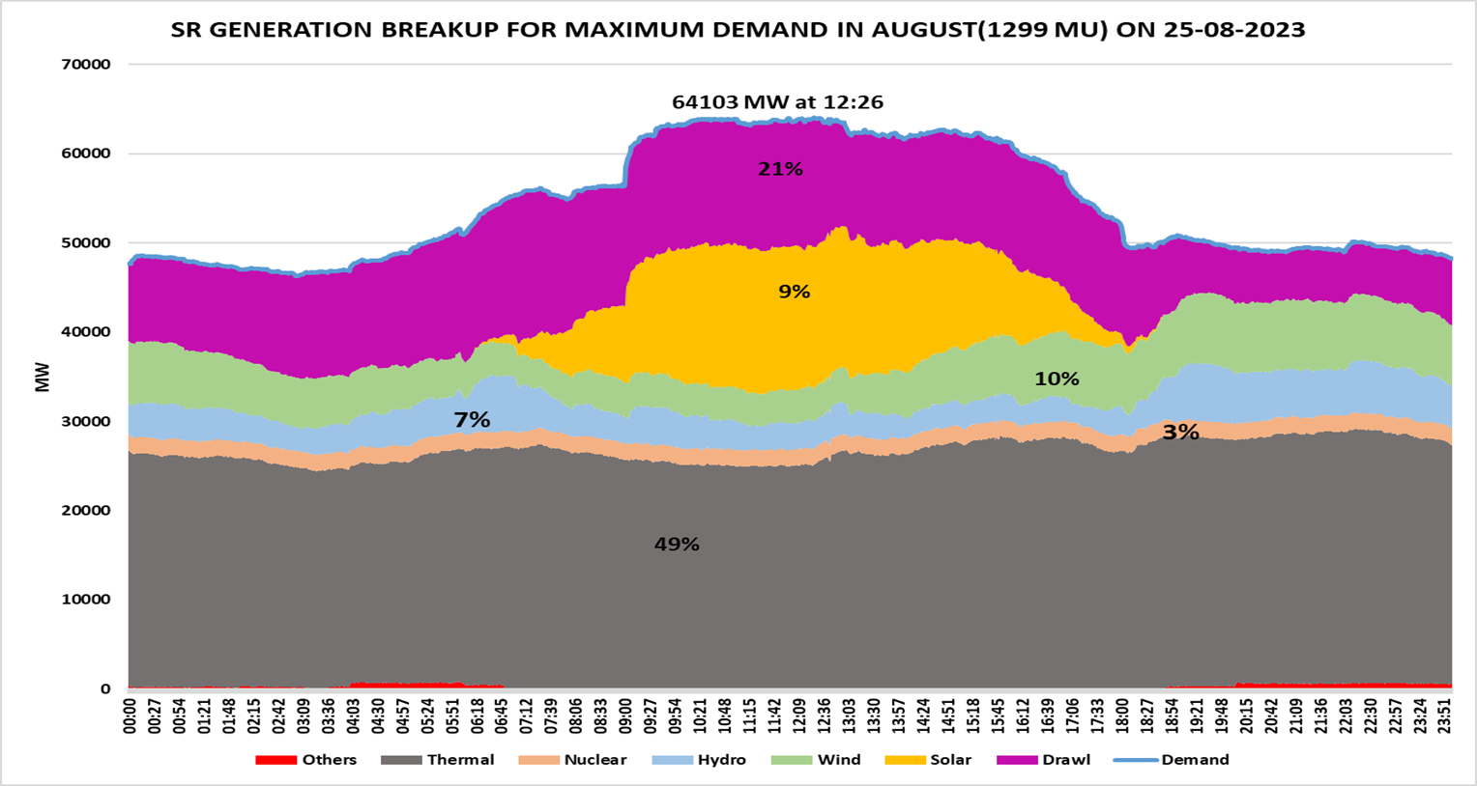
Selecting Load generation balance-Over a day:

Slide 18
Scenarios for study:
4 scenarios over a day are considered
Solar peak (12:00 to 13:00 Hrs)
Morning peak (07:00 to 07:30 Hrs)
Evening Peak (18:30 TO 19:30 Hrs)
Off peak (Morning 03:00 Hrs)
For a specific scenario during a day will be carried out real time data (Units on bar, their generation, Transmission outages, Demand etc.)
Every 5 minutes simulation case is generated based on real time data.

Slide 19
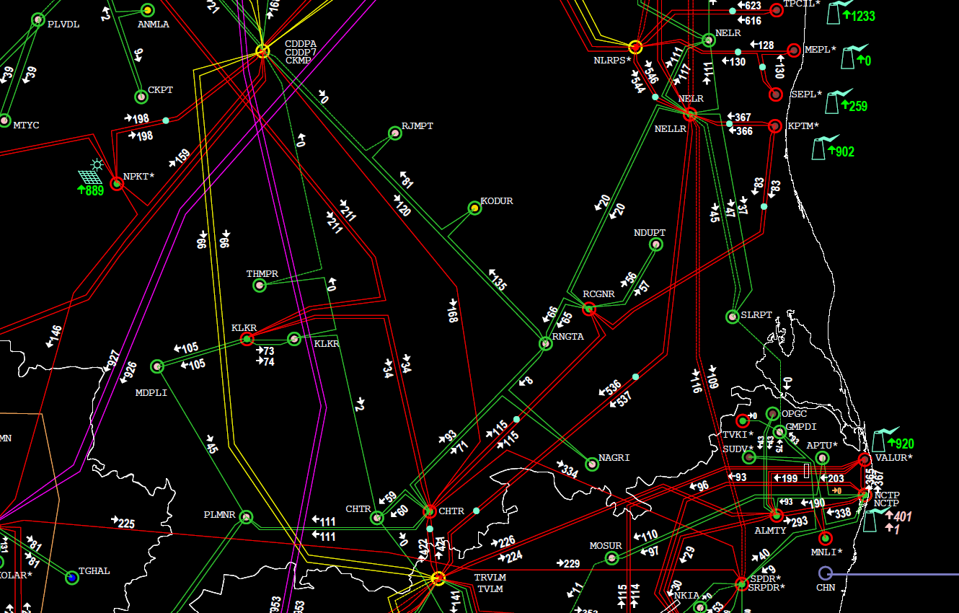
Impact of Shutdown
SDSTPS – 3*800 MW
S/D of 400kV SDSTPS-Nellore D/C requested.
Other connectivity is 400kV SDSTPS-Rachagunneri Quad Moose D/C.
QMDC can carry 1600 MVA -2100 MVA
Whether S/D can be facilitated?

Slide 20
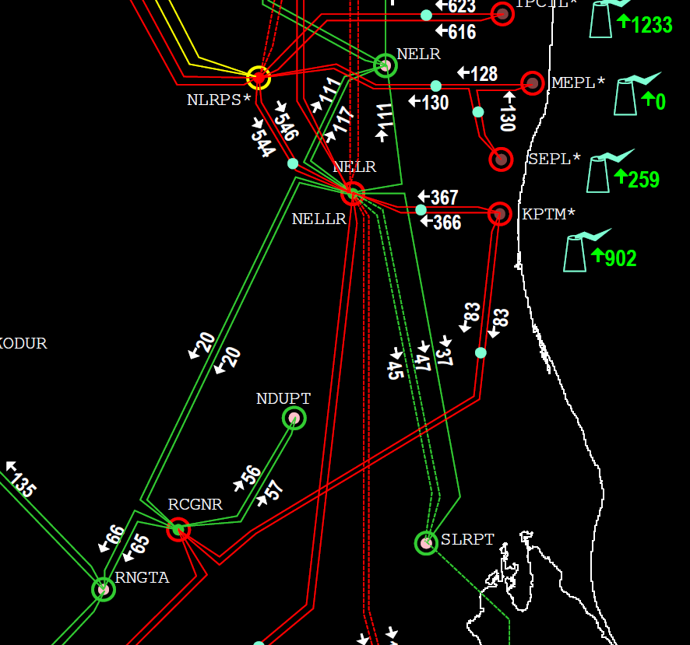
Impact of Shutdown
SDSTPS – 3*800 MW
S/D of 400kV SDSTPS-Nellore D/C requested.
Other connectivity is 400kV SDSTPS-Rachagunneri Quad Moose D/C.
QMDC can carry 1600 MVA -2100 MVA
Whether S/D can be facilitated?

Slide 21
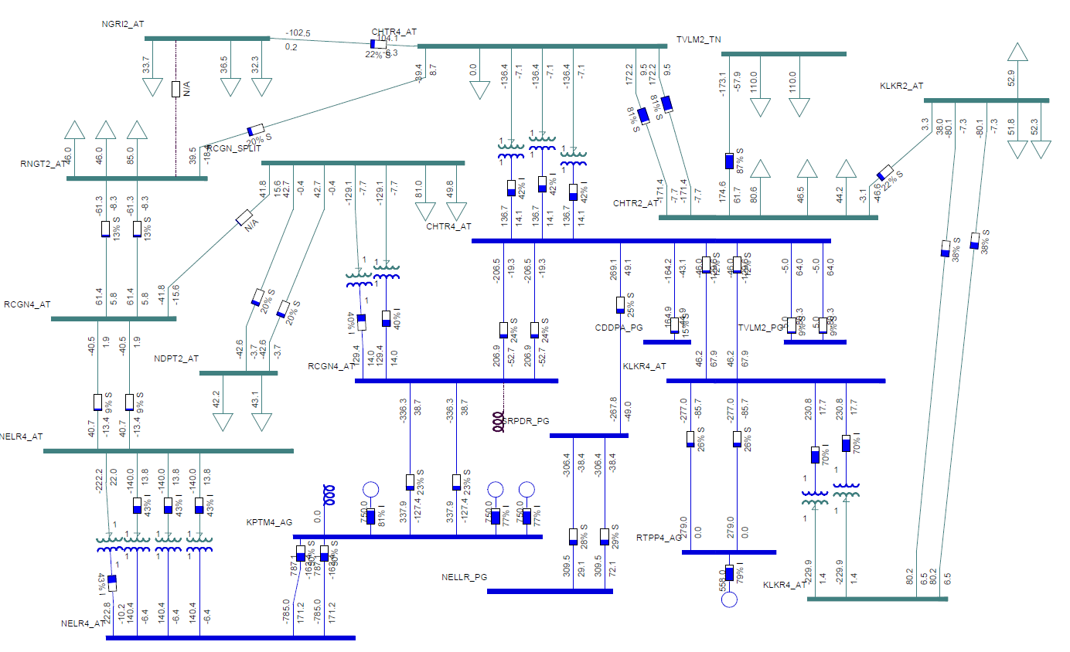
Base case:

Slide 22
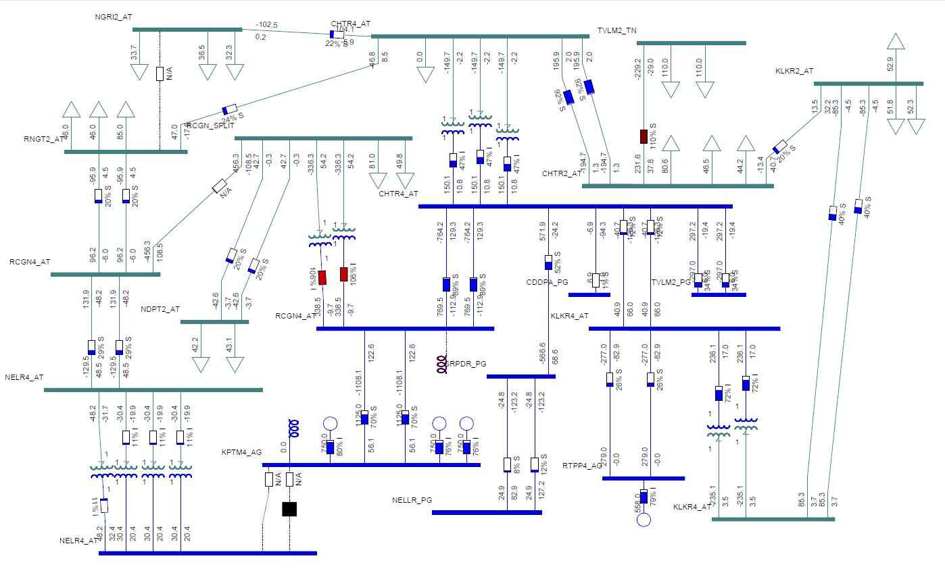

Slide 23
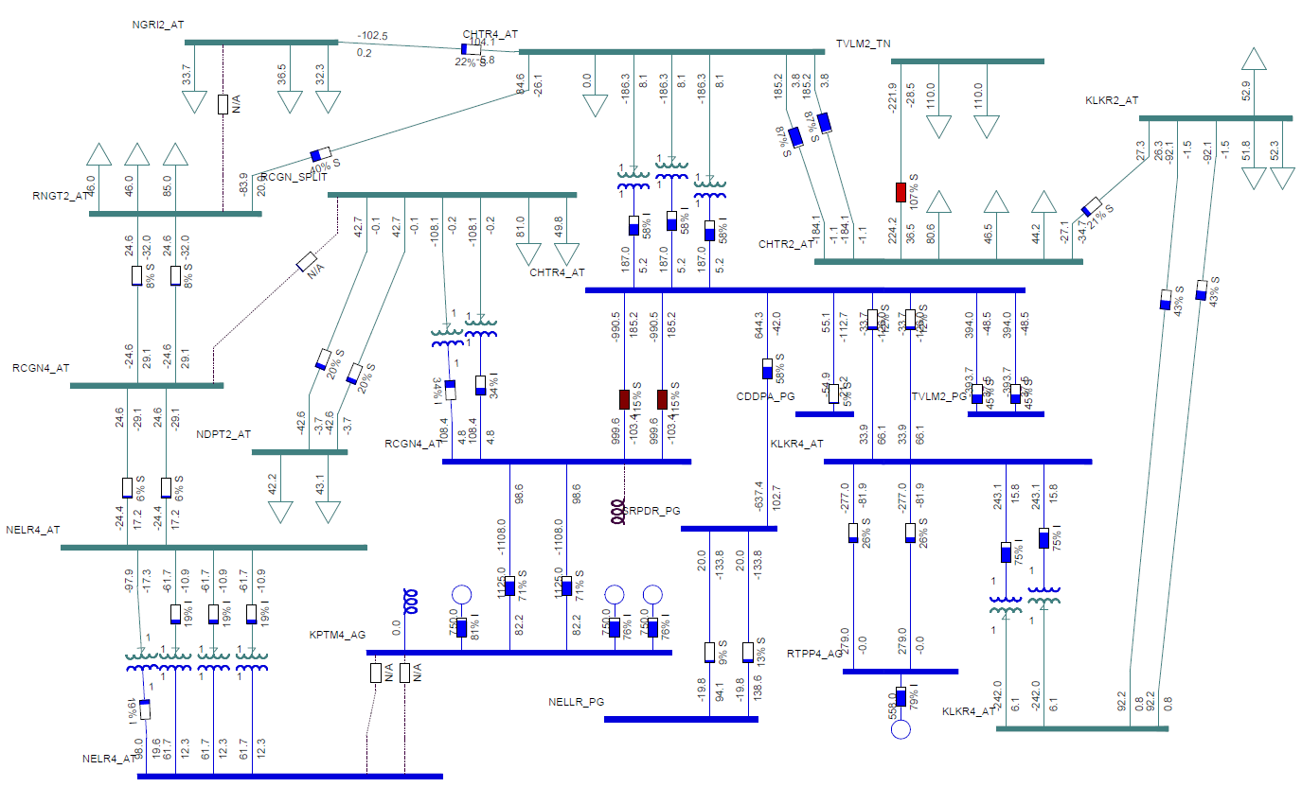

Slide 24
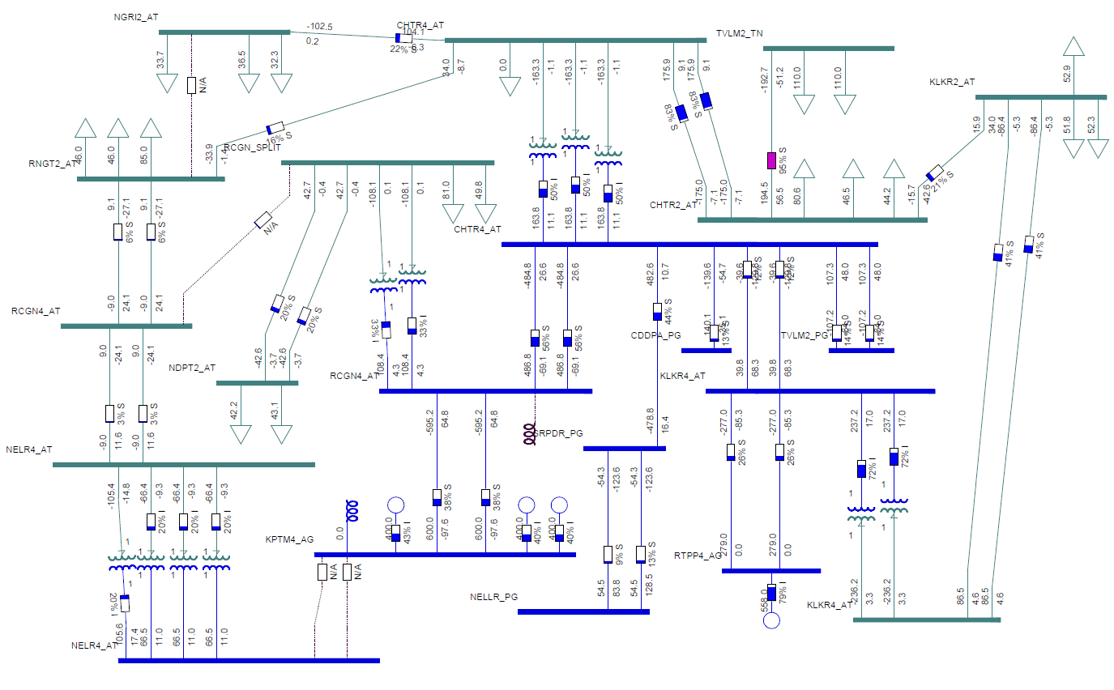

Slide 25
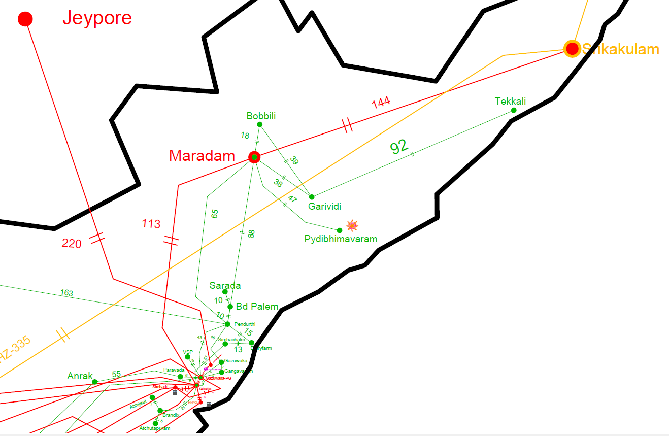
SPS Design for Maradam ICT-3

Slide 26
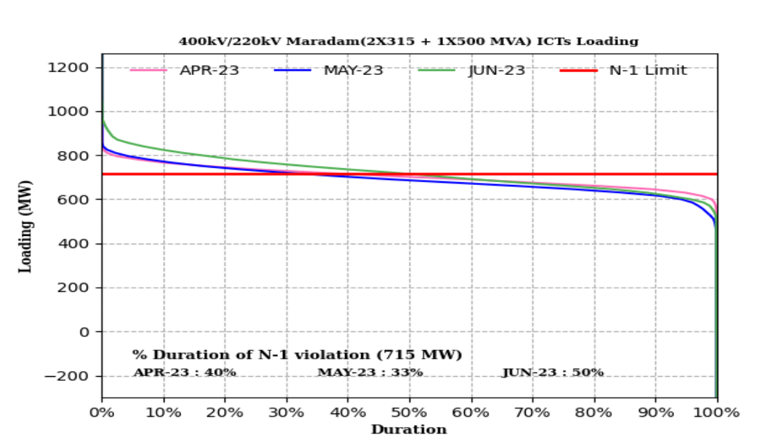

Slide 27
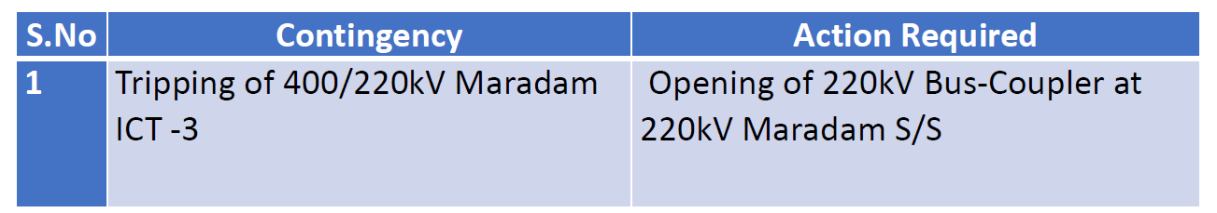
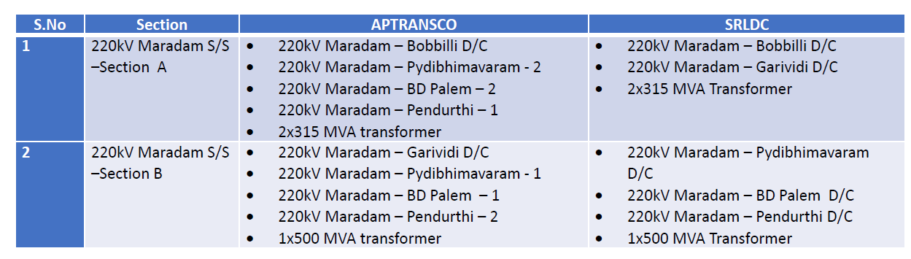
SPS Designing

Slide 28
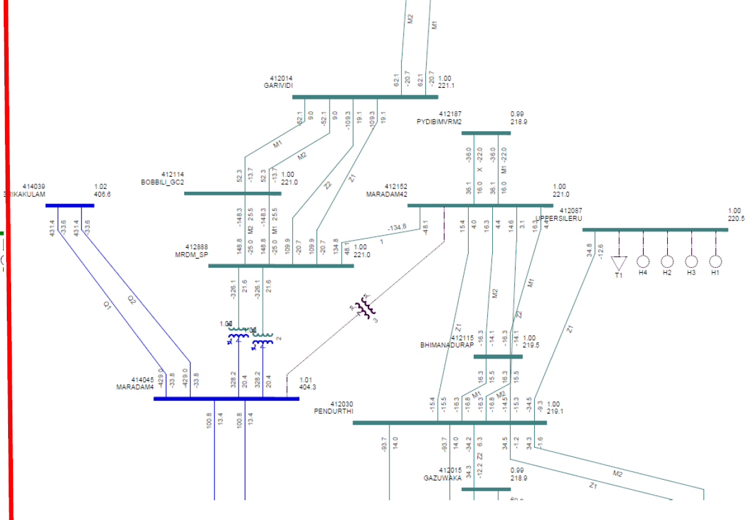
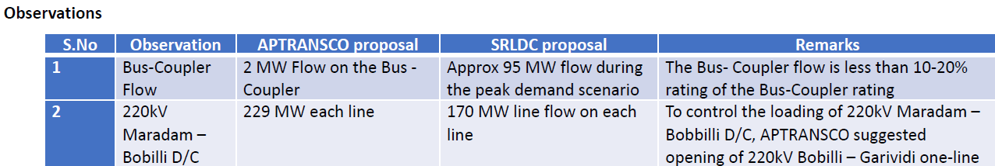
SPS Designing

Slide 29
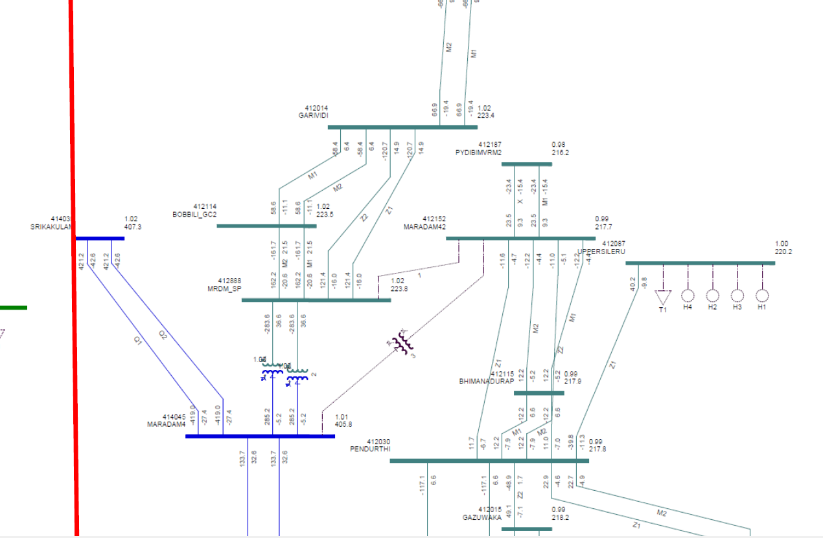

Slide 30
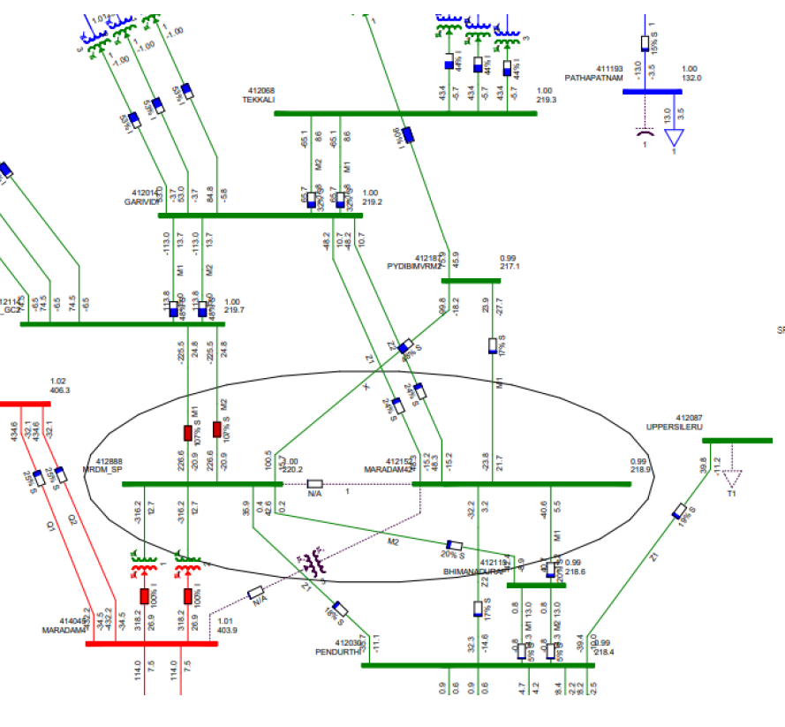

Slide 31

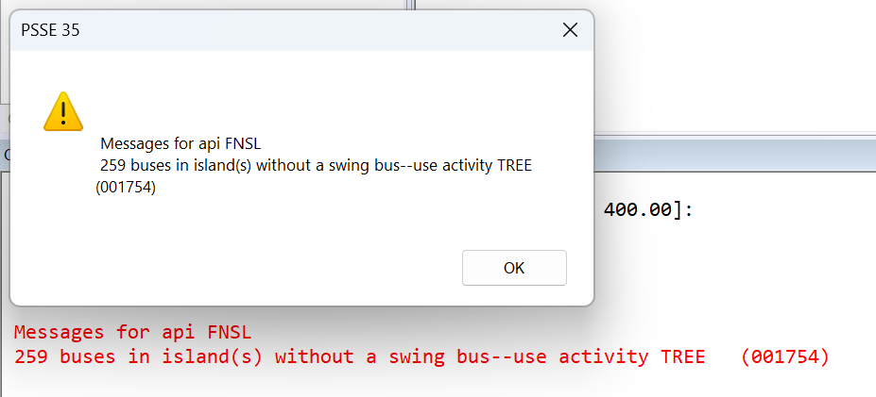
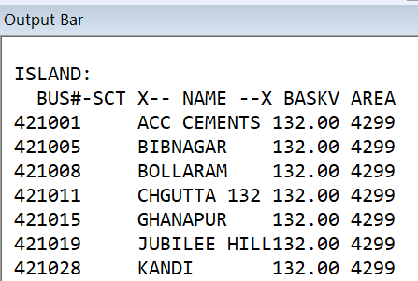
Islanding schemes design:
At extremely low frequencies (47.9Hz), some parts of the grid are islanded by opening the grid connected lines with matching load generation balance.
The transmission lines required to be tripped for forming the islanding are identified from studies.
The designed loads and generators with the network of the island are modelled and studies are carried out to check
Whether voltages at various substations are within stability limits
Power flows on transmission lines/ICTs are below thermal ratings

Slide 32
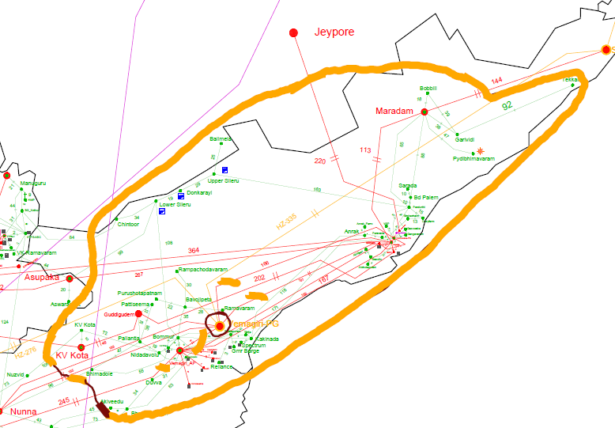
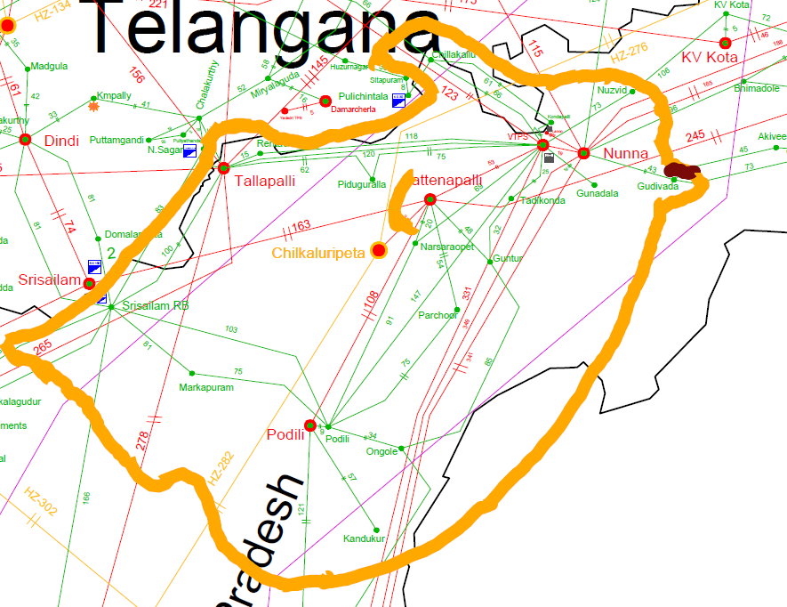
Islanding schemes design:
In Andhra Pradesh there are two Islanding schemes
Simhadri Islanding scheme
Vijayawada Islanding scheme

Slide 33
Capacitor bank requirement studies:
State-wise Instants (Date & time) of Low Voltage Scenario that occurred.
Load-Generation Data corresponding to this instant.
Iterative process, install 1MVAR capacitor bank at lowest voltage bus and do the load flow,
Check bus voltages at all the buses. Repeat the process till all bus voltages becomes above 0.95pu.

Slide 34
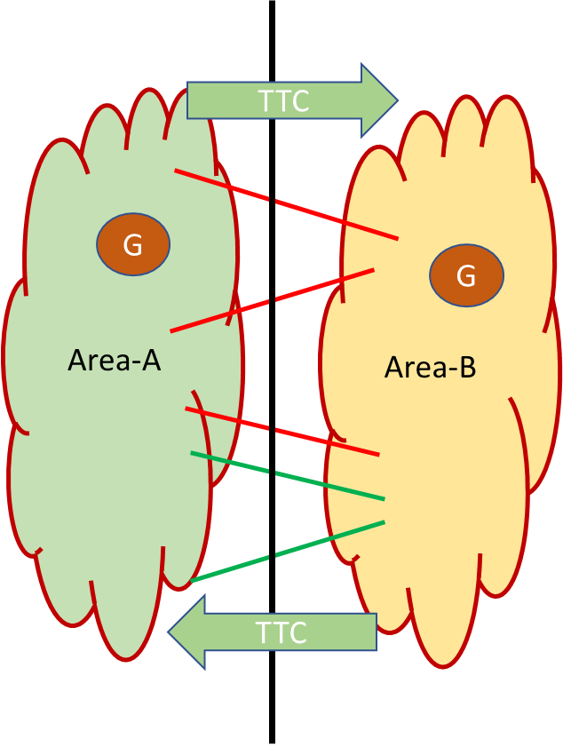
ATC/TTC Studies:
“Total Transfer Capability (TTC)” | Means the amount of electric power that can be transferred reliably over the inter-control area transmission system under a given set of operating conditions considering the effect of occurrence of the worst credible contingency
“Transmission Reliability Margin (TRM)” | means the amount of margin kept in the total transfer capability necessary to ensure that the interconnected transmission network is secure under a reasonable range of uncertainties in system conditions.
“Available Transfer Capability (ATC)” | means the transfer capability of the inter-control area transmission system available for scheduling commercial transactions (through long term access, medium term open access and short term open access) in a specific direction, taking into account the network security.
Mathematically, ATC = TTC - TRM

Slide 35
Total Transfer Capability-Properties
TTC is depends on
Network topology, point and quantum of injection/drawal.
Power flows in other paths of the interconnected network
Prevailing voltage profile in the network
TTC is directional in nature
Import capability is different from Export capability
Total Transfer Capability is time variant
Different for different time of the day/month/season/year
TTC
Area-A
Area-B
G
G
TTC

Slide 36
TTC Calculation-Why?
TTC assessment is required for reliable system operation and to facilitate non discriminatory open access in transmission as per CERC regulations on Open Access and Power Markets.
TTC and TRM - assessed with the help of simulation studies carried out for a representative scenario.
Construction of an accurate base case power system model is a key step in the execution of a meaningful study

Slide 37
Credible contingencies as per Planning Criteria
Outage of single transmission element (N-1) in the transmission corridor or connected system
Outage of a largest unit in the importing control area Station
Credible contingencies As per Transmission Planning criteria:
Outage of a 132kV or 110kV single circuit,
Outage of a 220kV or 230kV single circuit,
Outage of a 400kV single circuit,
Outage of a 400kV single circuit with fixed series capacitor(FSC),
Outage of an Inter-Connecting Transformer(ICT),
Outage of a 765kV single circuit
Outage of one pole of HVDC bipole.

Slide 38
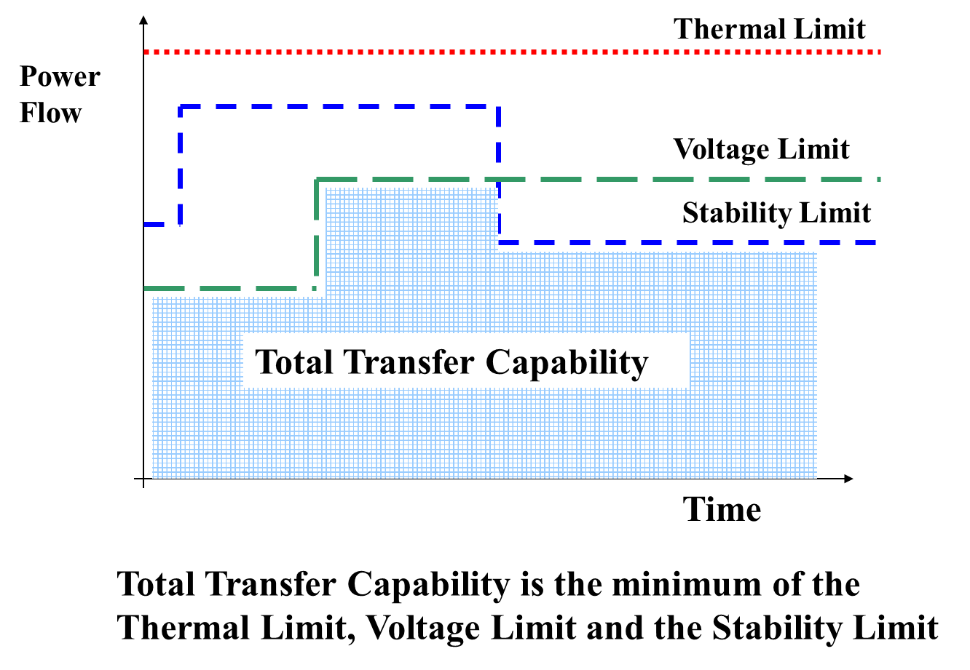
Salient points to be considered while assessing TTC
Violation of grid voltage operating range
Violation of transmission element loading limit in n-1 contingency case
or
Violation of emergency limit in the n-1 contingency case
or
Stability under n-1-1 contingency of a temporary single phase to ground fault on a 765 kV line close to the bus or a permanent single phase to ground fault on a 400 kV line close to the bus
Angular difference of 30 degrees between adjacent buses under n-1 contingency

Slide 39
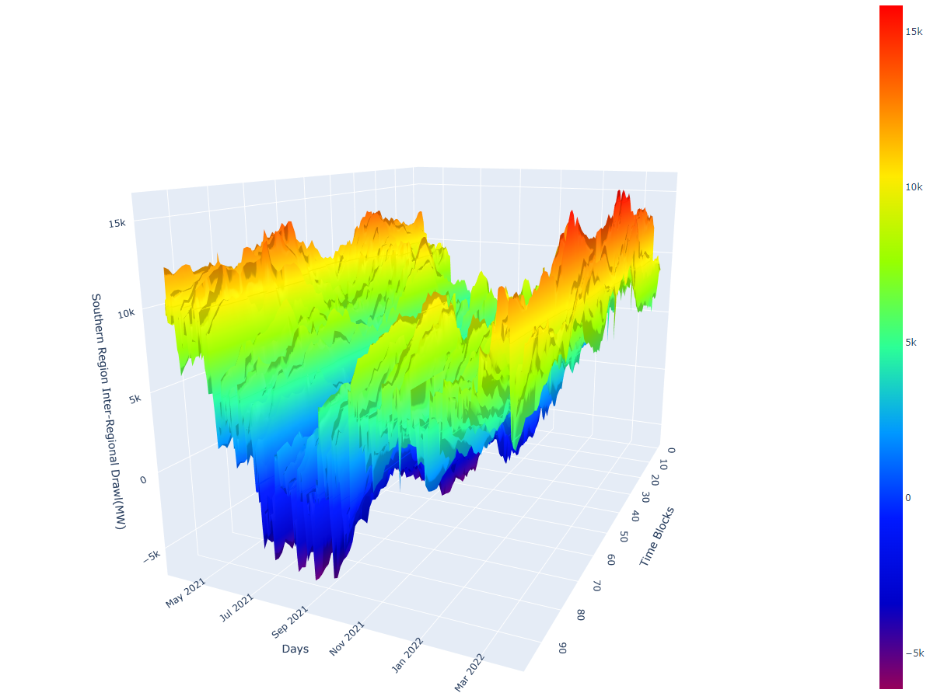
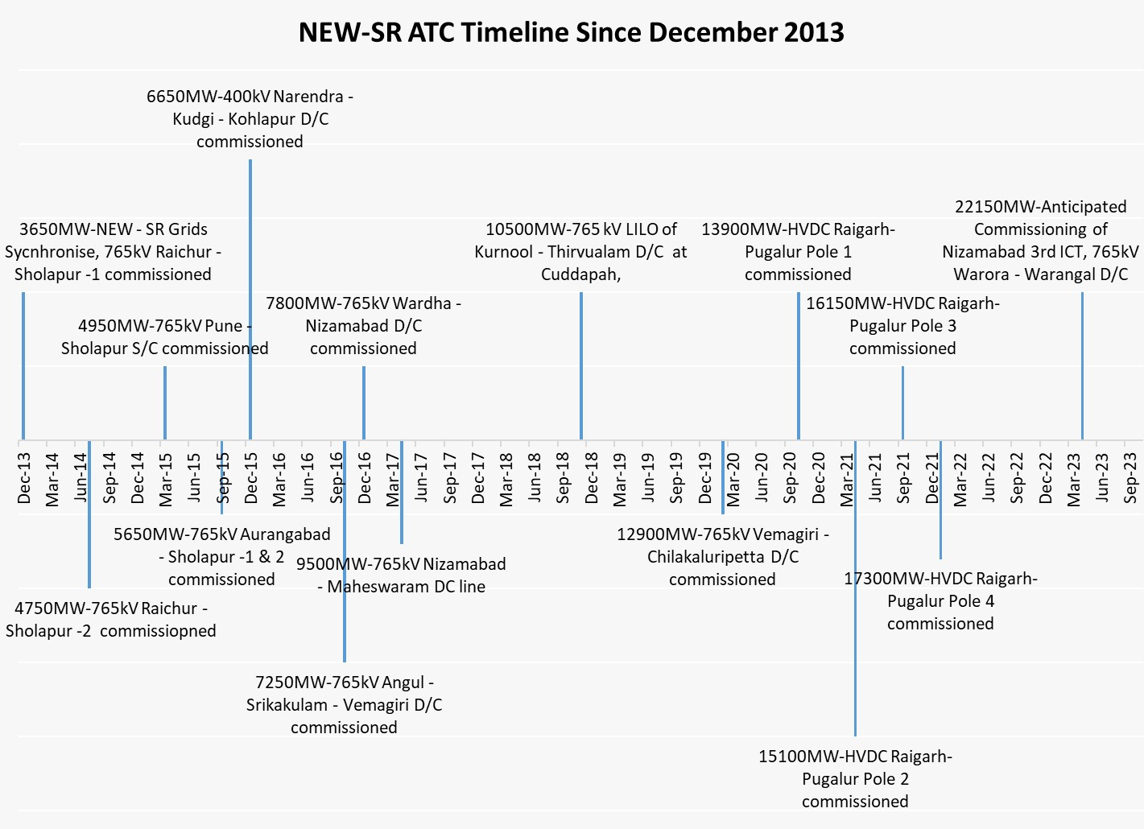
Inter-Regional Import Capability
Southern Regional Drawl for FY 2022-23
SR TTC Enhancement of 4000 MW after October 2023
Present TTC/ATC:17300/16300 MW
Maximum Import : 16300 MW
Planned system:
Nizamabad ICT3 - Oct 2023
765kV Warora – Warangal D/C – Sep 2023
Import: 22150 MW – Commissioning of Nizamabad 3rd ICT & 765kV Warora - Warangal
Future Anticipated Constraints
N-1 violation of 765/400kV Maheswaram ICTs
3rd ICT is approved
N-1 of 765kV Angul – Srikakulam will lead to 30 degrees angle violation

Slide 40
Inter-Regional Export Capability
Present SR export TTC – 6600 MW (Solar Hours), 5150MW (Non-Solar Hours)
Limiting constraints:
Angular separation between Kudgi & Kolhapur (PG) under N-1 touches 30 deg
Commissioning of 765kV Warora –Warangal & Narendra-Pune D/C
765/400kV ICT constraints at Sec-A and Sec-B of Kotra SS
One ICT in Section-A and Two ICTs in Sec-B are planned
N-1 Contingency of 400 kV Pune – Kalwa will overload 400 kV Pune –Khargar
Commissioning of 400kV Vikroli and Navi Mumbai station
Using existing transmission system for improving SR export capability
Gazuwaka maximum export is 700 MW due to Gazuwaka east bus low voltage issues.
Additional Connectivity for 400kV Jeypore S/S
Jeypore (POWERGRID) – Jagdalpur (CSPTCL) 400kV D/c line (conductor with minimum capacity of 2100MVA/circuit at nominal voltage)
HVDC Talcher-Kolar flow is limited to 1150 MW import even during SR export requirement due to 400kV Talcher-Meramundali over loading.
HVDC Raigarh - Pugalur maximum designed export capability is limited to 3000 MW.
Planned transmission system for improving SR export:
400kV Kolhapur(MH)-Kolhapur (PG) -2 : Reconductored
765kV Warora-Warangal D/C – Sep 2023
765kV Narendra-Pune D/C – June 2024
765kV Raichur-Koppal D/C – Sep 2025
Expected SR-WR TTC for April 2025: 11000MW
SR Export LTA/GNAs:
Under operation: 2350 MW
LTA/GNA with reconductoring:2300 MW
LTA/GNA with Narendra-Pune D/C:3315 MW
Total 7965 MW.
Further GNA is approved with this line.

Slide 41
S1→(S2&S3) and S3 Import TTC constraints
Present S1→(S2&S3) import TTC: 8500 - 9500MW
Limiting constraints:
400/230kV Trichy (Allundur) ICTs (2x315 MVA +1X500 MVA)
400/230kV Thiruvallam ICTs (2x315 MVA)
400/230kV Neyveli stage2 ICTs (2x250 MVA)
400/230kV NNTPS ICTs (2x500 MVA)
Planned system for relieving constraints
400/230kV Vellalavididi SS (Sep 2023)and replacement 315 MVA ICT-1 with 500 MVA ICT at Trichy SS (Dec 2023).
3rd ICT (500 MVA) is planned at Thiruvallam (Feb 2024)
400/230kV Cuddalore, Ariyalur substations are planned to relieve NLC and NNTPS ICTs. –Administrative approval stage.
Present S3 import TTC: 4100 MW
Limiting constraints:
400/220kV Kozhikode ICTs (2x315 MVA +1X500 MVA)
400/220kV Palakkad ICTs (2x315 MVA)
400/220kV Trichur HVDC ICTs (2x315 MVA)
Planned system for relieving constraints
3rd ICT (500 MVA) is planned at Palakkad (Oct 2023)
Planned 400kV North Kerala network relieves Kozhikode ICT loading
400kV UPCL-Kasargode D/C
400kV Mysore-Kozhikode D/C LILO at 400/220kV Wayanad SS
400kV Kasargode-Wayanad SS D/C

Slide 42
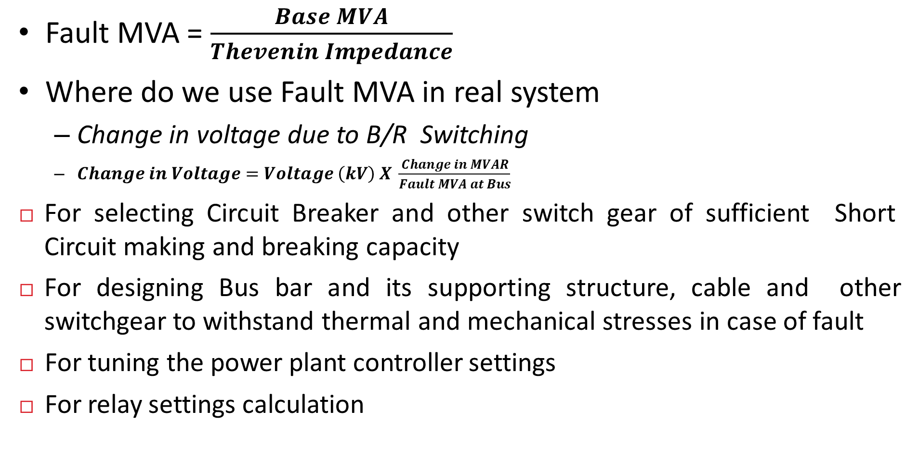
FAULT MVA at a Substation
Fault MVA = $\frac{Base MVA}{Thevenin Impedance}$
Where do we use Fault MVA in real system
Change in voltage due to B/R Switching
$Change in Voltage=Voltage \left(kV\right) X \frac{Change in MVAR}{Fault MVA at Bus}$
For selecting Circuit Breaker and other switch gear of sufficient Short Circuit making and breaking capacity
For designing Bus bar and its supporting structure, cable and other switchgear to withstand thermal and mechanical stresses in case of fault
For tuning the power plant controller settings
For relay settings calculation

Slide 43
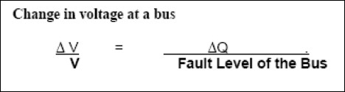
Fault Levels at Substations
Fault level of a substation besides giving an idea about the maximum breaking current possible at that substation, it also gives an idea about sensitivity of bus voltage to the reactive power injection or drawl.
The approximate relationship between voltage change due to change in reactive power and the short circuit strength of a bus is given by
Where Δ V & V (kV), Δ Q (MVAR), Fault Level (MVA)

Slide 44
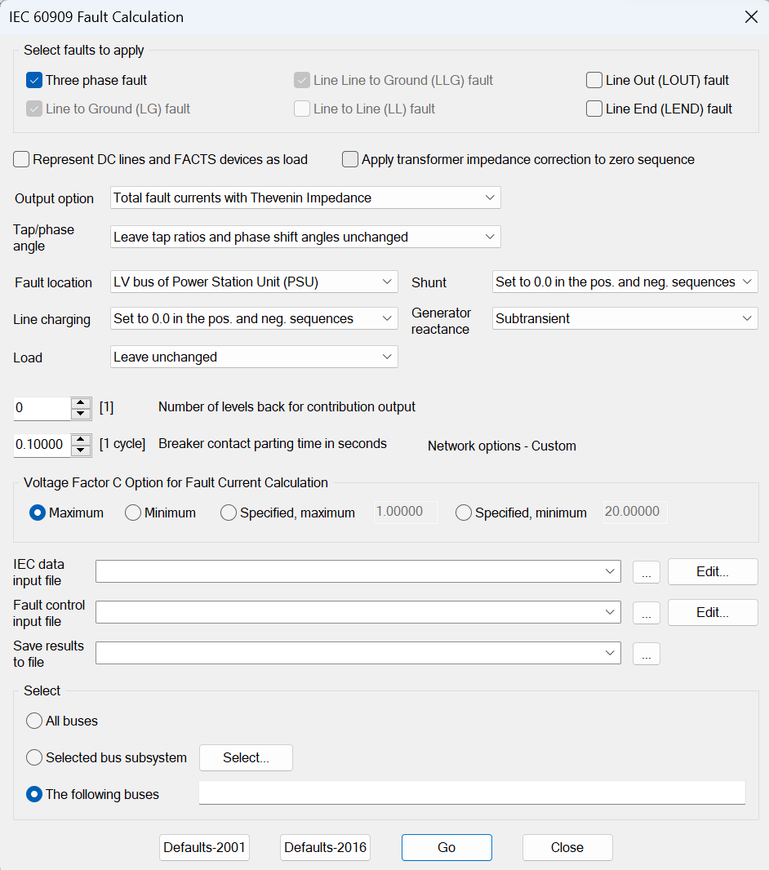
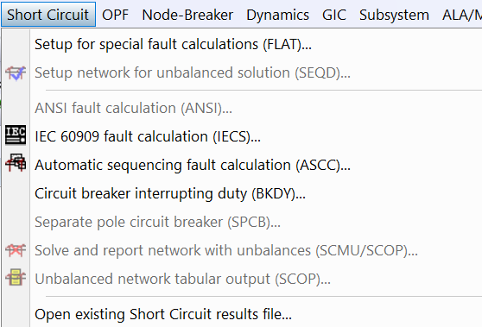
Short circuit current/MVA calculation in software:

Slide 45
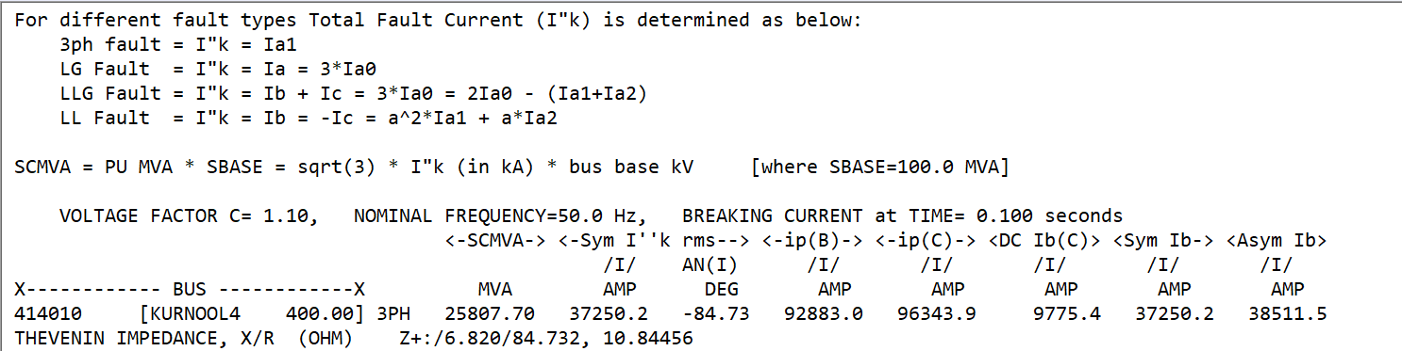
SC Studies out put (LLL):
For calculation fault current for L-G fault zero sequence impedance data is to be entered for all equipment and generators.

Slide 46
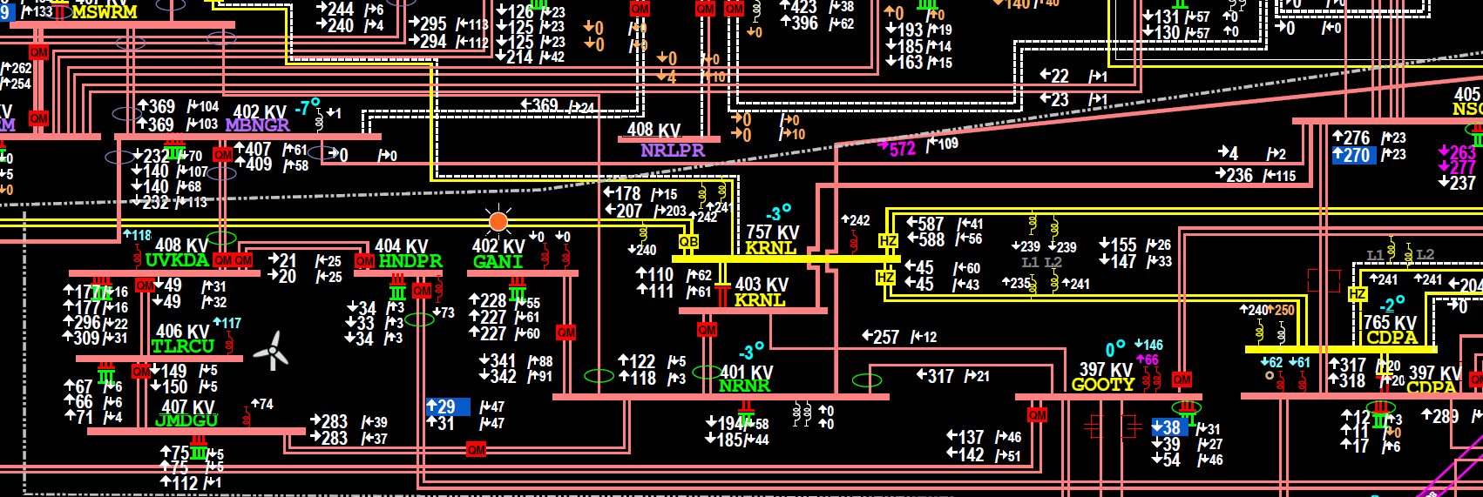
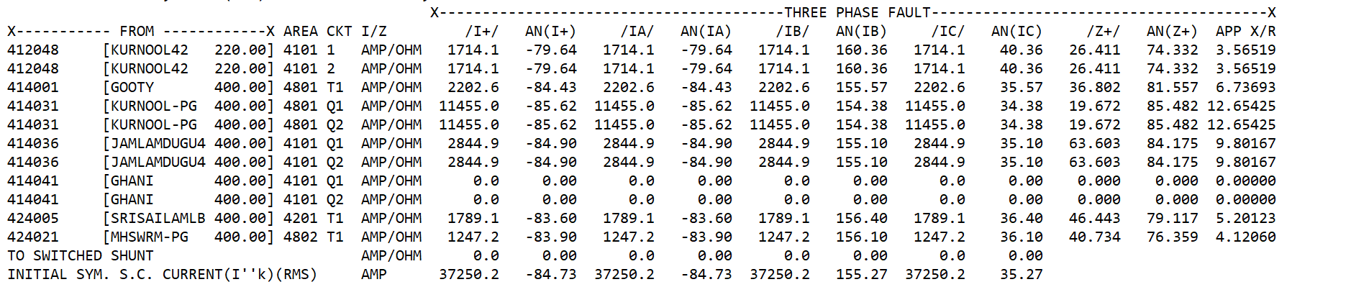
Fault contribution from various connected substations:

Slide 47
Fault contribution from various connected substations:
400/220kV Narnoor SS:

Slide 48
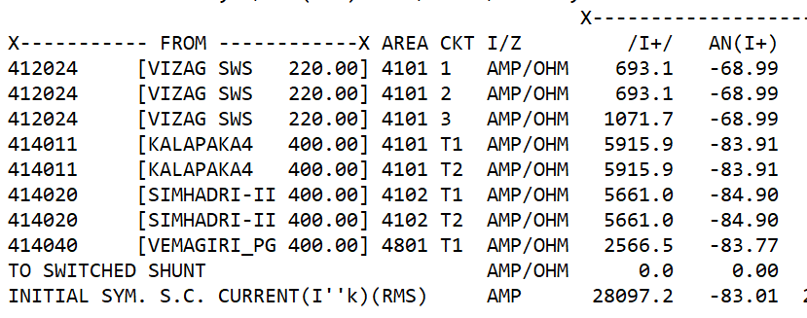
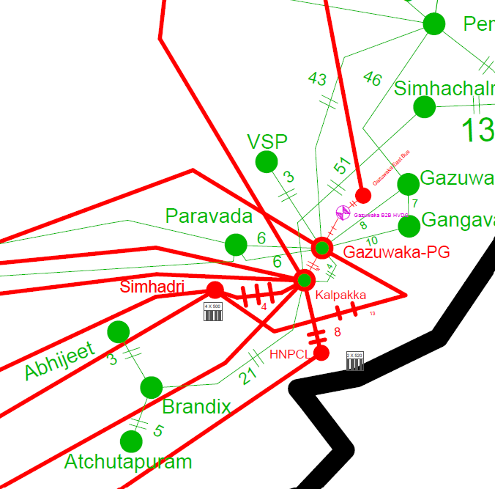
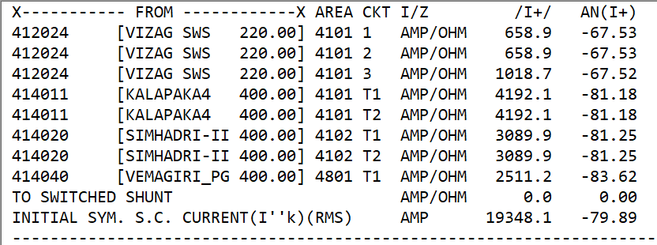
400kV Gazuwaka SC MVA with and without Simhadri Generators:
With Simhadri Generators (4x500 MW)
Without Simhadri Generators (4x500 MW)

Slide 49
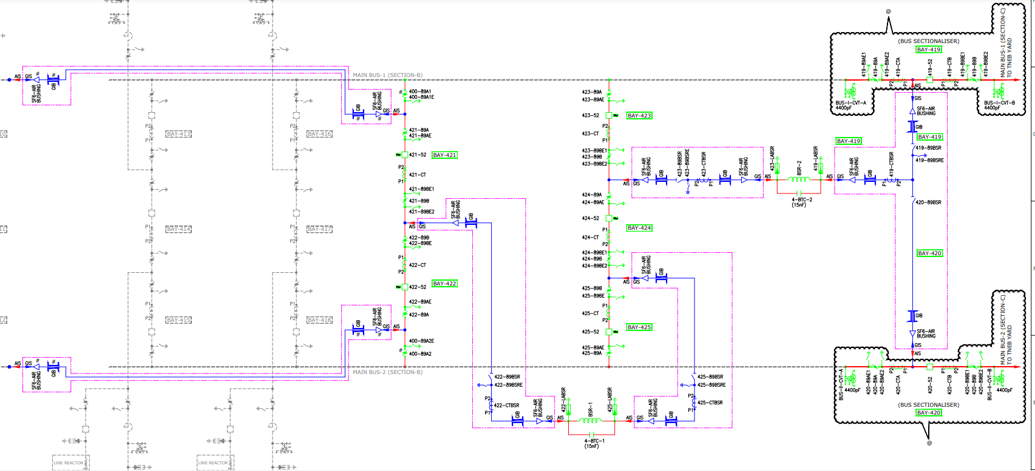
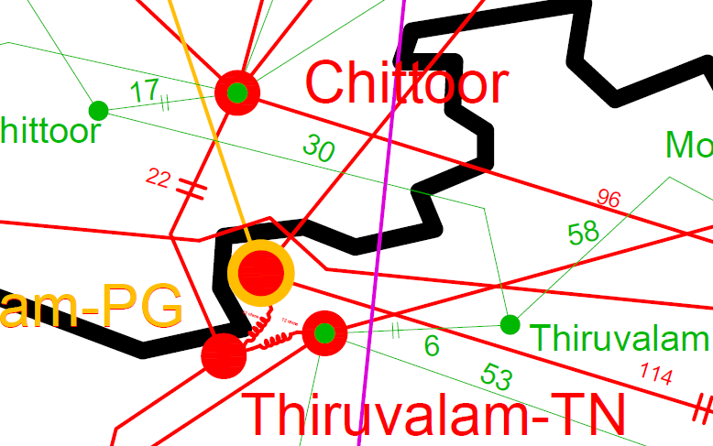
Bus series reactors at 400kV Thiruvallam SS:

Slide 50
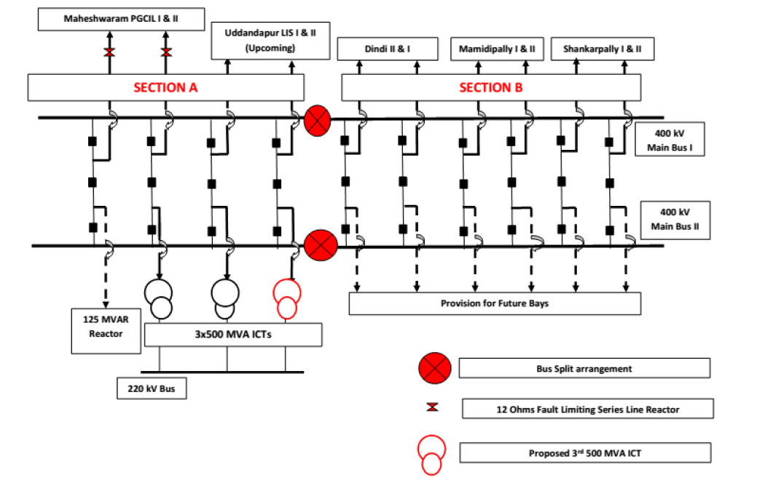
Proposal of Line series reactors and Bus split at 400kV Maheswaram SS:

Slide 51

Short circuit MVA based on PMU data
Change in voltage=3kV =0.0075 pu
Fault MVA=125/0.0075 =16666 MVA
Short circuit current =24kA

Slide 52

Short circuit MVA based on PMU data
Change in voltage=2.6kV =0.0065 pu
Fault MVA=125/0.0065 =19230 MVA
Short circuit current=28kA

Slide 53
CEA Planning criteria on SC study
The short circuit studies shall be carried out using the classical method with flat pre-fault voltages and sub-transient reactance (X”d) of the synchronous machines.
MVA of all the generating units in a plant may be considered for determining maximum short-circuit level at various buses in system. This short-circuit level may be considered for substation planning.
Vector group of the transformers shall be considered for doing short circuit studies for asymmetrical faults. Inter-winding reactances in case of three winding transformers shall also be considered.
For evaluating the short circuit levels at a generating bus (11kV, 13.8kV, 21kV etc.), the unit and its generator transformer shall be represented separately.

Slide 54
CEA Planning criteria on SC study…
Short circuit level both for three phase to ground fault and single phase to ground fault shall be calculated.
The short-circuit level in the system varies with operating conditions, it may be low for light load scenario compared with for peak load scenario, as some of the plants may not be on-bar.
For getting an understanding of system strength under different load-generation / export-import scenarios, the MVA of only those machines shall be taken which are on bar in that scenario.

Slide 55

CEA Planning criteria on Fault level
The maximum short-circuit level on any new substation bus should not exceed 80% of the rated short circuit capacity of the substation equipment. The 20% margin is intended to take care of the increase in short-circuit levels as the system grows. The rated breaking current capability of switchgear at different voltage levels may be taken as given below:
Measures such as splitting of bus, series reactor, or any new technology may also be adopted to limit the short circuit levels at existing substations wherever they are likely to cross the designed limits.

Slide 56
Quiz
Impact of Short Circuit Ratio
🞑 What is the expected voltage rise for idle charging 300 kMs twin moose line from a 400 kV level substation when fault level of substation is
8000 MVA
17000 MVA
Impact reactor rating
🞑 Expected voltage dip at above substation when charging 63 MVAr Reactor and when charging 125 MVAr reactor

Slide 57

Thank You
vamshiballikonda@gmail.com
+91 9480811828

Slide 58

Y-Bus Matrix Properties:
N-bus system size of admittance matrix is NxN
The matrix is symmetric, i.e., Yij=Yji.
A diagonal element Yii = Self Admittance
is obtained as the sum of admittances for all branches connected to bus i, including the shunt branch
The off-diagonal elements are the negative of the admittances connecting buses i and j, i.e., Yij=-yji = mutual admittance.
Summation of all the elements of ith row of admittance matrix is the value of shunt admittance at that bus.

Slide 59

Available information:

Slide 60
Quantities to be determined:
The magnitude of the voltage at every bus where this is not specified in the input data.
The phase of the voltage at every bus
The reactive power output of each plant for which it is not specified
The real power, reactive power, and current flow in each transmission line and transformer

