Slide 1


Professional Ethics, Work Culture & Moral Values

Slide 2
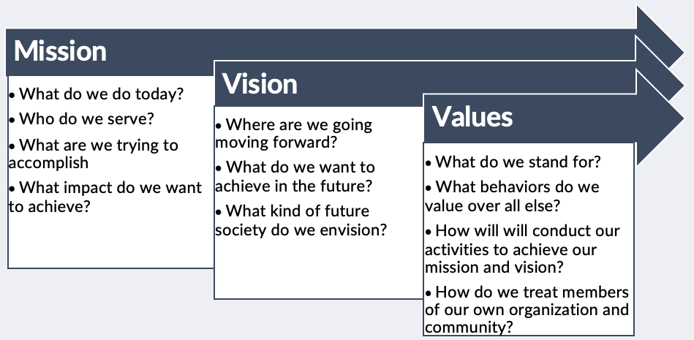

Slide 3
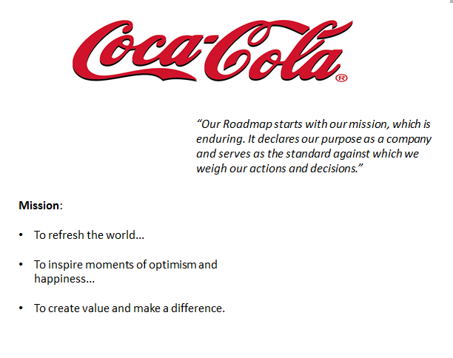

Slide 4
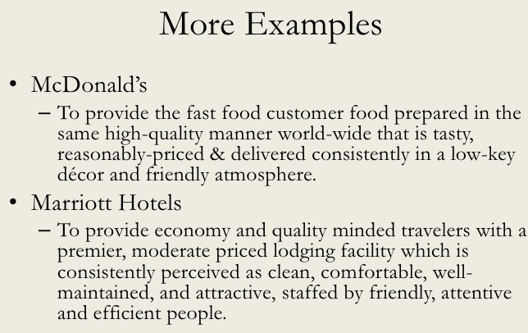

Slide 5
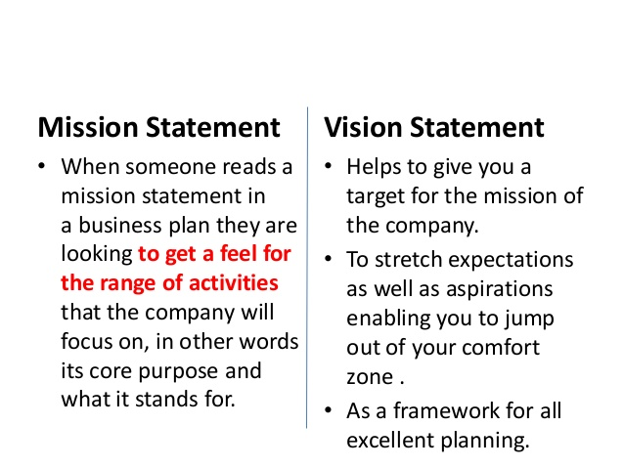

Slide 6
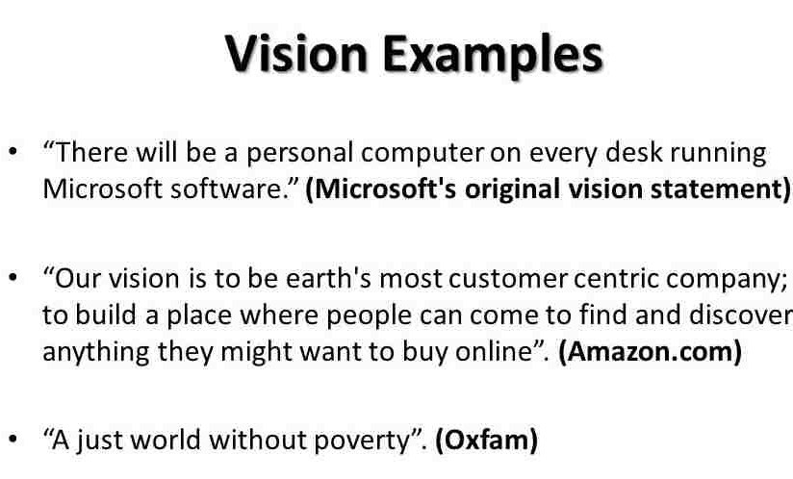

Slide 7
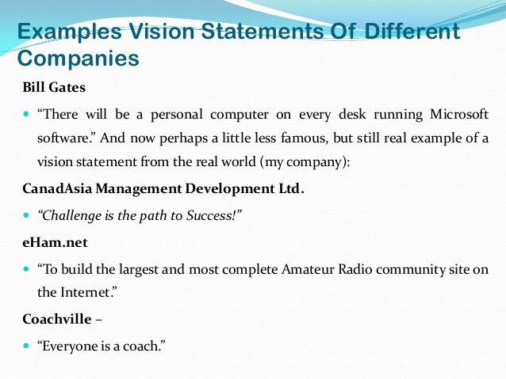

Slide 8


Slide 9
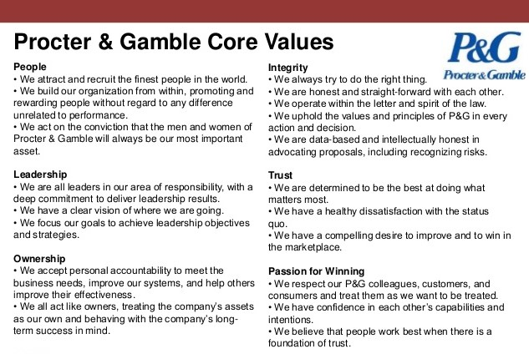

Slide 10
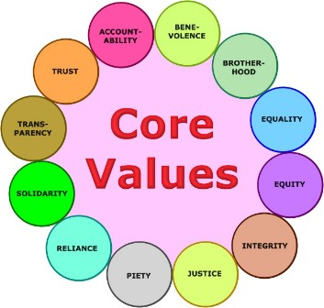

Slide 11

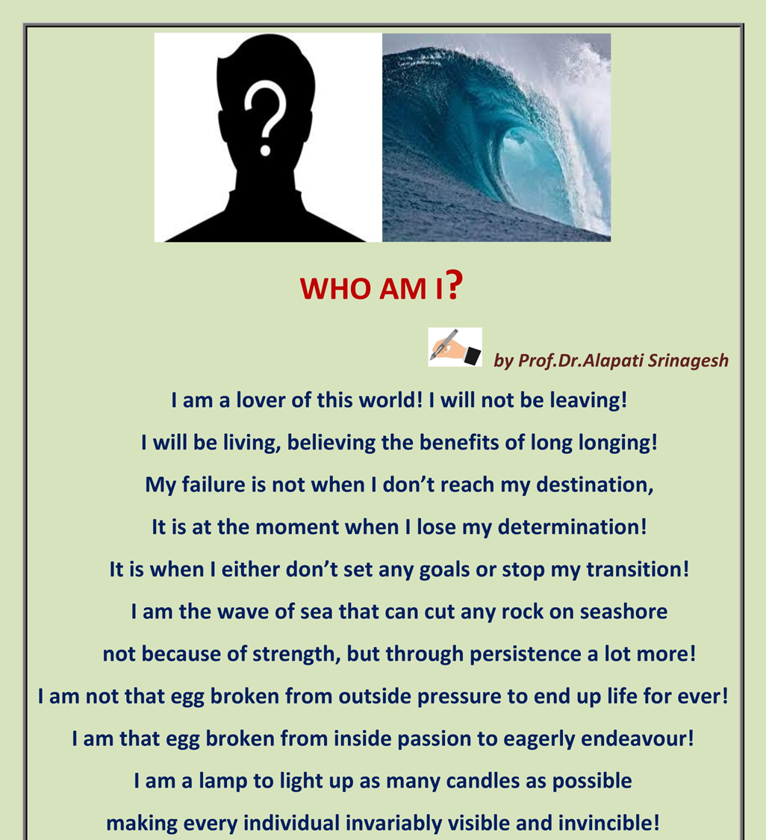
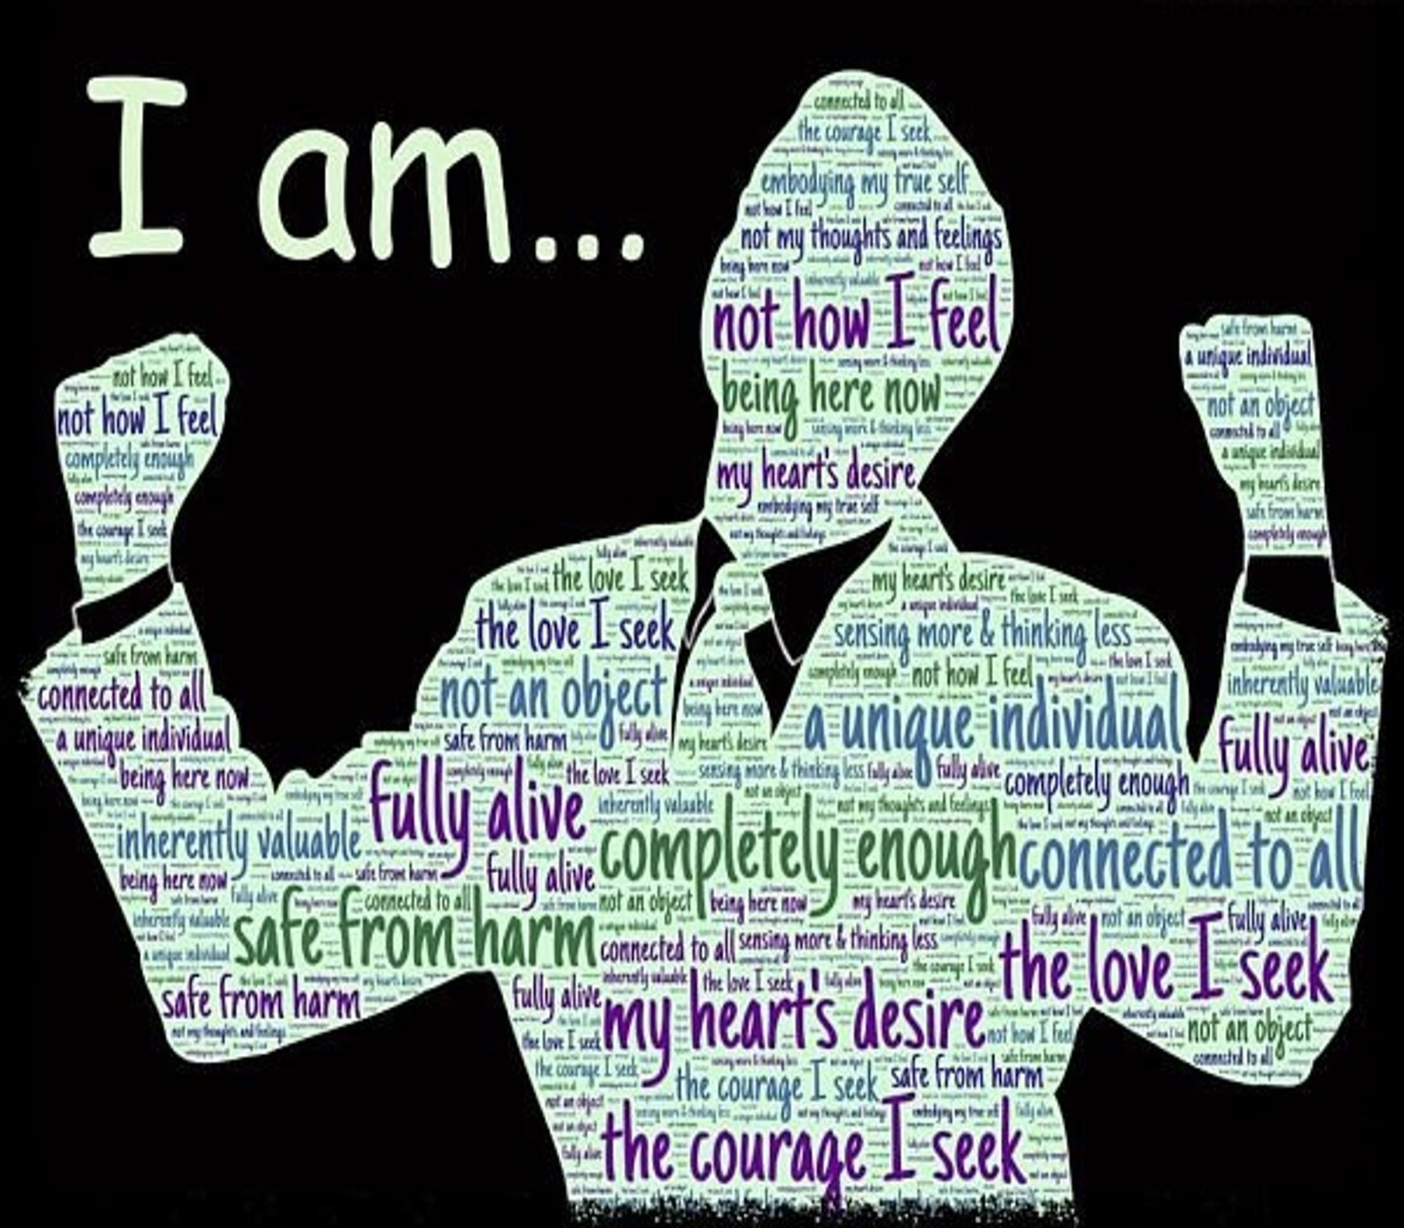

Slide 12
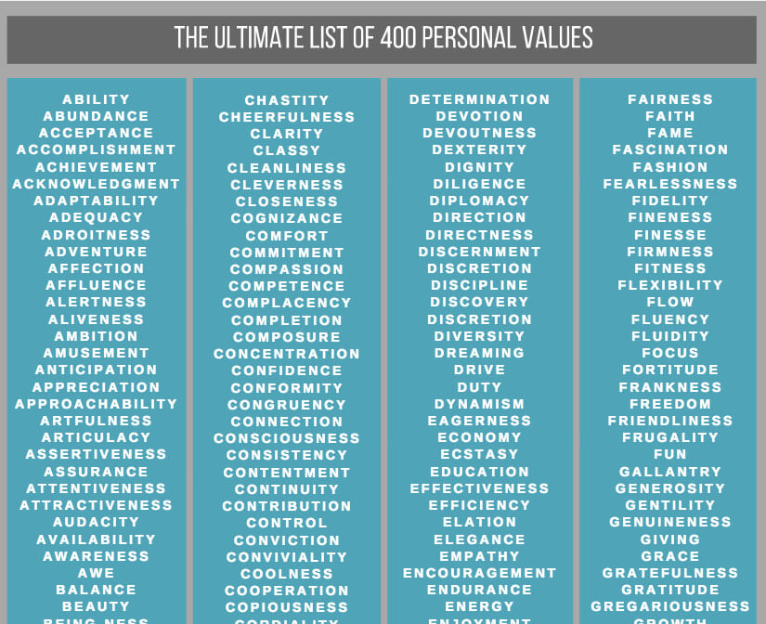

Slide 13

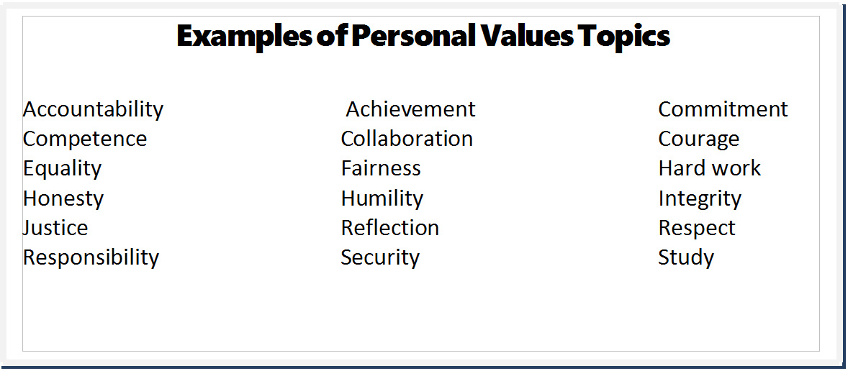

Slide 14
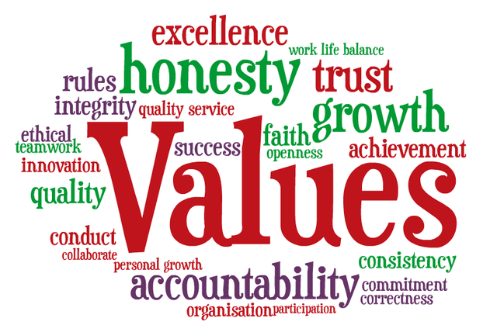

Slide 15


Slide 16


ETHICS IN MANAGEMENT
Character doesn’t stay at home when we go to work.
WATCH:
Ethics is derived from Greek word Ethos
-Character
- Sentiments of society

Slide 17

ETHICS
The rules or standards governing the conduct of a person or the members of a profession
The study of the general nature of morals and of the specific moral choices to be made by a person; moral philosophy.

Slide 18
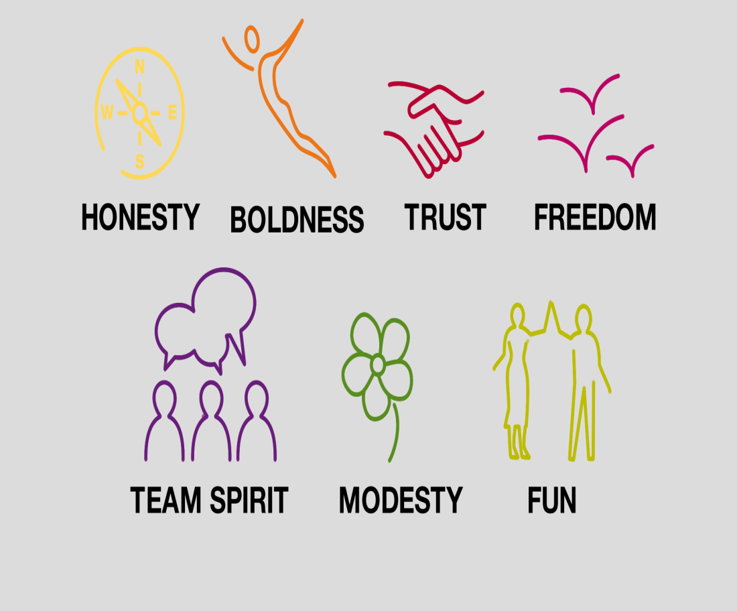
Ethics is about our actions and decisions.
Ethical dilemmas
Consist of conflicts between right & right
Moral temptations
Consist of conflicts between right & wrong

Slide 19
PERSONAL ETHICS Everyday examples
• Software piracy
• Expense account padding
• Copying of homework or tests
• Income taxes
• “Borrowing” nuts and bolts, office supplies from employer
• Copying of Videos or CDs
• Plagiarism
• Using the copy machine at work

Slide 20
Fill the GAP in your knowledge
Gather and assess information
relevant
Confidentially
Apply laws
Policy & procedures
service wide
agency specific

Slide 21
Ethical tenet
Tenet: Doctrine held by a group or person
In business, other terms used in place of “tenet” include value, belief, and principle
Which word works best…?

Slide 22
The 5 P’s of Ethical Management (Blanchard & Peele)
Purpose – your personal vision
Pride – your sense of satisfaction
Patience – sometimes it’s a long road
Persistence – standing your ground
Perspective – be focused and clear
“There is no pillow as soft as a clear conscience.”- French Proverb

Slide 23
Is it Legal? (Blanchard & Peele)
Violation of criminal laws?
Violation of civil laws?
Violation of company policy?
Appearance of being improper or immoral?
Will it harm or embarrass the customers or company?
“Reputation is character minus what you’ve been caught doing.”
– Michael Iapoce,
A Funny Thing Happened on the Way to the Boardroom

Slide 24
Is it Right? (Blanchard & Peele)
How will it make you feel about yourself?
Will you be proud of yourself after making this decision?
How would you feel if your decision made the front page?
“The time is always right to do the right thing.”
- Dr. Martin Luther King, Jr.

Slide 25
The Ethics Check (Blanchard & Peele)
Is it legal?
Is it balanced?
How will it make you feel about yourself?
“It’s not hard to make a decision when you know what your values are.”- Roy Disney

Slide 26
At the End of the Day (Blanchard & Peele)
How do you feel about yourself?
How do others feel about you?
Did what you do match what you said?
Did what you do match what you feel?
Did what you do match what other people believe is right or good?
“Live in such a way that you would not be ashamed
to sell your parrot to the town gossip.”
- Will Rogers

Slide 27
Ethical Tenets
Organizational acts originate in the choices, behaviors, and actions of individuals
Ethical decisions may, at some point, involve any and all organizational stakeholders
Personal ethics and organizational ethics cannot be separated
You are part of the organization…

Slide 28
Issac Asimov:
“Never let your sense of morals
prevent you from doing
what is right.”

Slide 29
Why bother ?
We are all different.
Our values are different.
Hence,
our behaviours.
[ HENCE, THE CONSEQUENCES ]

Slide 30

Would You Lie?

Slide 31
Divine
Human
Animal

Slide 32
Values are needed
to move towards DIVINITY
Values
are shaped by our
nature-nurture influences

Slide 33
Morals are determined
within a broad context of a culture or society
Our morals
affect our interactions
with others in all aspects of our life

Slide 34
Ethics
help in orienting our own behaviour
and
helps to interpret
the behaviour of others

Slide 35
Ethics is a study of
good conduct, character, & motives and is concerned with determining
what is good or valuable
for all people

Slide 36
Individual
and
Society
Individual gain Vs.
Social good

Slide 37
Professional Ethics
implies and assumes
responsibility and accountability
for whatever you are doing

Slide 38
Morals
define personal character, while
ethics
stress a social system in which those morals are applied.

Slide 39
‘Act in such a way that
you always treat humanity,
whether in your own person or
in the person of any other,
never simply as a means, but always
at the same time as an end.’
Does the action you propose
result in USING someone?

Slide 40
ACCOUNTABILITY
Being answerable
for one’s own actions.
Accountable to self,
the profession,
the employer,
and society

Slide 41
What is a Dilemma?
A difficult problem
seemingly incapable of
a satisfactory solution.
A situation involving
choice between
equally unsatisfactory alternatives.

Slide 42
Ethical dilemmas
are situations involving
conflicting morals claims,
and give rise in such questions as :
What is ought to be done ?
What harm and benefit result
from this decision or actions ?
What is good [virtue]
or what is duty [right] ?

Slide 43
Professional Ethics
Codes of conduct
established by professionals
to govern ethical behavior
within that profession.

Slide 44
The answer to the question
“what must I do in X case?”
should be based on
ethical values,
as well as,
on professional knowledge.

Slide 45
ETHICS
seeks to answer questions about morality;
that is about concepts like
good and bad, right and wrong, justice, virtue, etc.
MORALS
means a set of beliefs
distinguishing right and wrong behaviours.
VALUES
show something’s degree of importance
with the aim of determining
what action or life is best to do or live.

Slide 46
QUESTIONS TO ASK
Is it the right thing to do?
Will this stand the test of public?
If something terrible were to happen,
could I defend my actions?
Is it balanced and fair?
[contd]

Slide 47
QUESTIONS TO ASK [contd]
How will it make me feel about myself?
Does this choice lead to the greatest good for the greatest number of people?
And the most important one
for self judgement :
Would I do this in front of my family?

Slide 48
DISCUSSING ETHICAL DILEMMAS
What values come into play for you personally in resolving this situation?
What consequences might your decision have on the others involved?
Could you personally live with this decision?

Slide 49
Certain other issues : ETHICAL DILEMMAS
Money earning attitude –
taking up private coaching,
working in Tutorial Colleges, etc.
Personal Life – habits, hobbies, leisure-time activities – life beyond college working hours
The need to be a Role Model

Slide 50
Why do people act in unethical ways?
○ Self-deception – people have different personalities when working, and when not working. Often the quote, “everyone else was doing it” is commonly thought of under this category.
○ Self-indulgence – “it was done on behalf of someone else”
○ Self-protection – lying to try and fix a problem, or stop a problem from occurring, may result working in an unethical way.
○ Self-righteous – one view is right, and no other view matters.

Slide 51
For in the same way you judge others, you will be judged, and with the measure you use, it will be measured to you.

Slide 52

4
PURUSHARTHAS
&
ASHRAMAS
DHARMA
ARTHA
KAMA
MOKSHA
BRAHMACHARYA
GRUHASTHA
VANAPRASTHA
SANYASA

Slide 53
In DARKNESS, you cannot see.
In DARKNESS – you can THINK.
Whether in LIGHT or in DARKNESS
we can THINK –
What type of THOUGHTS
we are getting ?

Slide 54

YOU
ARE
YOUR
........
THOUGHTS
BE AWARE OF . . .
&
BE CAREFUL ABOUT . . .

Slide 55
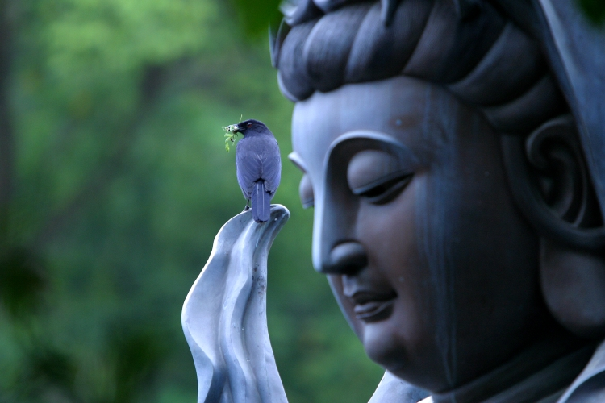
W. A. T. C. H.
W = WORDS
A = ACTIONS
T = THOUGHTS
C = CHARACTER
H = HEAD & HEART

Slide 56
LOVE FOR GOD
FEAR OF SIN
SOCIAL MORALITY

Slide 57
LOVE – the most basic human value
IN UNDERSTANDING
with love in
your heart
in speech
TRUTH
in action
RIGHTEOUSNESS
in thought
PEACE
in understanding
NON- VIOLENCE

Slide 58
START THE DAY WITH L O V E
SPEND THE DAY WITH L O V E
FILL THE DAY WITH L O V E
END THE DAY WITH L O V E
~ that is the way to practice
V A L U E S

Slide 59
Give your
Honest Best,
Always,
and ADD LOVE
to whatever you are doing.

Slide 60
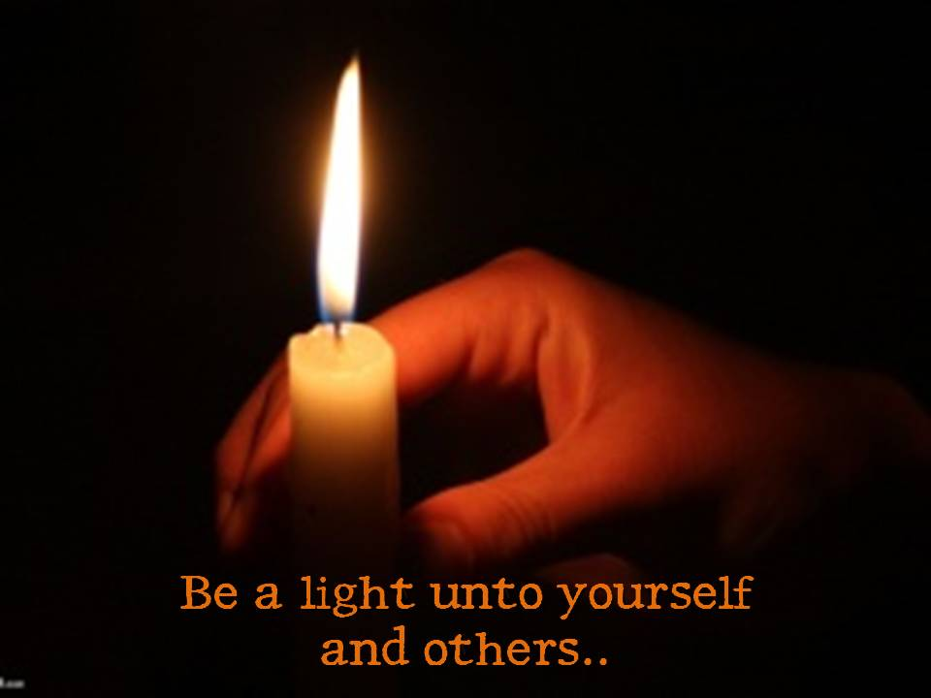

Notes:
60

Slide 61
PROFESSIONAL ETHICS
Professional ethics encompass the personal, organizational and corporate standards of behaviour expected of professionals.
Professionals, and those working in acknowledged professions, exercise specialist knowledge and skill. How the use of this knowledge should be governed when providing a service to the public can be considered a moral issue and is termed professional ethics.
Professionals are capable of making judgements, applying their skills and reaching informed decisions in situations that the general public cannot, because they have not received the relevant training.
One of the earliest examples of professional ethics is the Hippocratic Oath to which medical doctors still adhere to this day.

Slide 62
Components
Some professional organizations may define their ethical approach in terms of a number of discrete components. Typically these include:
Honesty
Integrity
Transparency
Accountability
Confidentiality
Objectivity
Respectfulness
Obedience to the law
Loyalty

Slide 63
what is ethical behavior?
Ethical Behavior
- what is accepted as “good” and “right” in the context of the governing moral code
Values
broad beliefs about what is or is not appropriate behavior

Slide 64
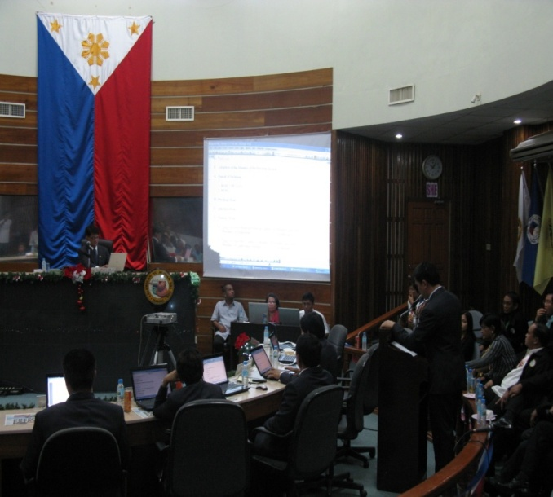

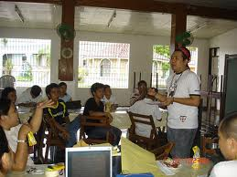
PUBLIC OFFICE
Public office is both a duty and a position of great importance in a government bureaucracy.

Slide 65
Public office is a public trust. Public officers and employees must at all times be accountable to the people, serve them with utmost responsibility, integrity and loyalty, and efficiency, act with patriotism and justice, and lead modest lives.

Slide 66

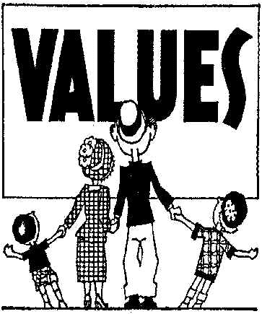
Values of Public Administration
The sum of the values of the people in a society it serves.
It changes as rapidly as do the people values

Slide 67
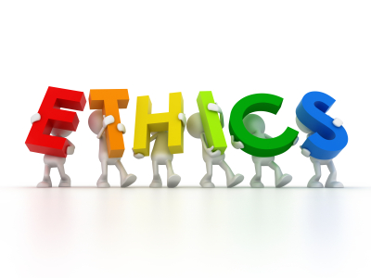

“The greatest ethical test that we're ever going to face is the treatment of those who are at our mercy.” Lyn White
In law a man is guilty when he violates the rights of others. In ethics he is guilty if he only thinks of doing so. - Immanuel Kant
Non-violence leads to the highest ethics, which is the goal of all evolution. Until we stop harming all other living beings, we are still savages.- Thomas A. Edison

Slide 68
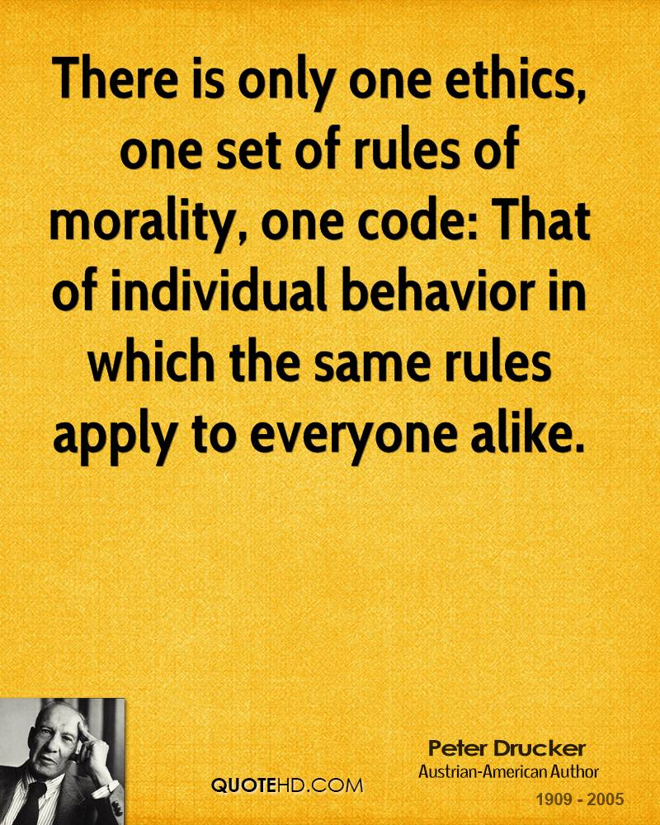

Slide 69
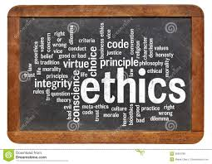
Ethics is the activity of man directed to secure the inner perfection of his own personality.- Albert Schweitzer
Apart from values and ethics which I have tried to live by, the legacy I would like to leave behind is a very simple one - that I have always stood up for what I consider to be the right thing, and I have tried to be as fair and equitable as I could be. Ratan Tata

Slide 70
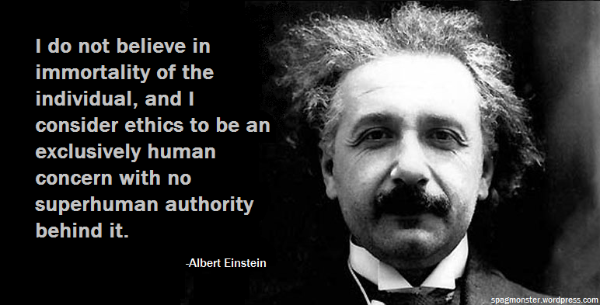

Slide 71
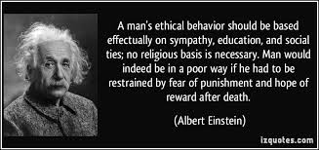

Slide 72
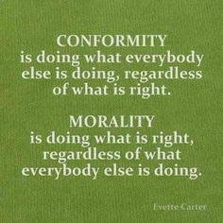

Slide 73
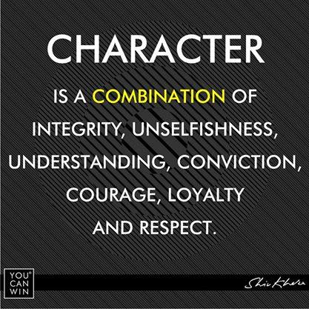

Slide 74
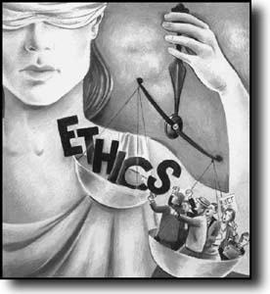
Administrative ethics
Ethics is a way of life
“Society’s view of what constitutes appropriate behavior by its public officials”

Slide 75

Ethics in the workplace
What is an ethical dilemma?
Situation that requires choosing a course of action

Slide 76
Examples of ethical dilemmas
Should I support my bosses incorrect views?
Should I sign a false document?
Should I accept a gift from a client?
Should I give special treatment to a friend of boss’ friend?

Slide 77
Ethical Dilemmas
Confronting conflicting responsibilities is the most typical way public administrators experience ethical dilemmas.
- Terry Cooper
What Are Your Responsibilities?
To the public
To the stakeholders
To the organization
To the profession
To your colleagues
To yourself

Slide 78
9 causes/factors of negative behavior in government:
1. The difficulty of coping the economic realities because of unrealistic salary levels of government employee;
2. The excessive desire for wealth and the “good life” among other higher-echelon government officials;
3. Low moral standards or values
4. An administrative behavior that facilitates or support corruption

Slide 79
9 causes/factors of negative behavior in government:
5. Related to the preceding factor, strong corrupting influence of clientele
6. Bad example set by the leadership
7. The kinship system
8. A cumbersome system of justice
9. Unenforceable and obsolete laws

Slide 80
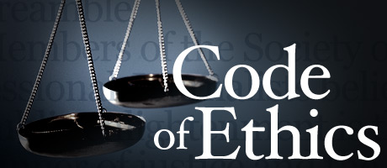
Code of ethics for pubic service
Code of Ethics s a self-regulation manual among professionals

Slide 81

For most public servants the taking of an oath of loyalty merely formalizes a resolution already made. It amounts to an outer expression of an inner dedication - the legal aspects of a code of ethics by which the public employee is guided in all his official acts and by which he expects all his fellow workers to proceed
John A. Vieg

Slide 82

How
was this
Session ?
Did something touch
your HEART ?

Slide 83
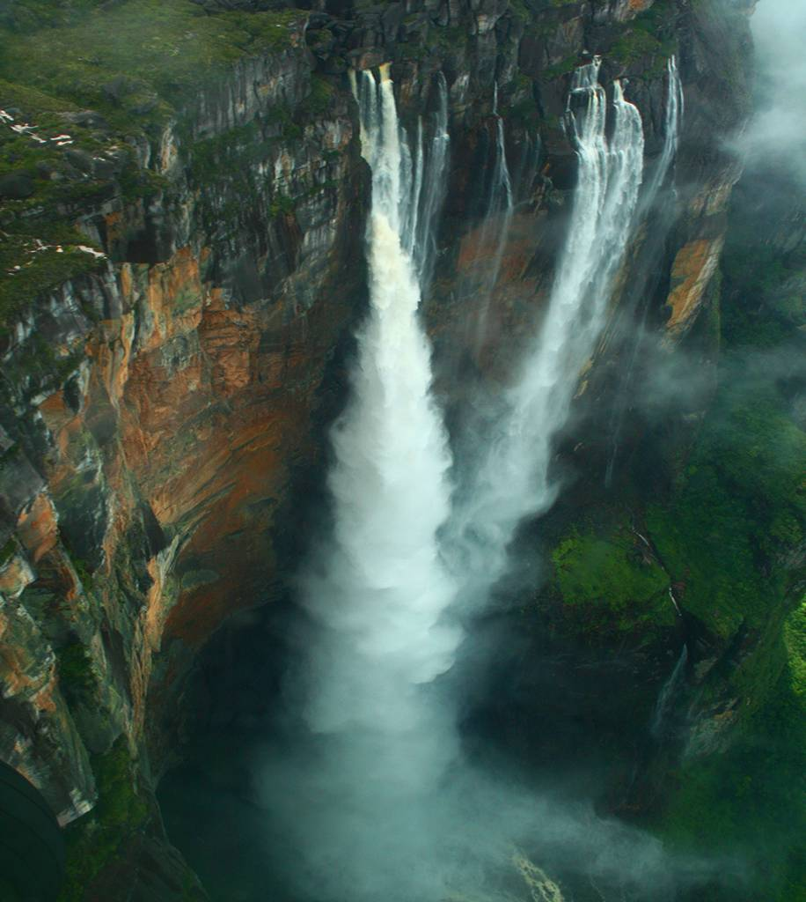

Thank you once again
22 October 2024
83
Notes:
83

Slide 84


WhatsApp: 8790713552 Phone: 9346239452
LinkedIn Profile URL https://www.linkedin.com/in/alapatisrinagesh
2 Minute Professional Video Resume
https://www.youtube.com/watch?v=D7jZsMowkwc
YouTube Channel URL
https://www.youtube.com/channel/UC_fNuX1Q-3UM4C9Gk8xlyGQ
https://twitter.com/vijayeebhava

Slide 85

