Slide 1
Technical Training Programme
BY
A. Srinivasu
EE/MRT/400KV/ VSP

Slide 2
Introduction
This topic involves:
Functioning of various relays in 132 kV , 220 kV & 400 kV Substations i.e. feeders and PTR’s.
Reason for mal – Operation of relays in the EHT sub-stations.
Various types of numerical relays being adopted in APTRANSCO at various EHT sub-stations.

Slide 3
Cable Schedules and Ferrules
In our APTRANSCO Substations , Switch yard equipment Like CT , CVT, Circuit Breakers, Power transformer and station transformer and control room equipment like Battery bank , Battery charger ,DCDB , ACDB, C&R panel , Telecom panel are inter connected through Marshalling boxes, Terminal connectors and control cables.

Slide 4
Current Transformer
CVT /
BUS PT
Circuit Breaker
Isolator
MB
MB
MB
MB
FCC
Power Transformer
Station Transformer
Telecom Panels
Control and Relay Panels
DCDB
ACDB
JB
Battery Charger
CT / PT signals
DC Supply
Battery Bank
Back Up DC
AC Supply
Telecom signals

Slide 5
Marshaling Boxes
Terminal Blocks were provided in MB to connect cables from CT (R,Y,B) to CTMB and CTMB to C&R panel.
In Marshaling TBs, Concerned cables of MB (CTMB) are connected on the left side of TB and receiving end equipment (C&R panel) cables are connected right side of TBs.

Slide 6
Types of Terminal Blocks
Terminal Blocks
Disconnecting type:
Link provided to make and break the TB. These are used for testing and trouble shooting works . Used for CT,CVT,DC and AC terminals
Non Disconnecting type:
Used for Control and
Indication type Signals

Slide 7
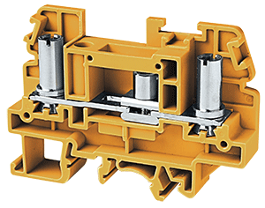
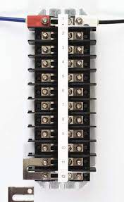
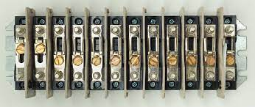
Disconnecting type Sliding TB Block
Non Disconnecting type TB Block

Slide 8
Ferrules for Cable terminations :
S.No | Ferrule | Description | example
1 | A | Distance protection / Main Protection CT currents | A511(Rph),A531(Yph),A551(Bph),A571(N)
2 | B | Bus bar Protection CT Currrents | B111(Rph),B131(Yph),B151(Bph),B171(N)
3 | C | Over current protection / Back up Protection CT currents | C411(Rph),C431(Yph),C451(Bph),C471(N)
4 | D | Metering current | D311(Rph),D331(Yph),D351(Bph),D371(N)
5 | E | CVT/PT Secondary voltages | E111(Rph),E131(Yph),E151(Bph),E171(N)
6 | G | Ground
7 | H | AC supply | H1(Ph) , H2(N)
8 | J | DC Source | J1(+ve) , J2(-ve)
9 | K | Control Circuits | K1(+ve),K2(-ve)
10 | L | Indication Circuit | L1(+ve),L2(-ve)
11 | M | Motor Circuit
12 | N | Neutral
13 | S | CT Secondary | 1s1,1s2,2s1,2s2,3s1,3s2
14 | a | PT Secondary | 1a1,1an,2a1,2an,3a1,3an
15 | U | NO/NC contacts or Spare
Ferrules means using of Alphabets and numbers for identification of cable terminations.

Slide 9
Cable scheduling of CT secondary cables:
R-ph Secondary CTJB
Y-ph Secondary CTJB
B-ph Secondary CTJB
Current Transformer Marshaling Box
C & R Panel
Bus Bar / LBB
BCU / TVM
Main 2 Relay
Main 1 Relay
***Note :1. For Bus bar , S1 of secondary is shorted to form star point and connected to ground.
2. For others , S3 (or other according to CT ratio) of secondary is shorted to form star point and connected to ground

Slide 10
CT Marshalling Box
R ph CT
TB 1
TB 3
TB 4
TB 5
Core 1
Core 3
Core 4
Core 5
Y ph CT
C & R Panel
TB 2
B ph CT
Core 2

Slide 11
CT Cable Scheduling from CTJB to CTMB:
4-1-CT R-1S1-1S1-R / TB1-C1-1 -1S1-R
1.Equipment
2.Cross Ferrule from CT JB
4-1
CT
R-1S1
1S1
R
Bay Number
Equipment
Connection No.
Wire No.
Phase.
3.Ferrule to CTMB
MB
TB1
C1
1
1S1
R
Box/Chamber
Terminal Block
Core
Connector No.
Wire No.
Phase.

Slide 12
CT Cable Scheduling from CTJB to CTMB:
SL. NO | CABLE NO. |  |  | EQUIPMENT DESIGNATION |  | SIZE | NO. OF RUNS | ESTIMATED LENGTH | INTERCONNECTION DETAILS |  |  | Wire Nos. |  | Ferrule Nos. |  | APPLICATION
 |  |  |  | FROM | TO |  |  |  | CORE | FROM | TO | FROM | TO | FROM | TO
10 | 4 | 01 | 110 | 4-1-CT R | 4-1-CT MB | 5Cx2.5 | 1 | 22 | 1 | 1S1 | TB1-C1-1 | 1S1-R | 1S1-R | 4-1-CT MB-TB1-C1-1 -1S1-R/ 1S1-1S1-R | 4-1-CT R-1S1-1S1-R / TB1-C1-1 -1S1-R | CORE -1
 |  |  |  |  |  |  |  |  | 2 | 1S2 | TB1-C1-2 | 1S2-R | 1S2-R | 4-1-CT MB-TB1-C1-2 -1S2-R/ 1S2-1S2-R | 4-1-CT R-1S2-1S2-R / TB1-C1-2 -1S2-R | LBB PROTN & BB PROTN
 |  |  |  |  |  |  |  |  | 3 | 1S3 | TB1-C1-3 | 1S3-R | 1S3-R | 4-1-CT MB-TB1-C1-3 -1S3-R/ 1S3-1S3-R | 4-1-CT R-1S3-1S3-R / TB1-C1-3 -1S3-R
 |  |  |  |  |  |  |  |  | 4 | 1S4 | TB1-C1-4 | 1S4-R | 1S4-R | 4-1-CT MB-TB1-C1-4 -1S4-R/ 1S4-1S4-R | 4-1-CT R-1S4-1S4-R / TB1-C1-4 -1S4-R
 |  |  |  |  |  |  |  |  | 5 | SPARE
11 | 4 | 01 | 111 | 4-1-CT Y | 4-1-CT MB | 5Cx2.5 | 1 | 10 | 1 | 1S1 | TB1-C1-5 | 1S1-Y | 1S1-Y | 4-1-CT MB-TB1-C1-5 -1S1-Y/ 1S1-1S1-Y | 4-1-CT Y-1S1-1S1-Y / TB1-C1-5 -1S1-Y | CORE -1
 |  |  |  |  |  |  |  |  | 2 | 1S2 | TB1-C1-6 | 1S2-Y | 1S2-Y | 4-1-CT MB-TB1-C1-6 -1S2-Y/ 1S2-1S2-Y | 4-1-CT Y-1S2-1S2-Y / TB1-C1-6 -1S2-Y | LBB PROTN & BB PROTN
 |  |  |  |  |  |  |  |  | 3 | 1S3 | TB1-C1-7 | 1S3-Y | 1S3-Y | 4-1-CT MB-TB1-C1-7 -1S3-Y/ 1S3-1S3-Y | 4-1-CT Y-1S3-1S3-Y / TB1-C1-7 -1S3-Y
 |  |  |  |  |  |  |  |  | 4 | 1S4 | TB1-C1-8 | 1S4-Y | 1S4-Y | 4-1-CT MB-TB1-C1-8 -1S4-Y/ 1S4-1S4-Y | 4-1-CT Y-1S4-1S4-Y / TB1-C1-8 -1S4-Y
 |  |  |  |  |  |  |  |  | 5 | SPARE
12 | 4 | 01 | 112 | 4-1-CT B | 4-1-CT MB | 5Cx2.5 | 1 | 22 | 1 | 1S1 | TB1-C1-9 | 1S1-B | 1S1-B | 4-1-CT MB-TB1-C1-9 -1S1-B/ 1S1-1S1-B | 4-1-CT B-1S1-1S1-B / TB1-C1-9 -1S1-B | CORE -1
 |  |  |  |  |  |  |  |  | 2 | 1S2 | TB1-C1-10 | 1S2-B | 1S2-B | 4-1-CT MB-TB1-C1-10 -1S2-B/ 1S2-1S2-B | 4-1-CT B-1S2-1S2-B / TB1-C1-10 -1S2-B | LBB PROTN & BB PROTN
 |  |  |  |  |  |  |  |  | 3 | 1S3 | TB1-C1-11 | 1S3-B | 1S3-B | 4-1-CT MB-TB1-C1-11 -1S3-B/ 1S3-1S3-B | 4-1-CT B-1S3-1S3-B / TB1-C1-11 -1S3-B
 |  |  |  |  |  |  |  |  | 4 | 1S4 | TB1-C1-12 | 1S4-B | 1S4-B | 4-1-CT MB-TB1-C1-12 -1S4-B/ 1S4-1S4-B | 4-1-CT B-1S4-1S4-B / TB1-C1-12 -1S4-B
 |  |  |  |  |  |  |  |  | 5 | SPARE

Slide 13
CT Cable Scheduling from CTMB to C&R Panel:
4-1-CT MB-TB1-1-1S1-R / TB1-14 -B111
1.Equipment
2.Cross Ferrule from CT MB
4-1
CT
MB
TB1
C1
1
1S1
R
Bay Number
Equipment
Box/Chamber
Terminal Block
Core
Connector No.
Wire No.
Phase.
3.Ferrule to Relay Panel
TB1
14
B111
Terminal Block
Connector No.
Wire No.

Slide 14
CT Cable Scheduling from CTMB to C&R Panel:
SL. NO | CABLE NO. |  |  | EQUIPMENT DESIGNATION |  | SIZE | NO. OF RUNS | ESTIMATED LENGTH | INTERCONNECTION DETAILS |  |  | Wire Nos. |  | Ferrule Nos. |  | APPLICATION
 |  |  |  | FROM | TO |  |  |  | CORE | FROM | TO | FROM | TO | FROM | TO
4 | 4 | 01 | 204 | 4-1-CT MB | 4R1B | 10Cx2.5 | 1 | 70 | 1,2 | TB1-1 | TB1-14 | 1S1-R | B111 | 4R1B-TB1-14 -B111/ TB1-1-1S1-R | 4-1-CT MB-TB1-1-1S1-R / TB1-14 -B111 | CORE-1
 |  |  |  |  |  |  |  |  | 3,4 | TB1-5 | TB1-16 | 1S1-Y | B131 | 4R1B-TB1-16 -B131/ TB1-5-1S1-Y | 4-1-CT MB-TB1-5-1S1-Y / TB1-16 -B131 | LBB PROTN & BB PROTN
 |  |  |  |  |  |  |  |  | 5,6 | TB1-9 | TB1-18 | 1S1-B | B151 | 4R1B-TB1-18 -B151/ TB1-9-1S1-B | 4-1-CT MB-TB1-9-1S1-B / TB1-18 -B151
 |  |  |  |  |  |  |  |  | 7,8 | TB1-4 | TB1-20 | 1S4-N | B171 | 4R1B-TB1-20 -B171/ TB1-4-1S4-N | 4-1-CT MB-TB1-4-1S4-N / TB1-20 -B171
 |  |  |  |  |  |  |  |  | 9,10 | SPARE

Slide 15
ANSI / IEEE Standard Device Numbers for Relays
2 -- Time Delay Starting or Closing Relay
2/50Z : Timer Relay LBB Protection
2/50 ZX : Auxiliary Relay LBB Protection
2/99 : Timer Relay Over Current Protection
21 -- Distance Relay
21.1 :Distance Protection Main 1
21.2 : Distance Protection Main 2
24 -- Volts per Hertz Relay
27 -- UnderVoltage Relay
27X : Auxiliary Relay U/V protection
30 -- Annunciator Relay
30ABC : Auxiliary Relay Buchholz,HV wdg Temp, IV wdg Temp
30DEF :Auxiliary Relay LV Wdg, Oil Temp, Low oil Level
30 GHJ : Auxiliary Relay for PRV,Spare.
50 -- Instantaneous Overcurrent
50/51H : Non Dir. O/C Relay with High Select. CAG 17 HV Side
50/51L : Non Dir. O/C Relay with High Select. CAG 17 LV Side
50/51N : 1 Pole Inv.Time O/C or E/F Relay
50Z : Local Breaker Back up Protection Relay

Slide 16
ANSI / IEEE Standard Device Numbers for Relays
51 -- AC Inverse Time Overcurrent Relay
51ABC : Non Directional IDMT O/C Relay (CDG 11)
52 -- AC Circuit Breaker
59 -- Over voltage Relay
67 -- AC Directional OverCurrent Relay
67ABC : Dir. IDMT O/C Relay (CDD 21)
67 NH : Dir. IDMT E/F Relay with Inst.High
80 -- DC Supply supervision Relay
81 -- Frequency Relay
86 -- Lock Out Relay or Master Trip Relay
87 -- Differential Protective Relay
95 -- Trip Circuit Supervision Relay
96 -- Auxiliary Bus bar trip / LBB trip relay
Suffixes Indicating Zoe of Protection
B -- BUS
G -- Ground or Generator
L -- Line
N -- Neutral
T -- Transformer
U -- Unit.

Slide 17
Protection Relays used for Various Feeders / PTRs:
Non Directional 3 O/L + 1 E/L with High Set
33 kV Feeders
132 kV Feeders
1. Distance Protection or LDP
2. Back up Directional 3 O/L + 1 E/L
132/ 32 kV PTRs
1. HV : Non Directional 3 O/L + 1 E/L
2. LV : Non Directional 3 O/L + 1 E/L
3. Differential Protection

Slide 18
Protection Relays used for Various Feeders / PTRs:
220 kV Feeders
1. Main 1 : Distance Protection or LDP
2. Main 1 : Distance Protection or LDP
220/132 kV PTRs
1. HV : Non Directional 3 O/L + Directional E/L
2. LV : Non Directional 3 O/L + Directional E/L
3. Differential Protection
220 kV SS
Bus Bar Protection

Slide 19
Protection Relays used for Various Feeders / PTRs:
400 kV Feeders
1. Main 1 : Distance Protection or LDP
2. Main 2 : Distance Protection or LDP
400/220 kV PTRs
1. HV : Directional O/L & E/L
2. LV : Directional O/L & E/L
3. Differential Protection
4. REF
400kV Bus
Bus Bar Protection

Slide 20
Protection Relays used for Various Feeders / PTRs:
400 kV Bus Reactor
1. Back up Distance Protection
2. Differential Protection
3. REF

Slide 21
Over Current Relays:
Over Current Relays
Over current Relay monitors the currents in the Relay and operates when the current exceeds the pickup value.
Over current Relays has to clear the faults as per the time setting.
There are different kinds of Relays based on time of operation.
1.DT Over current
2.Instantaneous
3.Inverse (IDMT)
4.Very Inverse
5. Extreme Inverse
Directional & Non Directional Relay
Phase over current & Earth fault Relay

Slide 22
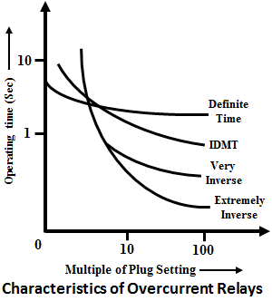
Different types of Over current Relays:
DT Over Current : Definite time O/C relay operates after predetermined time ,when the current exceeds its pick-up value the operating time independent of magnitude of fault current. It is used for DEF protection in 400kV & 220kV Distance relays.
Instantaneous O/C relay : Relay operates instantaneously when fault current exceeds the high set value . It is used for High set function in O/L and E/L relays.
Inverse time O/C relay : time of operation of relay inversely proportional to fault current . Time decrease as fault current increase.

Slide 23
Different types of Over current Relays:
4. IDMT O/C relay : combination of Inverse relay and definite time O/C relay acts as inverse relay when fault current exceeds the pick up value and later acts at definite time relay irrespective of fault current. It is used for O/L & E/L relays.
5. Very inverse O/C relay : Initially time of operation is low and saturation occurs at later stage. Used in Generating stations and Industries.
6. Extreme Inverse : Time of operation is very low for fault currents exceeding pick up value. Used in Generating stations and Industries.

Slide 24
Non Directional O/C and Earth Fault Relay:
Line
Relay
Over Current Relay:
PS : 100 %
TS : 0.1 Sec
IEC Inverse Curve
High set : 600%
Earth Fault Relay:
PS : 20 %
TS : 0.07 Sec
Inverse Curve
High set : 100%

Slide 25
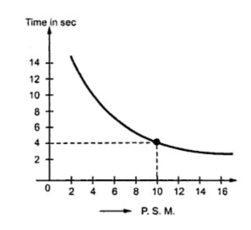
Non Directional O/C and Earth Fault Relay:
Plug setting Multiplier , PSM =
Fault current
CT Rated current x PS
= 4000/(400x1)
=10
Time operation of Relay = Time setting x Time from graph for PSM (10)
= 0.1 x 4
= 0.4 sec

Slide 26
Directional Over current Relay for phase faults (67):
Voltage measuring unit added to the over current relay for directional operation of the relay.
It monitors the PT secondary voltages and CT secondary currents and operates for the faults when the line current exceeds the pick up value in the set direction.
The parameters for proper operation of the Directional over current relay are
Direction ‐ Forward
Plug setting
Time setting
RCA – Relay Characteristic Angle
ROA – Relay operating Angle

Slide 27
Directional Over current for phase faults (67):
The two methods of polarization of directional voltage are
a) Cross polarization method
b) Self polarization method
Cross polarization method is being used in Electro magnetic directional over current relays. In this method for phase faults Relay uses other two phases voltages as reference voltage and for earth faults it will use open delta voltage.
Self polarization method is being used in numerical directional over current relays. In this method Relay uses its own voltage as reference voltage.

Slide 28
Over current Protection :
Cross polarization method:
In 3 p power system we consider that the Rph voltage starts with 0 deg, Yph starts with 240 deg, Bph starts with 120 deg.
In this method suppose we take fault on Rph , the current will take reference of other two phase voltages YB .
For forward direction it will take Vyb and for reverse direction Vby.
90°
55°
Take Ref voltage Vyb
Draw Max.Torque Line
180°
0°
Take RCA angle in Anti-Clockwise direction
55°
RCA
If fault lies in this region relay operates
235°
270°

Slide 29
Directional Over current for phase faults (67):
Self polarization method:
In Ideal Condition Rph voltage starts at 0 deg, Yph voltage starts at 240 deg and Bph voltage starts at 120 deg.
In Ideal condition Rph current follows Rph Voltage, Yph current follows Yph voltage and Bph current follows Bph voltage.
Let a fault occur on Rph . Then the fault current will check its direction with respect to its own voltage i.e Vr and this method is called self polarisation.
Vb
Ib
Vr
Ir
Iy
Vy

Slide 30
Earth Fault Protection :
Directional Earth fault protection trips only if the fault sensed by the particular phase is in forward direction with respect to its reference vector i.e. voltage direction.
During an earth fault the current in the faulted phase increases to a very high value and voltage decreases and hence is unreliable to take it as a reference.
To over come the issue the relay calculates V0 i.e. zero sequence voltage and takes its opposite direction as the reference.
Pre Fault
Fault
Resultant Phasor : Sum of all Phases

Slide 31
Earth Fault Protection :
Resultant Phasor : Sum of all Phases
This resultant vector is mathematically equivalent to 3Vo as we know Zero sequence voltage Vo = (Vr + Vy + Vb)/3 and in this case Vr is small .
Also it is directionally opposite to the faulted phase. Hence ‘-3Vo’ is taken as reference phasor for determining the direction of the earth fault.

Slide 32
Earth Fault Protection :
Non -Operating Region
To find the direction of the fault the ‘-3Vo’ phasor is taken as reference and fault current Ir is drawn.
A line corresponding to Maximum Torque angle is drawn which is given by RCA from the reference phasor.
Zero torque line is drawn 90 degrees on both sides from this Maximum torque line. This line signifies the boundary / limit of operation of the relay.
Any thing beyond this is non operating region for the relay.
If the fault current phasor is with in the boundary of ROA line then DEF is in forward direction and relay acts. Otherwise it doesn’t act.
ROA
-3Vo
RCA
Ir

Slide 33
Transformer backup Protection Settings:
400/220 kV
500MVA ICT
HV SIDE
CT Ratio : 500/1
LV SIDE
CT Ratio :1200/1
PHASE TIME OVERCURRENT (67P)
Pickup = 1.25
Curve : IEC S Inverse
RCA = 45
Pickup = 1.0
Curve : IEC S Inverse
RCA = 45
INSTANTANEOUS OVER CURRENT (50P)
Pickup = 8.0
Time delay = 0s
Pickup = 8.0
Time delay = 0s
GROUND OVERCURRENT ELEMENTS-(67N)
Pickup = 0.2
Curve : IEC S INVERSE
RCA = -45
Pickup = 0.2
Curve : IEC S INVERSE
RCA = -45

Slide 34
CT Secondary Core Connections in MB: Distance protection
CTMB
TB1
Rct
RISI
1
Main 1/ Main 2
RIS2
2
A11
R
Yct
YISI
3
A31
4
Y
YIS2
A51
B
A71
Bct
BISI
N
5
BIS2
6

Slide 35
Over current Protection:
Formula for calculation of Forward direction Boundary:
Limit Angles = Ref.Angle - RCA ± ROA
For R-Ph:
Ref.Angle = 0
RCA = 45 (as per sett.)
ROA = 85 as per setting or otherwise 90
Limit angle1 = 0 – 45 + 85
= 40
Limit angle2 = 0 -45 -85
= -130 or 230
Operating Region : 40 to 0 to 230
For Y-Ph:
Ref.Angle = -120 or 240
RCA = 45 (as per sett.)
ROA = 85 as per setting or otherwise 90
Limit angle1 = -120 – 45 + 85
= -80 or 280
Limit angle2 = -120 -45 -85
= -250 or 110
Operating Region : 280 to 240 to 110
For B-Ph:
Ref.Angle = 120
RCA = 45 (as per sett.)
ROA = 85 as per setting or otherwise 90
Limit angle1 = 120 – 45 + 85
= 160
Limit angle2 = 120 -45 -85
= -10 or 350
Operating Region : 160 to 120 to 350

Slide 36
Over current Protection:
110 °
Vb
40°
160 °
Vr
Vy
350°
230 °
280 °
R – Ph
Y – Ph
B – Ph

Slide 37
Earth Fault Protection:
Formula for calculation of Forward direction Boundary:
Limit Angles = Ref.Angle - RCA ± ROA
**Check Relay manual to confirm the lag/ lead signs of angles
For R-Ph:
Ref.Angle = 0
RCA = 65 (as per sett.)
ROA = 80 as per setting or otherwise 90
Limit angle1 = 0 – 65 + 80
= 15
Limit angle2 = 0 -65 -80
= -145 or 215
Operating Region : 15 to 0 to 215
For Y-Ph:
Ref.Angle = -120 or 240
RCA = 65 (as per sett.)
ROA = 80 as per setting or otherwise 90
Limit angle1 = -120 – 65 + 80
= -105 or 255
Limit angle2 = -120 -45 -90
= -265 or 95
Operating Region : 255 to 240 to 95
For B-Ph:
Ref.Angle = 120
RCA = 65 (as per sett.)
ROA = 80 as per setting or otherwise 90
Limit angle1 = 120 – 65 + 80
= 135
Limit angle2 = 120 -65 -80
= -25 or 335
Operating Region : 135 to 120 to 355

Slide 38
Earth Fault Protection:
90 °
95 °
90 °
90 °
135 °
Vb
15 °
180 °
0 °
180 °
Vr
180 °
0 °
0 °
Vy
335 °
215 °
255 °
270 °
270 °
270 °
R – Ph
Y – Ph
B – Ph

Slide 39
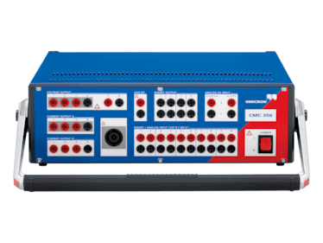
Universal Relay Test Kit :
DC Voltage
1Ph Voltage
AC 3 Ph Voltage
Relay FeedBack
AC 3 Ph. Current (set 1)
Power Switch
AC 3 Ph. Current (set 2)
Make : Omicron Model : CMC 356

Slide 40
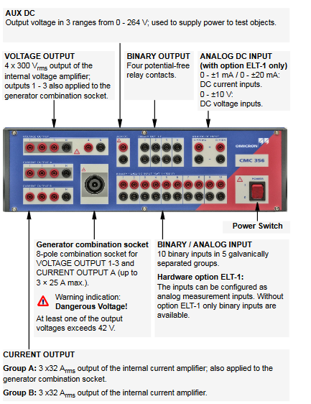
Universal Relay Test Kit :

Slide 41

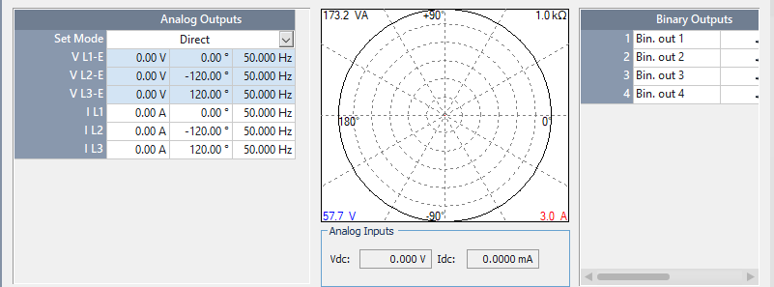
Universal Relay Test Kit :
Step 4 :
Choose “Quick CMC” for simple voltage and current injection.

Slide 42
Testing of Directional Earth Current:
Directional Over Current
PICK UP
Directionality
Non Directionality
1.Give Healthy 3 Ph phase voltages.
2.Give pick up current in the phase we want to test.
3. Calculate the time as per curve given in settings. This timing should match with relay trip feedback
4. Observe DT Send signal by relay
Calculate the directional operating region using the formula
Limit Angles = Ref.Angle + RCA ± ROA
Give pickup current for the particular phase we want to test.
Vary the phase angle from No-trip to trip region.
Observe DT Send signal from the relay
Give Zero voltages and 1 A current in all phases.
Wait for the relay to give VT fuse fail alarm.
Give pick up current and observe the relay trip time.
Observe DT Send signal from the relay.

Slide 43
Testing of Directional Over Current:
Directional Over Current
PICK UP
Directionality
Non Directionality
1.Give Healthy 3 ph phase voltages.
2.Give pick up current in the phase we want to test.
3. Calculate the time as per curve given in settings. This timing should match with relay trip feedback
Calculate the directional operating region using the formula
Limit Angles = Ref.Angle + RCA ± ROA
Give pickup current for the particular phase we want to test.
Vary the phase angle from No-trip to trip region.
Give Zero voltages and 1A current in all phases.
Wait for the relay to give VT fuse fail alarm.
Give pick up current and observe the relay trip time.

Slide 44
Single Bus Scheme:
Advantages
Due to its simple design, it is easy and convenient to operate.
It is very economical, because of its least capital cost among all bus Bar systems.
Line 1
Line 2
Bus
Disadvantages
In this type, maintenance activity of any bay or equipment such as a transformer is not possible without service interruption of the particular bay or equipment.
In case of fault on bus or bus outage for maintenance, all the bays connected to the bus get interrupted
Trafo 1
Trafo 2

Slide 45
Double Bus Scheme:
Advantages
The feeder source / loads are divided between both bus.
Any interruption on one bus will not make the station dead.
During Maintenance on any bus the loads can be switched to other bus.
Disadvantages
In this type, maintenance activity of any bay or equipment such as a transformer is not possible without service interruption of the particular bay or equipment.

Slide 46
Double Bus Scheme with Transfer bus:
Advantages
The feeder source / loads are divided between both bus.
Any interruption on one bus will not make the station dead.
During Maintenance on any bus the loads can be switched to other bus.
Any problem or maintenance activity in a breaker wont interrupt load because transfer bay breaker can be used to shift load to transfer bus
Disadvantages
Requires an entire bay and bus arrangement.
Can be used as an alternate arrangement for only one bay.

Slide 47
220 kV With Transfer Bus Scheme:
Transfer Bus Bay
Line Bay
Bus Coupler
ICT LV Bay
Bus 1
Bus 2
203-89A
203-89B
201 -89A
201-89B
202 89A
202 89B
204-89A
204- 89B
Bus PT
203- ACT
203-BCT
201 -52
202-52CB
204-52CB
201-CT
202-89L
204-89T
203- 52CB
201-89C
202-89C
204-89C
Transfer Bus PT
204-CT
Transfer Bus
202-CT
CVT
CVT
To Line
To ICT
LA
LA

Slide 48
Transfer Trip Logic for Transfer Bus Scheme
Transfer Bus Breaker can be used in case of Breaker problem in any of feeder bays or ICT LV bays.
The Line Isolator or T – Isolator is closed and the respective Bay’s 89C isolator is closed. Similarly TBC’s 89C Isolator and Breaker are closed .
This puts the respective Bay in transfer mode and all the protection relays of this bay point their protection trips towards Transfer Bus breaker.
TTX
TTX
ICT LV
Line
Transfer Bus Coupler Trip Circuit
3 Ph Trip relays :86 A and 86B
3 Ph Trip relays :86 A and 86B
Transfer mode relay
Transfer mode relay
1 Ph relays for A/R :86R1,86Y1 and 8B1
Inter trip from HV:86AX,86BX
Bus bar and LBB trip relays : 96
Bus bar and LBB trip relays : 96

Slide 49
Line
ICT
401-52CB
402A-CT
402-52CB
402B-CT
403-CT
403-52CB
401-CT
401-89A
402-89A
403-89A
401-89
402-89B
403-89
P2 P1
P2 P1
P1 P2
P1 P2
Line Bay
Tie Bay
ICT Bay
Bus 1
Bus 2

Slide 50
Line
ICT
401-52CB
402A-CT
402-52CB
402B-CT
401-CT
401-52CB
401-CT
401-89A
402-89A
402-89B
401-89A
401-89
401-89
Bus 1
Bus 2
Bus Bar
Main 1
Main 2

Slide 51
Line
ICT
401-52CB
402A-CT
402-52CB
402B-CT
401-CT
401-52CB
401-CT
401-89A
402-89A
402-89B
401-89A
401-89
401-89
Bus 1
Bus 2
HV O/C
Differential
Bus bar

Slide 52
Dia system consists of three bays with double bus arrangement . In Dia system we can accommodate two 400kV lines or combination of Line and ICT in three Bays.
There are two types of Dia formations
I formation
H formation
In Aptransco system , I formation is being used. Two feeders connected through 3 breakers . That’s’ why it is called one and half breaker system.
Feeder 1 will get power from Main Bus 1 and Main Bus 2 ( through Tie CB)
Feeder 2 / ICT will get power from Main Bus 2 and Main Bus 1 ( through Tie CB)
401 Bay can be taken shutdown without power interruption to the feeder 1 . Power flows through ie Bay 402 and Main 403 Bay.

Slide 53
403 Bay can take shut down with out power Interruption to ICT . ICT can take power from BUS 1 through 401 Bay and 402 Bay.
Line -1 : 4-1-CT & 4-2-B CT connected.
ICT : 4-3-CT & 4-2- A CT connected.
Line 1 : Distace protection Zone covers line & reach between 4-1- CT P1 and 4-2-B-p1
ICT : Differential protection & HC o/L protection Zone covers ICT & reach between 4-2-A-P! and 4-3-CT P1
For line 1 : protection operation , 4-1-52 and 4-2-52 will trip.
For ICT : protection operation , 4-3-52 and 4-2-52 will trip.
BUS I : Bus bar covers from 4-1-CT P2 to Bus 1.
BUS 2 : Bus bar covers from 4-3-CT P2 to BUS 2

Slide 54
For BUS 1 : Bus bar operation 4-1-52 will trip.
For BUS 2 : Bus bar operation 4-3-52 will trip.
If fault occurs in reach 4-1-CT P1 to 4-2-B-P1 with line Isolator open or ICT 89 T open , STUB protection will operate and will trip Main Breaker and Tie Breaker.

Slide 55
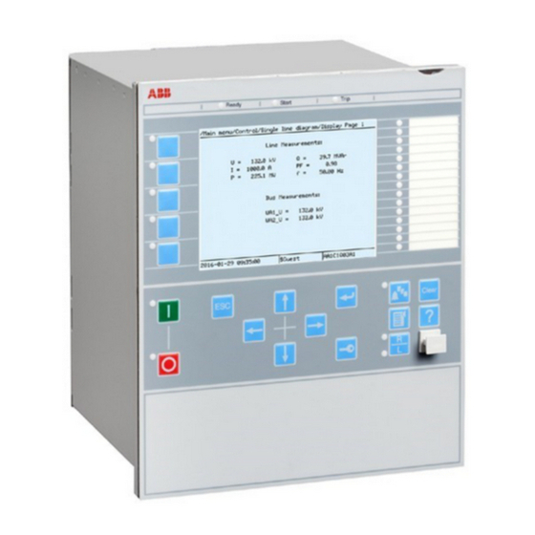
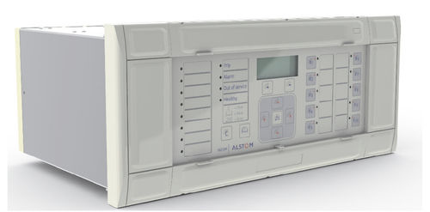
Distance Protection Relays
MICOM P444
ABB REL 670

Slide 56
Distance Protection Scheme
It is used to protect EHV transmission lines from momentary faults, persistent faults , Ph-Ph faults , Ph – E faults and and Insulator faults etc.
Relay operates on Impedance measurement i.e ratio of Voltage and current.
The relay continuously monitors the CVT/Bay Pt secondary voltages and CT secondary currents of all three phases.
Under fault conditions if the ratio of voltage to current (Z=V/I) i.e fault impedance reaches lower than the zone setting impedance, the relay operates.
Quadrilateral Characteristic mho relays are used as Distance Relays for long transmission lines.
These relay not operate properly for short distance lines.

Slide 57
Distance Protection Scheme
Zone 3
Setting : 100%Z1 + 100% of adj. short line
Time delay : 700 ms
Zone 2
Setting : 100%Z1 + 20% of adj. short line
Time delay : 350 ms
Zone Rev.
Setting : 20%Time delay : 350 ms
Zone 1
Setting : 80%
Time delay : 0 ms
Far End
Far End
Substation
Zone 4
Setting : 100%Z1 + 100 % of adj. Long line
Time delay : 1.2 ms
Remote End

Slide 58
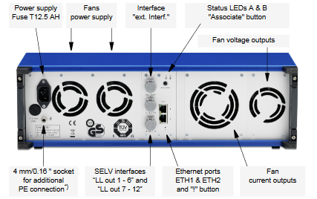
Universal Relay Test Kit :

Slide 59


Universal Relay Test Kit :
Step 1 :
Ensure proper Ground connection to the kit.
Connect your Ethernet cable to laptop and test kit.
Ensure proper power supply.
Ensure proper connections of kit current and voltages to the TB Blocks as per relay requirement
Step 2 :
Open “Omicron Link Device” and click the device name to associate the device i.e. Test kit
Step 3 :
Choose “Omicron Test Universe” to Begin Testing.

Slide 60
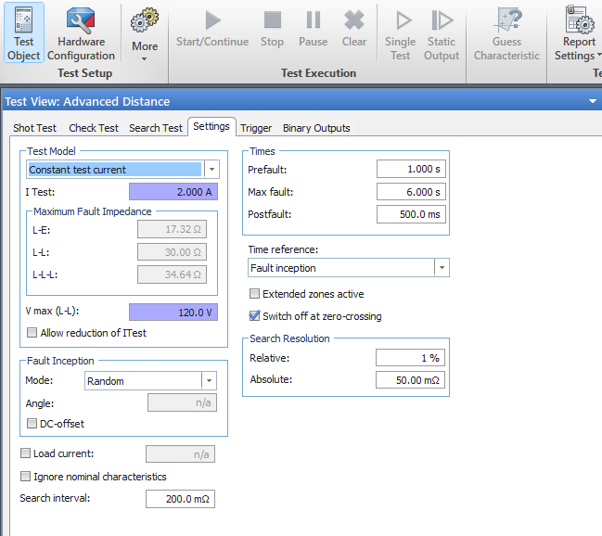
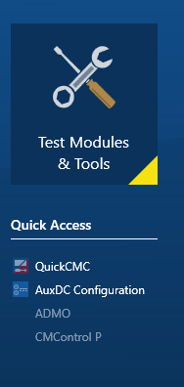
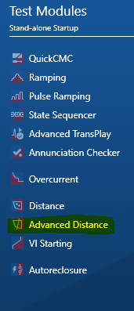
Universal Relay Test Kit :
Step 5 :
For Distance Protection Testing , Under Test modules Choose “Advance Distance Testing”. This opens the Testing Interface

Slide 61
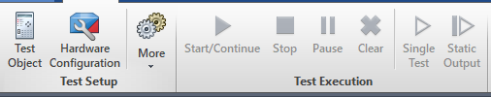
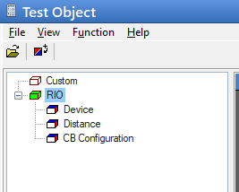
Universal Relay Test Kit :
Step 6 :
Now in the interface choose Test Object → File → Import → import PTLfile
PTL file will be in Xrio_auto format.
This should be obtained from the manufacturers website for the particular relay we are testing and keep it ready in our test laptop.
This step creates the template for the particular relay model.

Slide 62
Universal Relay Test Kit :
Step 7 :
Now again under “File” Choose Import relay setting → standard file for Xrio → “settings in XRIO format”.
The settings in XRIO format can be downloaded from the particular relay after configuring it.
Step 8 :
Click ok to go to Main Page.
Choose shot test tab to view the Quadrilateral characteristics of the relay.

Slide 63
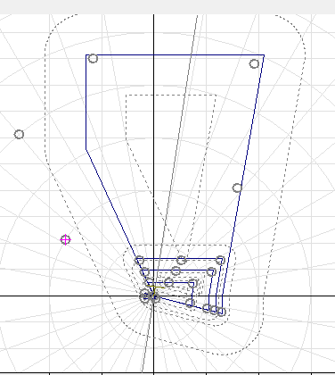
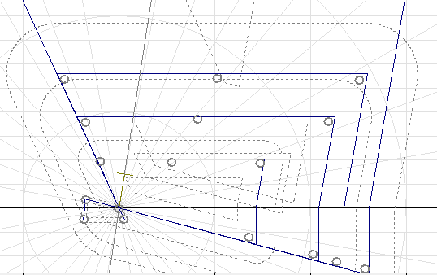
Universal Relay Test Kit :
Step 9 :
Choose points on the characteristics as per the requirement of test conditions for zone and phase.

Slide 64
Other Protection Functions:
Over Voltage Protection
Power Swing Block
Over Current Protection
Earth Fault Protection
VT Fuse Fail Block
Broken Conductor Alarm
STUB
SOTF

Slide 65
Over Voltage Protection:
Parameters : Voltage Pick up value and Delay Time
Over voltage protection
Stage 1 Pick up value : 110 %
Time Delay : 10s
Stage 2
Pick up value :
140 %
Time Delay : 100ms

Slide 66
Power Swing Block:
Power Swing Detected
Is it in zone1
Yes
No
Trip
Time delay > 2 s
Yes
No
Trip
Block

Slide 67
Over Current Protection in EHV:
Over Current
Directional
No
Yes
Trips in 800ms if pick up current above 2A
Fault with in RCA
Yes
No
Trips in 3s if pick up current above 2 A
No trip

Slide 68
Earth fault Protection in EHV:
Earth Fault
Directional
No
Yes
Trips in 800ms if pick up current above 0.2A
Fault with in RCA
Yes
No
Trips in accordance to IEC S Inverse Curve
No trip

Slide 69
Other Protection Functions:
VT Fuse Fail Block : Blocks directional protection features of the relay if protection core voltages are absent .Time Delay : 5s
Broken Conductor Alarm : Issues alarm if Broken conductor is sensed by the relay . Operates on the principle of I2/I1 ( > 0.2) and time delay of 5 s
STUB : When feeder is in off condition , we will close the breaker with Line isolator open to complete the Dia and take advantage of redundancy provided by one and half breaker system. In such cases the protection will be shifted to stub mode as line currents and voltages are not present . Enabled By : Line isolator open Status , Pick up : 2 A and Time delay 0s

Slide 70
Other Protection Functions:
89 L : Line Isolator in open condition
STUB Protection is Enabled

Slide 71
Switch On To Fault (SOTF):
It protects the feeder while closing the breaker on to a fault persistent / un cleared present in the system.
Ignores Zone protection timing and operates instantaneously
Remains active for 500ms after breaker close command is given.

Slide 72
Carrier and DT Scheme:
Coupler 1
Coupler 2
Card 1 : Permissive . Carrier Send /Receive
Card 2 : Trip. DT send / Receive
Card 1 : Permissive . Carrier Send /Receive
Card 2 : Trip. DT send / Receive
Channel 1 : Line 1 Main 1
Channel 1 : Line 2 Main 1
Channel 2 : Line 2 Main 2
Channel 2 : Line 1 Main 2

Slide 73
Carrier and DT Scheme:
Carrier are permissive signals issued by the relay during distance protection operation. These are mainly used to communicate the relay is picked in Zone1 i.e instantaneous trip or AR action for Ph N fault. Sending a carrier equates to giving permission for the other end relay to trip instantaneously even if it is picked in Zone2 or go for AR scheme in case of Ph N fault.
DT are trip signals issued by relay during various protection operations.
DT Sent Conditions:
Manual Trip of Main CB if Tie CB already open.
Manual Trip of Tie CB if Main CB already open.
Bus Bar Protection Operated and Tie CB already open.
Over Voltage Protection Operated.
Directional Earth Fault Operated.
LBB in Tie Bay Operated.

Slide 74
Auto Recloser:
When a single Phase to Ground fault occurs the relay trips the breaker pole phase under fault and after 1s close pulse will be issued by external AR relay or BCU.
Most Single Phase to Ground faults are momentary in nature and hence continuity in supply will be maintained by AR function.
Block conditions for AR:
AR function blocks if any condition is not satisfied:
CB Healthy
A/R function ON
Carrier Healthy
Fault is not with in Reclaim time.
Fault is in Zone 1 or Zone 2 with Carrier Receive.
86A,86B and 96 in reset state.
CB status and no pole discrepancy.
BCU
A/R is implemented through
Dedicated A/R Relay
Main 1 or Main 2

Slide 75
Auto Recloser:
AR Started for Ph. to N fault
Protection Relay trips single pole of Main and Tie Breaker
After 1s Dead time
AR close pulse issued to Main CB
AR on Main CB Successful. Tie AR issues close pulse to Tie CB after2s dead time
Main CB Trips with operation of Pole discrepancy (time delay setting : 1.5s). But Tie CB May attempt AR
No
Main CB closes
Tie CB closes
No
Tie CB Trips with operation of Pole discrepancy : time delay setting : 2.5s
Yes
No
Main Breaker trips all three phases ; Further AR is not attempted on Tie CB and Hence tripping its remaining phases
Yes
persistent fault detected
Yes
AR operation Cycle completed.

Slide 76
Mutual Compensation:
It occurs in parallel lines running on the same tower.
The proximity of these feeders in live conditions results in mutual inductance over each other.
Due to this additional inductance the behavior / parameters are altered.
This phenomenon should be taken into consideration by the protection distance relay and compensate accordingly.
The compensation is achieved by running star point of the current transformer of line 1 relay into the compensation coil of line 2 relay and vice versa.

Slide 77
Mutual Compensation:
R ph
Y ph
Bph
R ph
Y ph
Bph
C1
C3
C5
C13
C2
C4
C6
C12
C2
C4
C6
C12
C1
C3
C5
C13

Slide 78
Line Differential Protection:
132 kV
Cables And Composite Lines With Single Circuit OR more than one Circuit
Over head lines with more than one Circuit
Radially fed Substations, Radially fed Loads and Generators connected through dedicated Transmission Line with Single Circuit
Over head lines with Single Circuit
Generator connected through dedicated transmission line
Radially fed Substation/ Load with single source
Use LDP for All Lengths
Use LDP if Length is less than or equal 3 km
Use LDP if Length is less than or equal 3 km
Use LDP if Length is less than or equal 3 km
Use LDP if Length is more than 3 km

Slide 79
Line Differential Protection:
400 kV and 220 kV
Cables And Composite Lines With Single Circuit OR more than one Circuit
Over head lines with more than one Circuit
Radially fed Substations, Radially fed Loads and Generators connected through dedicated Transmission Line with Single Circuit
Over head lines with Single Circuit
Generator connected through dedicated transmission line
Radially fed Substation/ Load with single source
Use LDP for All Lengths
Use LDP if Length is less than or equal 10 km
Use LDP if Length is less than or equal 10km
Use LDP if Length is less than or equal 10km
Use LDP if Length is more than 10 km

Slide 80
Line Differential Protection:
R ph
Y ph
Bph
R ph
Y ph
Bph
C1
C3
C5
C2
C4
C6
C2
C4
C6
C1
C3
C5
FOCC
Source End
Receiving End

Slide 81
Line Differential Protection:
Line Differential Relay
FOCC Healthy
YES
NO
Acts as Differential Protection
Acts as Distance Protection
Requires two sets of currents
Set 1 : own Bay CT currents
Set 2 : Other end Bay CT currents
Requires Line Impedance characteristics , Own Bay current and voltages.

Slide 82
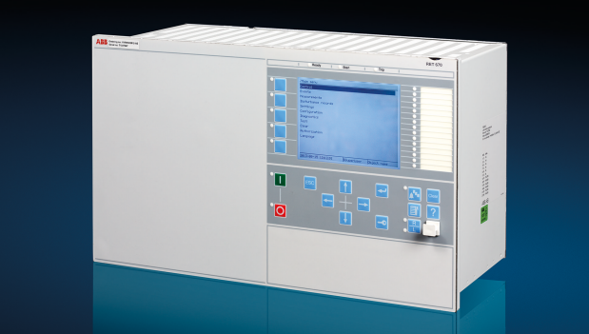
Differential Protection Relay :
500/1
HV CT
HV
LV
1200/1
LV CT
P1
P2
P2
P1
(HV )IA<0
(LV) IA<180
Differential Relay

Slide 83
Differential Protection Relay:
It is used to isolate the power transformer for its internal faults and the associated equipment that lies between HVCT and LVCT.
It works on Merz-price current comparison method.
It compares the differential current l diff and Bias current I bias obtained from currents of HVCT and LVCT.
Differential currents I diff = Vector sum of all currents in the Bus Zone
= IHV + ILV
Bias currents I bias = Vector sum of HV and LV /2
= (IHV+ILV)/2

Slide 84
Differential Protection Relay: For stable operation of the Differential relay for external and internal faults ,the parameters to be followed are
Stability and Pickup: The relay is to be stable under no load and full load conditions and is to be operated when the differential current exceeds the pickup value.
Slope S1 is used to provide protection to the relay due to CT ratio errors under the tap change conditions and full load conditions.
Slope S2 is used to provide protection to the relay from CT saturation errors under through fault conditions.
2nd harmonic block is to be provided in the differential protection relay to cover the 2nd harmonics produced due to inrush currents developed while charging the transformer
5th harmonic block is to be provided in the differential relay to cover the 5th harmonics produced due to excitation currents occurred in the transformer under sudden load off conditions

Slide 85
Stability and Pick up:
Stability means During normal operation , the differential current is zero and Bias current is equal to half the sum of HV and LV currents
Pick up current is the minimum differential current above the set value
Relay Settings:
I diff : 0.2A
Break point 1 : 1A
Break point 2 : 5A
Slope 1 : 0.3 i.e 30%
Slope 2 : 0.6 i.e 60%
2nd harmonic: 15%
5th harmonic : 25%
Pick up current = Full load current (secondary) * differential setting * MF
MF is the multiplying factor and
MF = 1 for 3 phase pickup
MF = 1.732 for 1 phase pickup

Slide 86
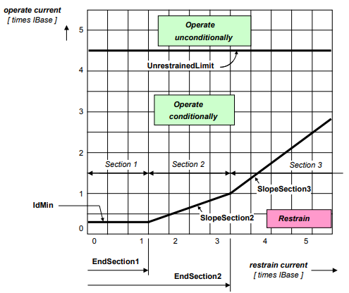
Slope Characteristics :
Section 1 represents Idiff pickup , Section 2 represents Slope 30% region and Section 3 represents Slope 60% region .
The relay will not operate in restraint region and it will operate in operating region when Idiff currents exceeds the slope line.

Slide 87
Testing of 400/220kV 500MVA ICT Differential relay :
HV Side of 400/220 kV 500 MVA ICT:
Full load Current
= 500 *1000/√3 * 400
= 721.7 A
2. Full load current in Secondary = Full load current / CT Ratio
= 721.7/1000
= 0.7217.
3. Differential setting = 0.2A
4. Multiplication factor = √3 for 1ph and 1 for 3 ph
5. Pick up value 1 Ph = 0.2 x √3
= 0.347 A
6. Pick up value 3 Ph = 0.2A
LV Side of 400/220 kV 500MVA ICT:
Full load Current
= 500 *1000/√3 * 220
= 1312 A
2. Full load current in Secondary = Full load current / CT Ratio
= 1312/1600
= 0.82.
3. Differential setting = 0.2A
4. Multiplication factor = √3 for 1ph and 1 for 3 ph
5. Pick up value 1 Ph = 0.2x(0.82/0.72) x √3
= 0.393 A
6. Pick up value 3 Ph = 0.2x(0.82/0.72)
= 0.227 A

Slide 88
Stability and Pick up:
Gradual current increase is observed till relay pick up threshold and compare with two calculated value.
For pick up test on HV side and LV side separately, injecting secondary current to the HV side with LV side Zero
The relay should pick up and trip as per setting similarly inject current on LV side with HV side to Zero
Pick up current = Full load current (secondary) * differential setting * MF.

Slide 89
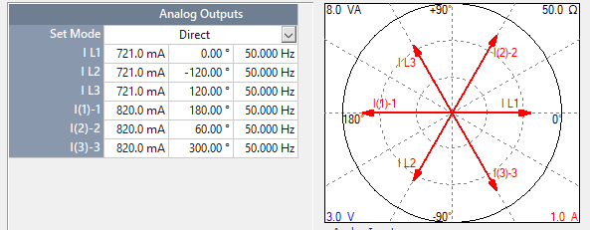
Testing of Differential Protection:
1. Calculate Full load current for Both HV and LV:
I flc = MVA / (√3*Vline)
2.With the obtained values enter the currents of HV and LV in opposite direction. The Relay should not trip and hence stability is confirmed.
Opposite Direction
HV Current
LV Current

Slide 90
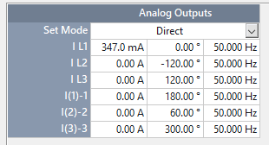
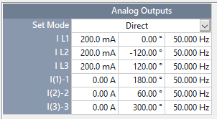
Testing of Differential Protection:
3. For testing pick up of the relay. We need to calculate the pick up value.
4. Pickup formula = Set Value * MF.
Pickup factor = 1 for 3Ph or √3 for 1Ph.
Start from a value below pickup value and ramp up to pick up value
1 Ph PICK UP
3 Ph PICK UP

Slide 91
Slope 1 testing :
Testing 30 % Slope :
Apply full load current on both sides i.e. 0.72<0 A in HV side and 0.82<180 A in LV side.
Increase current on HV side till relay trips (tripped at 0.842<0 A) and note Idiff and Ibias value.
Idiff1 = 0.202 and Ibias1 = 0.743
Apply 5 times full load current on both sides i.e. 3.605<0 A in HV side and 4.1<180 A in LV side.
Increase current on HV side and note Idiff and Ibias value in relay when it trips.
Idiff2 = 0.761 and Ibias2 = 2.6
Slope = (Idiff2 – Idiff1)/(Ibias2 – Ibias1)
= (0.761-0.202) / (2.6-0.743)
= 30.1 %

Slide 92
Slope 2 testing :
Testing 60 % Slope :
Apply 7 times full load current on both sides i.e. 5.1<0 A in HV side and 5.79<180 A in LV side.
Increase current on HV side and note Idiff and Ibias value in relay when it trips (tripped at 6.32<0 A).
Idiff1 = 1.68 and Ibias1 = 5.48
Apply 8 times full load current on both sides i.e. 5.76 <0 A in HV side and 6.56 <180 A in LV side.
Increase current on HV side and note Idiff and Ibias value in relay when it trips (tripped at 7.46<0 A).
Idiff2 = 2.21 and Ibias2 = 6.36
Slope = (Idiff2 – Idiff1)/(Ibias1 – Ibias2)
= (2.21-1.68) / (6.36-5.48)
= 60.22%

Slide 93
2nd harmonic block testing: Setting 15%
2nd harmonic pick up = full load current * pick up
= 0.7217 * 0.15
=0.108 A
Inject current HV : 0.72<0 at 50 Hz IV current 0.82<180 at 100 Hz
Current decreased on IV side and relay operated at 0.13<180 at 100 Hz
For 2nd harmonic relay operated = 0.13/0.82 = 15.8%
5th harmonic block testing: Setting 25%
5th harmonic pick up = full load current * pick up
= 0.7217 * 0.25
=0.180 A
Inject current HV : 0.72<0 at 50 Hz IV current 0.82<180 at 250 Hz
Current decreased on IV side and relay operated at 0.21<180 at 250 Hz
For 5th harmonic relay operated = 0.21/0.82 = 25.6%

Slide 94
Harmonic Block HV Side:
Harmonics Detected
2nd Harmonics Pick up = full load current * pickup
= 0.7217 * 0.15
= 0.108 A
5th Harmonics Pick up = full load current * pickup
= 0.7217 * 0.25
= 0.180A
2nd Harmonics
5th Harmonics
yes
No
yes
No
<15 %
<25 %
Trip
Block
Trip
Block
***Apply full load secondary current on LV side

Slide 95
Harmonic Block LV side:
Harmonics Detected
2nd Harmonics Pick up = full load current * pickup
= 0.82 * 0.15
= 0.123 A
5th Harmonics Pick up = full load current * pickup
= 0.82 * 0.25
= 0.205A
2nd Harmonics
5th Harmonics
yes
No
yes
No
<15 %
<25 %
Trip
Block
Trip
Block
***Apply full load secondary current on HV side

Slide 96
Over Excitation Protection:
This function protects the power transformer from over fluxing caused by voltage increase in the power system.
The relay uses Voltage and Frequency to calculate the alarm and trip levels.
If fault repeats within tCooling time delay of 1200s then relay trips instantaneously.
Over Flux V/Hz
At 96% of Trip level
Issue alarm after 10s
Stage 1 : 114% of UB/f
Stage 2 : 140% of UB/f
Trip according to IEEE curve timing
Trip instantaneously

Slide 97
Restricted Earth Fault :
It is a high impedance differential protection and is stable under external faults.
During internal faults , current flows through neutral bushing CT secondary towards stabilizing resistor value (1660 Ohms) which is sensed by the relay to issue trip signal ,for a pick up voltage of 33.18 V.
It also gives out alarm if the relay senses 10V for 10s.

Slide 98
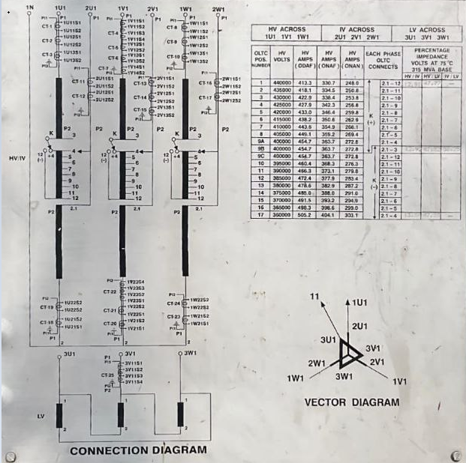
Restricted Earth Fault :

Slide 99
Restricted Earth Fault :
64 R REF Protection Relay
Trafo side
P1
Bus side
P2
P1
Trafo side
220 kV Bus side
P2
P1
Trafo side
Neutral Earth side
SR
Relay coil for REF Protection
P2
SD

Slide 100
Bus Bar Protection Scheme:
It is used in 400 kV and 220 kV substations to protect the switchyard equipment from Bus faults
Bus faults occur due to
Failure of current transformers
Failure of circuit breakers
Insulators
Snapping of Jack Bus conductors and Bus Jumpers etc.,
Two types of Bus bar protections
High Impedance Bus Bar
Low Impedance Bus Bar

Slide 101
Bus Bar Protection Scheme:
High Impedance Scheme
PBDCB (Static Relays)
RADSS(ABB)
RL
RL
RL
RL
Rs
UR
Rres
RCT
RCT
RCT
RCT
I >
F1
F2
F3
P.Tr
RCT : CT secondary core resistance
RL : CT secondary Lead Resistance
Rs : Stabilising Resistor
Rres : Non Linear Resistor.

Slide 102
Bus Bar Protection Scheme:
High Impedance Scheme
PBDCB (Static Relays)
RADSS(ABB)
Bus bar operates on voltage across the relay.
Separate voltage measurement modules available for Main Zone and Check zone.
In this scheme , for external faults , the voltage across measuring module shall raise above relay pick up value and there is a chance of Mal-Operation of relay is avoided by adding resistor Rs to the measuring module.
For Internal faults, the fault current flows through the setting resistor will result in high voltage increase across the whole scheme and result in saturation of all CT’s in the Bus and voltage rise in CT Secondary cables to Limit High voltages in measuring module
Non Linear resistors are used to limit the voltage below 2 kV as the standard insulation level of secondary equipment cables are 2 kV
CT’s of High Knee point voltage (KPV above two times of net pick up voltage) are used.

Slide 103
Bus Bar Protection Scheme:
High Impedance Scheme
PBDCB (Static Relays)
RADSS(ABB)
5.For Stable operation of two scheme,
All CT’s used in the scheme have equal CT ratio. Aux.CT’s will be used for Higher CT Ratio feeders.
CT’s of high Knee point voltage and similar magnetizing characteristic will be used.
6.External LBB scheme used in this High Impedance BB scheme chances of Mal operation due to cable faults and relay testing without isolation of LBB relay.
7. Voltage super vision with time delay will be provided to cover non reporting / missing of any secondary currents for Main Zone and Check Zone.

Slide 104
Bus Bar Protection Scheme:
Low Impedance Scheme
Scheme operates on Current of relay.
It works on Kirchhoff's Current Law.
Only one CT Secondary core is used for both Main Zone and Check Zone Currents.
For external through faults , and internal bay faults , for stable operation of the scheme, slope factor ‘k’ is used to cover errors occurrence in CT secondary currents of all feeders and CT Saturation errors.
CT supervision cab be provided to cover the non reporting and wrong polarity of CT currents.
Internal LBB with re trip and back trip will be provided.

Slide 105
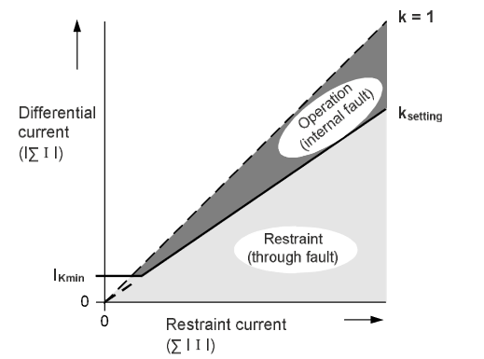
Bus Bar Protection Scheme:
Bus bar scheme operates under Bus fault conditions , when the I diff. currents beyond the restraint region.
The scheme monitors Main zone Currents and Check Zone Currents.
Main Zone currents I diff = Vector sum of all currents in the Bus Zone
= I1 + I2 + …….
Check Zone currents I bias = Scalar sum of all bay currents in all Bus Zones
= I1 + I2 + …….

Slide 106
Bus Bar Protection Scheme:
Low Impedance Scheme
Centralized BB Scheme
Distributed BB Scheme
1.Provided with single unit called Central unit. Core units or 3 units + 1 unit.
2.All CT inputs , Isolator & CB wiring will be given to central unit. Hence more No.of cables required.
3.Fibre optic Cable / Data cable is not required.
4.Suitable for less No.of feeders.
5.Suitable for single Bus Substation and Double Bus substation.
1.Provided with central unit and Bay Unit (peripheral Unit) for individual ( feeder/ PTR bays).
2. CT inputs , Isolator and CB status will be given to Individual Bay units.
3.Fibre optic cable /Data cable is needed to communicate all Peripheral units with central unit.
4.Can accommodate more No.of Feeders.

Slide 107
CT Secondary Core Connections in MB: Bus Bar protection
CTMB
TB2
Rct
R4SI
1
Bus bar
R4S2
2
B11
R
Yct
Y4SI
3
B31
Y4S2
4
Y
B51
B
Bct
B4S1
B71
N
5
B4S2
6

Slide 108
220KV Bus Bar Protection Scheme:
Testing Procedure
Settings:
CT ratio of 220kV feeders : 800/1 A
Bus Coupler : 2400/2 A
ICT LVs : 1200/1 A
Settings:
I diff : 0.3 A
Kdiff : 0.5
1. Measurement check:
Inject currents in all feeders, one after another and check measurements in PU and CU
I<0 for Rph
I<120 for Yph
I<240 for Bph

Slide 109
Bus Bar Protection Scheme:
Testing Procedure
2. Case 1 : Bus 1 pickup and stability testing.
1.Keep all feeders on Bus 1
2. Pick up : Inject 0.25<0 in feeder 1 and increase current , check for operation and note down the pick up value when relay trips.
3.Repeat for all the feeders
4. For checking stability, Inject 1<0 in feeder1 and 1<180 in feeder2.
5. For checking timing, Inject 1<0 in feeder1 and 1<0 in feeder 2 and note the time ofoperation
6.Repeat this for all the feeders and check for 1Ph and 3Ph.

Slide 110
Bus Bar Protection Scheme:
Testing Procedure
3. Case 2 : Bus 2 pickup and stability testing.
1.Keep all feeders on Bus 2
2. Pick up : Inject 0.25<0 in feeder 1 and increase current , check for operation and note down the pick up value when relay trips.
3.Repeat for all the feeders
4. For checking stability, Inject 1<0 in feeder1 and 1<180 in feeder2.
5. For checking timing, Inject 1<0 in feeder1 and 1<0 in feeder 2 and note the timeofoperation.
6.Repeat this for all the feeders and check for 1Ph and 3Ph.

Slide 111
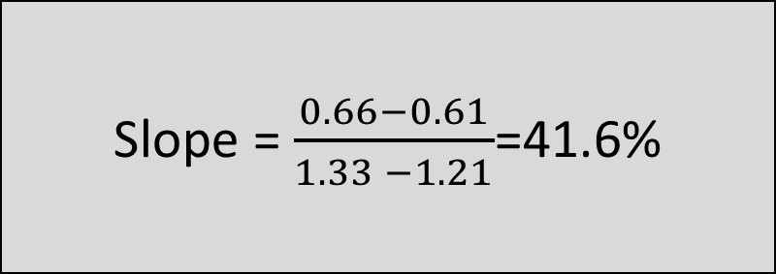
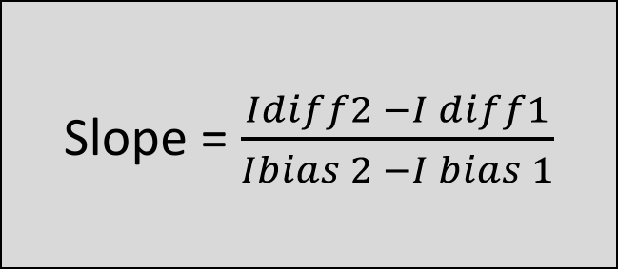
Bus Bar Protection Scheme:
Testing Procedure
4. Case 3: Bus 1 Slope testing.
1.Keep all feeders on Bus 1
2. Inject 1<0 in feeder1 and 1<180 in feeder2 and decrease current in feeder 1 gradually.
3. Relay operates at 0.33<0 , Note(IBias1 , Idiff1) i.e. (IBias1 =0.61, Idiff1=1.21)
4.Inject 0.3<0 in feeder1 and 0.3<180 in feeder2 and increase current in feeder 1 gradually.
5. Relay operates at 0.91 <0 , Note(IBias2 , Idiff2) i.e. (IBias2 =0.66, Idiff2=1.33)
6.Calculate slope.
Slope = $\frac{Idiff2 −I diff1}{Ibias 2 −I bias 1}$
Slope = $\frac{0.66−0.61}{1.33 −1.21}$=41.6%

Slide 112
Bus Bar Protection Scheme:
Testing Procedure
5. Case 4: Bus 2 slope testing.
1.Keep all feeders on Bus 2
2. Inject 1<0 in feeder1 and 1<180 in feeder2 and decrease current in feeder 1 gradually.
3. Relay operates at 0.33<0 , Note (IBias1 , Idiff1).
4.Inject 0.3<0 in feeder1 and 0.3<180 in feeder2 and decrease current in feeder 1 gradually.
5. Relay operates at 0.91 <0 , Note (IBias2 , Idiff2).
6.Calculate slope.

Slide 113
Bus Bar Protection Scheme:
Testing Procedure
6. Case 5 : Bus 1 & Bus 2 with Bus coupler testing.
1.Keep feeder 1 on Bus1 and feeder 2 on Bus2 with Bus coupler closed.
2. Inject 1<0 in feeder1 and 1<180 in feeder2 .
3. Create Bus 1 fault by changing phase angle as , 1<0 in feeder1 and 1<0 in feeder2 .
4. All Bus 1 feeders & Bus coupler should trip.
5. Create Bus 2 fault by changing phase angle as , 1<180 in feeder1 and 1<180 in feeder2 .
6. All Bus 2 feeders & Bus coupler should trip.
7.Repeat this for all the feeders and check for 1Ph and 3Ph.

Slide 114
Bus Bar Protection Scheme:
Testing Procedure
7. Case 6 : Bus 1 & Bus 2 Tied testing.
1.Keep feeder 1 on Bus1 and feeder 2 , Bus1and Bus 2 Tied by closing both Bus Isolators of feeder 1.
2. Inject 1<0 in feeder1 and 1<180 in feeder2 .
3. Create Bus 1 fault by changing phase angle as , 1<0 in feeder1 and 1<0 in feeder2 .
4. Both Bus 1 and Bus 2 connected feeders should trip.
8. Case 7 : Bus 1 & Bus 2 selection.
1.Keep Bus 1 and Bus 2 selector switch out individually.
2. Create Bus 1 fault and Bus 2 fault individually.
3. Verify operation of Bus scheme.

Slide 115
Bus Bar Protection Scheme:
Testing Procedure
9. Case 8 : Bus isolator selection.
1.Remove Feeder – 1 Bus isolator close indication.
2. Create Bus fault.
3. Verify whether bus bar scheme is considering previous close status.
10. Case 9 : PU & CU link.
1.Remove PU & CU connection.
2. Check whether Bus bar is going to block state or not.
11. Case 10: LBB.
1.Check LBB measurements , Retrip and final trip for all feeders.
2. LBB final trip should trip all elements connected to the particular bus.

Slide 116
Bus Bar Protection Scheme:
Bay currents will be measured by peripheral units and communicated to central unit.
Central unit process all the data from PU’s
If any PU fail, Bus bar will be in off condition.
Suitable for any number of zones upto 8 Zones.
416-PU
413-PU
404-PU
401-PU
LINE 6
LINE 5
LINE 2
LINE 1
Bus 1
416
413
404
401
Central Bus Bar Unit
417
414
405
402
418
415
406
403
Bus 2
ICT 1
ICT 2
LINE 4
LINE 3
418-PU
415-PU
406-PU
403-PU

Slide 117
Bus Bar Protection Scheme:
When a fault occurs the direction of all the current are towards the fault .
Hence the sum of current is not zero.
The central Bus unit issues a trip to the particular bus connected breakers to isolate the fault.
Alarm : 5 % and 5 Sec
Trip : 1600/3000 A
416-PU
413-PU
404-PU
401-PU
LINE 6
LINE 5
LINE 2
LINE 1
Bus 1
416
413
404
401
Central Bus Bar Unit
417
414
405
402
418
415
406
403
Bus 2
ICT 1
ICT 2
LINE 4
LINE 3
418-PU
415-PU
406-PU
403-PU

Slide 118
Local Breaker Backup (LBB) Scheme in Main Bay :
LINE 6
LINE 5
LINE 2
LINE 1
When a fault occurs on Line 6 and its main breaker fails to open then LBB relay operates and try to isolate the fault.
As soon as the fault occurs ‘3Ph Initiation ‘ signal is sent to LBB relay by main protection relay .
416
413
404
401
417
414
405
402
418
415
406
403
ICT 1
ICT 2
LINE 4
LINE 3

Slide 119
Local Breaker Backup (LBB) Scheme in Main Bay :
LINE 6
LINE 5
LINE 2
LINE 1
Re-Trip
After receiving ‘3Ph- Initiation’ signal. The LBB relay waits for 100ms and checks if current is still greater than the pick up value
If it is greater than the pickup value then the LBB relay attempts to issue re – trip to the circuit breaker
416
413
404
401
417
414
405
402
418
415
406
403
ICT 1
ICT 2
LINE 4
LINE 3

Slide 120
Local Breaker Backup (LBB) Scheme in Main Bay :
DT send
LINE 6
LINE 5
LINE 2
LINE 1
Final Trip
After waiting for another 100ms from re trip instance .
The LBB relay again checks if the value of the current is greater than the pick up value.
If yes, then it proceeds to trip
All the breaker connected to the bus
It’s Tie bay breaker
DT sent to other end breaker
416
413
404
401
417
414
405
402
418
415
406
403
ICT 1
ICT 2
LINE 4
LINE 3

Slide 121
Local Breaker Backup (LBB) Scheme in Tie Bay :
It is a current operated protection. When faults occurs 3ph Initiation signal is given by the main protection relays .
This triggers a timer in LBB relay which waits for t1=100ms and checks if CT currents are above the set value = 0.2 Ib. If these conditions are satisfied the LBB relay issues Re-trip to the breaker .
Retrip to Tie CB
Case 1 : Retrip
After 100ms if current is above 0.2 Ib.
Again Trip is given to Tie Breaker
DT send
Case 2 : Final trip
After 200ms if current is above 0.2 Ib.
LBB relay trips Main Breakers in the Dia and also sends DT. Thus cutting off the Power Flow to the faulty breaker.
DT Send
Final Trip
Final Trip

Slide 122
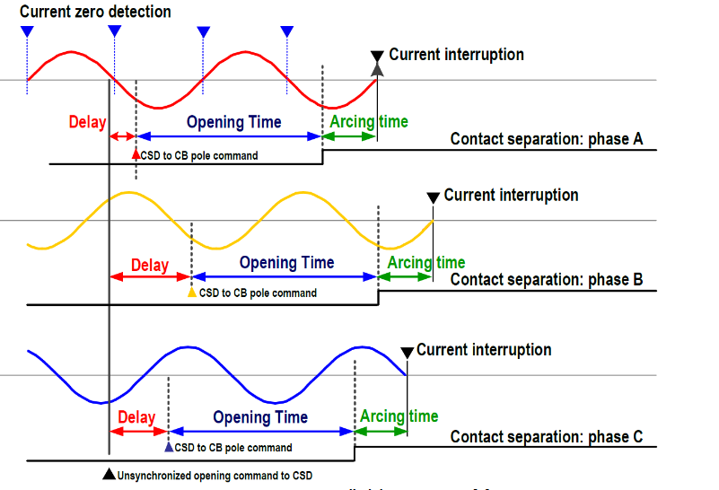
Control Switching Device:
While Switching off an inductive load it is desirable to interrupt at zero crossing of the current waveform especially for High voltage systems.
If proper separation is not present between contacts of the breaker during some high transient over voltages . Re ionization may take place resulting in arcing phenomenon.

Slide 123
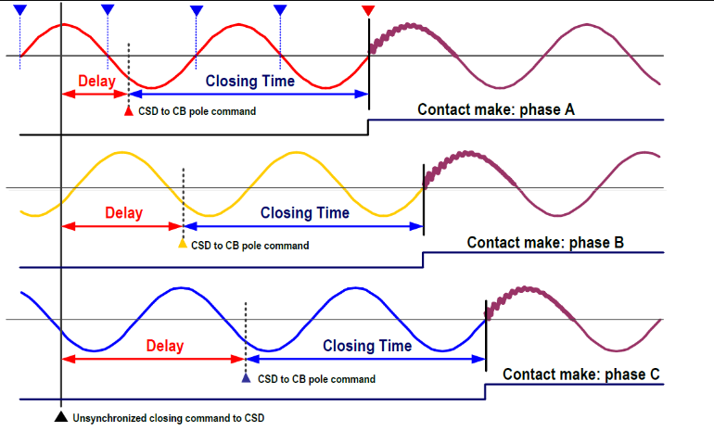
Control Switching Device:
Reduces Re-striking of arc.
Reduces in rush current and wear of contacts.
Increases system reliability , life of equipment.
Lowers switching voltages, fluctuations and harmonic stress.

Slide 124
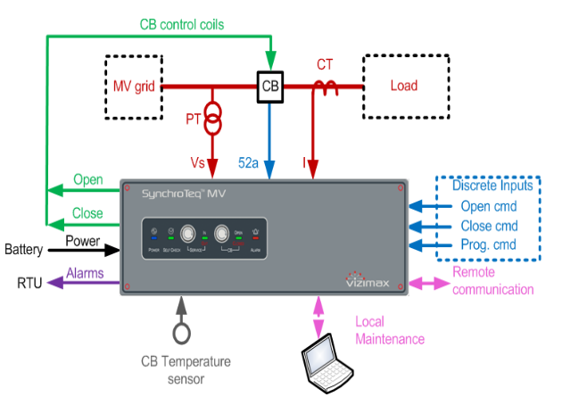
Control Switching Device:
Control switching device monitors and synchronizes the switching of circuit breaker according to the zero crossing.
It requires inputs from various elements such as
Voltage : Voltage transformer
Current : Current transformer
Auxiliary contact : Circuit Breaker

Slide 125
Islanding Scheme:
It is a procedure where the inter connected grid is intentionally isolated to during a wide spread disturbance.
A Group of generating stations or generating station is selected to feed local transmission and distribution networks.
In the event of inability of generation to meet with demand the frequency of the system decreases.
Under frequency protection is adopted for feeders , which are not part of the particular island scheme or feeders that were covered under other Islands.
Generally , Cut off frequency is 47.5 Hz and trip time is instantaneous.
Objectives:
Convert inter connected power system to Island that are self sufficient.
Continue power supply in the island that is formed.
Avoid tripping of Generators.
Quick Restoration of island back to interconnected power system.

Slide 126
THANK YOU

