Slide 1
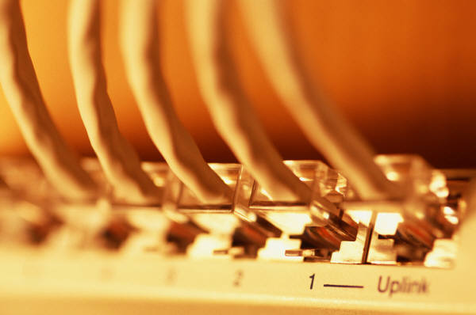
Presentation on Networking and Cyber Security
By Ramana R
( Network & Security APCPDCL)

Slide 2
Course Content
Virtual Private Network (VPN)
Introduction to Cybersecurity tools and cyber attack
Cloud and Cloud Computing
Network Troubleshooting Problems and Solutions

Slide 3
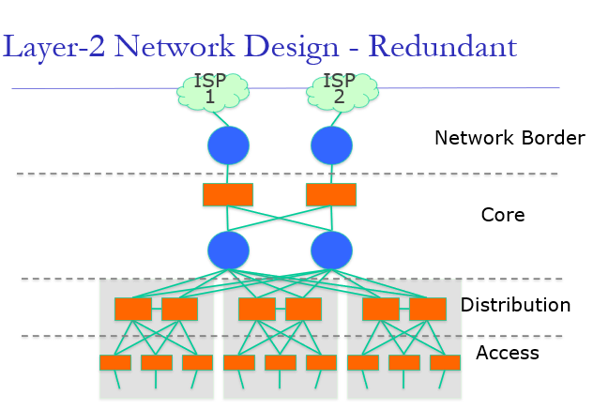

Slide 4
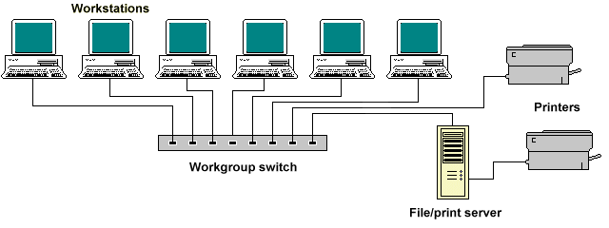
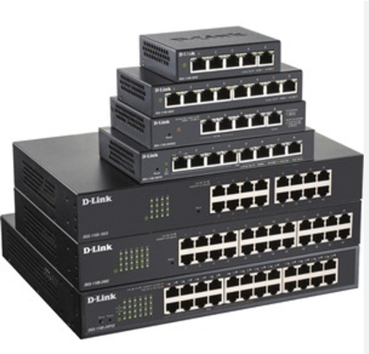
Switches L2 and L3
Switches add more intelligence to data transfer management.
They can determine if data should remain on a LAN and transfer data only to the connection that needs it.
Another difference between a bridge and switch is that a switch does not convert data transmission formats

Slide 5
A VLAN (Virtual Local Area Network) is a technology used to create logical networks within a physical network infrastructure. It allows you to segment a network into multiple virtual networks, each acting as if it were a separate physical network. VLANs provide flexibility, security, and scalability to network administrators.
Default VLAN - all switches have default VLAN
Data VLAN -
Voice VLAN
Management VLAN
Native VLAN-untagged traffic
Port-based VLAN
Tagged VLAN
Protocol-based VLAN
Create the VLAN: Switch#vlan database
Switch(vlan)#vlan vlan_number
Switch(vlan)#exit
Assign ports to the VLAN (in configuration mode):
Switch(config)#interface fastethernet 0/9
Switch(config-if)#switchport access vlan 10
access – Denotes this port as an access port and not a trunk

Slide 6
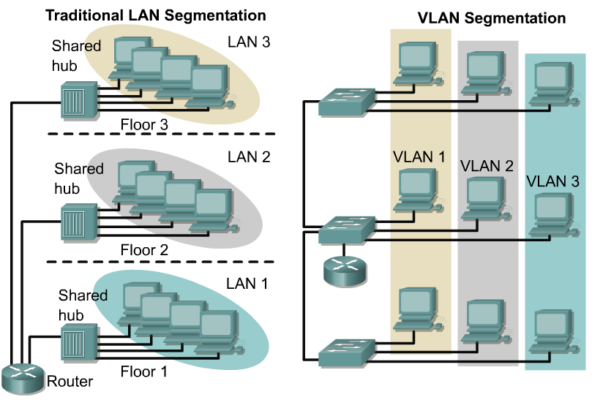
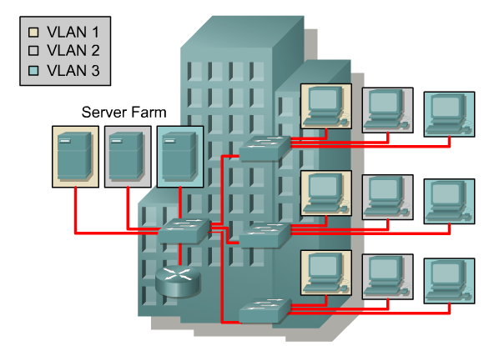
VLAN introduction
VLANs provide segmentation based on broadcast domains.
VLANs logically segment switched networks based on the functions, project teams, or applications of the organization regardless of the physical location or connections to the network.
All workstations and servers used by a particular workgroup share the same VLAN, regardless of the physical connection or location.

Slide 7
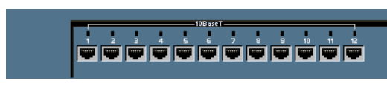
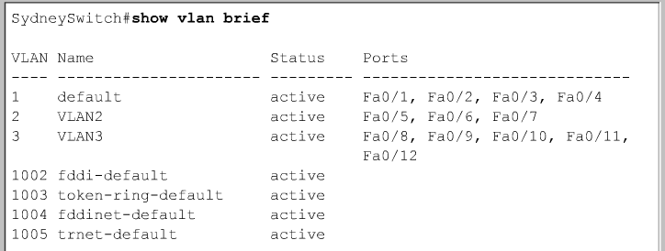
show vlan-switch brief
vlan 1 default
vlan 2
vlan 3
show vlan-switch brief

Slide 8
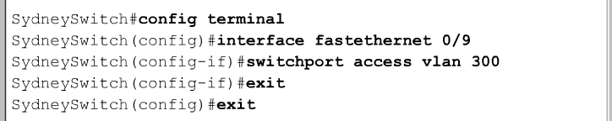
Deleting a Port VLAN Membership
Switch(config-if)#no switchport access vlan vlan_number
Deleting a VLAN
Switch#vlan database
Switch(vlan)#no vlan vlan_number
Switch(vlan)#exit

Slide 9

Routers
Routers have all the capabilities listed above.
Routers can regenerate signals, concentrate multiple connections, convert data transmission formats, and manage data transfers.
They can also connect to a WAN, which allows them to connect LANs that are separated by great distances

Slide 10
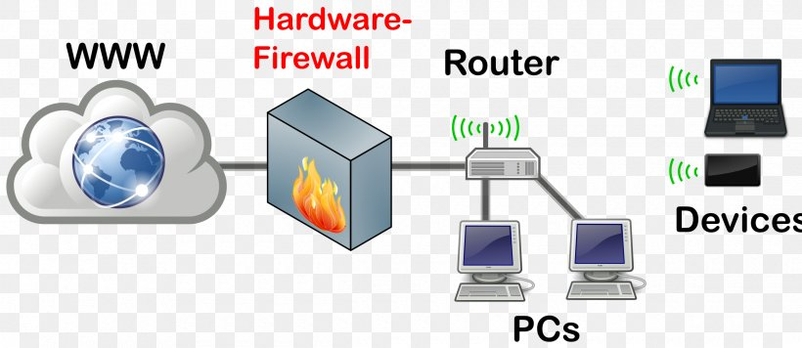
Firewall
A firewall is a network device or software for controlling network security and access rules.
Firewalls are inserted in connections between secure internal networks and potentially insecure external networks such as the Internet.
Firewalls are typically configured to reject access requests from unrecognized sources while allowing actions from recognized ones.
The vital role firewalls play in network security grows in parallel with the constant increase in cyber attacks.

Slide 11
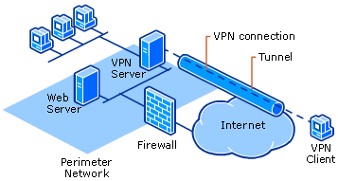
Virtual Private Network
VPN is a private network that can access public networks remotely. VPN uses encryption and security protocols to retain privacy while it accesses outside resources.
When employed on a network, VPN enables an end user to create a virtual tunnel to a remote location. Typically, telecommuters use VPN to log in to their company networks from home

Slide 12
Virtual Private Network (VPN)
VPNs are private data networks over public network – usually the Internet.
VPNs extend corporate networks to remote offices, mobile users, telecommuters and other extranet partners.
VPNs use advanced encryption and ‘tunneling’ technology to establish secure, end-to-end private network connections over Internet.
Secure VPNs use Internet as a corporate communication medium. Data is encrypted before sending, moved over to Internet, and then decrypted at the receiving end.
Encryption creates a security ‘tunnel’ that can’t be attacked
Lower costs – remote access costs have reduced by 80 percent while LAN-to-LAN connectivity costs is reduced by 20-40 percent.
Anywhere anytime access – ubiquitous public internet offers transparent access to central corporate systems i.e. email, directories, internal-external web-sites.

Slide 13
Types Of VPN-Two basic VPN types are explained below.
1.Remote Access VPN
2. Site – To- Site VPN
1.Remote Access VPN: This type of VPN is commonly used by individual users to connect to a corporate private network over the internet. It enables users to access resources on a corporate private network securely from a remote location.
VPN client – software, hardware as well as firewall or NGFW based solutions available.

Slide 14
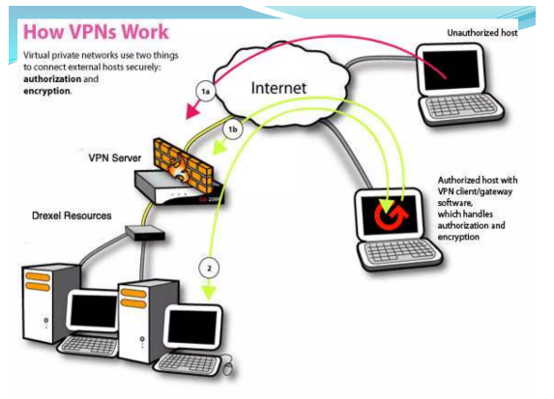

Slide 15
Site-to-Site VPN: Also known as a router-to-router VPN, this type of VPN is used to connect multiple networks securely over the
internet.
It establishes a secure connection between two or more local networks, allowing them to communicate with each other as if they were on the same physical network.
Intranet VPNs provide full access to company’s network
Reduced cost of long distance access calls and internal equipment inventory.
Extranet VPNS provide business partners with limited access to a company’s network.

Slide 16
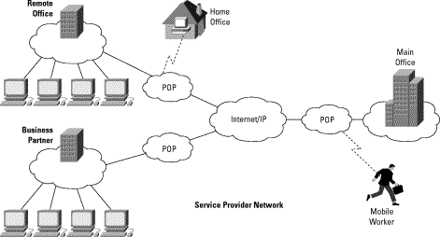
A typical VPN

Slide 17
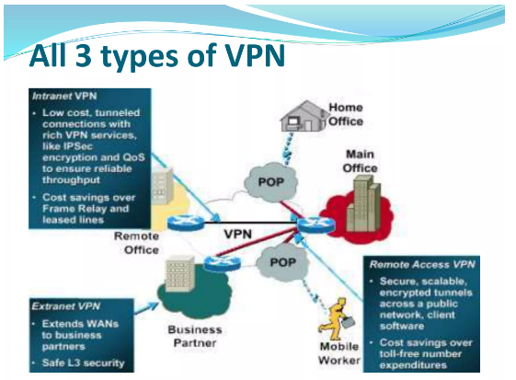

Slide 18
Types of VPN Protocols
1.Internet Protocol Security or IPsec
2.Layer 2 Tunneling Protocol (L2TP)
3.Point – To – point Tunneling Protocol (PPTP)
4.Secure Sockets Layer SSL and Transport Layer Security TLS
ISAKMP (Internet Security Association and Key Management Protocol) and IPSec are essential to building and encrypting the VPN tunnel. ISAKMP, also called IKE (Internet Key Exchange), is the negotiation protocol that allows two hosts to agree on how to build an IPsec security association. ISAKMP negotiation consists of two phases: Phase 1 and Phase 2.
VPNs provide reliable access to network
VPN software allows transmitted data packets to transparently switch over to a different path in case of a device failure
Redundancy in hardware components reduces the risk of downtime
Router based VPNs – adding encryption support to existing router(s) can keep the upgrade costs of VPN low.
Firewall based VPNs – workable solution for small networks with low traffic volume.

Slide 19
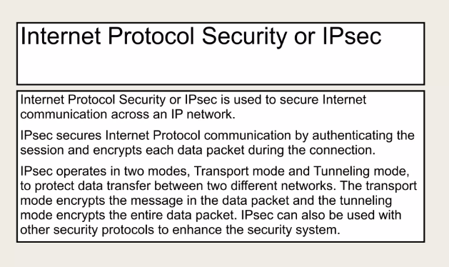

Slide 20
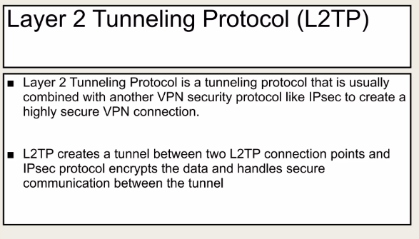

Slide 21
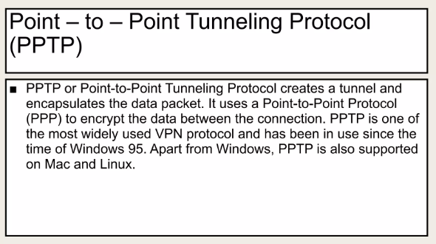

Slide 22
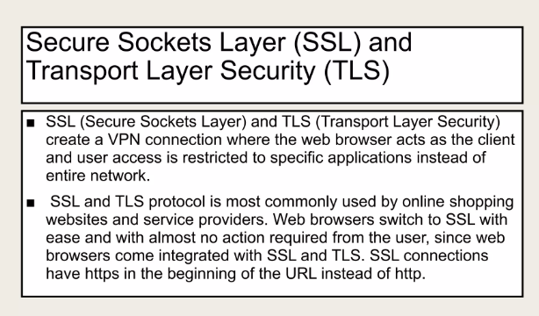

Slide 23
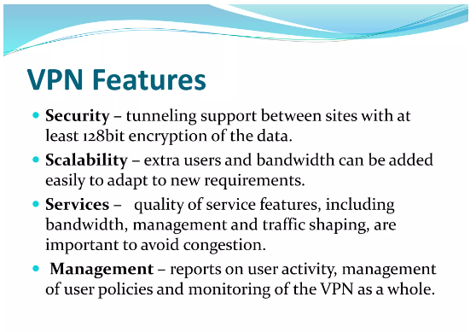

Slide 24
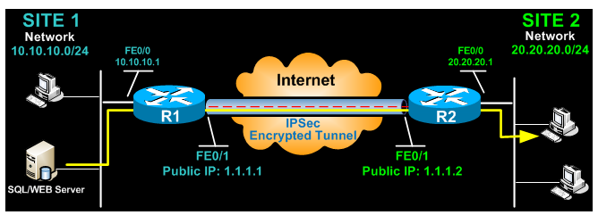
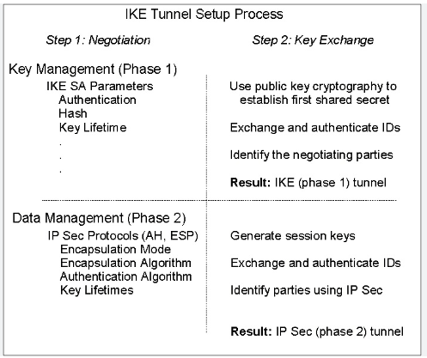
IPSec is a protocol suite to authenticate and encrypt the packets being exchanged between two points VPN is a private connection over a public network

Slide 25
These steps are:
(1) Configure ISAKMP (ISAKMP Phase 1)-First step is to configure an ISAKMP Phase 1 policy.
R1(config)# crypto isakmp policy 1 R1(config-isakmp)# encr 3des
R1(config-isakmp)# hash md5
R1(config-isakmp)# authentication pre-share
R1(config-isakmp)# group 2
R1(config-isakmp)# lifetime 86400
R1(config)# ip access-list extended VPN-TRAFFIC R1(config-ext-nacl)# permit ip 10.10.10.0 0.0.0.255 20.20.20.0 0.0.0.255
3DES - The encryption method to be used for Phase 1.
MD5 - The hashing algorithm
Pre-share - Use Pre-shared key as the authentication method
Group 2 - Diffie-Hellman group to be used
86400 – Session key lifetime. Expressed in either kilobytes (after x-amount of traffic, change the key) or seconds. Value set is the default value.

Slide 26
STEP 2: CREATE IPSEC TRANSFORM (ISAKMP PHASE 2 POLICY)
Configure IPSec (ISAKMP Phase 2, ACLs, Crypto MAP)
Our example setup is between two branches of a small company, these are Site 1 and Site 2. Both the branch routers connect to the Internet and have a static IP Address assigned by their ISP as shown on the diagram:
#crypto ipsec transform-set TS esp-3des esp-md5-hmac
- ESP-3DES - Encryption method
- MD5 - Hashing algorithm
STEP 3: CREATE CRYPTO MAP
R1(config)#cryptomap CMAP 10 ipsec-isakmp R1(config-crypto-map)# set peer 1.1.1.2
R1(config-crypto-map)# set transform-set TS
R1(config-crypto-map)# match address VPN-TRAFFIC
STEP 4: APPLY CRYPTO MAP TO THE PUBLIC INTERFACE
R1(config)# interface FastEthernet0/1 R1(config- if)# crypto map CMAP

Slide 27
ESTABLISHING AND VERIFYING THE IPSEC VPN TUNNEL-
R1# show crypto session Crypto session current status
Interface: FastEthernet0/1
Session status: UP-ACTIVE
Peer: 1.1.1.2 port 500
IKE SA: local 1.1.1.1/500 remote 1.1.1.2/500 Active
IPSEC FLOW: permit ip 10.10.10.0/255.255.255.0 20.20.20.0/255.255.255.0
Active SAs: 2, origin: crypto map
R1# ping 20.20.20.1 source fastethernet0/0 Type escape sequence to abort.
Sending 5, 100-byte ICMP Echos to 20.20.20.1, timeout is 2 seconds:
Packet sent with a source address of 10.10.10.1
.!!!!
Success rate is 80 percent (4/5), round-trip min/avg/max = 44/47/48 ms

Slide 28
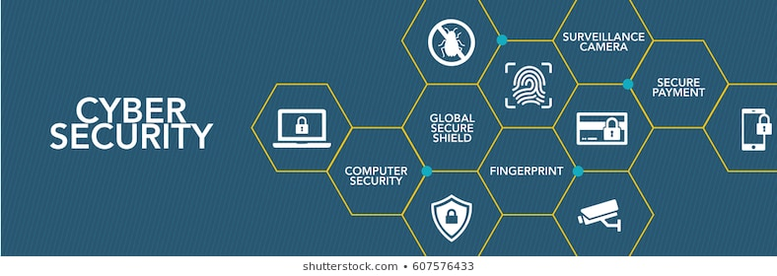




Slide 29
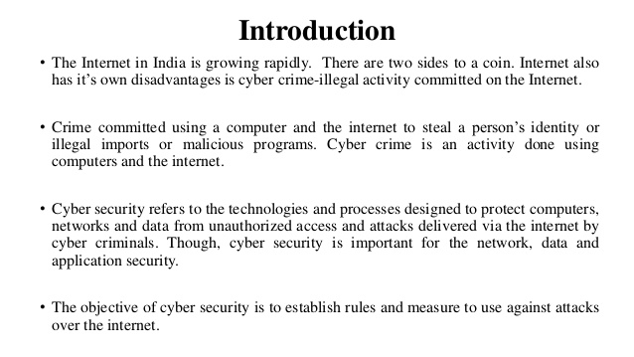

Slide 30
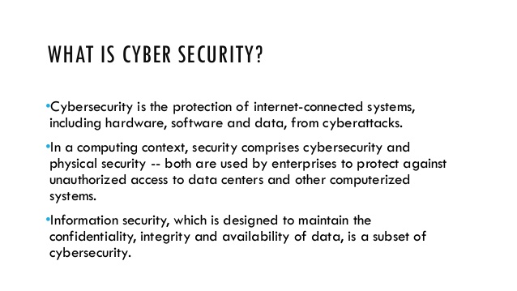

Slide 31
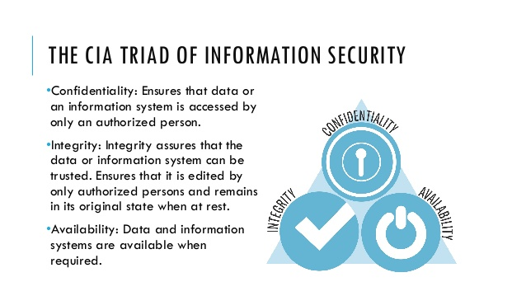

Slide 32
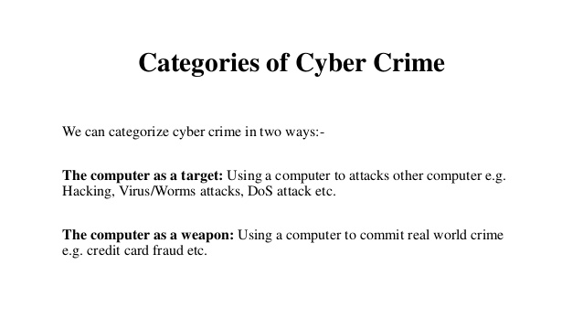

Slide 33
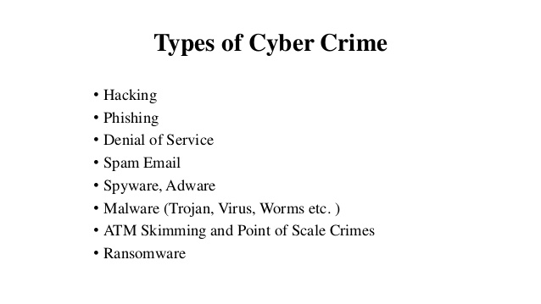

Slide 34
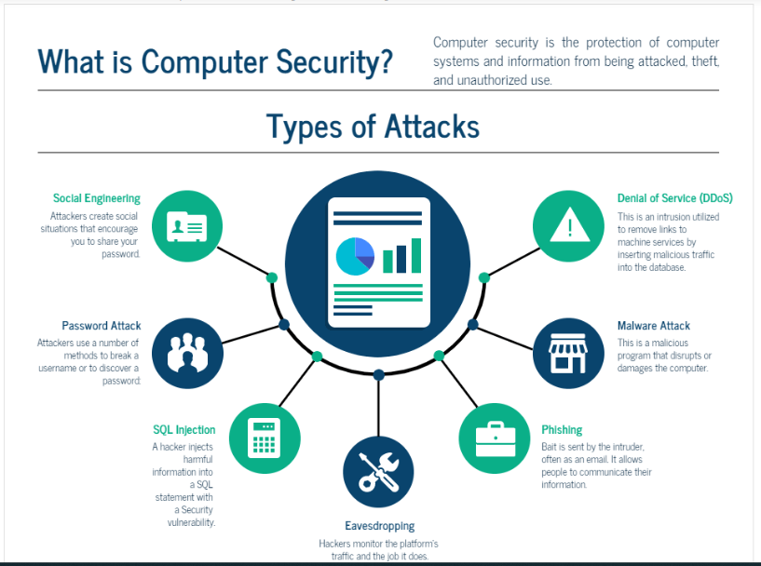

Slide 35
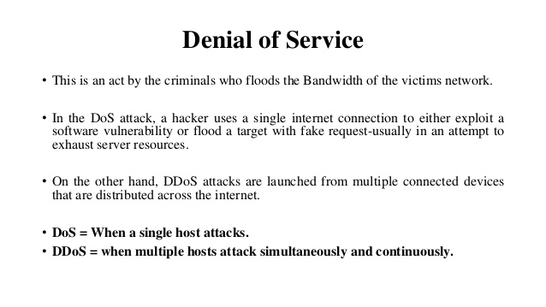

Slide 36
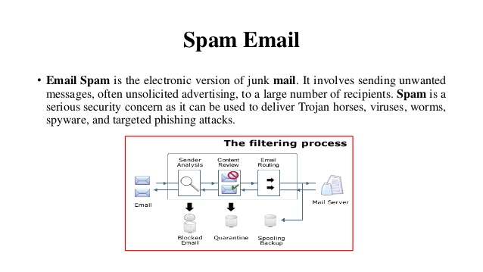

Slide 37
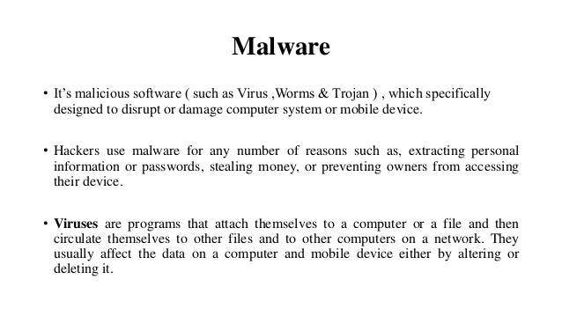

Slide 38
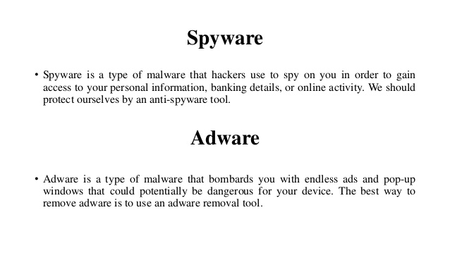

Slide 39
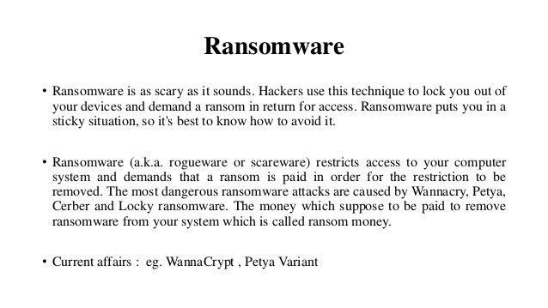

Slide 40
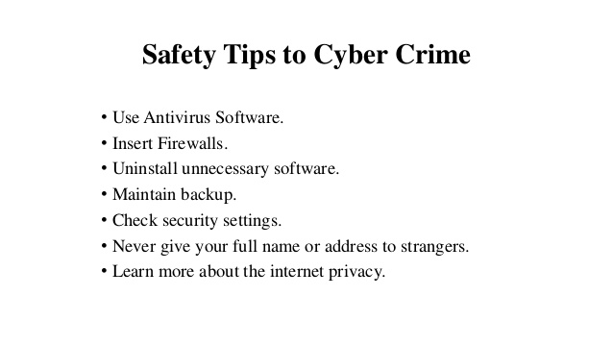

Slide 41
CYBER SECURITY DO’S
Use complex passwords with a minimum length of 8 characters, using a combination of capital letters, small letters, numbers and special characters.
Change your passwords at least once in 45 days.
Use multi-factor authentication, wherever available.
Save your data and files on the secondary drive (ex: d:\).
Maintain an offline backup of your critical data.
Keep your Operating System and BIOS firmware updated with the latest updates/patches. 7. Install enterprise antivirus client offered by the government on your official desktops/laptops. Ensure that the antivirus client is updated with the latest virus definitions, signatures and patches
Configure NIC’s NTP Service (samay1.nic.in, samay2.nic.in) in your system’s NTP Settings for time synchronization.
Use authorized and licensed software only. 1
Ensure that proper security hardening is done on the systems.
When you leave your desk temporarily, always lock/log-off from your computer session
When you leave office, ensure that your computer and printers are properly shutdown.
Hardware Virtual Private Network (VPN) Token for connecting privately

Slide 42
CYBER SECURITY DON’TS
Don’t use the same password in multiple services/websites/apps.
Don’t save your passwords in the browser or in any unprotected documents.
Don’t write down any passwords, IP addresses, network diagrams or other sensitive information on any unsecured material (ex: sticky/post-it notes, plain paper pinned or posted on your table, etc.)
Don’t save your data and files on the system drive (Ex: c:\ or root).
Don’t upload or save any internal/restricted/confidential government data or files on any non-government cloud service (ex: google drive, dropbox, etc.).
Don’t use obsolete or unsupported Operating Systems.
Don’t use any 3rd party DNS Service or NTP Service.
Don’t use any 3rd party anonymization services (ex: Nord VPN, Express VPN, Tor, Proxies, etc.).
Don’t use any 3rd party toolbars (ex: download manager, weather tool bar, askme tool bar, etc.) in your internet browser.
Don’t install or use any pirated software (ex: cracks, keygen, etc.).
Don’t open any links or attachments contained in the emails sent by any unknown sender.
Don’t share system passwords or printer passcode or Wi-Fi passwords with any unauthorized persons
.Don’t plug-in any unauthorized external devices, including USB drives shared by any unknown person.
Don’t use any unauthorized remote administration tools (ex: Teamviewer, Ammy admin, anydesk, etc.)
.Don’t share any sensitive information with any unauthorized or unknown person over telephone or through any other medium.

Slide 43
Network Troubleshooting Tools
Ping : It helps us to determine two things: latency and packet loss. Because ICMP is typically the lowest priority packet in the pecking order.
>ping google.com
Traceroute / Tracert
Ipconfig / Ifconfig
Nslookup
Netstat
Speed test

Slide 44

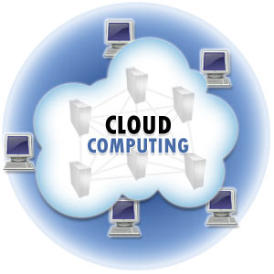
Cloud Computing
Cloud computing is Internet-based computing, whereby shared resources, software, and information are provided to computers and other devices on demand, like the electricity grid.
A Cloud is a type of parallel and distributed system consisting of a collection of interconnected and virtualized computers that are dynamically provisioned and presented as one or more unified computing resources based on service-level agreements established through negotiation between the service provider and consumers.

Slide 45
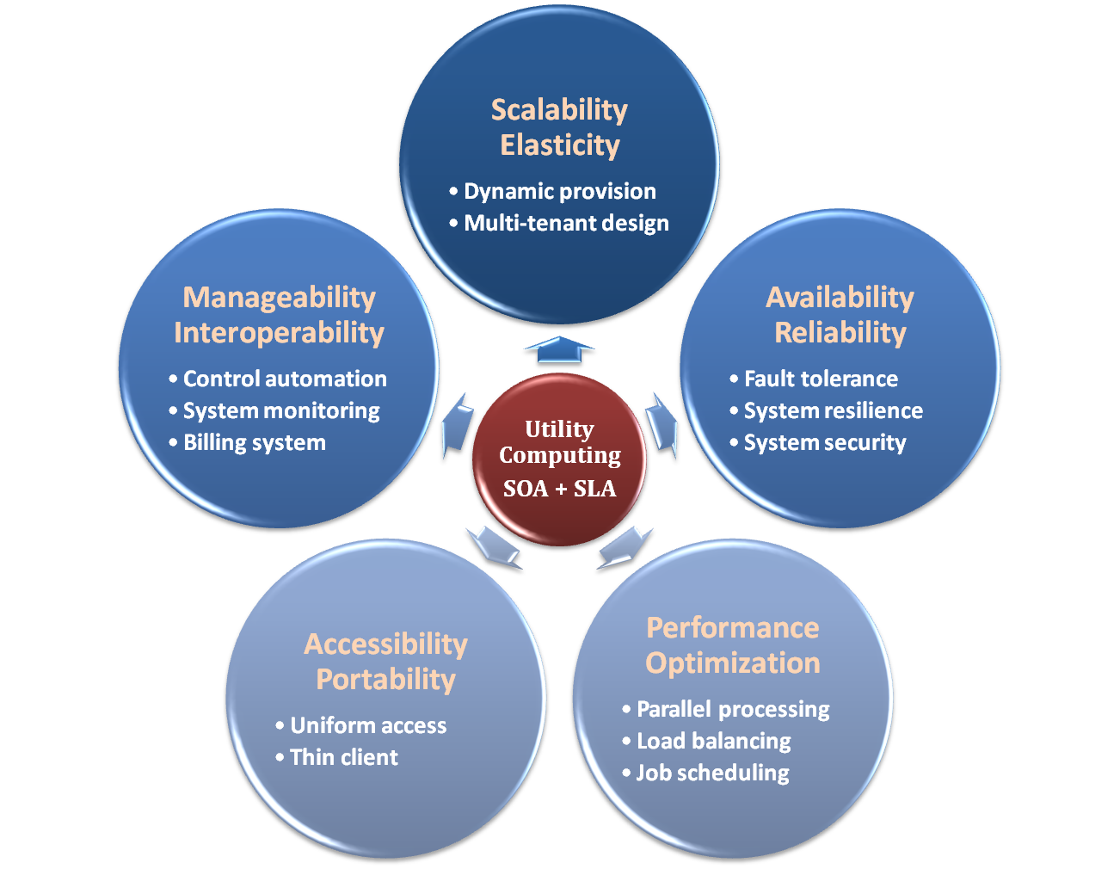
Properties & Characteristics

Slide 46
IaaS
Infrastructure as a Service – IaaS
The capability provided to the consumer is to provision processing, storage, networks, and other fundamental computing resources where the consumer is able to deploy and run arbitrary software, which can include operating systems and applications.
The consumer does not manage or control the underlying cloud infrastructure but has control over operating systems, storage, deployed applications, and possibly limited control of select networking components .
Examples :
Amazon EC2
Eucalyputs
OpenNebula
… etc

Slide 47
PaaS
Platform as a Service – PaaS
The capability provided to the consumer is to deploy onto the cloud infrastructure consumer-created or acquired applications created using programming languages and tools supported by the provider.
The consumer does not manage or control the underlying cloud infrastructure including network, servers, operating systems, or storage, but has control over the deployed applications and possibly application hosting environment configurations.
Examples :
Microsoft Windows Azure
Google App Engine
Hadoop(High Availability Distributed Object Oriented Platform)
… etc

Slide 48
SaaS
Software as a Service – SaaS
The capability provided to the consumer is to use the provider’s applications running on a cloud infrastructure. The applications are accessible from various client devices through a thin client interface such as a web browser (e.g., web-based email).
The consumer does not manage or control the underlying cloud infrastructure including network, servers, operating systems, storage, or even individual application capabilities, with the possible exception of limited user-specific application configuration settings.
Examples :
Google Apps (e.g., Gmail, Google Docs, Google sites, …etc)

Slide 49
Cloud-Deployment Model
There are four primary cloud deployment models :
Public Cloud
Private Cloud
Community Cloud
Hybrid Cloud
 | Public Cloud | Private Cloud
Infrastructure | Homogeneous | Heterogeneous
Policy Model | Common defined | Customized & Tailored
Resource Model | Shared & Multi-tenant | Dedicated
Cost Model | Operational expenditure | Capital expenditure
Economy Model | Large economy of scale | End-to-end control

Slide 50


