Slide 1
WELCOME
My Values, Team Values aligning with Organisational Values

Slide 2
Values
Values are an internal reference for what is good or bad, desirable or undesirable in ourselves and others.
They are moral principles, based on beliefs, so significant to us as individuals that they drive our behaviour: our interactions with others and the world.

Slide 3
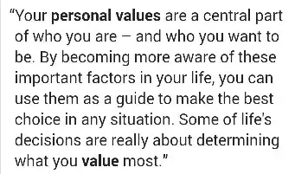
My Values

Slide 4
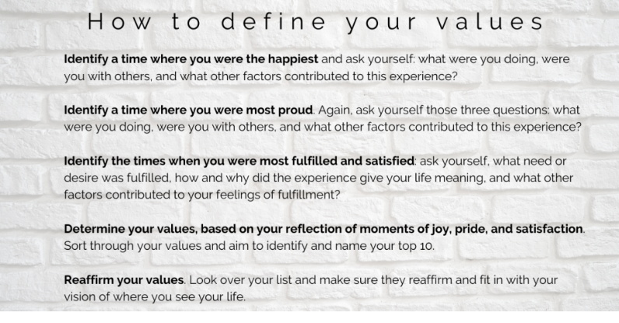

Slide 5
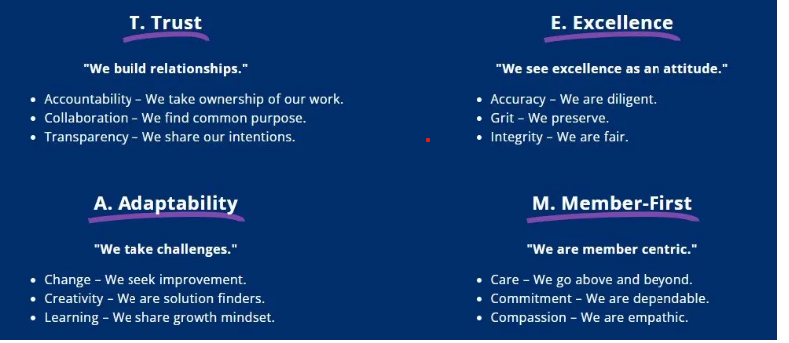
Team Values

Slide 6
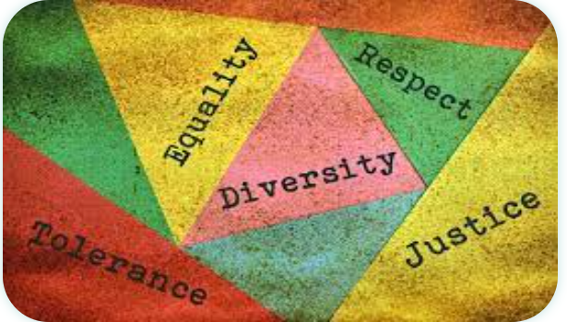
Community Values

Slide 7
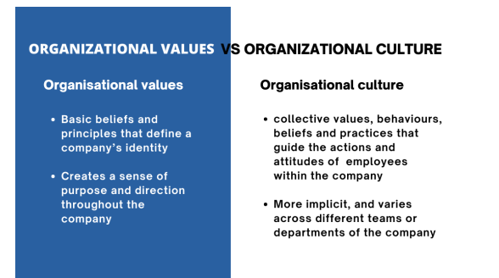

Slide 8
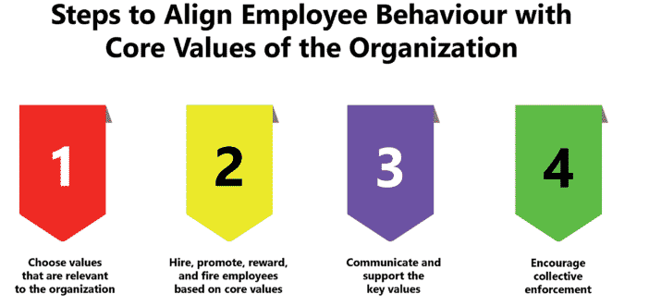
Organisational values

Slide 9


