Slide 1
MRT&Tr -Vijayawada BY T Sreemannarayana Murthy EE/MRT&T/Vijayawada

Slide 2
220kv Substatons in Krishna District
1.Gunadala 220Kv ss
2.Gudivada 220kv ss
3.Nunna 220kv ss
4.Chillakallu 220kv ss
5.Kondapalli 220kv ss
6.Nuzvid 220kv ss
7.A Konduru220kv ss
Substatons in Krishna District

Slide 3
132 kv substations
1.Auto Nagar 2.Vijayawada
3.Bhavanipuram 4.Konumolu
5.Rangannagudem 6.Kambhampadu
7.Chigurukota 8.Avanigadda
9.Pamarru 10.Machilipatnam
11.Ganguru 12.Nandigama
13 Narasapuram

Slide 4
UPcoming sub-stations
220kv Tiruvuru ( in construction stage)
132kv Mylavaram( in construction stage)
132kv Vuyyuru
132kv Ramanakkapet
132kv Buntumilli

Slide 5
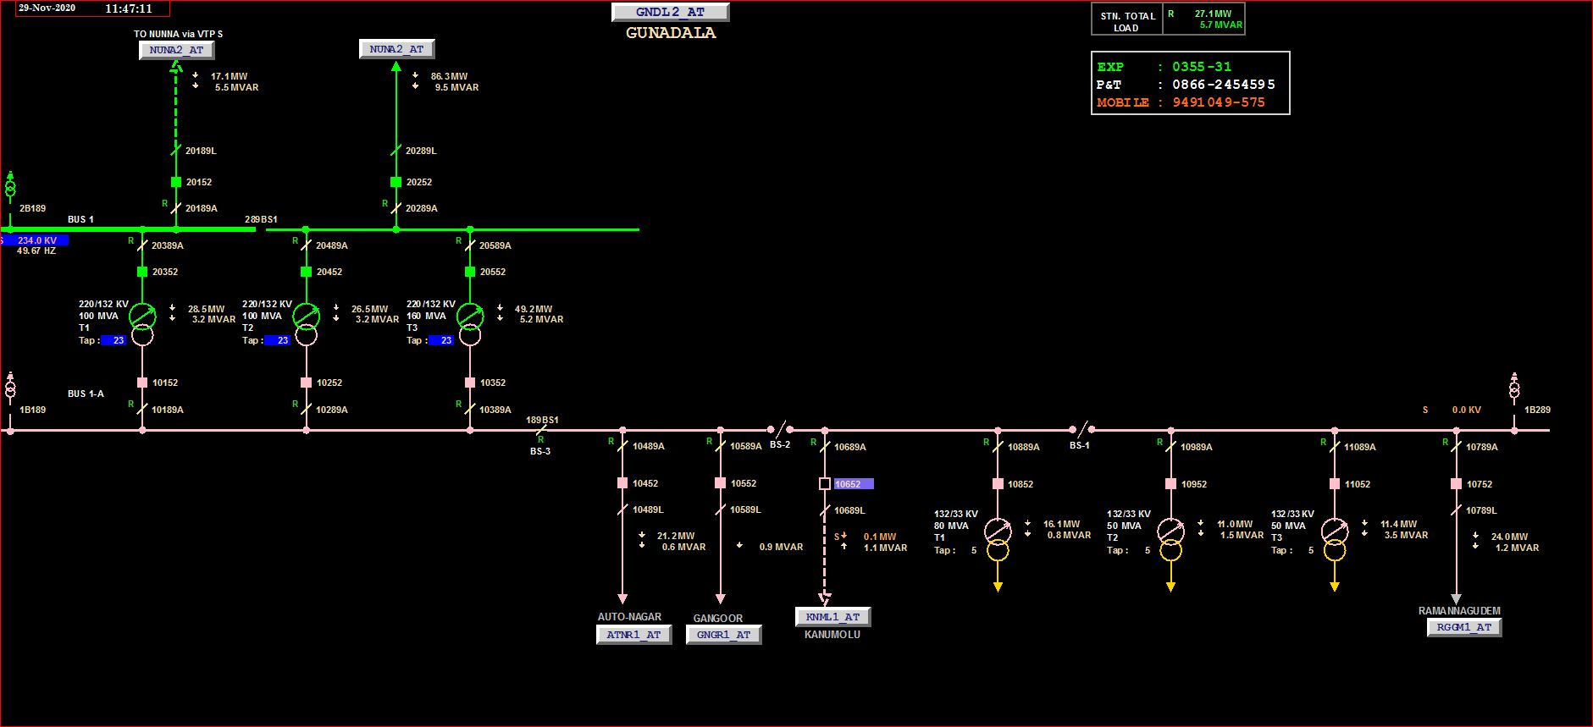
Gunadala 220kv substation

Slide 6
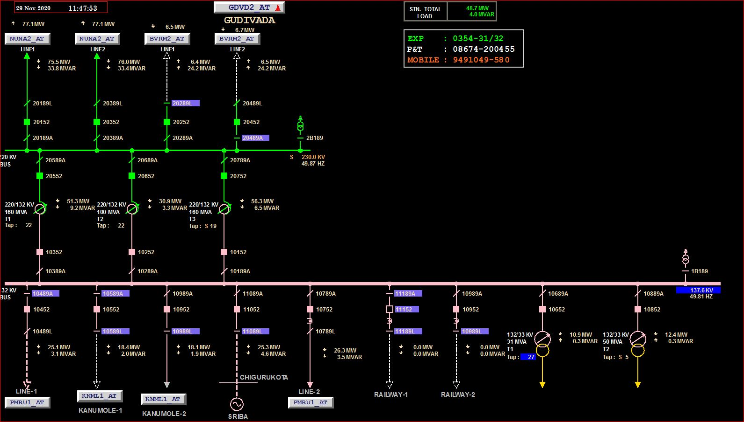
Gudivada 220kv substation

Slide 7
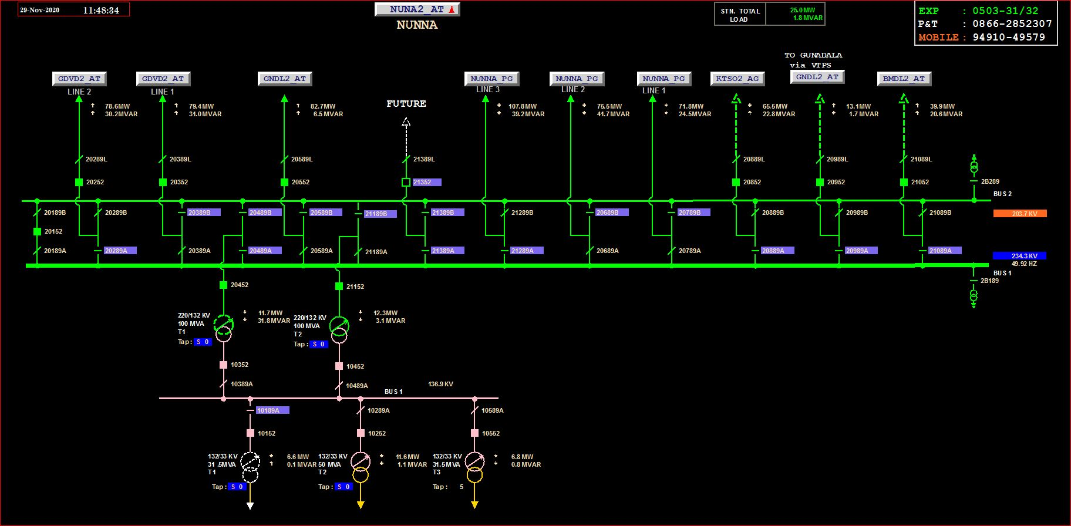
Nunna 220 kv substation

Slide 8
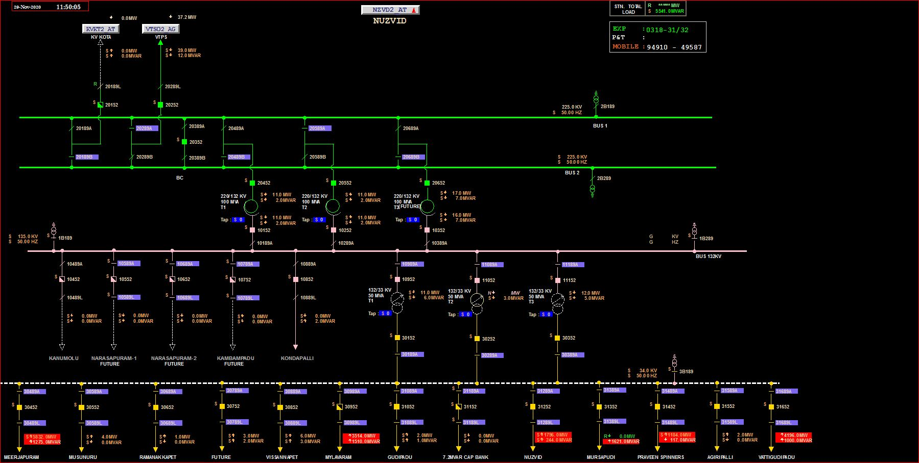
Nuzvid 220 substaion

Slide 9
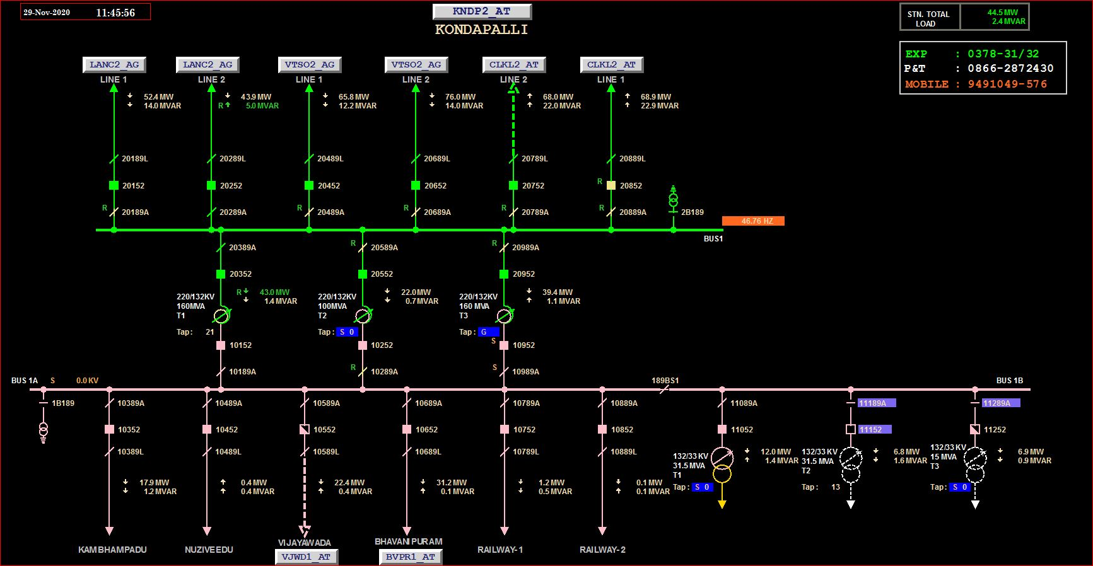
Kondapalli 220 substation

Slide 10
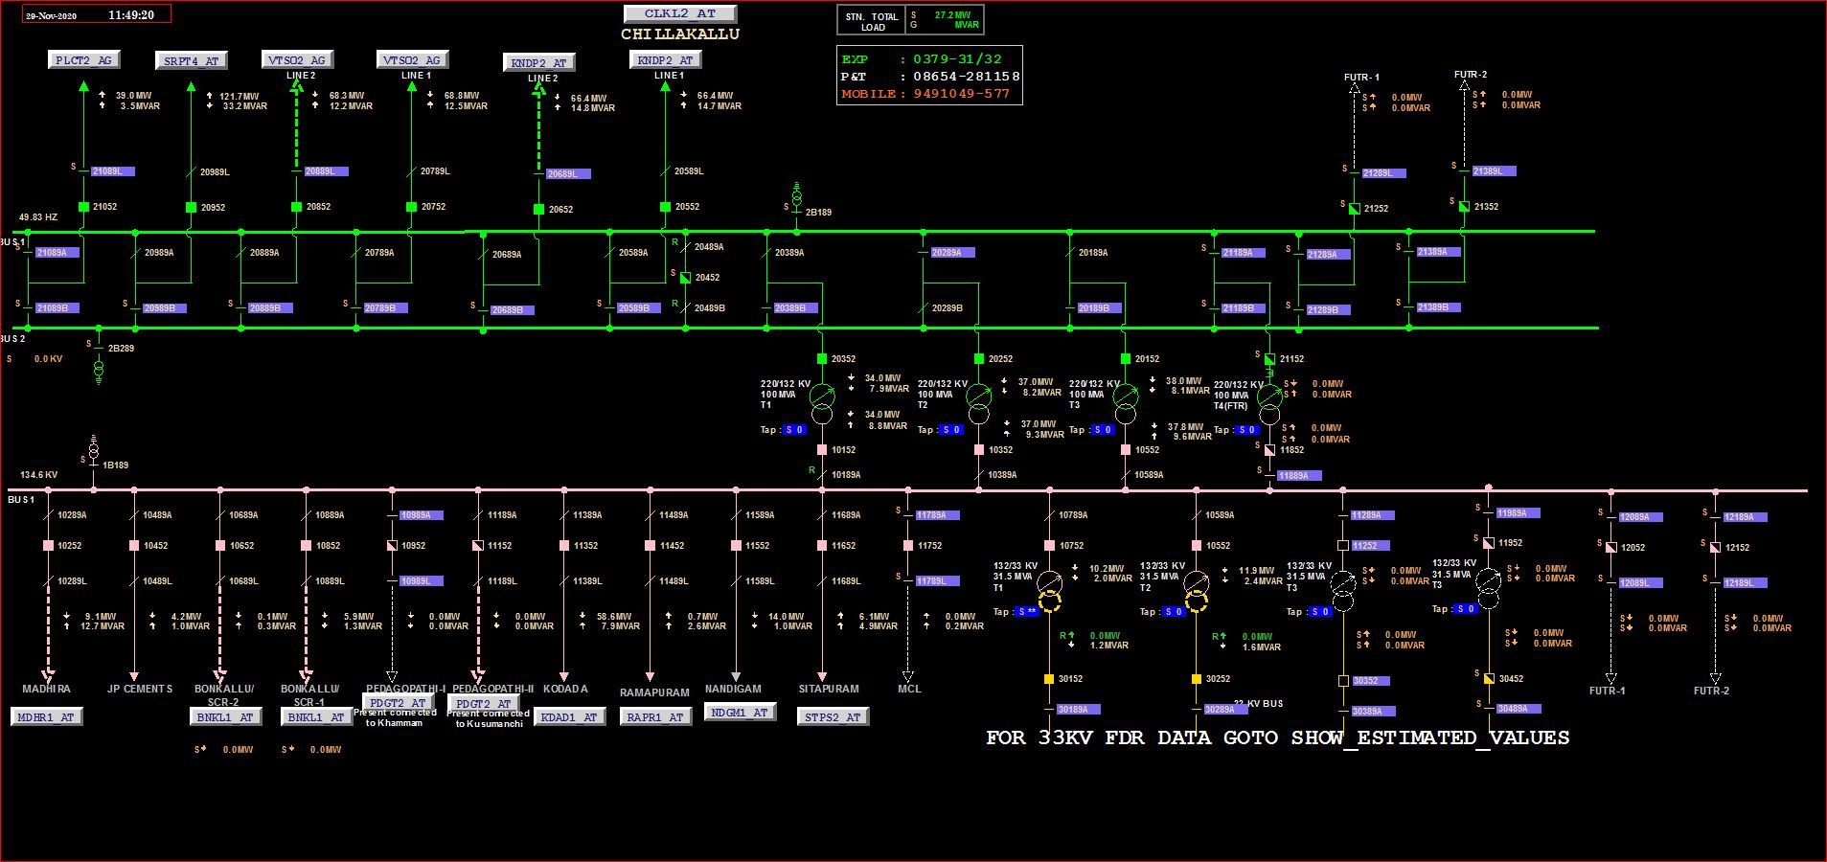
Chillakallu 220 substation

Slide 11
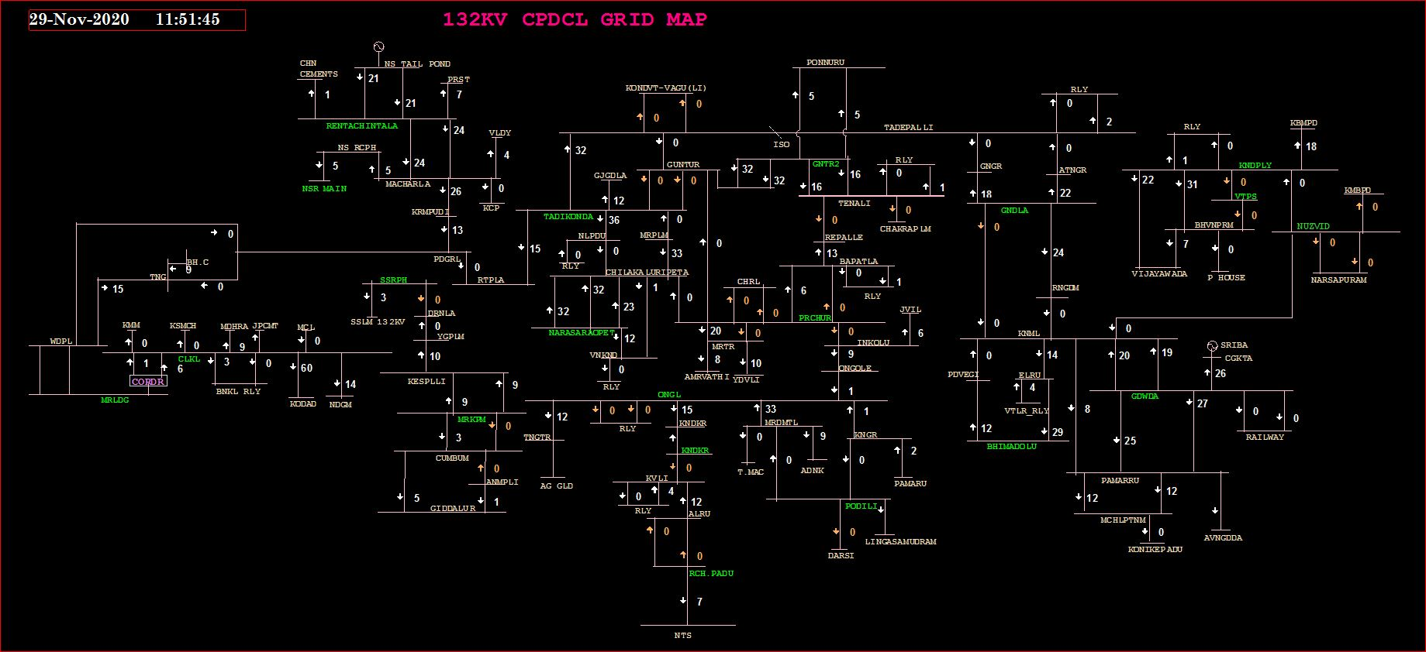
CPDCL network map

Slide 12
220kv Gunadala Substation
S.No | Capacity | Total taps/Tap position | make | YOM | DOC | %Impedance | Remarks
1 | 100MVA 220/132kv | 25/23 | Alstom | 2005 | 15/8/2005 | 9.65
2 | 100MVA 220/132kv | 25/23 | CGL | 1995 | 19/11/2014 | 1023
3 | 160MVA 220/132kv | 25/23 | Toshiba | 2015 |  | 9.41
4 | 80MVA /132/33kv | 25/5 | Aditya | 2016 | 24/03/2018 | 11.64
5 | 50MVA 132/33kv | 25/5 | CGL | 2004 | 08/09/2004 | 12.34
6 | 50MVA 132/33kv | 25/5 | Vijai Elec | 2009 | 15/05/2009 | 12.33

Slide 13
220kv Gudivada Substation
S.No | Capacity | Total taps/Tap position | make | YOM | DOC | %Impedance | Remarks
1 | 160MVA 220/132kv | 22 | BBL | 2019 | 08/01/2020 | 10.26
2 | 100MVA 220/132kv | 22 | CGL | 2005 | 28/12/2005 | 10.60
3 | 160MVA 220/132kv | 19 | Toshiba | 2015 | 22/11/2017 | 9.14
4 | 50MVA 132/33kv | 5 | BBL | 2019 | 29/09/2019 | 12.50
5 | 50MVA 132/33kv | 5 | Toshiba | 2015 | 15/12/2015 | 11.94
6 | 50MVA 132/33kv | 5 | ECE |  | 31/5/2021

Slide 14
220kv Konadapalli Substation
S.No | Capacity | Total taps/Tap position | make | YOM | DOC | %Impedance | Remarks
1 | 160MVA 220/132kv | 21/ | BBL | 2019 | 07/01/2020 | 10.30
2 | 100MVA 220/132kv | 25/ | BHEL | 2014 | 10/03/2015 | 10.00
3 | 160MVA 220/132kv | 25/ | Toshiba | 2015 | 23/04/2016 | 9.40
4 | 50MVA 132/33kv | 21/ | BBL | 2016 | 12/01/2017 | 12.47
5 | 31.5MVA 132/33kv | 25/ | EMCO | 1997 | 13/12/2012 | 8.27
6 | 31.5MVA 132/33kv | 25/ | BBL | 2012 | 27/04/2013 | 11.78

Slide 15
220kv Nunna Substation
S.No | Capacity | Total taps/ Tap position | make | YOM | DOC | %Impedance | Remarks
1 | 100MVA 220/132kv | 25/ | CGL | 1980 | 07/03/2015 | 9.80
2 | 100MVA 220/132kv | 15/ | BHEL | 2013 | 08/09/2016 | 12.00
3 | 31.5MVA 132/33kv | 25/ | BHEL | 1968 | 15/04/2011 | 12.80
4 | 50MVA 132/33kv | 25/ | T&R | 2012 | 06/12/2012 | 11.82
5 | 31.5MVA 132/33kv | 25/ | Aditya vidyut app | 2017 | 12/04/2018 | 12.08

Slide 16
220kv Chillakallu Substation
S.No | Capacity | Total taps/ Tap position | make | YOM | DOC | %Impedance | Remarks
1 | 100MVA 220/132kv |  | BHEL | 1995 | 12/03/1997 | 10.69
2 | 100MVA 220/132kv |  | TELK | 2000 | 14/12/2000 | 11.71
3 | 100MVA 220/132kv |  | Vijai Elec | 2009 | 17/02/2010 | 9.84
4 | 31.5MVA 132/33kv |  | APEX | 1990 | 07/05/1991 | 12.72
5 | 31.5MVA 132/33kv |  | TAL | 2008 | 28/112015 | 12.33
6 | 10/16MVA 132/33kv |  | Indotech |  | 21/12/2020

Slide 17
220kv Nuzvid Substation
S.No | Capacity | Total taps/Tap position | make | YOM | DOC | %Impedance | Remarks
1 | 100MVA 220/132kv | 25/ | BBL | 2016 | 20/09/2018 | 9.937
2 | 100MVA 220/132kv | 25/ | BBL | 2016 | 20/09/2018 | 9.906
3 | 160MVA 220/132kv | 25/ | BBL | 2019 | 25/07/2020 | 11.91
4 | 50MVA 132/33kv | 25/ | Bharat Bijilee | 2007 | 30/01/2012 | 9.13
5 | 50MVA 132/33kv | 25/ | TELK | 2004 | 28/11/2004 | 13.58
6 | 50MVA 132/33kv | 25/ | BBL | 2011 |  | 6.85
7 | 50MVA 132/33kv | 25 | ECE

Slide 18
PTRs in 132/33KV substations
S.No | Name of 132KV substation | Capacity | Total taps/Tap position | make | YOM | DOC | %Impedance | Remarks
1 | Vijayawada | 50MVA | 25/ | Vijai Elec. | 2010 | 29/03/2013 | 12.12
 |  | 50MVA | 25/ | BHEL | 1984 | 14/07/2010 | 12.58
 |  | 50MVA | 25/ | ECE | 2020 | 31/12/2020
2 | Auto Nagar | 50MVA | 25/ | Toshiba | 2018 |  | 12.50
 |  | 50MVA | 25 | Toshiba | 2016 | 14/05/2016 | 12.50
3 | Bhavanipuram | 31.5MVA | 25/ | Andrewyule | 2003 | 31/07/2016 | 11.46
 |  | 31.5MVA | 25/ | EMCO | 1999 | 11/08/2016 | 13.15

Slide 19
PTRs in 132/33KV substations
S.No | Name of 132KV substation | Capacity | Total taps/Tap position | make | YOM | DOC | %Impedance | Remarks
4 | Konumolu | 50MVA | 25/ | Toshib | 2018 | 23/07/2018 | 12.50
 |  | 31.5MVA | 25/ | APEX | 2000 | 14/06/2012 | 13.09
 |  | 50MVA | 25/ |  | 2020
5 | Ganguru | 31.5 MVA | 25/ | BBL | 2016 |  | 12.50
 |  | 50MVA | 25 | Toshiba | 2016 | 14/05/2016 | 12.50
6 | Pamarru | 50MVA | 25/ | Toshiba | 2015 | 02/08/2015 | 12.50
 |  | 50MVA | 25/ | Toshiba | 2015 | 11/08/2016 | 12.50

Slide 20
PTRs in 132/33KV substations
S.No | Name of 132KV substation | Capacity | Total taps/Tap position | make | YOM | DOC | %Impedance | Remarks
7 | Machilipatnam | 50MVA | 25/ | Toshiba | 2018 | 05/06/2018 | 12.50
 |  | 50MVA | 25/ | BBL | 2019 | 23/10/2019 | 12.50
 |  | 50MVA | 25 | ECE
8 | Chigurukota | 50MVA | 25/ | Toshiba | 2016 | 18/07/2017 | 11.94
 |  | 31.5MVA | 25 | GEC | 2018 | 21/07/2018 | 12.50
9 | Avanigadda | 31.5MVA | 25/ | BBL | 1994 | 08/08/2016 | 12.37
 |  | 31.5MVA | 25/ | BBL | 2004 | 31/03/2010 | 13.27

Slide 21
PTRs in 132/33KV substations
S.No | Name of 132KV substation | Capacity | Total taps/Tap position | make | YOM | DOC | %Impedance | Remarks
10 | Nandigama | 50MVA | 25/ | Toshiba | 2018 | 05/06/2018 | 12.50
 |  | 50MVA | 25/ | BBL | 2019 | 23/10/2019 | 12.50
11 | Rangannagudem | 50MVA | 25/ | Toshiba | 2016 | 18/07/2017 | 11.94
 |  | 31.5MVA | 25 | GEC | 2018 | 21/07/2018 | 12.50
12 | Kambhampadu | 50MVA | 25/ | Althom | 1999 | 0/08/2016 | 12.37
 |  | 31.5MVA | 25/ | IMP | 2014 | 31/03/2010 | 13.27

Slide 22
S.No | Name of ss | 160 MVA | 100 MVA | 80 MVA | 50 MVA | 31.5 MVA | 16 MVA
1(220KV) | Gunadala | 1 | 2 | 1 | 2
2 | Guduvada | 2 | 1 |  | 2
3 | Nunna |  | 2 |  | 1 | 2
4 | Konadapally | 2 | 1 |  | 1 | 2
5 | Chillakallu |  | 3 |  |  | 2 | 1
6 | Nuzvid | 1 | 2 |  | 4
7(132KV) | Auto Nagar |  |  |  | 2
8 | Vijayawada |  |  |  | 3
9 | Bhavanipuram |  |  |  |  | 2
10 | Ganguru |  |  |  | 2
11 | Konumolu |  |  |  | 2 | 1
12 | Pamarru |  |  |  | 2
13 | Machilipatnam |  |  |  | 2
14 | Chigurukota |  |  |  | 2 | 1
15 | Avanigadda |  |  |  |  | 2
16 | Nandigama |  |  |  | 2
17 | Rangannagudem |  |  |  | 1 | 1
18 | Kambhampadu |  |  |  | 1 | 1
 | total | 6 | 11 | 1 | 26 | 14 | 1 | 59

Slide 23
MR T & Transformer testing
Current transformer
Potential transformer
Circuit breaker
Isolator
C&R panels
Bus bar panels
Power transformer
Lighting Arrester

Slide 24
Current Transformer
CTs are used to step down the currents to a safe and measurable level
Generally currents will be stepped diwn to 1 amp or 5amp
In APTRANSCo substations CT with 1 amp secondary will be used.
CT secondary should Never be open circuited

Slide 25
Tests on CTS
Insulation resistance tests (pry to earth, pry to sec core-1, pry to sec core-2,core-1 to earth,core-2 to earth,core-1 to core-2)
Ratio test: primary injection test: current injected in primary wdg and measured in secondary wdg
Tan delta and capacitance: Maximum allowable value for new CT s is 0.7%
For old cts it is upto 1.7% allowed

Slide 26
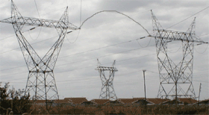
Thank You

