Slide 1

WELCOMES
AP GENCO, VJA
ENGINEERS
B.S.N.L. AP CIRCLE.,
VIJAYAWADA

Slide 2
Services of BSNL
Services
Voice
Data
Wireline
Wireless
Wireline
Wireless

Slide 3
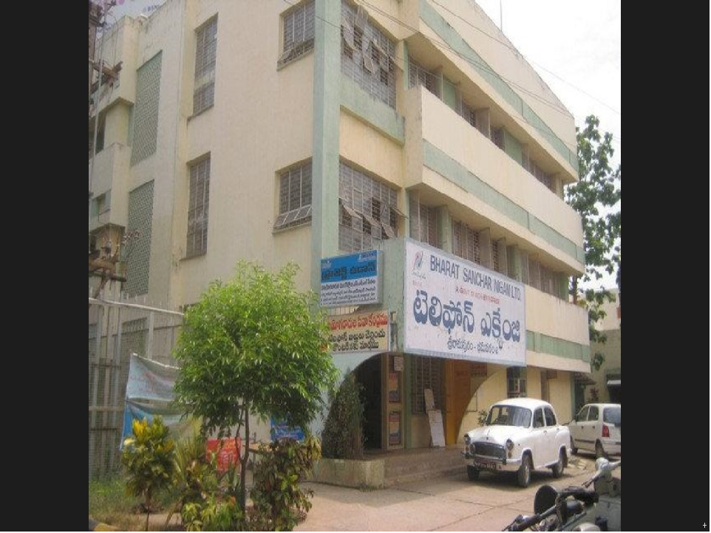

Slide 4
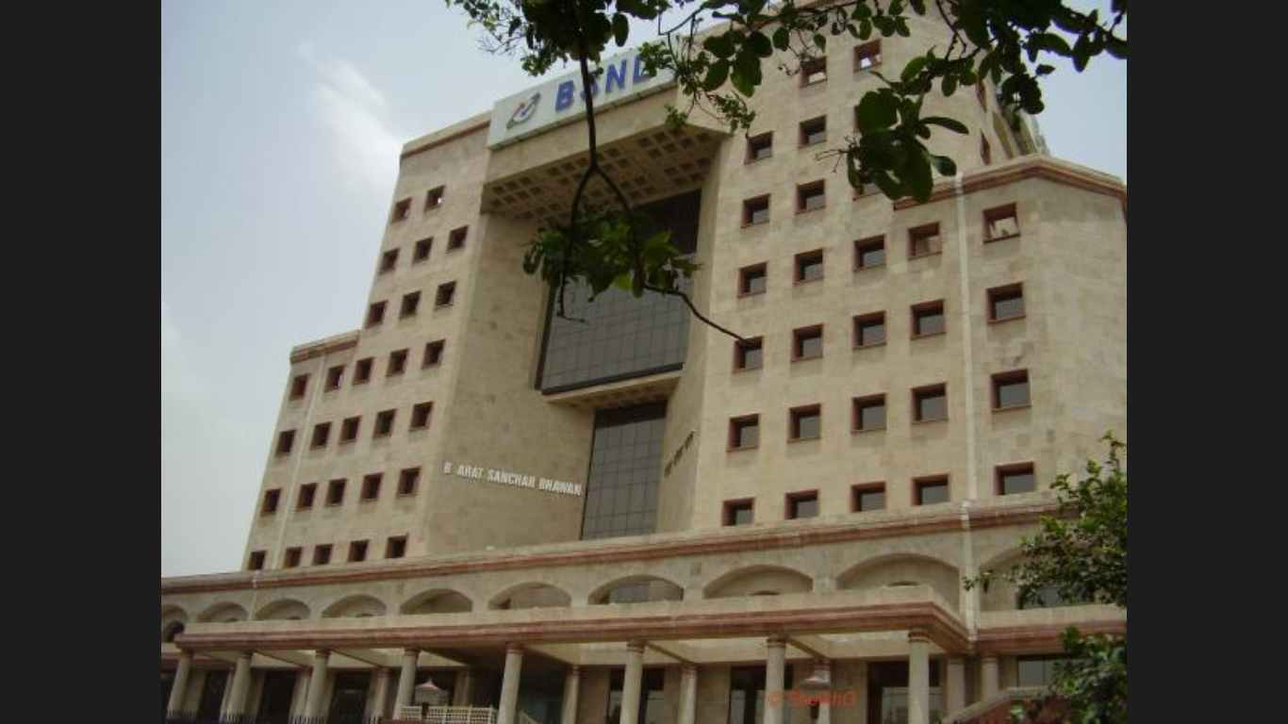

Slide 5
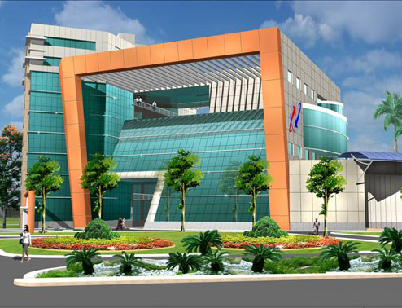
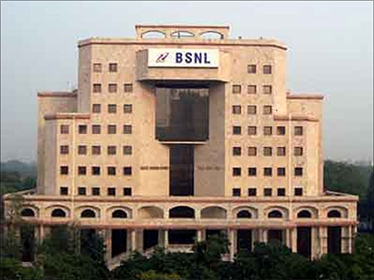
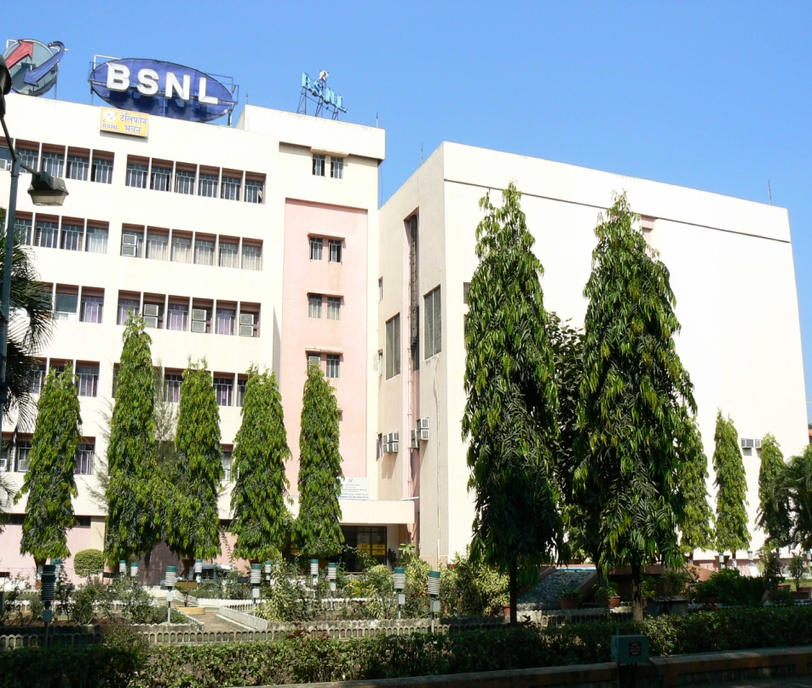
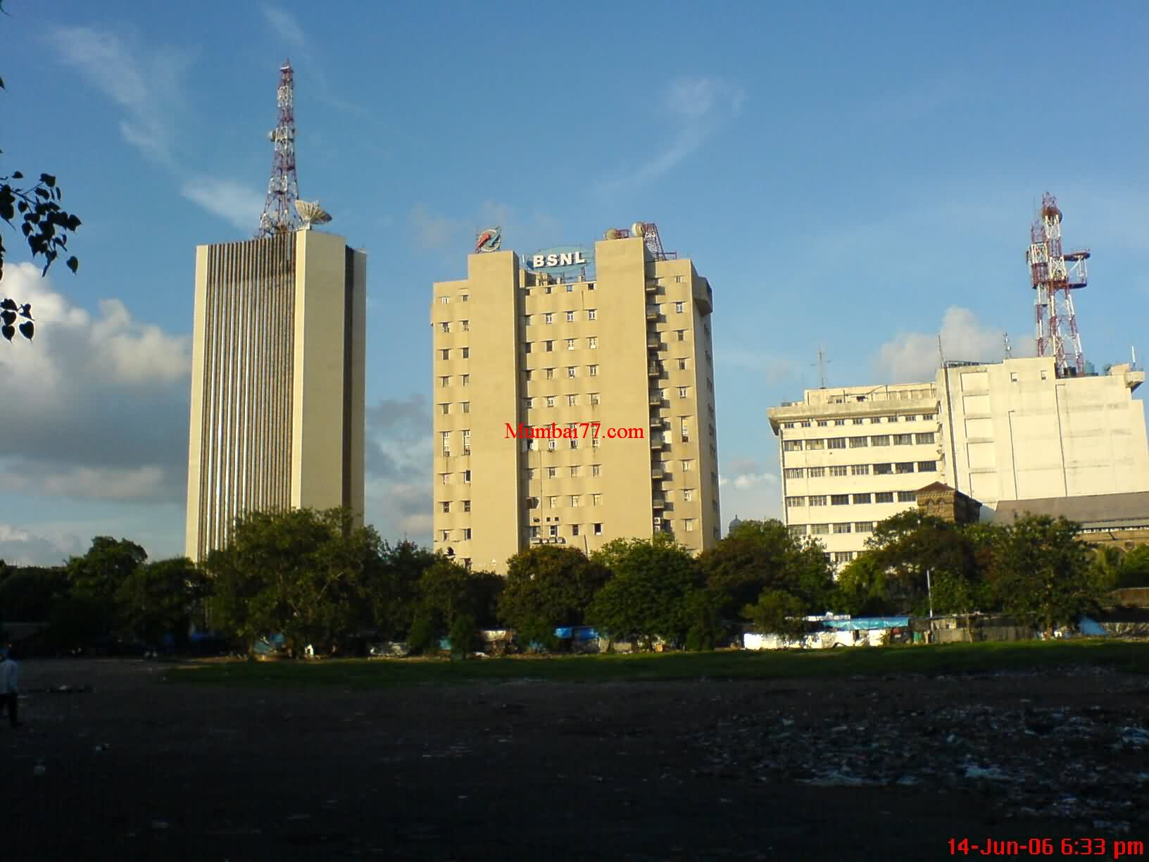

Slide 6
About Business in INDIA TELECOM
No. of Mobile Customers in India = 132 Cr
No. of Landlines working in India = 3 Cr
No. of Data Customers in India = 82 Cr
Business Turn-over in India = Rs 400000 Cr per annum

Slide 7
SALIENT FEATURES
EMPLOYABILITY
(a) Telecom Manufacturing side
(B) Telecom
operations side

Slide 8
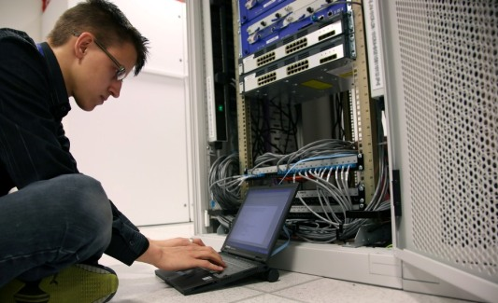

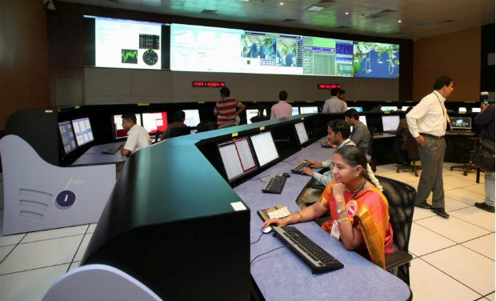
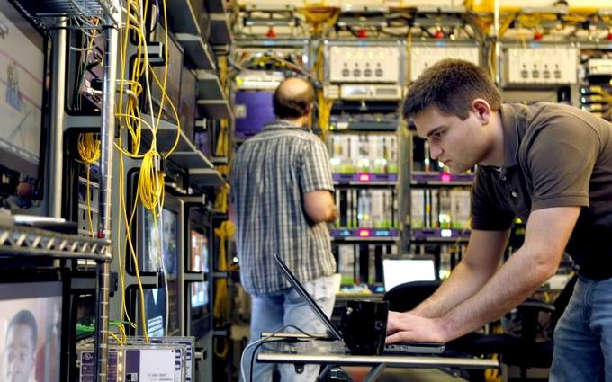

Slide 9
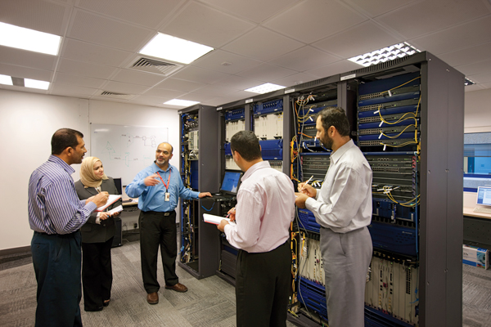
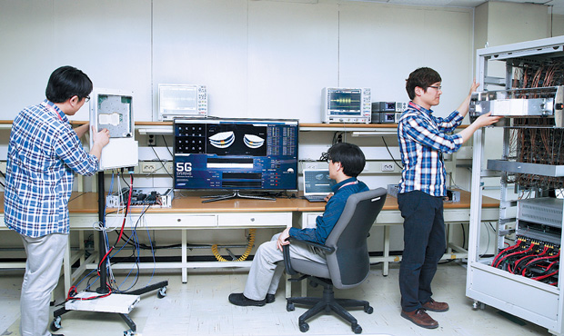
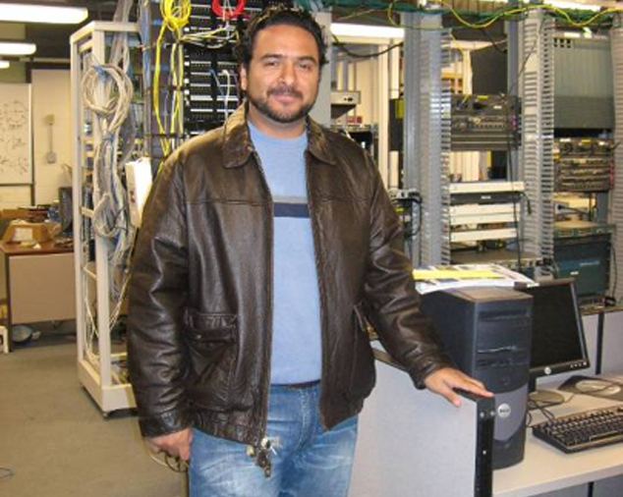
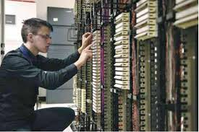

Slide 10
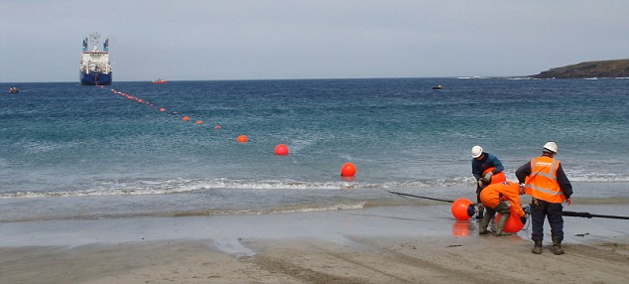
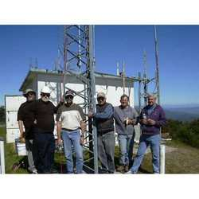


Slide 11
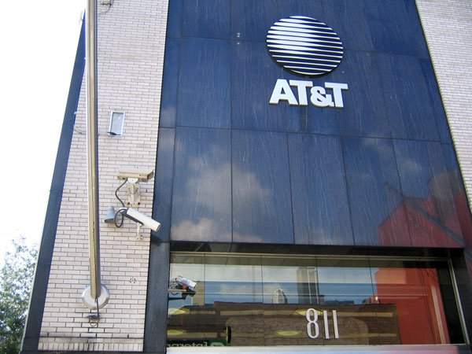
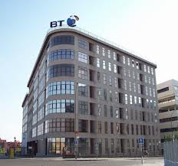
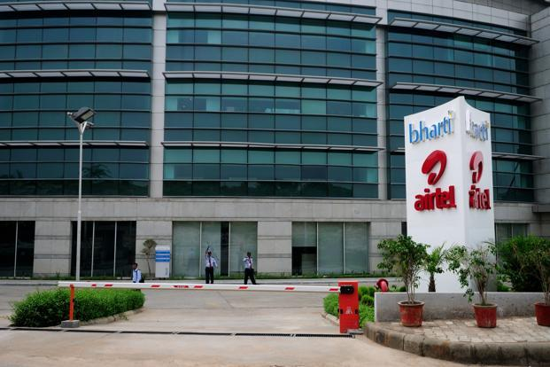
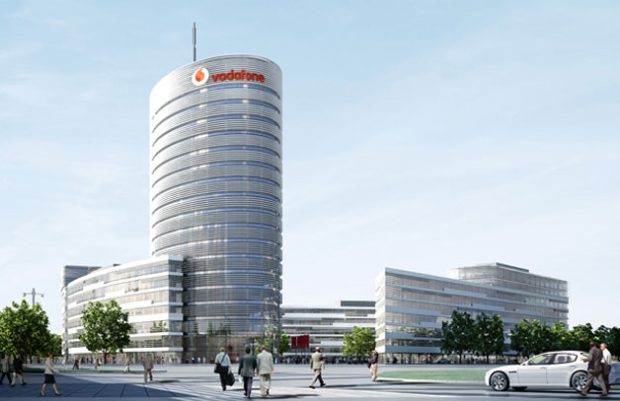

Slide 12
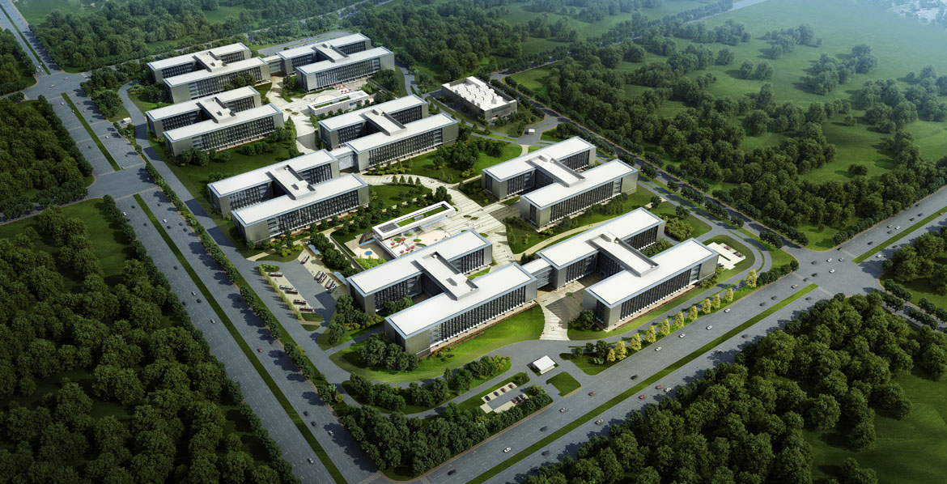
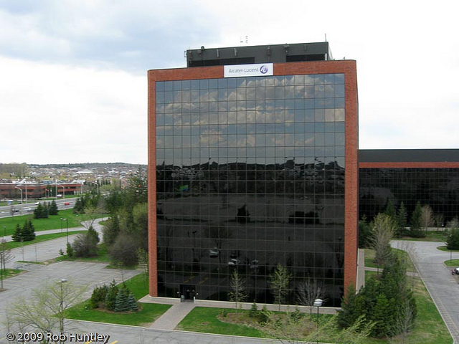
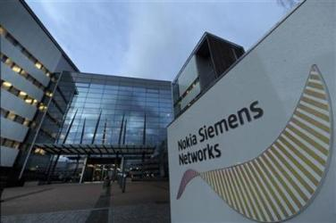
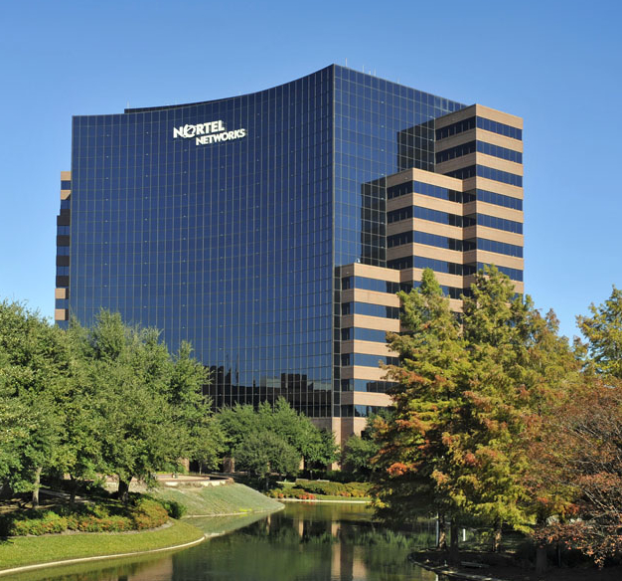

Slide 13
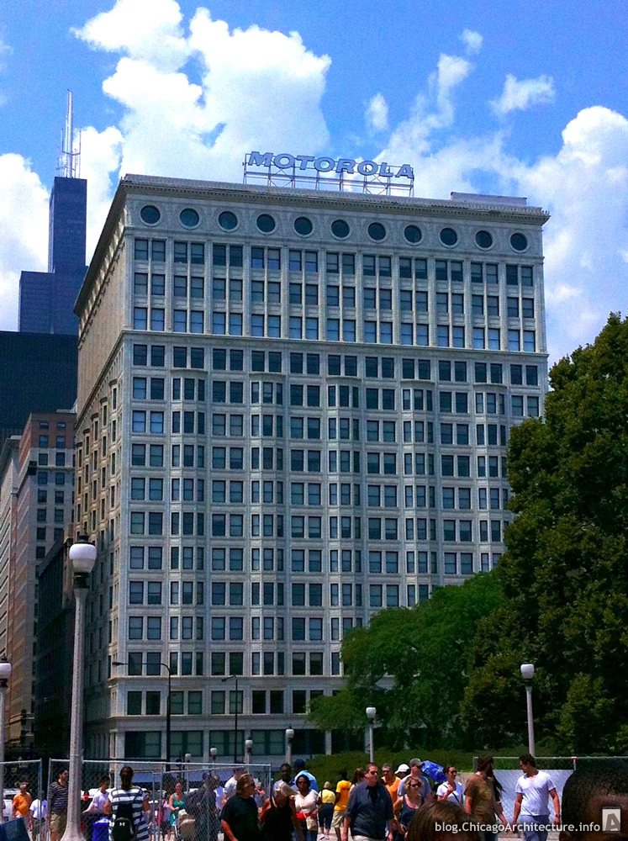
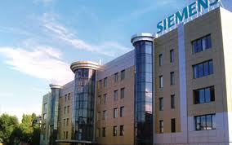
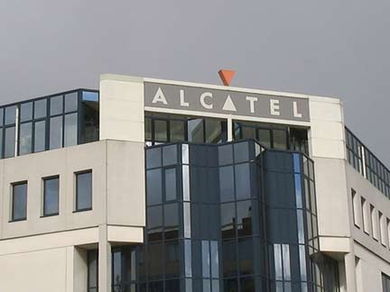


Slide 14
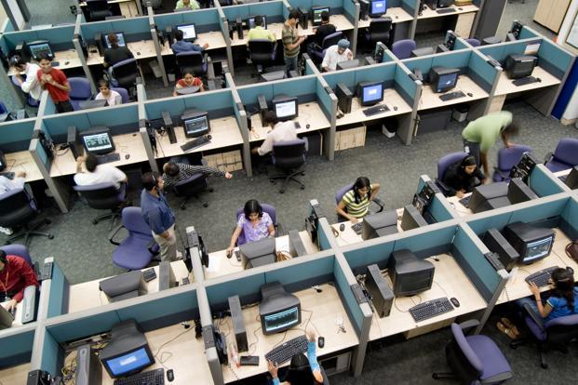


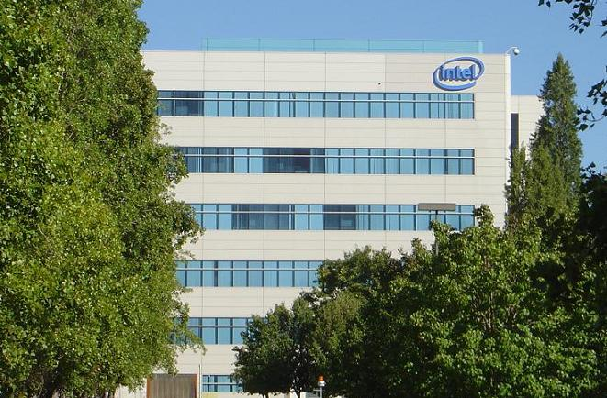
60% of present day IT projects are Telecom Software developments

Slide 15
DATA SERVICES

Slide 16
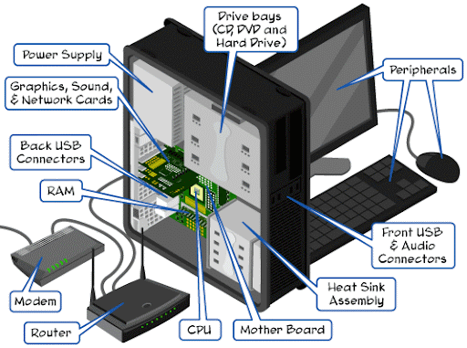

Slide 17
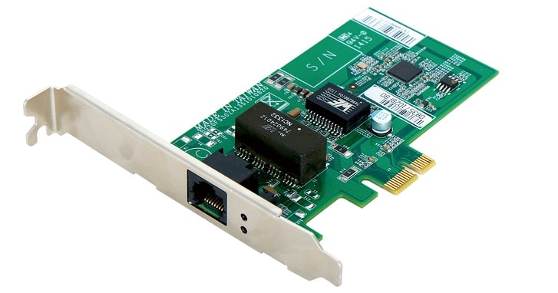
NIC CARD

Slide 18
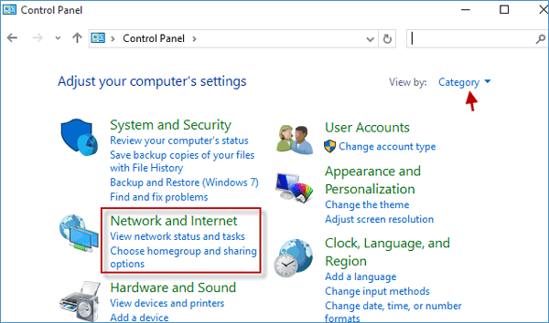

Slide 19
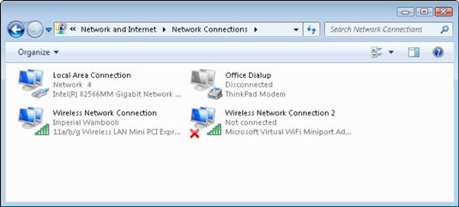

Slide 20
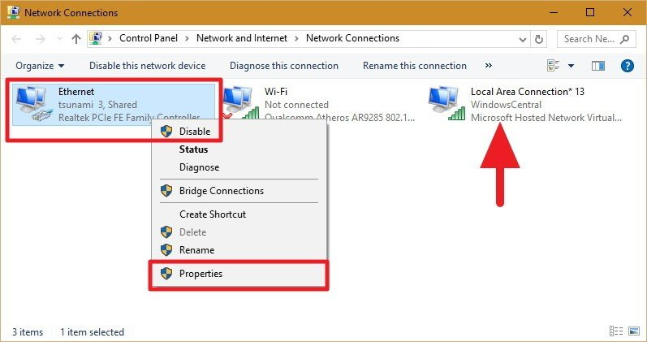

Slide 21
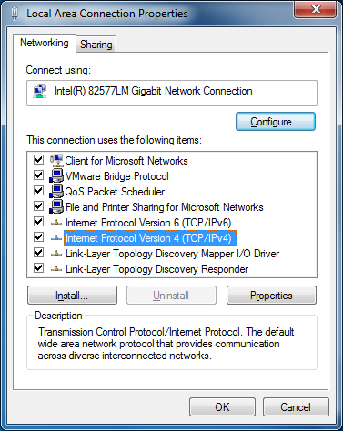

Slide 22
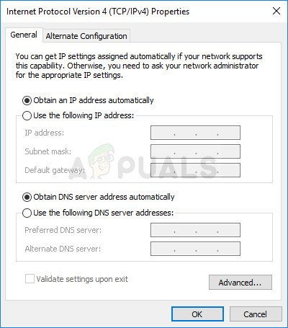

Slide 23
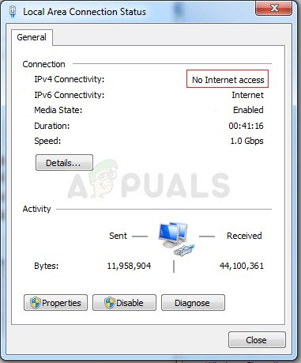

Slide 24
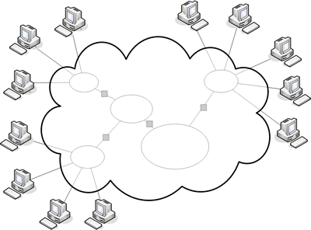
Dynamic IP 112.211.192.16
Static IP 204.15.23.255
Facebook
user
Server

Slide 25



TELECOM EXAMPLES
Telephone Exchange

Slide 26



TELECOM EXAMPLES
Branch office
Server Point

Slide 27

CDN NOC CENTRE
ADSL
DATA CENTRE
NOC
switch
NOC
switch
NOC
switch
NOC
switch
CDN Network with MPLS
M P L S
Multicasting
IGMP snooping / PIM-DM
BRAS
BRAS
BRAS
BRAS
Caching server
Tier-1 switch
Tier-1 switch
Caching server
Tier-1 switch
Tier-1 switch
Tier-2 switch
Tier2-switch
Tier-2 switch
Tier-2 switch
Tier-2 switch
DSLAM
DSLAM
DSLAM
DSLAM
DSLAM
CPE
CPE
CPE
CPE
CPE
CPE
CPE
27

Slide 28
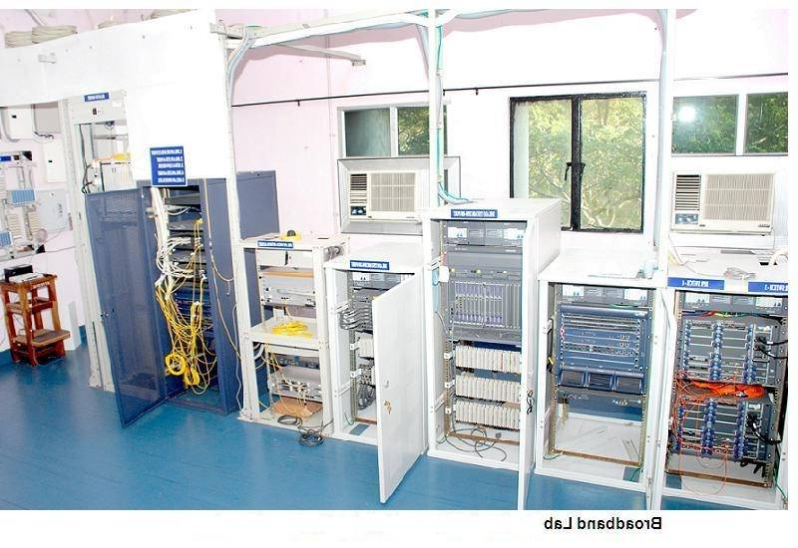
Broadband Equipment

Slide 29

Current MPLS Core
JALLUNDHAR
CHANDIGARH
NOIDA
DEHRADUN
NEW DELHI
JOTHPUR
JAIPUR
LUCKNOW
PATNA
GUWAHATI
AHMEDABAD
RAJKOT
AHMEDABAD
INDORE
RANCHI
JABALPUR
KOLKATTA
RAIPUR
A1 Node
A2 Node
A3 Node
A4 Node
NAGPUR
MUMBAI
PUNE
BHUBANESWAR
HYDERABAD
BELGAUM
VIJAYAWADA
BANGALORE
MANGALORE
CHENNAI
COIMBATORE
ERNAKULAM

Slide 30
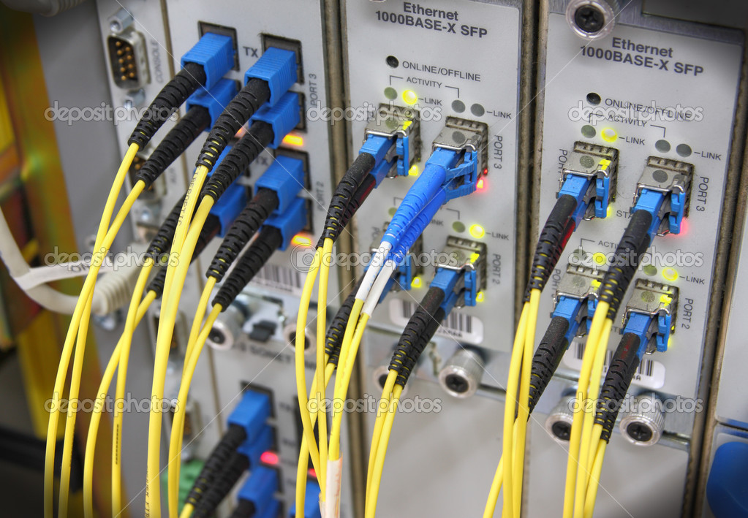

Slide 31
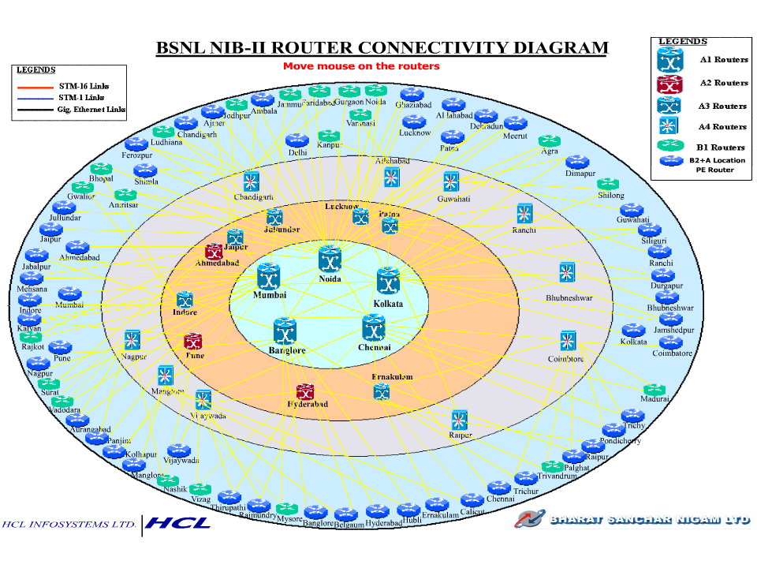
B1+B2=73
A4=10
A3=6
A2=3
A1=5

Slide 32

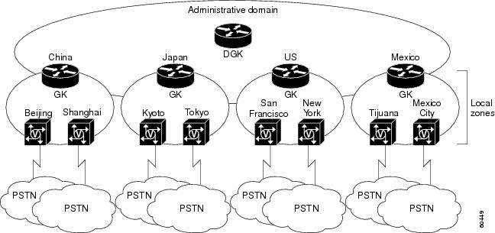

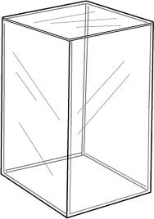
Internet cloud
INDIA

Slide 33




POINT OF PRESENCE
BRAS
BRAS
Tier-2 switch
Tier-2 switch
DSLAM
DSLAM
DSLAM
DSLAM

Slide 34
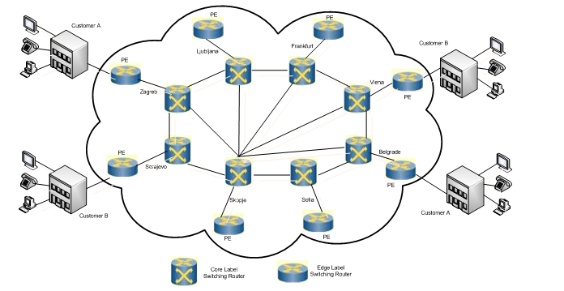
MPLS VPN

Slide 35
Internet Cloud

Slide 36
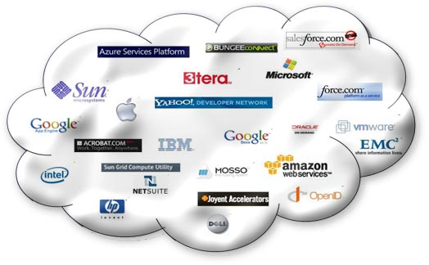


BSNL

Slide 37
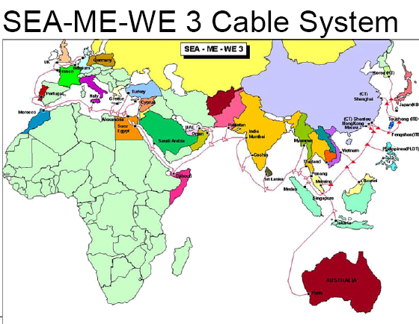

Slide 38
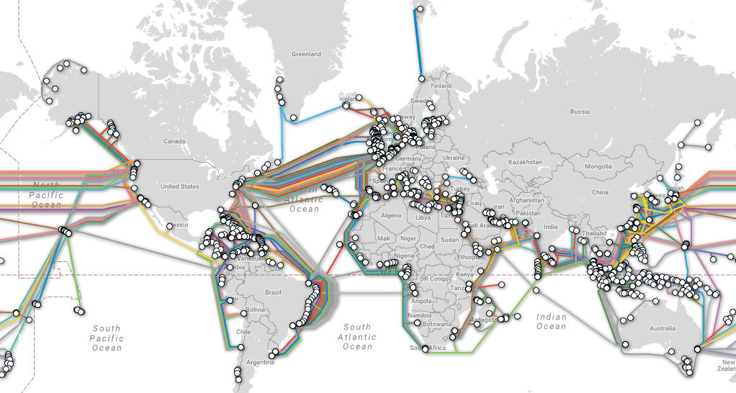

Slide 39
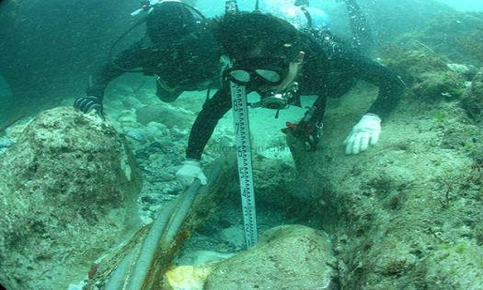
UNDER OCEAN OF CABLES

Slide 40
Network Architecture
1 MSC=16 BSC
1 BSC=1024 TRU
OSS
HLR
AUC
EIR
(
PSTN
ISDN
B
T
S
B
T
S
BSC
MSC VLR
A Interface
B
T
S
A-bis interface
Air interface
MSC VLR
BSC:BASE STATION CONTROLLER, BTS: BASE TRANSRECEIVER STATION, OSS: OPERATION AND SUPPORT SUBSYSTEM.ss

Slide 41
3G rel99 Architecture (UMTS) - 3G Radios
2G MS (voice only)
CN
BSS
Abis
E
PSTN
PSTN
A
B
BSC
MSC
C
GMSC
BTS
Gb
VLR
D
Gs
SS7
2G+ MS (voice & data)
H
IuCS
RNS
Gr
HLR
ATM
AuC
Gc
Iub
IuPS
Gn
Gi
PSDN
RNC
SGSN
IP
GGSN
Node B
3G UE (voice & data)
BSS Base Station System
BTS Base Transceiver Station
BSC Base Station Controller
RNS Radio Network System
RNC Radio Network Controller
CN Core Network
MSC Mobile-service Switching Controller
VLR Visitor Location Register
HLR Home Location Register
AuC Authentication Server
GMSC Gateway MSC
SGSN Serving GPRS Support Node
GGSN Gateway GPRS Support Node
UMTS Universal Mobile Telecommunication System
Notes:
41

Slide 42
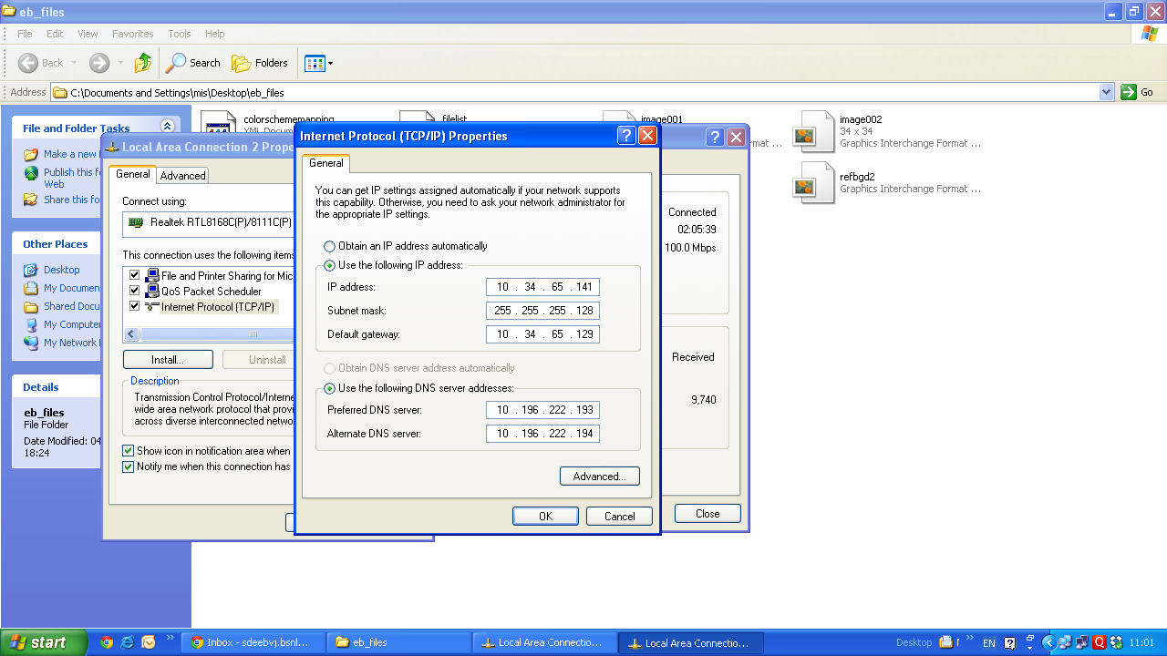
AP BSNL INTRANET IP ASSIGNING
TO CONNECT TO INTERNET, USER NEED UNIQUE IP

Slide 43
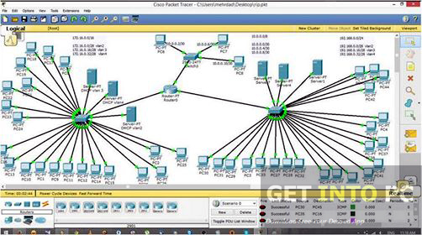

Slide 44
I.P. V4

Slide 45
Definition of IP Address
* “A unique string of decimal numbers
separated by full stops that identifies
each computer using the Internet
Protocol to communicate over a
network.”
* It is a Four Fielded Octet
* It indicates Network
* It indicates Host
* Ex : 121.25.122.2

Slide 46
Dmins
AP BSNL INTRANET IP ASSIGNING

Slide 47
IP required for
(1) Website Administrators
(2) Static IP Users
(3) Internet Service Providers for Internet
(4) Corporate/Entrepreneurs for Intranet
(5) Networking Engineers
(6) Research & Development

Slide 48
Static IP 204.15.23.255
Facebook
Dynamic IP 112.211.192.16

Slide 49
IP Addresses
Hostname gmail.com have IP Address 74.125.79.83
The following IP address ranges belong to Facebook:
66.220.144.0 - 66.220.159.255
69.63.176.0 - 69.63.191.255
204.15.20.0 - 204.15.23.255
All IP addresses belonging to "WhatsApp Inc", that were looked up on this site.
50.22.210.151 3/06/2015 1:01:23AM 208.43.244.170 3/06/2015 12:49:46 AM

Slide 50
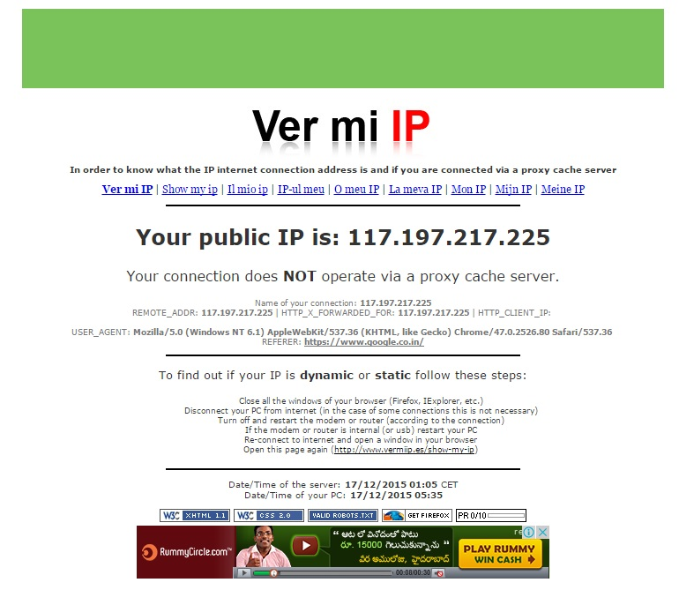

Slide 51

If I have many more Systems in a larger area

Slide 52

Limited Hosts

Slide 53
What is an IP address?
Each host on a TCP/IP network is uniquely identified at the IP layer with an address.
The IP address is also known as Protocol address
The IPv4 address is 32 bits long
2^32=4294967296=429Cr

Slide 54
Country | Country Code | Addresses(million) | Per Capita
United States | US | 1474.319 | 5.297
China | CN | 194.425 | 0.152
Japan | JP | 153.327 | 1.210
European Union | EU | 114.103 | -
Germany | DE | 85.300 | 1.038
Canada | CA | 76.197 | 2.446
South Korea | KR | 72.239 | 1.542
United Kingdom | GB | 70.795 | 1.187
France | FR | 68.385 | 1.155
Australia | AU | 37.378 | 1.979
Italy | IT | 32.344 | 0.561
Brazil | BR | 29.755 | 0.175
Russian Federation | RU | 24.919 | 0.170
Taiwan | TW | 24.681 | 1.109
Netherlands | NL | 21.249 | 1.339
Sweden | SE | 18.998 | 2.144
India | IN | 18.312 | 0.018
Notes:
54

Slide 55
Where do IP addresses come from?
Standards
Allocation
Regional Internet Registries (RIRs)
distribute IPv4, IPv6, and AS numbers
to the Internet community
RIRs maintain accurate registration of
Internet resource usage for the community
IANA : Internet Assigned Numbers Authority
IETF : Internet Engineering Task Force
Allocation
Assignment
End user
Notes:
55

Slide 56

Regional Internet Registries
1992: “…it is [now] desirable to consider delegating the registration function to an organization in each of those geographic areas.” (RFC 1338)
Notes:
56

Slide 57
Who Are the IP Address Provisioning Organizations?
ICANN | Allocate to RIRs =Regional Internet Registries Internet Corporation for Assigned Names and Numbers (ICANN) Internet Assigned Numbers Authority [IANA]
RIR | Allocate to Service Providers Assign to Enterprises The Asia Pacific Network Information Centre
NIR/LIR/ISP | Reallocate to Service Providers Reassign to Enterprises
IANA
AFRINIC, APNIC,
ARIN, LACNIC,
RIPE NCC

Slide 58
IPv4 Address Scheme
How we see an IP address? 140.179.220.220
What the Internet machines see an IP address? 11001010000011100100000000000001
For human understanding the 32 bits of IP address are separated into 4 bytes of 8 binary digits
Each binary byte is converted into decimal and is separated by a dot hence also known as Dotted Decimal Notation

Slide 59
IPv4 Address Scheme
32 Bits
In decimal the address range is 0.0.0.0 to 255.255.255.255
The IP address is of the form <networkID,hostID>
Network Host
8 Bits
8 Bits
8 Bits
8 Bits
172 . 16 . 122 . 204

Slide 60

If there are many systems in a Company?

Slide 61
IPv4 Address Scheme
There are five classes of addresses A, B, C, D & E.
A, B & C classes are used to represent host and network address.
Class D is a special type of address used for multicasting.
Class E is reserved for experimental use.

Slide 62
IPv4 Address classes
Class-A:
N
H
H
H
Class-B:
N
N
H
H
Class-C:
N
N
N
H
Class-D:
For Multicast
Class-E:
For Research
N=Network number assigned by IANA
H=Host number assigned by network administrator.

Slide 63
IPv4 Address Scheme
Class:A : 0-127 . 0-255 . 0-255 . 0-255
Class:B : 128-191 . 0-255 . 0-255 . 0-255
Class:C : 192-223 . 0-255 . 0-255 . 0-255
Class:D : 244-239 . 0-255 . 0-255 . 0-255
Class:E : 240-255 . 0-255 . 0-255 . 0-255
The IP address is of the form <networkID,hostID>
8 Bits
8 Bits
8 Bits
8 Bits
0-127 [=126N]
128-191 [=64N]
192-223 [=32N]
224-239 [=16N]
240-255 [=16N]

Slide 64
IP Address Bit Patterns
8 Bits
8 Bits
8 Bits
8 Bits
Class-A:
0 0 0 0 0 0 0 0
0 1 1 1 1 1 1 1
0-127 [=126N]
Class-B:
1 0 0 0 0 0 0 0
1 0 1 1 1 1 1 1
128-191 [=64N]
Class-C:
1 1 0 0 0 0 0 0
1 1 0 1 1 1 1 1
192-223 [=32N]
Class-D:
1 1 1 0 0 0 0 0
1 1 1 0 1 1 1 1
224-239 [=16N]
Class-E:
1 1 1 1 0 0 0 0
1 1 1 1 1 1 1 1
240-255 [=16N]

Slide 65
Identifying a class of address by a machine
Address Identifier
Network Address
Host Address
A
0
7 bits Network Address
24 bits Host Address
B
10
14 bits Network Address
16 bits Host Address
C
110
21 bits Network Address
8 bits Host Address
D
1110
Multicast address (224.0.0.0-239.255.255.255)
E
1111
Reserved for future use

Slide 66
Class-A address (Networks)
0nnnnnnn
hhhhhhhh
hhhhhhhh
hhhhhhhh
Network
Host
0
7 bits Network Address
24 bits Host Address
Number of Networks = 2⁷ i.e.128 (0-127)
Network ID ‘0’ is not used.
Network ID ‘127’ is reserved for loop back and is used for internal testing.
Number of Networks = 126
Network IDs = 1-126

Slide 67
Class-A address (Hosts)
0nnnnnnn
hhhhhhhh
hhhhhhhh
hhhhhhhh
Network
Host
0
7 bits Network Address
24 bits Host Address
Number of Networks = 2⁷ i.e.128
Number of Hosts=2²⁴=16777216
No Host ID can have all zeros i.e. 0.0.0 and specifies network address.
No Host ID can have all ones i.e. 255.255.255 and specifies the broadcast address.
Number of Hosts per network= 2²⁴ -2=16777214

Slide 68
Class-B address
10nnnnnn
nnnnnnnn
hhhhhhhh
hhhhhhhh
Network
Host
10
14 bits Network Address
16 bits Host Address
Number of Networks = 2¹⁴ i.e.16384
Number of Hosts = 2¹⁶ i.e. 65,536 (0-65,535)
No Host ID can have all zeros i.e. 0.0 and specifies network address.
No Host ID can have all ones i.e. 255.255 and specifies the broadcast address.
Number of Hosts per network= 2¹⁶ -2=65534

Slide 69
Class-C address
110nnnnn
nnnnnnnn
nnnnnnnn
hhhhhhhh
Network
Host
110
21 bits Network Address
8 bits Host Address
Number of Networks = 2²¹ i.e. 2097152
Number of Hosts = 2⁸ i.e. 256 (0-255)
No Host ID can have all zeros i.e. 00000000 and specifies network address.
No Host ID can have all ones i.e. 11111111 and specifies the broadcast address.
Number of Hosts = 2⁸-2 = 254

Slide 70
Class-D & E addresses
1110
Multicast address (224.0.0.0-239.255.255.255)
Class D are special addresses are known as multicast addresses
This address is assigned to a group of networks and not to represent a unique address
This address is used to send IP datagrams to a group but not to all the hosts on the network
This address is also used to address router update messages
1111
Reserved (240.0.0.0-255.255.255.255)

Slide 71
Networks Vs Hosts
In Classless environment we can have 2³²=4294967296 Hosts
Class Networks Hosts/Network
A 126[128-2] 16777214 [256x256x256(-2)]
B 16382 [=64x256(-2)] 65534 [256x256(-2)]
C 2097150 [32x256x256 (-2] 254 [256-2]
So, In Cl-A : [Appr 211 cr]
In Cl-B : [Appr 107 cr]
In Cl-C : [Appr 53 cr] Total = 371 Cr

Slide 72
Address space utilisation
128
127
10000000
100%
01111111
B-25%
10111111
0
191
0
1
A-50%
192
11000000
0
1
C-12.5%
11011111
1
0
223
1
D-6.25%
224
11100000
239
0
11101111
240
00000000
E-6.25%
255
0
11110000
11111111

Slide 73

Classes of IP addresses are identified by the decimal number of the 1st octet
Class A address begin with a 0 bit
Range of class A addresses = 0.0.0.0 to 127.255.255.255
Class B address begin with a 1 bit and a 0 bit
Range of class B addresses = 128.0.0.0 to 191.255.255.255
Class C addresses begin with two 1 bits & a 0 bit
Range of class C addresses = 192.0.0.0 to 223.255.255.255.

Slide 74
Reserved Addresses
Network address: It is used to identify the network itself.
Broadcast address :Used to broadcast packets to all devices on a network.

Slide 75
Private IP addresses
Class A - 10.0.0.0 to 10.255.255.255
Class B - 172.16.0.0 to 172.31.255.255
Class C - 192.168.0.0 to 192.168.255.255

Slide 76
AP BSNL INTRANET IP ASSIGNING

Slide 77
SUB NETTING

Slide 78
Subnetting
•Creating Multiple independent Networks from a Single Network.
•Converting Host bits into Network Bits
i.e. Converting 0’s into 1’s
•Subnetting can be performed in two ways.
–FLSM (Fixed Length Subnet Mask)
–VLSM (Variable Length subnet mask)
•Subnetting can be done based on requirement .
– Requirement of Networks ?
–Requirement of Hosts ?

Slide 79
Default subnet mask
•Subnet Mask differentiates Network portion and Host Portion
•Represented with all 1’s in the network portion and with all 0’s in the host portion.

Slide 80
Default subnet mask
Class A : N.H.H.H
11111111.00000000.00000000.00000000
Default Subnet Mask for Class A is 255.0.0.0
Class B : N.N.H.H
11111111.11111111.00000000.00000000
Default Subnet Mask for Class B is 255.255.0.0
Class C : N.N.N.H
11111111.11111111.11111111.00000000
Default Subnet Mask for Class C is 255.255.255.0

Slide 81
How Subnet Mask Works ?
IP Address:192.168.1.1
Subnet Mask:255.255.255.0
ANDING PROCESS:
192.168.1.1 = 11000000.10101000.00000001.00000001
255.255.255.0 = 11111111.11111111.11111111.00000000
=======================================
192.168.1.0= 11000000.10101000.00000001.00000000
=======================================
Hence, 192.168.1.0 is the Network Address.
The output of an AND table is 1 if both its inputs are 1.
For all other possible inputs the output is 0

Slide 82
Requirement of Networks is 4 ?
Class C : N.N.N.H110xxxxx.xxxxxxxx.xxxxxxxx.xxxxxxxxClass C : 192.168.1.0
•No. of Subnet=2^n >=4
Req. of Subnet=2^2 >=4
n=2
No. of Host=2^h –2
[“-2” is for Network ID & Broadcast ID]
=2^6 –2=64 –2=62 Hosts/Subnet

Slide 83
Actual Octet Format in Class-C:
N.N.N.00000000
=> N.N.N.ΦΦ000000 [ Since, n=2 ]
There are 6 Zeros,
No. of hosts=2⁶-2=64-2=62 Hosts/Subnet
So, There are 4 subnets and 62 Hosts per each subnet.

Slide 84
If Subnet Mask is 255.255.255.192 , Then New Networks and respective hosts are :
192.168.1.00000000= 192.168.1.0 [I Subnet]
192.168.1.01000000= 192.168.1.64 [II Subnet]
192.168.1.10000000= 192.168.1.128 [III Subnet]
192.168.1.11000000= 192.168.1.192 [IV Subnet]
Ranges : 192.168.1.0 to 192.168.1.63=>64 IDs
192.168.1.64 to 192.168.1.127 =>64 IDs
192.168.1.128 to 192.168.1.191 =>64 IDs
192.168.1.192 to 192.168.1.255 =>64 IDs

Slide 85
Now subnet Mask :
N.N.N.ΦΦ000000
=>11111111. 11111111. 11111111.11000000
=>255 .255 .255 . (128+64)+0+0+0+0+0+0+0
=>255 .255 .255 .192
[ It can be understood like this:
NID = All 1’s, SID= All 1’s, HID=All 0’s]
[For, 9 subnets, 128+64+32=224]

Slide 86
In 192.168.1.0 to 192.168.1.63
192.168.1.0 is Network ID & 192.168.1.63 is Broadcast ID
Hence, there are 62 IDs for host in First Subnet
In 192.168.1.64 to 192.168.1.127
192.168.1.64 is Network ID & 192.168.1.127 is Broadcast ID
Hence, there are 62 IDs for host in Second Subnet
In 192.168.1.0.128 to 192.168.1.191
192.168.1.128 is Network ID &192.168.1.191 is Broadcast ID
Hence, there are 62 IDs for host in Third Subnet
In 192.168.1.192 to 192.168.1.255
192.168.1.192 is Network ID &192.168.1.255 is Broadcast ID
Hence, there are 62 IDs for host in Fourth Subnet

Slide 87
Range of IP addresses
192.168.1.0 -- 192.168.1.63 /26
192.168.1.64 – 192.168.1.127 /26
192.168.1.128 – 192.168.1.191/26
192.168.1.192 – 192.168.1.255 /26
Similarly in Class – A and Class – B also.,

Slide 88
Now subnet Mask :
N.N.N.Φ0000000
=>11111111. 11111111. 11111111.10000000
=>255 .255 .255 . (128)+0+0+0+0+0+0+0+0
=>255 .255 .255 .128
[ It can be understood like this:
NID = All 1’s, SID= All 1’s, HID=All 0’s]
[For, 9 subnets, 128+64+32=224]

Slide 89
Now subnet Mask :
N.N.N.ΦΦΦ00000
=>11111111. 11111111. 11111111.11100000
=>255 .255 .255 .128+64+24+0+0+0+0+0+0
=>255 .255 .255 .224
[ It can be understood like this:
NID = All 1’s, SID= All 1’s, HID=All 0’s]
[For, 9 subnets, 128+64+32=224]
[For, 16 subnets, 128+64+32+16=240]

Slide 90
I.P. V6

Slide 91
IPv6
To meet the continual growth of the Internet, IETF has proposed a set of specifications commonly known as the next generation IP protocol (“IPng” or IPv6”).
IPv6 increases the address size from 32 bits to 128 bits, supporting up to 3.4X10³⁸ nodes.
It is represented using hexadecimal values separated by colons using the format X:X:X:X:X:X:X:X:, where each X refers to a four digit hexadecimal integer (16 bits each).
One such address could be BA98:7654:3210:FEDC:BA98:7654:3210:0043.

Slide 92

Problems of IPv4
Addressing problem
Routing Crisis
End to End problem
Security
Mobility
Performance
Cost

Slide 93


Address Crisis

Slide 94

Routing Crisis

Slide 95

End to End problem

Slide 96


Mobility

Slide 97


Security Problem

Slide 98
IPv6 Features
Larger address space
Global reachability
Flexibility
Auto-configuration
Aggregation
Multi-homing
Efficient Routing
Scalability
Easy Mobility
Better security

Slide 99

IPv6
No more room in IPv4
Quite empty in IPv6

Slide 100

Larger Address Space
Notes:
Autoconfiguration allows a host to automatically join a ipv6 network upon startup.

Slide 101

Global Reachability
From 32 bits to 128 bits addresses enables:
– Global reachability:
• No hidden networks, hosts
• All hosts can be reachable and be "servers"
Notes:
Autoconfiguration allows a host to automatically join a ipv6 network upon startup.

Slide 102

Flexibility
From 32 bits to 128 bits addresses enables:
– Flexibility
Notes:
Autoconfiguration allows a host to automatically join a ipv6 network upon startup.

Slide 103


Auto-Configuration
• "Plug and play"
– By autoconfiguration
Notes:
When a network is connected to many ISPs , the technique is called Multi homing.
IPv6 multihoming is required to preserve the scalability of the interdomain routing system. A proposed method is to assign multiple provider-dependent aggregatable (PA) IPv6 prefixes to each site, instead of a single provider-independent (PI) prefix.
Autoconfiguration & renumbering features are defined in RFC 2462

Slide 104

Aggregation
• Aggregation
Notes:
When a network is connected to many ISPs , the technique is called Multi homing.
IPv6 multihoming is required to preserve the scalability of the interdomain routing system. A proposed method is to assign multiple provider-dependent aggregatable (PA) IPv6 prefixes to each site, instead of a single provider-independent (PI) prefix.
Autoconfiguration & renumbering features are defined in RFC 2462

Slide 105

Multi-homing

Slide 106


Efficient Routing

Slide 107

Scalability

Slide 108


Easy Mobility

Slide 109

End to End Security

Slide 110
Better Security
X
X

Slide 111


Slide 112
4 digit Hexadecimal Integer
Minimum : 0000₁₆ = 0₂ = 0₁₀
Maximum : ffff₁₆ = 1111 1111 1111 1111₂
= 65535₁₀

Slide 113


IP Address Schemes
IPV4 Address (Present)
IPV6 Address (Future)
Total Addresses = 2^32 = 4 billion
Some addresses are reserved for special purposes like private networks or multicast addresses. However practically only 250 million addresses are usable.
Total Addresses = 2^128 = 340 billion, billion, billion, billion
12/11/2023
Notes:
113

Slide 114


Slide 115


Slide 116
Decimal equivalent of ffff is 65535
So,
65535x65535x65535x65535x65535x65535x65535x65535
= 3.4x 10³⁸ = 340 x 10³⁶
= 340 Trillion Trillion Trillion

Slide 117


Slide 118


Slide 119
Introduction to Routers

Slide 120
Router fundaments
The router is a device that connects two networks
A router accepts packets on at least two network interfaces and forwards packets from one interface to another.
A router works at network layer.
Each router maintains a database called routing table of the router
This routing table contains network addresses.
Routers do not talk to remote computers

Slide 121
Router fundamentals
Router is like a PC and has
Mother board
CPU
Memory
Ports & interfaces to hook peripherals
May have a monitor to serve as a console
Types of routers
Hardware routers
Cisco, juniper, nortel , dlink, DAX
Software routers
Microsoft server , LINUX server

Slide 122
CISCO’s HIERARCHICAL DESIGN MODEL
Access Layer : Small organization
Ex:1600,1700,1800,2500 series
Distribution Layer: Medium size organization
ex: 2600,2800,3600,3700,3800
Core layer : Very large organizations and ISPs.
ex:7200,7600,10000,12000

Slide 123

Cisco 1600,1700,1800,2500 series Routers

Slide 124

2600,2800,3600,3700,3800 series routers

Slide 125

:7200,7600,10000,12000 routers

Slide 126

7200,7600,10000,12000 routers

Slide 127

EDGE ROUTER

Slide 128


Slide 130
Interfaces of routers
LAN Interface to connect to the switch
WAN Interface to connect to the next router (serial port)
Administrative port (console port)
Auxiliary port

Slide 131

DIFFERENT PORTS

Slide 132
Types of WAN technologies
Leased Line
MLLN(Managed leased line network)
ISDN
MPLS
Broadband

Slide 133
Routing and Routing Protocols
Introduction to Static Routing

Slide 134
Routing Methods
Routers must learn the direction to remote networks in order to forward packets.
Two ways to learn this information:
Dynamically
Information is learned from other routers
Often through RIP, OSPF, or EIGRP routing protocols
Statically
Configured manually
Requires the network administrator to add and delete static routes when topology changes
In large networks it requires a tremendous amount of administrative time
On small, or unchanging networks, it requires very little maintenance

Slide 135
Static Routing
Routes for each destination network has to be manually configured by the administrator.
Used in small networks.
Route may be up or down but static routes will remain in the routing tables and traffic would still be sent towards the route
Not suitable for large networks

Slide 136
Static Route Operation
Static route operations can be divided into 3 stages:
A network administrator manually configures the static route on the router
The router installs the route in its routing table
Packets are routed using the static route

Slide 137
Configuring Static Routes
Send traffic through an interface:
Send traffic to the next router’s address:
Destination Network
Subnet Mask
Local Router’s Outgoing Interface
Destination Network
Subnet Mask
Next Hop IP Address (address of next router)

Slide 138

Configuring the Outbound Interface

Slide 139

Configuring the Next-Hop Address

Slide 140
Static Routes as Backups
Often static routes are used for backup purposes, such as when the dynamically learned route fails.

Slide 141

Backup Route Example
For Router0, the preferred path to the 192.168.0.0 network is through the switch.
No Routing Protocol
192.168.0.0/24
192.168.2.1
192.168.2.2
192.168.1.2
192.168.1.1

Slide 142
Dynamic Routing
Changes in the network topology are updated dynamically.
Only the directly connected networks information is required for configuration.
Administrative work is reduced.
It is used in medium and large networks.
RIP & OSPF are routing protocols

Slide 143


Slide 144


Slide 145
Intra-AS Routing
Also known as Interior Router Protocols (IRP) or Interior Gateway Protocols (IGP)
Most common:
RIP: Routing Information Protocol
OSPF: Open Shortest Path First
IGRP: Interior Gateway Routing Protocol (Cisco proprietary)

Slide 146


Slide 147
Routing Updates
A
B
C
10.1.1.0
10.1.2.0
10.1.3.0
10.1.4.0
.2
.1
.2
.1
.2
.1
Routing Table-A
Routing Table-B
Routing Table-C
NW VIA HOP
10.1.1.0 ---------- 0
10.1.2.0 ---------- 0
NW VIA HOP
10.1.2.0 ---------- 0
10.1.3.0 ---------- 0
NW VIA HOP
10.1.3.0 ---------- 0
10.1.4.0 ---------- 0
10.1.3.0 10.1.2.2 1
10.1.1.0 10.1.2.1 1
10.1.2.0 10.1.3.1 1
10.1.4.0 10.1.2.2 2
10.1.4.0 10.1.3.2 1
10.1.1.0 10.1.3.1 2
After exchanging 2 periodic updates, the network is converged.
147

Slide 148
Hop Count
A hop count metric simply count router hops.
From router-A it is 1 hop to network 192.168.5.0 if packets are sent out interface 192.168.3.0 and 2 hops if sent out 192.168.1.0
A
B
192.168.7.0
192.168.2.0
192.168.1.0
192.168.3.0
C
192.168.6.0
192.168.4.0
192.168.5.0

Slide 149
OSPF “advanced” features (not in RIP)
Selects high Bandwidth route
Security: all OSPF messages authenticated (to prevent malicious intrusion); TCP connections used
Multiple same-cost paths allowed (only one path in RIP)
For each link, multiple cost metrics for different Type Of Service (e.g., satellite link cost set “low” for best effort; high for real time)
Integrated uni- and multicast support:
Multicast OSPF (MOSPF) uses same topology data base as OSPF
Hierarchical OSPF in large domains.

Slide 150
Bandwidth
A bandwidth metric would choose a higher bandwidth over a lower bandwidth.
A packet from router A to C will follow path A-B-C.
A
B
192.168.7.0
192.168.2.0
192.168.1.0
A-C: 64kbps
A-B: 2mbps
B-C: 2mbps
192.168.3.0
C
192.168.6.0
192.168.4.0
192.168.5.0

Slide 151
IGRP (Interior Gateway Routing Protocol)
CISCO proprietary; successor of RIP (mid 80s)
Distance Vector, like RIP
Several cost metrics (delay, bandwidth, reliability, load etc)
Uses TCP to exchange routing updates
Loop-free routing via Distributed Updating Alg. (DUAL) based on diffused computation

Slide 152
MPLS

Slide 153


Slide 154


Slide 155


Slide 156


Slide 157


Slide 158

PACKET FORMAT

Slide 159


Slide 160

Traditional

Slide 161

Overview of MPLS Forwarding

Slide 162








Typical example of MPLS
134.5.6.1
134.5.1.5
Egress Routing Table
200.3.2.7
2
Destination
Next Hop
99
134.5/16
134.5.6.1
3
200.3.2.7
200.3.2.7
0
200.3.2/24
200.3.2.1
1
2
3
5
Ingress Routing Table
5
Destination
Next Hop
200.3.2.7
134.5/16
(2, 84)
200.3.2.7
56
200.3.2/24
(3, 99)
MPLS Table
MPLS Table
200.3.2.1
200.3.2.7
In
Out
In
Out
(1, 99)
(2, 56)
(3, 56)
(5, 0)

Slide 163


Slide 164


Slide 165


Slide 166


Slide 167


Slide 168


Slide 169


Slide 170
MPLS Terminology
Forwarding Equivalence Class (FEC)— The group of packets are forwarded in the same manner over the same path with the same forwarding treatment.
LER (Label edge router)---Boarder routers of MPLS domain where the adding or removing of the label will be taking place. These are also called as edge routers.
LSR (Label switched router)---These are the high speed routers in the core of the MPLS N/W. These are also called as core routers. These routers will swap the labels.

Slide 171

Any Doubts Please…..!

Slide 172
THANK YOU

