Slide 1
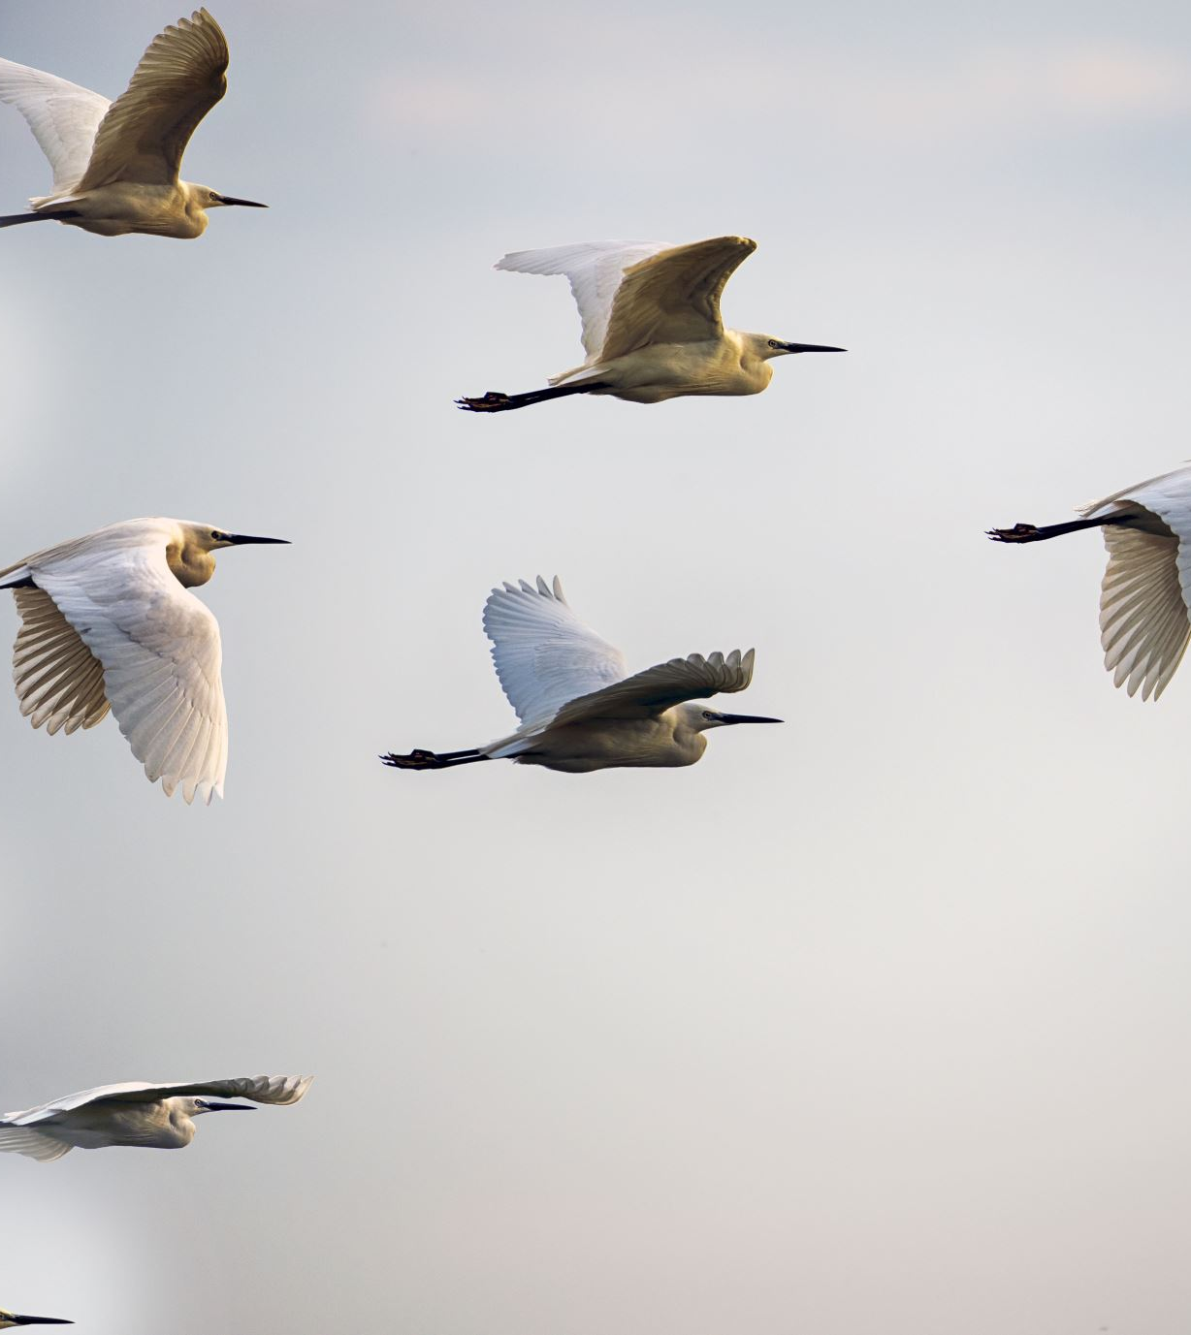
Navarathnas
by
Mr. K.Venugopal
Entrepreneur
Certified Trainer

Slide 2

Who is Leader ?

Slide 3

The Power Of Thought

Slide 4
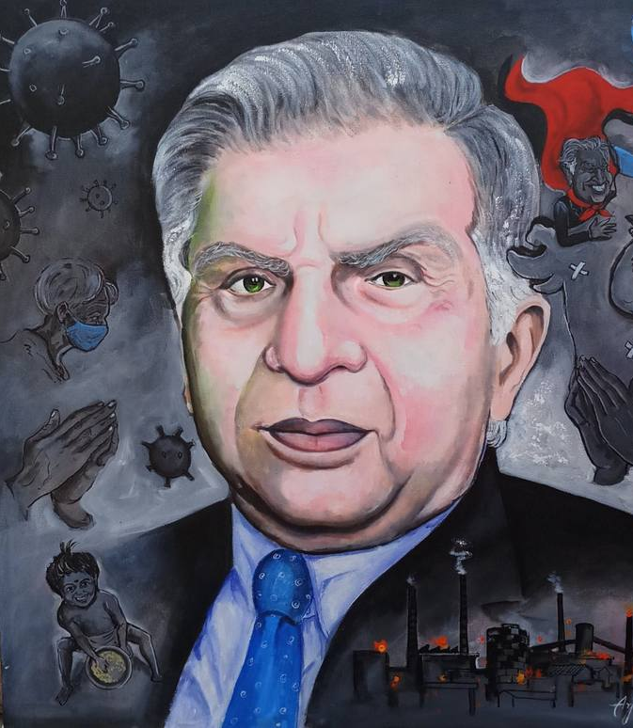
The Power of Attitude

Slide 5
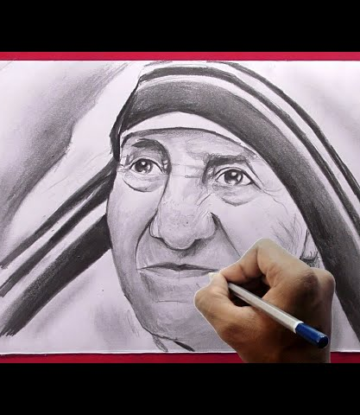
The Power Of Love

Slide 6
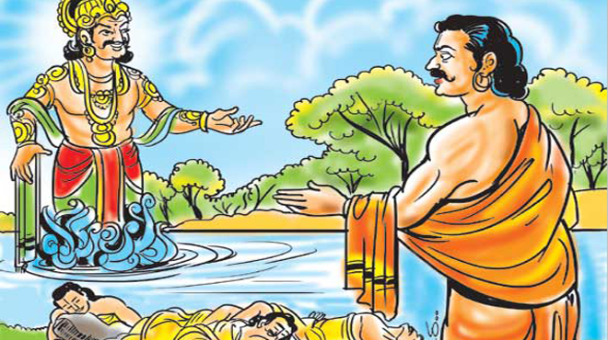
The Power Of Integrity

Slide 7

The Power Of Passion

Slide 8

The Power Of Focus

Slide 9
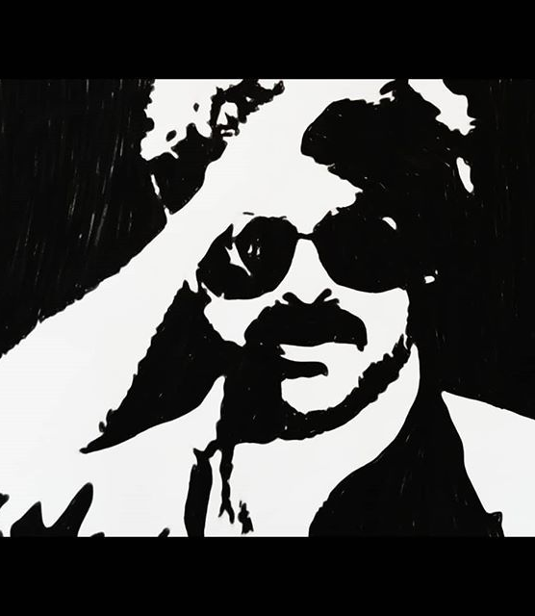
The Power Of Belief

Slide 10

The Power Of Optimistic

Slide 11
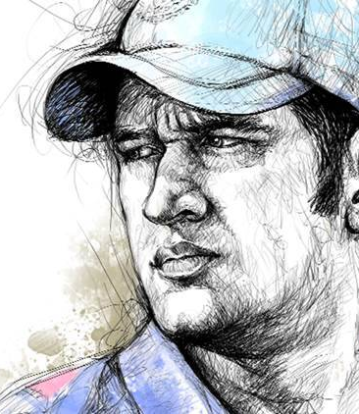
The Power Of Decision

Slide 12

Thank You
@Venugopallove
9959 505 365
This Photo by Unknown author is licensed under CC BY-NC.

