Slide 1
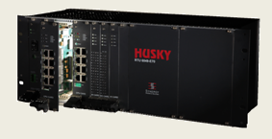
Husky RTU Training
RTU 6049-E70

Slide 2

Overview
The HUSKY RTU 6047-E70 is a powerful, flexible and modular RTU capable of handling various application requirements like for the power, railways, oil & gas, etc.
Supports a wide range of industry protocols.
Provides remote monitoring and control facilities for more than one control stations (SCADA/HMI).

Slide 3
Features
Provides Basic telemetry Features like analog and digital I/O acquisition
Provides control facilities for remote control through digital outputs and analog outputs
Generation, acquisition, and storage of chronological process events (sequence of events) for transmission to master stations of various protocols
Acquisition of data from IEDs over serial/Ethernet protocols with option for RTU-level time stamping and transmission to master stations
Acquisition, storage and transmission of counters/accumulators from process I/O or IEDs
Capability to execute application logics for I/O processing and control requirements
Redundant CPU support
Redundant power supply support
Support for multiple master stations over different protocols with redundant communication links
Support for multiple, simultaneous slave devices over different protocols with redundant communication links

Slide 4
Features(contd.)
Self-diagnostics on each module for detection and reporting of faults
Easy-to-use Windows based HUSKY STUDIO configuration and diagnostics software
Diagnostics information available for transmission to master stations of telemetry protocols
Can also be used as protocol converter/ data concentrator.

Slide 5
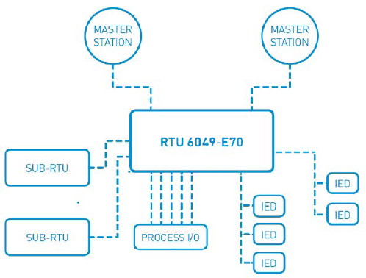
Application Architecture

Slide 6
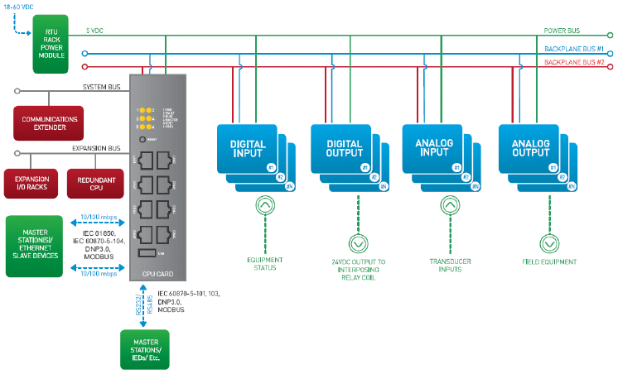
System Architecture

Slide 7
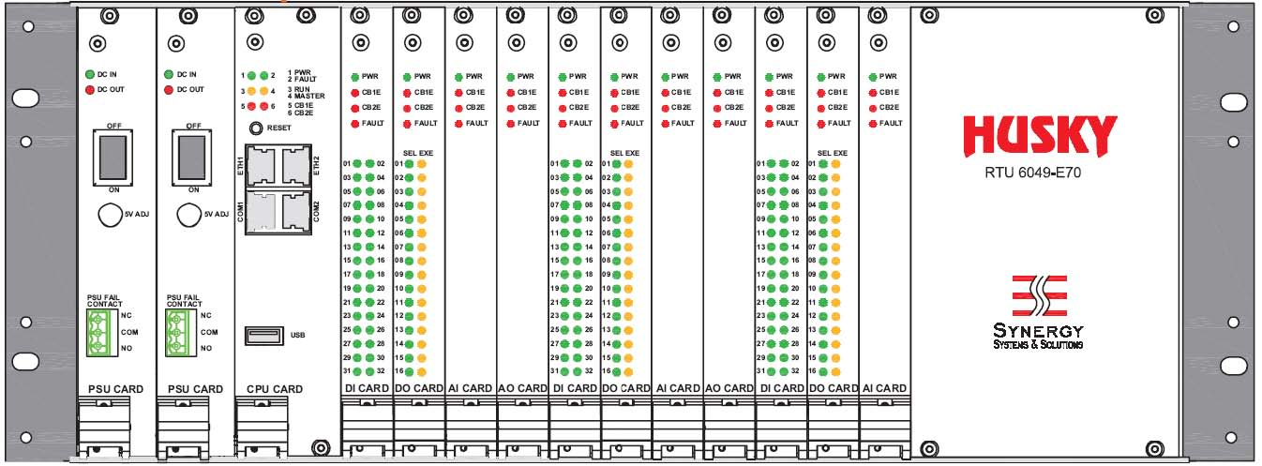
System Architecture(contd.)
Modules Designed in 4U Format
Different sub-rack options available( 84HP-wide, standard 19” and 40HP-wide )
Rack Provided with Backplane for providing power, communication and other essentials to the each of the module slots

Slide 8
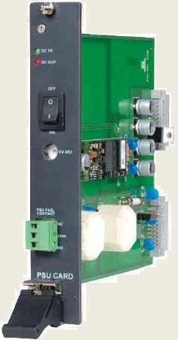
Power Supply (PSU)
RTU 6049-E70 modules primarily operate on +5VDC power supply
Supply provided to each module over the backplane by the rack power supply unit.
Different power supply units are available for accommodating different input voltages, and wattage requirements.
Power Supply Unit is installed in PSU slots in the rack.
LED | Purpose
DC IN | Input Supply Present
DC OUT | Out On Indication

Slide 9
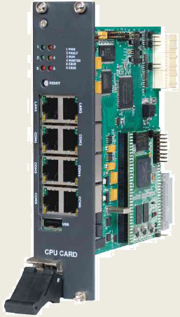
Processor Unit (CPU)
CPU Module is RTU’s brain.
RTU can have either one or two (for redundant configurations) CPUs installed.
Performs the tele-control tasks, data processing, communications, logic execution, etc.
Processor unit is installed in the CPU slot on the main rack.

Slide 10



Processor Unit (contd.)
LED | Purpose
PWR | Power ON
FAULT | Fault Entry Present
RUN | 1Hz: Safe Mode 5Hz: Normal Mode
MASTER | ON: Master CPU OFF: Standby CPU
CBE1 | Fault in Local Rack
CBE2 | Fault in Expansion Rack
LAN
COM

Slide 11
I/O Slots
Sub-rack housing arrangement provides for insertion of I/O modules into various I/O slots.
Sub-rack housing arrangement provides for insertion of I/O modules into various I/O slots. These I/O slots are generic in nature, i.e., any type of I/O module can be inserted in any of the slots (except for the power supply, processor unit slots).
I/O modules mate with the backplane through metric and DIN connectors.
Connections to the process I/O are done through two 20-pin (2x10) Molex connectors (connectors C & D) on the rear of the backplane for each slot.

Slide 12
I/O Bus
The I/O modules installed in the sub-racks are connected with the processor unit over two high-speed I/O bus.
The bus connectivity is provided by the backplane board installed in sub-rack.
The I/O bus is based on the CAN2.0 industry standard and provides an error-tolerant high-speed (1Mbps) data path between the I/O modules and the processor unit

Slide 13
I/O Modules
Various I/O modules for industry standard field inputs are provided.
I/O modules for handling Digital I/O, Analog I/O available.
All I/O modules feature a dedicated on-board microcontroller that performs the functions of the module.
By distributing the intelligence across the modules, the CPU processing capability is increased manifold, with the CPU primarily focussing on communications, and other logic functions.

Slide 14
Common I/O module Features
Dual redundant high speed I/O bus for I/O exchange with CPU
On-board 32-bit microcontroller
Hot swap capability
Isolation between field and logic
Surge Protection
Local fault diagnosis
EMI/EMC Compliant
These I/O modules can be inserted into any of the backplane I/O slots

Slide 15
Telemetry Functions(Digital Inputs)
The primary function of the RTU is to perform telemetry functions. This includes data acquisition from the I/O modules and transmission of control commands to the process through these modules.
Digital (binary) status inputs are primarily available from digital input modules of the RTU, which performs signal conditioning and sensing of the digital input signal. The digital input module senses the input voltage, and generates ON/OFF status for that channel accordingly. This status is then acquired by the CPU over the I/O bus.

Slide 16
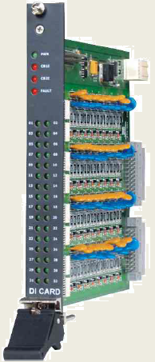
Digital Input Module
32 / 16 channel Digital Input Card with on board 32-bit microcontroller for providing accurate time-stamping of events.
LED | Purpose
PWR | Indicates presence of input power
CB1E, CB2E | Error in Backplane IO bus
FAULT | Indicates presence of critical fault in the module
01 … 32 | Channel Status. When lit means ON

Slide 17
Digital Inputs
Scanning of digital points at 1ms resolution
Single-bit and double-bit indications
Generation of sequence of events
Input filtering for filtering spurious events due to contact bounce
Anti-chatter algorithm to suppress chattering inputs
Pulse counting up to 1kHz
Binary Coded Decimal (BCD) inputs

Slide 18
Sequence of Events (SoE)
Digital input modules continuously scan the input channels at better than 1ms resolution. This allows for recording of status changes with a timestamp of 1ms resolution.
The current status of each channel as well as time-stamped events recorded on each input is transferred to the CPU. The CPU collates the information from all the modules to generate a chronological sequence of events.
The DI modules can buffer up to a maximum of three events per channel for transmission to CPU.
The first two events stored are the oldest events recorded on the channel, while the third event is the most recent event recorded on the channel. This ensures that the first-ever event in a series of multiple events on a single channel is available, as well as the event for current state of that channel.

Slide 19
Double-bit Indications
Digital input (DI) modules support monitoring of double-bit status inputs like circuit breaker status, block valve status, etc.
Two consecutive channels can be grouped together to make a double-bit indication.
The double-bit channels within a module are always grouped together, either at beginning of the module or at the end of the module.
Double-bit indications can be formed beginning at an odd-numbered channel only.
Double-bit indications consume the DPS memory type, whereas single-bit indications consume the DI memory type.

Slide 20
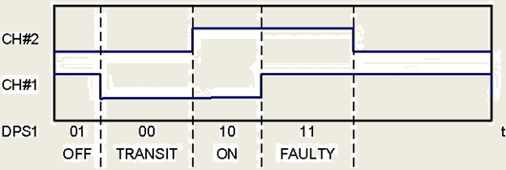
Double-bit Indications (contd.)
Transit delay (in milliseconds) can be configured to suppress reporting of intermediate states during normal operation.
When a double-bit channel enters an intermediate state, a transient delay timer is started on that channel. If the channel changes state before timer expires, then the original intermediate state is not reported as an event. However, if timer expires, then an event indicating the intermediate state is reported.
Timer can be specified on per module basis, although it is usually kept the same for all inputs.

Slide 21
Input Filtering
For suppressing spurious events due to contact bounce on input channels, a filter time (in milliseconds) can be specified on each of the input channels of a DI module.
This filtering is performed by the DI module itself, thus reducing transfer of unnecessary events to CPU.
When a channel changes state, a timer (tmrfilt) of duration tfilt is started. If the state of channel changes before the timer expires, then the previous state change is not recorded (neither under current channel state nor under events). If the channel changes state again, then tmrfilt is restarted.
Therefore, the new state of a channel is reported only when it stays in that state for a minimum duration of tfilt.
The time-stamp for an event provided by the digital input module is time when the channel actually changed state, although the input filter will delay the generation of the event by tfilt time.

Slide 22
Status Inversion
Each channel of a digital input module can be marked as inverted.
This causes the state of the channel to reported as “ON” when the channel is off (LED status), and “OFF” when the channel is on (LED status).
Signal inversion is typically used for reporting a normally-closed contact state as “OFF”.
For double-bit indications, both the channels of the input are marked as inverted when selected.

Slide 23
Chatter Filter
The DI modules incorporate an anti-chatter algorithm to suppress frequently changing inputs that generate spurious events. Chattering normally occurs with electromechanical relays that have reached their end-of-life, or when their coil operating voltage is not enough to hold the relay contact in closed position. The algorithm operates based on two user-configurable parameters - chatter monitoring time (in milliseconds) and number of allowed changes in that period
When an input channel changes state a timer (tmrchtrblk) is started. During this period, the number of state changes on that channel is counted. If the count exceeds number of allowed changes before tmrchtrblk expires, then the channel is considered to be chattering, and therefore marked as blocked. The last state when the channel was marked as blocked becomes the current state of the input. Once the channel is marked blocked, a tmrchtrunblk is started. If the number of state changes on the channel during this timer period is less than (number of allowed changes)/2, then the channel is unblocked, and an event to this effect is transferred to the CPU.
During the time the channel is marked as blocked, no state changes are reported to the CPU.

Slide 24
BCD Inputs
Status inputs encoded as binary coded decimal (BCD) values can be processed by the digital input module.
The BCD inputs are decoded by the module in groups of four channels, with one set of four channels representing one BCD digit.
The lowest channel number in a group forms the LSB of the BCD digit, while the highest channel number in that group forms the MSB.
If the decoded value of a BCD digit exceeds decimal 9, then the digit value is forced to 9.
All BCD digits can only be wired beginning at channel #1, 5, 9, etc.

Slide 25
Pulse Counters
The digital input module also features pulse counting feature on selected channels of the module
Each channel can be configured for counting of Form ‘A’ or Form ‘B’ type pulses up to 1 kHz frequency. The pulse counter values are periodically scanned by the CPU from the DI module, based on the counter scan time parameter.
Pulse counter values consume the CI memory type (32-bit unsigned).
Pulse counter values can be reset by an external command from a master station.
For channels on which pulse counters are enabled, DI reporting is disabled.

Slide 26
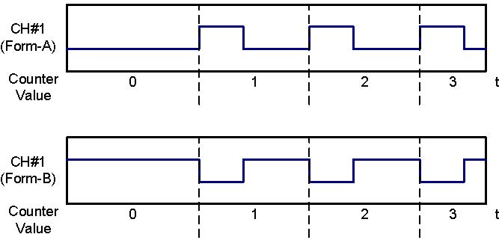
Pulse Counters (contd.)

Slide 27
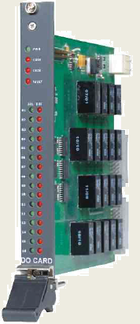

Digital Output Module
16 / 8 channel potential free, normally open, digital output card with feedback monitoring circuit.
LED | Purpose
PWR | Indicates presence of input power
CB1E, CB2E | Error in Backplane IO bus
FAULT | Indicates presence of critical fault in the module
01 … 16

Slide 28
Digital Outputs
Digital outputs are typically used to control process equipment through generation of ON/OFF commands. Control commands can be received over a communication protocol or through programmed user-logics. The following functions are supported by the RTU for digital outputs –
Latched outputs
Pulsed outputs with user-configurable pulse lengths
Option for generation of pulse-train outputs
Select-before-execute (SBE) control commands
Single-bit and double-bit commands
Command requests received by the RTU are directed to the corresponding digital output module by the CPU. Command requests contain apart from the command value, a qualifier of command (QOC), which specifies the type of command and other command-specific parameters.

Slide 29
Pulsed Outputs
A pulsed output is defined by a low-to-high-to-low transition of the state of an output channel.
The duration for which the output remains high is defined as the pulse duration
When a command request with QOC = Short Pulse/Long Pulse/Default, then a pulse output request is forwarded to the corresponding digital output module with command type as pulse output. The pulse duration is derived based on the QOC of the command. For QOC = Short/Long pulse, the pulse duration is determined on the command receiving task’s protocol parameters. For QOC = default, the pulse duration is determined from the digital output module’s channel-specific pulse length parameter.
HUSKY RTU also supports issuing of pulse-train outputs, with configurable duty cycles (thi for high duration, tlo for low duration).
A digital output module marked for SBE operation, cannot be operated with pulse output commands. A negative command confirmation is returned in this case.
Pulsed outputs are classified as direct-operate commands, which require a single command request to activate the output channel.

Slide 30
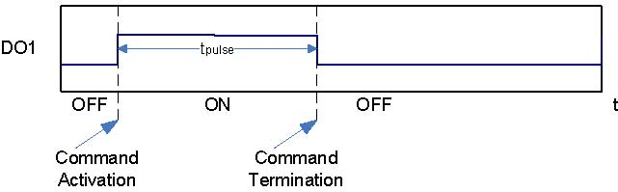
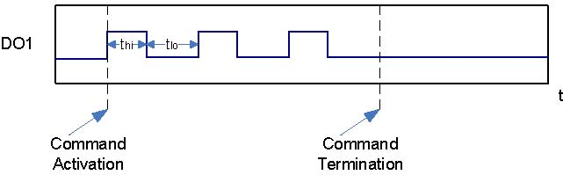
Pulsed Outputs (contd.)

Slide 31
Latched Outputs
Latched/persistent outputs force the output channel to a permanent ON/OFF state.
Therefore, the output state does not change until a new command with the desired output state is issued.
An command with value = ON turns on the output channel, while a command with value = OFF turns off the output channel.
A latched command is executed when a command with QOC = Persistent is issued. The output state is determined by the value specified in the command request.
A digital output module marked for SBE operation, cannot be operated with latch output commands. A negative command confirmation is returned in this case.
Latched outputs are classified as direct-operate commands, which require a single command request to activate the output channel.

Slide 32
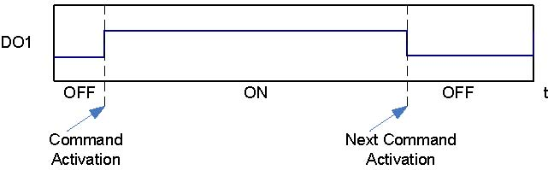
Latched Outputs (contd.)

Slide 33
Select-before-Execute (SBE) Operation
Select-before-Execute (SBE) outputs require a two step operation to activate the output channel. The two steps are ‘select’ and ‘execute’.
For achieving this two-step operation, the digital output modules feature one relay per output channel, and one master relay for a group of channels. E.g., E70-DOA-001 has 16 channels in two groups of 8. Therefore there are 16 relays, one for each channel, plus two master relays one for each group.
When a select command request is received, the module performs a hardware check to ensure that no other output channel is already activated. A feedback circuit on the module monitors the on-board relay contacts so that only the correct output channel is activated during a select request. A negative confirmation is sent if either relay fails to operate, or any other channel’s relay is already operated. A positive confirmation is sent when no error occurs.
When an execute command request is received, the module validates that the specified channel is already selected, i.e., its corresponding relay output is activated. After successful validation of the execute request, the master relay (execute relay) is turned on, which then completes the circuit towards the field devices. The master relay’s contacts are also monitored and a positive confirmation is sent only when the execute feedback circuit receives proper input from the master relay contacts.

Slide 34
Select-before-Execute (contd.)
When a channel is successfully selected, a timer tmrsel is started with duration of tsel = 12 seconds. If the execute command request for that channel is not received before the expiry of this timer, the channel is automatically deselected. Any execute command received after expiry of this timer is replied with a negative confirmation. A cancel command request can be issued after selection of a channel, to invalidate the channel selection.
Due to the nature of SBE operation, only one command per group of channels can be activated at a time.
Multiple select command requests on the same channel, resets tmrsel, and a positive confirmation is returned.

Slide 35
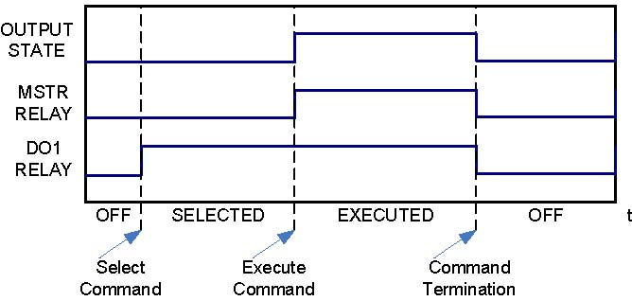
Select-before-Execute (contd.)

Slide 36
Double-bit Commands
Two consecutive channels of the digital output module can be combined together to form a double-bit command. In case of double-bit commands only one of the two channels can be active at a time.
A command request with value = ON triggers the first channel, whereas a request with value = OFF triggers the second channel.
For latched outputs, a new command sets the opposite state of the channel.
The double-bit channels within a module are always grouped together, either at beginning of the module or at the end of the module.
Double-bit commands can be formed beginning at an odd-numbered channel only.
Double-bit commands consume the DPC memory type, whereas single-bit commands consume the DO memory type.

Slide 37
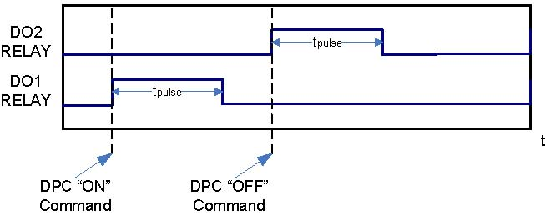
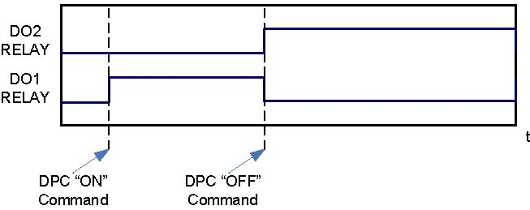
Double-bit Commands

Slide 38
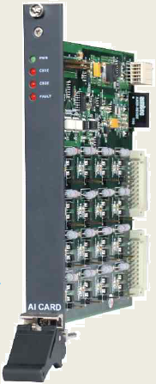
Analog Input Module
Multiple Channel differential input Analog module with on-board memory to store calibration data to compensate inaccuracies.
LED | Purpose
PWR | Indicates presence of input power
CB1E, CB2E | Error in Backplane IO bus
FAULT | Indicates presence of critical fault in the module

Slide 39
Analog Inputs
Analog inputs are used for monitoring of process parameters like voltage, current, temperature, energy, etc.
16-bit resolution inclusive of 1-sign bit for hardwired analog values
Multiple input ranges for voltage and current signals
Under/over-range monitoring
Live-zero monitoring
Rate-of-change monitoring with alarm generation .
Exception reporting based on user-specified deadband.

Slide 40
Input Ranges & Scaling
The analog input modules support DC Voltage (up to 10VDC) and DC Current (up to 20mA).
Industry standard signal inputs like 0-10VDC, ±10VDC, 4-20mA, are supported by the modules
The analog input modules provide a 16-bit signed value (i.e., 15 data bits plus 1 sign bit) that is linearly scaled as per the input present on the channel.
Uni-polar inputs are represented by a raw count value in the range of 0-32767 counts, while bipolar inputs are represented by a raw count value in the range of ±32767 counts.

Slide 41
Exception Reporting
Analog input values are periodically scanned by the CPU and the internal memory database updated. These values are typically reported to master stations on cyclic/on-demand basis.
However, certain applications demand exception (spontaneous) reporting of values based on change in value, alarm limit violation, etc. A channel can be enabled for exception reporting, by enabling the SoE feature of that channel.
The SoE generated includes a time-stamp indicating the time of generation of the exception report.

Slide 42
Deadbands
Deadband is defined on per channel basis, in percentage terms of the positive side maximum value (i.e., value at 32767 counts).
The deadband specified is the amount of minimum change by which the input must vary in either increasing or decreasing direction from the previous value that was reported by exception.
The database value is always updated based on last received value from the module irrespective of the deadband value specified.
Deadband around zero is used to force the value of the input to zero when the actual input is within a specified limit near zero.

Slide 43
Alarm Function
Analog values can also be reported by exception based on high/low alarm conditions.
A non-zero value on the high/low alarm limit enables the alarm monitoring function on that channel.
When the input value goes below the low alarm limit, an exception report is generated. Similarly, when the input value goes above the high alarm limit, an exception report is generated.
To prevent frequent generation of exception reports, when the input value is hovering around an alarm limit, a 0.5% deadband is used to provide alarm hysteresis function. Once an exception report for an alarm is generated, a new exception report is not generated unless the value has changed from previous alarm value with a difference greater than the specified deadband.

Slide 44
Self Calibration
The analog input modules have built-in precision reference circuits that are used to calibrate the analog front-end (AFE) of the analog input module.
The modules also have a built-in temperature sensor. When the module registers a temperature change of more than 50ºC, all channels of the module are automatically calibrated.
While calibrating, the zero errors, and linear scaling errors are accounted for.
If the error is beyond the compensation capability of the module, the module is flagged as ‘out-of-calibration’. An alarm indication to this effect is raised by the module, using the calibration alarm memory address with value as 1.

Slide 45
Expansion Racks
Expansion racks are required for accommodating higher I/O requirements.
RTU’s expansion bus is used connect the expansion racks with the main rack which hosts the CPU module.
Each expansion rack is provided with at least one PSU module, and one I/O scanner module.
The I/O scanner module collects the data of the local rack for forwarding it to the CPU module.
The I/O scanner module scans the I/O modules independently and buffers the acquired data in its internal memory.
The I/O scanner module transfers current values, sequence of events to the CPU.
It accepts command/set-point requests, configuration of I/O modules from the CPU, and forwards the requests to the corresponding I/O module in the rack.

Slide 46
Expansion Bus
The expansion bus is a high-speed bus (up to 10Mbps) used for exchanging data across racks of the RTU.
This bus is based on the ARCNet industry standard, and provides a reliable transfer of data and time-guaranteed access to the bus for each node.
The data between expansion racks and main rack is transferred over the expansion bus.
Also in case of redundant CPU architecture, the two CPU modules synchronize themselves using this bus.
Dedicated bandwidth is made available for this purpose on the expansion bus.
For network segments (section between two racks) of up to 1.5m, the bus can be operated using copper media at a speed of 10Mbps. For longer network segments, the bus operates at 2.5Mbps.
Fiber-optic media support is also available for the expansion racks, which allow the bus to be operated at its maximum speed of 10Mbps.

Slide 47
System Bus
The system bus is a set of high-speed busses available on selected slots of the backplane.
The system bus is used for communication between the CPU and communication extender modules or other speciality modules.
The system bus consists of a 16-bit parallel interface, and a single channel serial interface.
Both interfaces operate independent of each other, and can be used simultaneously.
The exact interface used is dependent on the type of module interacting with the CPU.

Slide 48
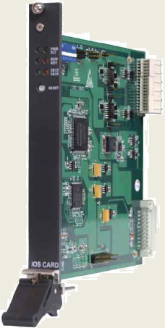
IO Scanner Module
Expansion Module that extends the capability of CPU to interrogate data from expansion racks
Interrogate the IO cards installed in its racks and transfers the data and SoE to CPU in the form of memory blocks.
A dedicated “Hot Swap Controller” is present on the card to allow fail safe hot swapping of cards without affecting the backplane bus.

Slide 49
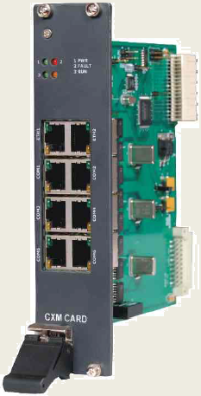
Comm. Extender Modules (CXM)
Additional serial/Ethernet ports can be added to the CPU by way of installing communication extender modules (CXMs).
Communications between the CXMs and the CPU is achieved through the system bus’ 16-bit parallel interface via the backplane.
The CXMs act as peripheral add-on boards to the CPU module, and provide the required serial and/or Ethernet ports.
CXMs can be installed only on the racks where CPU modules are present.
These modules can be installed only in specific slots in the backplane

Slide 50




Comm. Extender Module (contd.)
LED | Purpose
PWR | COM
FAULT | Fault Entry Present
ACT
LAN
COM

Slide 51
Speciality Modules (SPM)
Speciality modules (SPM) provide a specific function in the RTU that is not achievable through the standard RTU modules.
For example, for providing connectivity between the RTU and a LON-works network, SPM E70-LNA-001 is available.
This module handles the LON network interfacing and performs data acquisition, and processing functions on behalf of the CPU.
The data thus acquired is transferred to the CPU in a standard manner.
SPMs can be installed only on slots designated for this purpose on the backplane.

Slide 52
I/O Memory
The processor unit comprises of a memory-based database for storage of the I/O values. This database is partitioned according to different memory types.
Internally, all variables are referred to using their unique memory address which comprises of the memory type and the element number within the memory type.
When configuring the RTU database in HUSKY Studio, the variable addresses are referred to using user-friendly aliases.
Examples- %BV1001 – Represents element #1001 under the BV type, %I16V0123 – Represents element #123 under the I16V type, %F32V0001 - Represents element #1 under the F32V type.
All memory types have element number ranging from 1 to the capacity of the particular memory type.

Slide 53
Memory Types
Memory Type | Description | Capacity
%DI – Digital Input | Used for physically connected 1-bit binary input signals | 4096
%DPS – Double-point Status | Used for physically connected 2-bit binary input signals | 4096
%AI – Analog Input | Used for physically connected Analog input signals (16-bit signed value) | 1024
%CI – Counter Input | Used for physically acquired counter/accumulator signals | 512
%DO – Digital Output | Used for physically connected 1-bit binary output signals | 2048
%DPC – Double-point Control | Used for physically connected 2-bit binary output signals | 2048
%AO – Analog Output | Used for physically connected Analog output signals (16-bit signed value) | 512
%BV – Boolean Variable | Memory-based Boolean variables used for logics, communication task acquisition | 4096
%DPV – 2-bit Status Variable | Memory-based 2-bit variables used for logics, communication task acquisition | 4096
%I16V – Integer Variable | Memory-based 16-bit signed variables used for logics, communication task acquisition | 16384
%I32V – Integer Variable | Memory-based 32-bit signed variables used for logics, communication task acquisition | 10240

Slide 54
Memory Types (contd.)
Memory Type | Description | Capacity
%F32V – Floating-point Variable | Memory-based 32-bit floating point variables used for logics, communication task acquisition | 10240
%BS – Boolean Status | Boolean status variables used by the system to indicate various system status | 4096
%I32S – Integer Status | 32-bit integer status variables used by the system to indicate various system status | 2048

Slide 55
I/O Quality Flags
All memory types support a basic set of quality flags in addition to current value. These flags can be used for reporting the status of the value over protocols supporting transfer of such information.
Topical – This flag when set indicates that the value is current / updated. When this flag is not set the value is not topical. This could be due to loss of connectivity between the processor unit and source of the value (e.g., I/O module).
Invalid – This flag when set indicates that the value is not within the specified valid limits. E.g., when a 4-20ma input goes below 4mA.
Blocked – This flag when set indicates that the value has been blocked for acquisition from its source by the user.
Substituted – This flag when set indicates that the current value is a user substituted value, and is not from the actual source.
Chatter – This flag is provided by digital input modules that support chatter filtering. When this flag is set, it indicates that the input channel is in chattering state.

Slide 56
Retentive I/O Memory
Retentive I/O memory is used for storage of variables whose values need to be persisted across processor reboots (including power off conditions).
For such variables, the last updated value (with quality) is saved in the non-volatile memory of the CPU, which is backed up by a battery.
Within the addressing range of a memory type, retentive variables are located towards the end of the range.
For Example, BV type has 8192 elements, addressed from BV0001-BV8192. Of this range, the one can configure the last 512 elements as non-volatile. Therefore, addresses BV7681-BV8192 are stored in the non-volatile memory of the RTU.
Except for counters (CI type), all other hard-wired I/O are always non-volatile.

Slide 57
Husky Studio
HuskyStudio is a unified configuration, programming and diagnostic software for Husky series of RTUs.
It allows engineers to configure, program and monitor the RTU from a single application suite thereby eliminating need of different software.
Basic Functionality
Configuration of I/O Modules
Database Configuration
Configuration of I/O ports
Protocol Configuration
RTU Programming using IEC61131-3
Offline Logic Simulation
RTU Diagnostics

Slide 58
Overview
HuskyStudio works on the concept of project.
A project is a collection of files comprising of RTU configuration, variable definition, IO module configuration and logic programs.
HuskyStudio enables you to configure all aspects of the RTU from a single editor.

Slide 59
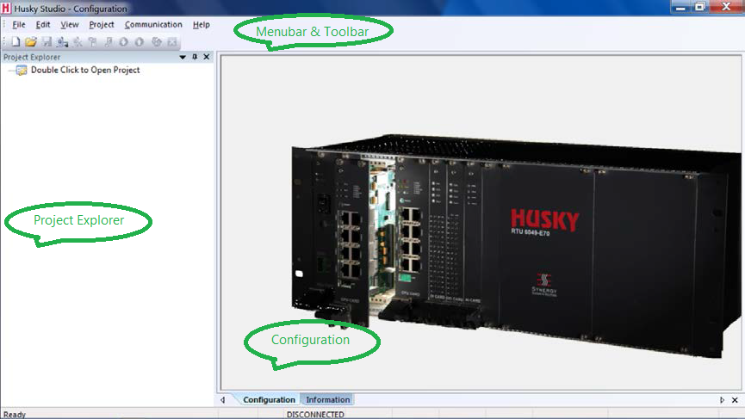
Working Area

Slide 60
Creating a New Project

Slide 61
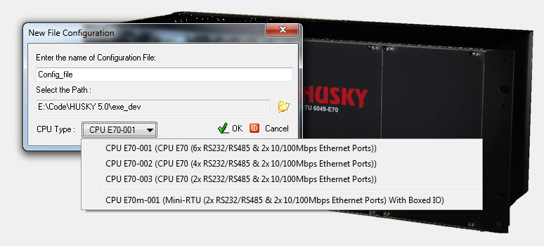
Creating a New Project (contd.)

Slide 62
Hardware Configuration
Every configuration consists of one or more racks and corresponding backplane.
A rack is an enclosure which is mounted inside a panel and holds various IO modules.
A backplane is like a motherboard mounted at the backside of the rack.
A backplane consists of one or more CPU slots, special slots and IO slots.

Slide 63
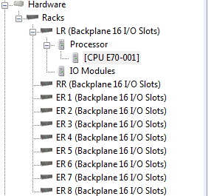
CPU Slots
Every backplane consists of pre-defined no. of CPU slots which are reserved for CPU only.
User can change the CPU model by double clicking on the Processor node and selecting the appropriate CPU model.

Slide 64
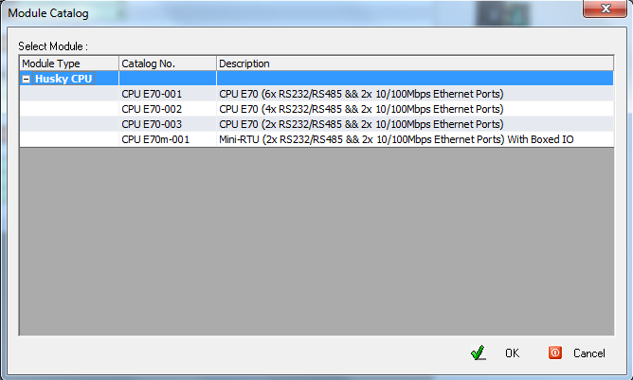
CPU Slots (contd.)

Slide 65
IO Slots
IO Slots are meant for inserting input output modules of RTU, for example, Digital Input, Digital Output etc.
To insert an IO module in a slot, double click on the desired slot. Select the IO module from the list and press OK.

Slide 66
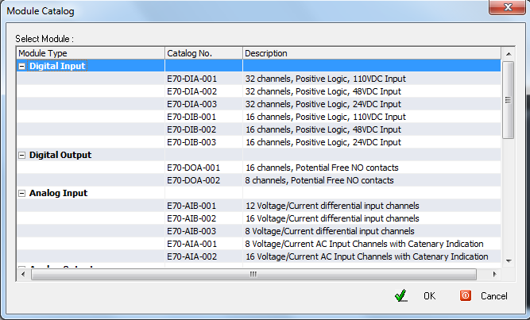
IO Slots (contd.)

Slide 67
CPU Configuration

Slide 68
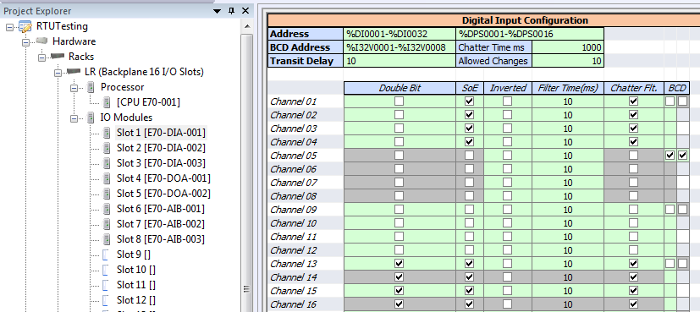
DI Configuration

Slide 69
DO Configuration

Slide 70
AI Configuration

Slide 71
AI Alarm Configuration

Slide 72
CXM Configuration

Slide 73
Variables
HuskyStudio engineers the system using the concept of variables rather than addresses.
Variables allow you to specify meaningful description to every address.
Variables are used to acquire data from slave devices and transfer the same to master stations.
Variables are normally created automatically.
Variables created by user or via some user action are called User Variables. For example, module variables are user variables that are created when a module is inserted into the slot. The variables are deleted when the module is removed from the configuration. Similarly, when an IO map is created for the communication task, variables are automatically created.
Variables created by system are known as system variables. System variables are automatically created and can not be edited or deleted by user. System variables are automatically marked for event generation.

Slide 74
Properties of Variables
Variable Name: This is a system generated name that can not be modified by user. The
Variable Description: A meaningful description of the variable so that it is easy to relate with. The description can be anything up to 40 characters long. Description can be changed anytime.
Address: Displays the RTU memory address allocated to the variable. This is only for information purpose and can not be edited by user.
Initial Value: Each variable can be assigned an initial value when the RTU is powered up for the first time. Initial values can be useful in logics where it is desired to provide a meaningful non zero value to a variable.
SoE: An event is generated only if SoE is marked for the variable. By default, events are not generated on any variable.
Quality: Displays the quality of the variable.
Value: The value as stored in RTU database.

Slide 75
Types of Variables
Module Variables: Variables that are created when a new module is inserted into a slot (local rack or extension rack) are known as module variables. Module variables always begin with R denoting rack. Module variables names are of type R1.15.DI, R3.10.AI, R3.10.BV etc.
Communication Task Variables: Communication task variables are created while creating IO maps in a communication task. There are two types of communication tasks, viz. Master and slave. Master tasks are producer of data while slave tasks are consumer of data produced by masters. Variables are always created by producers, which means, master tasks. So whenever an IO map is created in a master task, its corresponding variable is created. IO task variables are created in the following fashion <TaskName>.<DeviceName>.<Map No.>.
Logic Variables: Logic variables are created while writing logics. They are created only on user command and never automatically.

Slide 76
Diagnostic Vaiables
System / diagnostic variables are automatically created by system and provide various system level and diagnostic information

Slide 77
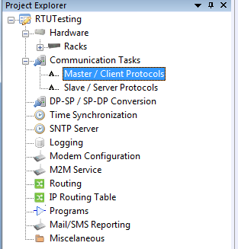
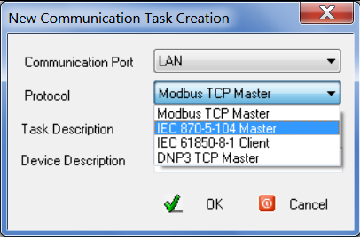
Communication Tasks
Communication tasks are protocols configured in RTU for mater and slave communication.
User can configure multiple master and slave tasks running simultaneously.
Master tasks acquire data from slave devices connected to RTU while slave tasks provide data to master stations.

Slide 78
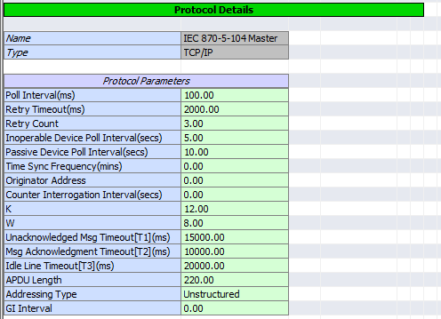
IEC 104 Master Task

Slide 79

Port Details for IEC 104 Master
Master task require communication port settings that enables the task to communicate with the slave.
For dual communication, simply check the “Dual” checkbox and specify the parameters for port

Slide 80
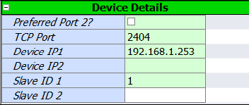
104 Device & IO Mapping
TCP Ports: Specifies the TCP port to be used for communication.
Device IP: Specifies the IP address of the device connected to the RTU. It is important to note that the IP address of the device and IP address of the Ethernet port being used for communication, must belong to same subnet. Device will not communicate otherwise.
Slave ID: This tells the slave ID of the device being communicated by the RTU.

Slide 81
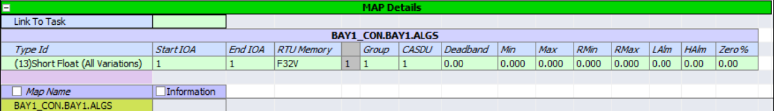
104 Device & IO Mapping (contd.)
IO mapping defines the data to be acquired or to be served to the master.
IO mapping defines the database for a task. User can create different IO mapping for different devices to serve multiple sets of data.

Slide 82
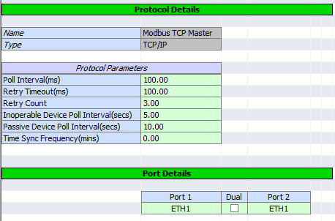
Modbus TCP/IP Master Task

Slide 83
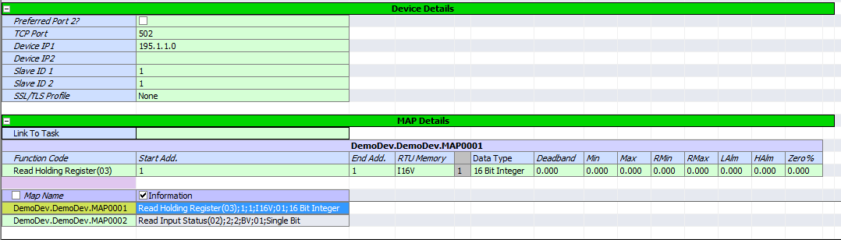
Modbus Device & IO Mapping

Slide 84
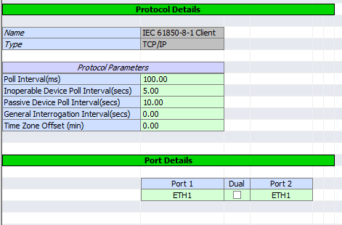
IEC 61850 Master task

Slide 85
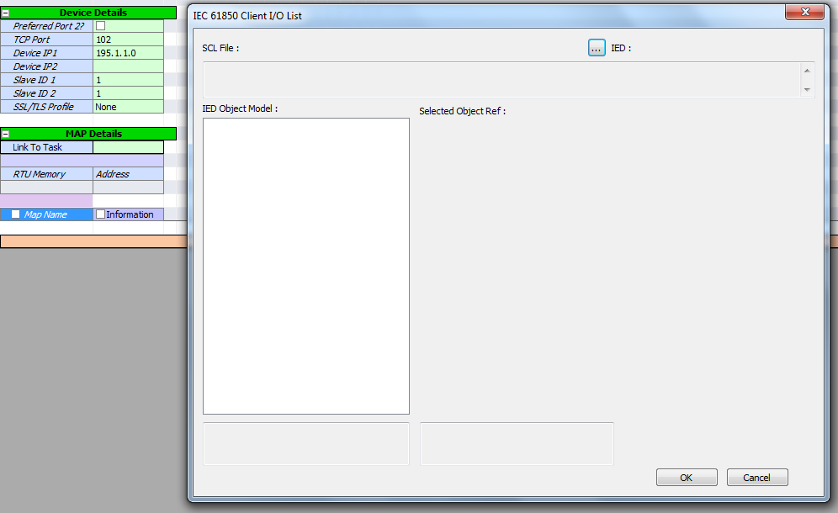
IEC 61850 Device & IO Mapping

Slide 86
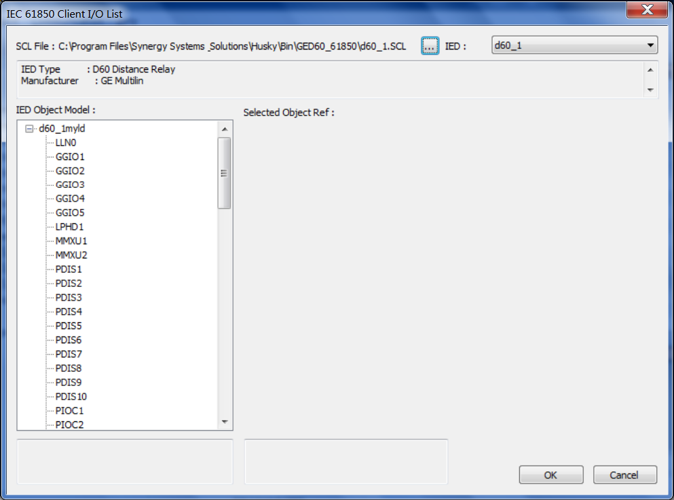
IEC 61850 IO List Dialog

Slide 87

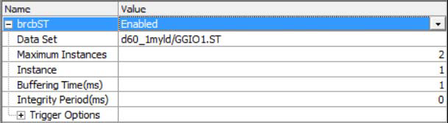
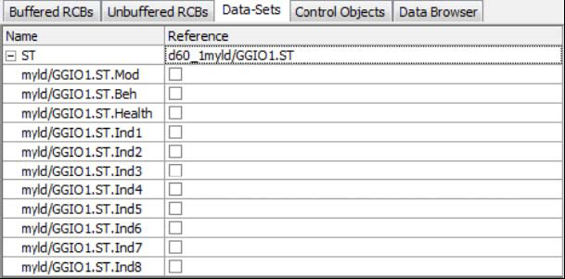
Enable Data Set

Slide 88
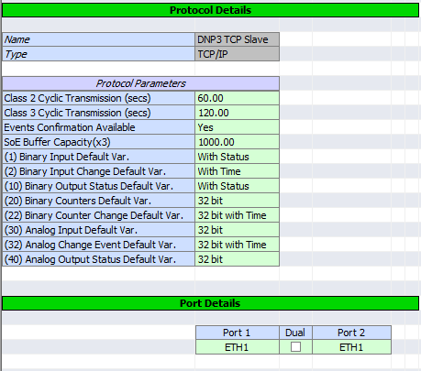
DNP3 Slave Task

Slide 89
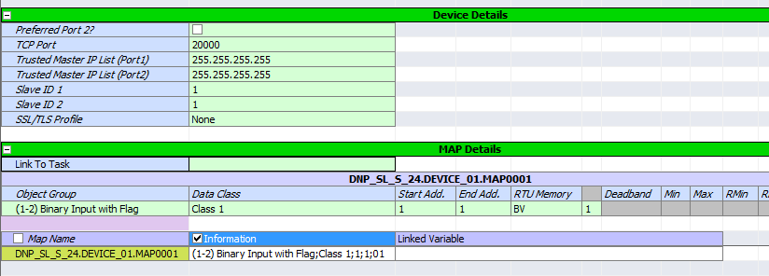
DNP3 Slave Device & IO List

Slide 90
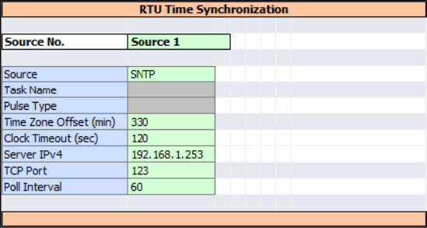
Time Synchronization
Time synchronization allows you to specify different time sources to synchronize RTU’s clock with an external master clock.
Up to eight different time sources can be specified.
Multiple time sources act as backup time sources. In case of failure of primary time source, backup time sources are used to keep the RTU clock synchronized with external clock.

Slide 91
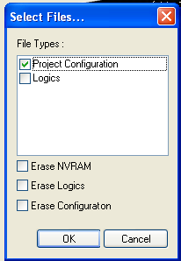
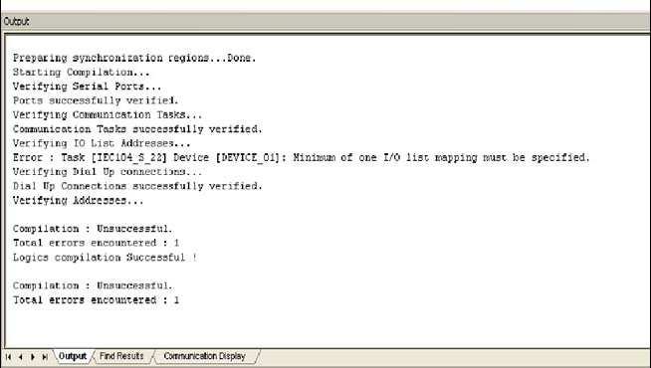
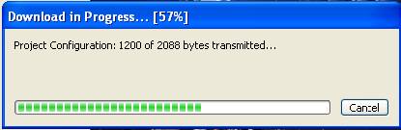
Compiling & Downloading
Once user has configured the project, it must be downloaded to the RTU for new RTU to take effect.
Before project is downloaded, it is compiled by HuskyStudio to detect configuration errors and discrepancies.

Slide 92
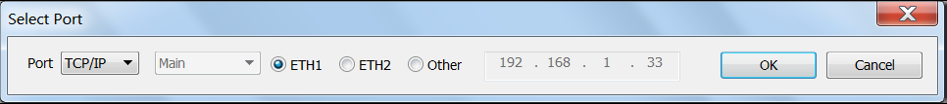
Connecting to RTU
To download the configuration user must connect to the RTU.
HuskyStudio can communicate with RTU either over serial or Ethernet. This is dependant on the service ports configured in the project under the CPU configuration

Slide 93
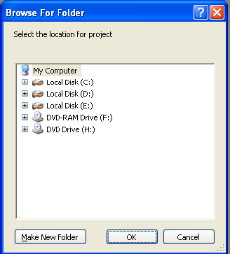
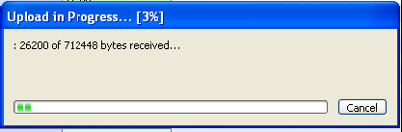
Uploading Project
It is sometimes required to read the configuration stored in the RTU. This is required when a configuration is not available and user wish create a project with the existing configuration present in the RTU.
Upload option will read the configuration from RTU and create a project for user.

Slide 94
The End

