Slide 1

REFRESHER TRAINING PROGRAM FOR FINANCE AND ACCOUNTS PROFESIONAL
DAY-3-17/03/2023
SESSION-2
BY CA AKSHAY JAIN
GST & INCOME TAX
FOCUS ON POWER SECTOR

Slide 2

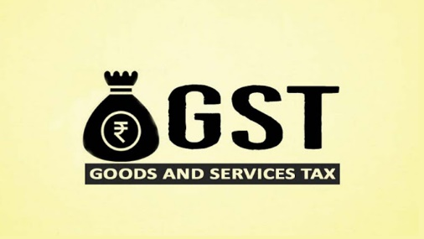
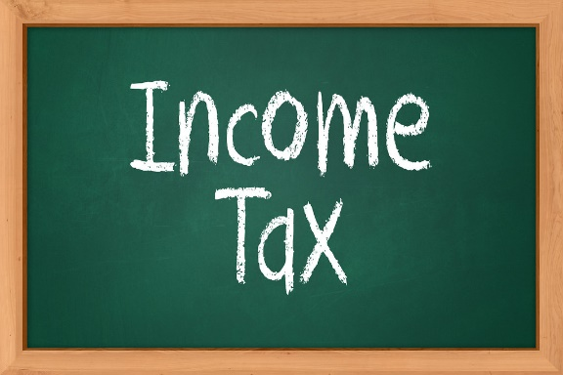
LEARNING OBJECTIVES-
BASIC INTRODUCTION TO GST
DISCUSSION ON SOME IMP CONCEPTS OF GST
IMPACT OF GST ON POWER SECTOR
RECENT DEVELOPMENTS IN GST
RECENT CASE LAWS RELEATING TO POWER SECTOR
INCOME TAX AMENDMENTS FOR PERSONAL TAXATION & CORPORATE
INCOME TAX TDS

Slide 3
QUICK VIEW-
BASIC INTRODUCTION (Types of heads, GST Flow chart)
BLOCKED CREDIT U/S 17(5)-ITC not available
UTILIZATION OF ITC-Set off rules
GST TDS –Applicability and rate
REVERSE CHARGE UNDER GST-Various services covered
IMPORTANT GST DUE DATES

Slide 4
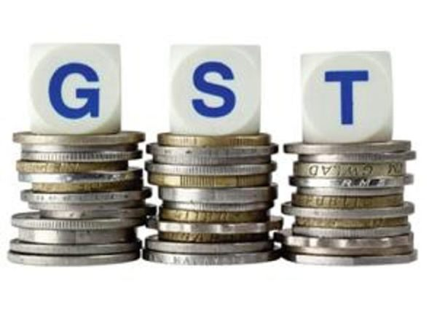
RECENT DEVELOPMENTS IN GST-
Section 16 is amended for a condition that in cases where a recipient taxpayer fails to pay to their supplier invoice value including the GST within 180 days from the date of issue of invoice, then they must pay with interest computed under Section 50 on it.
Section 17(5) is revised to include another item under ineligible ITC- Expenditure on CSR initiative for corporates.
Sections 37, 39, 44, and 52 are amended to restrict taxpayers from filing GSTR-1 (return for outward supplies), GSTR-3B (summary returns), GSTR-9 (annual returns), and GSTR-8 (e-commerce operator) for a tax period after the expiry of three years from the due date.
Due date of claiming ITC, making sales/credit-debit note amendments of a financial year is extended upto 30th November of year following the financial year.
                Contd….

Slide 5
RECENT DEVELOPMENTS IN GST-Contd…..
Section 110 of Finance Act 2022 was notified. Hence, taxpayer can transfer CGST in cash from one GSTIN to another as CGST or IGST only as a distinct person in form PMT-09.
CGST Rule 36(4) is amended to remove 5% additional ITC over and above ITC appearing in GSTR-2B. From 1st January 2022, businesses can avail ITC only if it is reported by supplier in GSTR-1/ IFF and it appears in their GSTR-2B.
The e-invoicing system will extend to those businesses with a AATO of more than Rs.10 crore from 1st October 2022 vide the Central Tax notification no.17/2022.
HSN code of six digits becomes mandatory for businesses with more than Rs.5 crore turnover in Table 12 of GSTR-1

Slide 6

GST RISK PARAMETERS-
1. Positive difference b/w ITC in GSTR-3B and 2B
2. Stop Filers
3. Late filing of returns
4. Ration of inward supplies (Liable to RCM) to total turnover
5. Ratio of Non-GST supplies/Zero Rated/ NIL RATED to Total Turnover
6. Very High ratio of tax paid through ITC of total Tax payable
7. Difference in outward supplies reported in GSTR-1,3B and E-Way bill
8. Short payment of tax in case of TDS or TCS deduction

Slide 7

GST-FOCUS ON POWER SECTOR
APPLICABILITY OF GST ON POWER SECTOR
NOTIFICATION AND CIRCULARS IN CONNECTION WITH GST
CLASSIFICATION OF GST-GOOD OR SERVICE?
LATEST CASE LAWS

Slide 8

LATEST CASE LAWS –POWER SECTOR
Sembcorp Energy India Ltd-HC
Suzlon Energy Ltd-AAR
Keshav Projects-AAR
Duet Hotels Pvt Ltd-AAR
Southern Power Distribution Company of AP Ltd -AAR

Slide 9
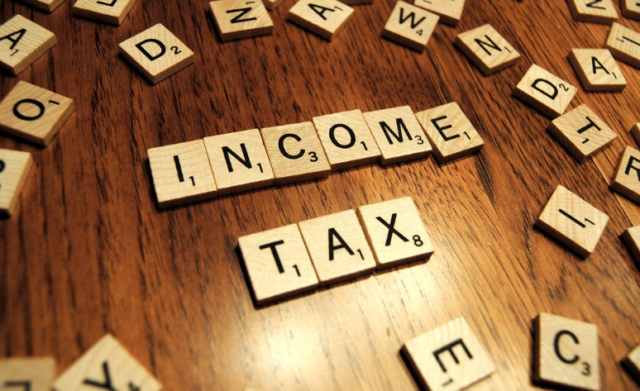
INCOME TAX
AMENDMENTS MADE VIDE FINANCE ACT,2023 APPLICABLE TO INDIVIDUALS AND CORPORATE SECTOR
TDS UNDER INCOME TAX

Slide 10

THANK YOU
-QUERIES PLEASE MAIL TO CAAKSHAYJAIN1996@GMAIL.COM

