Slide 1
Welcome to the Presentation on Fire Prevention and Fire Fighting Equipments
Safety, Accident Prevention & Disaster Management
(SAFETY)

Slide 2
PREVENTION OF FIRE
Introduction
In order to minimize the risk of fire, all possible precautions should be taken at the time of design of Electrical equipment to:
Eliminate potential sources of fire
Select adequately rated equipments for normal and abnormal duties.
Install, operate and maintain the equipment within the limit of design.
Adopt arrangements necessary to limit the spread of fire as well as its control.

Slide 3
PREVENTION OF FIRE
General guidelines:
All oil filled equipment such as transformers and switchgears should be located outdoor. Indoor transformers and switchgear should be dry type.
Switchgear and transformers should be kept in separate areas.
Auxiliary room, Battery room and control room should be separate and located away from main power equipment. Two exits should be provided in the rooms where operating personnel work.
Vermin proof enclosures should be used for indoor switchgear

Slide 4
PREVENTION OF FIRE
Elimination of electric fire hazards:
Electricity faults caused by failure of insulation, improper earthing or any other snag in the system can ignite fire. The design approach should eliminate/ minimize these causes.
Insulation damage is caused by thermal stress, mechanical stress, moistures, dirt, and high voltage.
To avoid thermal stress, we should choose equipment of suitable rating for expected duty.
To minimize mechanical vibrations equipment should be installed on properly designed foundation.
Idle equipments in humid areas should be kept warm by use of heaters.

Slide 5
PREVENTION OF FIRE
Elimination of electric fire hazards(contd…)
Insulation failure results in dissipation of large magnitudes of fault current at the place of fault. Therefore effective steps should be taken to limit the magnitude of fault currents as well as its duration.
Since improper grounding gives rise to voltage, which may cause fire, it is necessary to keep a record of the ground resistance value as well as physical condition of the grounding material.
Prevention of hot spots :
Over loading causes insulation failure and fire. Therefore heat detector alarm system and protective relay should be used to alert and disconnect equipment before preset temperature reaches due to overload.

Slide 6
PREVENTION OF FIRE
Arrangements to limit spread of fire :
Switch Gears:
Switchgear cubicles should be divided into high and low voltage part with complete separation.
Fire barrier should be provided between cable box compartment, bus bars and the circuit breakers.
Each cubicle should be completely isolated from the other by metallic partition.
The bus bar housing should also have fire barrier between compartments.
The bus bars should be covered with insulating sleeves to avoid fault.
When a fault interrupts, gas products are diverted away from the electricity live parts.

Slide 7
PREVENTION OF FIRE
Cable Trenches:
The power cables and control cables should not be run in the same trenches.
Alternating and direct current control cables should have separate trench.
Armoured control cables are to be preferred as they minimize short circuit due to mechanical damage.
The station grounding conductors should not be run in the control cable trench.
The cable trenches should be skirted and covered to avoid water collection in the trench.

Slide 8
PREVENTION OF FIRE
Transformers:
Fault inside oil filled transformers, particularly at the bushing is a serious threat to fire. Measures should be taken to prevent the spread of fire to other areas.
The cable trenches should be blocked near transformers to prevent hot burning, finding its way through the trenches to neighboring equipment.

Slide 9
FIRE EXTINGUIHING TECHNIQUES
Fire is initiated by ignition and sustained by simultaneous supply of three essentials :
-Heat
-Oxygen
- Material of combustion
Fire extinguishing techniques aim at rapidly removing one/two or all the three essentials
cooling is removal of heat
smothering is removal of oxygen supply
starving is the removal of combustible material supply

Slide 10
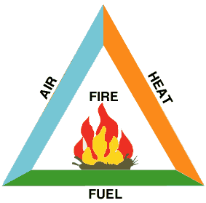
FIRE TRIANGLE

Slide 11
TYPES OF FIRES
According to European and US Standards, Fires are classified into five classes: A, B, C, D, E on the basis of the material involved in the fire. The types of fire extinguishing techniques recommended differ with the class of Fire.
Water is used as quenching medium for class A fires. Water is not suitable for Class B, Class C, Class E fires.

Slide 12
TYPES OF FIRES
Classification of Fires as per European Standards
Fire Class | Combustion Material Involved
Class A Fire | Fires involving Ordinary Solid Materials such as Wood, Coal, Plastics, Cloths, Paper, Rags, Rubbish, Construction and Packing material, Rubber, etc.
Class B Fire | Fires involving Flammable Liquids / Vapours/ Solvents: Transformer oil, Liquid chemicals Lubricating oils, Paints/varnishes/thinners Greases, Contained/Uncontained.

Slide 13
TYPES OF FIRES
Classification of Fires as per Europian Standards (contd…)
Fire Class | Combustion Material Involved
Class C Fire | Fires involving live Electrical Equipment, in Energised state. If equipments is dead Class is A or B
Class D Fire | Fires involving Metals like magnesium, titanium.
Class E Fire | Fires involving Flammable Gases and Fuels Hydrogen, Ammonia, Acetylene, LPG, Petrol, Furnace oil.

Slide 14
FIRE FIGHTING EQUIPMENT
Substation should be provided with following Fire Fighting Equipment as per TAC Rules and Indian Electricity Rules.
Fire Fighting Equipment
Fire Buckets
Fire Extinguishers
-Mechanical Foam
-Dry Chemical Powder : (a)sodium bi carbonate (BC)
(b)Ammonium Phosphate Powder (ABC)
-Carbon dioxide
Emulsifier

Slide 15
FIRE FIGHTING EQUIPMENT
Fire Buckets
Fire Buckets are of 9ltrs. Capacity having round bottom with handle. These are painted white from inside and post office red color from outside. Its bottom is painted black. “FIRE” is written on it. It is filled with sand.
Fire Extinguishers:
Mechanical Foam fire Extinguisher:
It is a container of 9ltr capacity. It contains 8.750 ltrs water and 0.250 ltrs foam forming agent. A gas cartridge is used to generate pressure inside the container to discharge the foam.

Slide 16
Dry Chemical Powder Fire Extinguisher (Sodium bi Carbonate):
These fire extinguishers are available in different sizes. It consists of the following main parts:
Cylinder
Cam Assembly with plunger
Gas Cartridge
Normally powder contains:
Sodium bi-carbonate 97%
Magnesium stearate 1.5%
Magnesium carbonate 1%
Tri calcium phosphate 0.5%

Slide 17
FIRE FIGHTING EQUIPMENT
Dry Chemical Powder Fire Extinguisher (Ammonium Phosphate):
These fire extinguishers are available in different sizes. These do not contain gas cartridge. Powder as well as gas is filled directly in the cylinder at predetermined pressure for the size.
CO2 Fire Extinguishers:
These fire extinguishers are available in different sizes. Liquefied gas is filled in it. When it is released, the liquid vaporizes and rapid expansion lowers the temperature. A part of the gas gets solidified in small particles. Cooling effect and reduction of oxygen extinguishes the fire.

Slide 18
FIRE FIGHTING EQUIPMENT
Fire Extinguishers:
S.No | Type of Extinguisher | Class A | Class B | Class C | General
1 | Carbon dioxide | Suitable for small surface fires only. | Suitable. Does not leave residue or affect equipment or contaminate other stuff. | Suitable. Non conductor and does not damage equipment. | These extinguishers are made in variety of sizes. Liquid CO2 contained in a strong cylinder is released by the valve or trigger and sends out a shower of gas or “snow” which both cools and stops fire.

Slide 19
2 | Dry Chemical | Suitable for small surface fires only. | Suitable. Chemical releases smothering gas and fog and shields operation from heat. | Suitable. Chemical is a non-conductor, fog ordinary chemical shields the operator from heart.
3 | Foam | Suitable. Has both smothering and wetting action | Suitable. Smothering blanket does not dissipate, floats on top of spilled liquid. | Unsuitable. Foam being a conductor should not be used on live equipment. | Extinguishments is by Blanketing or smothering the fire with a heavy layer of a foamy substance consisting of largely of tiny bubbles of CO2.

Slide 20
4 | Water | Suitable. Water saturates material and prevents rekindling | Unsuitable. Water will spread and not put it out. | Unsuitable. Water being conductor should not be used on live electric equipment.
5 | Carbon tetrachloride | Suitable. To a limited extent on Class ‘A’ Fires. | Suitable. Releases heavy smothering gas on fires | Suitable. Non- conductor and will not damage equipment | These are available in one quart size and above and are of pump or pressure type. The liquid is pumped on to the fire and extinguishes the fire by smothering it.

Slide 21
FIRE PREVENTION & FIRE FIGHTING EQUIPMENT
Note:
Even if premises are equipped with an automatic sprinkler installations , it is also necessary to have portable fire extinguishers as these may enable an outbreak to be extinguished before the automatic sprinkle comes into operation.
Portable foam, soda acid or water fire fighting equipment is intended for non-electrical fires and shall not be used on electrical apparatus fires unless such apparatus has been made dead.

Slide 22
FIRE PREVENTION & FIRE FIGHTING EQUIPMENT
Emulsifier:
It is a system of application of water at a particular angle on burning transformer oil. The system contains water tank and a pump room having a water pumping system i.e. main pump and jockey pump. The system is set at auto mode at pre determined temperature – normally 67°C. Emulsifier points automatically spray water at a particular angle on burning transformer oil. Thus fire gets extinguished.

Slide 23
FIRE PREVENTION & FIRE FIGHTING EQUIPMENT
Reguirement of fire extinguishers as per TAC recommendation:
One 9 ltrs fire bucket shall be provided for every 100 mtrs.of floor area or part there of .One 9 ltrs mechanical foam fire extinguisher/ 5kg Dry powder fire extinguisher / 4.5 kg.CO2 Fire Extinguisher should be provided to six buckets or part thereof with minimum of one fire extinguisher and two buckets per compartment. Buckets may be dispensed with provided the supply of extinguisher is one and a half times as indicated here above.

Slide 24
FIRE PREVENTION & FIRE FIGHTING EQUIPMENT
Requirement of fire extinguishers as per TAC recommendation(contd..):
Every sub-station should train its employees in fire fighting. It should form its own fire fighting team. Team should be given frequent mock drills. Duty of each member of the fire fighting team should be written and circulated among the staff. A list of all employees with their contact number and home addresses should be displayed in the substation.
Workers should also be provided first aid training. First Aid Box should be provided and a chart indicating the first aid to be given in case of electric shock should be displayed in the substation.

Slide 25
FIRE PREVENTION & FIRE FIGHTING EQUIPMENT
Introduction
In order to minimize the risk of fire, all possible precautions should be taken at the time of design of Electrical equipment to:
Eliminate potential sources of fire
Select adequately rated equipments for normal and abnormal duties.
Install, operate and maintain the equipment within the limits of design.
Adopt arrangements necessary to limit the spread of fire as well as its control.

Slide 26
FIRE PREVENTION & FIRE FIGHTING EQUIPMENT
General guidelines:
All oil filled equipment such as transformers and switchgears should be located outdoors. Indoor transformers and switchgears should be dry type.
Switchgears and transformers should be kept in separate areas.
Auxiliary room, Battery room and control room should be separate and located away from main power equipments. Two exits should be provided in the rooms where operating personnel work.

Slide 27
FIRE PREVENTION & FIRE FIGHTING EQUIPMENT
Elimination of electric fire hazards:
Electricity faults caused by failure of insulation, improper earthing or any other snag in the system can ignite fire. The design approach should eliminate/ minimize these causes.
Insulation damage is caused by thermal stress, mechanical stress, moisture, dirt, and high voltage.
To avoid thermal stress, we should choose equipment of suitable rating for expected duty.
To minimize mechanical vibrations equipment should be installed on properly designed foundation.
Idle equipments in humid areas should be kept warm by use of heaters.

Slide 28
FIRE PREVENTION & FIRE FIGHTING EQUIPMENT
Elimination of electric fire hazards (continued):
To ensure that the system is maintained within desired limits of operation, automatic voltage regulators should be used. Over voltage relays are used to isolate the equipments, which are subjected to excessive voltage than permitted.
Guards are provided on transmission lines to prevent fault due to birds.
Vermin proof enclosures should be used for indoor switchgears.

Slide 29
FIRE PREVENTION & FIRE FIGHTING EQUIPMENT
Insulation failure results in dissipation of large magnitudes of fault current at the place of fault. Therefore effective steps should be taken to limit the magnitude of fault currents as well as its duration.
Reactors should be used in the power system network at places where fault levels are to be restricted.
Use protective relays, circuit breakers and adequately rated fuses to minimize fire during fault.
Protective relays provide first line of defence. The relays are backed up by “Back Up” relays. Reliability measures are in inbuilt to ensure its correct operation when required.
The protective relays operate the circuit breakers, which in turn isolate the faulty equipment thus minimizing fire risk.

Slide 30
FIRE PREVENTION & FIRE FIGHTING EQUIPMENT
Groundings :
The ohmic value of the grounding main of electrical installation should be as low as possible.
It is necessary to connect all ground points in the area grid by duplicate earth connections.
Seggregated noncurrent carrying metallic parts be electrically bonded.
Since improper grounding gives rise to voltage, which causes fire, it is necessary to keep a record of the ground resistance value as well as physical condition of the grounding material.

Slide 31
FIRE PREVENTION & FIRE FIGHTING EQUIPMENT
Prevention of hot spots :
Over loading should not be done as its causes insulation failure and fire. Therefore heat detector alarm system and protective relay should be used to alert and disconnect equipments before preset temperature reaches due to overload.

Slide 32
FIRE PREVENTION & FIRE FIGHTING EQUIPMENT
Maintenance& operating procedures:
Besides following the routine maintenance practices prescribed for the equipment, special diagnostic tests should be conducted to detect incipient faults. High voltage tests, timing test, contact and insulation resistance measurements are some of these tests, monitoring the trend of the results of tests will enable to take out equipment and rectify them before the faults develop into serious troubles.

Slide 33
FIRE PREVENTION & FIRE FIGHTING EQUIPMENT
Maintenance& operating procedures:
In polluted areas, the insulators require frequent cleaning. Silicon grease is applied to insulators to reduce pollution deposits. Operating instructions should be written taking into account all anticipated normal and abnormal operating conditions. The safety tagging systems should be adopted.
Interlocks must form part of the equipment designed to ensure that electrical equipments are put into and out of service correctly.

Slide 34
FIRE PREVENTION & FIRE FIGHTING EQUIPMENT
Arrangements to limit spread of fire :
Switch Gears:
Switchgears cubicles should be divided into high and low voltage part with complete separation.
Fire barrier should be provided between cable box compartment, bus bars and the circuit breakers.
Each cubicle should be completely isolated form the other by metallic partition.
The bus bar housing should also have fire barrier between compartments.
The bus bars should be covered with insulating sleeves to avoid fault.

Slide 35
FIRE PREVENTION & FIRE FIGHTING EQUIPMENT
Cable Trenches:
The power cables and control cables should not be run in the same trenches.
.Armoured control cables are to be preferred as they minimize short circuit due to mechanical damage.
The station grounding conductors should not be run in the control cable trench.
The cable trenches should be skirted and covered to avoid water collection in the trench.

Slide 36
FIRE PREVENTION & FIRE FIGHTING EQUIPMENT
Transformers:
Fault inside oil filled transformers, particularly at the bushing is a serious threat to fire. Measures should be taken to prevent the spread of fire to other areas
Soak pits should be made below the transformer tank and should be filled up with rubbles. The soak pit should be connected to brunt oil tank located away from all the equipments to contain the excess oil in the soak pit.
The transformers should be separated by fire protection walls in between.
The cable trenches should be blocked near transformers to prevent hot burning, finding its way through the trenches to neighboring equipment.
Transformer should be provided with automatic fire suppression system i.e. emulsification.

Slide 37
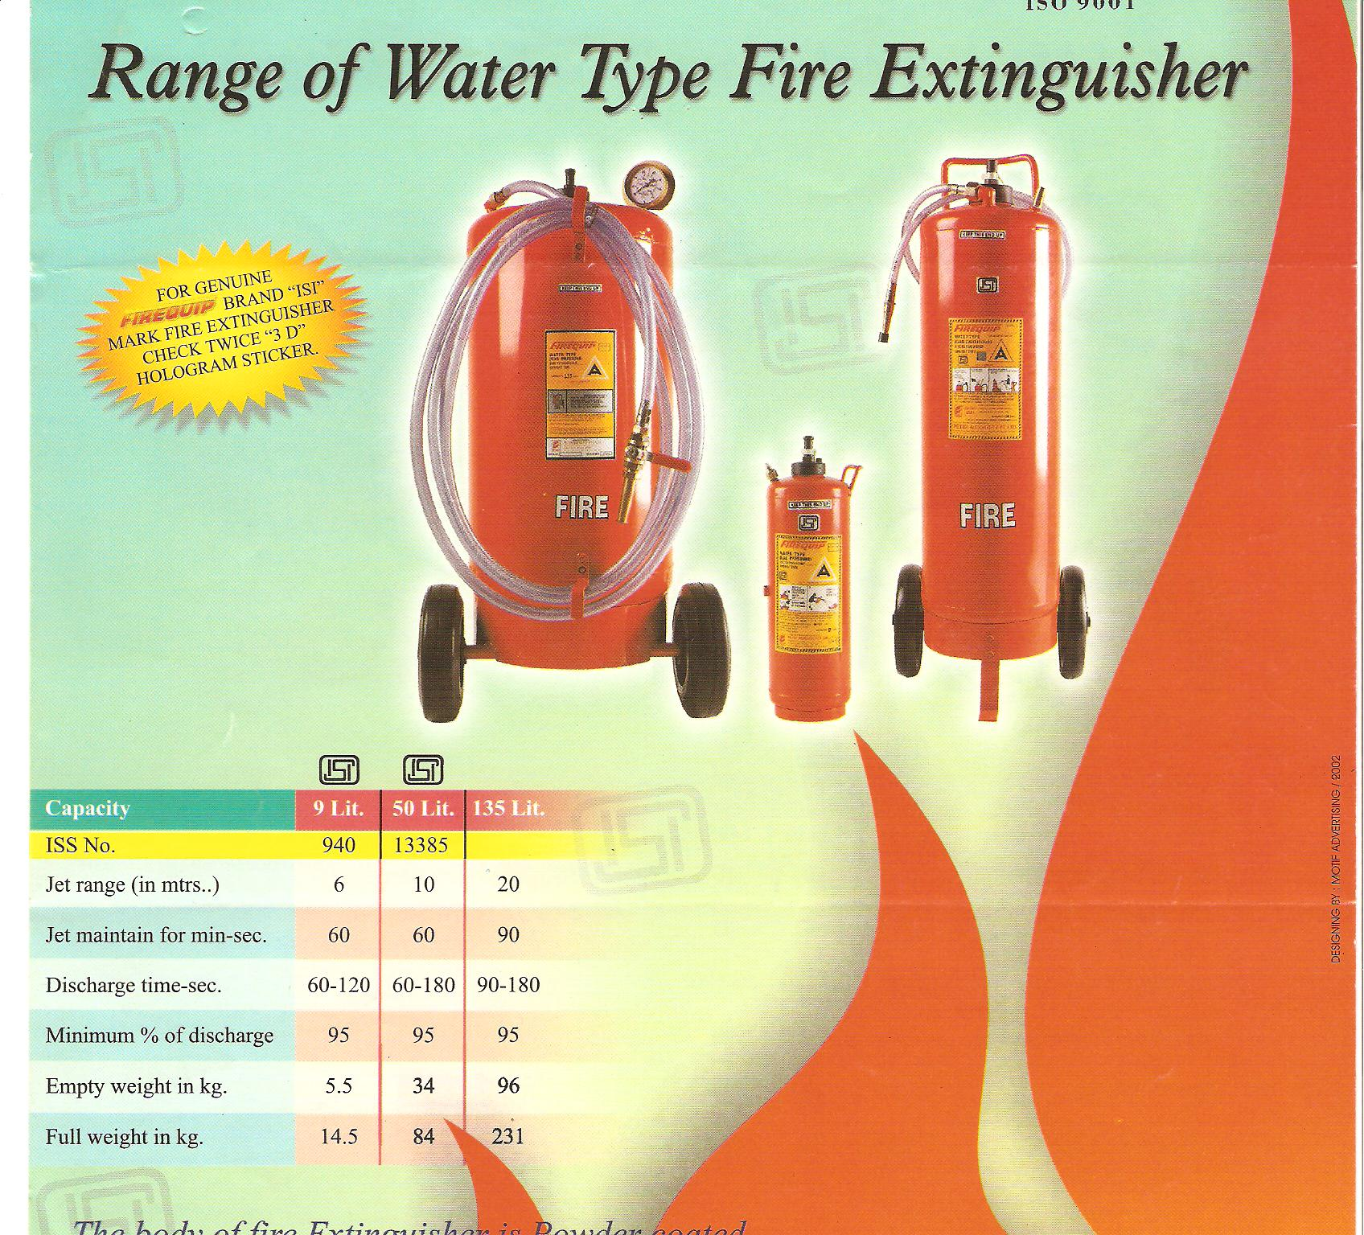

Slide 38
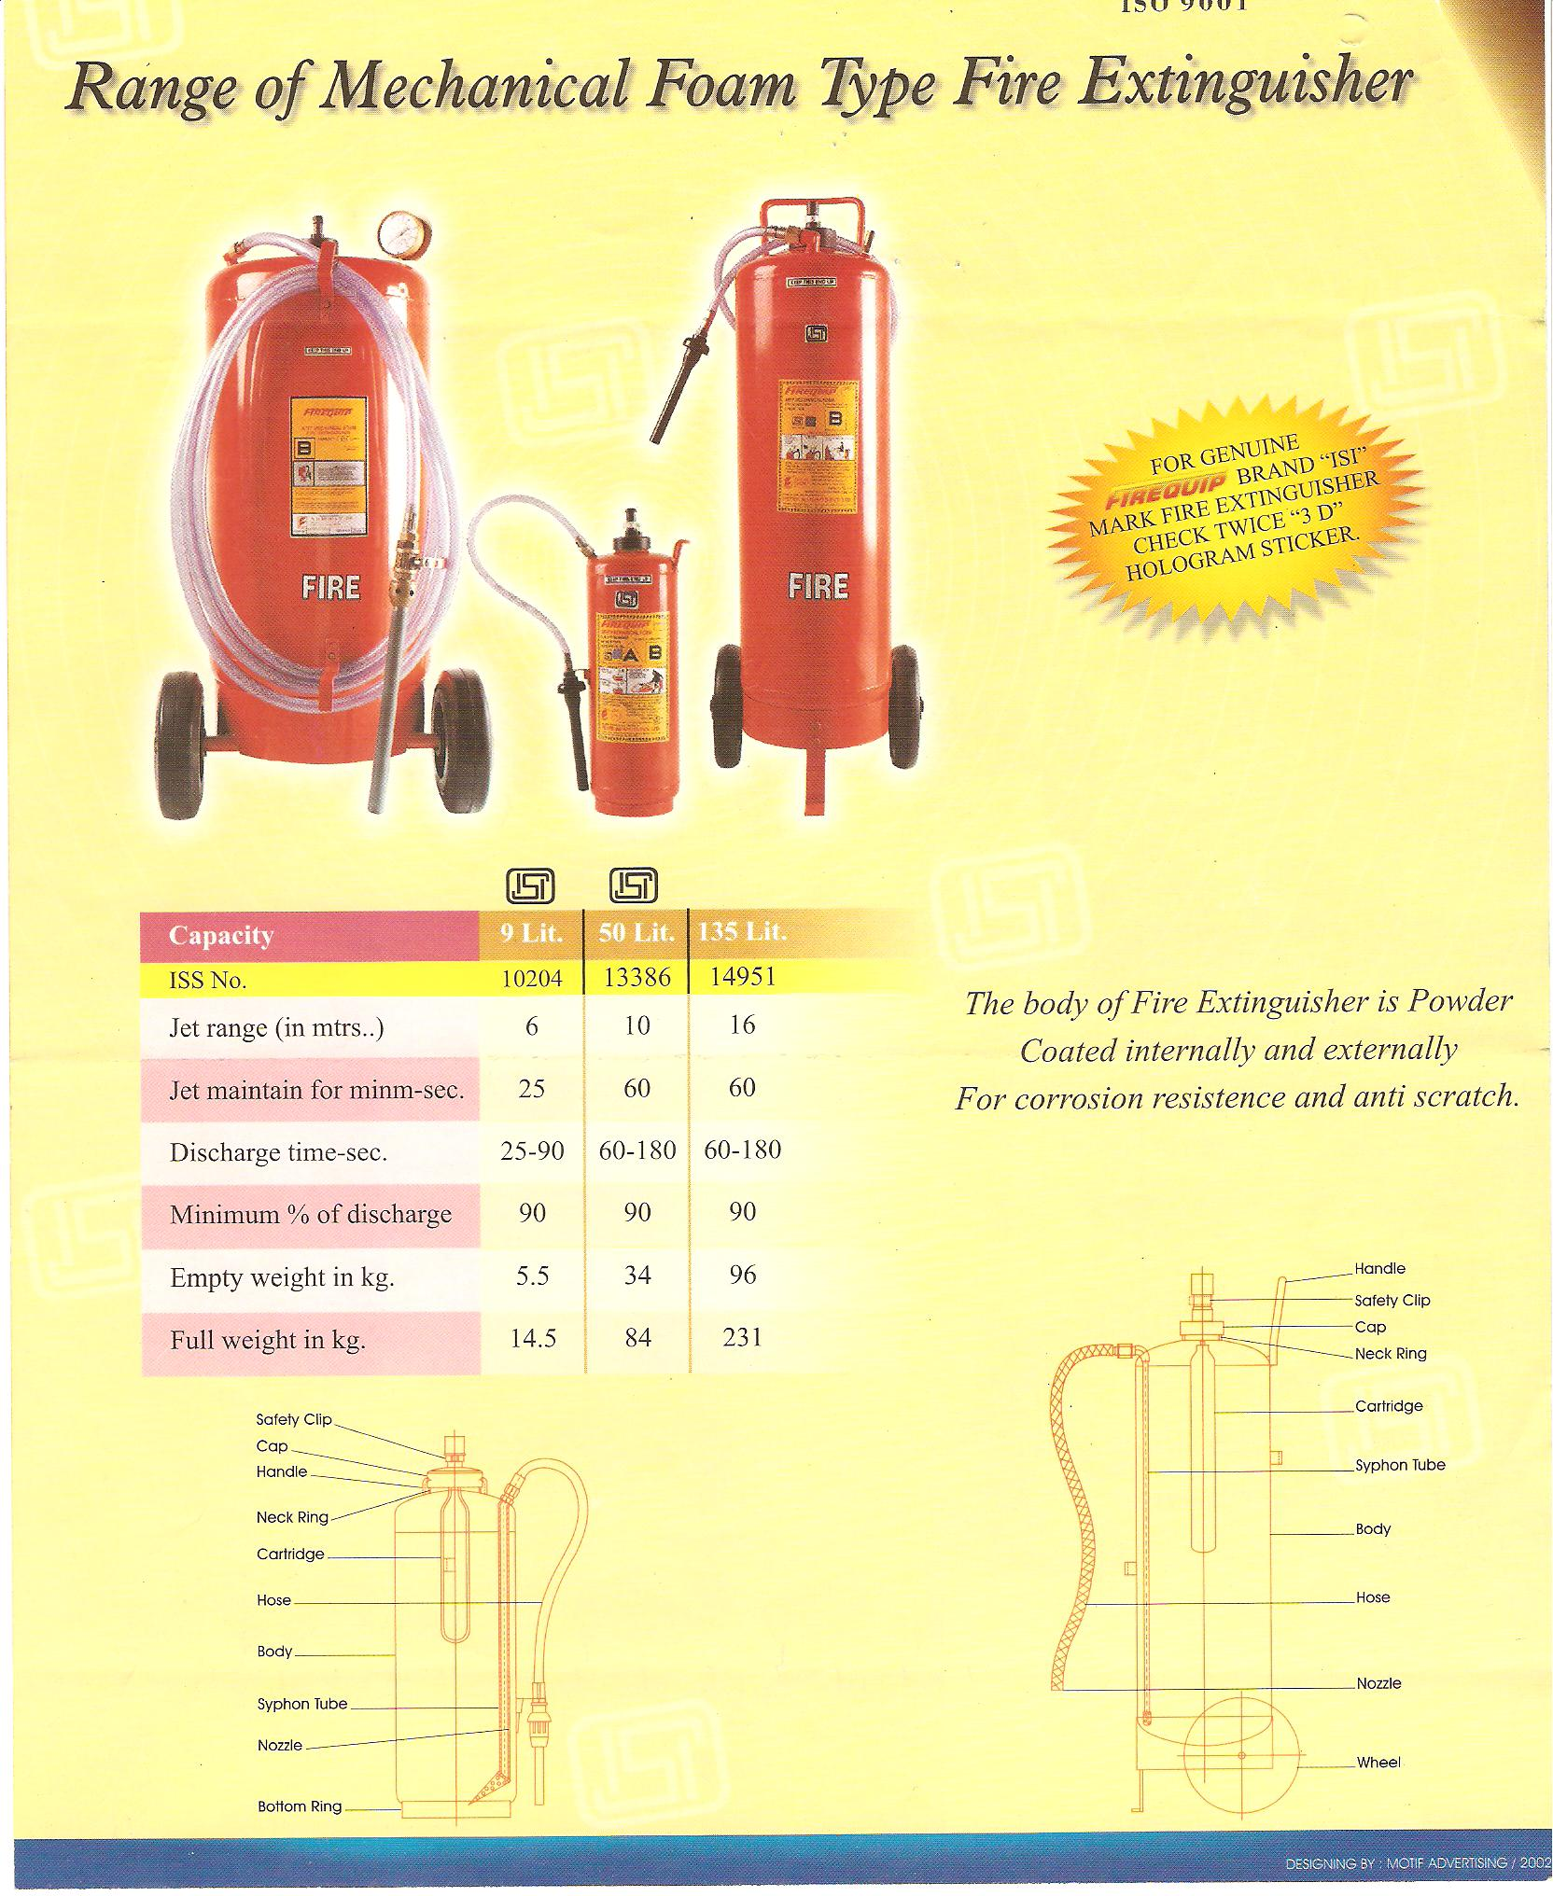

Slide 39
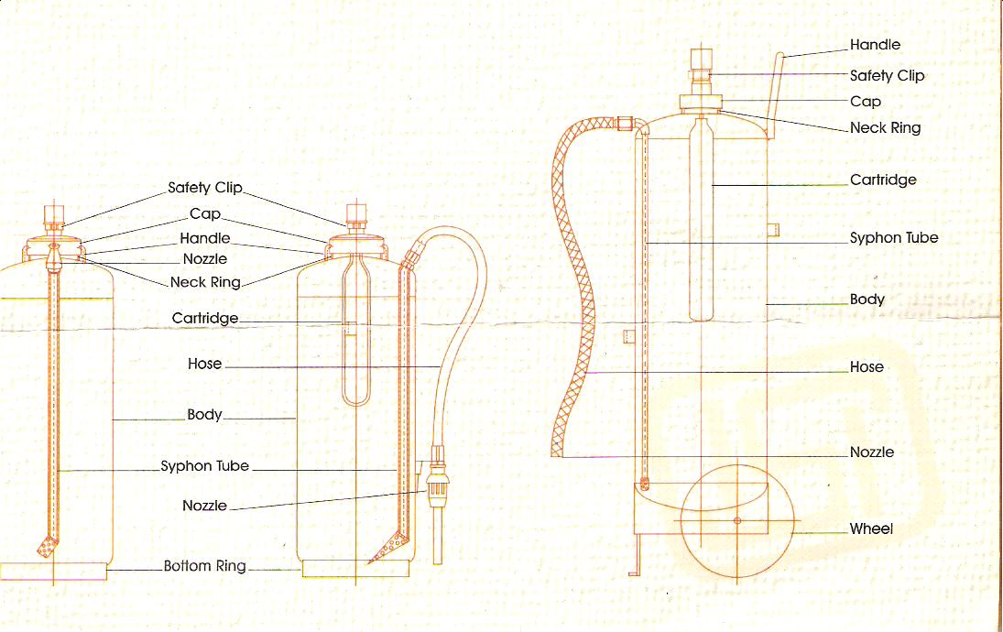
FOAM TYPE- MECHANICAL

Slide 40
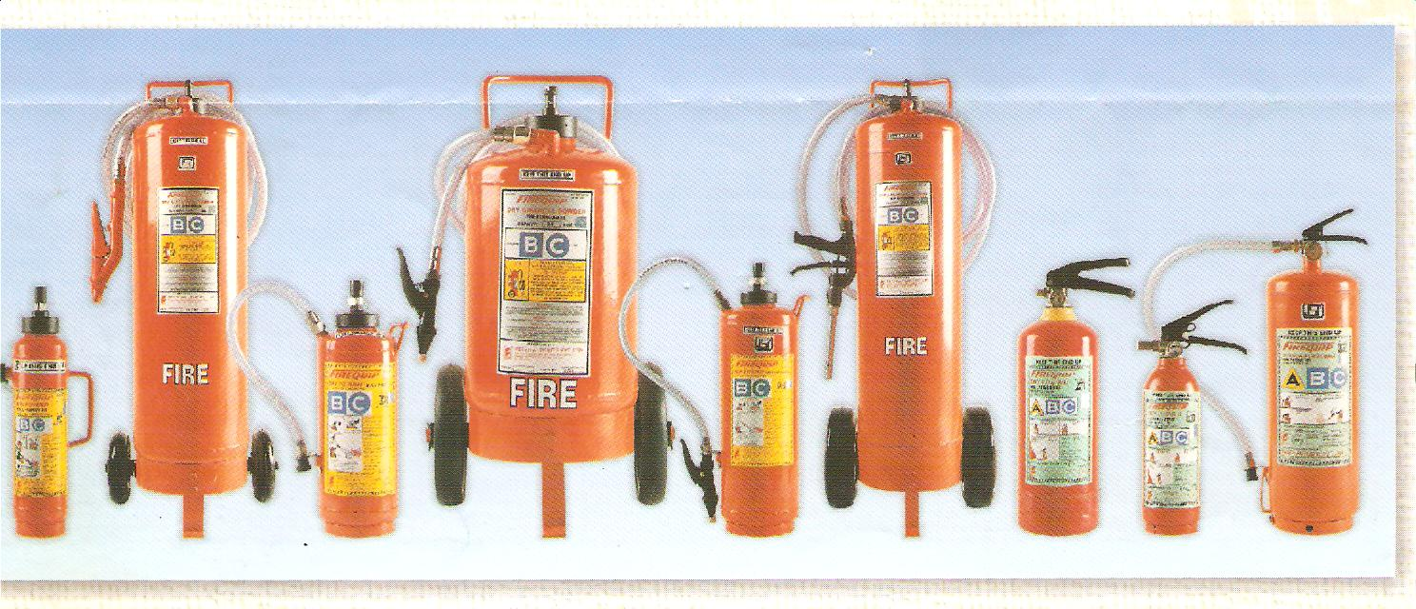
DRY CHEMICAL POWDER

Slide 41
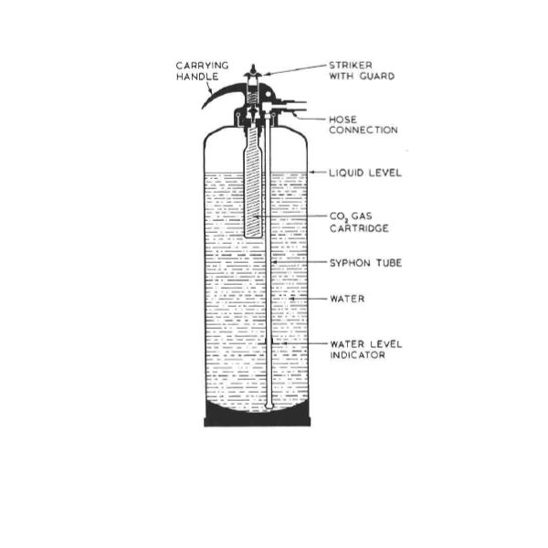

Slide 42
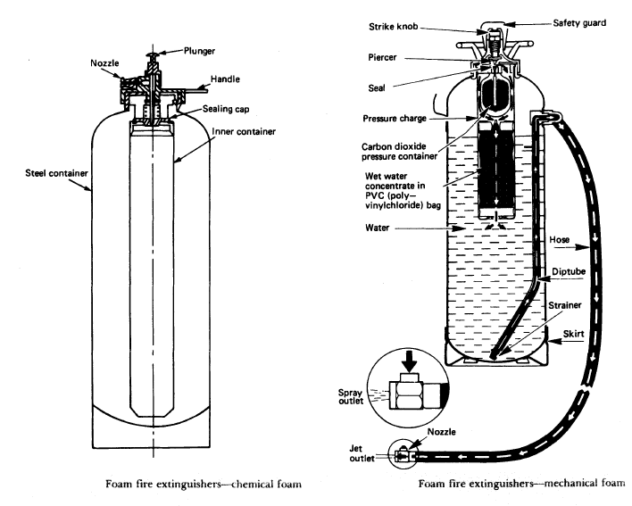
MECHANIAL FOAM TYPE FIRE EXTINGUISHER

Slide 43
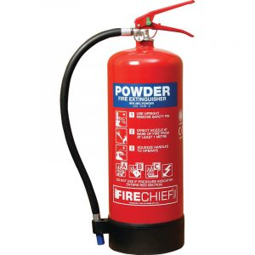
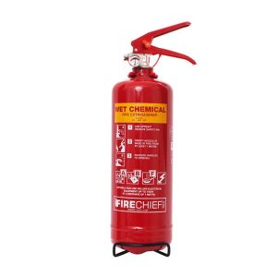
CHEMICAL EXTINGUISHERS
DCP EXTINGUISHER
WET CMEMICAL EXCHANGER

Slide 44
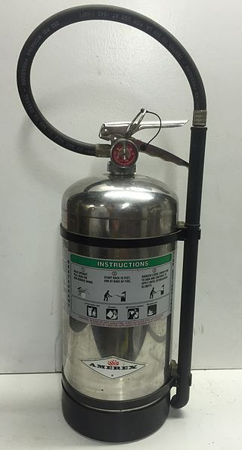
WET CHEMICAL EXTINGUISHER
6-liter wet chemical fire extinguisher for use in commercial kitchens
commercial kitchens
Wet chemical extinguishers can also be used for fires caused by various organic materials including wood, coal, textiles, fabrics, cardboard and paper. (CLASS A FIRE)
Location:This type of fire extinguisher needs to be placed near to the source of the fire risk in commerical kitchens and canteen

Slide 45
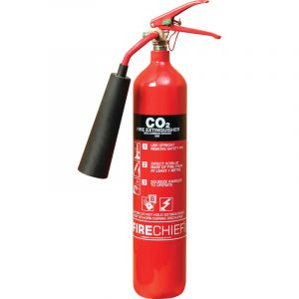
Carbon dioxide extinguishers

Slide 46
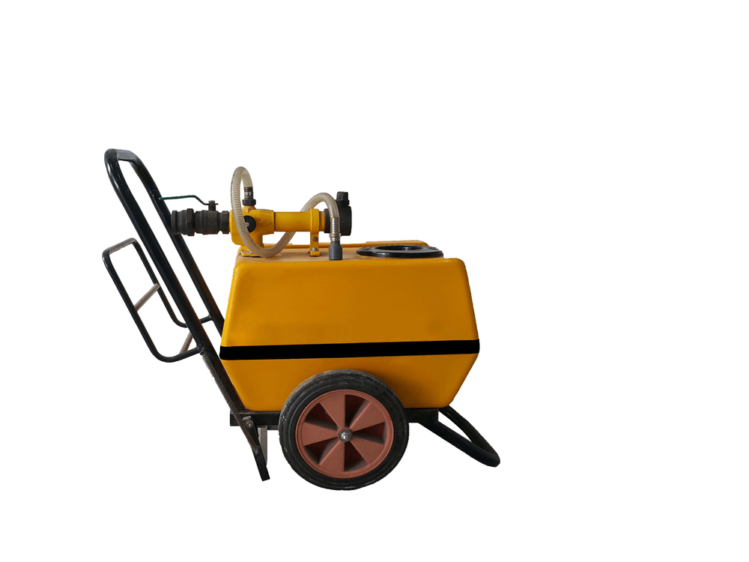
SEMI-PORTABLE FIRE EXITINGUISHERS
The semi-portable type of fire extinguisher is higher in capacity and weight than the portable ones.
They are considered to be the second line of defense in case the portable fire extinguisher fails to stop the fire exposure.
As they are heavier to lift, it is provided with a wheel-trolley arrangement which can be dragged to a nearby fire location.
These can be a semi-portable foam fire extinguisher or semi-portable DCP type fire extinguisher.

Slide 47
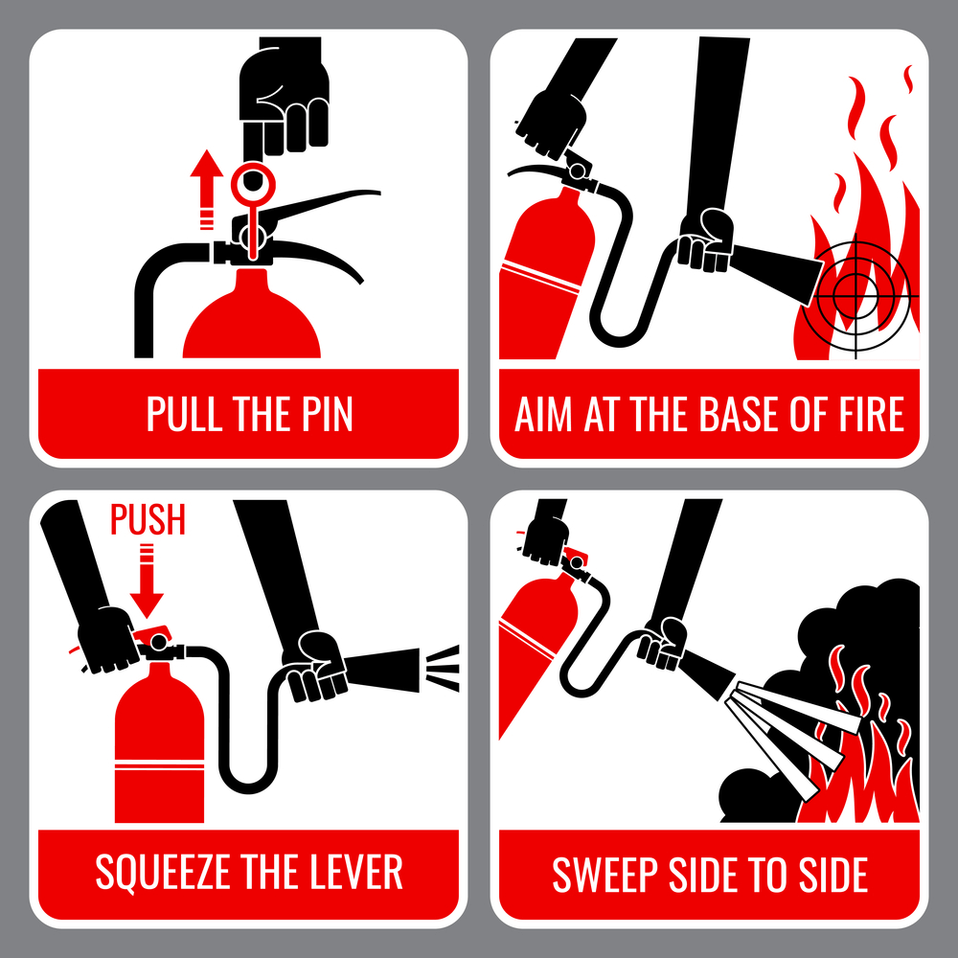

Slide 48
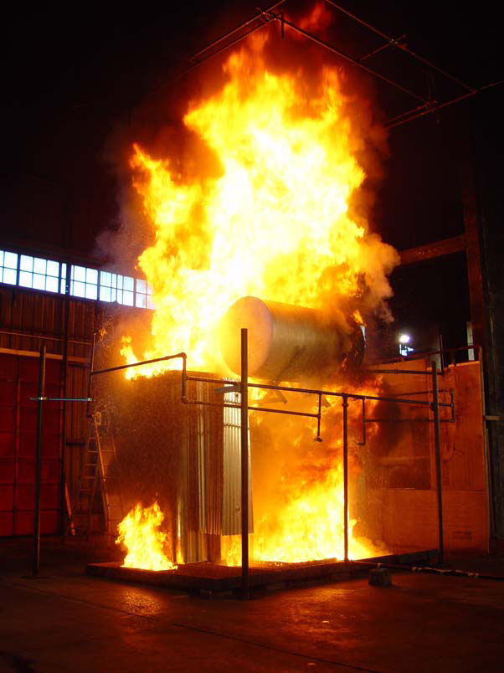
Integrated Compressed Air Foam Systems

Slide 49
FIRE PREVENTION & FIRE FIGHTING EQUIPMENT
TYPES OF FIRES
According to Europian and US Standards, Fires are classified into five classes: A, B, C, D, E on the basis of the material involved in the fire. The types of fire extinguishing techniques recommended differ with the class of Fire.
Water is used as quenching medium for class A fires. Water is not suitable for Class B, Class C, Class E fires.
Classification of Fires as per Europian Standards

Slide 50
FIRE PREVENTION & FIRE FIGHTING EQUIPMENT
Classification of Fires as per Europian Standards
Fire Class | Combustion Material Involved | Fire Extinguishing Medium
Class A Fire | Fires involving Ordinary Solid Materials such as Wood, Coal, Plastics, Cloths, Paper, Rags, Rubbish, Construction and Packing material, Rubber, etc. | Water or Solutions with high water content. Cooling and wetting of material helps in quenching the fire.
Class B Fire | Fires involving Flammable Liquids / Vapours/ Solvents, Liquid chemicals Lubricating oils, Paints/ varnishes/ thinners Greases. | Limiting air or oxygen supply, fire inhibiting Dry chemicals, Foam, Halon. Water is not suitable.

Slide 51
FIRE PREVENTION & FIRE FIGHTING EQUIPMENT
Classification of Fires as per Europian Standards
Fire Class | Combustion Material Involved | Fire Extinguishing Medium
Class C Fire | Fires involving live Electrical Equipment, in Energised state. If equipments is dead Class is A or B | Co2 gas, Dry chemicals. Waters is not suitable.
Class D Fire | Fires involving Metals like magnesium, titanium. | Normal extinguishing media not suitable. Special chemicals and techniques are used.
Class E Fire | Fires involving Flammable Gases and Fuels Hydrogen, Ammonia, Acetylene, LPG, Petrol, Furnace oil. | Starvation of fire is most useful by closing inlet value. Special methods necessary.

Slide 52
FIRE PREVENTION & FIRE FIGHTING EQUIPMENT
Firefighting equipment
Substation should be provided with following Fire Fighting Equipment.
First level Fire Fighting Equipment
Fire Buckets
Fire Buckets are of 9ltrs. Capacity having round bottom with handle. These are painted white from inside and post office red color from outside. Its bottom is painted black. “FIRE” is written on it. It is filled with sand.
2. Fire Extinguishers
a) Mechanical Foam fire Extinguisher:
It is a container of 9ltr capacity. It contains 8.750 ltrs water and 0.250 ltrs foam forming agent. A gas cartridge is used to generate pressure inside the container to discharge the forms. It is used on class ‘B’ type of fire.

Slide 53
FIRE PREVENTION & FIRE FIGHTING EQUIPMENT
Dry Chemical Powder Fire Extinguisher
i) Dry Chemical Powder Fire Extinguisher (Sodium bi Carbonate):
It is used on ‘B’ & ‘C’ type of fire. It is especially suitable for oil and electrical fires.
ii)Dry Chemical Powder Fire Extinguisher (Ammonium Phosphate Powder):
These fire extinguishers are used on ‘A’, ‘B’, ‘C’ and Electrical fires.
Sodium bi Carbonate (BC)
Ammonium Phosphate
Powder (ABC)

Slide 54
FIRE PREVENTION & FIRE FIGHTING EQUIPMENT
c) CO2 Fire Extinguishers:
These fire extinguishers are available in different sizes. Liquefied gas is filled in it. When it is released, the liquid vaporizes and rapid expansion lowers the temperature. A part of the gas gets solidified in small particles. Cooling effect and reduction of oxygen extinguishes the fire.

Slide 55
FIRE PREVENTION & FIRE FIGHTING EQUIPMENT
Fire Extinguishers:
S.No | Type of Extinguisher | Class A | Class B | Class C | General
1 | Carbon dioxide | Suitable for small surface fires only. | Suitable. Does not leave residue or affect equipment or food stuff. | Suitable. Non conductor and does not damage equipment. | These extinguishers are made in variety of sizes. Liquid CO2 contained in a strong cylinder is released by the value or trigger and sends out a shower of gas or “snow” which both cools and stops fire.

Slide 56
2 | Dry Chemical | Suitable for small surface fires only. | suitable Chemical releases smothering gas and fog and shields operation from heat. | Suitable. Chemical is a non-conductor, fog ordinary chemical shields the operator from heart.
3 | Foam | Suitable. Has both smothering and wetting action | Suitable. Smothering blanket does not dissipate, floats on top of spilled liquid. | Unsuitable. Foam being a conductor should not be used on live equipment. | Extinguishments is by plan keting or smothering the fire with a heavy layer of a foamy substance consisting of largely of tiny bubbles of CO2.

Slide 57
4 | Water | Suitable. Water saturates material and prevents rekindling | Unsuitable. Water will spread and not put it out. | Unsuitable. Water being conductor should be not be used on live electric equipment.
5 | Carbon tetrachloride | Suitable. To a limited extent on Class ‘A’ Fires. | Suitable. Releases heavy smothering gas on fies | Suitable. Non- conductor and will not damage equipment | These are available in one quart size and above and are of pump or pressure type. The liquid is pumped on to the fire and extinguishes the fire by smothering it.

Slide 58
FIRE PREVENTION & FIRE FIGHTING EQUIPMENT
Note:
Even if premises are equipped with an automatic sprinkler installations , it is also necessary to have portable fire extinguishers as these may enable an outbreak to be extinguished before the automatic sprinkle comes into operation.
Portable foam, soda acid or water fire fighting equipment is intended for non-electrical fires and shall not be used on electrical apparatus fires unless such apparatus has been made dead.

Slide 59
FIRE PREVENTION & FIRE FIGHTING EQUIPMENT
Emulsifier:
It is a system of application of water at a particular angle on burning transformer oil. The system contains water tank and a pump room having a water pumping system i.e. main pump and jockey pump. The system is set at auto mode at pre determined temperature – normally 67 C. Emulsifier points automatically spray water at a particular angle on burning transformer oil. Thus fire gets extinguished.

Slide 60
FIRE PREVENTION & FIRE FIGHTING EQUIPMENT
Reguirement of fire extinguishers as per TAC recommendation:
One 9 ltrs fire bucket shall be provided for every 100 mtrs. Of floor area or part there of One 9 ltrs mechanical foam fire extinguisher/ 5kg Dry powder fire extinguisher / 4.5 kg.CO2 Fire Extinguisher should be provided to six buckets or part thereof with minimum of one fire extinguishers and two buckets per compartment. Buckets may be dispensed with provided the supply of extinguisher is one and a half times as indicated here above.

Slide 61
FIRE PREVENTION & FIRE FIGHTING EQUIPMENT
Requirement of fire extinguishers as per TAC recommendation:
Every sub-station should train its employees in fire fighting. It should form its own fire fighting team. Team should be given frequent mock drills. Duty of each member of the fire fighting team should be written and circulated among the staff. A list of all employees with their contact number and home addresses should be displayed in the substation.
Workers should also be provided first aid training. First Aid Box should be provided and a chart indicating the first aid to be given in case of electric shock should be displayed in the substation.

Slide 62
FIRE PREVENTION & FIRE FIGHTING EQUIPMENT
Fire hazards in transformers
Transformers carry current and generate heat due to a variety of energy losses. Their constructions therefore cool by dissipating the heat. Transformer can be classified into three types depending upon the heat dissipation facility and insulation used.
Dry Type Transformer
Askarel Insulated Type
Oil Insulated Type

Slide 63
FIRE PREVENTION & FIRE FIGHTING EQUIPMENT
Dry transformers are of four types:
Self- cooled unventilated
Self-cooled ventilated
Forced air- cooled
Sealed tank gas filled (Nitrogen or per Fluropropane) varieties

Slide 64
FIRE PREVENTION & FIRE FIGHTING EQUIPMENT
Cause of Fire:
Fire do occur in dry type transformers due to insulation failures of windings.
Askarel- insulated transformer is very safe as the liquid used for insulation are non flammable in nature. The cost of these transformers, however, is very high compared to other types.
Oil insulated type transformer are the most common and present the greatest fire hazard. Although during normal operation, the heat is efficiently dissipated, fires in oil insulated transformers can result due to abnormal conditions caused by:
Overload during switching or through lighting’s surges.
Gradual deteriorations of insulation, transformer oil etc.

Slide 65
FIRE PREVENTION & FIRE FIGHTING EQUIPMENT
Low oil level itself
Failure of insulating bushings
An arcing that follows an electrical breakdown can burn through the case or vaporize the oil, creating pressure sufficient to force off the cover or rupture the casing. Considerable burning oil may then be expelled and an intense fire/ explosion may follow.

Slide 66
FIRE PREVENTION & FIRE FIGHTING EQUIPMENT
Safe Practices:
Many fires which frequently occur on transformers in operation all over the country can be easily prevented if established safe practices are followed by owners of such equipment.
Such safe practices are stipulated in the Indian Standards, the rules of the TAC and in other codes of practice.
-Periodic checks for purity, breakdown voltage, acidity and ageing of products in the insulating oil must be carried out as per manufacturers instructions or to relevant Indian standards.

Slide 67
FIRE PREVENTION & FIRE FIGHTING EQUIPMENT
Protection Systems:
Modern transformers, because of their cost, sometimes in excess of a few crore of rupees, warrant special fire protection system. There is sufficient value in the thousands of gallons of oil and external attachments (e.g. fans, controls tap changing equipment, instruments bushings, lighting arrestor) to justify some type of fixed fire extinguishing equipment. Fixed water spray systems are normally recommended for safeguarding transformers against fire hazards.

Slide 68
FIRE PREVENTION & FIRE FIGHTING EQUIPMENT
Water Spray System:
A solid stream of water discharged from a hose will not extinguish an oil fire as water, being heavier than oil, sinks to the bottom of the oil surface and in fact agitates the flame thus intensifying the fire.
It was discovered in the year 1932 that water released in fine drops and directed at the surface of an oil fire at an optimum velocity produces an emulsion of oil in water which will float and extinguish fire. As a result the mulsifire or water spray system came into use during 1933-36. Basically, the system consists of a number of nozzles located around the transformer on pipe headers charged with water under pressure. A detection system that automatically detects the fire, also activates the spray system to release fine droplets of water over the surface of the transformer.

Slide 69
FIRE PREVENTION & FIRE FIGHTING EQUIPMENT
Water Spray System (continued):
The practical location of the piping and nozzles with respect to the surface to which the spray is to be applied, or to the zone in which the spray is to be effective, is determined by the physical arrangement and protection needs. Once the criteria are established, the size(rate of discharge) of nozzles to be used, the angle of the nozzle discharge cone, and the water pressure needed can be determined.
Once the type of nozzle has been selected and the location and spacing to give the desired area coverage has been determined, hydraulic calculations are made to establish the appropriate pipe sizes and water supply requirement.

Slide 70
FIRE PREVENTION & FIRE FIGHTING EQUIPMENT
Water Spray System (continued):
When water spray is to be used for fire protection of oil filled electrical equipment such as transformers and large switch gear, special care must be taken to provide safe electrical clearance.
Many factors govern the size of a water spray system, including the nature of hazards or combustibles involved, amount of type of equipment to be protected, adequacy of other protection, and the size of the area which could be involved in a single fire.
Because most water spray systems must perform as deluge type systems with all nozzles or devices open and because a high density of water discharge needed there is a heavy demand for water. Each hazard should be protected by its own system which should be adequate for dependable protection.

Slide 71
FIRE PREVENTION & FIRE FIGHTING EQUIPMENT
Water Supplies:
Fixed spray systems are usually supplied from one or more of the following:
Connections from reliable water- work system of adequate capacity and pressure. Automatic fire pumps having reliable power and a water supply of adequate capacity and reliability.
An elevated (gravity) tank of adequate capacity and elevation.
The capacity of pressure tanks generally is inadequate to supply water spray systems. Such tanks, however, may be accepted as water supplies to small systems.

Slide 72
FIRE PREVENTION & FIRE FIGHTING EQUIPMENT
Maintenance:
It is important that fixed water spray systems be inspected and maintained on a regularly scheduled program.
Items such as strainers, piping, control values, heat actuated device and the spray nozzles should be included in the schedule for regular check and maintenance.

Slide 73
THANK YOU

