Slide 1
Welcome to the Presentation
on
“Fire Protection Equipment”
A.SAIPRASAD SARMA
RETD. CE/APTRANSCO

Slide 2
ELECTRICITY AS AN INFRASTRUCTURE
Electricity is the essential requirement of all facets of our life and a basic need being the critical infrastructure for the socio-Economic development of any country.
Its uniqueness lies in the fact that it is the only infrastructure sought after and used incessantly for all the 24 hrs,365 days, for decades to come
Considered to be the back bone of all infrastructures as their development depends on progress in power sector. Thumb rule:1%raise in GDP needs 1.5%raise in the power consumption.
Transmission is defined as transfer of bulk power over a long distance at voltages of 132kV and above, ie., EHV
Cherished objective of any transmission utility is Transmitting total generated Power from power plants to distribution centres with least losses, at a standard voltage profile and higher reliability, without any congestion, maintaining higher availability and quality even under transient conditions, besides maintaining performance standards as stipulated by respective Electricity Regulatory commission.

Slide 3
FIRE PREVENTION & FIRE FIGHTING EQUIPMENT
Fire accidents are a major risk in cases of oil filled transformers/equipment in substations
It can cause equipment loss/damage, interruption to major load, loss of revenue, danger to personnel, loss of skill, loss of confidence/morale among staff and loss of time for supervising staff.
In order to minimize the risk of fire all possible precautions should be taken at the time of design of Electrical equipment to:
Eliminate potential sources of fire
Select adequately rated equipments for normal and abnormal duties.
Install, operate and maintain the equipment within the limit of design.
Adopt arrangements necessary to limit the spread of fire as well as its control.

Slide 4
FIRE PREVENTION & FIRE FIGHTING EQUIPMENT
STANDARDS : Fire equipments, design and layout of fire protection system shall conform to the latest edition of the following standard as well as this specification.
(i) IS:1646 : Code of practice for fire safety of buildings (General: electrical installation)
(ii) IS :1647 : Code of practice for fire fighting of buildings
(iii) IS:1648 Code of practice for fire fighting of buildings, fire fighting equipment and its maintenance.
(iv) IS:2189 : Code of practice for erection, installation and maintenance of automatic fire detection and alarm. (v) IS:2190 : Selection, installation and maintenance of first aid fire extinguisher code of practice.
(vi) Tariff Advisory Committee Manual.
(vii) National Fire Protection Authority of America Manual.

Slide 5
FIRE PREVENTION & FIRE FIGHTING EQUIPMENT
General guidelines:
All oil filled equipment such as transformers and switchgears should be located outdoors,
indoor transformers and switchgears should be dry type.
Switchgears and transformers should be kept in separate areas.
Auxiliary room, Battery room and control room should be separate and located away from main power equipments.
Two exits should be provided in the rooms where operating personnel work.
It is a statutory requirement that power company’s and consumer’s switch gears should be separated by fire proof wall.

Slide 6
Elimination of electric fire hazards:
Electricity faults caused by failure of insulation, improper earthing or any other snag in the system can ignite fire.
The design approach should eliminate/ minimize these causes.
Insulation damage is caused by thermal stress, mechanical stress, electrical stress,moisture, dirt, and high voltage.
To avoid thermal stress, we should choose equipment of suitable rating for expected duty.
To minimize mechanical vibrations equipment should be installed on properly designed foundation.
Idle equipments in humid areas should be kept warm by use of heaters.

Slide 7
Elimination of electric fire hazards (continued):
To ensure the system is maintained with in desired limit of operation, automatic voltage regulators should be used.
Over voltage relays are used to isolate the equipments, which are subjected to excessive voltage than permitted.
Bird Guards are provided on transmission lines to prevent fault due to birds.
Lightning arrestor condition nonitoring with leakage current test
Vermin proof enclosures should be used for indoor switchgears.

Slide 8
FIRE PREVENTION & CAUSES OF FAILRE
Insulation failure results in dissipation of large magnitudes of fault current at the place of fault.
Therefore effective steps should be taken to limit the magnitude of fault currents(specifying higher impedance for transformer)and its duration.
Reactors should be used in the power system network at places where fault levels are to be restricted.
Use protective relays, circuit breakers and adequately rated fuses to minimize fire during fault.
Protective relays provide first line of defense ( operating within 100 milli seconds for 400kV and above and within 160ms for 220kv and below.) The relays are backed up by “Back Up” relays.
Reliability measures are to be in inbuilt to ensure its correct operation when required.
The earthing hall be proper to operate protective relays ope /circuit breakers, to isolate the faulty equipment timely.

Slide 9
FIRE PREVENTION- GROUNDINGS :
The ohmic value of the grounding main of electrical installation should be as low as possible.
It is necessary to connect all ground points in the area grid by duplicate earth connections.(Full fault current)
Segregated noncurrent carrying metallic parts be electrically bonded.
Since improper grounding gives rise to voltage, which causes fire, therefore it is necessary to keep a record of the ground resistance value as well as physical condition of the grounding material.

Slide 10
FIRE PREVENTION- Prevention of hot spots
Over loading should not be done as its causes insulation failure and fire.
Therefore heat detector alarm system and protective relay should be used to alert and disconnect equipments well before temperature reaches design hot spot temperature due to overload.
Where permissible, material capable of withstanding higher temperatures shall be used

Slide 11
FIRE PREVENTION
Maintenance& operating procedures:
Besides following the routine maintenance practices prescribed for the equipment, special diagnostic tests should be connected to detect incipient faults.
High voltage tests, timing test, contact resistance, DGA, Furan test, tan delta,partial discharge test, Frequency domain spectroscopy and insulation resistance measurements are some of these tests, monitoring the trend of the results of tests will enable to take out equipment and rectify them before the faults develop into serious troubles.
Using thermal imaging camera for taking photographs of joints and connections to know the condition of joints

Slide 12
FIRE PREVENTION- Maintenance& operating procedures
Maintenance& operating procedures: In polluted areas the insulators require frequent cleanings. Silicon grease is applied to insulators to reduce pollutions deposits.
In Seacoast areas prone for salt pollution, Zinc sleeved insulators are to be used along with longer petticoats and water washing( hot line water washing can be used to avoid interruption)
Operating instructions should be written taking into account all anticipated normal and abnormal operating conditions. The safety tagging systems should be adopted.
Interlocks must form part of the equipment designed to ensure that electrical equipments are put into and taken out

Slide 13
FIRE PREVENTION -Arrangements to limit spread of fire
Switch Gears:
Switchgears cubicles should be divided into high and low voltage part with complete separation.
Fire barrier should be provided between cable box compartment, bus bars and the circuit breakers.
Each cubicle should be completely isolated form the other by metallic partition.
The bus bar housing should also have fire barrier between compartments.
The bus bars should be covered with insulating sleeves to avoid fault.
When a fault interrupts, gas products are to be diverted away from the electricity live parts.

Slide 14
FIRE PREVENTION- CABLE TRENCHES
The power cables and control cables should not be run in the same trenches. If unavoidable different trays shall be used in the same trench
Alternating and direct current control cables should have separate trenches.
Armoured control cables are to be preferred as they minimize short circuit due to mechanical damage.
The station grounding conductors should not be run in the control cable trench.
The cable trenches should be provided with slopes and covered to avoid water collection in the trench.
An earth flat of 50x6mm shall be provided and earthed every 10mts and the flat shall be connected to the earthmat

Slide 15
FIRE PREVENTION -TRANSFORMERS
Fault inside oil filled transformers, particularly at the bushing is a serious threat to fire. Measures should be taken to prevent the spread of fire to other areas
Soak pits should be made below the transformer tank and should be filled up with rubbles. The soak pit should be connected to brunt oil tank located away from all the equipments to contain the excess oil in the soak pit.
The transformers should be segregated in separate enclosures preferably with fire resisting barriers. The barriers shall have the fire with standing capability for 4 hrs
The cable trenches should be blocked near transformers to prevent hot burning fliuid, finding its way through the trenches to neighboring equipment.
Transformer should be provided with automatic fire suppression system i.e. emulsification/ water/ mist /Nitrogen quenchig/ integrated compressed air-foam and water system.
Transformers shall be provided with special type pressure relief valve,havingsafetyvalves,not to spilloil when internal pressure raises
Similarly special type breathers

Slide 16
FIRE PREVENTION - TYPES OF FIRES
Fire is the common term for combustion which is the chemical reaction of oxidation, which happens when for example the organic compounds (paper, oil, wood) are combined with oxygen in air at a high temperature. This happens in a number of steps
First step is when the organic molecules are decomposed and many different gases are formed; including hydrogen, carbon oxide, methane and different alcohols.
According to Europian and US Standards, Fires are classified into five classes: A, B, C, D, E on the basis of the material involved in the fire.
The types of fire extinguishing technique recommended differ with the class of Fire.
Water is used as quenching medium for class A fires. Water is not suitable for Class B, Class C, Class E fires.

Slide 17
FIRE FIGHTING EQUIPMENT
Classification of Fires as per Europian Standards
Fire Class | Combustion Material Involved | Fire Extinguishing Medium
Class A Fire | Fires involving Ordinary Solid Materials such as Wood, Coal, Plastics, Cloths, Paper, Rags, Rubbish, Construction and Packing material, Rubber, etc. | Water or Solutions with high water content. Cooling and wetting of material helps in quenching the fire.
Class B Fire | Fires involving Flammable Liquids / Vapours/ Solvents, Liquid chemicals Lubricating oils, Paints/ varnishes/ thinners Greases, Contained/ Uncontained. | Limiting air or oxygen supply, inhibiting fire. Dry chemicals, Foam, and Halon are used. Water is not suitable.

Slide 18
FIRE PREVENTION & FIRE FIGHTING EQUIPMENT
Classification of Fires as per Europian Standards
Fire Class | Combustion Material Involved | Fire Extinguishing Medium
Class C Fire | Fires involving live Electrical Equipment, in Energised state. If equipments is dead Class is A or B | Co2 gas andry chemicals. Waters is not suitable.
Class D Fire | Fires involving Metals like magnesium, titanium. sodium | Normal extinguishing media not suitable. Special chemicals, extinguishers of ‘D’ rating and special techniques are used. See note on the next slide
Class E Fire | Fires involving Flammable Gases and Fuels Hydrogen, Ammonia, Acetylene, LPG, Petrol, Furnace oil. | Starvation of fire is most useful. Special methods necessary. inlet valve to be closed.

Slide 19
Fire Class | Combustion Material Involved | Fire Extinguishing Medium
Class k Fire | involves vegetable oils, animal oils, or fats in cooking appliances. | Extinguishers with a K rating are designed to extinguish fires involving vegetable oils, animal oils, or fats utilized in commercial cooking appliances.
Note:
Class D fires involve combustible metals, such as magnesium, titanium, and sodium. Extinguishers with a D rating are designed to extinguish fires involving combustible metals.
Common extinguishing agents may react with a combustible metal fire causing the severity of the fire to increase.
The most common method for extinguishing a combustible metal fire is to cover the burning material with a dry powder, such as sand, which will not react with the material.
If you store or use combustible metals, contact the Fire Prevention Services office for a consultation regarding the proper type and amount of extinguishing agent that should be availabl

Slide 20
Extinguishers with a K rating are normally required where deep-fryers and/or griddles are utilized to prepare large quantities of food.
An example would be a commercial kitchen similar to those found in restaurants and cafeteria
Multiple portable extinguishers :
They are rated for use with more than one classification of fire. For example, an extinguisher with a B&C rating is suitable for use with fires involving flammable liquids and energized electrical equipment.
An extinguisher with an A,B,C rating is suitable for use with fires involving ordinary combustibles, flammable liquids and energized electrical equipment.
An extinguisher that is rated for use with multiple hazards should include a symbol for each hazard type.

Slide 21
Definition of Fire
Fire is a rapid chemical oxidation reaction which gives heat and light followed by smoke and fumes
Fire is an exothermic oxidation reaction in the presence of heat and fuel.
There are two phase of combustion
Smoldering phase b) Flaming phase
In smoldering phase a fire required three
components
1. Heat 2. Oxygen 3. Fuel
Above three factors can be represented as a Fire Triangle
Removing any one will help in fire quenching.

Slide 22
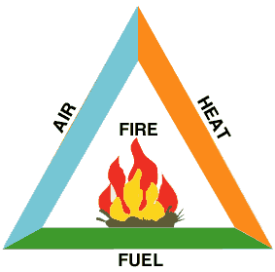
FIRE TRIANGLE

Slide 23
FIRE TETRAHEDRON
(FLAMING OF FLAMES)
According to “Walter M. Haessler “ 1974 concept flaming combustion can be conceived as Tetrahedron. According to him there are four rather than three factors are involved in flaming combustion process. Those are as follow:-
1. Reducing agent (FUEL)
2. Oxidizing agent (AIR)
3. Heat( temperature)
4. Chemical chain reaction

Slide 24
Fire fighting medium
WATER
FOAM
DRY CHEMICAL PODER
CARBON DIOXIDE
NITROGEN AND
HALON
ARGON/HELIUM{Generating stations)

Slide 25
FIRE EXTINCTION MECHANISM
WATER - COOLING
FOAM - BLANKETING
Dry Chemical.Powder. – NEUTRALIZATION OF CHAIN REACTION
CARBON DIOXIDE AND NITROGEN-
- INERTING(preventing oxygen)
HALON – NEUTRALIZATION OF CHAIN REACTION
Helium – blanketing and oxygen purging

Slide 26
TYPE OF FIRE EXINGUISHER
WATER TYPE
MECHANICAL FOAM TYPE
CHEMICAL FOAM TYPE
CO2 TYPE
DRY CHEMICAL POWDER TYPE
HALON TYPE

Slide 27
FIRE PREVENTION & FIRE FIGHTING EQUIPMENT
Firefighting equipment
Substation should be provided with following Fire Fighting Equipment as per TAC Rules and Indian Electricity Rules.
Fire Fighting Equipment
Fire Buckets
Fire Extinguishers
Mechanical Foam
Sodium bi Carbonate (BC)
Dry Chemical Powder
Ammonium Phosphate Powder (ABC)
Carbon dioxide

Slide 28
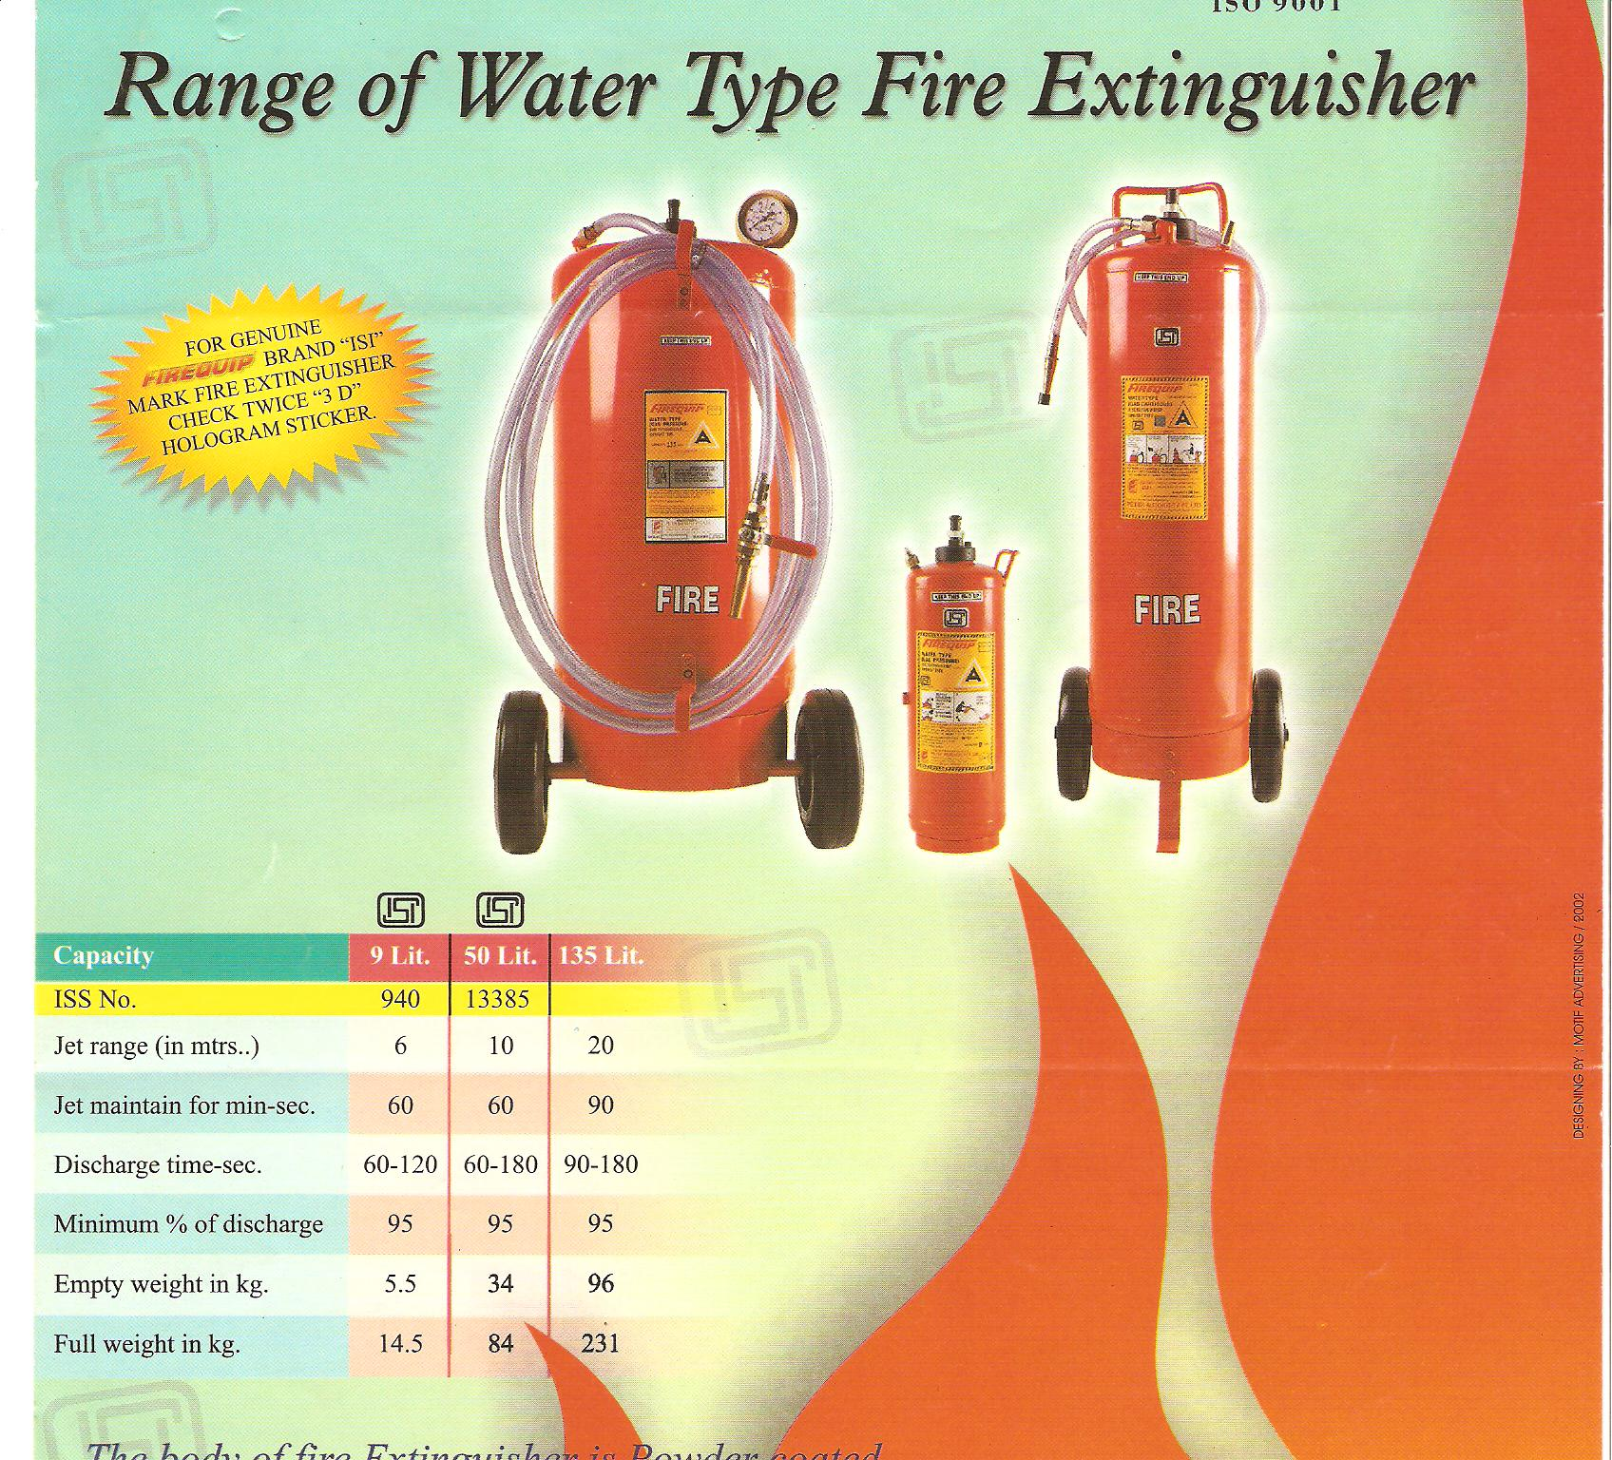

Slide 29
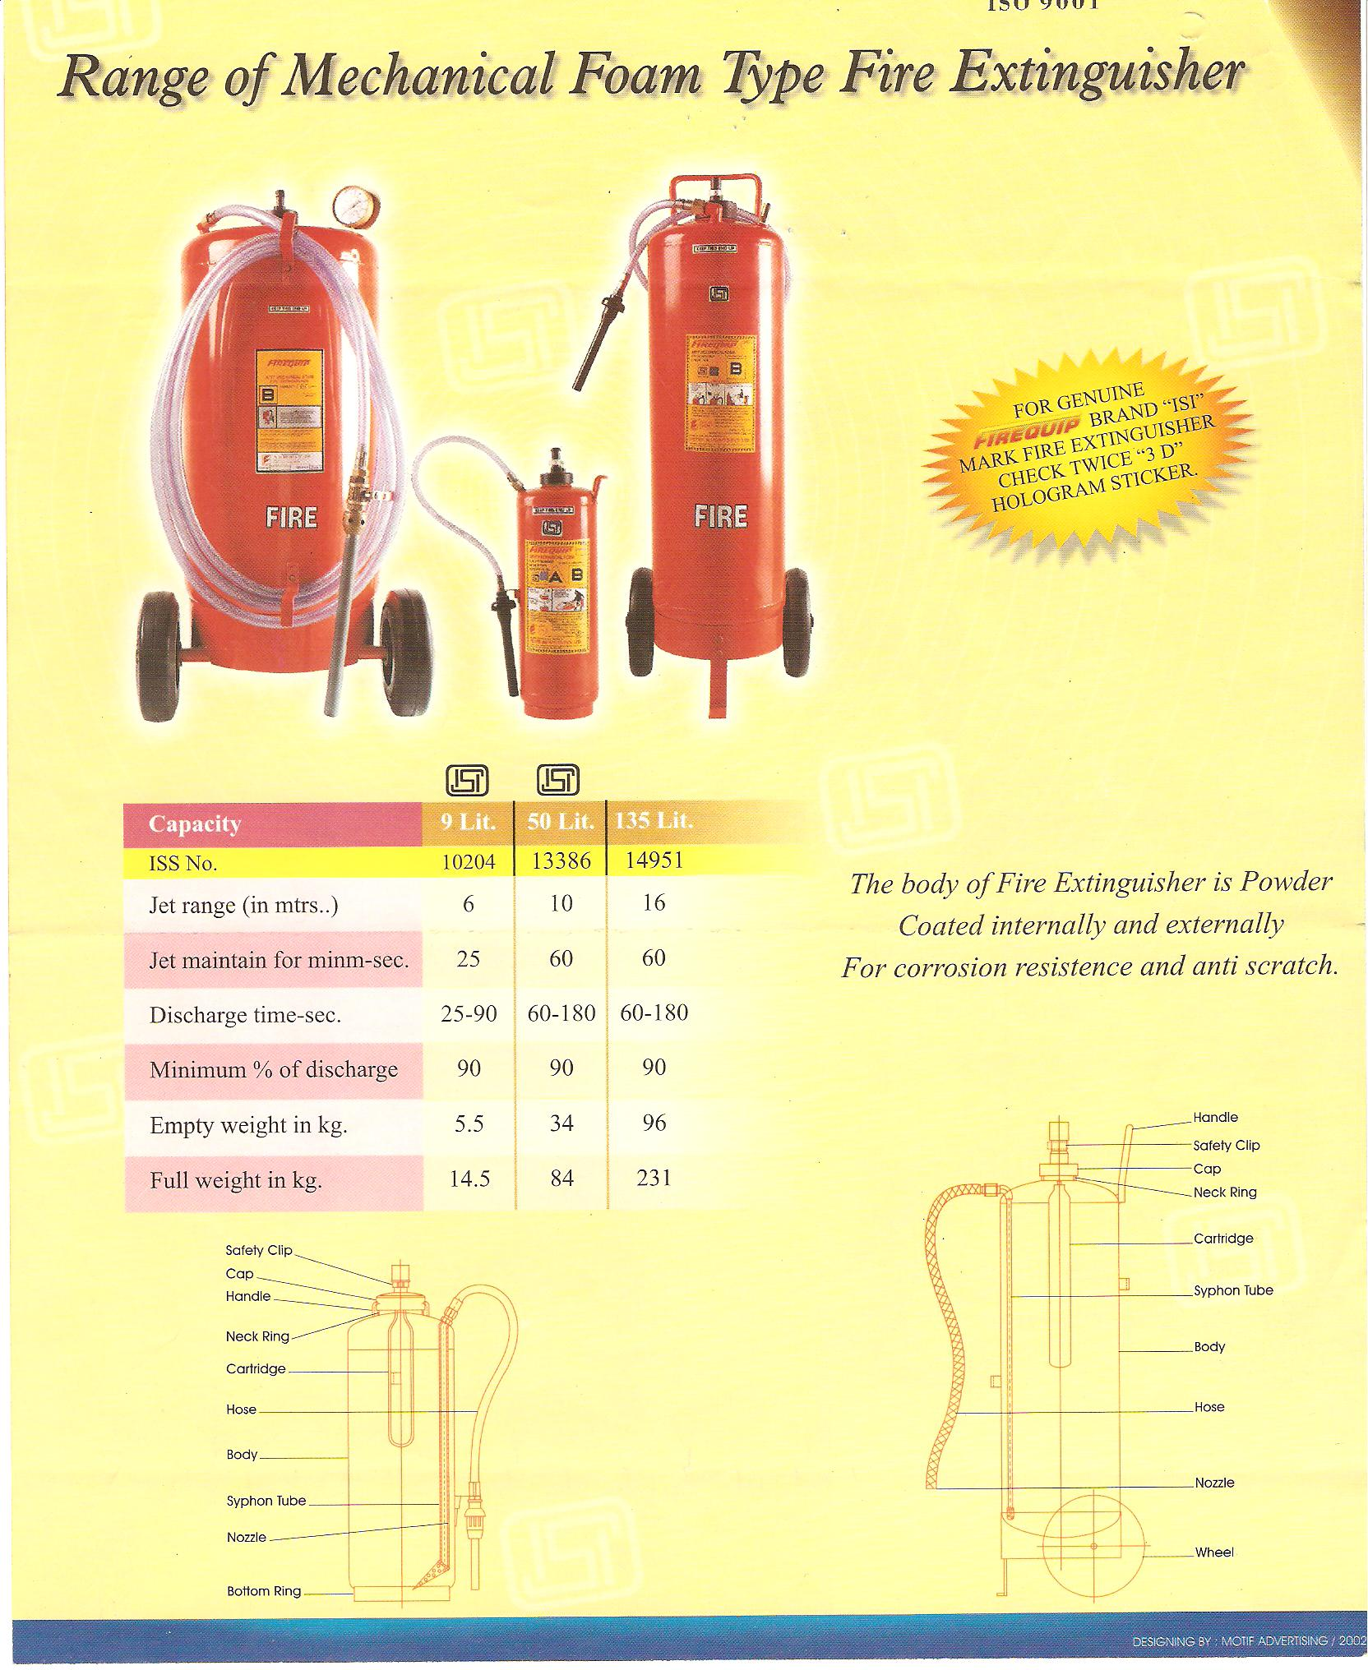

Slide 30
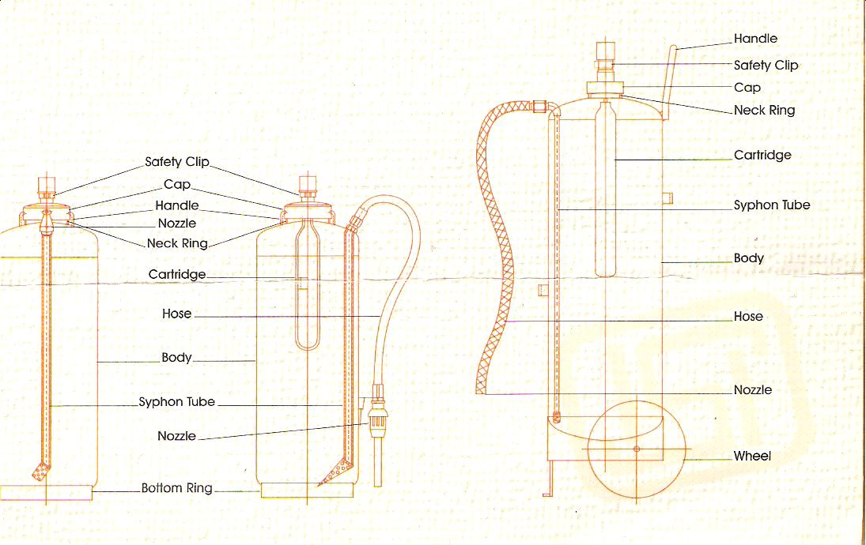
FOAM TYPE- MECHANICAL

Slide 31
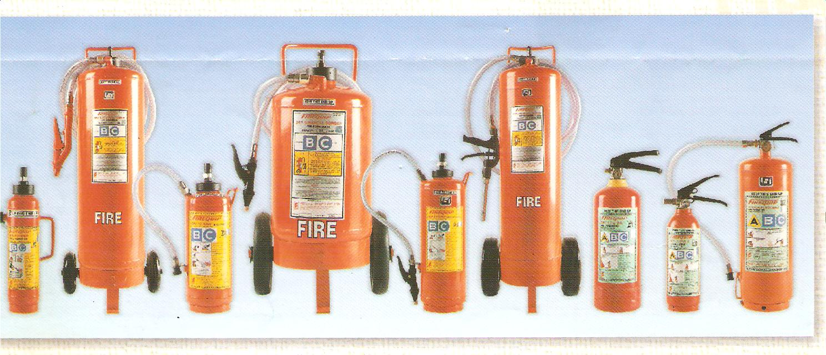
DRY CHEMICAL POWDER

Slide 32
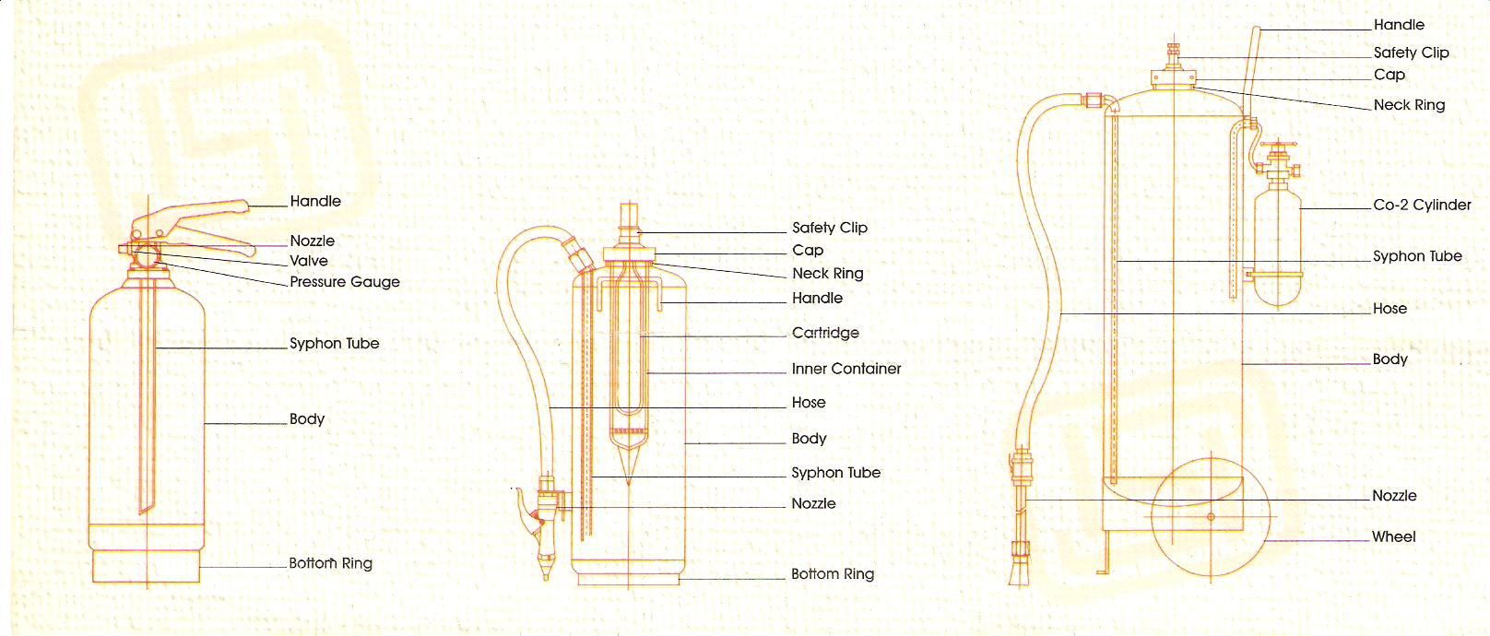
DRY CHEMICAL POWDER

Slide 33
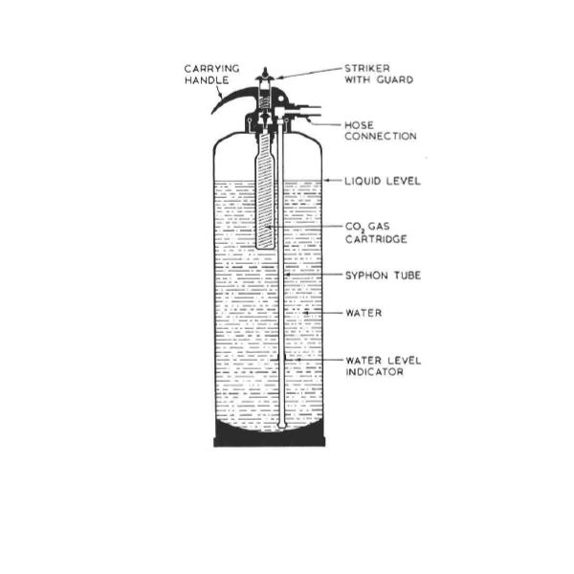

Slide 34
WATER TYPE FIRE EXTINGUISHER,
The arrangement of the extinguishers comprises of a container which holds the water or . Sodium bicarbonate
A small glass bottle (phial) containing sulphuric acid/ CO2 gas catridge is placed below a plunger mechanism, which is covered by a safety glass along with a screw and cap at the top.
When the plunger is struck hard, the glass bottle breaks, resulting in mixing of acid and soda, a chemical reaction takes place which produces carbon dioxide (CO2)gas.
Alternately where Co2 gas catridge is placed a plunger operation mechanism Releases the gas
The carbon dioxide gas released pressurizes the space above the liquid (used for extinguishing the fire) and forces it out through the internal pipe of the nozzle.
Note: As the CO2, which is used in soda acid fire extinguisher, may create a toxic effect in confined spaces, These Extinguishers are now banned to Be used in confined spaces.

Slide 35
Disadvantage with sodium bicabonate solution is that it leaves a chemical residue
Improved versions: a ) using water mist b) water spray
water spray extinguishers:
This type of extinguisher comes equipped with a spray nozzle instead of a jet nozzle which means the water is able to cover much greater surface area quickly in order to put out fire more rapidly. by blanketing oxygen and cooling
This can be used also on class c fires, if equipment is de-energised

Slide 36
WATER MIST EXTINGUISHERS
As the name suggests, this type of extinguishers come equipped with a different type of nozzle that is responsible for releasing extremely small, microscopic water particles.
This extinguisher nozzle releases micro particles that blankets oxygen.
The expnsion in to mist increases volume by 1600 times causing effective cooling of the fire.
Also keeps the person using the extinguisher safe by creating a wall of mist which helps in reducing the feeling of heat.
This can be used on A,B,and C fires as mist is not a conductor

Slide 37
FOAM EXTINGUISHERS
Foam extinguishers are used to extinguish Class B fires and are located near flammable liquids.
There can be two types of foam type fire extinguishers depending upon its contents-
A)Chemical foam type fire extinguisher
B)Mechanical foam type fire extinguisher
These extinguishers work by creating a cooling effect on the fuel that is responsible for causing the fire.
When it is poured on burning liquid, the fire is extinguished by creating a barrier between the fuel and the flame with the help of the foaming agent which blankets oxygen
Chemical foam extinguisher – The chemicals used in this foam type fire extinguisher are Sodium bicarbonate and Aluminium sulphate.
The main container is filled with sodium bicarbonate, whereas the inner container is filled with aluminium sulphate

Slide 38
. The inner container has a cap at the top, which is kept in place
The plunger is turned to release the cap and the extinguisher is then inverted for both the chemicals to mix.
Carbon dioxide is produced from the chemical reaction which pressurizes the container from inside and forces out the foam
This type of portable foam fire extinguisher chemical equation is shown below:
Al₂ (SO₄)₃ + 6 NaHCO₃ -> 2Al (OH) ₃ + 3Na₂SO₄ + 6 Co₂
Note: Chemical Foam Extinguishers are now banned in confined spaces because of the poisonous effect which the gas can create

Slide 39
Mechanical foam Type fire extinguisher
This extinguisher type also consists of two containers- the outer one is filled with water, whereas the central one has carbon dioxide charge and foam solution.
The mechanical foam fire extinguisher uses a long hosepipe connected to the dip tube inside the internal structure of fire extinguisher which allows it to use the foam portable fire extinguisher upright.
mechanical foam type fire extinguisher diagram showing different foam extinguisher parts are given in the next slide 41

Slide 40
The central container has a plunger mechanism at the top, which when pressed releases the carbon dioxide and allows foam and water to mix.
The foam and water are then forced out through a special nozzle which creates the mechanical foam
Foam extinguishers are used on Class B fires and will be located in the vicinity of flammable liquids.
This type of fire extinguisher should not be used for fires caused by flammable metals, kitchen fires and fires that involve electrical equipment.

Slide 41
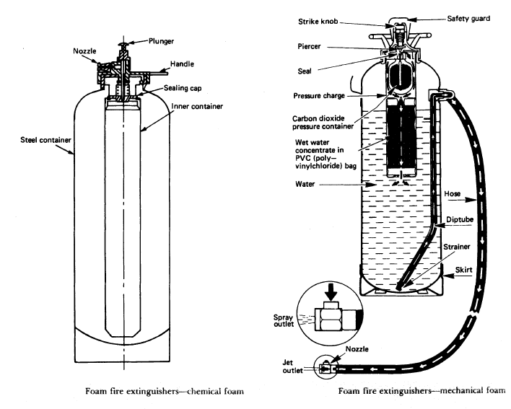
MECHANIAL FOAM TYPE FIRE EXTINGUISHER

Slide 42
DRY CHEMICAL POWDER EXTINGUISHER
Sodium bicarbonate powder is used to extinguish almost all types of fires.
It is mainly located in the engine room and near electrical equipment.
Dry powder extinguisher contains sodium bicarbonate powder in the outer container.
DCP extinguisher diagram IS given
Small container with carbon dioxide is placed beneath the plunger mechanism.
When the plunger is pushed, it releases the carbon dioxide gas, which in turn forces the dry powder out of the discharge nozzle.
itcan be used for class A, class B and class C fires

Slide 43
. However, these should not be used in enclosed spaces as the dry powder in the extinguisher can be easily inhaled
. Also, it’s not easy to clean up the leftover residue once the fire is over.
These can also be used for fires involving electrical equipment upto 1000V
. This type of fire extinguisher should not be used for fires that involve electrical equipment over 1000 V and fires that involve cooking oil
There are also special dry powder extinguishers that are typically used for fires caused by flammable metals.
The label colour for this type of extinguisher is Blue

Slide 44
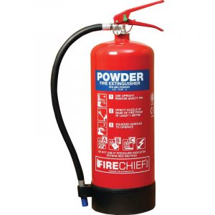
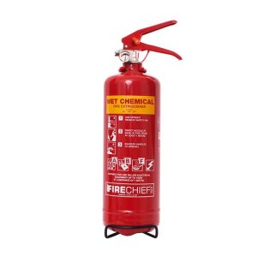
CHEMICAL EXTINGUISHERS
DCP EXTINGUISHER
WET CMEMICAL EXCHANGER

Slide 45
WET TYPE CHEMICAL EXITINGUISHERS
Wet chemical extinguishers are designed for use on Class K fires, involving cooking oils and fats.
They can also be used on Class A fires although it is more usual to have a foam or water extinguisher for A type of fire risk
Wet chemical (potassium acetate, potassium carbonate, or potassium citrate) extinguishes the fire by forming an air-excluding soapy foam blanket over the burning oil through the chemical process of saponification (an alkali reacting with a fat to form a soap) and by the water content cooling the oil below its ignition temperature.
Dry powder extinguishers smother fires by forming a barrier between the fuel and source of oxygen.
The label colour for this type of extinguisher is yellow.

Slide 46
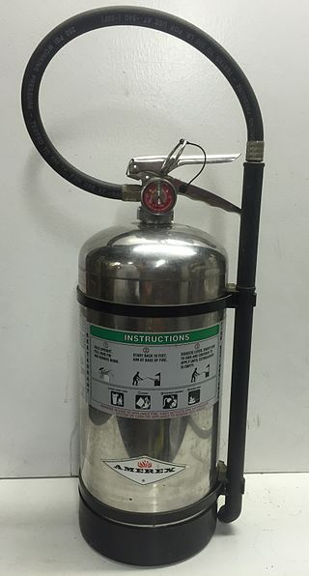
WET CHEMICAL EXTINGUISHER
6-liter wet chemical fire extinguisher for use in commercial kitchens
commercial kitchens
Wet chemical extinguishers can also be used for fires caused by various organic materials including wood, coal, textiles, fabrics, cardboard and paper. (CLASS A FIRE)
Location:This type of fire extinguisher needs to be placed near to the source of the fire risk in commerical kitchens and canteen

Slide 47
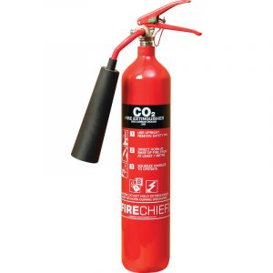
Carbon dioxide extinguishers

Slide 48
Carbon dioxide extinguishers
Carbon dioxide extinguishers are mainly used for class B or class C fires.
They are not used for accommodation areas and confined spaces because of the gas used in lethal.
These are widely used as engine room fire extinguisher.
Carbon dioxide is stored in liquid form under pressure.
A central tube acts as an outlet for carbon dioxide gas.
A plunger attached to a bursting disc at one end and a trigger at the other is used to release the carbon dioxide gas.
The liquid changes to gas as it comes out of the extinguisher through a Hose
CO2 extinguishers are mainly used for electrical fire risks and are usually the main fire extinguisher type provided in computer server rooms.
They also put out Class B fires.

Slide 49
The extinguisher contains a high pressure cylinder filled with CO2 liquid leaving a small space in the top filled by CO2 vapour
The cylinder contains a dip tube for a syphon action fitted with s a pressure guage
The operating lever has a piercer arrangement and a safety clip
The cylinder is fitted with a hose attached with spray nozzle
The pressurized Co2 vapour pushes out co2 liquid once safety pin is pulled which will be aimed at fire.
The co2 liquid blankets entry of oxygen and also provides a cooling effect quenching the fire
This type of extinguisher has a black label.
Location: Near to the source of fire

Slide 50
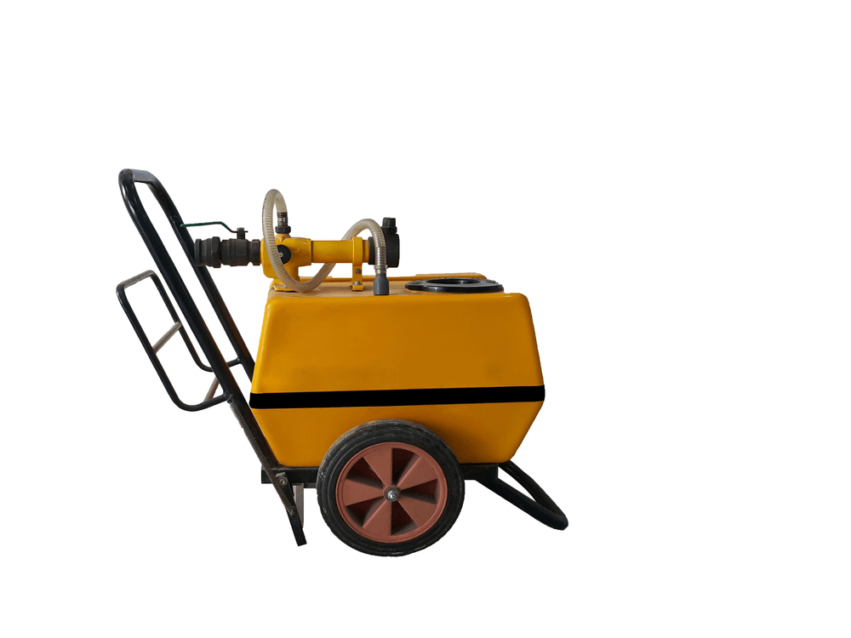
SEMI-PORTABLE FIRE EXITINGUISHERS
The semi-portable type of fire extinguisher is higher in capacity and weight than the portable ones.
They are considered to be the second line of defense in case the portable fire extinguisher fails to stop the fire exposure.
As they are heavier to lift, it is provided with a wheel-trolley arrangement which can be dragged to a nearby fire location.
These can be a semi-portable foam fire extinguisher or semi-portable DCP type fire extinguisher.

Slide 51
IS 15683 : 2006 ‘Portable fire extinguisher—Performance and construction’ :
10204 : 2001Specification for mechanical foam type (first revision)
10658 : 1992 dry powder fire extinguisher (trolley mounted)
11108 : 1984Specification -halon 1211 type
11833 : 1986Specification for dry powder fire extinguishers for metal fires
13385 : 1992 fire extinguisher 50 litre capacity wheel mounted water type (gas cartridge)
13386 : 1992 50 litre capacity mechanical foam type
13849 : 1993 dry powder type (stored pressure)
14609 : 1999Dry chemical powder fighting A, B, C class fires—
14951 : 2001Fire 135 litre chemical foam type—
15397 : 2003 mechanical foam type (stored pressure)—

Slide 52
MAINTENANCE OF PORTBLE FIRE EXTINGUISHERS
Fire extinguishers shall be inspected when initially placed in service and thereafter at approximately 30-day intervals.
Fire Extinguishers shall be inspected, manually or by electronic means, at more frequent intervals when circumstances require.
Periodic inspection of fire extinguishers shall include
a. Location in designated place
b. No obstruction to access or visibility
c. Operating instructions on nameplate legible and facing outward
d. Safety seals and tamper indicators not broken or missing
e. Fullness determined by weighing or “hefting”

Slide 53
f. Examination for obvious physical damage, corrosion, leakage, or clogged nozzle
g. Pressure gauge reading or indicator in the operable range or position
h. Condition of tyres, wheels, carriage, hose, and nozzle checked (for wheeled units)
B) TESTING:
The fire extinguishers shall be tested for satisfactory operation as per relevant Indian Standard at least once a year and record of such tests shall be maintained
Every extinguisher shall be hydraulically pressure tested once in 3 years There shall not be any leakage or visible distortion. Extinguisher which fails in this requirement shall be replaced.
Life time : 10 years for all except Carbon dioxide (15y)

Slide 54
Pressure Test Procedure and Safety Precautions
All valves and internal parts shall be removed and the extinguisher emptied;
All traces of extinguishing materials like dry powder / mechanical foam should be removed from inside the shell before filling with water;
In case of externally mounted gas cartridges/containers for higher capacity dry powder extinguishers, the cartridge / container must be removed and shell opening be suitably plugged;
The hose of the hydrostatic test pump is then attached to the flexible connection to the discharge nozzle, hose assembly or test fitting, as the case may be;
The extinguisher should then be placed in a suitable protective test case or behind a protective shield/barrier before applying the test pressure;

Slide 55
The cap or the test fitting, as the case may be, must be tightened slowly while the water supply remains open. When all the entrapped air within the shell has been bled off, and water emerges the cap/test fitting must be tightened fully,
Pressure is then applied slowly so that the test pressure (as given in Annex E) is reached slowly within 1 min, and maintained for the duration of 2.5 min.
Observations are made about distortion or leakage of the extinguisher body; if any.
After hydraulic testing, all traces of water and moisture must be removed from dry powder and stored pressure extinguishers preferably by use of a suitable cylinder dryer taking care that the temperature within the shell does not exceed 65°C.

Slide 56
Quarterly maintenance
Clean the exterior of the extinguisher, polish the painted portion with wax polish, the brass/ gun metal parts with metal polish, chromium plated parts with silver polish and plastic components to be thoroughly washed with soap solution
Check the nozzle outlet and vent holes as well as the threaded portion of the cap for clogging, and check that plunger is clean and moving freely.
Ensure that the cap washer is intact and also grease the threads of the cap, plunger, etc, and wipe clean.
Make sure that the extinguisher is in proper condition and is not accidentally discharged. In case of stored pressure extinguisher, pressure gauge is to be checked .
Check all the components of the extinguisher as per the maintenance check list given for each extinguisher in slide.
Maintenance shall be carried out by the manufacturers or his authorised agent or professional firemen.

Slide 57
ANNUAL INSPECTION
Despite monthly and quarterly inspection Annual inspection has to be carried out thoroughly
If the extinguisher is due for discharge test, after ensuring that the cap and components are fully tightened and nozzles and vent holes are free of any dust or dirt, operate the extinguisher for testing the performance.
In case the extinguisher is not due for discharge test (see 12.3) as per the schedule, the contents of the extinguisher has to be emptied in clean buckets and remove the components.
In case the extinguisher is operated, after operation clean the extinguisher and remove all components.
In case it fails in discharge test as per the procedure given in this standard the inside surface of the cylinder and the surface of the containers has to be examined for the condition of plating, rust formation, etc.

Slide 58
If there are visible rust marks,the cylinder shall be thoroughly washed with clean water, dry it and fill it with water for 24 hrs. and observe the surface again.
If there are still signs of rust formation and plating thickness is not adequate, the surface should be freshly plated or phosphated as the case may be (see also 11.10.3).
The above procedures are for water type gas pressure, foam and dry powder type fire extinguisher.
Discharge Test
All extinguishers installed in a premise irrespective of being use in a live fire condition shall be subjected to an operational test as per the frequency of testing given in Annex D
. The operational test should be carried out in such a frequency, keeping in view the frequency given in Annex D for type of the extinguisher, in annually cyclic manner so that all the extinguishers installed in a premise are subjected to discharge test.
If more than 10 percent of the extinguishers, subjected to discharge test fail during the testing, then all the extinguishers installed in the premises shall be subjected to the discharge test.

Slide 59
For CO₂ and clean agent extinguisher if the cylinders are not due for recharging then the weight of the contents and the pressure of the containe with content areto be cheked.
If the same is in order as per the monthly checklist, then the contents need not be discharged
If, however, these extinguishers are due for an operational test, then after operational test, if facilities are available for pressure testing and recharging, the cylinders can be pressure tested and recharged at site after checking up the exterior and other components.
Alternately they should be sent to the manufacturer or other competent agency for pressure testing and re-charging.
Examine the external surface of the fire extinguisher in respect of painting and if there is damage to the painting, the surface should be re-painted as per Indian Standards.
Components, if those are pressure parts, should be subjected to hydraulic pressure test.
If the damage is beyond repair, the part should be replaced by a correct component.

Slide 60
Check up the condition of the label and if it is not in order ensure to replace with correct label.
Examine the cylinder and its components in detail apart from functional point of view for any physical damage, cracks, dents, etc. In case of any doubt, such
The annual inspection should be combined with the testing requirements as given under 12 for operational test and hydraulic pressure test.
The extinguishers after inspection should be refilled immediately and the date of inspection and refilling should be indelibly marked on the extinguishers and recorded in the register of fire extinguishers.

Slide 61
Water (Stored Pressure)/Powder (Stored Pressure) Extinguisher
As this type of extinguisher is pressurized, it can be opened for inspection/maintenance after discharge only.
It should be tested for discharge as per Annex D and maintenance as described in (a) to (h), here under shall be carried out:
a) The pressure gauge,be checked ,extinguisher be discharged an its performance be d checked ;
b) The pressure gauge be Checked before and after discharge for its correctness;
c)The extinguisher be opened and the body be checked externally and internally using an illuminating probe; for corrosion or damage take action as per general safety and maintenance steps
d)Valve assembly be examined, a long with discharge hose, nozzle, strainer, vent holes, siphon tube and they may be cleaned;
e)Sealing washers, siphon tube and hose (if fitted) may be examined and if necessary be replaced
f)The operating mechanism may be ckecked for free movement and it may be cleaned, rectified or replaced, if necessary;
G) The extinguisher may be refilled with fresh water or powder (stored pressure), screw cap be tightened and the extinguisher, be pressurised checking the pressure gauge for correct pressure
H) Safety clip/wire seal or equivalent may be replaced as originally fitted
Notes:
may be replaced

Slide 62
REFILLING
Once in 5 years
Portable fire extinguisher, water type 9 litre (gas cartridge).
Portable fire extinguisher, mechanical foam type 9 litre (cartridge type).
Portable fire extinguisher, water type 50 litre (gas cartridge).
Portable fire extinguisher, mechanical foam type 50 litre (cartridge type).
Fire extinguisher, carbon dioxide type (portable and trolley mounted).
Higher capacity dry powder fire extinguisher (trolley mounted).
Dry powder fire extinguisher for metal fires.
Clean agent fire extinguishers.
Once in 2 years
Portable tire extinguisher, water type stored pressure.
Portable fire extinguisher, mechanical foam type stored pressure.
135 litre fire engine, foam type.
D-1.2 Once in Three Years
BC and ABC powder extinguisher confirming to IS 4308 and IS 14609 respectively

Slide 63
BEFORE MAINTENANCE TO BE CHECKED
Ensure that there is no residual pressure in any hose and/or nozzle assembly;
Unscrew the cap or valve assembly slowly for two or three turns only, to allow any residual pressure to escape via the vent holes and do not unscrew it further until all pressure is released, keep away the head and body to avoid injuries;
Do not depend on pressure indicating devices like gauges (in the cases of stored pressure type extinguisher) to verify whether the container is under pressure or not, as they could malfunction;
if pressure is not being released after unscrewing the cap or valve assembly two or three turns, then do not unscrew it further without taking appropriate safety measures; sudden release of pressure may eject parts, cap assembly, or the contents of the extinguisher. The use of suitable clamping arrangements and appropriate personal protection is advisable;
under no circumstances should the valves of carbon dioxide or stored pressure type extinguisher of gas cartridges/ containers be attempted to be removed under filled conditions; and
At all times when attempting to remove parts from extinguisher at the time of inspection/ maintenance, persons, should ensure that they are clear of any parts which may be ejected.

Slide 64
Non-rechargeable Dry Chemical Fire Extinguisher
When an inspection of any non-rechargeable dry chemical fire extinguisher reveals a deficiency in any of the conditions, it shall be removed from further use, discharged, and destroyed at the instruction of the owner or returned to the manufacturer.
Non-rechargeable Halon/Clean Agent Fire Extinguisher
When an inspection of any non-rechargeable fire extinguisher containing a halon/clean agent reveals a deficiency in any of the conditions, it shall be removed from service, not discharged, and returned to the manufacturer. If the fire extinguisher is not returned to the manufacturer, it shall be returned to a fire equipment dealer or distributor to permit recovery of the halon.

Slide 65
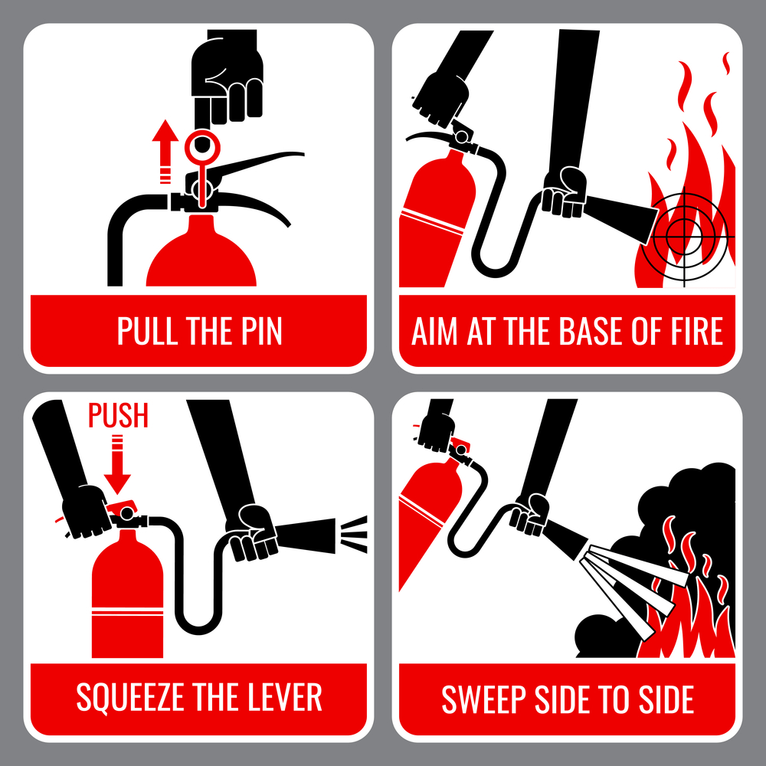

Slide 66
Key Properties of HIGH-PRESSURE Gas Quenching Mediums
If an inert gaseous atmosphere is to have any effect on a heat-soaked metal part, it needs to be dense and thick.
Usually, the gas is delivered as a mass under High-Pressure Gas Quenching, the substance is propelled into a vacuum-sealed furnace.
From here, convection currents and heat transference laws quickly cool a hardened metal item.
The gaseous mediums , in the order of preference, are Nitrogen, Helium, Argon and Hydrogen.
Hydrogen combusts when it comes into contact with oxygen. But hydrogen is a safety risk.Efficiency of Argon is low
The Benefits of Gas Quenching: . Sticking with a high-pressure stream of nitrogen or helium, a vacuum furnace, one that’s equipped with a quenching chamber, receives velocity-delivered stream of quenching gas.

Slide 67
The gas cooling action doesn’t cause the metal to deform or experience dimensional changes.
That’s a feature that liquid quenching can’t duplicate, by the way.
Also, the process is significantly accelerated, so the hardened work piece receives a more responsively applied cooling profile.
Provided with perfectly timed quenching notches, high-pressure gas cooling systems are more governable than their oil or water facilitated quenching counterparts

Slide 68
GAS QUENCHING
Gas quenching is an important step in the treatment of steel parts.
The process consists of cooling the parts down from their critical temperature quickly in order to strengthen and harden the metal. These metals include ferrous and alloys.
A variety of mediums can be applied to the quenching process.
These include polymers, oils, water, and gases such as helium, and nitrogen.
The overall choice should be made based on part size, steel composition, and desired results.
Typically used in vacuum furnace applications, gas quenching can provide a variety of advantages over traditional polymer or oil-based quenching approaches.
By using gas quenching, the residue can be eliminated, which is an unwanted byproduct in many types of liquid quenching

Slide 69
Gas quenching also provides better temperature uniformity in the gas chamber, reducing the risk of part distortion.
Furnace manufacturer may provide high-pressure surge tanks and compressors.
Once all the components of process are in place, additional benefits of gas quenching include:
Cleaner end products
Ability to control the cooling process
Safer and more environmentally safe compared to other quenching mediums.

Slide 70
INERTING
Many conventional heat treatment furnaces have purge or inerting requirements.
This is done in an effort to remove or clear unwanted material from the furnace atmosphere.
A Nitrogen or Argon controlled atmosphere is most commonly used for this application.
As Nitrogen or Argon is introduced into a furnace, the risk for oxidation of the component parts being heat-treated is reduced.
The inerting process is also done as a safety measure since the gases used purge flammables, oxygen, and water from the furnace.
The amount of gas flow required for any furnace varies and is based upon furnace volume.

Slide 71
FIRE FIGHTING EQUIPMENT
Emulsifier
Fire Buckets are of 9ltrs. Capacity having round bottom with handle.
These are painted white from inside and post office red color from outside.
Its bottom is painted black. “FIRE” is written on it. It is filled with sand.
Fire Extinguishers:
Mechanical Foam fire Extinguisher:
It is a container of 9ltr capacity. It contains 8.750 ltrs water and 0.250 ltrs foam forming agent.
A gas cartridge is used to generate pressure inside the container to discharge the forms.
It is used on class ‘B’ type of fire.

Slide 72
Dry Chemical Powder Fire Extinguisher (Sodium bi Carbonate):
These fire extinguisher are available in different sizes. It consists of the following main parts:
Cylinder
Cam Assembly with plunger
Gas Cartridge
Normally powder contains:
Sodium bi-carbonate 97%
Magnesium stearate 1.5%
Magnesium carbonate 1%
Tri calcium phosphate 0.5%
It is used on ‘B’ & ‘C’ type of fire.
It is especially suitable oil and electrical fire.

Slide 73
FIRE FIGHTING EQUIPMENT
Dry Chemical Powder Fire Extinguisher (Ammonium Phosphate):
These fire extinguishers are available in different sizes.
These do not contain gas cartridge.
Powder as well as gas is filled directly in the cylinder at predetermined pressure for the size.
These fire extinguishers are used on ‘A’, ‘B’, ‘C’ and Electrical fire.
CO2 Fire Extinguishers:
These fire extinguishers are available in different sizes.
Liquefied gas is filled in it.
When it is released, the liquid vaporizes and rapid expansion lowers the temperature.
A part of the gas gets solidified in small particles.
Cooling effect and reduction of oxygen extinguishes the fire.

Slide 74
FIRE PREVENTION & FIRE FIGHTING EQUIPMENT
Fire Extinguishers:
S.No | Type of Extinguisher | Class A | Class B | Class C | General
1 | Carbon dioxide | Suitable for small surface fires only. | Suitable. Does not leave residue or affect equipment or food stuff. | Suitable. Non conductor and does not damage equipment. | These extinguishers are made in variety of sizes. Liquid CO2 contained in a strong cylinder is released by the valve or trigger and sends out a shower of gas or “snow” which both cools and Blanketing of Oxygen and stops fire.

Slide 75
2 | Dry Chemical | Suitable for small surface fires only. | suitable Chemical releases smothering gas and fog and shields operation from heat. | Suitable. Chemical is a non-conductor, fog ordinary chemical shields the operator from heat.
3 | Foam | Suitable. Has both smothering and wetting action | Suitable. Smothering and blanketing Does not dissipate, floats on top of spilled liquid. | Unsuitable. As Foam conducts it should not be used on live equipment. | Extinguishment is by blanketing or smothering the fire with a heavy layer of a foamy substance consisting largely of tiny bubbles of CO2.

Slide 76
4 | Water | Suitable. Water saturates material and prevents rekindling | Unsuitable. Water will spread and not put it out. | Unsuitable. Water being conductor should be not be used on live electric equipment.
5 | Carbon tetrachloride | Suitable. To a limited extent on Class ‘A’ Fires. | Suitable. Releases heavy smothering gas on fies | Suitable. Non- conductor and will not damage equipment | These are available in one quart size and above and are of pump or pressure type. The liquid is pumped on to the fire and extinguishes the fire by smothering it.

Slide 77
FIRE FIGHTING EQUIPMENT
Note:
Even if premises are equipped with an automatic sprinkler installations , it is also necessary to have portable fire extinguishers as these may enable an outbreak to be extinguished before the automatic sprinkle comes into operation.
Portable foam, soda acid or water fire fighting equipment is intended for non-electrical fires and shall not be used on electrical apparatus fires unless such apparatus has been made dead.

Slide 78
Advantages of Water Spray Systems
Extinguishes fires quickly and prevents fires from spreading over a large area.
Minimizes the damage caused by fire and reduces down times, protects the future of the utility.
High flexibility in design and implementation
Reduces fumes and binds contaminants.
Allows large open areas and thus a more flexible use of the premises.
Uses water, a natural fire extinguishing agent that is available in unlimited quantities at a very low price.
The water spray fire extinguishing system when applied to oil type power transformers, has significant advantages such as high fire extinguishing efficiency, low engineering cost, operation and maintenance cost.

Slide 79
FIRE FIGHTING EQUIPMENT
Reguirement of fire extinguishers as per TAC recommendation:
One 9 ltrs fire bucket shall be provided for every 100 mtrs. Of floor area or part there of
One 9 ltrs mechanical foam fire extinguisher/ 5kg Dry powder fire extinguisher / 4.5 kg.CO2 Fire Extinguisher should be provided to six buckets or part thereof with minimum of one fire extinguishers and two buckets per compartment.
Buckets may be dispensed with, provided the supply of extinguisher is one and a half times as indicated here above.

Slide 80
FIRE FIGHTING EQUIPMENT
Guide lines for fire men in operating and maintaing fire extinguishers
Every sub-station should train its employees in fire fighting. It should form its own fire fighting team.
Team should be given frequent mock drills.
chart showing extinguisher types ,usage and methods of operation
Duty of each member of the fire fighting team should be written and circulated among the staff.
A list of all employees with their contact number and home addresses should be displayed in the substation.
Workers should also be provided first aid training.
First Aid Box should be provided with recommended medicines with a chart of medicines for display
A chart indicating the first aid to be given in case of electric shock should be displayed in the substation.

Slide 81
FIRE FIGHTING EQUIPMENT
Fire hazards in transformers
Transformers carry current and generate heat due to a variety of energy losses.
Their constructions enables cooling by dissipating the heat. Transformer can be classified into FOUR types depending upon the heat dissipation facility and insulation used.
Dry Type Transformer
Askarel Insulated Type
Mineral Oil Insulated Type
SF6 gas Filled (Immersed) Power transformer

Slide 82
FIRE PREVENTION & FIRE FIGHTING EQUIPMENT
Dry transformers are of four types:
Self- cooled unventilated
Self-cooled ventilated
Forced air- cooled
Dry transformers are fire resistant
Apart from the above in case of oil filled but withSealed tank with gas filling above oil (Nitrogen or per Fluropropane) which has remote chances for fire accidents

Slide 83
SF6 gas filled Power transformer
SF6 gas filled transformer is an advanced technology, for installation at underground stations, GIS Stations and fire-prone stations.
This technology is very much prevalent in Japan and other ASEAN Countries.
Even transformers of 300MVA, 300kV class are in operation
The basic transformer technology is similar to oil filled transformer.
The main difference is in insulation materials and pressure vessel.
SF6 gas besides being insulant and coolant,is not flammable. is also fire resistant.
Does not absorb moisture ( Non – Hygroscopic)
Such a transformer can avoid emulsifier system ,oil pit, fire fighting equipment, huge drainage system , oil tanks, conservator, Pressure relief valve etc.,

Slide 84
The pressure raise inside a transformer tank due to internal arc is far less compared to the strength of GIT tank and tank will not explode due to such pressure raise. Hence more safer.
Also conservator or a pressure relief valve are not requiredand so the transformer height can be reduced.( 2 to 2.5 mts in case of 300 kV class transformer)
With GIS , the GIT forms a compact substation with a reduced civil construction costs
No oil leakage Minimization of substation footprint
Lighter weight Easy, clean installation Easy inspection maintenance and long service life compared to oil filled transformer

Slide 85
More eco friendly and does not emit polluting gases as in case of Oil filled one when on fire
High resistance to moisture.
Reduced installation space.
High reliability.
Causes no pollution.
Employs a cooling medium in liquid phase such as a Refrigerant R113 otherwise known as Trifluorotrichloroethane or C2F3Cl3.
SF6 gas is obviously used as the second cooling medium

Slide 86
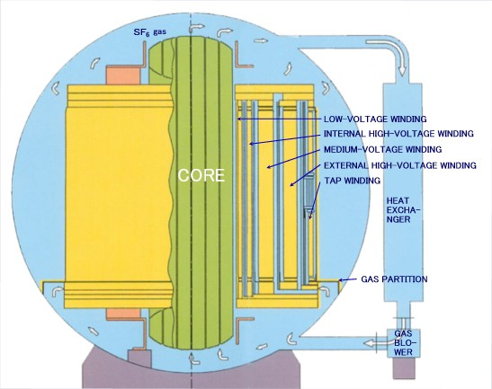

Slide 87
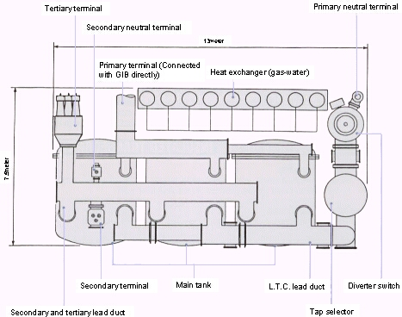
LAYOUT OF GIT

Slide 88
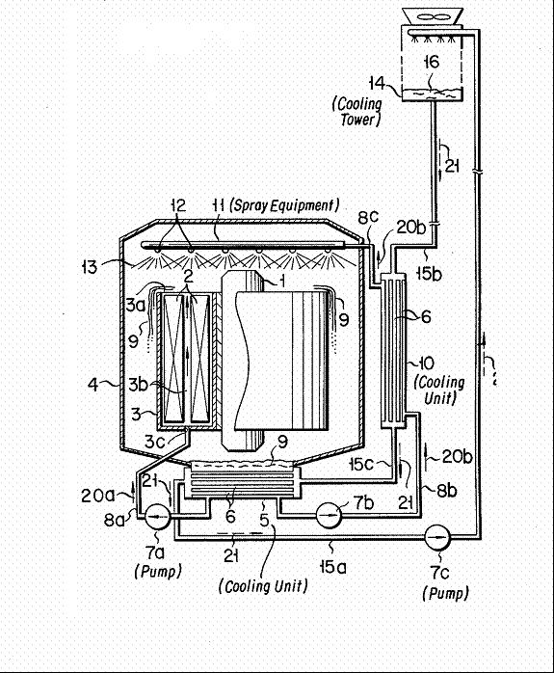

Slide 89
SPECIAL FEATURES
SF6 gas pressure shall be 0.14 or 0.43 Mpa-g (20ᵒC)
Solid insulation is PET film, PPS film, Aramide paper and Press board in place of Oil impregnated paper and Press board in case of Oil filled transformer.
Diverter switch comprises of vaccum interrupter in place of arcing switching in oil as in the case oil filled transformer
Tap selector is a slide switch in place of roller contact, without any arcing to be quenched

Slide 90
FIRE PREVENTION -CAUSE OF FIRE
F
Fire do occur in dry type transformers due to insulation failures of windings.
Askarel- insulated transformer is very safe as the liquid used for insulation are non flammable in nature.
The cost of these transformers, however, is very high compared to other types.
Oil insulated type transformer are the most common and present the greatest fire hazard.
Although during normal operation, the heat is efficiently dissipated, fires in oil insulated transformers can result due to abnormal conditions caused by:
Overload during switching or through lighting’s surges.
Gradual deteriorations of insulation, transformer oil etc.
Low oil level itself
Failure of insulating bushings

Slide 91
FIRE PREVENTION -CAUSE OF FIRE
An arcing that follows an electrical breakdown can burn through the case or vaporize the oil,
This creates pressure sufficient to force off the cover or rupture the casing.
Considerable burning oil may then be expelled and an intense fire/ explosion may follow.

Slide 92
CIGRE survey OF TRANSFORMER FAILURE
One of the earliest comprehensive failure rate surveys was carried out by CIGRÉ WG 12.05. as reported in Electra No 88 -1983.
The survey was comprehensive as it covered a total of 47 000 transformer aged from 0 to 20 years old in the service years from 1958 -78 and included more than 1000 failures over the 10 year period.
it is concluded that A)transformers with an on load tap changer have slightly higher failure rates than transformers without tap changers
B) transformers of higher voltage classes, above 300kVhave higher failure rates than the voltage classes 300 kV and below.

Slide 93
CAUSES OF TRANSFORMER FAILURE
A) When an arcing failure occurs within the porcelain shell of an OIP ( oil impregnated paper bushing) bushing,
It frequently results in an explosion of the upper or the lower porcelain shell.
B) Cable terminations failures often causes a transformer fire which can develop into a major fire where an oil filled cable box is connected to the main tank or the conservator and the oil from the main tank or the conservator feeds the fire.
This then can burn gasket and inspection and access covers and cause a major spill of oil from the main tank

Slide 94
OLTCs failures is the cause of 10 -15% of fires, however these fires are often minor fires as the volume of oil exposed to air is only a few hundred litres at the most, unless there has been a rupture of the barrier between the main tank and the OLTC diverter/arcing contact oil compartment.
Arcing failure within the diverter switch or a combined selector switch will in most cases cause rupture of the recessed disc in the OLTC cover or activate the re-sealable pressure relief device, if the arc energy is relatively low, as it may be if the tapping winding is at the neutral end.

Slide 95
Oil fires originating from rupture of transformer tanks is rare for voltages below 300 kV, but is less for voltages above 300 kV where the combination of longer flash over arc and higher system fault levels often have enough arc energy to cause rapid and very high pressure increase and rupture of the tank or bushing turrets, before the electrical protection have time to operate and interrupt the fault current.
If a rupture of the tank occurs whilst the arc is present, then there is a very high probability that it will ignite the hydrogen and other hydrocarbon gases generated by the arc and also the oil spilling from the tank, resulting in a major oil fire.

Slide 96
A low arc energy fault may only initiate a small oil fire, as the oil surface exposed in the OLTC and the amount of oil in the OLTC conservator is relatively small.
If the fault is cleared quickly by the protection before the fire escalates, then it may or may not developed into a major oil fire.
However, if the arc energy is high it is more likely that the OLTC cover or its tank may rupture and the barrier board to the main tank may be broken.
If this occurs then the oil will spill from the main tank, the conservator and the fire will quickly cover a much bigger surface and be fed by much larger oil volume

Slide 97
FIRE PREVENTION - SAFE PRACTICES:
Many fire accidents which frequently occur on transformers in operation all over the country can be easily prevented if established safe practices are followed by generating station and owners of such equipment.
Such safe practices are stipulated in the Indian Standards, the rules of the TAC and in other codes of practice. Important safety precautions are the following:
-As far as possible transformers should be installed in separate fire resisting compartments.
-Automatic water spray systems to protect both outdoor and indoor transformer should be provided.
-Periodically Purity, Breakdown voltage, Acidity and Ageing of products in the insulating oil must be checked as per manufacturers instructions or to relevant Indian standards.

Slide 98
POWER TRANSFORMER FIRE
10 MVA or Oil capacity more than 2000 Ltr. should be protected with Emulsifier system.
A Fire barrier shall be provided if transformers are less than 15 mtr. apart or the oil capacity exceeds 2K Ltr.
Drainage(Soak) pit shall accommodate total vol. of oil and fire fighting water.
Drain pipe shall be provided with flame arrestor
Adequate electrical clearance shall be maintained for water spray system
Where there is inadequate separation from buildings and adjacent transformers and equipment, fire-barriers can be used to reduce the risk of a transformer fire causing damage to adjacent assets.

Slide 99
Recommendation from guides based on heat flux indicates that barriers/non combustible walls shouldbe provided, if the heat flux in event of a fire is likely to exceed 5 kW/m2 at adjacent buildings or transformers.
The 5 kW/m2 is considered a critical level and it is also considered a heat flux greater than 5 kW/m2may cause shattering of porcelain bushings on to the adjacent transformers.
Most guides prescribe that external walls, doors and fire barriers should have a fire rating of at least 2hours [. Reference prescribes a 4 hours fire rating.)

Slide 100
Fire rated barriers are typically constructed from reinforced concrete or masonry supported by reinforced concrete piers.
But they can also be constructed by from metal protected by a fire and heat resistant material to give at least a 2 hours fire rating.
There are many alternative products available from a range of suppliers.
Most guides recommend that such barriers extend 1 m beyond the potential fire pool perimeter/ oil containment area and 1 m above the height of the bushings and the conservator.
Generally followed is 2mts above the highest bushing ie., HT bushing

Slide 101
The recommended separation distance can be reduced significantly where the transformer uses a less flammable class “K” insulated liquid rather than mineral oil.
Further reduction in separation distance
can be achieved if the transformer has enhanced protection features suchas increased strength of tank, pressure relief and additional fault current protection.

Slide 102
RECOMMENDED SEPARATION (IEC
Transformer type | Liquid volume | Clerance to
 |  | Other transformers mts | Combustible building surface in mts
Oil insulated transformers | > 1000 lt < 2000 | .3 | 7.6
 | > 2000 lt < 20000 | 5 | 10
 | > 20000 < 45000 | 10 | 20
 | >_ 45000 | 15.2 | 30.5
Less inflammable liquid w/o special protection | > 1000 lt < 3800 | 1.5 | 7.6
 | >_ 3800 | 4.6 | 15.2
Less inflammable liquid with special protection | clearance to other buildings or
 | Harizontal Vertical
 |  | 0.9 | 1.5

Slide 103
special protection covers increased tank rupture strength , enhanced tank pressure relief, Low fault current protection and high fault current protection
Separation between out door transformers (F.M)
 |  | Liquid volune | Harizontal
Less inflammable liquid w/o special protection |  | <3000 to >38000 | 1.5
 |  | >_ 38000 | 7.6
Mineral oil |  | <9000 | 1.5
 |  | >9000 -< 19000 | 7.6
 |  | >_ 19000 | 15.2

Slide 104
TRANSFORMER FIRE
Ensure complete isolation from concerned electrical department.
2. Till the isolation is ensured steps should be taken to protect surrounding properties;
3. Operate fixed fire installation, if available, but not automatically actuated.
Use foam extinguishers for oil fire.
4. Keep safe distance for fire fighting;
5. Ground monitor, if available, shall be utilized.
6. Attack the fire of oil splashed by using Foam or Dry ChemicalPowder (DCP) or CO2;

Slide 105
7. If possible drain valve, provided for draining oil from transformer, shall be opened;
8. All bushings shall be sprayed with water. Bottom to top)
9. Caution: If porcelain bushings or insulations do shatter, hot pieces of porcelain, which may be razor sharp, can be thrown over considerable distances.

Slide 106
CABLE GALLERY
1.Adequate ventilation
2. Provision of fire barriers
3. At least one fire exitinguisher within 30 mtr. distance.
4. Provision of fixed fire system for large cable galleries
5. Sprinkler system shall have design density of 12 LPM/m² over an area of 232 m²
6. Provision of linear heat detectors
7. Availability of BA sets in sufficient number
8. Good housekeeping
9. Exit signs at the means of escape
10. Adequate slope leading to sump

Slide 107
CONTROL ROOM
Fire check doors of 2 Hrs. fire resistance shall be provided
‘Fire Stop’ shall be used to seal cable entries/ openings
Control Room shall kept clear & free of waste material
Glass panels shall have min. 45 minutes Fire resistance
There should be auto shutoff system of AC in case of automatic actuation of Fixed Fire

Slide 108
GENERAL PRECAUTIONS
The majority of fires of electrical origin occur due to :-
By selection of inferior quality of electrical equipment and wiring.
Improper installation of electrical circuit.
Misuse of electrical system and apparatus.
Lack of knowledge about use of electrical appliances and system.
Lack of care in the maintenance of electrical system and equipment .

Slide 109
CAUSES OF FIRE
Short circuit caused by failure of insulation
By use of improper capcity of fuse /mcb (miniature circuit breaker).
Loose electrical contact .
Dischrge of static charge .
Temporary installation of electric circuit.
Earth fault

Slide 110
FIRE FIGHTING EQUIPMENT
Protection Systems:
Modern transformers, because of their cost, sometimes in excess of a few crore of rupees, warrant special fire protection system.
There is sufficient value in the thousands of gallons of oil and external attachments (e.g. fans, controls tap changing equipment, instruments bushings, lighting arrestor) to justify some type of fixed fire extinguishing equipment.
Fixed water spray systems are normally recommended for safeguarding transformers against fire hazards.
Of late Extinguishing systems using Nitrogen / water mist are preferred

Slide 111
EMULSIFIER
It is a system of application of water at a particular angle on burning transformer oil.
The system contains water tank and a pump room having a water pumping system i.e. main pump and jockey pump.
The system is set at auto mode at a pre determined temperature – normally 67 ͦ C.
Emulsifier points automatically spray water at a particular angle on burning transformer oil.
Sprayed water cools the top and sides of the transformer reducing heat and blankets entry of oxygen
Thus fire gets extinguished.

Slide 112
FIRE FIGHTING EQUIPMENT- WATER SPRAY SYSTEM
A solid stream of water discharged from a hose will not extinguish an oil fire as water, being heavier than oil, sinks to the bottom of the oil surface and in fact agitates the flame thus intensifying the fire.
It was discovered in the year 1932 that water released in fine drops and directed at the surface of an oil fire at an optimum velocity produces an emulsion of oil in water which will float and extinguish fire.
As a result the emulsifier or water spray system came into use during 1933-36.
Each Transformer should be protected by its own system which should be adequate for dependable protection.

Slide 113
HYDRANT SYSTEM
Hydrant System of fire protection essentially consists of a large network of pipe, combination of underground and over ground fed with pressurized water to a number of hydrant valves inside the switchyard as well as outside switchyard.
These hydrant valves are to be located at strategic locations near buildings, Transformers, and Reactors and other electrical equipments.
Hose Pipe of suitable length and fitted with standard accessories like branch pipes, nozzles etc. are to be kept in Hose Boxes.
Fire Protection & Fire Fighting System respective hydrant valves through instantaneous coupling and jet of water is to be directed to the equipment under fire hydrant protection shall cover the following:
(a) Control room building
(b) All Pump House, Stores.
(c) All switchyard equipment area including all power transformer and reactors. (
d) D.G. Set Building.

Slide 114
Provision of Hose Reel in conjunction with wet Riser shall be made at each floor level of Control Building / GIS Building conforming to the relevant I.S. Specification.
Hydrant System shall be so designed that minimum required water pressure shall be available even at the farthest point of the switchyard.
One no. of warning plate is to be kept near all the hydrant points to be utilized for combating fire hazard of power transformer and bus-reactor.
Water shall be sprayed only after checking that the power to the transformer/reactor has been put off and no live parts is there within 20 meter distance from the person using the hydrant

Slide 115
FIRE FIGHTING EQUIPMENT EMULSIFIER
Since the main combustibles of oil type power transformer fires are insulating oils, the fire hazard is of Class C.
The water spray system quenches the oil type transformer fire mainly through the cooling, suffocation and emulsification of water mist.
The result of applying these principles is to extinguish the fire within a few seconds.
The water droplets vaporize when heated, and can take away a lot of heat, providing cooling
At the same time, the volume of the water droplets will expand 1680 times after being vaporized, so that the oxygen content in the air around the combustibles is significantly reduced.
When the oxygen content in the air surrounding the combustibles is less than 15%, the fire is extinguished.

Slide 116
EMULSIFIER
In addition, when a high-speed water mist impacts the surface of the insulating oil to be burned, the insulating oil is mixed and emulsified on the surface layer with water, so that the combustion performance is remarkably lowered,
For oil type power transformers (or reactors) installed in open-air substations, due to the large droplet diameter (0.5mm~0.8mm), the longer spray duration (≥24min), and the higherinitial velocity of water spray,the nozzle protection covers the transformer body and the oil pit, which can ensure better fire extinguishing and fire control effects
. The disadvantage of this type of fire extinguishing system is the requirement of large quantity of water.
Generally, a large-capacity fire pool and a large-flow fire pump are required. Good drainage system.
For substation with severe water shortage and if the fire water source cannot be guaranteed, the water spray fire extinguishing system cannot be used.

Slide 117
EMULSIFIER
Basically, the system consists of a number of nozzles located around the transformer on pipe headers charged with water under pressure.
A detection system that automatically detects the fire, also activates the spray system to release fine droplets of water over the surface of the transformer.
The practical location of the piping and nozzles with respect to the surface to which the spray is to be applied, or to the zone in which the spray is to be effective, is determined by the physical arrangement and protection needs.
Once the criteria are established, the size(rate of discharge) of nozzles to be used, the angle of the nozzle discharge cone, and the water pressure needed can be determined.

Slide 118
FIRE FIGHTING EQUIPMENT
Once the type of nozzle has been selected and the location and spacing to give the desired area coverage has been determined, hydraulic calculations are made to establish the appropriate pipe sizes and water supply requirement.
Many factors govern the size of a water spray system, including the a) Nature of hazards or B)combustibles involved, c)amount of type of equipment to be protected, D)adequacy of other protection, and E)the size of the area which could be involved in a single fire.
Because most water spray systems must perform as deluge type systems with all nozzles or devices open a high density of water discharge is needed,

Slide 119
Under the combined action of various fire extinguishing mechanisms, oil type power transformer fires will be suppressed and eventually extinguished.
This system is mostly used for the protection of the following
Transformers, oil filled equipments of power stations
Turbo-alternators and other
Oil fired boiler rooms, oil quenching tanks.
Maintenance: Fixed water spray systems shall be maintained on a regularly scheduled program.
Items such as strainers, piping, control values, heat actuated device and the spray nozzles should be included in the schedule for regular maintenance.

Slide 120
FIRE FIGHTING EQUIPMENT-WATER SUPPLIES
Fixed spray systems are usually supplied from one or more of the following:
Connections from reliable water- work system of adequate capacity and pressure.
In case of deluge system stand by pumpoperated by DG set shall be available
Automatic fire pumps having reliable power and a water supply of adequate capacity and reliability.
An elevated (gravity) tank of adequate capacity and elevation.
The capacity of pressure tanks generally is inadequate to supply water spray systems.
Such tanks, however, may be accepted as water supplies to smaller systems.

Slide 121
HIGH VELOCITY WATER SPRAY (HVWS) SYSTEM( 400 KV S/S)
HVWS type fire protection essentially consists of a network of projectors and an array of heat detectors around 400 KV Power Transformer and 400 KV Bus Reactor to be protected from fire.
On operation of one or more heat detectors,water under pressure is to be directed to the projector network through a Deluge Valve from the pipe network laid for this automatic operation system.
Wet detection initiation system shall be employed for automatic operation.
However design consideration shall be on the basis of considering only one Transformer/Reactor of highest MVA/MVAR rating will be on fire at a time.
The system shall be designed to have a suitable pressure and suitable water quantity/hr. at the farthest transformer/reactor location .

Slide 122
Deluge system
Water for hydrant and High Velocity Water (H.V.W) Spray System shall be supplied with the help of one electrical motor driven pump with another pump driven by diesel engine to be kept as standby.
The diesel engine driven stand by pump shall operate when the header pressure is low or the motor driven pump fails to start.
One number diesel engine of suitable rating is also to be provided for this purpose with adequate battery and charger capacity .
Two numbers water storage tanks of suitable capacity shall be constructed (guided by relevant Technical Specification -Civil).
The capacity of the pump shall be decided according to the norms of TAC (Tariff Advisory Committee Manual).
The whole system will be kept pressurized with the help of air vessel of adequate capacity and two numbers jockey pumps & motors.
Jockey pump shall take care, if there is any minor leakage, One set of which shall be provided as a standby.
Power supply to pump house will be from two different source of A.C. Distribution Board located in control room building.
These two sources will be terminated at the incomer panel located in pump Fire Protection & Fire Fighting System house.
The changeover arrangement will be there to select either source.
.

Slide 123
The pumps and air vessel with all auxiliary equipment will be located in fire water pump house.
The control supply for local control panels, annunciation panels, battery charger units etc. shall be fed from the AC and DC distribution boards located at fire pump room
Operation of all the pumps shall be automatic and shall be brought into operation at preset pressure.
Fire pumps can be stopped manually only.
Manual start/stop provision shall be provided in local control panel.
Compound system i.e. both hydrant and HVSW shall comprise of Reservoir, Suction pipes, composite piping system delivery pipe etc. up to common intake point.
Piping for hydrant as well as HVSW shall be teed off from power intake or suitable point of the delivery pipe for hydrant as well as HVSW system

Slide 124
8.CONTROL AND INTERLOCK SYSTEM:
A) Electric Motor Driven Fire Water Pump
. Pump should start automatically under any of the following condition :
i) HVW spray or Hydrant system header pressure low.
ii) Operation of any deluge valve.
Pump should be stopped manually only.
Arrangement shall be there so that pump can be started manually in case of requirement.
B) Diesel Engine Driven Standby Pump
The pump should automatically start under any of the following condition.
i) Header Pressure low.
ii) Electric motor operated fire water pump fails to start.
iii) Pump should be stopped manually only.
iv) Arrangement for manual starting of pump is also to be made from local control panel.

Slide 125
c) Jockey Pump Jockey pump
shall start automatically when water pressure in header falls, below the sets value.
Jockey pump shall stop automatically when the pressure is normal.
Horizontal centrifugal pumps along with drives and accessories shall meet the requirement of TAC.
Each pump is to be provided with a nameplate having all important technical particulars.
Design, construction, erection, testing and trial operation of piping, valves,strainers, hydrant valves, hoses, nozzles,branch pipe, hose boxes, expansion joints and other accessories shall conform to the requirement of relevant IS & TAC.

Slide 126
Deluge system
A deluge system is a fixed fire protection system in which the pipe system is empty of water and kept pressurized with dry air, until a fire condition is detected
The loss of downstream pressure causes opening of the deluge valve and activation of the deluge system.
The dry pipe system also allows this system to be used in areas where sub-zero temperatures occurs
Then the deluge valve is operated to distribute pressurized water to the nozzles or sprinklers directing the water onto the object(s) to be protected.
Some common types of detection sensors use a low melting point material at the spray nozzles, where the melting of the sensor causes a loss of pressure in pipe downstream from the deluge valve.
Deluge systems are typically used where quick application of large quantities of water is required to Control a fire and protect high value adjacent assets, such as generator and transformers in power stations, bulk supply transformers at industrial plant and major transmission or substation transformer in city locations

Slide 127
Deluge system
Various types of sensors can be used in the detection systems.
The common ones include sensors for detection of: heat, smoke, infrared and/or ultraviolet radiation.
. Other types of activation can also be used.
The deluge system can quench a fire externally to a transformer by cooling the fire and the fuel and also by reducing the oxygen available for the combustion.
It can also cool the transformers tank, oil pipes and the cooler bank to prevent rupture form being caused by the fire and possible against explosion caused by heat from the fire.
It does not prevent tank rupture caused by internal arcing from the initiating fault.
Figure shows a typical water spray arrangement for a transformer and its oil containment area in a diagrammatic presentation.

Slide 128
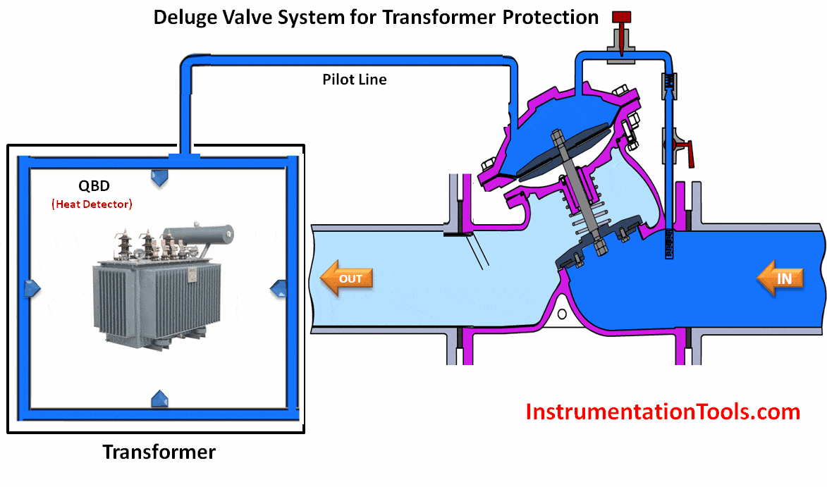

Slide 129
. In an oil cooled transformer, the oil is likely to catch fire after a certain set temperature is exceeded and instantly the entire transformer will catch fire and burn from all sides; even though the transformer is made up of metal.
To avoid this kind of fire, we use Water Spray System.
Here, there may be multiple metal rings of detectors, a detector is nothing but a temperature sensing element.
This detector ring is placed next to the most likely spots where the temperature is about to exceed or fire is about to take place.
Also the, entire transformer is surrounded by multiple sprays, at multiple levels,surrounding the transformer to start all at once.
Hence the entire transformer is flushed with water, to cool it down.

Slide 130
sprinklers are nothing but spray without any heat detecting bulbs .
Deluge Valve shall be provided in conjunction with High velocity water spray system.
Normally Deluge Valve will be in closed position, watertight, with air pressure on one side and water pressure on the other side balancing each other
When the fire does take place, the detector ring detects this; and gives the signal to the deluge valve or all the sprinklers
In case of fire the Quartzoid Bulb detector (QBD) shall burst at rated temperature due to heat which allows air/water in the detection pipe to drain out and in process
Deluge valve top chamber pressure reduces which inturn allows the Deluge valve to open fully (it is a butterfly valve)
As soon as the Deluge valve opens the water shall flow through the piping to all water spray nozzles mounted on the piping around the transformer.

Slide 131
Deluge system
High velocity water spray system shall be designed and installed in order to discharge water in the form of a conical spray consisting of droplets of water traveling at high velocity which shall strike the burning surface of 400 KV Transformer/Reactor with sufficient impact to ensure the formation of an emulsion. There by cooling transformer surfaces and oil
At the same time the spray shall also be able to efficiently cut off oxygen supply and provide sufficient cooling.
Minimum set point of the heat detectors used in HVW Spray System shall be determined.
Nozzles and sprinklers must be aimed to project water across all horizontal and vertical areas to be protected, but not aimed directly at bushings.
As that could possibly cause flashover, or crack of bushings by thermal shock.
This may happen not only during a fire, but also if the system is tested whilst the transformer remains energised.
A deluge system can also be effective for cooling adjacent structures and building surfaces to prevent deformation, structural collapse and the spread of the fire.
Foam can be added to a water deluge system. In such systems an air- or water-foam concentrate is introduced into the deluge water at a controlled rate.

Slide 132
Normally Deluge Valve shall be manually reset to initial position after completion of entire operation.
One water motor gong is to be provided with each Deluge Valve for audible alarm when water after passing the Deluge Valve is tapped through the water motor.
Each Deluge Valve shall be provided with a local panel for the purpose of manual / electrical operation of the valve.
Additionally latch is to be provided for local operation
Foam water systems are used to control and/or extinguish fires, as it acts both as smothering as well as a cooling agent.
It can be effective on transformer fire as it can cover horizontal surfaces such as the top of the transformer and the bund floor area where it reduces the risk of a pool fire.
It also adheres better to vertical surfaces than pure water.
The disadvantage of foam is that the fire fighting water is contaminated with the foaming agent and may require decontamination before it can be released he drains or nearby streams.

Slide 133
Deluge system requires a large volume of water
NFPA guidelines states 10.2 lts./minute/m2 for a deluge system for transformer fire protection.
This means that the water must be available and the
delivery system must be designed to deliver this quantity at the required pressure.
A lot of power substations are located in remote areas,or on the outskirts of towns where water is often not available.
Also,the drainage/oil separation system must also be able to handle the large flow of water from such a system.
However,it may be possible to reclaim and re-use of the water for ongoing fire fighting, if an effective oil water
separation system has been implemented as part of the design.

Slide 134
Deluge system
Water spray is not projected directly onto the rock filled pit ( soak pit).
This is not necessary as long as the pit has enough volume to contain any spilled oil and the fire fighting water well below the rock surface.
The reduced flow/ volume of water will assist in this objective.
Cable insulation is considered to be the source of fuel and propagates the fire.
Cable trays and cable run to and from the transformer must therefore also be included for protection by the deluge system.
To be effective a deluge system must be designed by design engineers, who have specific expertise. B

Slide 135
SAFE CLEARANCES
When water spray is to be used for fire protection of oil filled electrical equipment such as transformers and large switch gear, special care must be taken to provide safe electrical clearance.
The minimum Electrical clearance values between the Emulsifier system pipe work and live parts of the protected 400 KV reactor/ Transformers are to be maintained as furnished below.
1. 420 KV Bushing : 3500 mm
2. 245 KV Bushing : 2150 mm
3 145KV Bushing : 1300 mm
4. 52 KV Bushing : 630 mm
5. 36 KV Bushing : 320 mm.

Slide 136
Minimum water pressure available at the farthest and /or highest projector on the equipment protected shall be 3.5 kg/cm 2
However water pressure available at any projector shall not exceed 5.00 kg.cm 2 (g).
Applied rate of water in LPM /M 2 of the surface area of the entire 400 KV transformer/Reactor is to be determined
Area of transformer/reactor shall be calculated considering radiator, conservator, bottom surface of transformer/reactor etc.

Slide 137
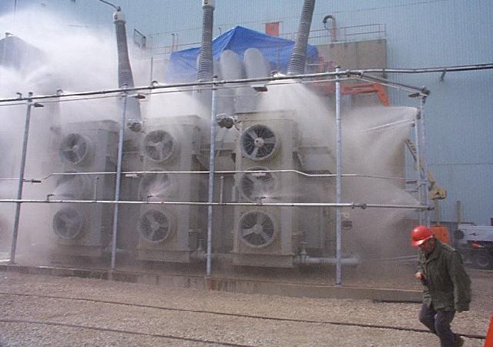

Slide 138
ALARAM AND ANUNCIATION SYSTEM
Prompt detection of fire is critical to employee evacuation and for notification of the fire department and plant emergency organization.
All fire alarms should be announced on control panels, plainly visible in the control room. One control panel each shall be located in fire water pump house and control room.
The alarm system, in accordance with NFPA standards, should include the announcement of fire alarms, supervisory signals and trouble signals.
Fire detection and Alaram system IS 2189
Supervisory signals indicate an abnormal condition that should be investigated and corrected.
Trouble signals indicate an adverse component or hardware condition such as an interrupted circuit, ground fault or power supply problem and should be repaired by qualified personnel.
The current state-of-the-art alarm system is a microprocessor-based addressable system.
Each detector or component has an identification, or address, and is connected to the control unit by a common conductor.
The control unit and initiating devices (i.e., detectors) communicate on a regular frequency to verify that everything is operating normally.

Slide 139
PANELS FOR ALARAM AND ANNUNCIATION SYSTEM
The following panels are required with complete acceessories for the successful operation of the system
s.nO | PANEL NAME
1 | Panel for Motor driven water pump | One no. Fire water pump house
2 | Panel for 2 Nos. Jack water pumps | One no. Fire water pump house
3 | Panel for 2 nos. Battery charger and diesel engine driven water pump | One no. Fire water pump house
4 | Annunciation panel | One no. Fire water pump house
5 | Annunciation panel | one no. In the control room

Slide 140
PANEL ACCESSORIES
Panel accessories | Motor driven fire water pump panel | diesel driven fire water pump panel
(a) Start/Stop push button : | 1 Set with starter indication lamp& thermal O/lrelay | 1 Set with starter & thermal O/Lrelay
b) Manual switch | 1 No | 1 No
c) Indicating lamp with drive ON/OF | 1set | 1set
Cable entries shall be from bottom with supply of suitable removable gland plate and cable glands as per requirement. All control and annunciation panel shall be made of sheet steel having 3 mm. Thick. Repeater of annunciation panel shall be located at main control room of Control building

Slide 141
ANNUNCIATION PANEL COMPONENTS
a) Indicating lamp showing power supply ‘ON’ and status indication lamp for each motor.
b) Annunciation windows shall be as follows :
i) Electric motor driven fire water pump running : 1 No.
ii) Electric motor driven fire water pump fail : 1 No.
iii) Diesel engine driven fire water pump running : 1 No.
iv) Diesel engine driven fire water pump fails to run : 1 No.
v) Fire in transformer/reactor : 1 No. for each equipment
vi) Fire fighting system in operation : 1 No.
vii) Fire in smoke detection system : 1 No.
viii) High zone speed diesel tank level low : 1 No.
ix) Spare : 6 Nos:All the control and annunciation panels to be supplied for smooth operation of fire fighting scheme both hydrant and HVW spray system shall be complete with supply of all accessories of reputed make

Slide 142
PANEL WIRING
All wiring shall be carried out with 1100V grade PVC insulated with multi core, having size of 2.5 sq.mm. or above stranded copper wires.
Spare contacts of all auxiliary relays, timers and switches shall be wired up to terminal blocks.
A minimum gap of 100 mm. shall be maintained in between two sets of terminal blocks.
Terminal blocks shall have at least 20% spare terminal blocks.
Terminals blocks shall be of 1100 V grade.
Suitable grounding arrangement with copper bus of suitable sizes at both ends is to be provided.
Space heater, lights, control selector switches, push buttons, indicating lamps, fuses, contactors, relays, timer, indicating Instruments / Annunciation etc. shall be provided.
Finishing paint on outside of all panels shall be of shade 692 (smoke grey) of IS:5 and that for inside of panels shall be glossy white
. All the control and annunciation panel shall be subject to all routine and acceptance tests as per relevant Indian Standard.

Slide 143
HEAT & SMOKE /FIRE DETECTORS AND SPRAY NOZZLES:
a) Suitable fire detection system using smoke detectors and/or heat detectors shall be provided for entire Integrated Control Room Building including
GIS Hall (Optical beam Smoke Detector),
Indoor Switchgear room,
Corridor and Toilets.
Fire detectors shall be located at strategic locations in various rooms of the Control room building.
Fire detector shall be provided on ceiling as well as on false ceiling in conference room, PLCC room, Control room and on ceiling in all other areas.
Coverage area of each smoke detector shall not be more than 80 m2 . and that of heat detectors shall not be more than 40 m2 .
The cabling for the detectors shall be concealed with proper route marking.

Slide 144
Manual call points (Break Glass Alarm Stations) shall be provided at strategic location in Control room building as well as 400KV Transformers & 400KV Reactor.
Manual Call point near Transformer & Reactor shall be housed with box & front glass to avoid ingress of water.
b) All equipment supplied shall conform to TAC norms.
c) Heat detectors to be used in HVW Spray system shall be tested type.
Temperature rating of heat detectors shall be selected taking into consideration the environment in which the detectors shall operate.
Minimum set point is to be specified .
d) High velocity water spray system shall be designed and installed to discharge water in the form of a conical spray consisting of droplets which shall strike the burning surface with sufficient impact to ensure the formation of an emulsion.

Slide 145
At the same the spray shall efficiently cut off oxygen supply and provide sufficient cooling.
Integral non-ferrous strainers shall be provided in the projectors ahead of the orifice to arrest higher size particle, which are not allowed to pass through the projector.
Material of construction of projector shall be in line with TAC/NFPA requirement
Both smoke and heat type fire detectors shall be used.
The set point shall be selected after giving due consideration for ventilating air-velocity and cable insulation.
The set point shall be adjustable.
Fire detectors shall be equipped with an integral LED, so that it shall be possible to know which of the detectors has been operated.

Slide 146
The detectors, which are to be placed in the space above the false ceiling or in the floor void, shall not have the response indicators on the body but shall be provided with remote response indicators.
Smoke/heat detector system shall be provided with proper capacity battery and battery charger for its operation during failure of power

Slide 147
CONVENTIONAL SYSTEM- PROBLEMS
conventional design calls for a grid of open type deluge/spray nozzles to be installed all around the transformer.
A typical system will use about 44 of them, designed to spray about 500gpm ofwater for a duration of one (1) hour.
Lot of water needs to be used
NFPA-850 for Power Plant Design goes even farther,
requiring water spray duration to last a full two (2) hours .
The system needs enough drainage system to carry the discharged water
But generally minimum provisions for drainage are specified to be only large enough to
a) contain the spill from the largest single container of any flammable or combustible liquid in the area.
B) for fixed fire suppression systems operating for a minimum of 10minutes

Slide 148
Water reservoirs have to be built (often underground) to accommodate this large demand and they also need regular maintenance.
Further powerful fire pumps are needed to provide water at a sufficiently high pressure to achieve the fire protection system.
Infrastructure costs for the utility company rise rapidly,
so much water is discharged on the flaming transformer to cool it and control the fire that soon, the curbs built around it is likely to overflow and hot oil is spilled around,

Slide 149
Water Mist Systems
Water Mist is also an efficient fire-fighting medium.
The difference between Water Mist and a traditional water based fire fighting systems is that the Water Mist systems require much less water as they use smaller water droplet (typically only 0.025 to 0.25mm dia. for high pressure watermist systems).
As heat absorption is a function of surface area and not volume, smaller droplets makes more surface area are available and therefore faster heat absorption for same quantity of water or equal heat absorption with much less water.

Slide 150
Water Mist
When a droplet of water vaporizes to steam, it expands by approximately 1,600 times.
Water mist is quickly converted to steam that smothers the fire and prevents further oxygen from reaching it.
At the same time, the evaporation creates a significant cooling effect of combustion gases and blocks the transfer of radiant heat.
Water Mist combines the fire suppression properties of both conventional water-based deluge or sprinkler systems and gaseous fire suppression systems.
Water mist system can be operated both in high and low pressures
But for oil filled transformers high pressure system is used

Slide 151
NITROGEN INJECTION SYSTEM
Fire hazards occurring at power transformer and interconnecting transformer installations are the matter of serious concern.
These installations are prone to fire because of several reasons such as internal faults , overheating , high order harmonics , failure of dielectric ,lightening etc.
This may result into loss of valuable assets. One Power transformer costs to Rs. 4 Crores.
Such a failure aksi longer interruption for considerable number of consumers enhancing consumer dissatisfaction
More over such types of incidences may cause fatal or non-fatal accidents to human being or stray animals.

Slide 152
On number of occasions there is a sudden blasting of porcelain bushings.
The pieces of porcelain are scattered in the switchyard with a velocity of bullet and cause damage to nearby equipments in the switchyard
The traditional means of protecting transformers from fire hazards is providing a Nitrogen Injection System.
As per standard code , the components of this system are shown by red color.
Therefore, pipelines, cubicles, valves and other components of this system are painted in red color.

Slide 153
In the event of occurrence of fire hazards , the system actuates and quenches fire quickly.
Nitrogen injection fire protection system designed for oil filled transformers shall prevent tank explosion
Fire during internal faults resulting in an arc, where tank explosion will normally take few seconds after arc generation
Also extinguish the external oil fires on transformer top cover due to tank explosion and /or external failures like bushing fires, OLTC fires and fire from surrounding equipment’s.

Slide 154
The system shall drain a pre- determined quantity of oil (1%)from the tank top through outlet valve to reduce the tank pressure
Then inject nitrogen gas at high pressure from the lower side of the tank through inlet valves to create stirring action and reduce the temperature of top oil surface below flash point to extinguish the fire.
Conservator tank oil shall be isolated during bushing bursting, tank explosion and oil fire to prevent aggravation of fire.
Transformer isolation shall be an essential pre-condition for activating the system. The system shall be designed to operate automatically.
manual operation feasible , in case of failure of power supply.

Slide 155
The system shall consist of following equipment’s.
1. Fire extinguishing cubicle placed on a plinth at about 5-10 meter away from the transformer.
2. Control box placed in the control room.
3. Necessary valves in the conservator pipe.
4. Suitable fire sensing components to be provided preferably in/on the tank cover
. 5. Signal box suitably placed

Slide 156
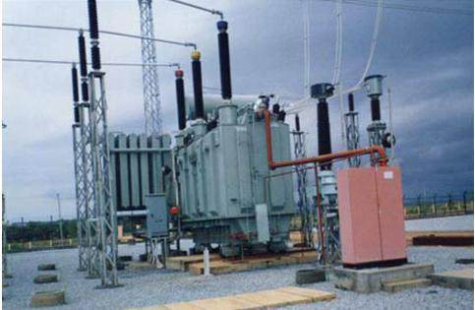

Slide 157
There are two modes for manual operation,
1. The lever inside the cubicle is pressed. The cubicle is provided near transformer in the switchyard.
2. One unit is provided in a control room by laying cable from the Nitrogen Injection system.
The glass cover provided on this unit is broken and the fire switch is closed.
This option is usually preferred when the system does not operate automatically and it is risky to go near transformer for pressing lever inside the cubicle.

Slide 158
Other parts
Sensors
The sensors are usually provided at the top side of transformer tank.
These units work as temperature transducers. The temperature of transformer oil is sensed by the sensors. Any abnormal rise in temperature due to fire hazards to the control box.
Valves
The valves provided at three locations.
a. Between conservator and breather.
b. On oil drain pipe and
c. At nitrogen cylinder.
2.3 Pipe lines
Basically two pipelines are provided, one for oil evacuation and the other for nitrogen filling.

Slide 159
Control Box
The control box receives signals from sensors and accordingly sends command to operate the system.
Oil Pit
It is the underground pit below the soil in which the small quantity of oil is drained from transformer tank.
Outdoor cubicle
The outdoor cubicle is provided near transformer installation . It comprises of nitrogen cylinder and mechanism for operating the system.

Slide 160
Indoor cubicle
The indoor cubicle is installed in the control room .
It is connected to the system through a control cable.
It comprises of fire switch , glass cover , hammer , LED indicators , Fire alarm indicators etc.
Whenever there is an occurrence of fire hazards , there is obliviously rise in temperature.
This temperature rise is detected by the sensors as shown by square packets in the figure .
The sensors inform abnormal condition caused because of rise in temperature to the control box.

Slide 161
In response , the control box performs following 3 actions in a sequential manner. A.)The valve provided near buckholz relay is closed. This stops circulation of transformer oil between conservator and main tank.
B. The Oil drain valve is opened and a small quantity of oil ( usually 1% ) is taken from top of the tank to the underground pit .
This creates a small gap at top of the transformer tank.

Slide 162
C.Now the nitrogen valve is opened so that the nitrogen gas is released from cylinder and gets injected inside the transformer tank.
The nitrogen gas is injected at the bottom of tank.
However , because of low density it goes up and fills the gap created by evacuation of the oil.
The nitrogen quenches the fire immediately

Slide 163
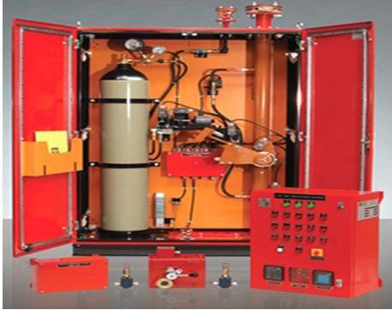
INDOOR AND OUT DOOR CUBICLE

Slide 164
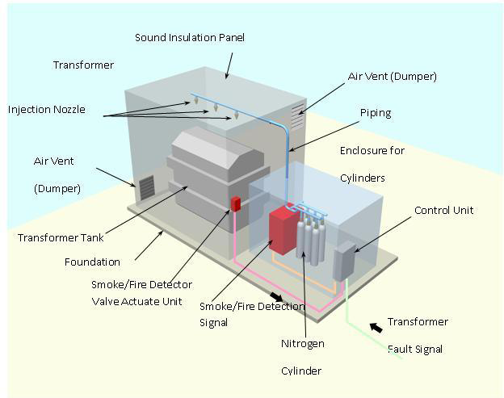

Slide 165
Gas injection systems
Gas injection systems have in the past been using CO2 or halon, but these gases attack ozone layer.
So , considering environmental protection and safety for human beings, for fire protection of power transformers mainly nitrogen and also sometimes a mixture gas of Nitrogen, Argon,and CO2, are used
Nitrogen is a cost effective and readily available gas.
when nitrogen gas is discharged to extinguish a fire, the concentration of nitrogen gas and oxygen gas in the room will change to about 87% (normally 78%) and 12.5% (normally 21%) by volume respectively, .

Slide 166
This means that oxygen concentration can be reduced from 21% to 12.5% within 1 minute after start of discharge, where as Continuous combustion requires more than 15% of oxygen concentration by volume.
Hence the gas mixture is effective for fire suppression.
For application on power transformers where sound insulation panels are installed the panel enclosure can be used as outer enclosure for the gas containment for the fire suppression.
It is required than any ventilation provided on the sound enclosure if fitted with dampers which closes during the gas injection and remains closed until the fire extinguishing is completed.

Slide 167
The Inert gas cylinders are installed outside the sound insulation panel and can be located near transformer, then length of piping can be minimized.
Inert gas is injected into the enclosure by smoke detection signal and transformer fault detection
signal.
Selection and combination of trigger signal depends upon each user’s practice and they are formed and gate circuit for alarm evacuation.
Transformer fault detection signal can be indicated through pressure relief device or Buchholz Relay.

Slide 168
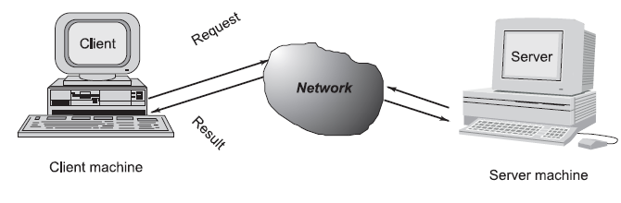
CLIENT SERVICE SOCKET

Slide 169
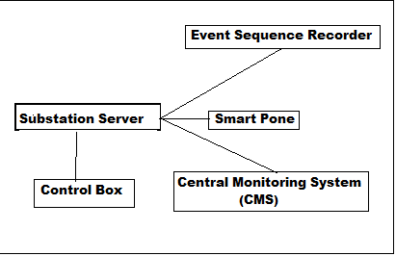

Slide 170
The proposed communication system is based on the notion of client server communication.
Server is the process that is offering some service on receipt of request from the client.
Client is the process that requests server to provide service.
Generally, programs running on client machines make requests to a program (often called as server program) running on a server machine.
They involve networking services provided by the transport layer, which is part of the Internet software stack, often called TCP/IP (Transport Control Protocol/Internet Protocol) stack.

Slide 171
The transport layer comprises two types of protocols, TCP (Transport Control Protocol) and UDP (User Datagram Protocol).
The most widely used programming interfaces for these protocols are sockets.
TCP is a connection-oriented protocol that provides a reliable flow of data between two computers. Example applications that use such services are HTTP, FTP, and Telnet.
UDP is a protocol that sends independent packets of data, called datagrams, from one computer to another with no guarantees about arrival and sequencing.

Slide 172
Applications that use such services include Clock server and Ping.
The TCP and UDP protocols use ports to map incoming data to a particular process running on a computer.
As shown in the Fig. on slide 149, the server is located at substation . The controlling unit of Nitrogen cooling system is connected to this server.
Various clients are located as Event Sequence Recorder ( ESR ) , Smart phone and Central Monitoring Station ( CMS ).
The communication between client and server is based on polled approach.
The clients continuously check whether there is ‘ Fire Hazard Occurred ‘ message. In the event of fire hazards taking place ,

Slide 173
such intimation is received by server from the controlling unit.
Server then gives the message ‘ Fire Hazard Occurred ‘ to its clients.
In this way the concerned engineers and authorities receive this message on their smart phone .
The message is also given to CMS and ESR. The client and server processes are asymmetric . Protocol ( TCP/UDP ) , port number , IP address of client and server is specified in order to establish communication.

Slide 174
The connection is done through sockets. Socket allows one process to speak with the other.
The source code is written for client side and server side socket.
For this purpose , Integrated Development Environment ( IDE ) is used. The IDE is mainly provided by Netbeans

Slide 175
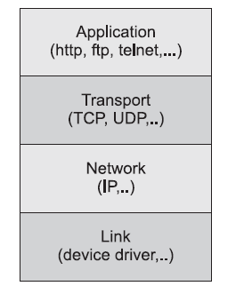

Slide 176
the source code for server side socket programming. Initially, the source code is developed in Netbeans IDE or Eclipse IDE. Later it can be embedded in an integrated circuit as a dedicated program.
The socket programming based technique is found to be an effective tool for quick communication of such incidences on CMS client , smart phones and ESR terminals .
It is possible to implement the proposed system on existing client-server network used for transmission of ABT data from substation/consumer installation to the Central Monitoring System.

Slide 177
The Java embedded system can be developed as a dedicated hardware for proposed Client –server Association .
The above system can quench the fire in power transformer within one minute.
Widely used in Maha transco
Compared with water spray system, gas injection system has advantages such as reducing civil work at installation, no necessity of securing water, reduced piping installation,no need for large fire water and jockey pumps, diesel set, battery and charger set, deluge valve,piping system so on. Over and above the quenching action is faster, causing lesser damages
It should be noted that for an Inert Gas for Oxygen Displacement or a Hypoxic enclosure to provide effective fire protection, the enclosure must remain intact.
So pressure venting may be required to ensure that the enclosure is not breached by the transformer failure event.

Slide 178
Hypoxic Enclosure
As previously stated oxygen is (among other factors) needed to start and sustain a fire.
The oxygen dissolved in the insulation liquid is not accessible for a fire.
Even if the gas analysis says30,000 ppm oxygen in the oil, this is not a fire risk.
To keep oxygen away from the origin of a fire , carbon dioxide, halon, nitrogen and other gases were used.
But They suffocated human beings and have environmental impact when release to the atmosphere.
It has been shown that there is certain level of oxygen concentrations in air, which prevents fire and still allows allow humans to breathe.

Slide 179
One mean to avoid a fire in an oil filled transformer would be to ensure the air surrounding the transformer has an oxygen content of less than 16 %.and It would then be 100 % fire proof.( Humans can survive in air with concentration in the oxygen even below 10 %.)
However, when the air has an oxygen content of less than 17 % it is called hypoxic and there should be some time restraints on working in hypoxic air because the hemoglobin cannot carry its full amount of oxygen.

Slide 180
Integrated Compressed Air Foam Systems
This is suitable for high voltage Power transformers with fixed piping system for fire protection
Despite many embedded safety features provided by manufacturers, their failure often produce very large fires that are very hard to extinguish.
Also fires provoke environmental damages by the release of thick black toxic smoke and
May also result in spilling of transformer oil
conventional design calls for a grid of open type deluge/spray nozzles to be installed all around the transformer.
A typical system will use about 44 of them, designed to spray about 500gpm ofwater for a duration of one (1) hour.
Lot of water needs to be used

Slide 181
Problems Associated With Conventional F.FSystem
NFPA-850 for Power Plant Design goes even farther,
requesting water spray duration to last a full two (2)hours .
But minimum provisions for drainage are specified to be only large enough to
a) contain the spill from the largest single container of any flammable or combustible liquid in the area. B) for fixed fire suppression systems operating for a minimum of 10minutes
A lot of power substations are located in remote areas,or on the outskirts of towns where water is often not available.

Slide 182
Water reservoirs have to be built (often underground) to accommodate this large demand and they also need regular maintenance.
Further powerful fire pumps are needed to provide water at a sufficiently high pressure to achieve the fire protection system.
Infrastructure costs for the utility company rise rapidly,
so much water is discharged on the flaming
transformer to cool it and control the fire that soon, the curbs built around it is likely to overflow and hot oil is spilled around,

Slide 183
As a solution to these problems FireFlex Systems ICAF Integrated Compressed Air Foam system is recommended for fixed piping network.
This new FM Approved AFFF ( Aqueous Film Forming Foam ) system helps in mitigating many of these potential problems while providing superior fire protection
Fire fighting foam is widely used in the industry to extinguish fires in hydrocarbon fuels such as transformer oil.
NFPA-11, TIA #05-1 in art. 7.15.1 states that where fixed spray type systems are used to protect 3 dimensional equipment like power transformers, the minimum density shall be applied over the projected area of rectangular prism envelope for the equipment
Furthermore, system discharge duration shall be designed for a minimum period of 5 minutes (art. 7.16).

Slide 184
FireFlex Systems the designer will locate a grid of local application nozzles to cover the transformer's surfaces, based on the published square area of coverage versus mounting distance ratio of the TAR-225L Nozzles.
But, because of the coverage area of each nozzle and the dense texture of Compressed Air Foam, the spray
nozzles grid all around the transformer uses much less nozzles than the equivalent deluge system
Quantity of AFFF foam concentrate can also be reduced by using certain Systems to 2% from normal 3% because of their high efficiency .

Slide 185
A typical high voltage power transformer Systems
are designed at the much lower water flow rate of
95gpm and will need a grid of only 16 nozzles against 500 gpm water and 44 nozzles required for Deluge
Because of the much shorter discharge time of 5
minutes, Only about 475 gallons of water (5 mts)will now be needed to completely suppress the fire against
required 5000gpm under deluge system for 10mts.
At the same time, it provides protection against burn-back, which deluge systems cannot do.
No need for large reservoirs, pumps, diesel set with battery with charger( 2 sets), bigger soak pit, oil water separation system, largerdrains containment dikes etc. saving investment.

Slide 186
water, foam and transformer oil can be easily pumped after a fire as only a small quantum is to be handled and treated.
Possibilities of damages to the environment are much reduced because the risk of overflowing water and transformer oil over the containment bunds is eliminated
A power transformer fire will involve both
( a) cascading fire from the oil coming from the expansion tank situated at the top of the casing
b) a pool fire in the curb surrounding the transformer.
This makes it very difficult to extinguish total fire .

Slide 187
Operation
ICAF System consists of a a grid of discharge nozzles installed around the transformer.
A first row of nozzles will be aimed at the top of the transformer casing to extinguish flames from the pooling transformer oil on the top of the transformer casing.
A second row will be installed to protect the sides of the transformer casing, extinguishing the cascading fire.
Foam accumulation in the curb will handle the burning oil by covering the surface.
Other nozzles will be located to properly cover the shape of the oil expansion tank ( conservator).

Slide 188
The resulting balanced flow piping is much simpler to install and of smaller diameter than the equivalent deluge grid system, reducing the costs
The foam concentrate is stored in a non-pressurized tank of only 10 gallons capacity and does not use bladders or complicated inductors and trims.
The entire foam trim is actually factory-built in a
user-friendly cabinet
A bank of three high pressure compressed air cylinders
is supplied to provide the pressure to the system so the
existing water pressure can be used to feed the system.
The compressed air cylinders and foam tank can be erected on a mobile plat form

Slide 189
Special considerations need to be given to the nozzle layout for this kind of hazard since power transformer configurations vary.
ICAF Systems are so efficient at extinguishing this type of fire the total suppression will be achieved three times faster than a typical deluge system .
The system operation is environment friendly

Slide 190
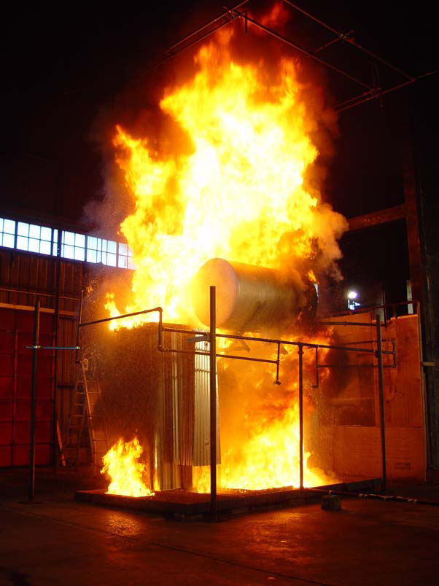
Integrated Compressed Air Foam Systems

Slide 191
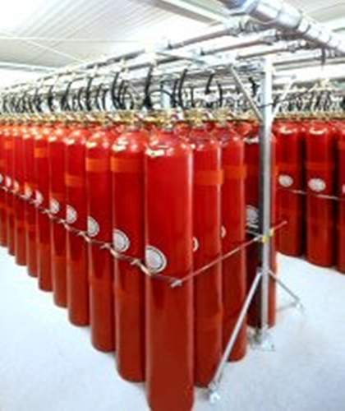

Slide 192
GREEN OIL IN PLACE OF MINERAL OIL
Transformer fluids are generally petroleum based fluids and are non-bio-degradable, non-renewable, non-environmental friendly with limited availability , lower flash points and very expensive.
Solution: Substitution of the mineral based dielectric oil with a new environmental-friendly dielectric fluid
An ideal liquid dielectric has very good electrical, physical and chemical properties along-with stable ageing characteristics.
It should be compatible with electrical equipment construction materials like paper, press board, copper, metal housing, polymer containers etc.
A practical study is proposed to test suitable vegetable oil, as a replacement for mineral oil.

Slide 193
vegetable based Transformer oils
Raw vegetable oils are not suitable for use as dielectric fluids because of poor dielectric strength and lack of hydrolytic/ thermal stability.
However, certain chemical/physical modifications are required to overcome these deficiencies.
The Research in this area should focus:
• The substitute oil should be developed from non-edible, indigenous oil
• It should be Eco-friendly (i.e. biodegradable), renewable hence provide safer disposal methods and avoid environment hazards
• Ensure very high class quality
• Provide safety margin for flash point by double than that of mineral oil •

Slide 194
PROPERTIES OF IDEAL LIQUID TO BE USED AS TRANSFORMER OIL
• High dielectric strength •
High impulse strength •
High volume resistivity
•Low dielectric dissipation factor ( Tan Delta)
• High specific heat and thermal conductivity
Good chemical stability
•Low viscosity
Non- hygroscopic- lesser absorption of moisture
•Low volatility and high flash point
• Good arc quenching properties
• Non-flammable and non-toxic
• Cheap and easily available.
Total absence of corrosive sulphur and PCB

Slide 195
Reduced fire hazards since the flash point is above 300°C
• Enhanced service life of transformer by non-absorbing moisture from the paper during normal service life and thereby, lesser shut downs and reduced investment on filtration etc.
• More useful for remote, pole mounted, sealed distribution transformer which are normally unattended
• Improved Reliability of Power Apparatus
• Total absence of corrosive sulphur and PCB
A methyl ester of rapeseed oil (MRSO) has also been tested for possible use in power capacitors.
Soyabean based transformer oil
Insulation systems for electrical distribution transformers are being re-evaluated based on their total life cycle cost both from economical and environmental perspectives.

Slide 196
Due to the inherently higher efficiency design offered by liquid cooled transformers,
Development has focused on fluids having improved environmental and health properties while maintaining the fire resistant properties of “less-flammable” fluids.
Because esters have lower inherent resistance to oxidation and differences in the type and magnitude of oxidation by-products, a novel insulation system has to be developed to overcome this potential handicap.

Slide 197
Envirotemp Fr3fluid
Envirotemp Fr3fluid is having superior properties as a transformer oil compared Mineral oil presently used.
Envirotemp Fr3fluid is a natural Ester solution, derived from renewable vegetable oils providing environmental benefits that are superior to Mineral oil
Its properties include:
Ultimately Biodegradable as designsted by EPA
Reduced carbon emissions: 56 times lesser emissions compared to Mineral oil
Non- toxic-Contains no petroleum, halogens,
Silicones or sulphur
d)Maintains Dielectric strength even in cold temperatures

Slide 198
Flash point as high as 360ᵒC compared to145ᵒC of mineral oil. Hence comparatively very high fire safety for equipment and personnel.
Offers highest ignition resistance among all types of oils used in transformers
Higher flash point helps in increasing the loading on the transformer(by 20% as practically seen)
Because of higher flash point and there by there is no need of mulsifier, deluge and fire mitigation techniques
Because of this higher reliability
Some of the largest utilities and transformers are using this oils for all voltage ranges upto 400KV

Slide 199
Maintenance free Vacuum type on load tap changer (OLTC) for Transformers
Resistor type on load tap changer is mainly used for transformers.
Due to operation of tap changer under load, heavy arcing is experienced in Diverter chamber of the tap changer.
This results in the corbanization of transformer oil in the OLTC chamber and sometimes in fire
This arcing damages the contact and also the oil.
In order to avoid the wear and tear, vacuum bottle is used for making and breaking of contact.
Vacuum type tap changers have almost same price as that of resistor type tap changers.
At the same time, it is more reliable and has very long contact life.
This helps longer life for the tap changer
VAC type tap changers are presently used only for Furnace transformers and\ few selected transformers.

Slide 200
RESIN CAST TRANSFORMERS-GENERAL
A Dry-type Transformer is defined as a transformer in which the core and windings are not immersed in an insulating liquid.
Two types:
A)Dry-type Transformer having one or more windings encapsulated in solid insulation is called an “Encapsulated Winding Dry-type Transformer”,
B) Non-encapsulated winding Dry-type transformer have none of the windings encapsulated with solid insulation.
The cast resin transformer was developed in Germany in the 1960s as an alternative to oil-filled transformers.
In contrast to an oil filled transformer, the coils of a cast resin transformer are coated with epoxy resin, which is able to withstand temperatures as high as 188 degree Celsius(Oil filled transformers Flash point of oil is 140 degreesC)

Slide 201
In a cast resin transformer, the dry epoxy resin coating the transformer coils serve as the insulation medium between coils.
To ensure effective insulation, appropriate precautions must be maintained to ensure that any moisture or condensation has been removed when the epoxy resin is cast.
Cast resin transformers use four main types of nsulation:
A) 155 degree Celsius Class “F” as per IEC60076 (International Electro technical Commission)
B) 180 degree Celsius Class “H”
C) 150 and 185 degree Celsius per ANSI (American National Standard Institute), IEEE (Institute of Electrical and Electronics Engineers), and NEMA (National Electrical Manufacturers Association).
.

Slide 202
Epoxy resin
Epoxy resin is a molecule containing more than one alpha epoxy group capable of being converted into a thermoset form.
The liquid epoxy resin has low viscosity and when compared to other liquid resin like, Phenolic, Polyester or Acrylic, have the following unique properties:
Low viscosity
Quick and easy curing
Low shrinkage
High adhesive strength
High mechanical strength
Good chemical resistance and electrical properties

Slide 203
A
Fire safety:
The Cast Resin Transformer is non – inflammable and will not spread fire to its surroundings orwill not explode.
The total calorific power released from a Cast Resin transformer to the surroundings will be only ¼ of that from an oil filled transformer. Hence No spreading of fire.
Type of insulation Calorific Power
Mineral oil-filled transformer 100
Silicone oil-filled transformer 88
Synthetic liquid filled transformer (eg. Askarel)63
Cast resin transformer 24
An internal fault in an oil filled transformer may lead to fire by self ignition.
In Resin cast transformer there is no such possibility.

Slide 204
The absence of inflammable insulating liquids(The epoxy resin insulation has high flash point) and with the self extinguishing materials ensure that there are no fire accidents
Non hygroscopic. Does not absorb moisture
Can be switched on without any delay even after long shut down.
Higher mechanical strength as both HV/LV Windings Impregnated and Cast Under vacuum Into Moulds Of Fiber glass reinforced epoxy forming rigid tubular coils
As HV windings are with strip windings, they have a greater capacity of resistance to impulse voltages and thus better Short Circuit With Stand Capability. and
A lower probability of occurrence of localized partial
discharges for the glass reinforced resin unfilled system (inter-turn voltage will be uniform for Strip winding.)
No oil or winding theft. No oil leakage.

Slide 205
No explosion either
A fire in a liquid or oil filled transformer can emit toxic gases. especially in the case of Askarel based liquids.
In Resin cast transformer there is no such toxic gas emissions and hazardous situation does not arise
The complete vaccum impregnation and filling of primary and secondary coils provide very good protection against atmospheric pollutions.
The glass reinforced resin casting are impervious to most common gasses , chemical fumes etc., Hence suitable for polluted industrial applications.
Since made for the specific International and National Standards and in conformity to classes C2, E2 and F1 means that Resin Cast transformers can be used in many environmental contexts.

Slide 206
The enclosure has a smooth surface which impedes both the deposit of dust and the action of polluting agents. Can be used in polluted areas
The low noise levels represent a safeguard for the environment and public health.
High mechanical strength: S/C proof
As the coils are cast in epoxy resin, the mechanical strength is extremely high and there is no chance of the Transformer failing under short circuit. This aspect is of utmost importance in India where experience shows that short circuit accounts for a large number of Transformer failures.
HV windings are enclosed in a cylindrical enclosure, which is impermeable, mechanically strong
The strength of Wave Cast transformers makes them ideal for such applications as impact loading, mobile machinery and transit systems

Slide 207
Less Space:small dimensions, less height and width .( reduction by 16% by dimension and 10%by weight).
When kept inside, Smaller enclosure requiring less space
cast resin transformers can be installed inside buildings, even near to rooms where people are present.
Simpler installation at reduced cost. No Enclosure is required
for indoor usage. Lesser space is required
Do not need the expensive building work which is required for oil transformers, such as collection pits, extinguishing grids and fire-resistant separation barriers
Transformers installed inside the building can be closer to the loads, with the advantage of saving in connection costs and reducing losses in the supply line
Glass reinforced cast resin unfilled systems have longer life

Slide 208
High short time overload capability: The current density in the winding with cast resin transformers is considerably lower than with oil transformers.
Cast resin transformers use class F 155°C insulating material, allowing for a maximum temperature rise of 100°K
The transformers can be overloaded, as long as the temperature rise on the windings does not remain above the
allowable value for long periods of time.
Performance can be improved by upgrading ventilation system and cooling system inside the windings, Through optimized forced ventilation, increase in performance - 40%
Short time load peaks, such as with wind power installations, can be easily overcome without there being a need to plan the relevant over sizing.

Slide 209
High reliability: The high technology employed in the manufacturing process of windings gives the product a high level of reliability.
Versatility and Performances: They can support overloads and perturbations which can be found in every installation
Advantageous capabilities of the enclosure: Instead of transformer bays or cable housings, a simple enclosure can be used for access prevention.
Enclosures can be complemented with the provision of high voltage flanges and low voltage cabinets to provide local stations.
Maintenance free. Low operational cost .They need only to be inspected regularly to check for no accumulation of dust and dirt

Slide 210
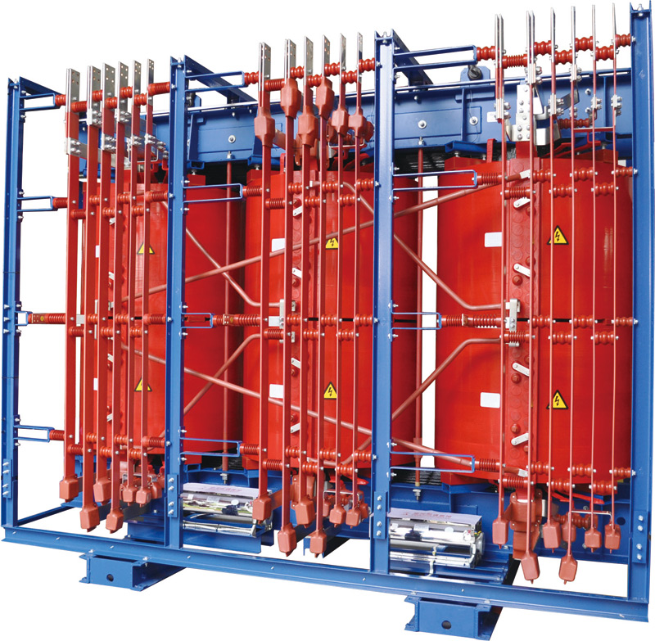

Slide 211
APPLICATIONS
Cast resin dry type distribution (dual voltage) transformers, which are used in a wide range of infrastructure, commercial, and residential developments to step down the voltage of electricity from the electric grid to lower levels;
Under High voltage Distribution System , mother transformer under LVDS is replaced by number of small capacity transformers locating them even in remote areas.
Because of this, maintenance of transformers in remote location becomes the main causality.
Further if oil filled transformers are used, theft of oil and windings will be on the increas, leading to failure .
Cast resin transformers are maintenance free and in the absence of oil, there can be no oil pilferage.
Since windings are cast in resin mould, chances for theft of windings are remote.

Slide 212
THANK YOU

