Slide 1
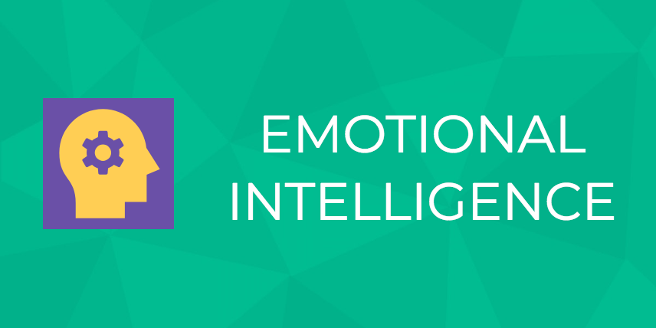
- Alapati Srinagesh

Slide 2
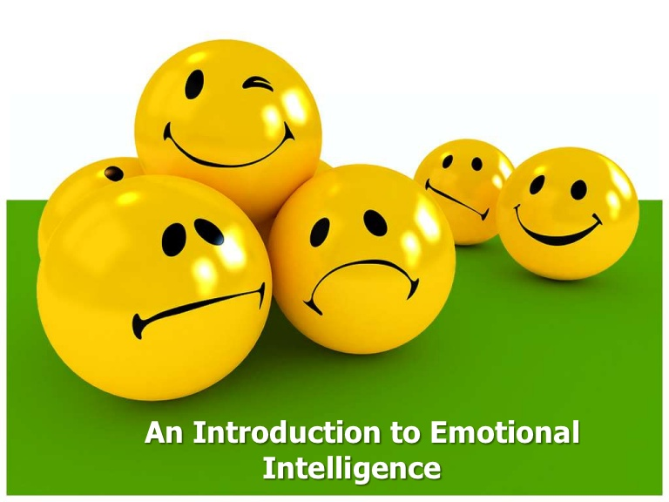
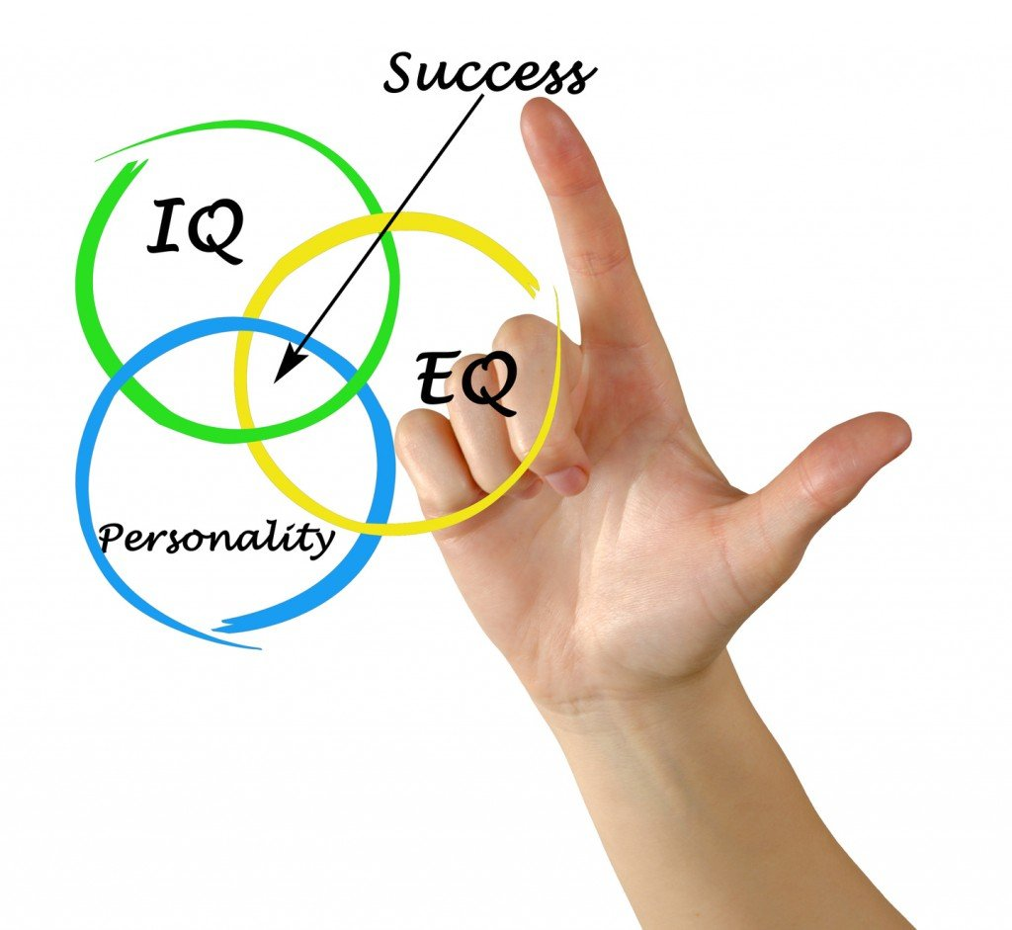

Slide 3
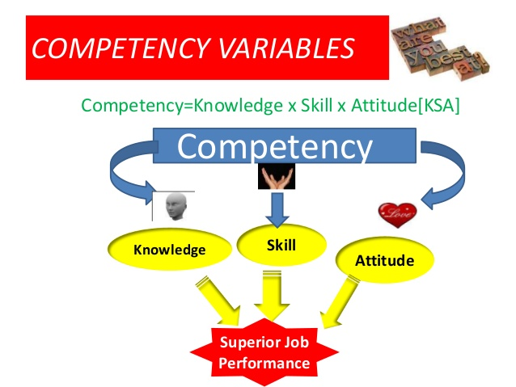
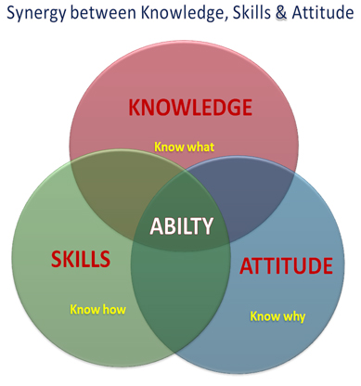

Slide 4
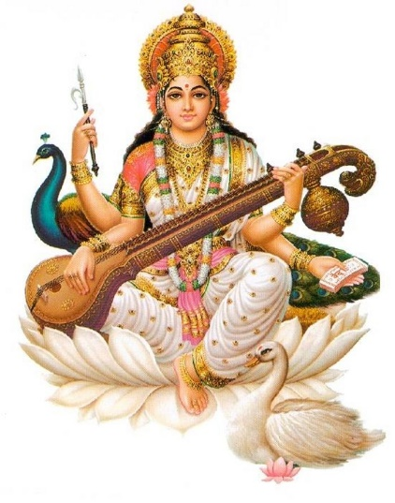
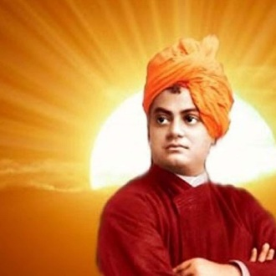
KSAW
Knowledge decides what to say.
Skill decides how to say.
Attitude decides how much to say.
Wisdom decides whether to say or not.
Wisdom is the ability to use experience, knowledge, understanding etc. in order to make sensible decisions or right judgments and following the soundest course of action.
Swami Vivekananda( born Narendranath Datta)
Swan: Indian mythology, it is said to eat pearls and separate milk from water from a mixture of both.

Slide 5
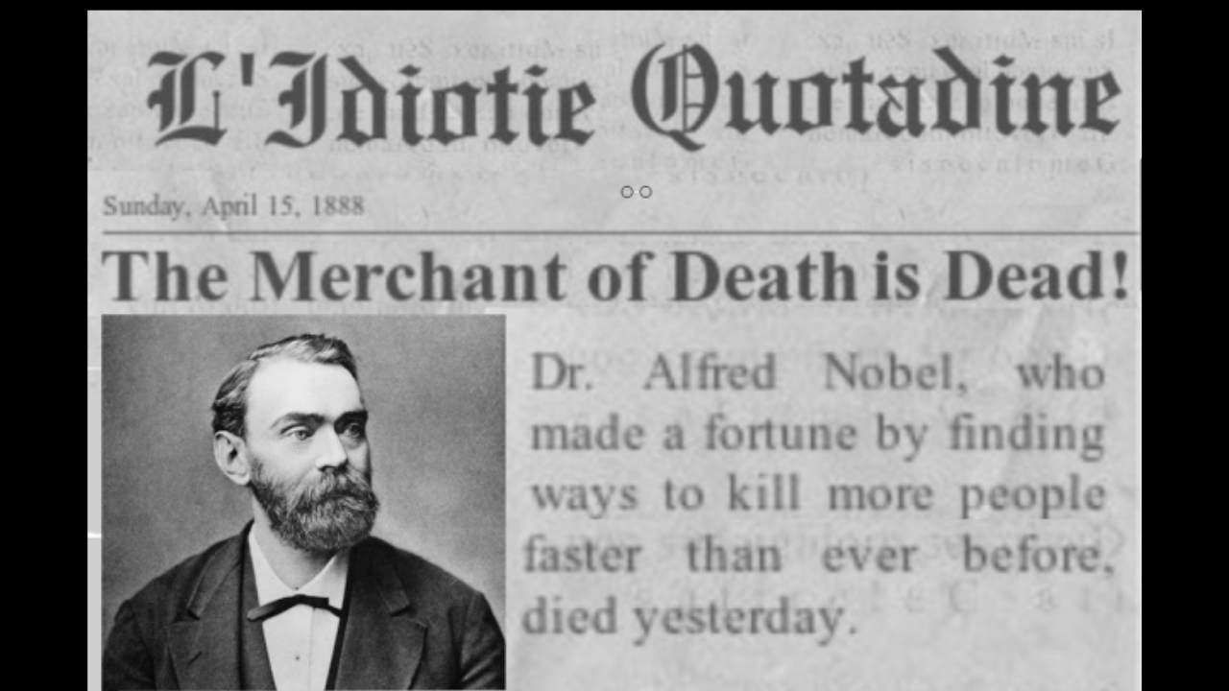
Some thought provoking incidents
Alfred Nobel: Merchant of Death is dead - The story behind the Nobel Prize!

Slide 6
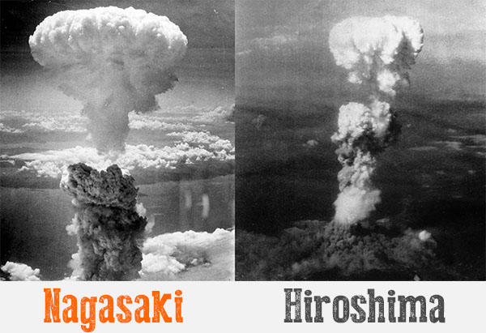
The United States detonated two nuclear weapons over the Japanese cities of Hiroshima and Nagasaki on August 6 and 9, 1945, respectively.
The two bombings killed between 129,000 and 226,000 people, most of whom were civilians, and remain the only uses of nuclear weapons in armed conflict.

Slide 7
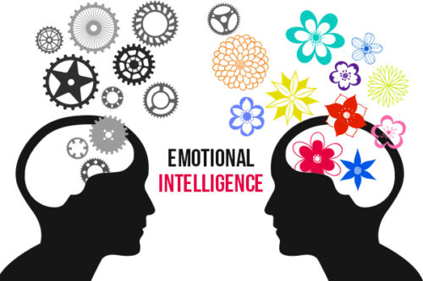
EMOTIONAL INTELLIGENCE
Emotional Intelligence, as a psychological theory, was developed by Peter Salovey and John Mayer.
"Emotional intelligence is the ability to perceive emotions, to access and generate emotions so as to assist thought, to understand emotions and emotional knowledge, and to reflectively regulate emotions so as to promote emotional and intellectual growth."- Mayer & Salovey, 1997

Slide 8
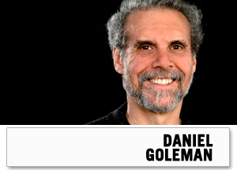
Daniel Goleman
Goleman is a science journalist who brought "emotional intelligence" on the bestseller list and has authored a number of books on the subject, including
"Emotional Intelligence,"
"Working With Emotional Intelligence,
"Social Intelligence: The New Science of Human Relationships."
Goleman describes 5 main components to Emotional Intelligence:
1.Self-awareness.
2.Self-regulation. ...
3.Motivation( Internal motivation)
4.Empathy. ...
5.Social skills

Slide 9
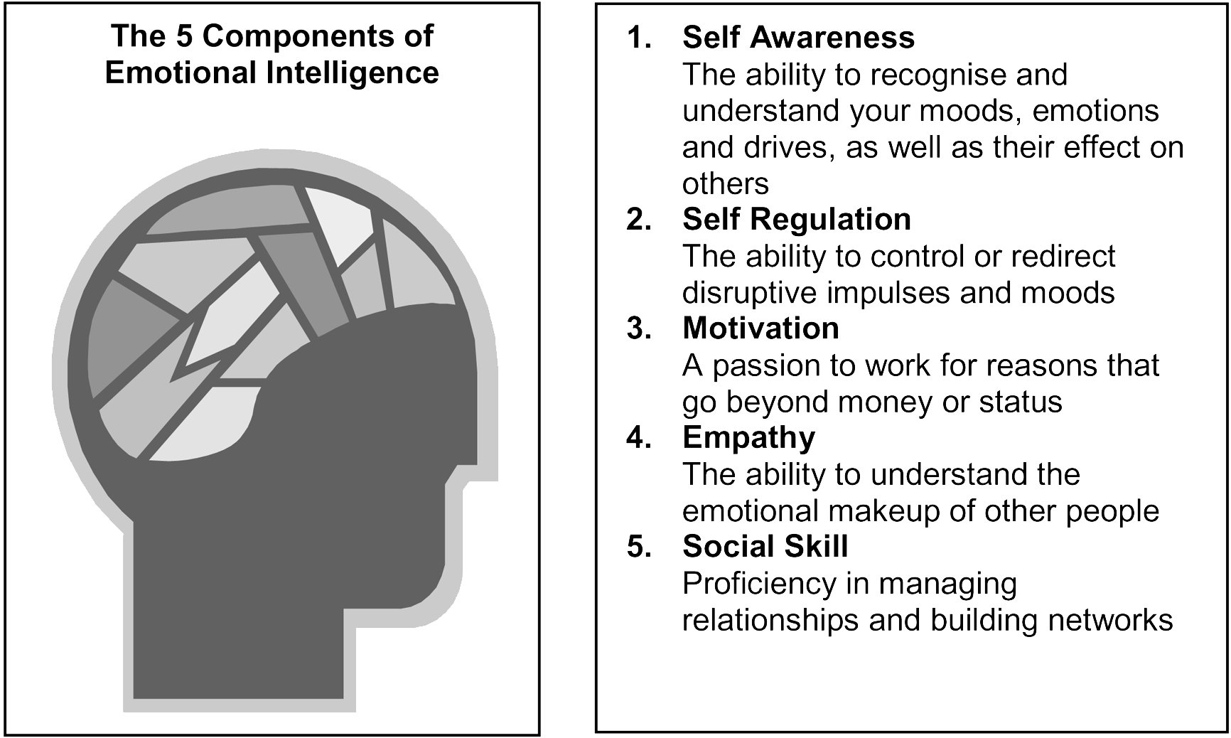

Slide 10
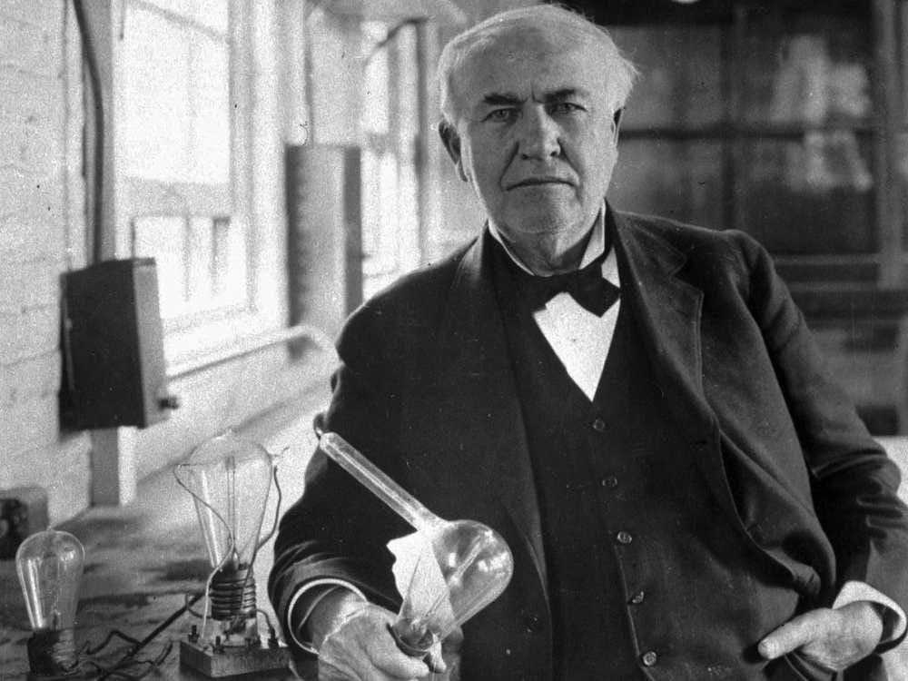
Internal Motivation: Thomas Alva Edison
Thomas Edison's Reaction To His Factory Burning Down Shows Why He Was So Successful
According to a 1961 Reader’s Digest article by Edison’s son Charles, Edison calmly walked over to him as he watched the fire destroy his dad’s work. In a childlike voice, Edison told his 24-year-old son, “Go get your mother and all her friends. They’ll never see a fire like this again.” When Charles objected, Edison said, “It’s all right. We’ve just got rid of a lot of rubbish.” Later, at the scene of the blaze, Edison was quoted in The New York Times as saying, “Although I am over 67 years old, I’ll start all over again tomorrow.” He told the reporter that he was exhausted from remaining at the scene until the chaos was under control, but he stuck to his word and immediately began rebuilding the next morning without firing any of his employees. [Credit to: “Thomas Edison’s Reaction To His Factory Burning Down Shows Why He Was So Successful”; Richard Feloni [May 9, 2014]]

Slide 11

Jessica Cox
is the world's first licensed armless pilot, as well as the first armless black-belt in the American Taekwondo Association.
She was born without arms due to a rare birth defect.

Slide 12

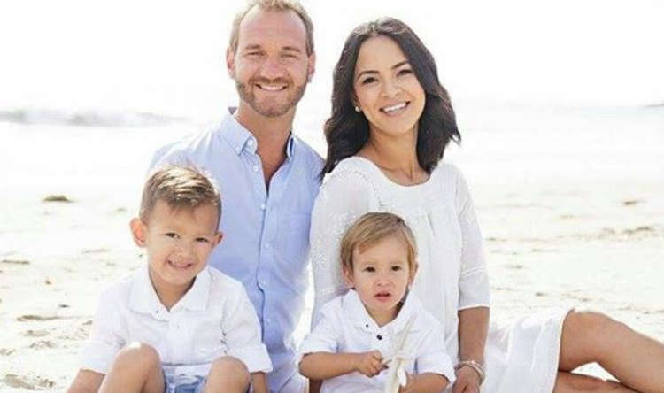
NICK VUJICIC

Slide 13
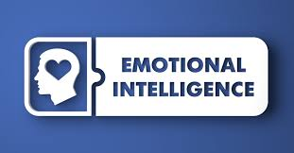
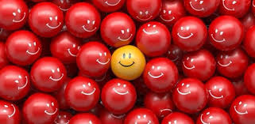
Emotional intelligence (EQ, as opposed to IQ) is our ability to recognize, understand, and regulate our emotions and to respond to those emotions in constructive ways that allow us to communicate, empathize with others, and overcome challenges.
In other words, it is being tuned into our emotional world and honing the ability to manage our emotions before our emotions manage us.

Slide 14



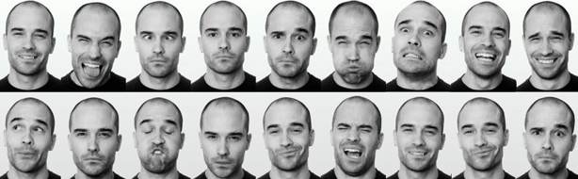

Slide 15
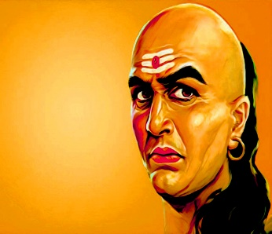
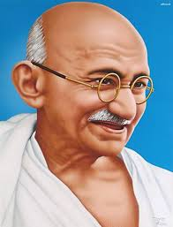
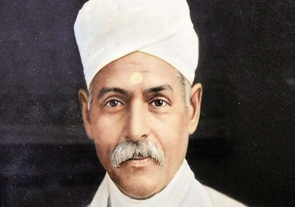
EMOTIONS : NEGATIVE Vs. POSITIVE
Fear : Courage
Sadness: Happiness
Pessimism : Optimism
Dissatisfaction: Contentment
Anger: Peace
Boredom: Excitement
Shy/Suspicion/Doubt : Confidence/Trust
Greed: Self-sufficiency
How to use Negative Emotion for Positive purposes?
Insult to Inspiration:
1. Chanakya 2. Gandhiji 3. Madan Mohan Malviya

Slide 16
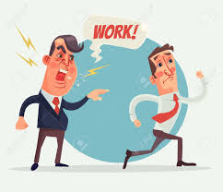
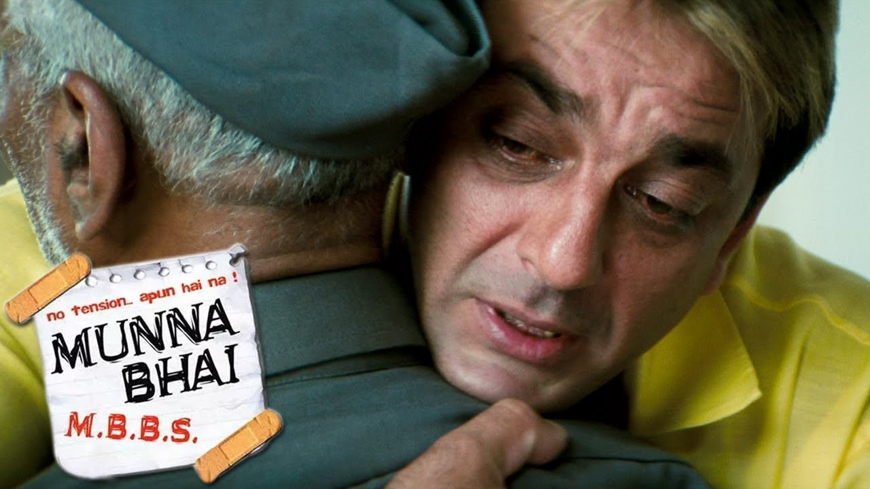

CHANGING EMOTIONS
From Bad Mood to Elevated on Friend’s Promotion
Manager’s Anger on Subordinate to Pleasure on Customer
Empathy : Munna Bhai: Making Angry Old man Cool
Empathy : Puppy

Slide 17



