Slide 1

Technical Programme on
"SOIL MECHANICS, FOUNDATION ENGINEERING &
GEOTECHNICAL INVESTIGATIONS RELATED TO ELECTRIC SUB-STATION, EXTRA HIGH TENSION TRANSMISSION LINES AS PER QC, QA WITH IEC CONFORMITY" for Engineers of APTRANSCO (Civil, Electrical & Telecom) at Training institute, APGENCO, Ibrahimpatnam
Dr. G. V. RAMA SUBBARAO
ASSOCIATE PROFESSOR,
DEPARTMENT OF CIVIL ENGINEERING,
V.R. SIDDARTHA SCHOOL OF ENGINNERING,
SIDDHARTHA ACADEMY OF HIGHER EDUCATION
-Deemed to be University
VIJAYAWADA – 520 007
E-Mail: drgeovrs@vrsiddhartha.ac.in
Civil@VRS - YouTube

Slide 2
CONTENTS
Introduction to Soil Mechanics & Foundation Engineering
Soil Stress & Deformation
Soil Strength
Foundation Types
Foundation Design
Earth Retaining Structures
Geotechnical Investigations
Construction Aspects
Case studies & examples, Successful foundation design
Extracts of important Indian Standards as per QC,QA with IEC conformity

Slide 3
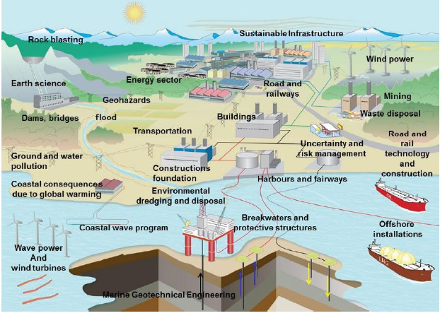
Modern Geotechnical Engineering

Slide 4
Introduction to
SOIL MECHANICS & FOUNDATION ENGINEERING
[GEOTECHNICAL ENGINEERING ]
Geotechnical engineering in an applied science dealing with the applications or principles of soil mechanics to practical problems.
It has a much wider scope than soil mechanics, as it deals with all engineering problems related with soils.
It includes site investigations, design and construction of foundations, earth-retaining Structures and earth structures.

Slide 5
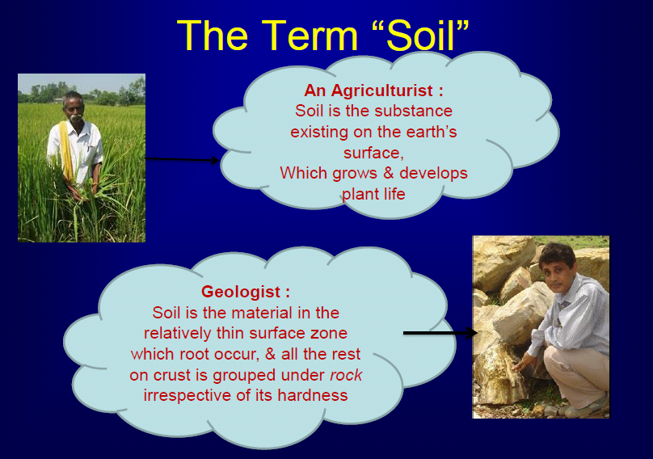

Slide 6
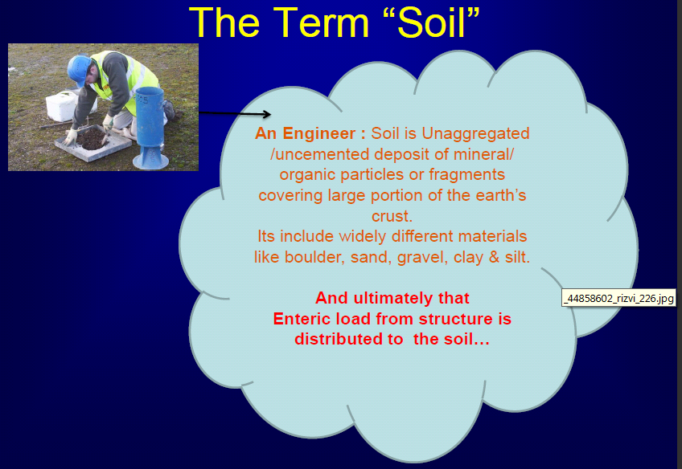
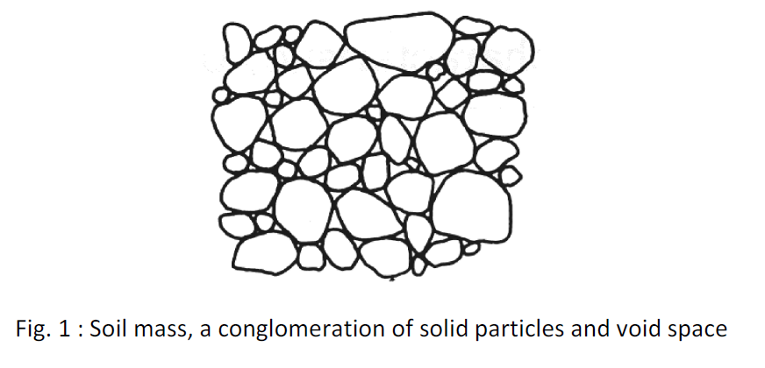

Slide 7
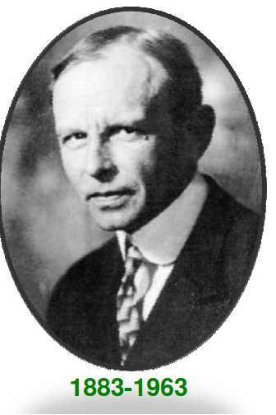
Unfortunately, soils are made by nature and not by man, and the products of nature are always complex.
Karl von Terzaghi, 1936

Slide 8
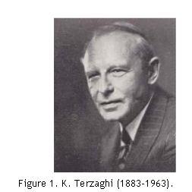
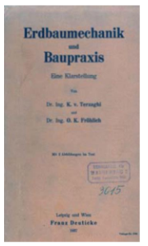

Slide 9
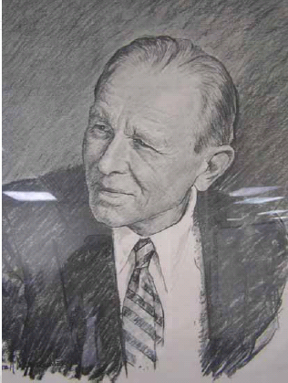
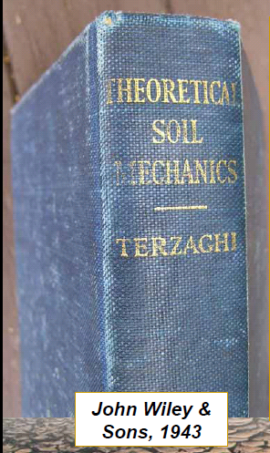


Slide 10
“Geotechnical Engineering” by Dr. C. Venkatramaiah - A comprehensive textbook covering various aspects of geotechnical engineering, including soil mechanics, foundation engineering, and ground improvement techniques.
“Soil Mechanics and Foundation Engineering” by Dr. K. R. Arora - A widely used textbook in Indian engineering universities, covering fundamental principles of soil mechanics and foundation engineering, with a focus on practical applications.
“Soil Mechanics and Foundation Engineering” by Dr. V. N. S. Murthy. “Foundation Engineering” by Dr. P. C. Varghese. “Advanced Foundation Engineering: Geotechnical Engineering Series” by Dr. V. N. S. Murthy

Slide 11
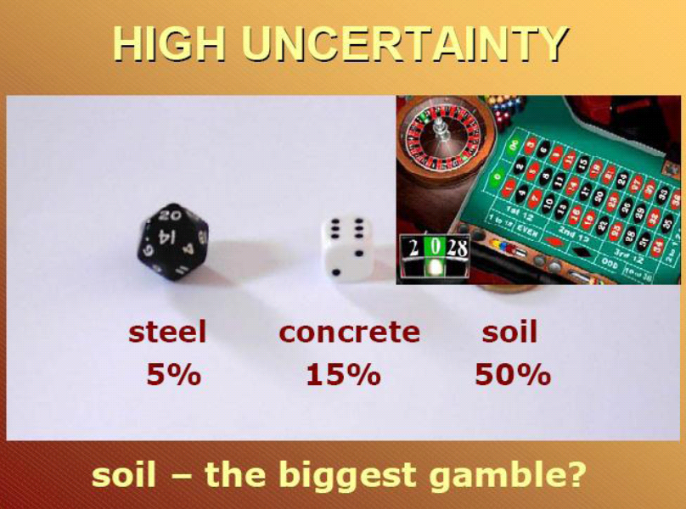

Slide 12
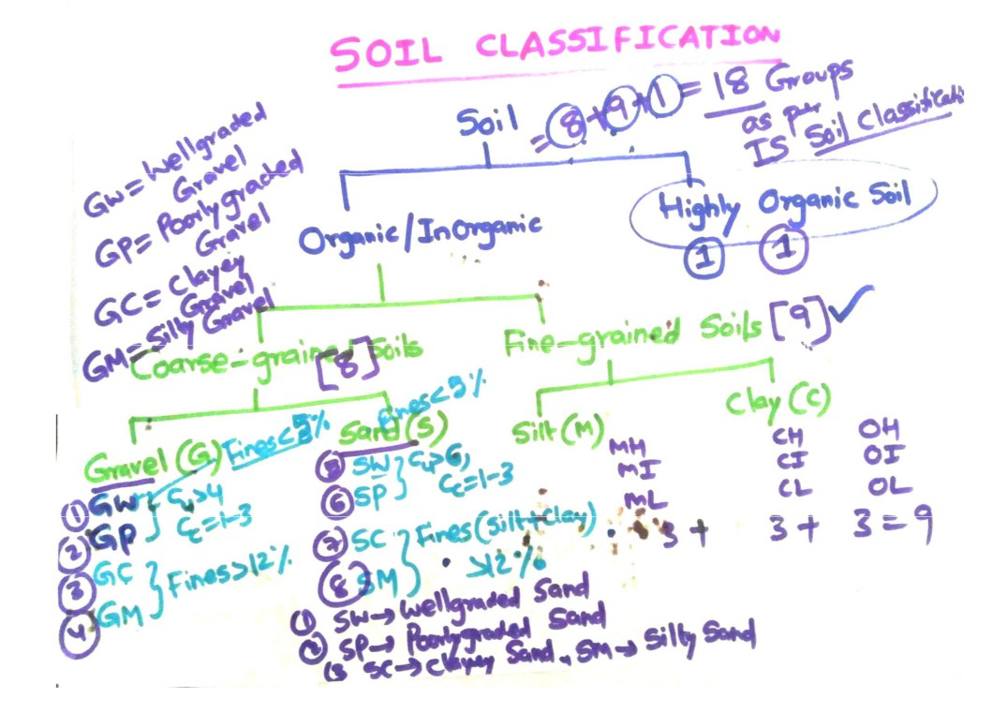

Slide 13



Typical Geotechnical Project
Geo-Laboratory
~ for testing
soil properties
Design Office
~ for design & analysis
soil samples
design details
construction site

Slide 14
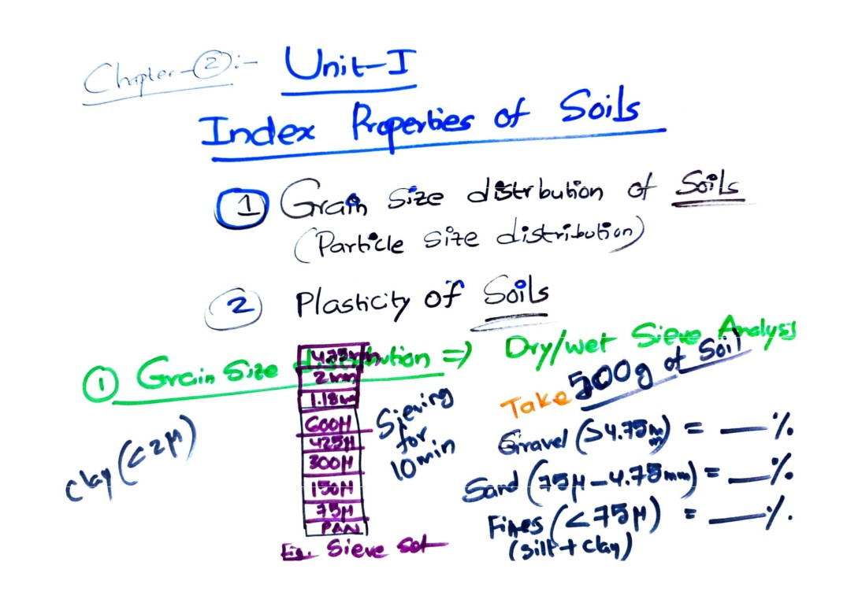

Slide 15
Sieve analysis – for coarse grain soils
Classify coarse by GSD and
fines from Atterberg limits (PI-LL chart)

Slide 16
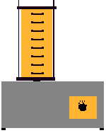
Grain Size Distribution
Determination of GSD:
In coarse grain soils …... By sieve analysis
stack of sieves
sieve shaker
Sieve Analysis

Slide 17
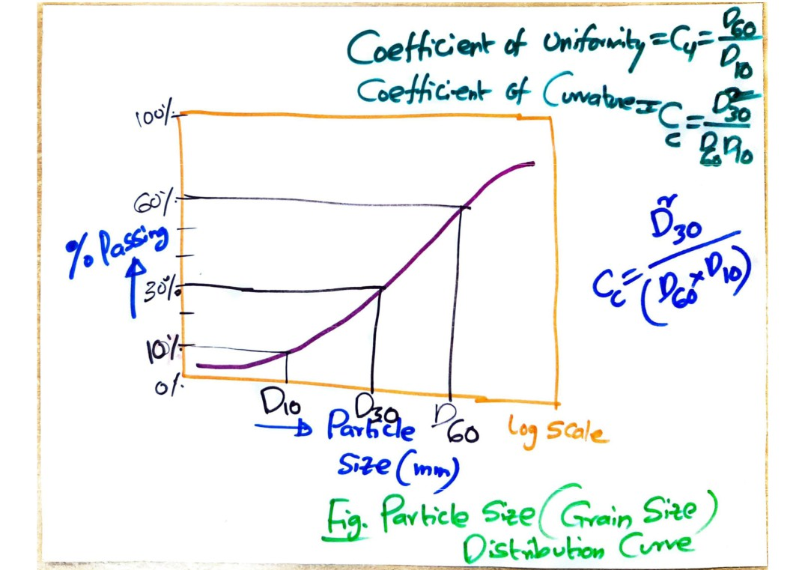

Slide 18
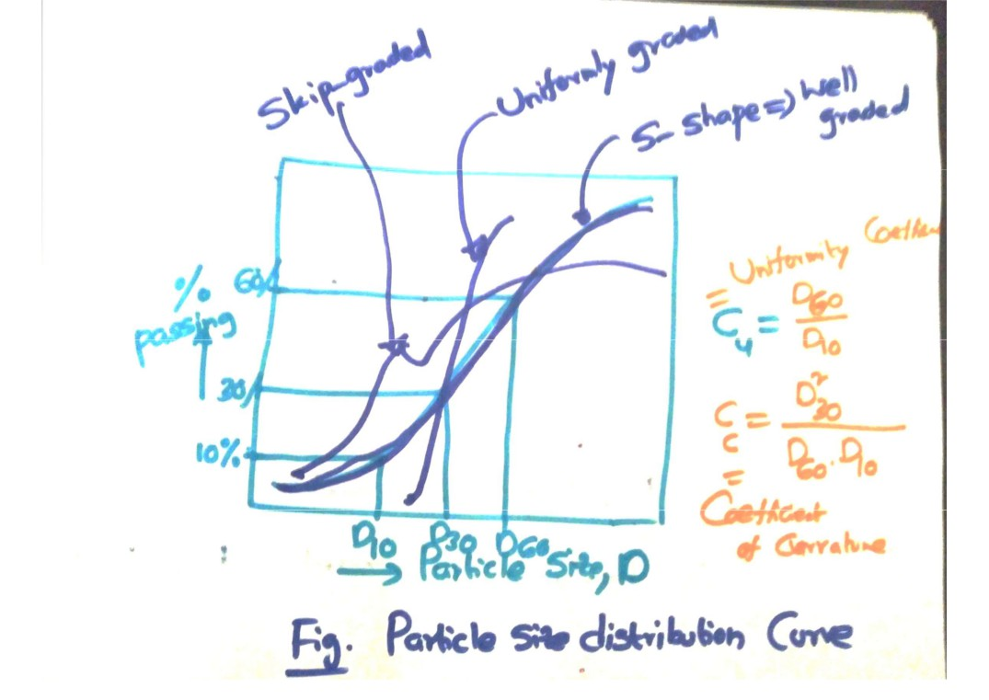

Slide 19
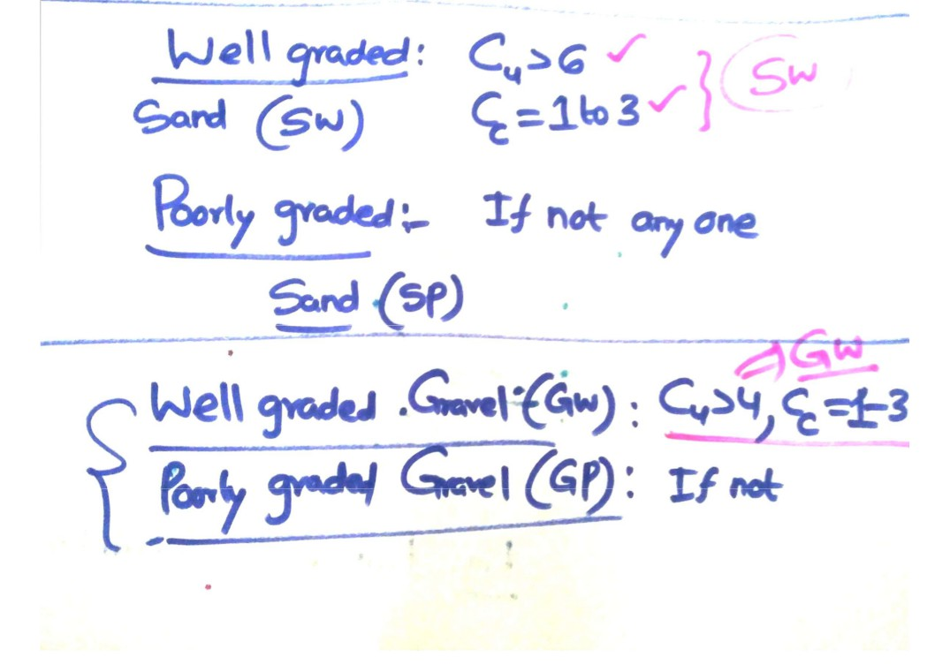

Slide 20
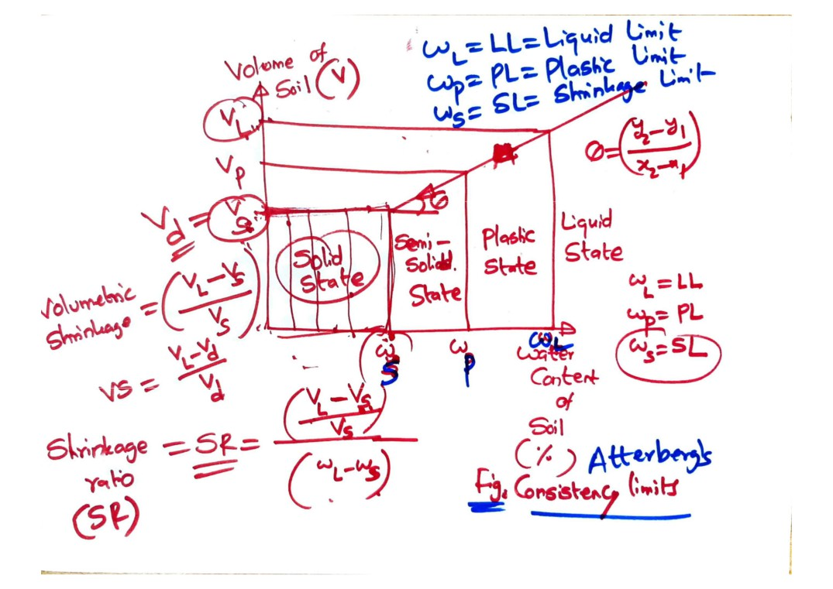

Slide 21
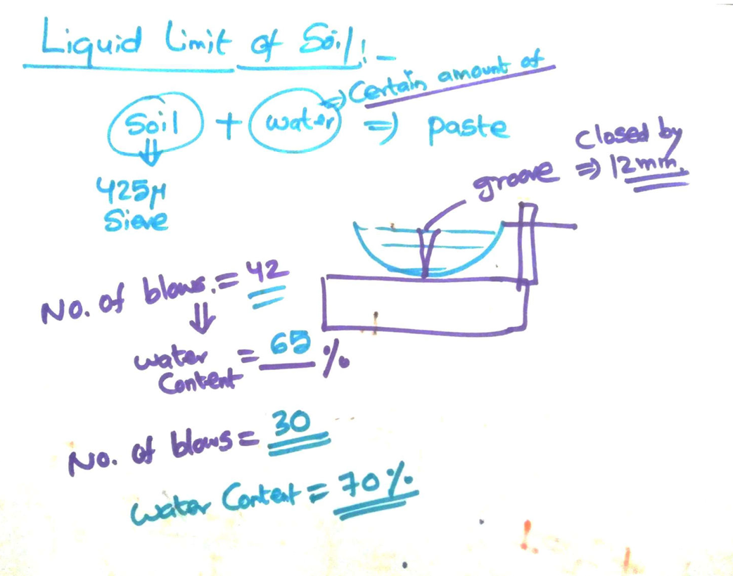

Slide 22
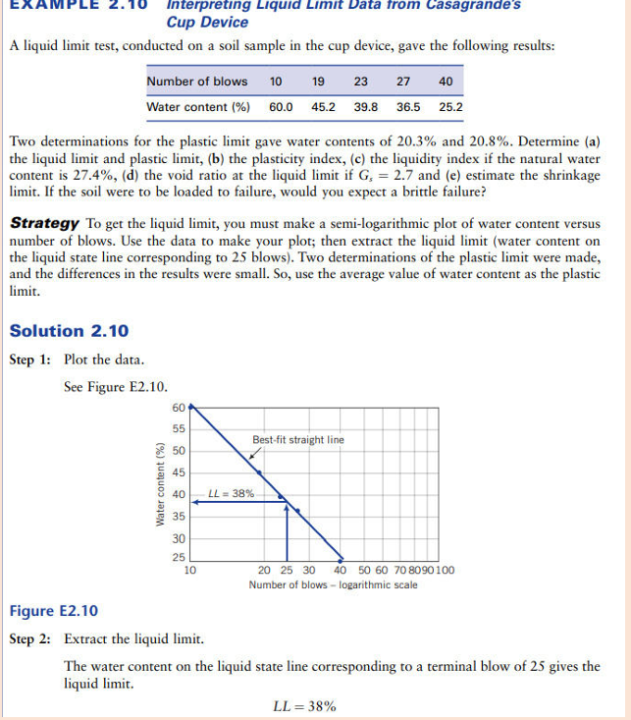

Slide 23
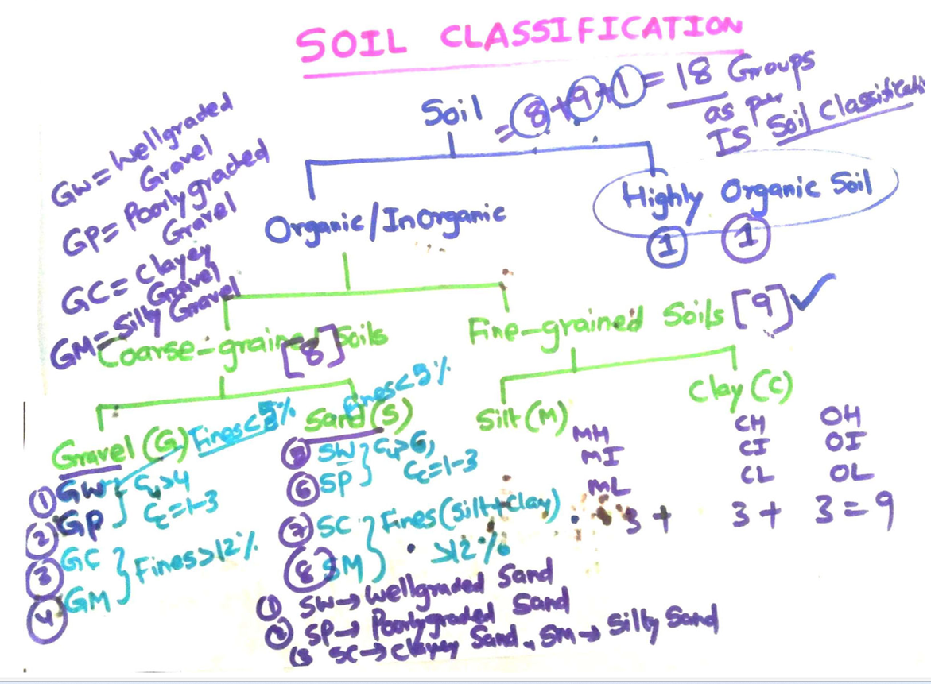

Slide 24
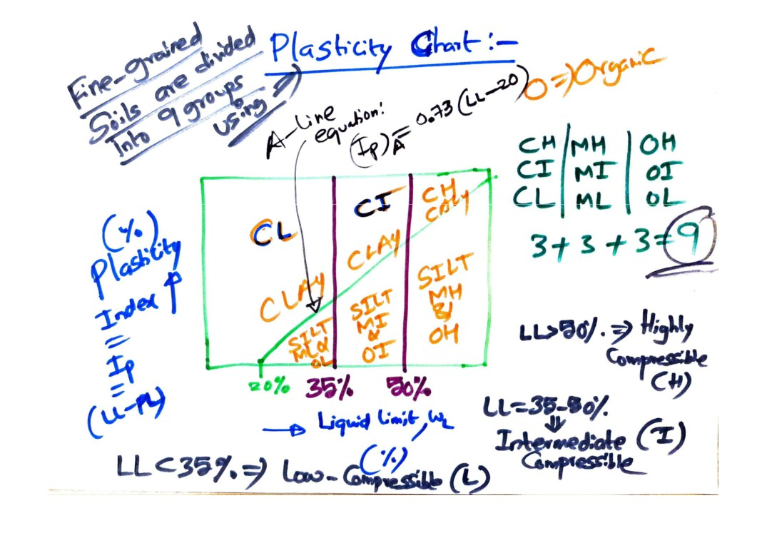

Slide 25
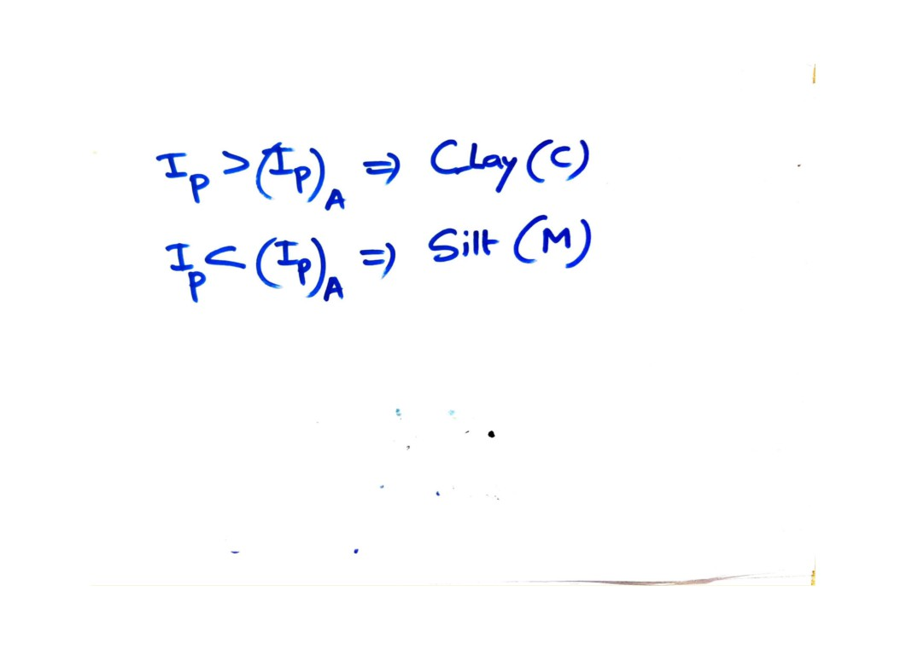

Slide 26
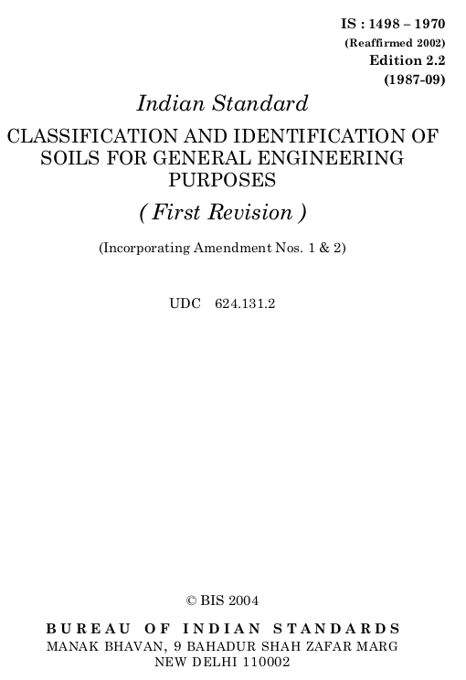

Slide 27
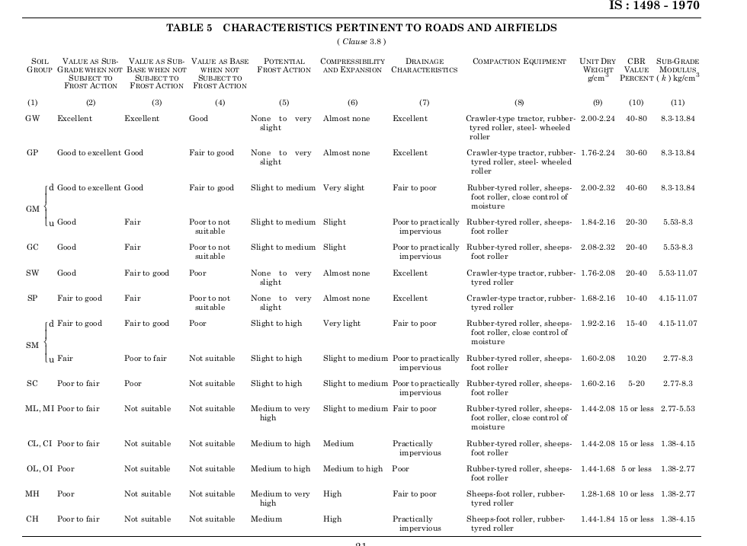

Slide 28
Case study
“GRAVEL+SAND”
DESIGN MIX

Slide 29
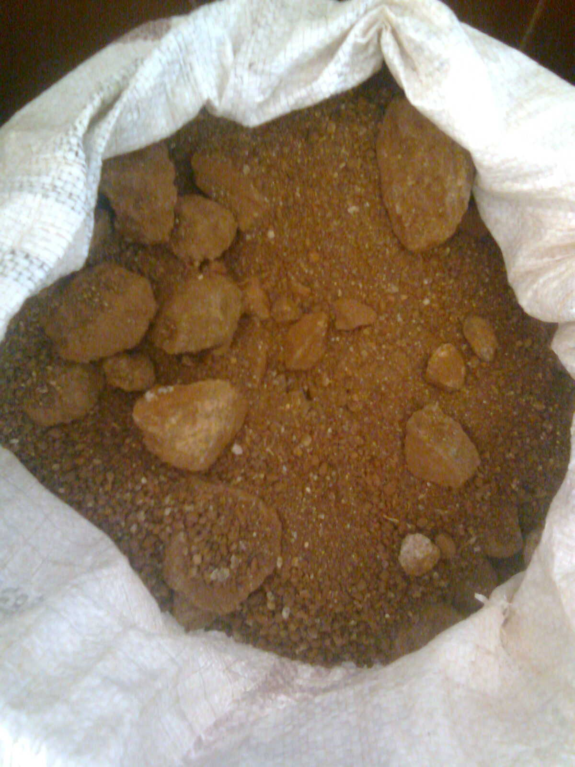
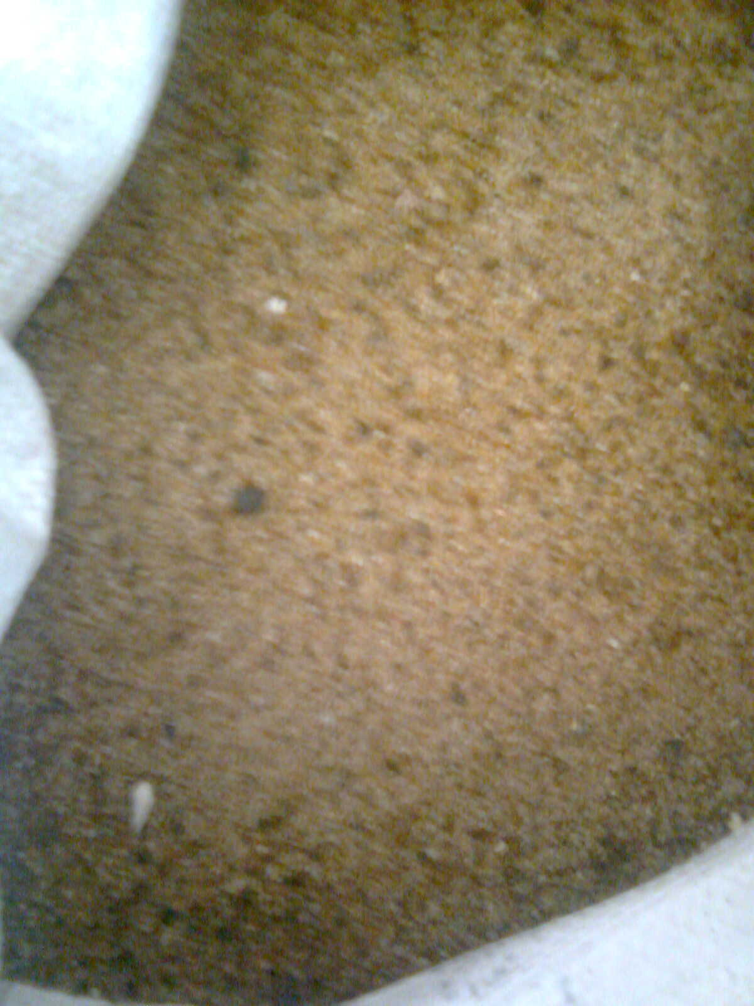
Gravel
Sand

Slide 30
DESIGN a GRAVEL+ (?%) SAND MIX which having
Plasticity Index (PI)<6%

Slide 31
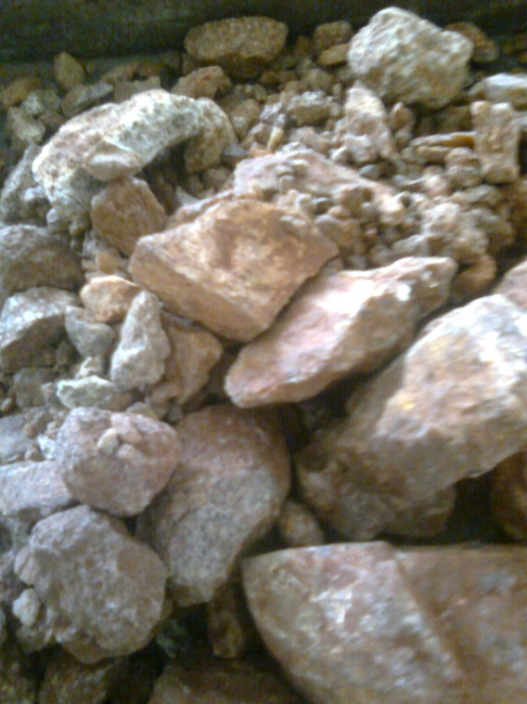
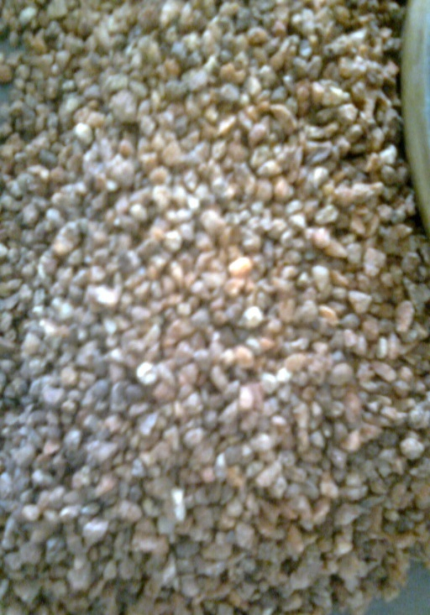
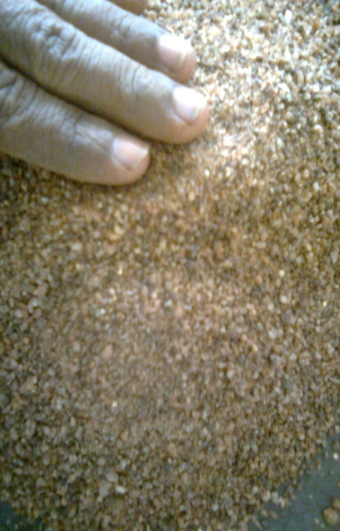
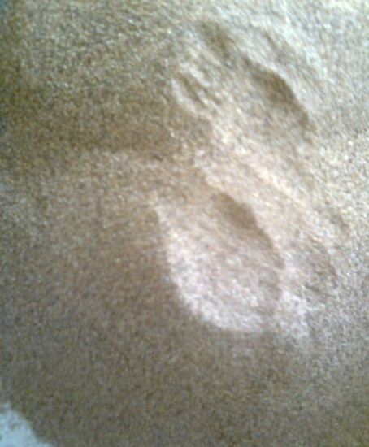
Sieve Analysis of Gravel

Slide 32
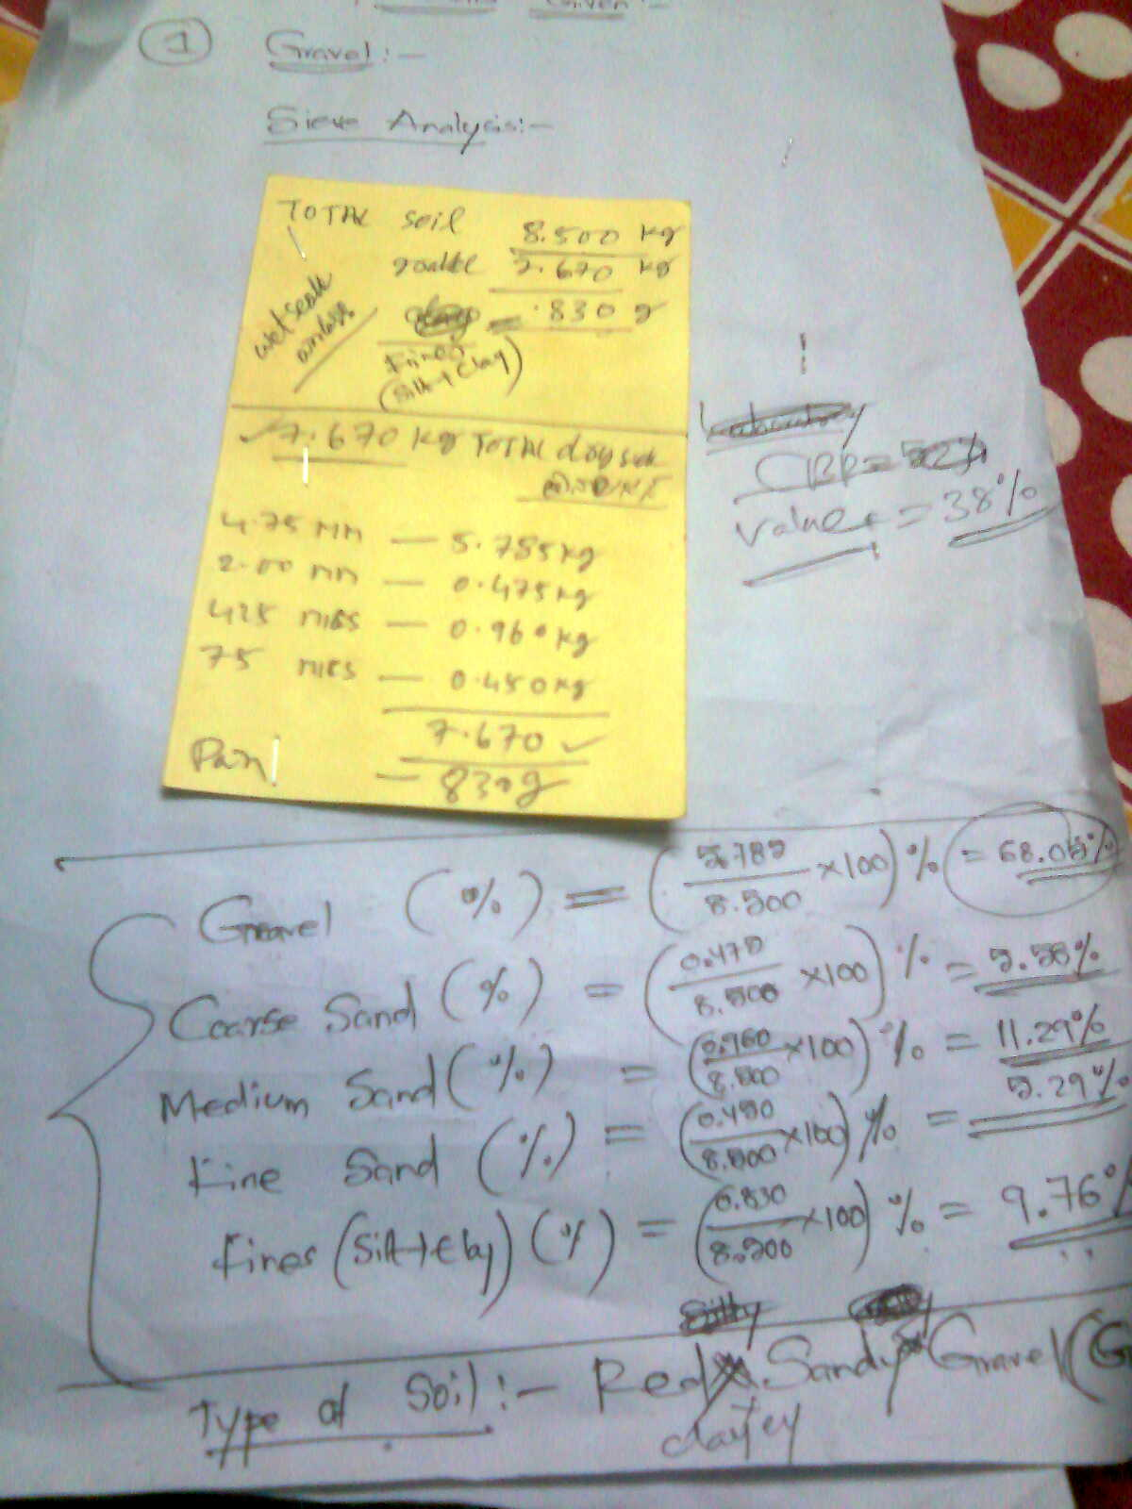
Sieve Analysis of Gravel

Slide 33
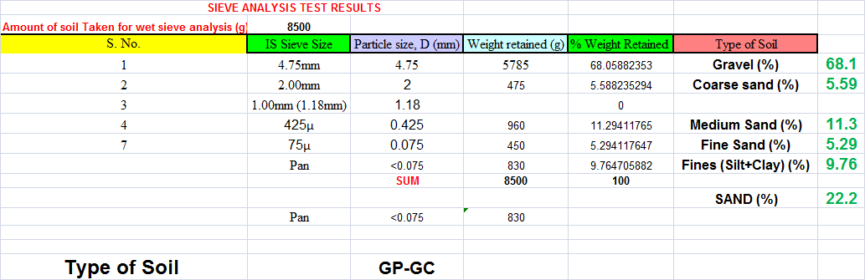

Slide 34
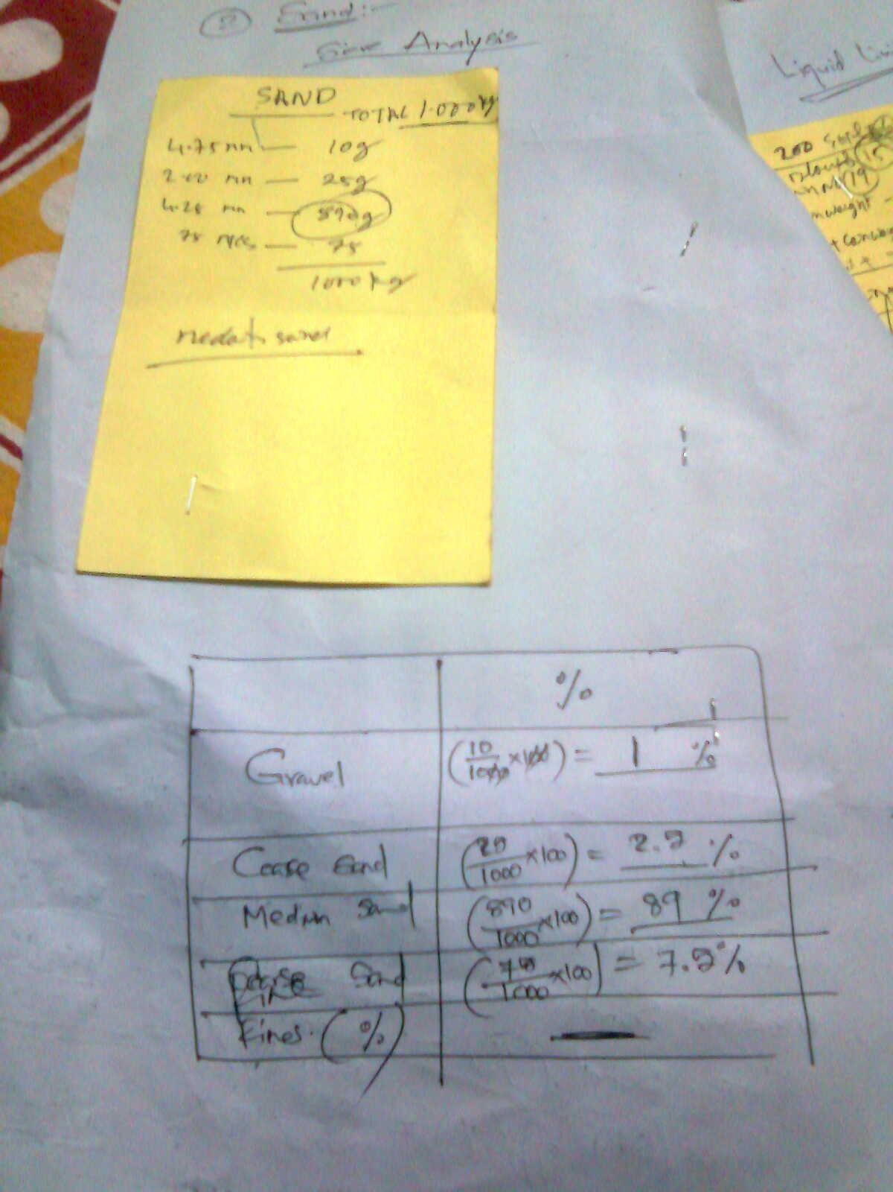
Sieve Analysis of Sand

Slide 35
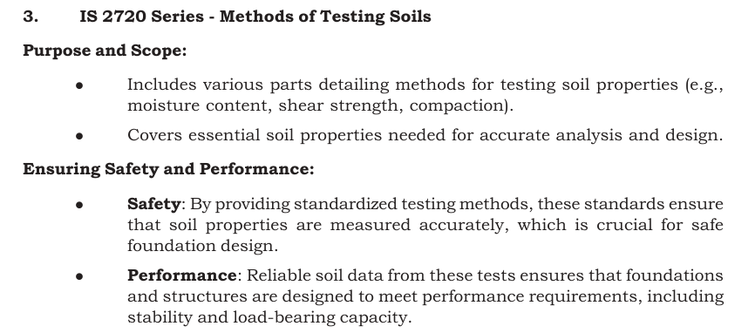

Slide 36
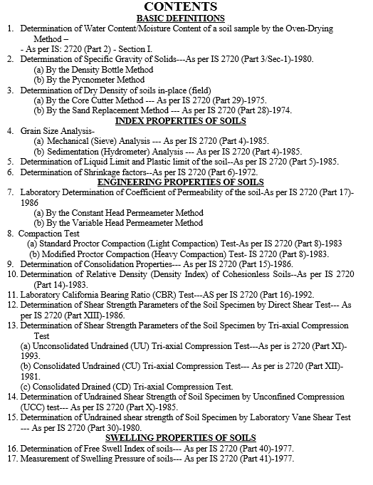

Slide 37
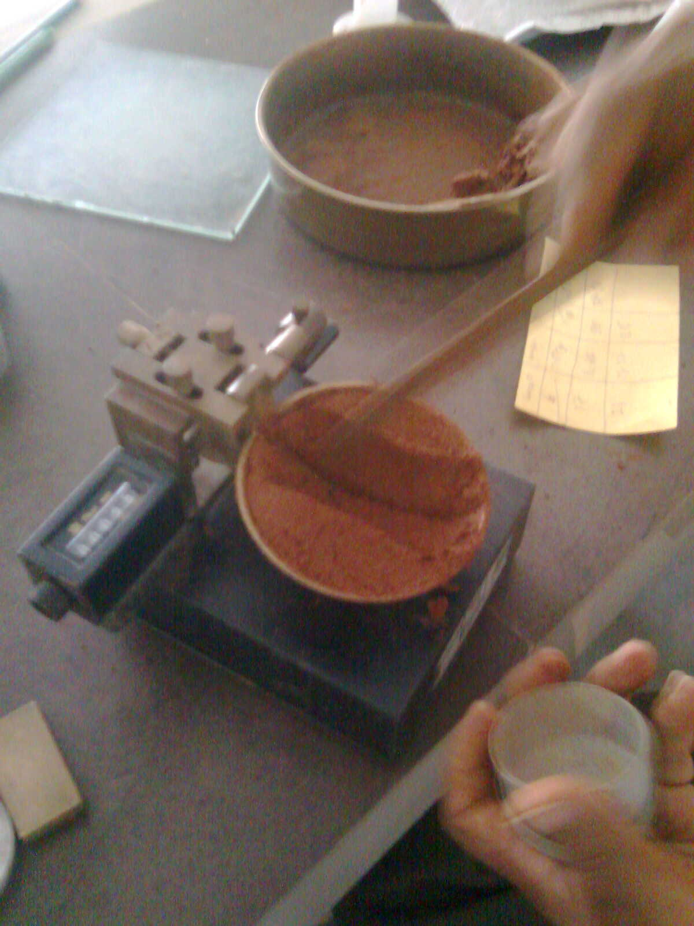
Liquid Limit Test

Slide 38
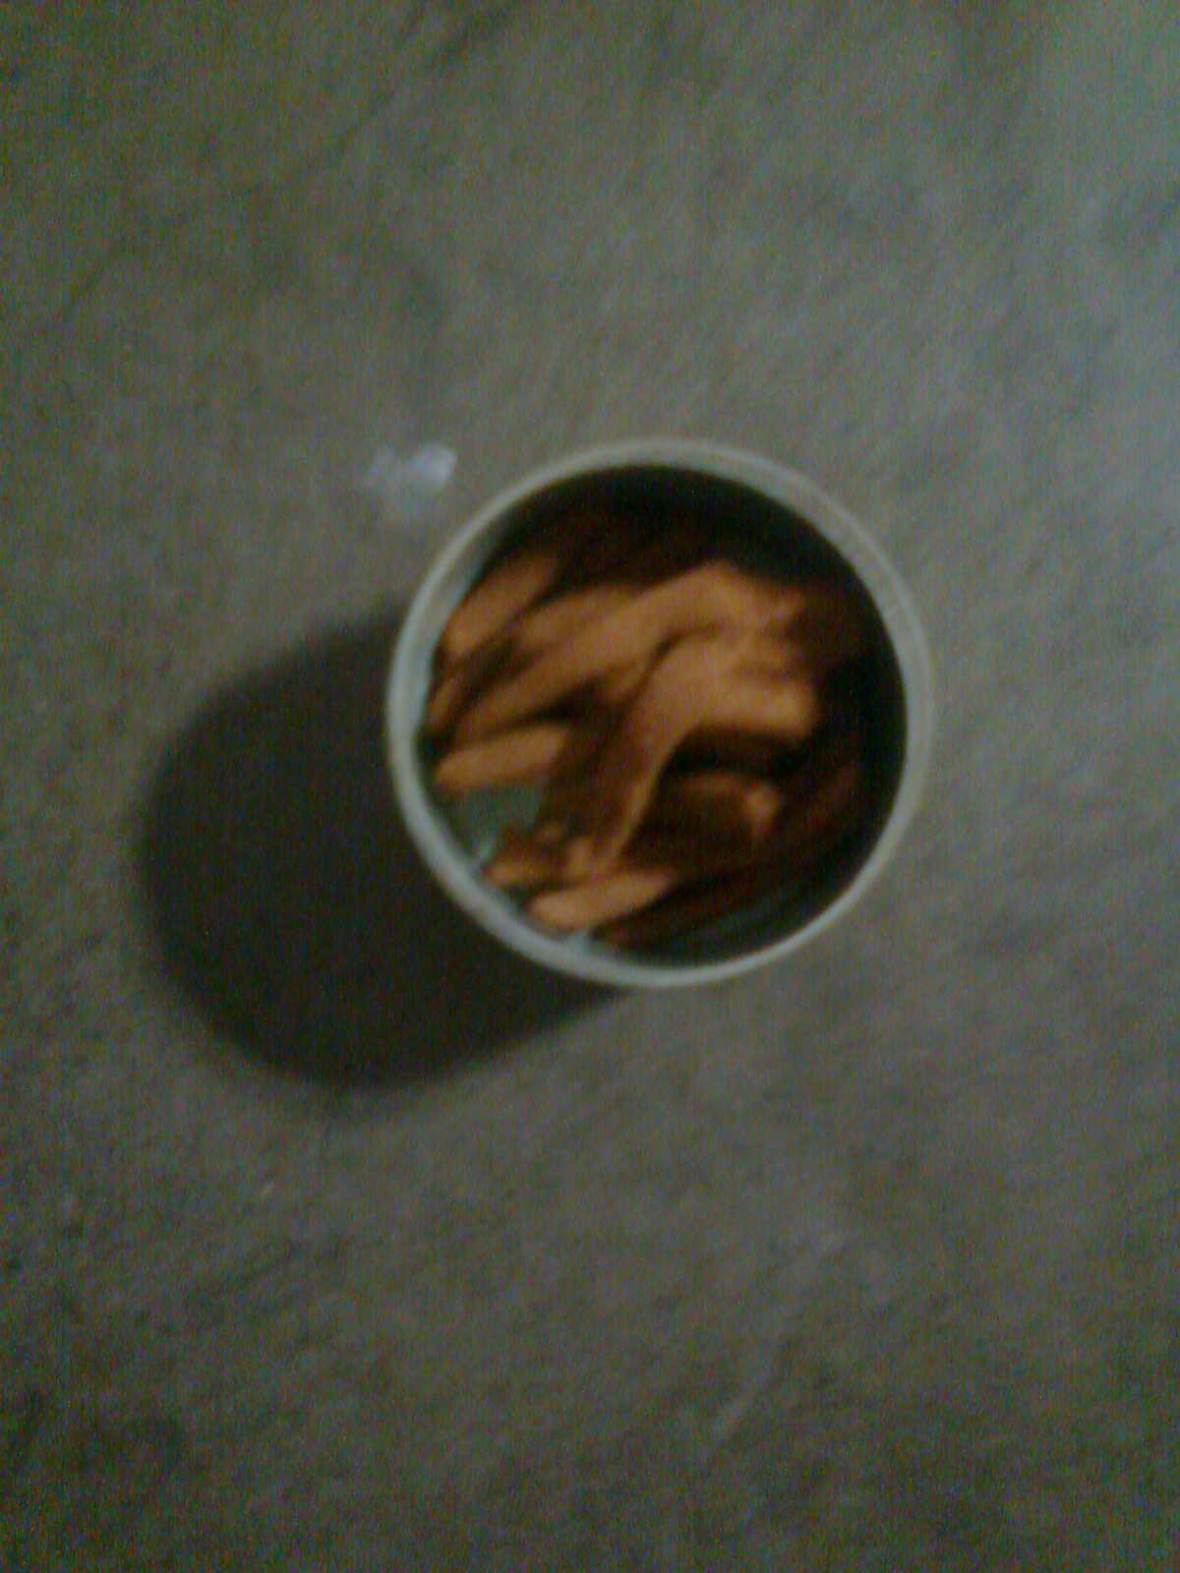
Plastic Limit Test

Slide 39
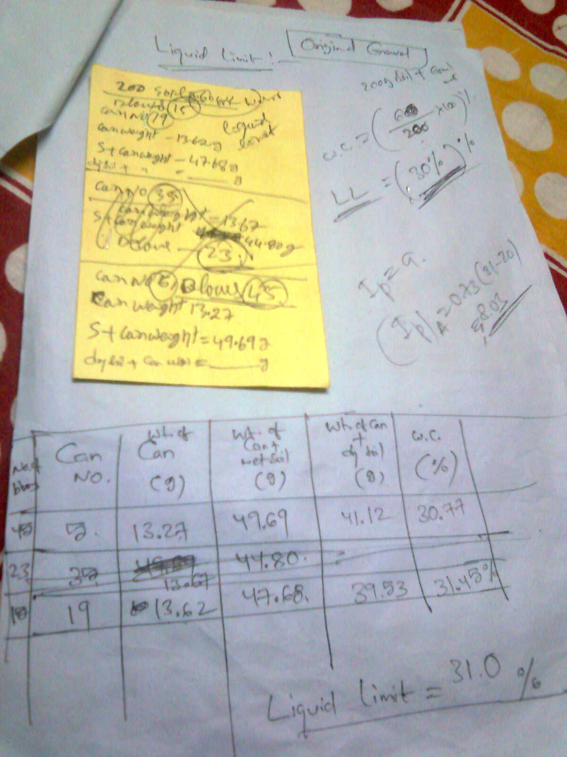
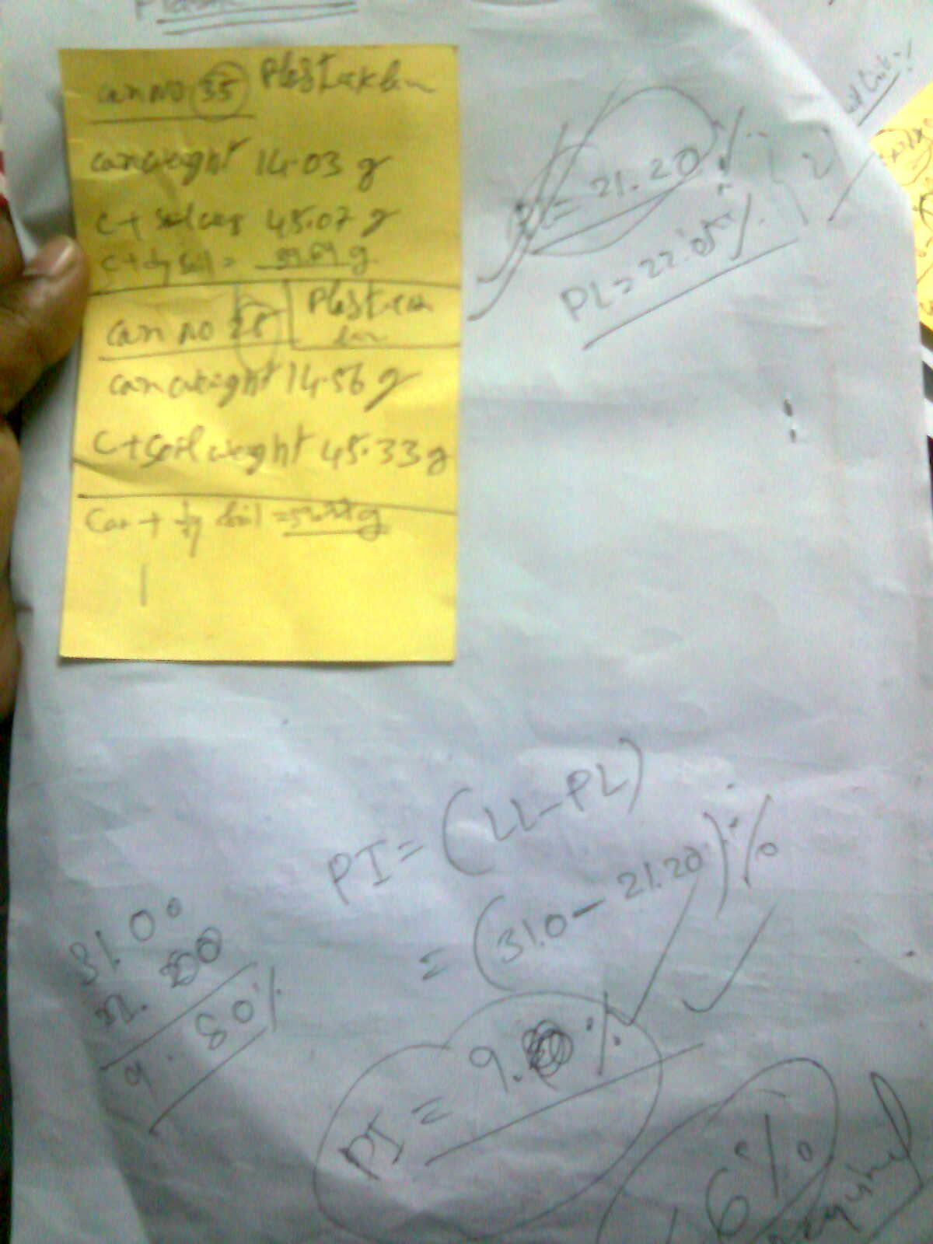

Slide 40
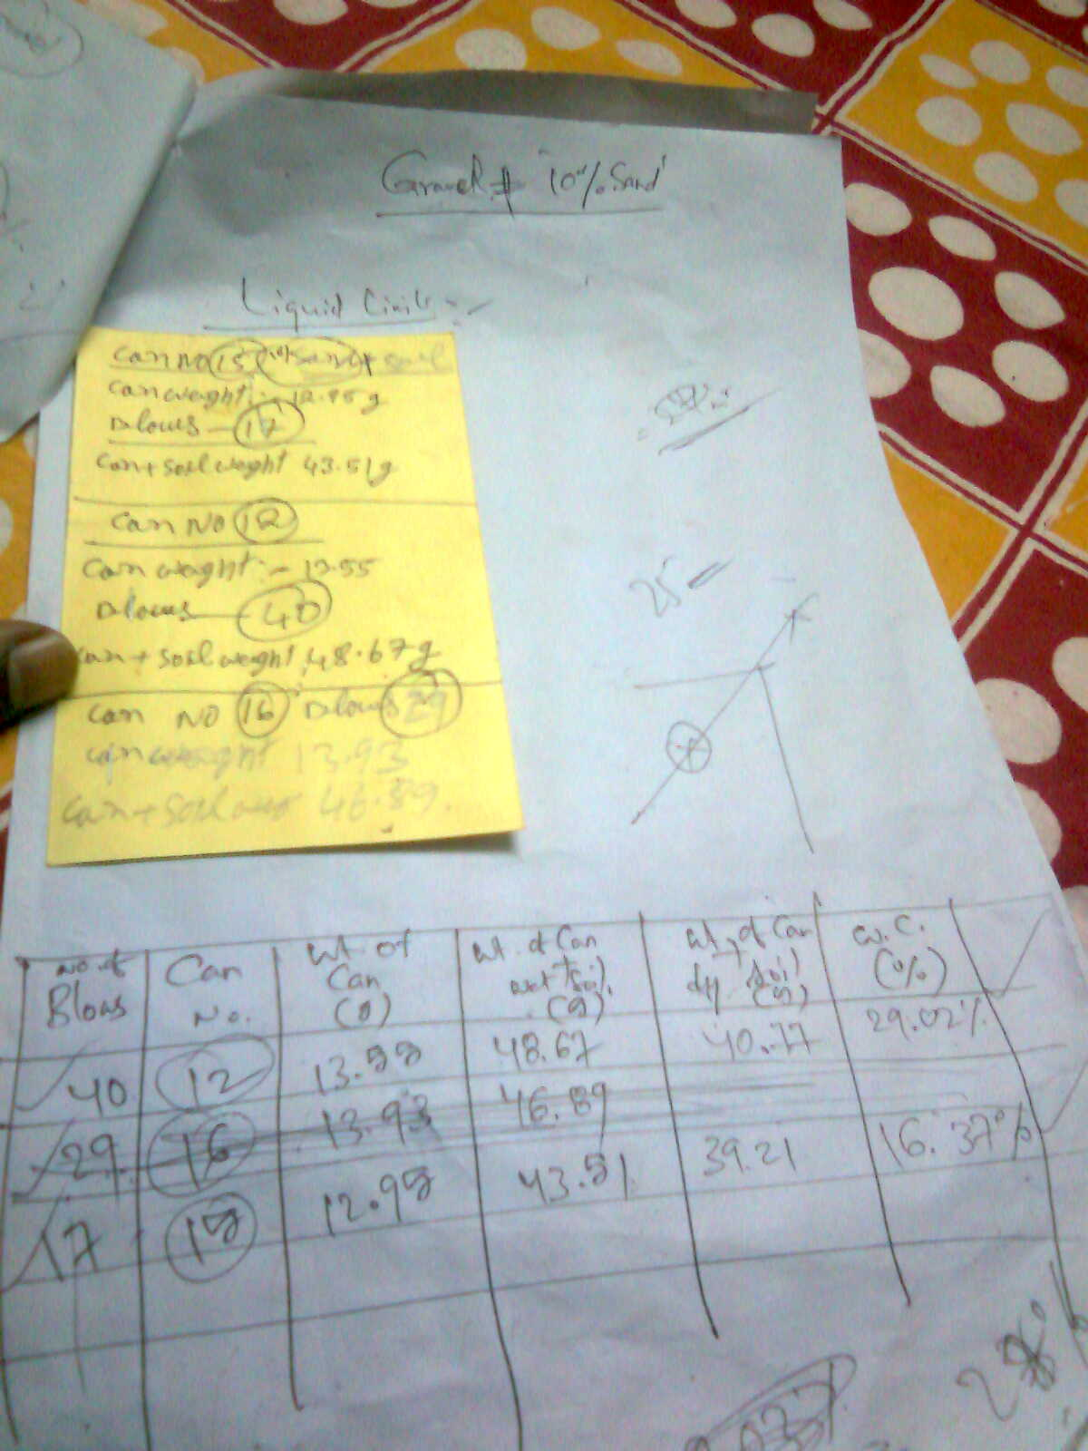
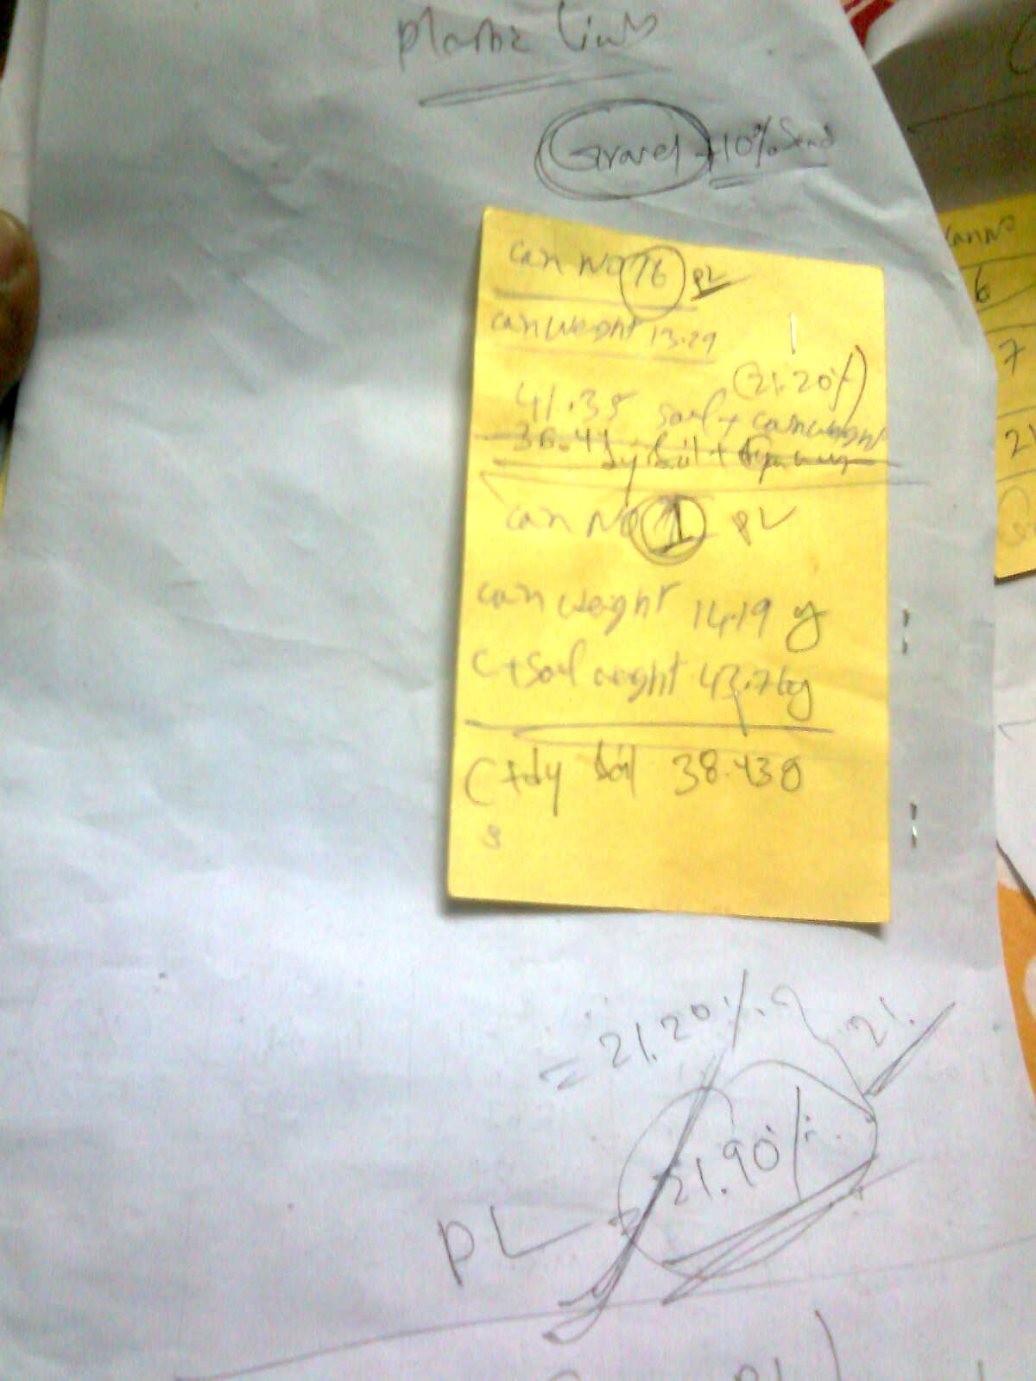

Slide 41
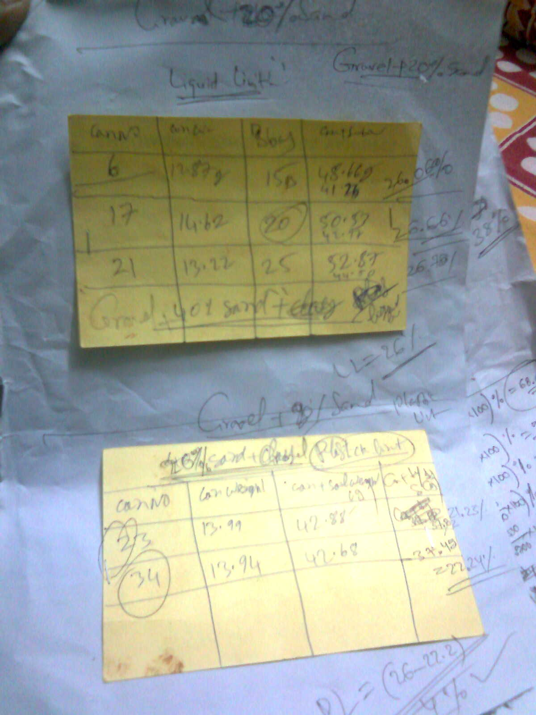

Slide 42
LIQUID LIMIT
Number of blows | 45 | 15
Container number | 5 | 19
Weight of container, g | 13.27 | 13.62
Weight of container + Wet soil, g | 49.69 | 47.68
Weight of container + Oven dry soil, g | 41.12 | 39.53
Weight of water, g | 8.57 | 8.15
Weight of oven dry soil, in g | 27.85 | 25.91
Water content (%) | 30.77 | 31.46
PLASTIC LIMIT
Container number | 35
Weight of container, g | 14.03
Weight of container + Wet soil, g | 45.07
Weight of container + Oven dry soil, g | 39.64
Weight of water, g | 5.43
Weight of oven dry soil, in g | 25.61
Water content (%) | 21.2 |  |  | 21.2
PLASTICITY INDEX (PI) (%) |  |  |  | 10.04

Slide 43
LIQUID LIMIT
Number of blows | 40 | 17
Container number | 12 | 15
Weight of container, g | 13.55 | 12.95
Weight of container + Wet soil, g | 48.67 | 43.51
Weight of container + Oven dry soil, g | 40.77 | 36.4
Weight of water, g | 7.9 | 7.11
Weight of oven dry soil, in g | 27.22 | 23.45
Water content (%) | 29.02 | 30.32
PLASTIC LIMIT
Container number |  | 1
Weight of container, g |  | 14.19
Weight of container + Wet soil, g |  | 43.76
Weight of container + Oven dry soil, g |  | 38.43
Weight of water, g |  | 5.33
Weight of oven dry soil, in g |  | 24.24
Water content (%) |  | 21.99 |  | 21.99
PLASTICITY INDEX (PI) (%) |  |  |  | 7.9

Slide 44
LIQUID LIMIT
Number of blows | 15 | 20 | 25
Container number | 6 | 17 | 21
Weight of container, g | 12.87 | 14.62 | 13.22
Weight of container + Wet soil, g | 48.66 | 50.53 | 52.87
Weight of container + Oven dry soil, g | 41.26 | 42.97 | 44.5
Weight of water, g | 7.4 | 7.56 | 8.37
Weight of oven dry soil, in g | 28.39 | 28.35 | 31.28
Water content (%) | 26.07 | 26.67 | 26.76
PLASTIC LIMIT
Container number |  | 34
Weight of container, g |  | 13.94
Weight of container + Wet soil, g |  | 42.68
Weight of container + Oven dry soil, g |  | 37.45
Weight of water, g |  | 5.23
Weight of oven dry soil, in g |  | 23.51
Water content (%) |  | 22.25 |  | 22.25

Slide 45
% of Sand Added | Liquid Limit, LL (%) | Plastic Limit, PL (%) | Plasticity Index, PI =(LL-PL) (%)
0 | 31.24 | 21.2 | 10.04
10 | 29.87 | 22 | 7.882
20 | 26.84 | 22.3 | 4.589

Slide 47
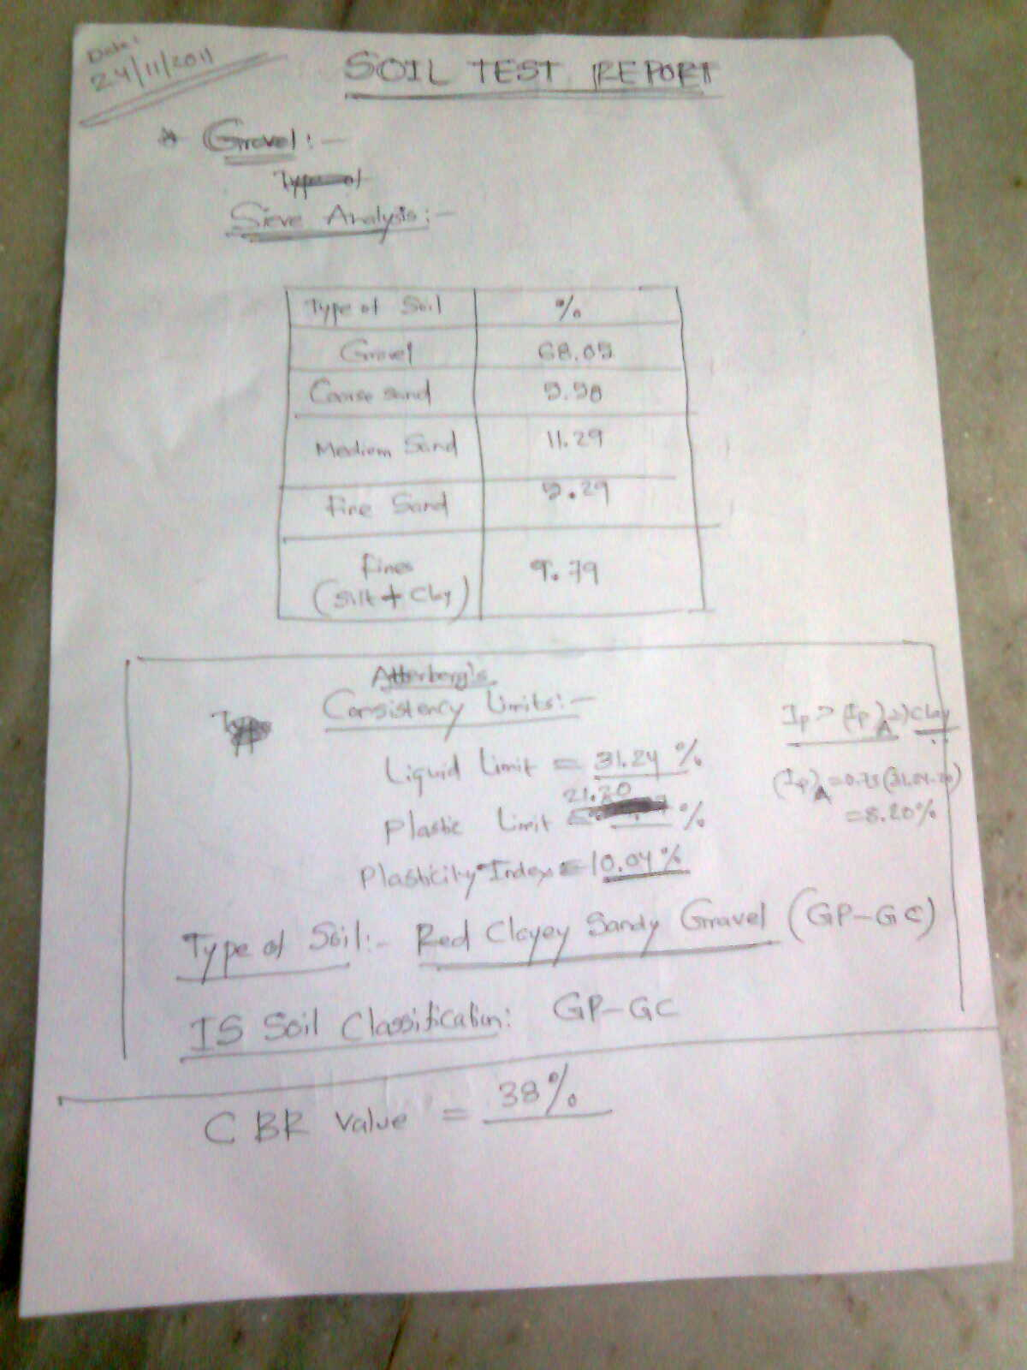

Slide 48
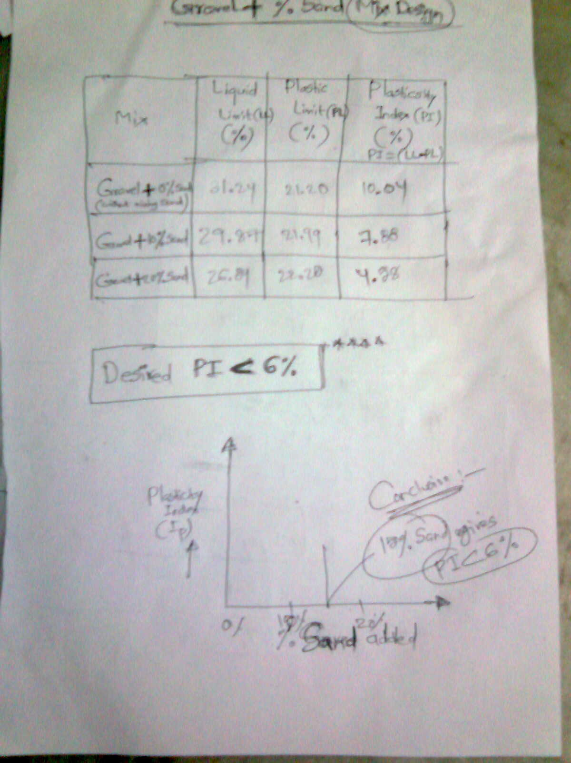

Slide 49
CONCLUSION
16% of Sand to be added to Gravel

Slide 50
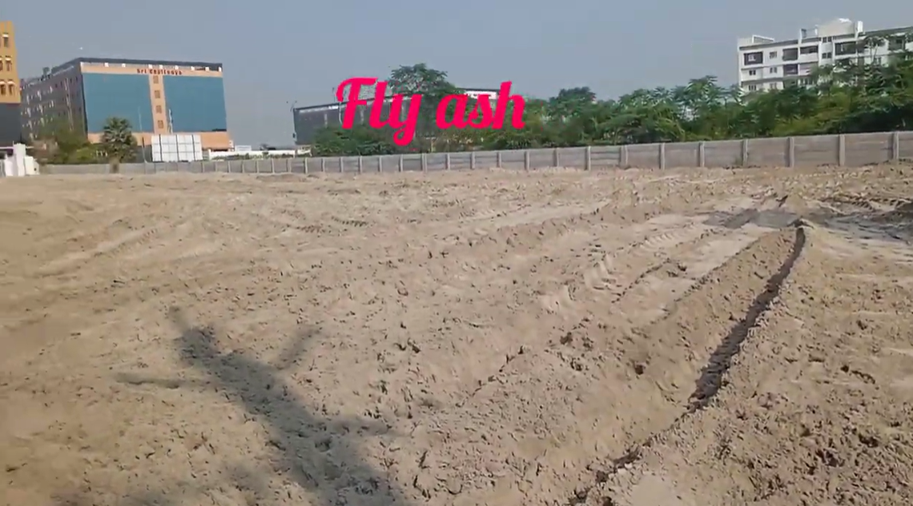

Slide 51
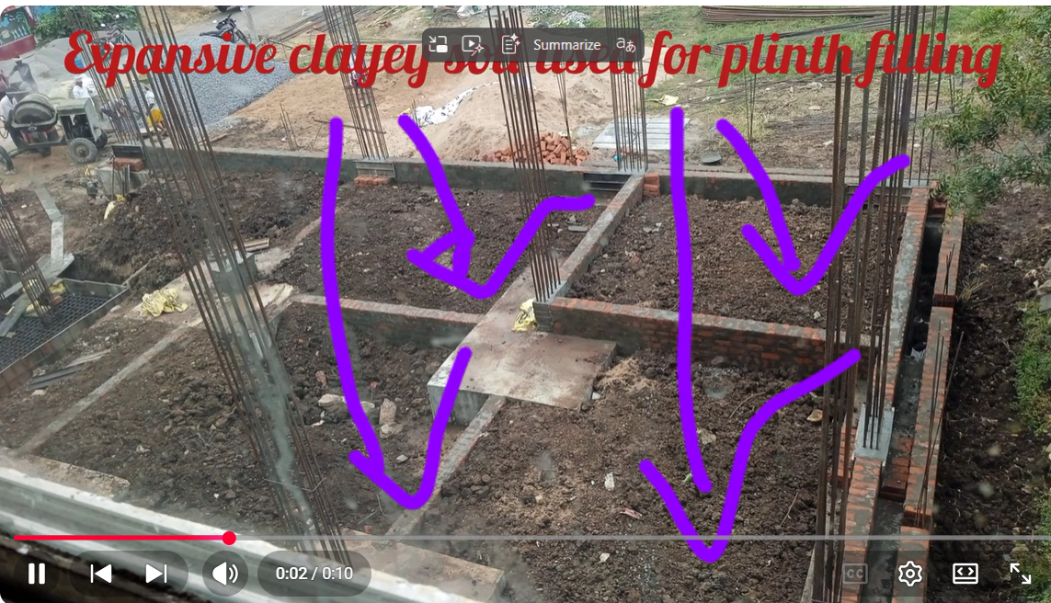

Slide 52
COMPACTION OF SOILS

Slide 53
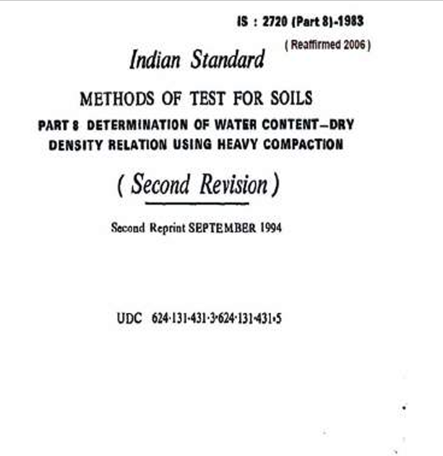

Slide 54
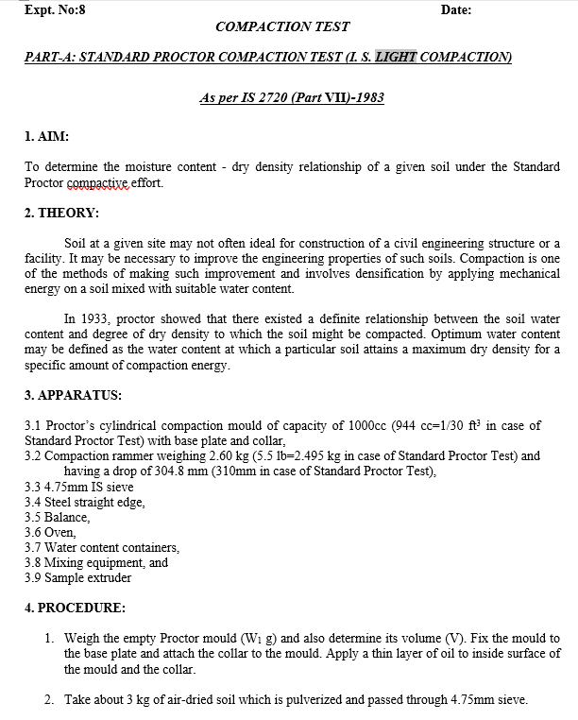

Slide 55
LABORATORY STANDARD PROCTOR COMPACTION TEST
MDD
Dry Density (g/cc)
OMC
Moisture content (%)
Fig. Standard Proctor Compaction Curve

Slide 56
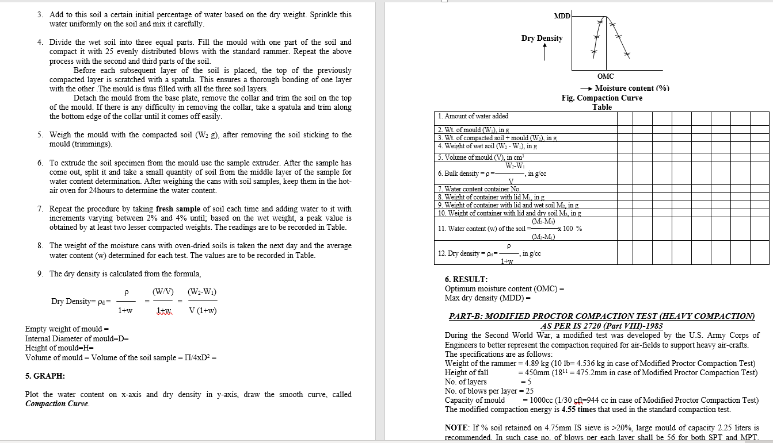

Slide 57
Degree of Compaction or Relative Compaction (%)

Slide 58
Case study
FIELD COMPACTION CONTROL
Testing for Construction of Vehicle shed for Zonal office building at 220KV SS Gunadala
@
TRANSCO NILAYAM, Gunadala, Vijayawada
For
Civil Survey Sub-division,
TRANSMISSION CORPORATION OF ANDHRA PRADESH
Date: 4-1-2014

Slide 59
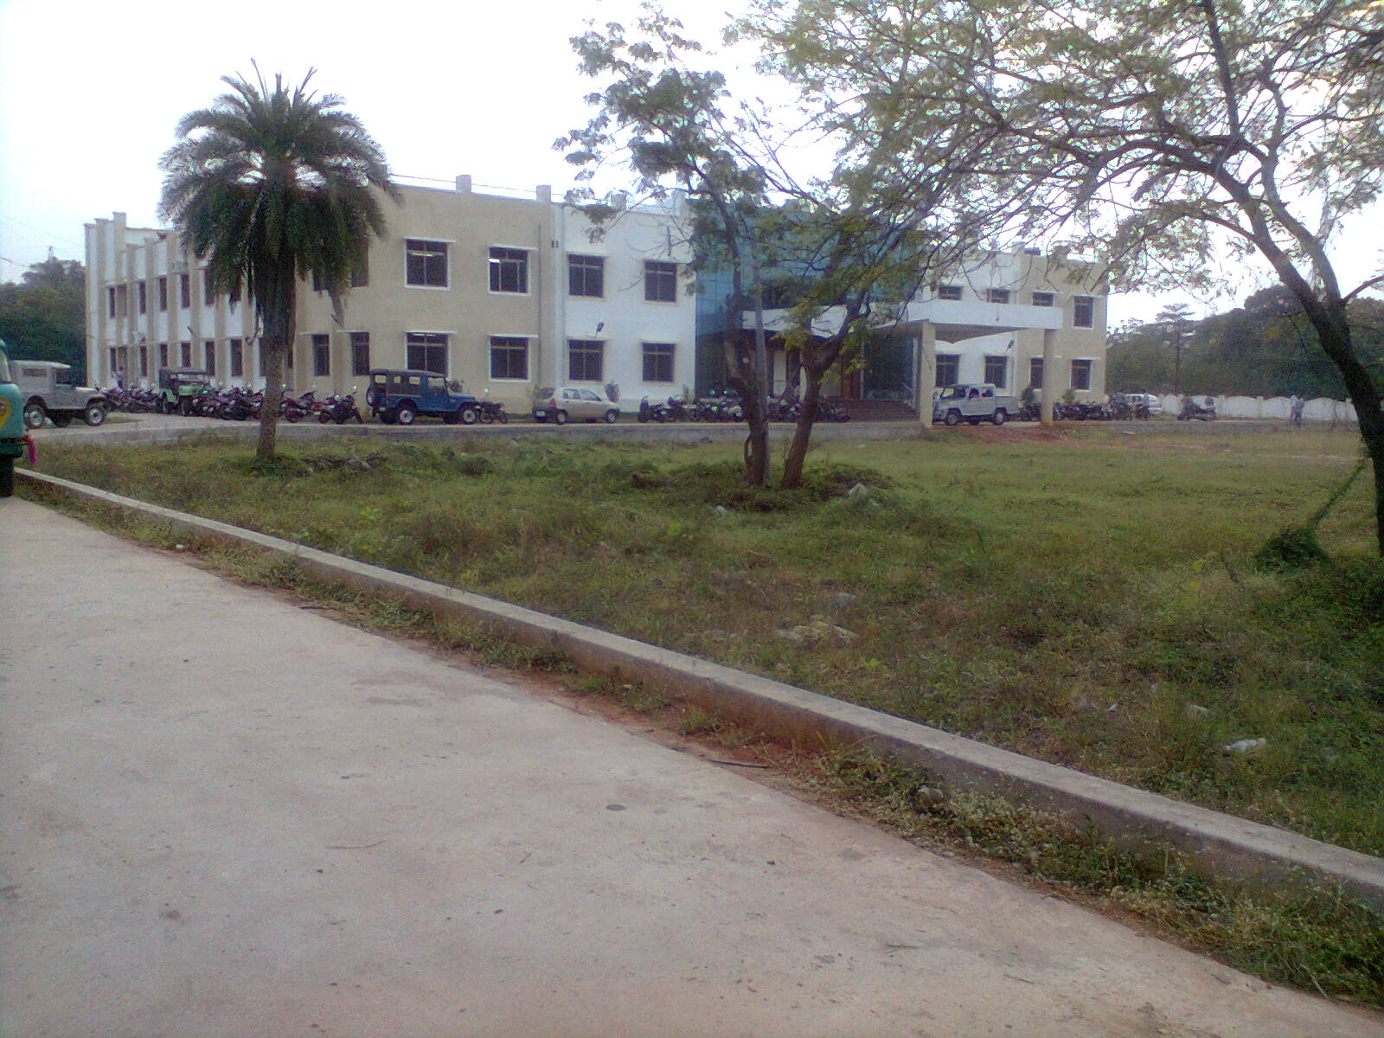
TRANSCO NILAYAM, Gunadala, Vijayawada

Slide 60

Filled up Soil for Constructing Parking Shed

Slide 61

Roller used for Compaction

Slide 62


Slide 63
Determination of
Field (in-situ) Density of Soil
by
Sand Replacement Method

Slide 64


Slide 65


Slide 66


Slide 67


Slide 68


Slide 69


Slide 70
REPORTING TEST RESULTS

Slide 71
DETERMINATION OF DENSITY OF COMPACTED LAYER BY SAND REPLACEMENT METHOD
Description | Sample
DETERMINATION OF BULK DENSITY OF SAND:
Diameter of calibration cylinder D (in cm) | 10
Height of calibration cylinder H (in cm) | 15
Volume of calibration cylinder =(3.14/4*D²*H) (in cc) | 1177.50
Weight of cylinder + Sand W1 (in g) | 6420
Weight of cylinder + Sand W2 (Kept on flat surface) (in g) | 6090
Weight of cylinder + Sand W3 (Kept on Calibration cylinder) (in g) | 4130
Weight of sand in conical portion only Wcp (in g) | 330
Weight of sand in calibration Cylinder & conical portion Wccp (in g) | 1960
Weight of sand in calibration cylinder only Wcc (in g) | 1630
Density of sand ﻻsand = | 1.38
FIELD OBSERVATIONS:
Weight of cylinder + Sand W₄ (in g) | 6060
Weight of cylinder + Sand W₅ (Kept on pit) (in g) | 4765
Weight of excavated soil W₆ (in g) | 1435
Weight of sand pit & conical portion Wpcp (in g) | 1295
Weight of sand pit only Wpit (in g) | 965
Volume of pit Vpit (in cc) | 697.11
Field Density (in g/cc) | 2.06
Container number | 26
Weight of container, g | 14.49
Weight of container + Wet soil, g | 52.9
Weight of container + Oven dry soil, g | 48.07
Weight of water, g | 4.83
Weight of oven dry soil, in g | 33.58
Field Moisture content (%) | 14.383562
Field Dry Density, FDD (in g/cc) | 1.7996484
Maximum Dry Density, MDD (in g/cc) from Lab (IS:2720-Part 8) | 1.838
OMC (%) | 15.6
Degree of Compaction (%) = (FDD/MDDx100) | 97.913405

Slide 72
Soil Strength
SHEAR STRENGTH OF SOILS
Soils are essentially frictional materials
  the strength depends on the applied stress
Strength is controlled by effective stresses
  water pressures are required
Soil strength depends on drainage

Slide 73


Shear failure
Soils generally fail in shear
embankment
strip footing
failure surface
mobilised shear resistance
At failure, shear stress along the failure surface reaches the shear strength.

Slide 74

Shear failure
failure surface
The soil grains slide over each other along the failure surface.
No crushing of individual grains.

Slide 75
Shear failure
τ
σ
τ
At failure, shear stress along the failure surface (τ) reaches the shear strength (τ_{f}).

Slide 76
Mohr-Coulomb failure criterion
σ_{n}
τ
The limiting shear stress (soil strength) is given by
τ = c + σ_{n} tan φ
where c = cohesion (apparent)
φ = friction angle

Slide 77
Mohr-Coulomb Failure Criterion
τ
φ
failure envelope
cohesion
friction angle
τ_{f}
c
σ
σ
τ_{f} is the maximum shear stress the soil can take without failure, under normal stress of σ.

Slide 78
Mohr-Coulomb Failure Criterion
Shear strength consists of two components: cohesive and frictional.
τ
τ_{f}
σ_{f} tan φ
φ
frictional component
cohesive component
c
c
σ_{f}
σ

Slide 79

c and φ are measures of shear strength.
Higher the values, higher the shear strength.

Slide 80
Mohr-Coulomb criterion (Principal stresses)
τ
R
φ
c
σ
σ₃
σ₁
c cot φ
p
Failure occurs if a Mohr circle touches the failure criterion. Then
R = sin φ ( p + c cot φ )

Slide 81
Mohr-Coulomb criterion (Principal stresses)
τ
R
φ
c
σ
σ₃
σ₁
c cot φ
p
Failure occurs if a Mohr circle touches the failure criterion. Then
R = sin φ ( p + c cot φ )

Slide 82
Mohr-Coulomb criterion (Principal stresses)
τ
R
φ
c
σ
σ₃
σ₁
c cot φ
p
Failure occurs if a Mohr circle touches the failure criterion. Then
R = sin φ ( p + c cot φ )

Slide 83
σ₁- σ₃ Relation at Failure
σ₁
X
σ₃
X
soil element at failure
σ₃
σ₁

Slide 84
Effective stress failure criterion
If the soil is at failure the effective stress failure criterion will always be satisfied.
are known as the effective (or drained) strength parameters.

Slide 85
Effective stress failure criterion
If the soil is at failure the effective stress failure criterion will always be satisfied.
are known as the effective (or drained) strength parameters.
Soil behaviour is controlled by effective stresses, and the effective strength parameters are the fundamental strength parameters. But they are not necessarily soil constants.

Slide 86
Total stress failure criterion
If the soil is taken to failure at constant volume (undrained) then the failure criterion can be written in terms of total stress as
c_{u} and φ_{u} are known as the undrained strength parameters

Slide 87
Total stress failure criterion
If the soil is taken to failure at constant volume (undrained) then the failure criterion can be written in terms of total stress as
c_{u} and φ_{u} are known as the undrained strength parameters
These parameters are not soil constants, they depend strongly on the moisture content of the soil.

Slide 88
Total stress failure criterion
If the soil is taken to failure at constant volume (undrained) then the failure criterion can be written in terms of total stress as
c_{u} and φ_{u} are known as the undrained strength parameters
These parameters are not soil constants, they depend strongly on the moisture content of the soil.
The undrained strength is only relevant in practice to clayey soils that in the short term remain undrained. Note that as the pore pressures are unknown for undrained loading the effective stress failure criterion cannot be used.

Slide 89
Mohr Circles & Failure Envelope
τ
Y
X
X
σ
Y
Soil elements at
different locations
X
~ failure
Y
~ stable

Slide 90
Mohr Circles & Failure Envelope
The soil element does not fail if the Mohr circle is contained within the envelope
GL
Δσ
σ_{c}
σ_{c}
Y
σ_{c}
σ_{c}+Δσ
Δσ
Initially, Mohr circle is a point

Slide 91
Mohr Circles & Failure Envelope
As loading progresses, Mohr circle becomes larger…
GL
Δσ
σ_{c}
σ_{c}
Y
σ_{c}
.. and finally failure occurs when Mohr circle touches the envelope

Slide 92
Orientation of Failure Plane
Failure plane oriented at 45 + φ/2 to horizontal
Y
45 + φ/2
GL
45 + φ/2
Δσ
σ_{c}
φ
σ_{c}
90+φ
Y
σ_{c}
σ_{c}+Δσ

Slide 93
Envelopes in terms of σ & σ’
Identical specimens initially subjected to different isotropic stresses (σ_{c}) and then loaded axially to failure
Δσ_{f}
σ_{c}
σ_{c}
σ_{c}
σ_{c}
u_{f}
Initially…
Failure
c, φ
in terms of σ
At failure,
σ₃ = σ_{c}; σ₁ = σ_{c}+Δσ_{f}
σ₃’ = σ₃ – u_{f} ; σ₁’ = σ₁ - u_{f}
c’, φ’
in terms of σ’

Slide 94
Tests to measure soil strength
1. Shear Box Test
Normal load
Top platen
Load cell to measure Shear Force
Motor drive
Soil
Porous plates
Rollers
Measure relative horizontal displacement, dx
vertical displacement of top platen, dy

Slide 95


Slide 96
Shear box test
Usually only relatively slow drained tests are performed in shear box apparatus. For clays rate of shearing must be chosen to prevent excess pore pressures building up. For sands and gravels tests can be performed quickly
Tests on sands and gravels are usually performed dry. Water does not significantly affect the (drained) strength.
If there are no excess pore pressures and as the pore pressure is approximately zero the total and effective stresses will be identical.
The failure stresses thus define an effective stress failure envelope from which the effective (drained) strength parameters c’, φ’ can be determined.

Slide 97
Typical drained shear box results
τ = F/A
Peak
Ultimate
N₁
N₂
σ = N/A

Slide 98
Tests to measure soil strength
2. The Triaxial Test
Deviator load
Confining cylinder
Cell water
Rubber membrane
O-ring seals
Soil
Porous filter disc
Cell pressure
Pore pressure and volume change

Slide 99
Stresses in triaxial specimens
F = Deviator load
σ_{r}
σ_{r}
σ_{r} = Radial stress (cell pressure)
σ_{a} = Axial stress

Slide 100
Stresses in triaxial specimens
F = Deviator load
σ_{r}
σ_{r}
σ_{r} = Radial stress (cell pressure)
σ_{a} = Axial stress
From equilibrium we have

Slide 101


Triaxial Test Apparatus
piston (to apply deviatoric stress)
failure plane
O-ring
impervious membrane
soil sample at failure
porous stone
perspex cell
water
cell pressure
pore pressure or
volume change
back pressure
pedestal

Slide 102
Types of Triaxial Tests
deviatoric stress (Δσ)
Under all-around cell pressure σ_{c}
Shearing (loading)
Is the drainage valve open?
Is the drainage valve open?
yes
no
yes
no
Consolidated sample
Unconsolidated sample
Drained loading
Undrained loading

Slide 103
Types of Triaxial Tests
Depending on whether drainage is allowed or not during
initial isotropic cell pressure application, and
shearing,
there are three special types of triaxial tests that have practical significances. They are:
Consolidated Drained (CD) test
Consolidated Undrained (CU) test
Unconsolidated Undrained (UU) test

Slide 104

For unconsolidated undrained test, in terms of total stresses, φ_{u} = 0
Granular soils have no cohesion.
c = 0 & c’= 0
For normally consolidated clays, c’ = 0 & c = 0.

Slide 105
Types of triaxial test
There are many test variations. Those used most in practice are:
UU (unconsolidated undrained) test.
Cell pressure applied without allowing drainage. Then keeping cell pressure constant increase deviator load to failure without drainage.
CIU (isotropically consolidated undrained) test.
Drainage allowed during cell pressure application. Then without allowing further drainage increase q keeping σ_{r} constant as for UU test.
CID (isotropically consolidated drained) test
Similar to CIU except that as deviator stress is increased drainage is permitted.

Slide 106
Advantages of the triaxial test
Specimens are subjected to (approximately) uniform stresses and strains
The complete stress-strain-strength behaviour can be investigated
Drained and undrained tests can be performed
Pore water pressures can be measured in undrained tests, allowing effective stresses to be determined
Different combinations of cell pressure and axial stress can be applied

Slide 107
Mohr Circles
To relate strengths from different tests we need to use some results from the Mohr circle transformation of stress.
τ
σ
σ₃
σ₁

Slide 108
Mohr Circles
To relate strengths from different tests we need to use some results from the Mohr circle transformation of stress.
τ
c
σ
σ₃
σ₁
The Mohr-Coulomb failure locus is tangent to the Mohr circles at failure

Slide 109
Effective stress Mohr-Coulomb criterion
As mentioned previously the effective strength parameters are the fundamental parameters. The Mohr-Coulomb criterion must be expressed in terms of effective stresses

Slide 110
Effective stress Mohr-Coulomb criterion
As mentioned previously the effective strength parameters are the fundamental parameters. The Mohr-Coulomb criterion must be expressed in terms of effective stresses

Slide 111
Effective stress Mohr-Coulomb criterion
As mentioned previously the effective strength parameters are the fundamental parameters. The Mohr-Coulomb criterion must be expressed in terms of effective stresses
where

Slide 112


Slide 113


Slide 114


Slide 115


Slide 116

Case study

Slide 117


Slide 118


Slide 119


Slide 120


Slide 121


Slide 122


Slide 123


Slide 124


Slide 125


Slide 126


Slide 127
Conducting UCC Test to evaluate
“Safe Bearing Capacity (q_{s})”

Slide 128


Slide 129


Slide 130


Slide 131


Slide 132



Slide 133
Initial diameter of soil specimen, D₀ (in cm) | 3.8
Initial length of soil specimen, L₀ (in cm) | 7.6
Initial area of soil specimen, A₀ = pi/4*D² (in cm²) | 11.34262
Test Result:
Deformation Dial Reading | 0 | 400 | 500 | 570 | 575 | 585
Change in length of soil sample [Axial deformation, DL] (in mm) | 0 | 4 | 5 | 5.7 | 5.75 | 5.85
Axial strain (e) = [DL/L*100] (in %) | 0 | 5.263158 | 6.578947 | 7.5 | 7.565789 | 7.697368
Corrected area at failure Ac = A0/(1-e) (in cm2) | 11.105 | 11.72194 | 11.88704 | 12.00541 | 12.01395 | 12.03108
Proving ring dial reading | 0 | 3 | 5 | 20 | 30 | 35
Proving Constant (1 Dial Division = 2.89 N) | 2.89 | 2.89 | 2.89 | 2.89 | 2.89 | 2.89
Axial force (P) (in N) | 0 | 8.67 | 14.45 | 57.8 | 86.7 | 101.15
Axial Stress=P/Ac (in N/cm²) | 0 | 0.739638 | 1.215609 | 4.814498 | 7.216611 | 8.407394
Axial Stress (in kPa) | 0 | 7.396384 | 12.15609 | 48.14498 | 72.16611 | 84.07394

Slide 135
UCC Strength (kPa) | 84.073941
Undrained Cohesion, Cu (kPa) | 42.036971
Net Safe Bearing Capacity, (q_{ns}) | 84.073941
Unit weight of Soil (kN/m3) | 16
Depth of foundation, m | 2.5
Safe Bearing Capacity, (q_{s}) in kPa | 124.07394
Safe Bearing Capacity, (q_{s}) in t/m² | 12.6

Slide 136
GEOTECHNICAL INVESTIGATIONS
SOIL EXPLORATION/ SOIL INVESTIGATION
The field and laboratory investigation studies carried out for the necessary information about the sub-soil characteristics including the position of ground water table are termed as SOIL EXPLORATION.

Slide 137

Leaning Tower of PISA

Slide 138


Slide 139


Slide 140


Slide 141


Slide 142
MAIN COMPONENTS OF
SUBSURFACE INVESTIGATIONS

Slide 143


Slide 144
LABORATORY INVESTIGATIONS
STATIC | DYNAMIC
INDEX CONSISTENCY PERMEABILITY COMPRESSIBILITY COMPACTION STRENGTH TESTS [UCS,COMPRESSION, TENSILE,BRAZILIAN] SHEAR STRENGTH TESTS [DIRECT, TRIAXIAL, VANE] ULTRASONIC PULSE VELOCITY DILATANCY SLAKE DURABILITY | RESONANT COLUMN TEST CYCLIC TRIAXIAL TEST

Slide 145
Planning of SOIL EXPLORATION/
SOIL INVESTIGATION Programme
Reconnaissance
Preliminary Investigation
Detailed Investigation

Slide 146


Slide 147


Slide 148


Slide 149


Slide 150

Soil Stress & Deformation

Slide 151


Slide 152


Slide 153


Slide 154


Slide 155



Slide 156

IS 13063 (1991): Code of practice for structural safety of buildings on shallow foundations on rocks [CED 48: Rock Mechanics]

Slide 157

IS 13063 (1991): Code of practice for structural safety of buildings on shallow foundations on rocks [CED 48: Rock Mechanics]

Slide 158

Methods of SOIL EXPLORATION/
SOIL INVESTIGATION

Slide 159

Methods of SOIL EXPLORATION/
SOIL INVESTIGATION

Slide 160
I. DIRECT METHODS OF SOIL INVESTIGATION
(TEST PITS)

Slide 161

TRIAL PIT

Slide 162
II. SEMI-DIRECT METHODS OF SOIL INVESTIGATION
(BORINGS)

Slide 163


Slide 164


Slide 165


Slide 166


Slide 167

Hand Operated Augers
Bulb Auger for Sandy Soils

Slide 168

Hand Operated Augers
Helical Auger

Slide 169


Slide 170


Slide 171


Slide 172


Slide 173

Rock Core Drilling

Slide 174


Slide 175
FIELD (in-situ) TESTS
Penetration Tests:
Standard Penetration Test (SPT)
Cone Penetration Tests (CPTs)
2. Plate Load Test
3. Pressure Meter Tests

Slide 176
IN –SITU INVESTIGATIONS
SAMPLING
1. AUGERS
2. BOREHOLES (A) DIAMOND DRILLING (B) PERCUSSION DRILLING
TESTING
STATIC | DYNAMIC
SPT CPT PLATE LOAD TEST PILE LOAD TEST PRESSUREMETER TEST PUMPING TEST CROSS-HOLE TEST BOREHOLE DEFORMATION TEST CABLE JACKING LARGE DIRECT SHEAR TEST | DCT BLOCK VIBRATION TEST PIEZOCONE PENETRATION (CPTU) MARCHETTI DILATOMETER TEST (DMT)
MEASUREMENTS
1. IN-SITU STRESSES
2. DISPLACEMENTS SUBSIDENCES 4. TILTS/ SWAYS

Slide 177
Standard Penetration Test (SPT)

Slide 178

https://youtu.be/TIaBRn6J1eo?si=DSZp5oBbi2z334

Slide 179


Slide 180


Slide 181


Slide 182


Slide 183


Slide 184

Donut Hammer

Slide 185


Slide 186


Slide 187


Slide 188


Slide 189


Slide 190


Slide 191


Slide 192


Slide 193


Slide 194


Slide 196

Rotary Boring carrying using barge

Slide 197
Cone Penetration Test (CPT)

Slide 198

https://youtu.be/EepT6mP6VN4?si=J7kUth2o-lRa587k

Slide 199



Slide 200




Slide 201
SAMPLE DISTURBANCE

Slide 202



Slide 203


Slide 205


Slide 206



Slide 208


Slide 209

Foundation Types

Slide 210

Shallow Foundations
~ for transferring building loads to underlying ground
~ mostly for firm soils or light loads
firm ground
bed rock

Slide 211



Slide 212
Deep Foundations
~ for transferring building loads to underlying ground
~ mostly for weak soils or heavy loads
P
I
L
E
weak soil
bed rock

Slide 213

Case study
Foundation Design

Slide 214


Slide 215


Slide 216


Slide 217


Slide 218


Slide 219


Slide 220


Slide 221


Slide 222


Slide 223


Slide 224


Slide 225


Slide 226


Slide 227


Slide 228


Slide 229


Slide 230


Slide 231


Slide 232


Slide 233


Slide 234


Slide 235


Slide 236


Slide 237


Slide 238


Slide 239


Slide 240


Slide 241


Slide 242


Slide 243


Slide 244


Slide 245


Slide 246


Slide 247


Slide 248


Slide 249


Slide 250


Slide 251

Case study
CE190423/11
REPORT ON
PLATE LOAD TESTS [K VALUE & SBC]
FOR RAW WATER TANK STRUCTURE (IN NEW WTP)
LOCATION:
PEDDAVARAM VILLAGE,
NANDIGAMA MANDAL,
NTR DISTRICT, ANDHRA PRADESH.
CLIENT:
M/s CRUX BIOETHANOL INDIA PRIVATE LIMITED
TEST CONDUCTED BY:
M/s STANDARD FOUNDATIONS
VIJAYAWADA
DEPARTMENT OF CIVIL ENGINEERING
V.R. SIDDHARTHA ENGINEERING COLLEGE
VIJAYAWADA-520 007

Slide 252
Report on PLATE LOAD TESTs for Modulus of Subgrade Reaction value and SBC FOR RAW WATER TANK STRUCTURE
(IN NEW WTP)
REPORT ON
PLATE LOAD TESTS [K-VALUE & SBC]
FOR RAW WATER TANK STRUCTURE (IN NEW WTP)
[PLATE LOAD TESTs]
INTRODUCTION:
M/s CRUX BIOETHANOL INDIA PRIVATE LIMITED requested the Civil Engineering
Department of V.R. Siddhartha Engineering College, Vijayawada to conduct PLATE
LOAD TESTS [Part-1] for the estimation of Modulus of Subgrade Reaction value and
SBC value [K-value] and Safe Bearing Capacity for Raw water Tank area below 1.50
meter in connection with construction of Raw water tank structure (in new WTP) at
PEDDAVARAM VILLAGE, NANDIGAMA MANDAL, NTR DISTRICT, ANDHRA
PRADESH.
MODULUS OF SUB GRADE REACTION (K-VALUE)
- PLATE LOAD TEST:
The Load Test is conducted at the test section of for Raw water Tank area below 1.50
meter in (in new WTP) at PEDDAVARAM VILLAGE, NANDIGAMA MANDAL,
NTR DISTRICT, ANDHRA PRADESH. The Load test was done as per IS: 9214-1971
specifications.

Slide 253
Report on PLATE LOAD TESTs for Modulus of Subgrade Reaction value and SBC FOR RAW WATER TANK STRUCTURE
(IN NEW WTP)
The Size of the plate will be 750 mm diameter circular plate and 30 mm thick.
The test was conducted 20.04.2023.
The reaction for the vertical compression load test on the plate was obtained by
means of Loaded Vehicle - JCB supported clears of the test plate. The load was applied by
means of hydraulic Jack through beam of the loaded vehicle. The settlements were
recorded by means of three dial gauges of sensitivity 0.01 mm placed on immovable
supports uniformly spaced at 120 degrees. The load was applied by means of hydraulic
jack and the reaction to the jack was provided by loaded vehicle. In between the beam and
jack, Proving Ring of 10000 kgf capacity is placed for the measurement of load and
pressure as per IS: 9214 -1979. [Refer Figure 1 for the arrangement].
The settlements were recorded by means of three dial gauges of sensitivity of 0.01
mm placed on immovable supports placed 2.0 m from the test plate. The test was carried
out by Method II as specified by IS: 9214-1979.
The test bearing plate is first seated by applying a load of 310 kgf equivalent to a
pressure of 0.07 kgf/cm² (7kPa) and released it after few seconds. The deflection dial
gauges and the proving ring dial gauge are set to read Zero. Then a load sufficient to
cause approximately 0.25 mm settlement is applied and when there is no appreciable
increase in settlement (when the rate of change of increase in settlement is less than
0.025 mm/ min.), the readings of the three-deflection dial gauges are recorded. The
load as measured by the proving ring is also recorded.

Slide 254
Report on PLATE LOAD TESTs for Modulus of Subgrade Reaction value and SBC FOR RAW WATER TANK STRUCTURE
(IN NEW WTP)
The load is increased with an additional settlement of approximately 0.25 mm. The load and
deflections are recorded. This procedure is repeated until a total settlement of not less than
1.75 mm has been produced. The results obtained from the load test are presented in Table-
1.
Computation of K value from the load test:
Generally, the Modulus of Subgrade Reaction value and SBC is proportional to the
deflection ie the pressure - deflection relationship is linear. K value will be the slope of this
linear relationship.
K-value = p /0.125 in kgf/cm²/cm- (1)
Where, p = pressure load intensity corresponding to deflection of plate of 1.25 mm
The following corrections are applied before a final value of Sub grade reaction "K" is
evaluated.
1. Correction when using plates smaller than 750 mm diameter
2. Correction of Load - Deflection Curve - This correction should be necessary if
the value of Ku is 5.55 kg/cm²/cm or more.
3. Correction for Bending of the plates.
4. Corrections for saturation
A graph between Load and the settlement of the plate was drawn (Figure-2) to assess the
Modulus of Sub Grade Reaction, K-value. The relationship is Linear and shear failure.
Load corresponding to 1.25 mm settlement
= 6700 kgf
Ku-Value [uncorrected] = [6011.905 / (4418.4375 x 1.107)] = 12.295 kgf/cm²/cm
K-Value after correction = [ 6700 / (4418. 4375 x 0.125)] = 12.131 kgf/cm²/cm
Hence, a modulus sub grade reaction, K value of 12.131 kgf/cm²/cm is recommended
for Raw water Tank area below 1.50 meter in connection with construction of Raw water
tank structure (in new WTP) at PEDDAVARAM VILLAGE, NANDIGAMA
VILLAGE, NTR DISTRICT, ANDHRA PRADESH.

Slide 255
Report on PLATE LOAD TESTs for Modulus of Subgrade Reaction value and SBC FOR RAW WATER TANK STRUCTURE
(IN NEW WTP)
PLATE LOAD TEST: [SBC]
The Load Test is conducted at the test section of for Raw water Tank area below 1.50
meter in connection with construction of Raw water tank structure (in new WTP) at
PEDDAVARAM VILLAGE, NANDIGAMA VILLAGE, NTR DISTRICT, ANDHRA
PRADESH.
The Plate Load test was done as per IS: 1888-1982. The Size of the plate will be 300 mm
x 300 mm x 25 mm thick. The test was conducted on 18.04.2023.
The reaction for the vertical compression load test on the plate was obtained by
means of loaded dead weight Kentledge - JCB supported. The load was applied by means of
JCB. The settlements were recorded by means of two dial gauges of sensitivity 0.01 mm
placed on immovable supports. The load was applied by means of hydraulic jack and the
reaction to the jack was provided by means of JCB beam.
The settlements were recorded by means of two dial gauges of sensitivity of 0.01 mm
placed on immovable supports placed 1.50 m from the test plate. The test was carried out by
applying a series of vertical downward incremental loads of approx. 1.40 tonnes. The
displacements in each loading stage were measured till the rate of displacement of the plate
as stipulated by the code. The load was maintained by least 15 minutes.
The results obtained from the load test are presented in Table-2. The plate is loaded
up to failure or up to the load corresponding to 25/ 50 mm total settlement.

Slide 256
Report on PLATE LOAD TESTs for Modulus of Subgrade Reaction value and SBC FOR RAW WATER TANK STRUCTURE
(IN NEW WTP)
The Plate was loaded up to 19.60 tonnes and the corresponding total settlement was
found to be 10.47 mm. The load was maintained for a period of 1 hour and then the plate
was unloaded. A graph between applied load and the settlement was drawn (Figure-3 and 4)
to assess the ultimate bearing capacity of soil and design of foundation for a
given settlement.
SAFE BEARING CAPACITY OF SOIL
Size of the Plate -300 mm x 300 mm
The following relationship for the settlement is used to find the settlement of the plate
as per IS: 1888-1982 for a given Size of the foundation
푺 =푺 [푩 (푩 +0.3)/ 푩 (푩 +0.3)]2
풓
풑
풓
풑
풑
풓
It is possible to identify the ultimate load from the Load Vs Settlement curve. The shape of
the curve indicates the soil condition. The Curve comes under "D" type curve for Dense
cohesionless soil as per IS: 1888:1982 In cases where yield point is not well defined,
settlements shall be plotted as abscissa against corresponding load intensities as ordinate,
both to logarithmic scales, which give two straight lines, the intersection of which shall be
considered as yield value.
Dr. G.V. Rama Subba Rao
Associate Professor

Slide 258


Slide 259
Report on PLATE LOAD TESTs for Modulus of Subgrade Reaction value and SBC FOR RAW WATER TANK STRUCTURE
(IN NEW WTP)
CE190423/11
CONCLUSIONS:
Based on the load tests data for Raw water Tank area below 1.50 meter in connection
with construction of Raw water tank structure (in new WTP) at PEDDAVARAM
VILLAGE, NANDIGAMA VILLAGE, NTR DISTRICT, ANDHRA PRADESH, the
following recommendations are made:
• The Modulus of Sub Grade Reaction load test results are presented in Table 1.
• The Load Vs Plate deflection curve is given in Figure 2.
• The load-deflection curve is linear and General Shear failure.
• A modulus sub grade reaction, K - value of 12.131 kgf/cm²/cm is recommended
for the for Raw water Tank area below 1.50 meter in connection with construction
of Raw water tank structure (in new WTP) at PEDDAVARAM VILLAGE,
NANDIGAMA VILLAGE, NTR DISTRICT, ANDHRA PRADESH.
• The Plate load test results are presented in Table 2.
• The Load Vs Plate Settlement curve is given in Figure 3 and 4.
• The shape of the load -settlement belongs to "D" as per IS: 1888:1982
• From the load settlement relationship on log-log scale an ultimate load of 8.00
tonnes is proposed.
• A safe bearing capacity of 29.67 t/m² [ 296 kN/m²] is proposed for Raw water
Tank area below 1.50 meter in connection with construction of Raw water tank
structure (in new WTP) at PEDDAVARAM VILLAGE, NANDIGAMA
VILLAGE, NTR DISTRICT, ANDHRA PRADESH.
Dr. G.V. Rama Subba Rao
Associate Professor
Professor & HOD-CIVIL
DEAN/Principal

Slide 260


Slide 261


Slide 262


Slide 263


Slide 264

Case study

Slide 265


Slide 266


Slide 267


Slide 268


Slide 269


Slide 270


Slide 271


Slide 272

Retaining Walls
Earth Retaining Structures
~ for retaining soils from spreading laterally
retaining wall
Road
Train

Slide 273


Slide 274


Slide 275


Slide 276

Case study

Slide 277
CONTIGUOUS PILE WALL AS DEEP EXCAVATION SUPPORTING SYSTEM AT A COMMERCIAL COMPLEX IN VIJAYAWADA, ANDHRA PRADESH, INDIA- CASE HISTORY
A supporting system for proposed 11.2m deep excavation was necessary for a commercial complex at Vijayawada, India. The planning of sub-soil has been carried as per the Indian standard codal provisions [12]. Five bore holes of 25m deep are taken in such a way that one at centre and one at each corner of the site. Average profile and properties of soil layers are evaluated as per Indian standard soil laboratory testing and classification procedures [13, 14] and are presented in Fig. 10. Presence of footings of adjacent buildings and underground utilities were some of the decisive factors that eliminated choice of diaphragm wall for supporting the excavation. In this situation, contiguous pile wall for supporting the excavation is the right the choice.

Slide 278
Detailed lateral earth pressures acting on the wall are calculated and shown in Fig. 11 Stability analysis of the wall has been carried to evaluate the depth of penetration (D_{P}) by equating active force on right side of the wall to passive force on left side of the wall. For the present case, D_{P} is 5.64m. By applying factor of safety of 1.5 to coefficient of passive earth pressure, D_{P} is 7.79m. An actual penetration depth (D_{P}) of 9.8m (=1.25x7.79m) is adopted. The factor of safety against sand boiling is 5.16 obtained by using equation (1) with consideration of sand layer throughout the penetration depth. This value is greater than 1.5. Hence, wall is stable against sand boiling also.
The diameter of pile used is 600mm. M30 grade concrete and Fe500 grade steel are used for making each pile. For contiguous piles, the c/c spacing is used for estimating reinforcement quantity. The pile is designed to resist the moment caused by the lateral earth pressure. The pile is designed to resist a maximum bending moment of 726.82 kN-m. This moment is evaluated from deducting moment due to the active force and moment due to the passive force with respect to pile bottom. Area of reinforcement required for the pile section is 10,179 mm² which can be obtained from Indian standard design aids [15]. A clear cover of 50mm provided to the pile section. The required area of main reinforcement is satisfied by providing 14 bars of 32mm diameter. The strength of the core concrete is enhanced by the confinement through spiral (helical) reinforcement [16, 17]. Therefore, helical reinforcement of 8mm Diameter and 50mm Pitch are provided. Reinforcement details are presented in the Fig. 12.

Slide 279
The pile wall comprised 600mm diameter bored cast-in-situ piles spaced at 0.7m c/c, with an average embedment depth of 9.8m. These shall be installed vertically along the proposed line of excavation. These piles were designed as cantilever retaining system without provision of anchors. Capping beam of 1200 x 750mm size was cast along the alignment of the pile which was designed to take care of differential changes in the earth pressures in the adjacent piles. The peripheral length of excavation was 310m and 442 piles were involved in the support work. Individual piles were constructed in the same way as a typical Bored Cast-in-situ piles using temporary casings and bentonite slurry.
Excavation operations proceeded only in those areas where pile concrete attained maturity. General construction sequence for the piling operation is: (i) Centering of rotary rig on the proposed pile point (ii) Carrying out the boring operation upto the upto about 21m below the existing ground level (iii) Driving the casing if needed (iv) Maintaining the stability of the borehole simultaneously with bentonite slurry (v) Continuing boring operation in soil using soil bucket and/or Soil auger depending on the stratum (vi) After completion of boring, cleaning of borehole by bentonite flushing (vii) Lowering of reinforcement cage into the borehole (viii) Repeat bentonite flushing operation and subsequently (ix) Pouring M30 grade concrete through tremie. The water drained out shall be let away from the site such that it does not re-enter in to the site. If ground water table is encountered in the region of operation, then suitable well point dewatering system should be activated to avoid flooding and subsequent collapse. Plate 1 shows the contiguous pile wall constructed at the site.

Slide 280


Slide 281

Fig. 11 Lateral Earth Pressures acting on the Wall

Slide 282


Slide 283


Slide 284

Case study

Slide 285


Sir ARTHUR THOMAS COTTON

Slide 286

Prof. Dr. P.V. Narasaiah garu

Slide 287

Prof. Dr. K. Mallikarjuna Rao garu, SVU

Slide 288


Slide 289

Thank You one and all

