Slide 1
DIFFERENT CASE STUDIES OF CIVIL WORKS
P.A.D.V.GOVINDARAJULU,M.TECH.,
DEE/CIVIL/DESIGNS/VS/VIJAYAWADA,
APTRANSCO

Slide 2
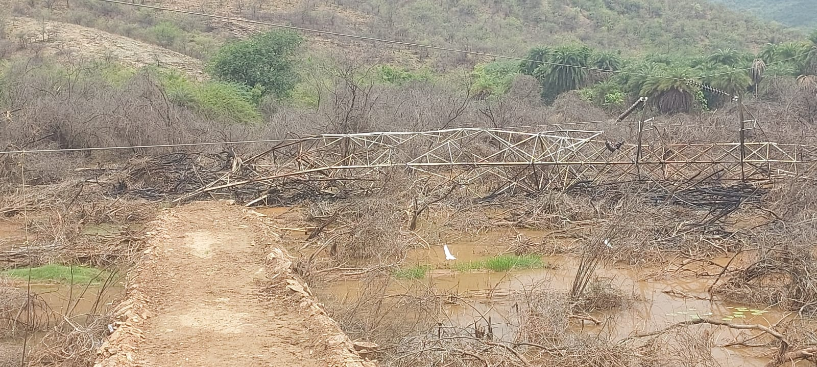
PROPOSED TOWER FOUNDATION AT COLLAPSED TOWER LOC.NO.99 OF RAJEMPETA TO CHINAKAPALLI 220KV DC LINE

Slide 3
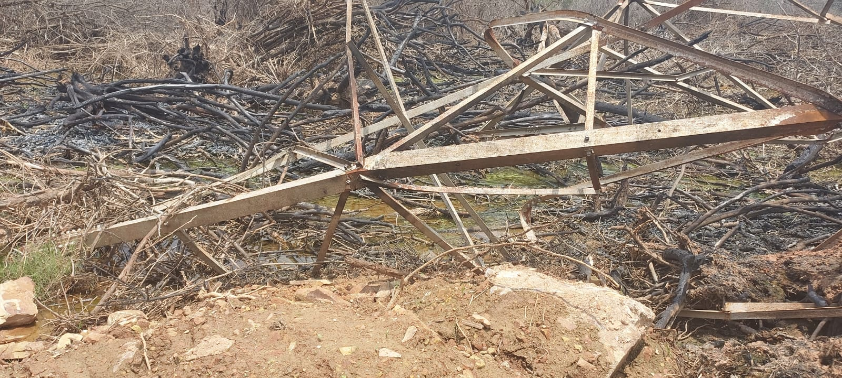

Slide 4
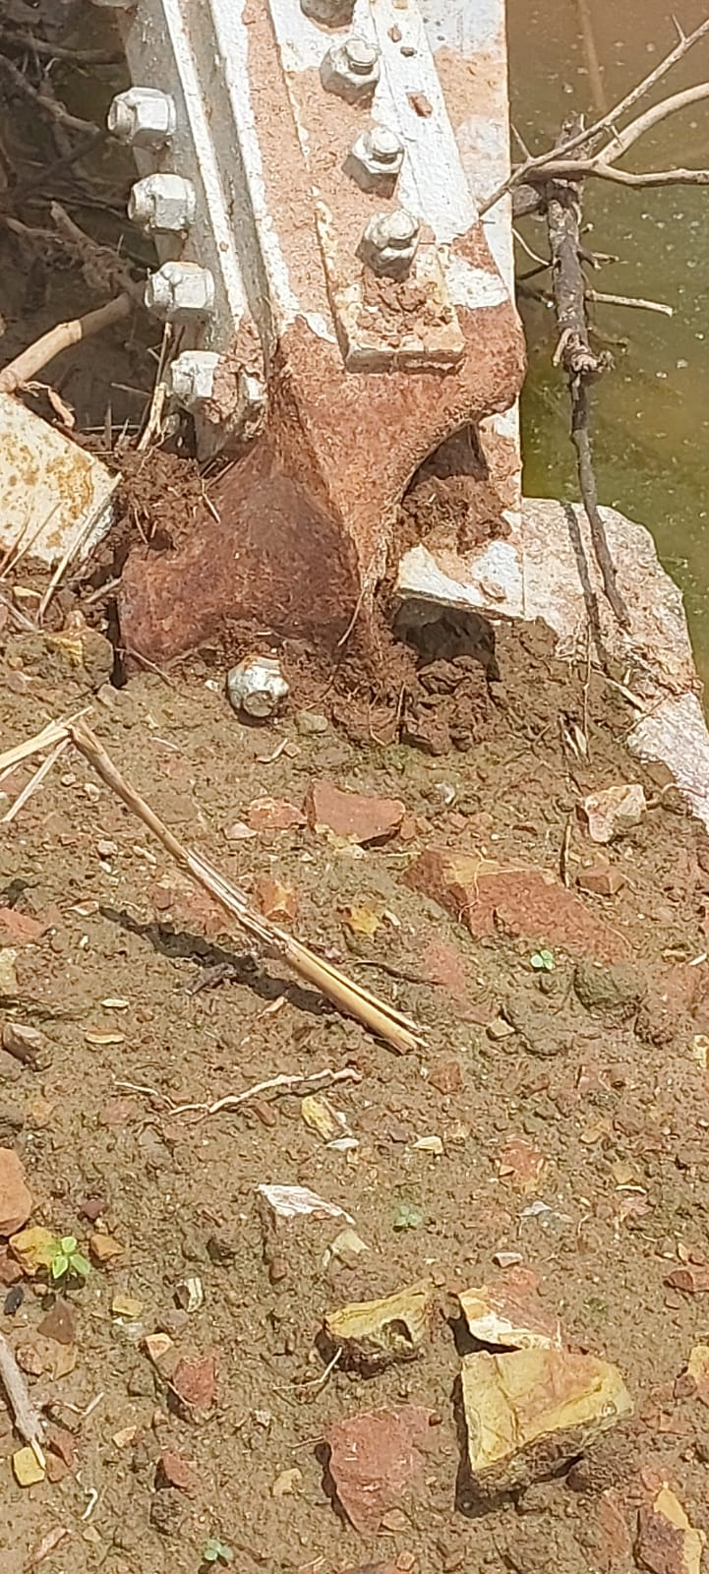
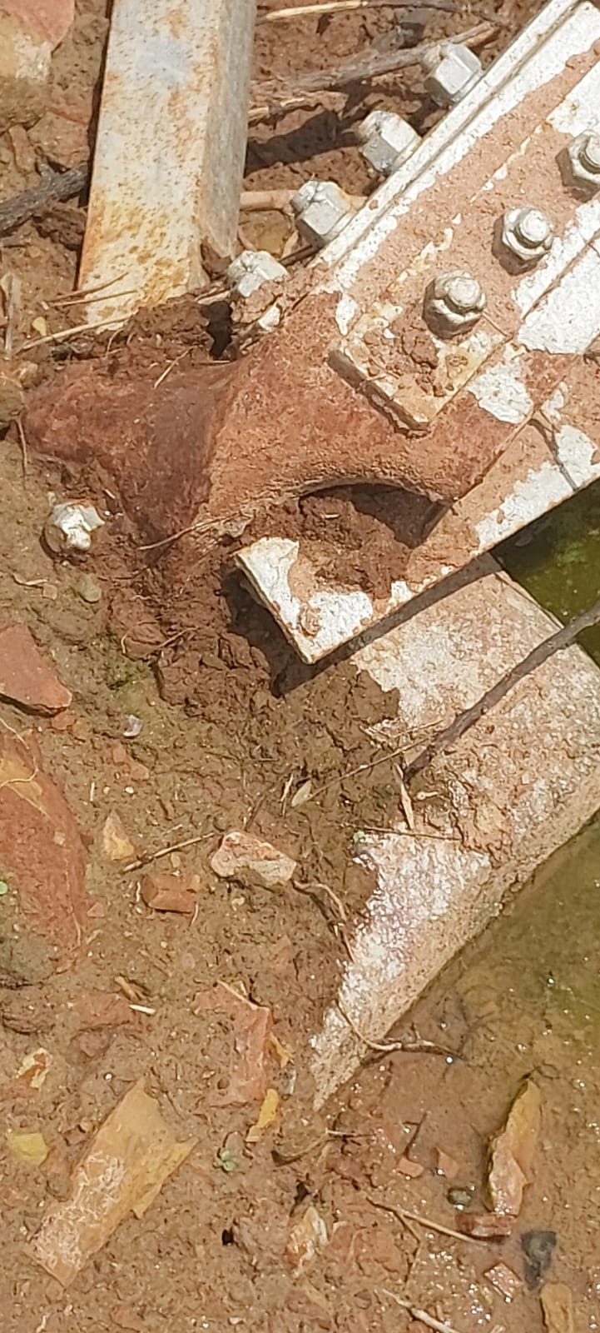

Slide 5
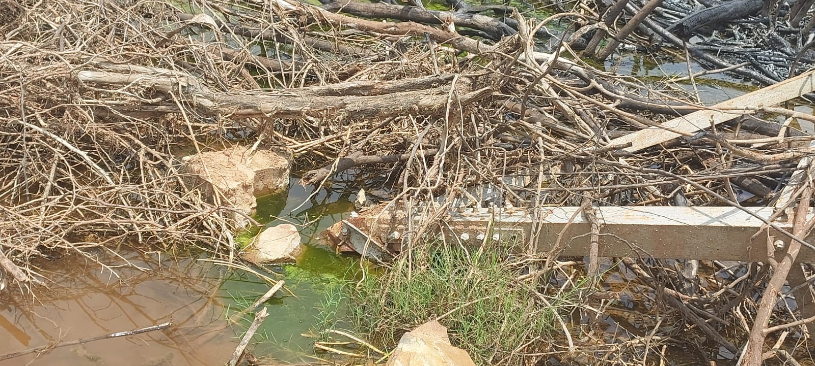

Slide 6
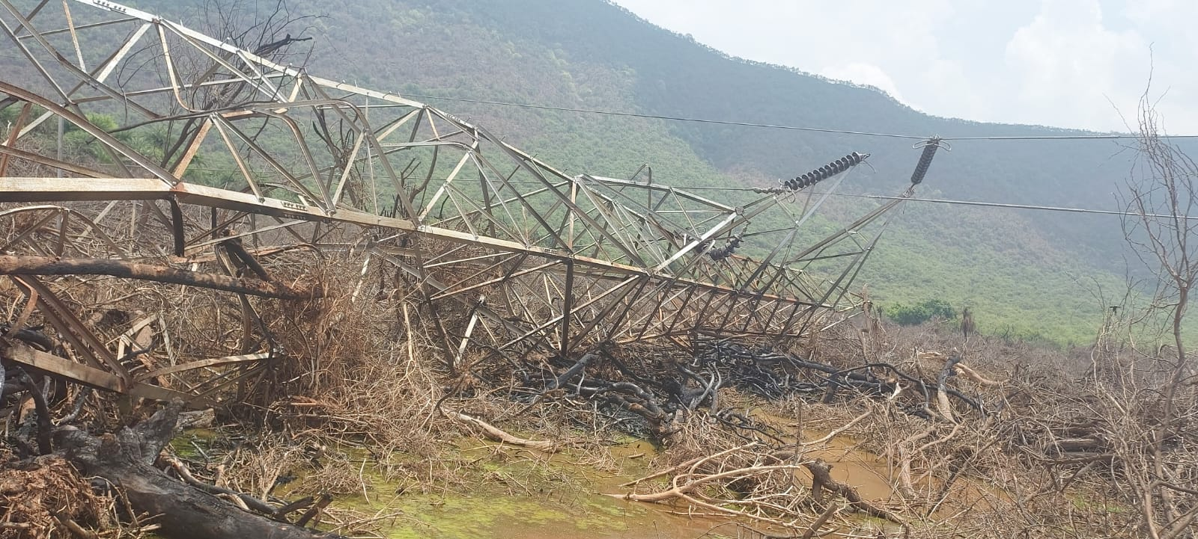

Slide 7
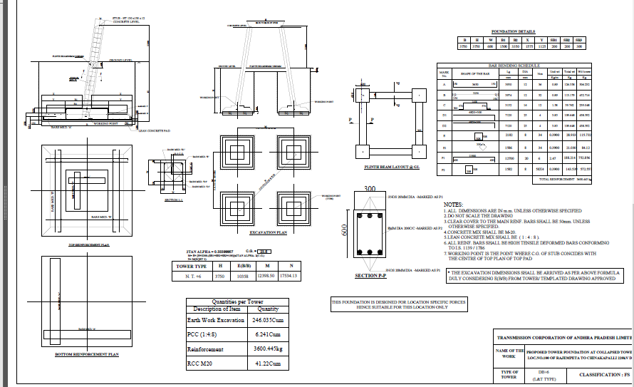

Slide 8
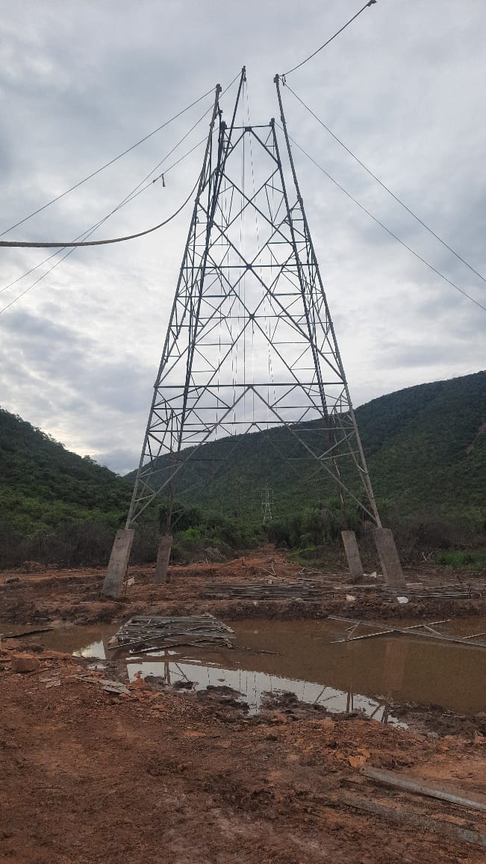

Slide 9
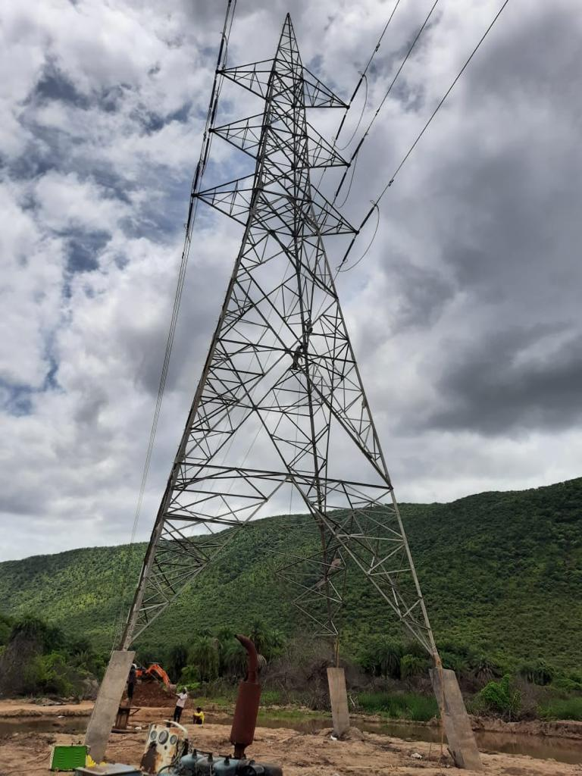

Slide 10
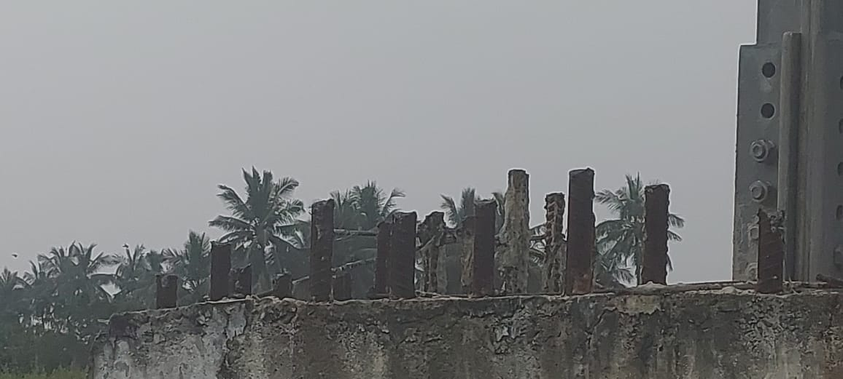
CRDA LINE WORKS

Slide 11
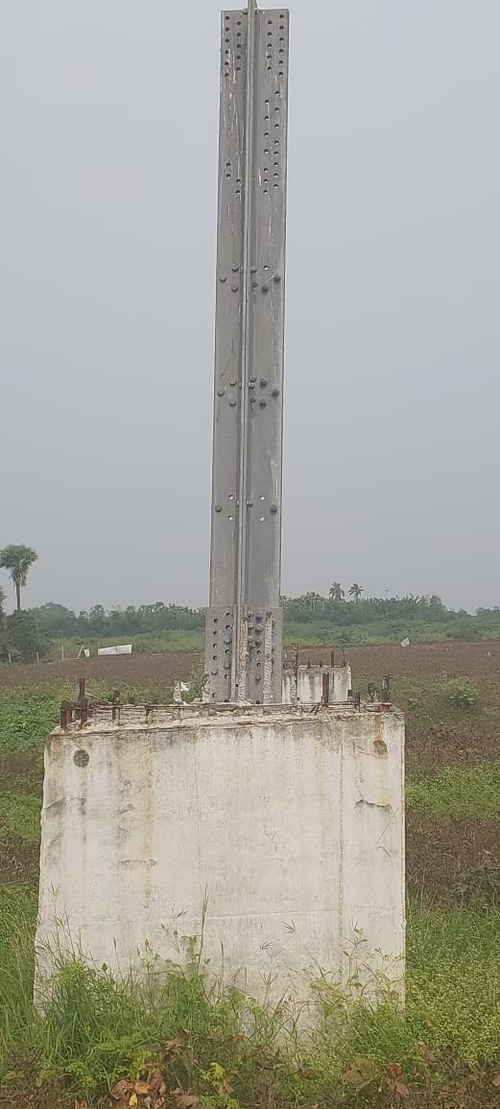
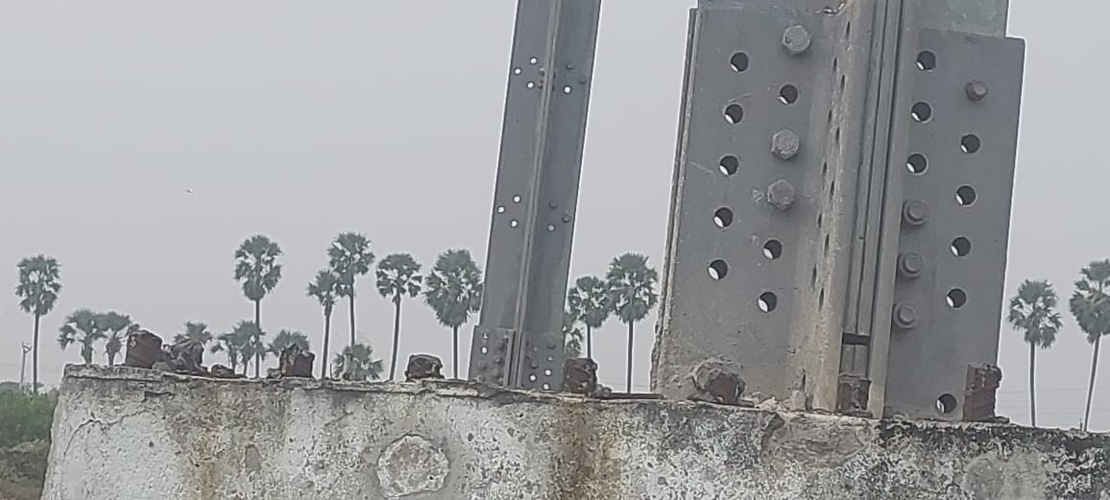

Slide 12
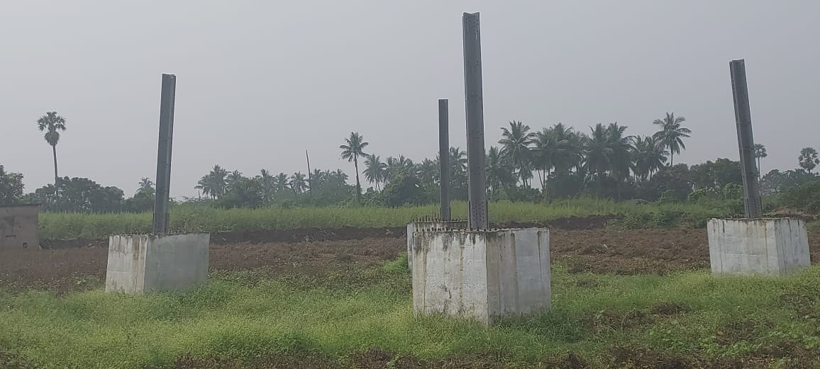

Slide 13
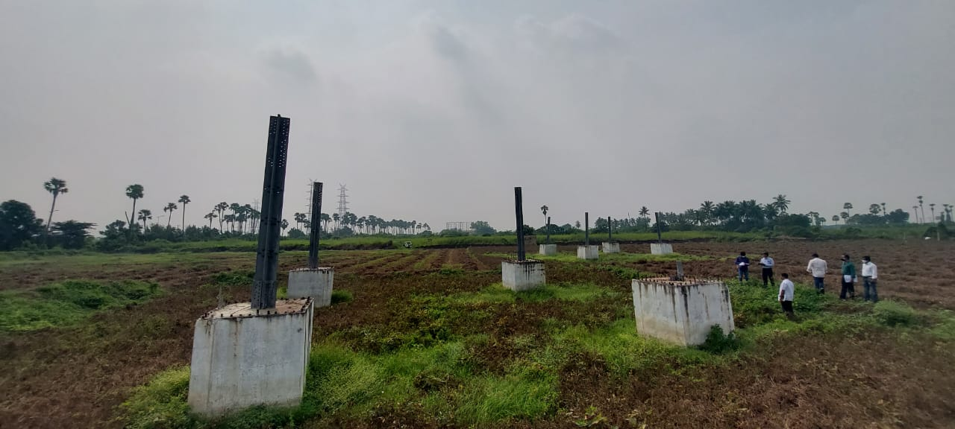

Slide 14
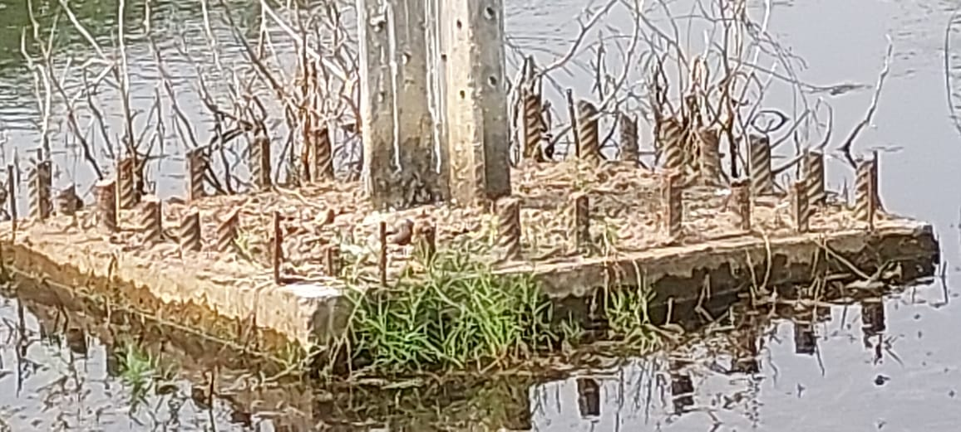

Slide 15
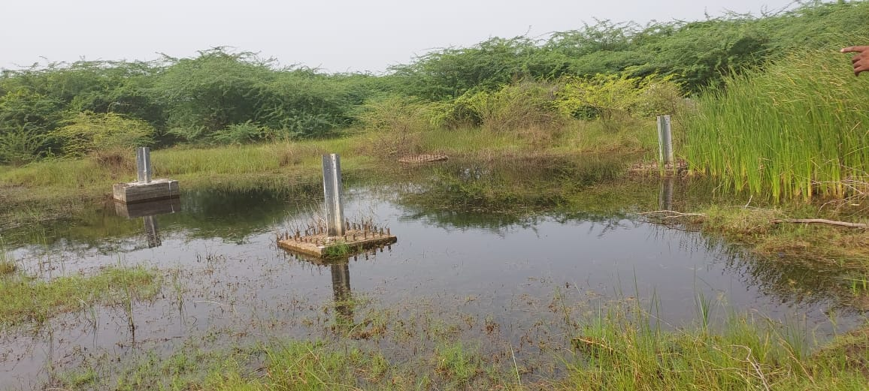

Slide 16
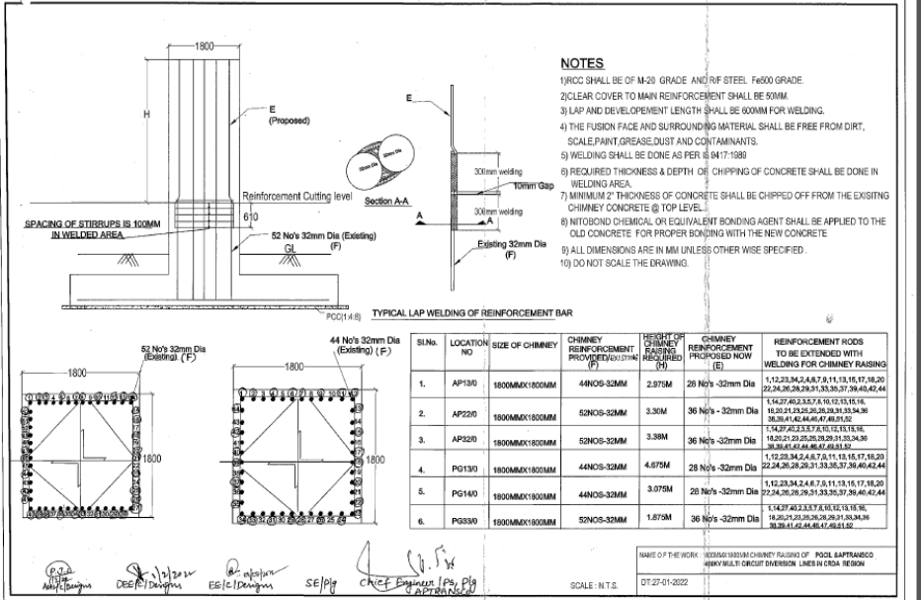

Slide 17
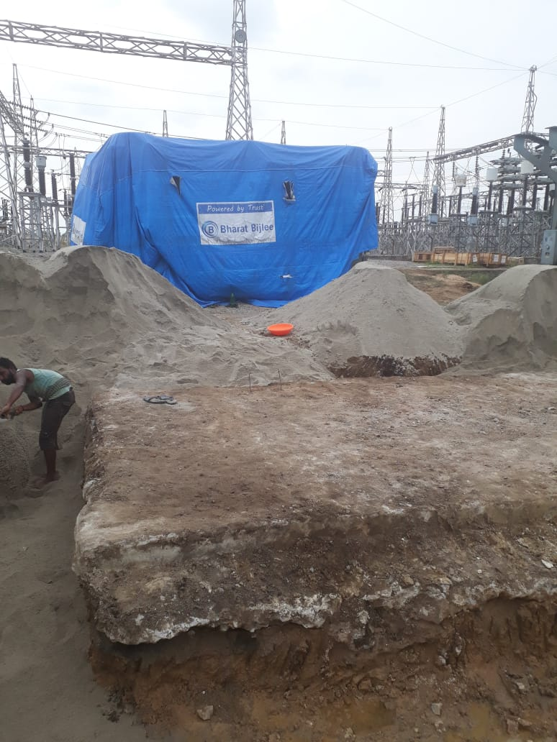
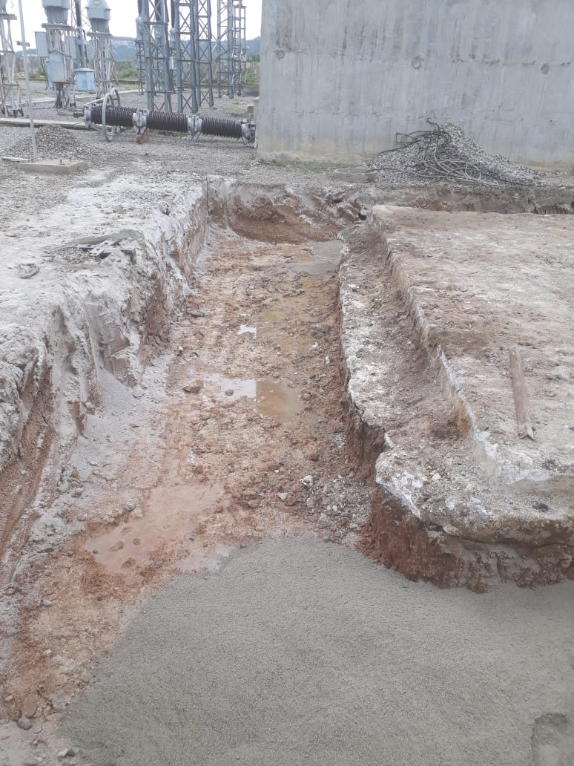
PTR ENHANCEMENT

Slide 18
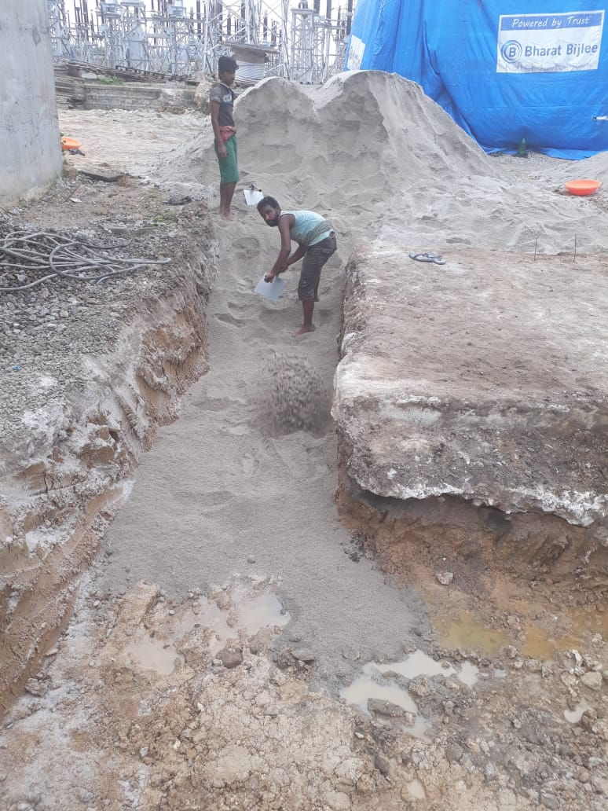
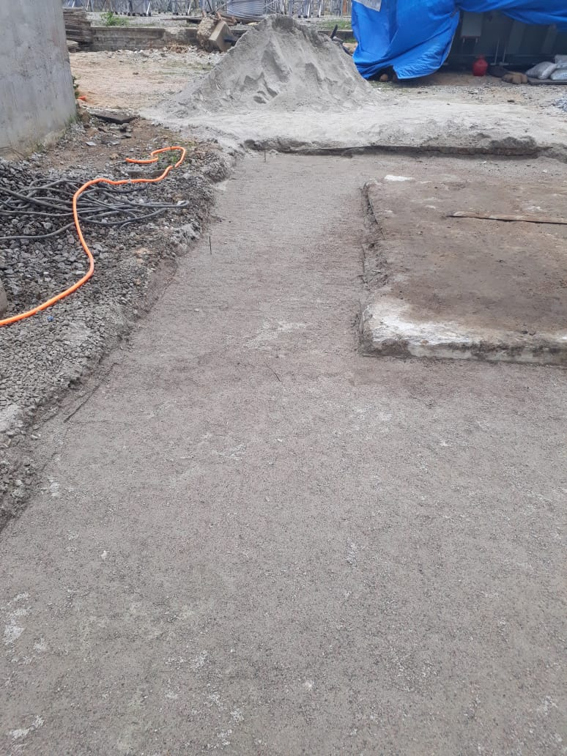

Slide 19
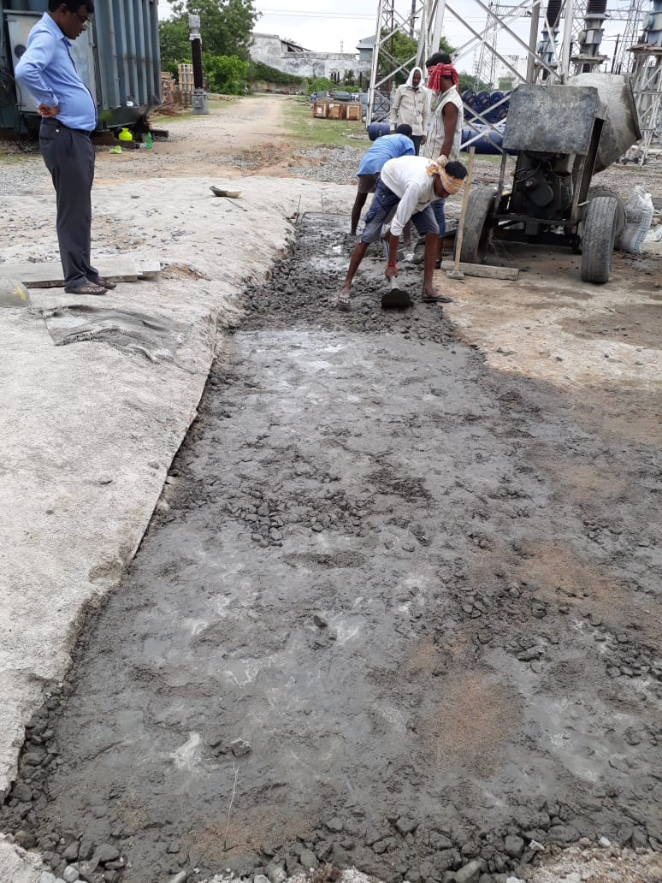
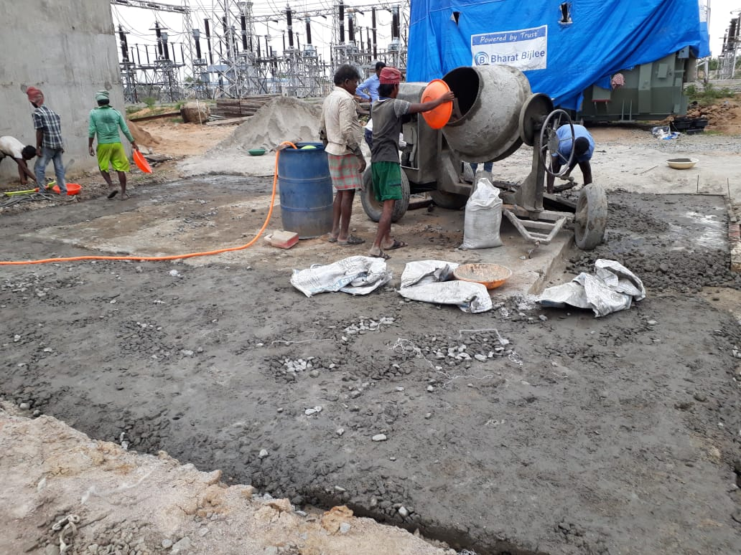

Slide 20
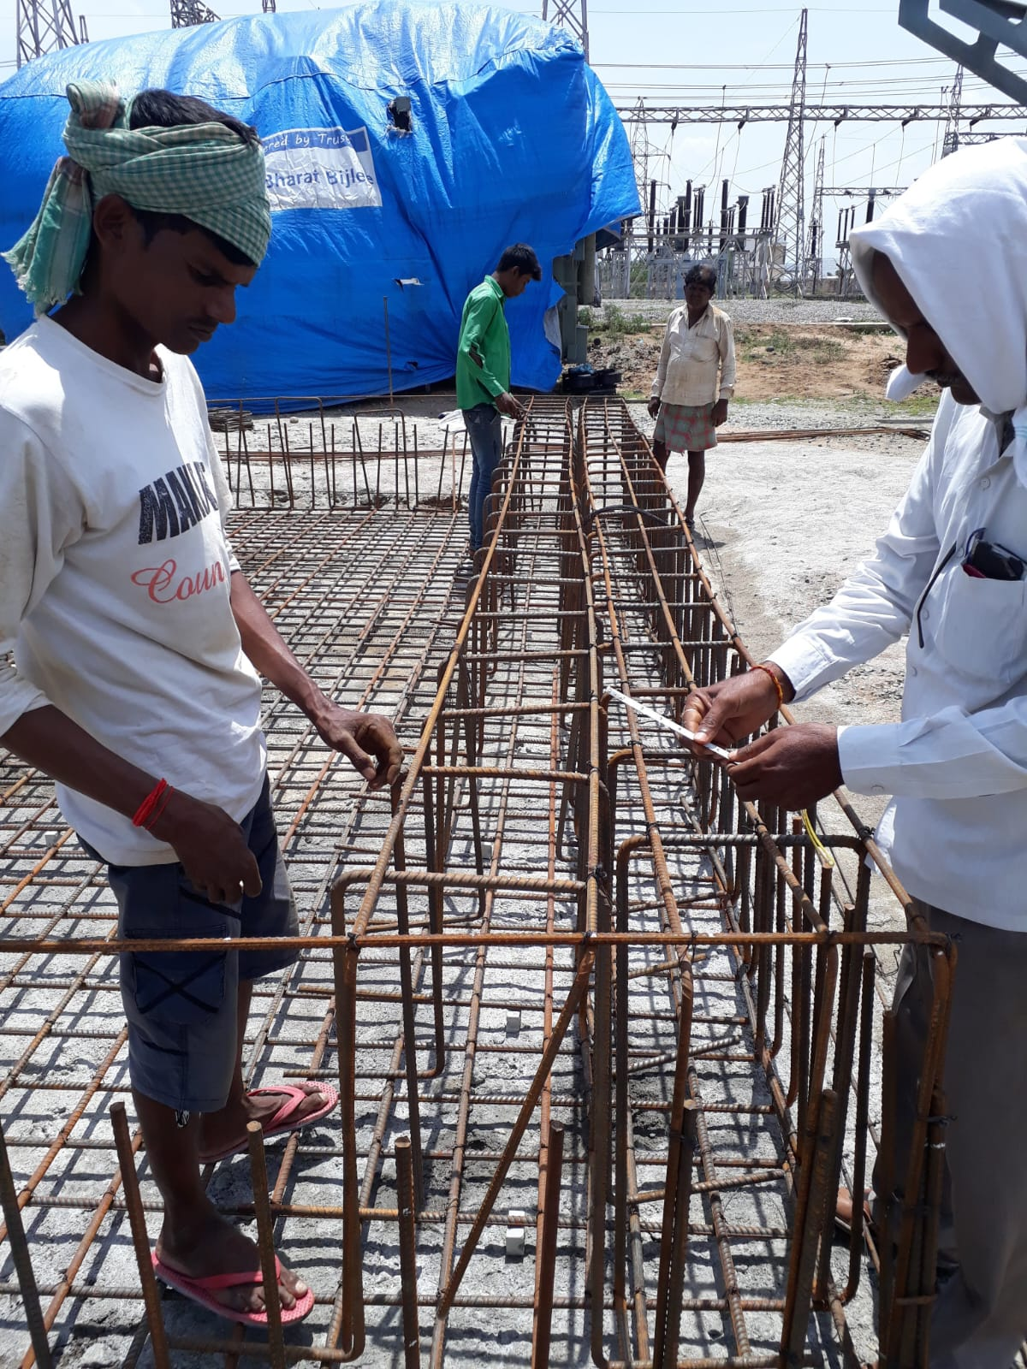

Slide 21
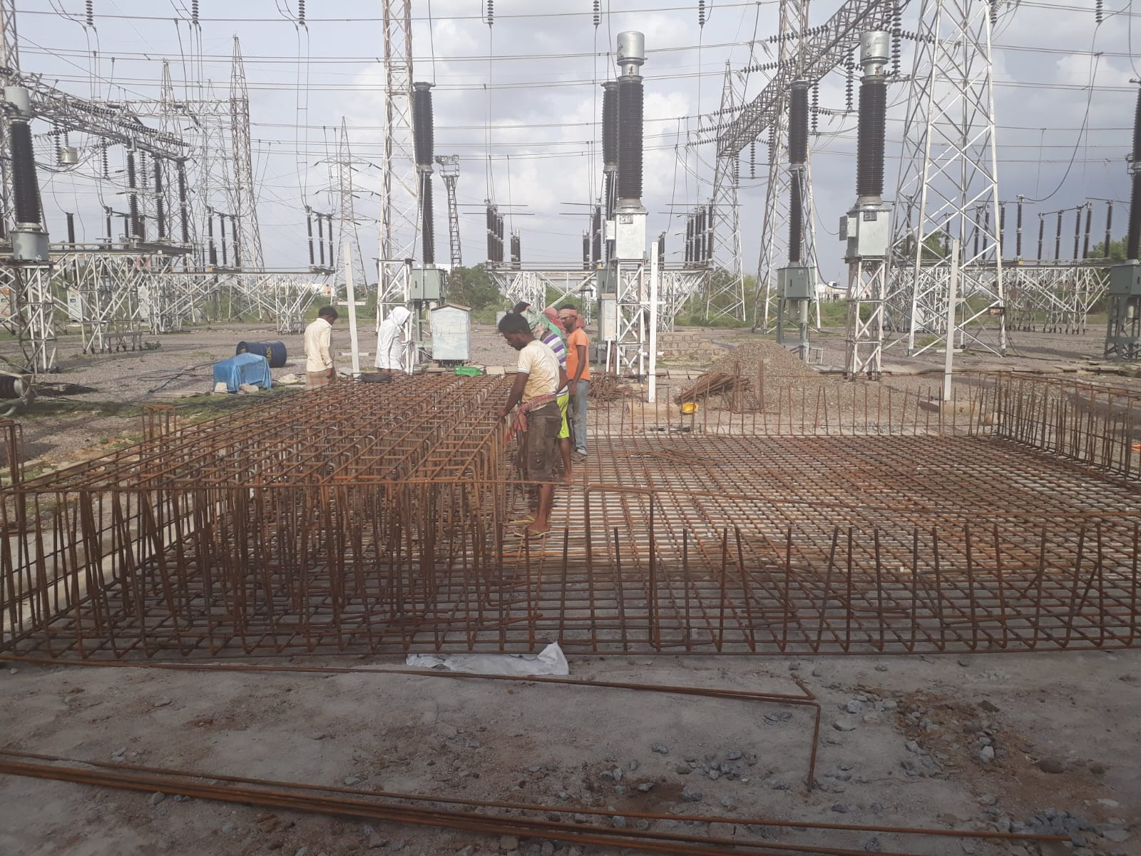

Slide 22
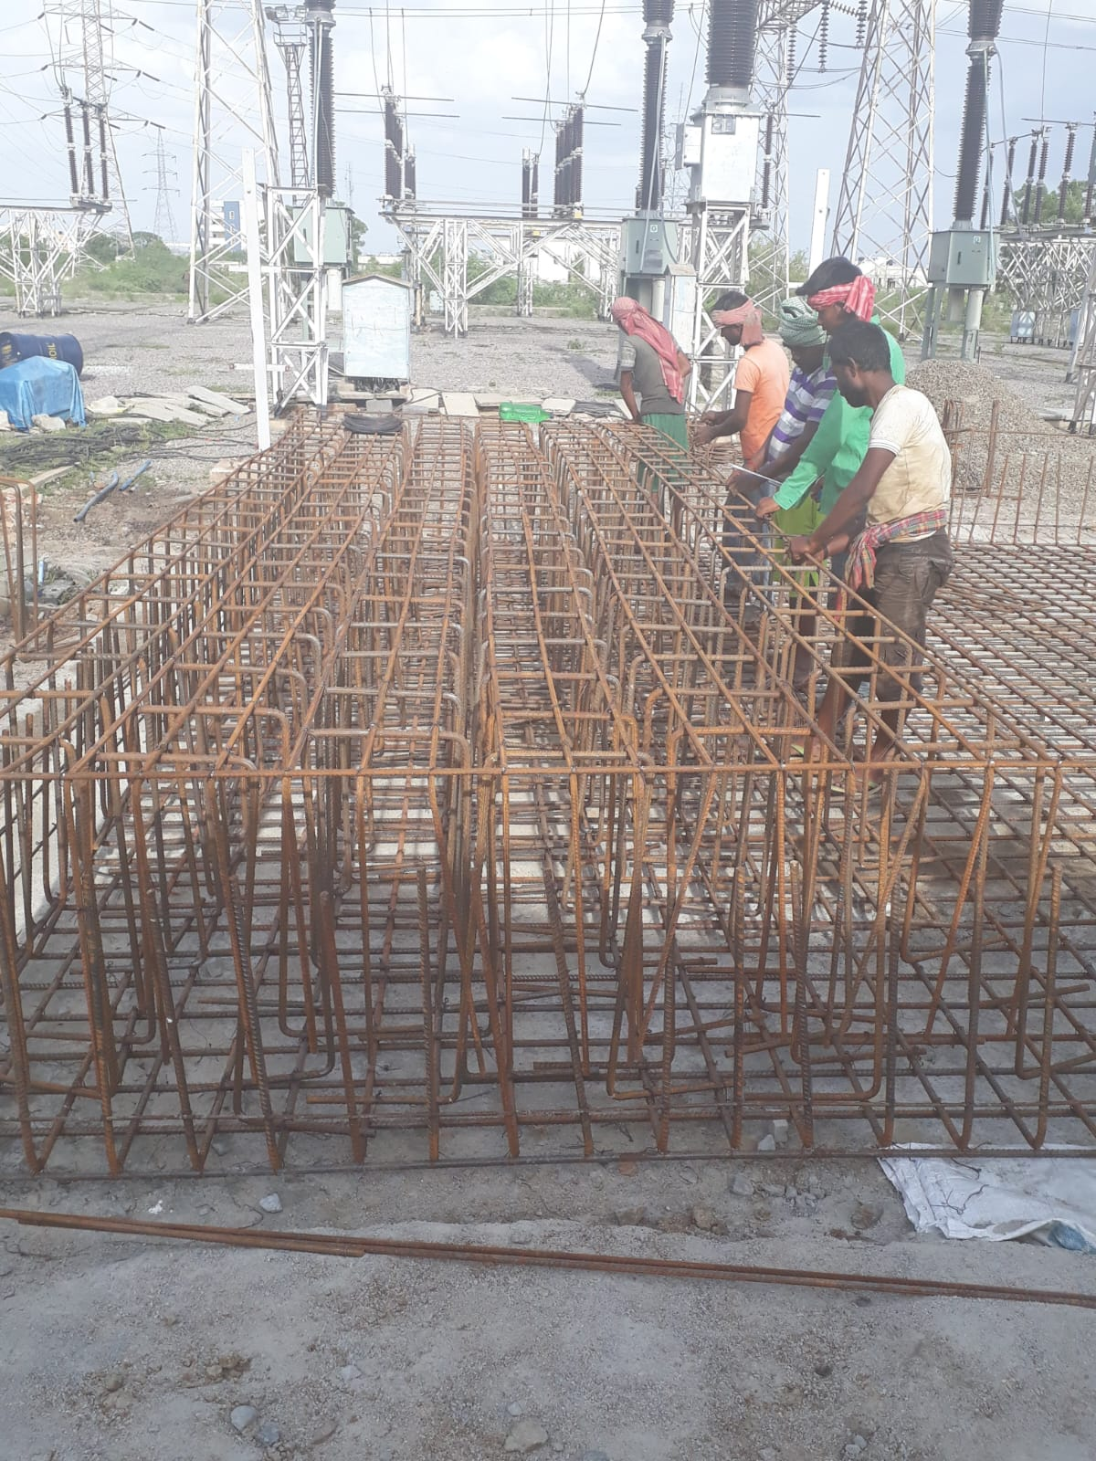

Slide 23
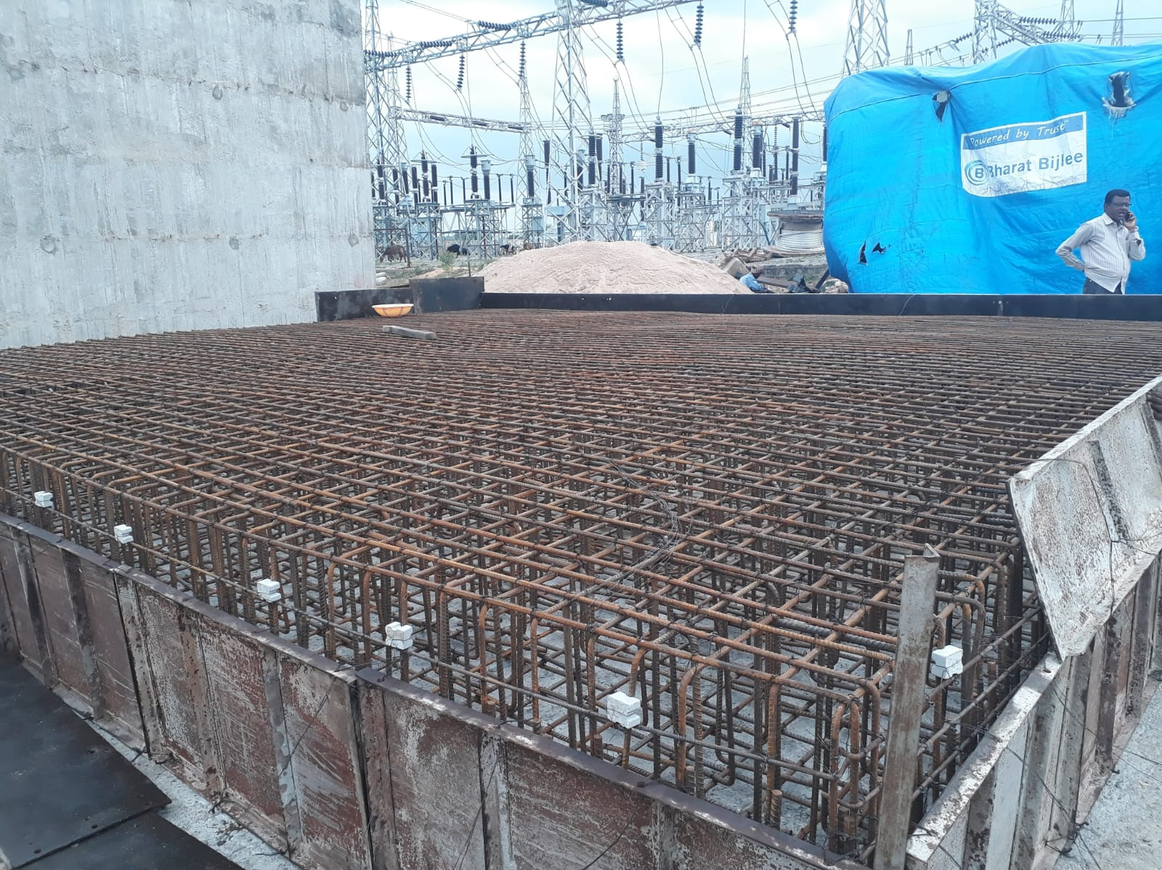

Slide 24
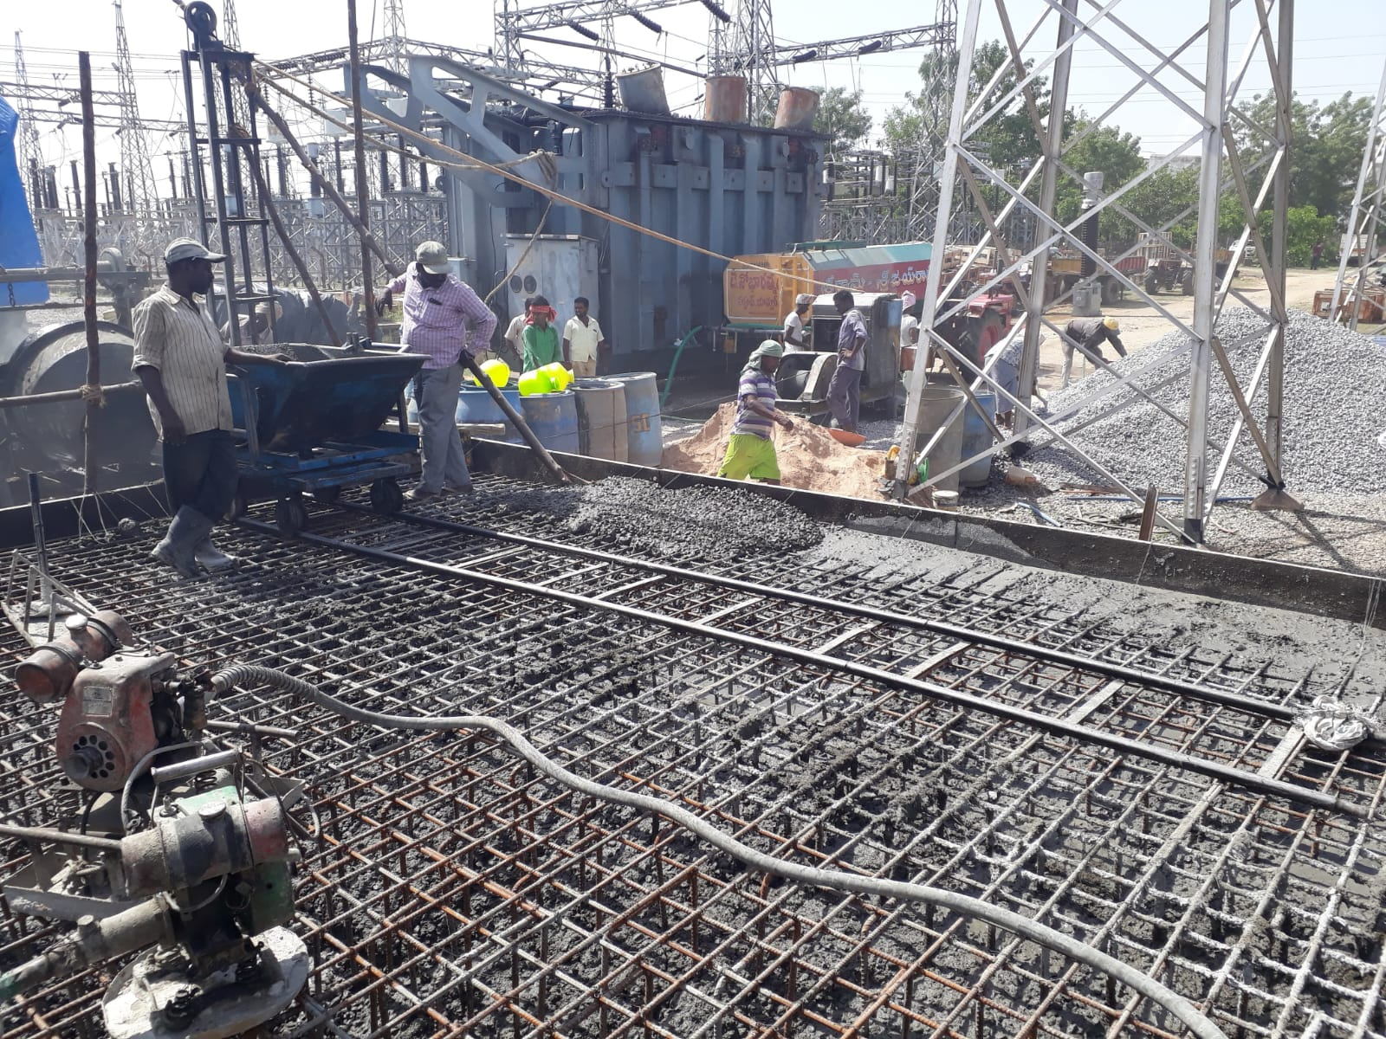

Slide 25
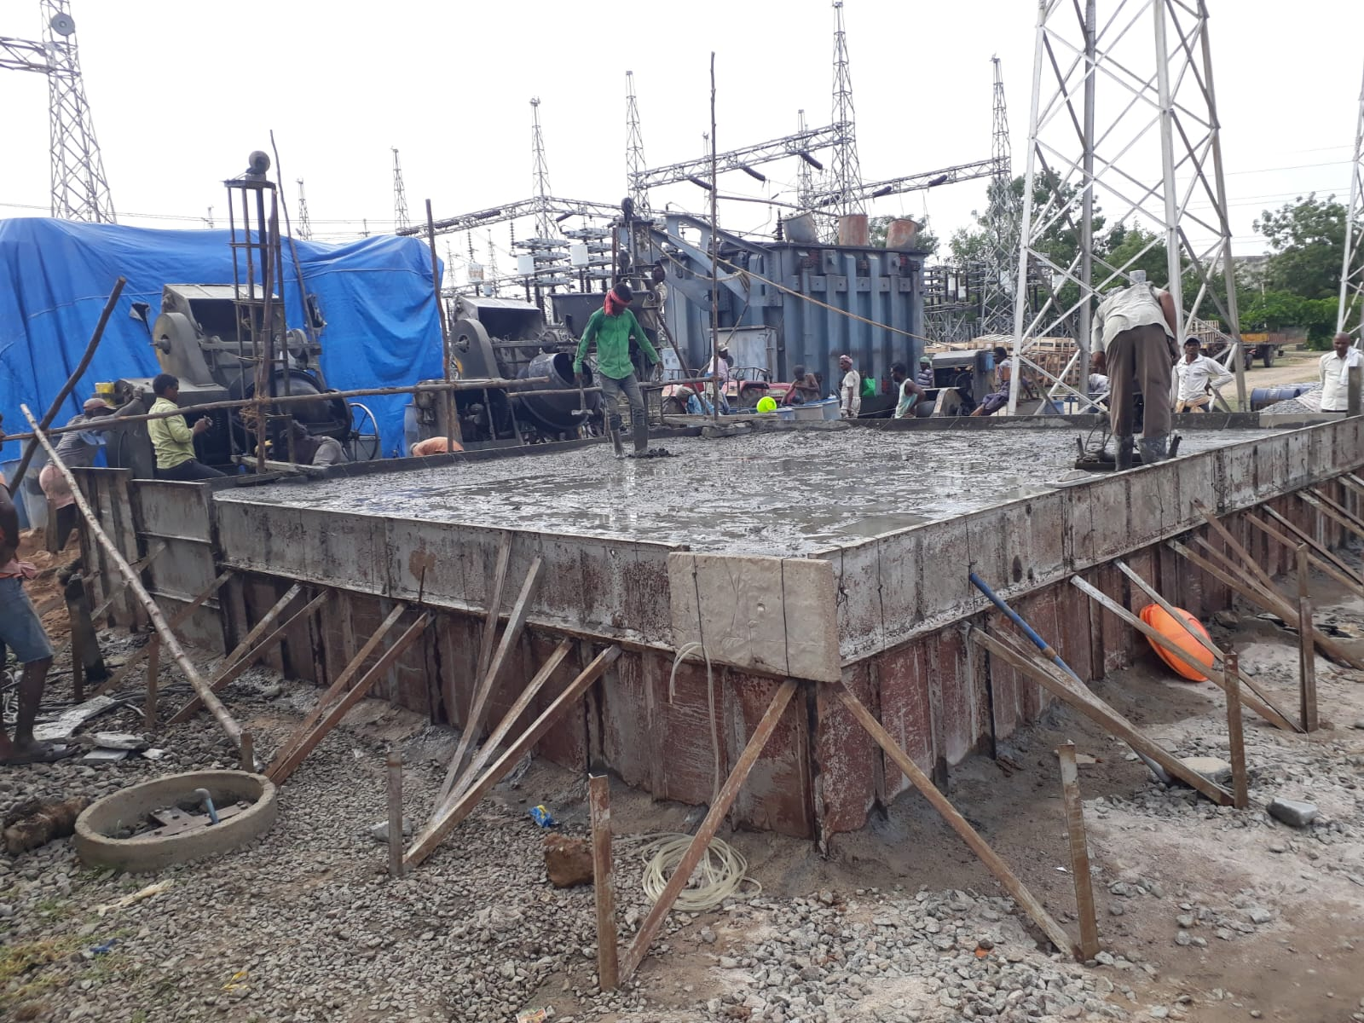

Slide 26
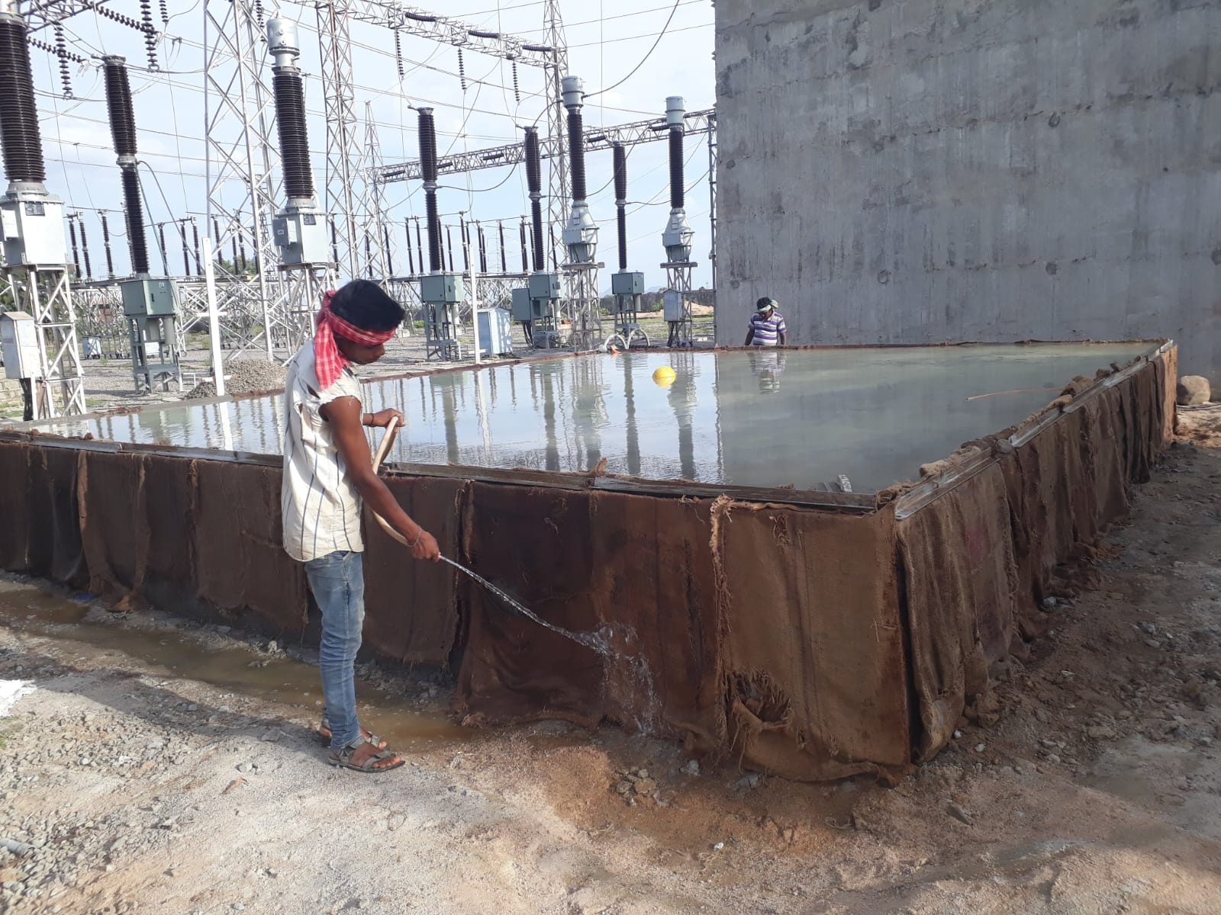

Slide 27
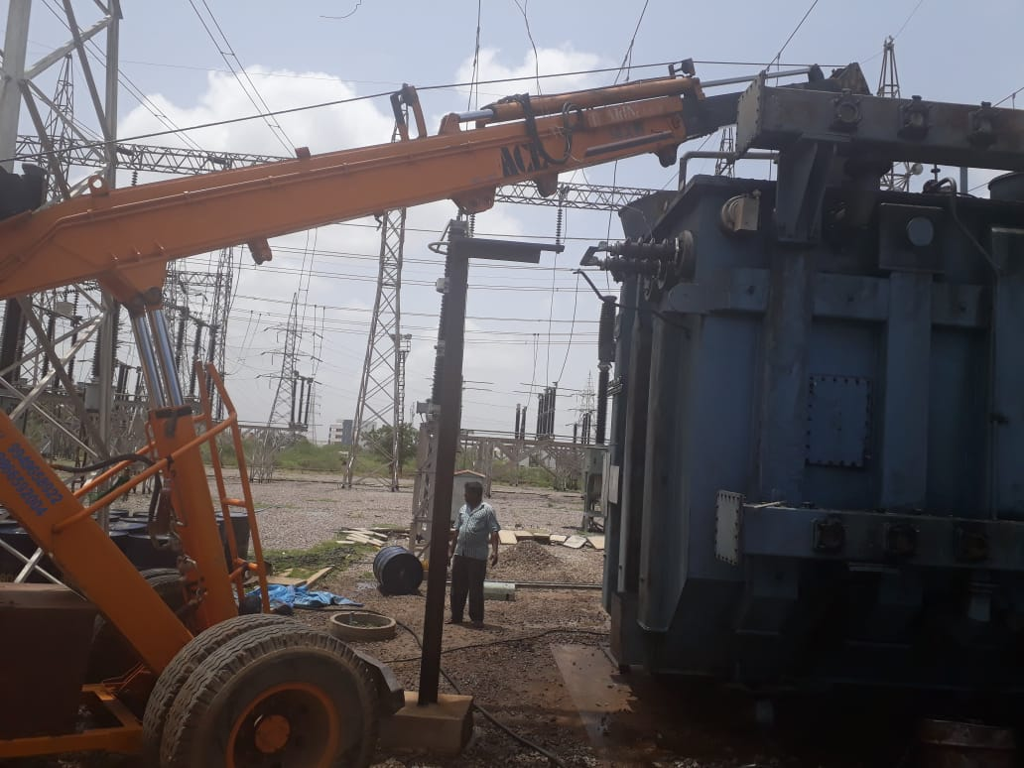

Slide 28
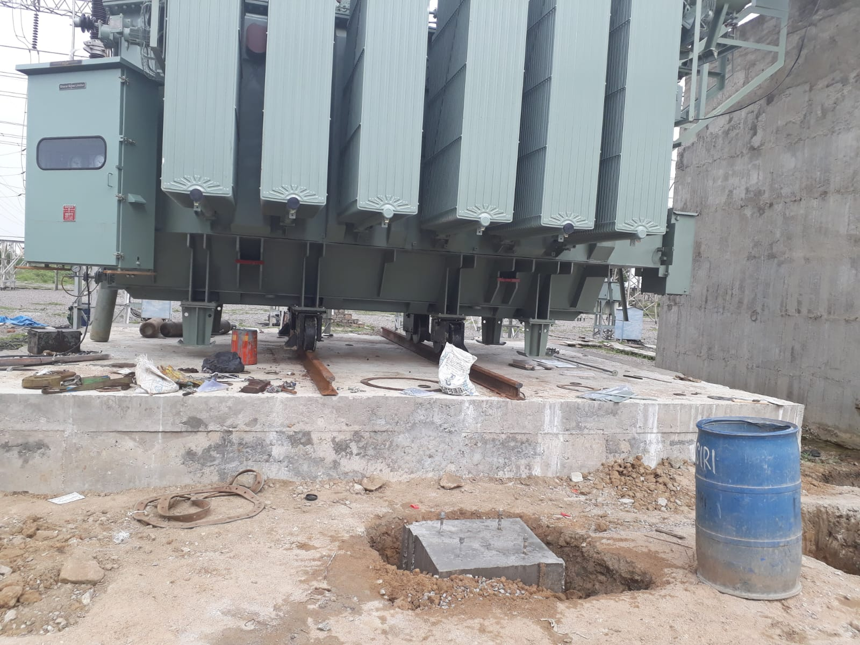

Slide 29
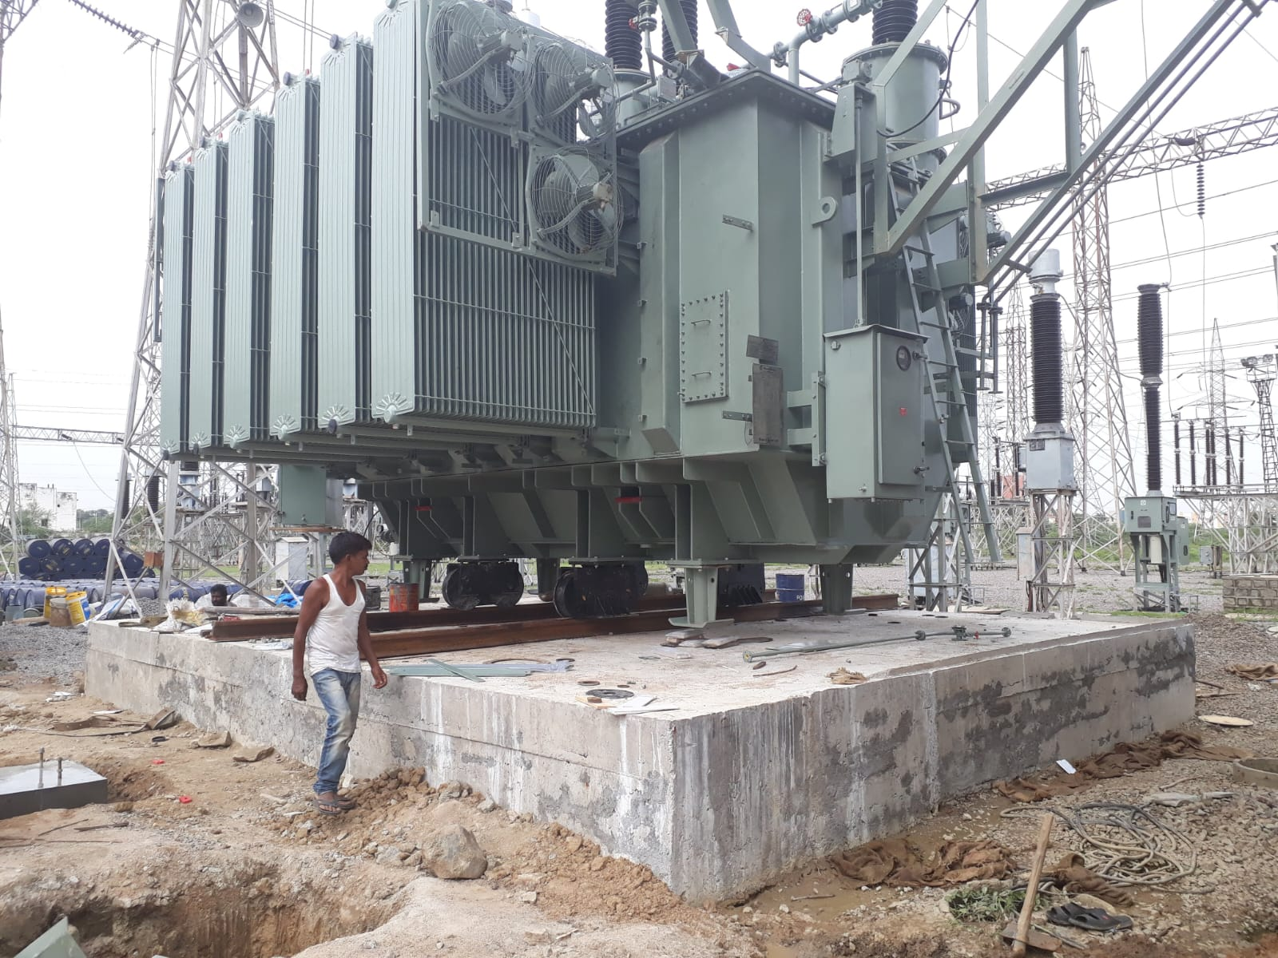

Slide 30
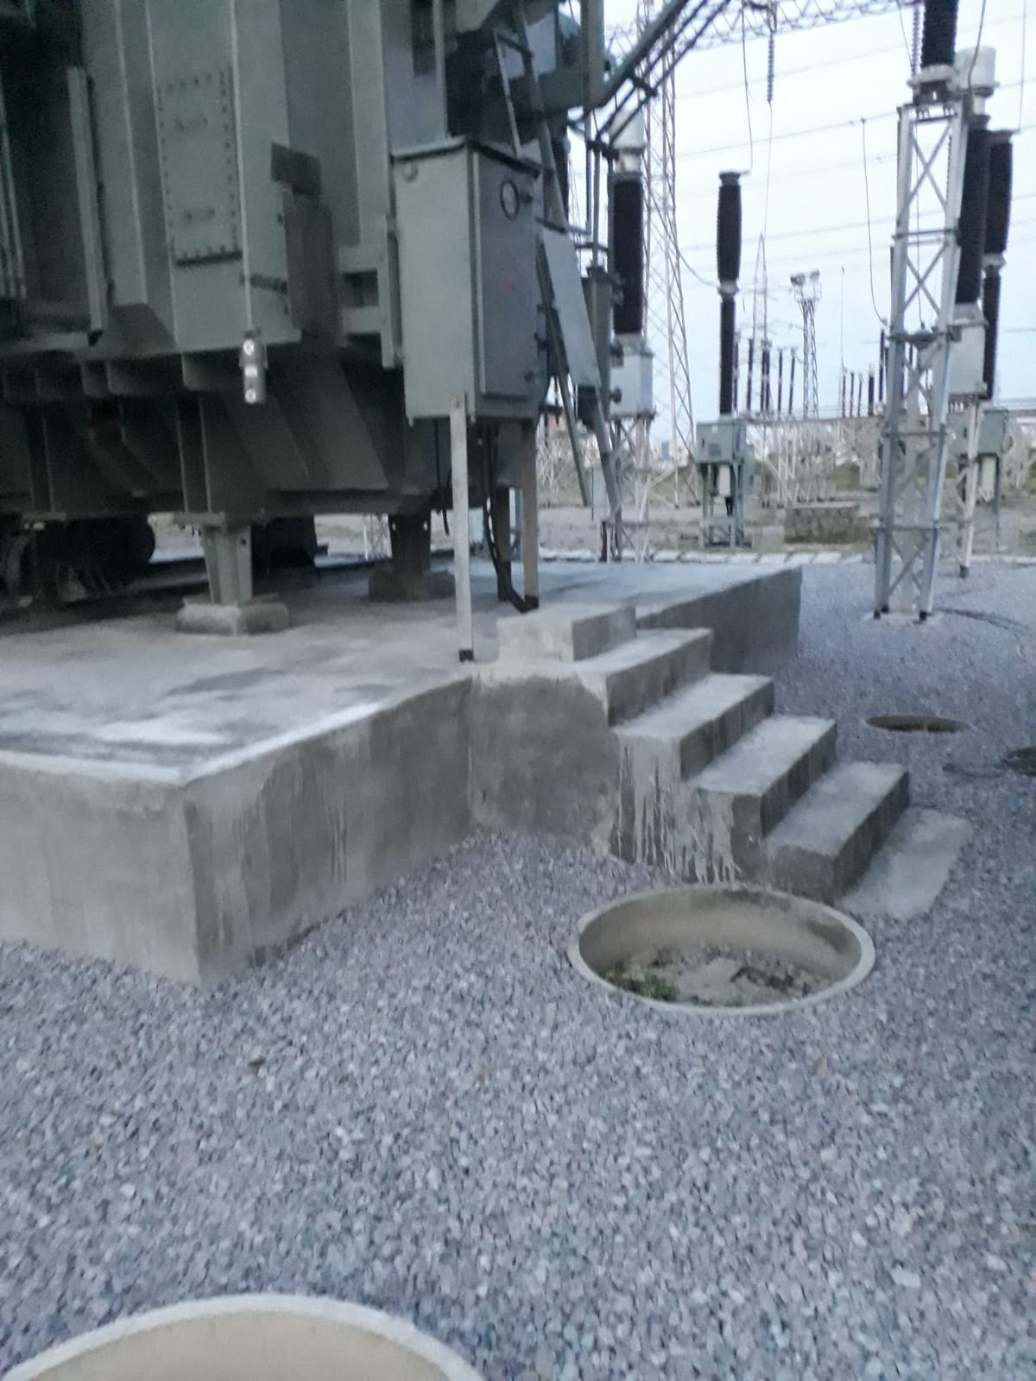

Slide 31
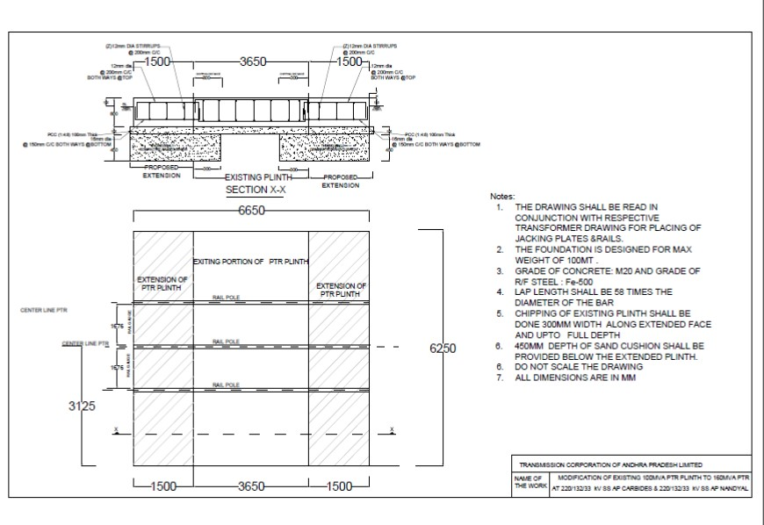
ENHANCEMENT OF 100MVA PTR TO 160MVA PTR AT AP CARBIDES

Slide 32
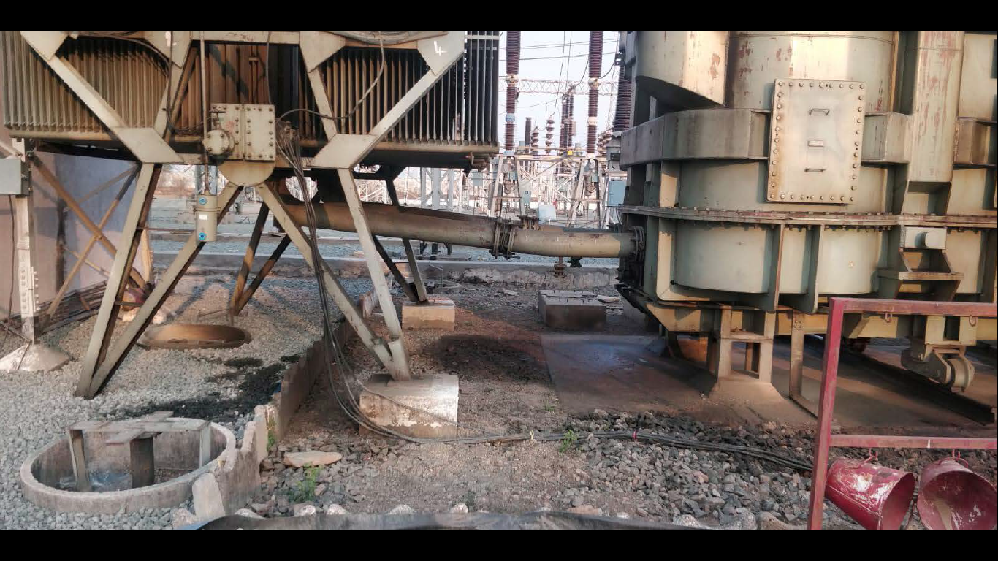

Slide 33
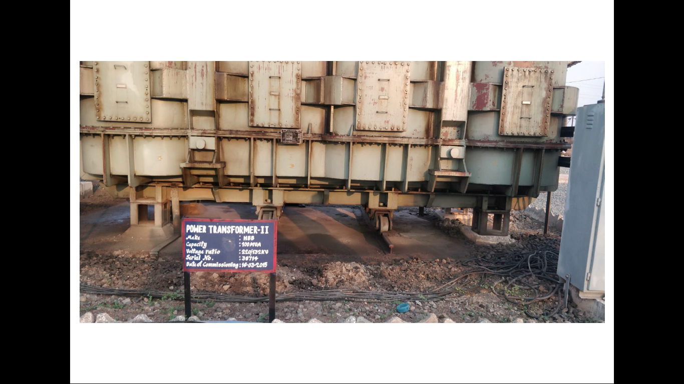

Slide 34
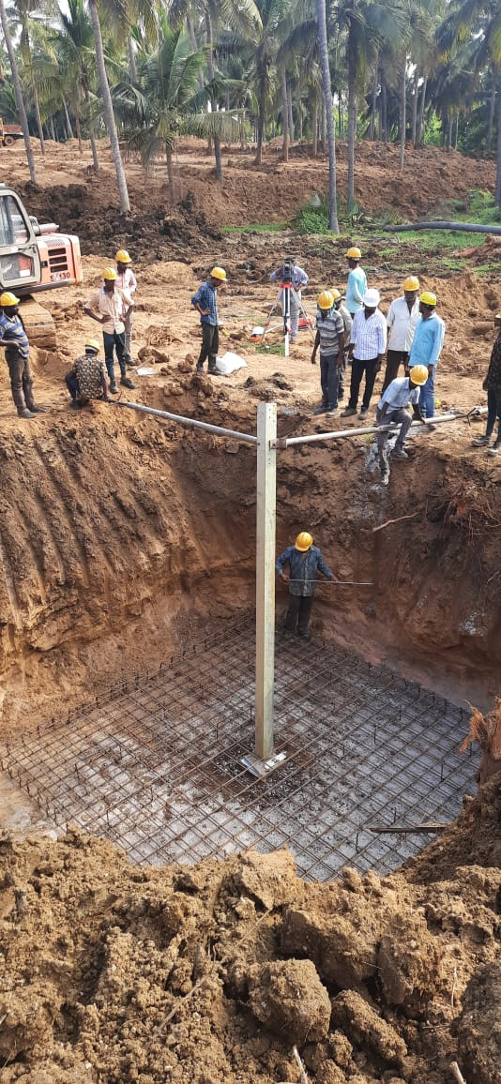
STUB SETTING

Slide 35
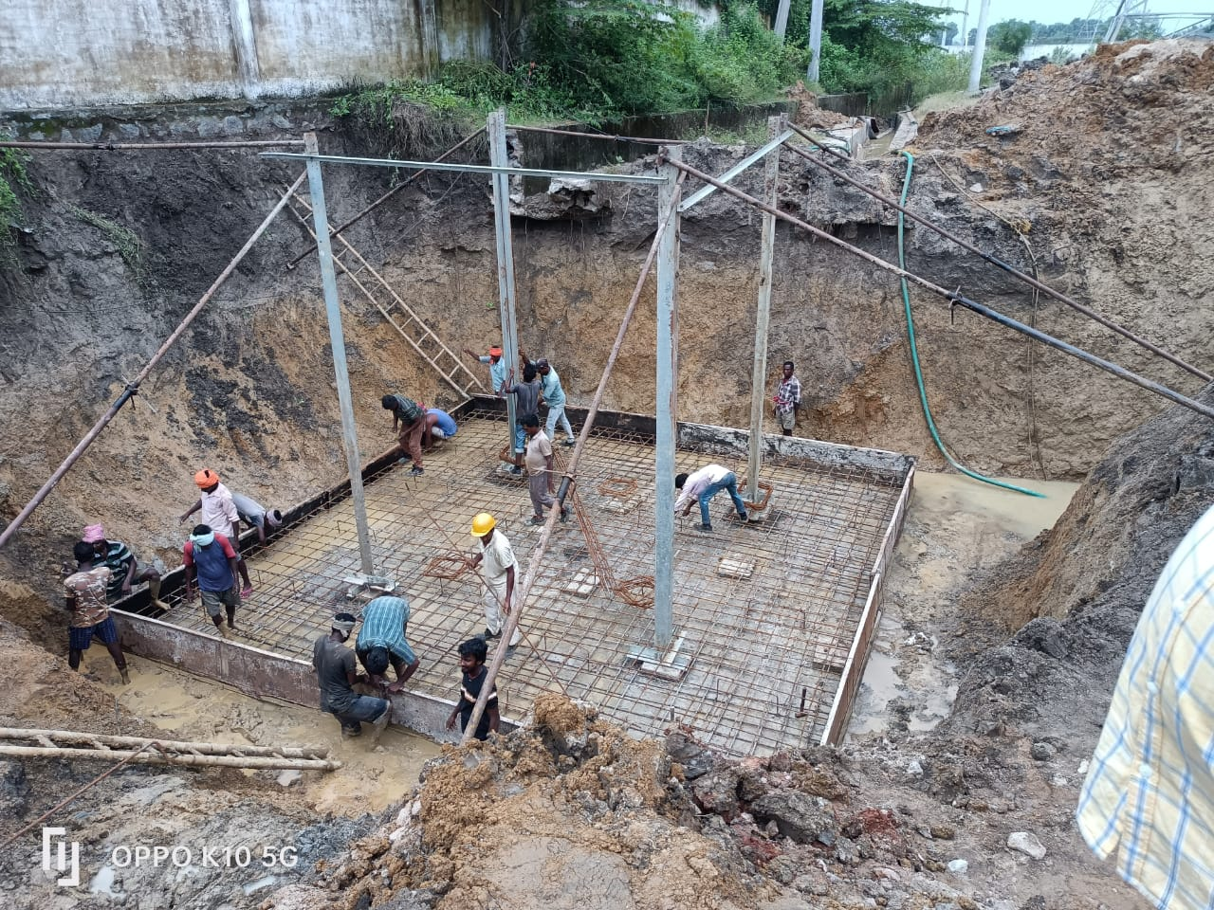

Slide 36
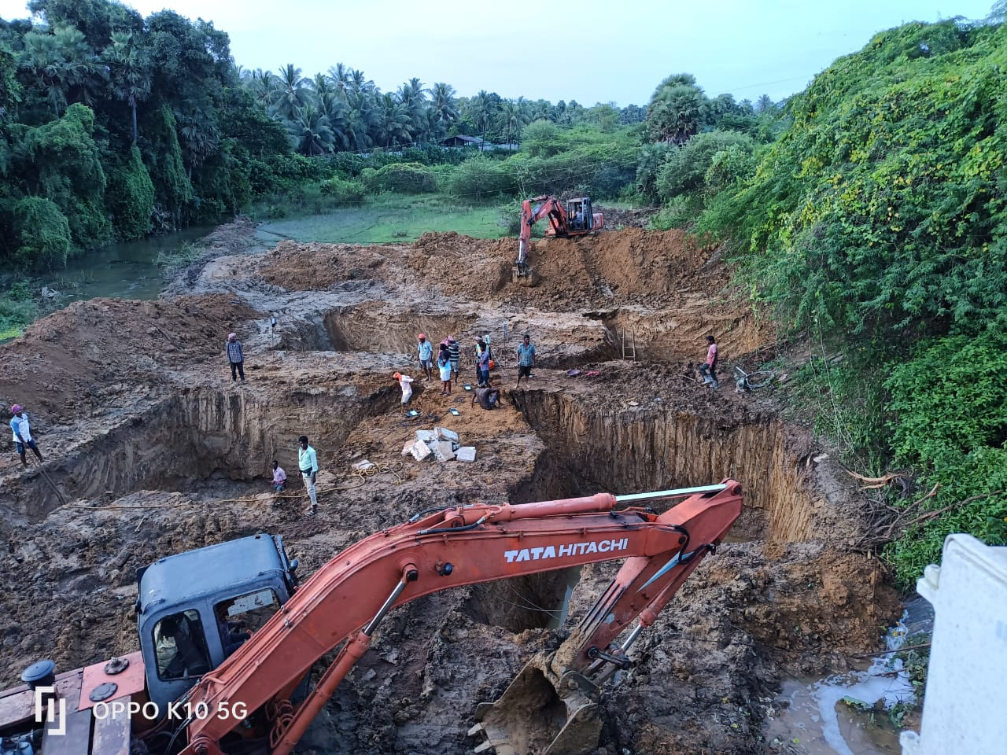

Slide 37
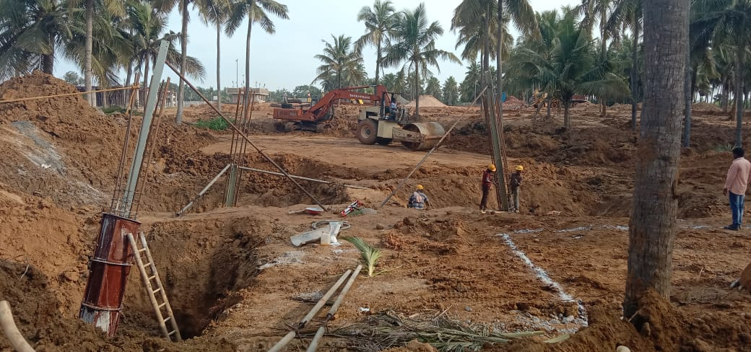

Slide 38
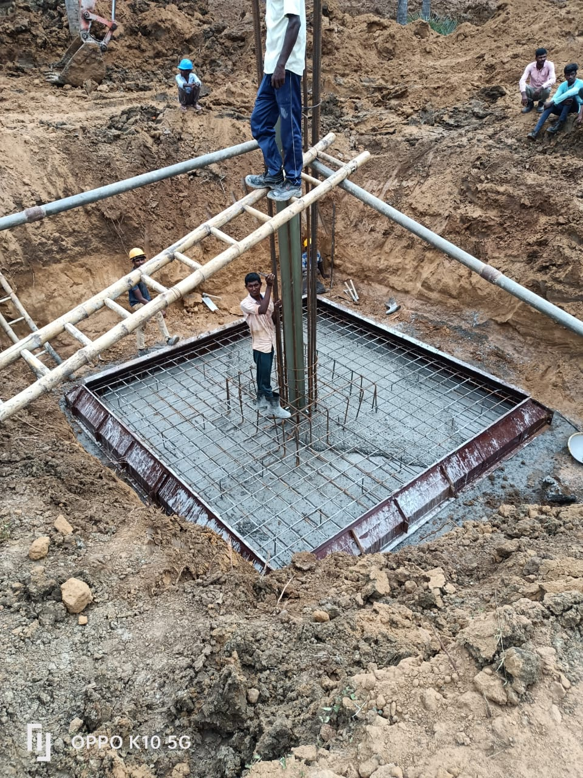

Slide 39
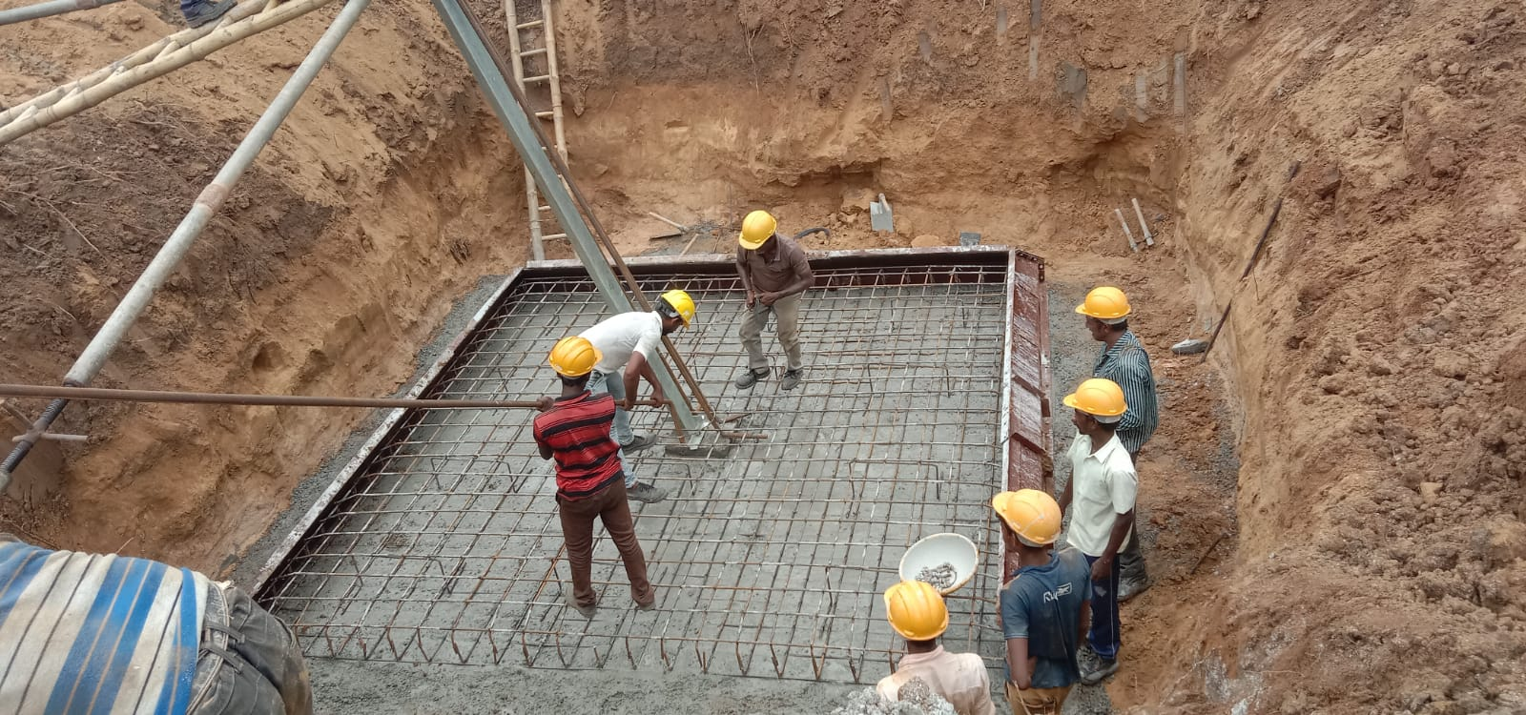

Slide 40
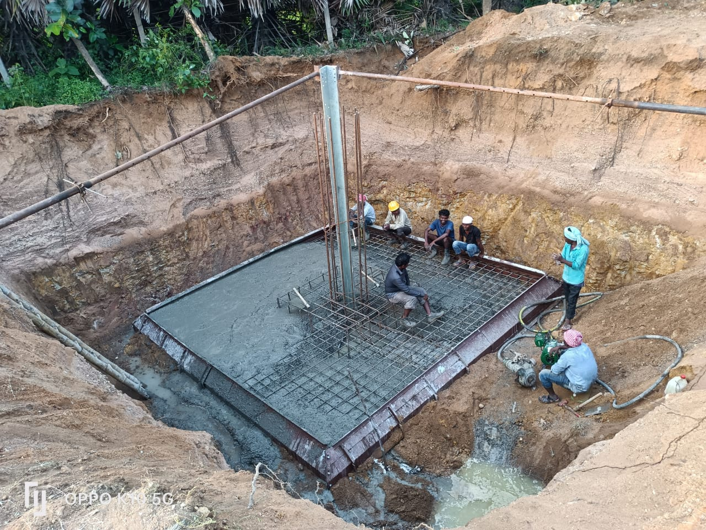

Slide 41
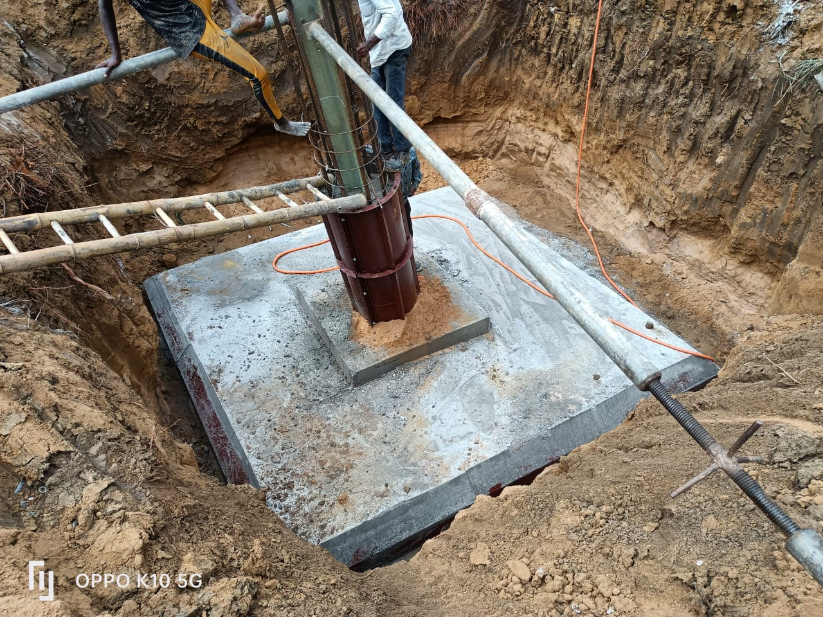

Slide 42
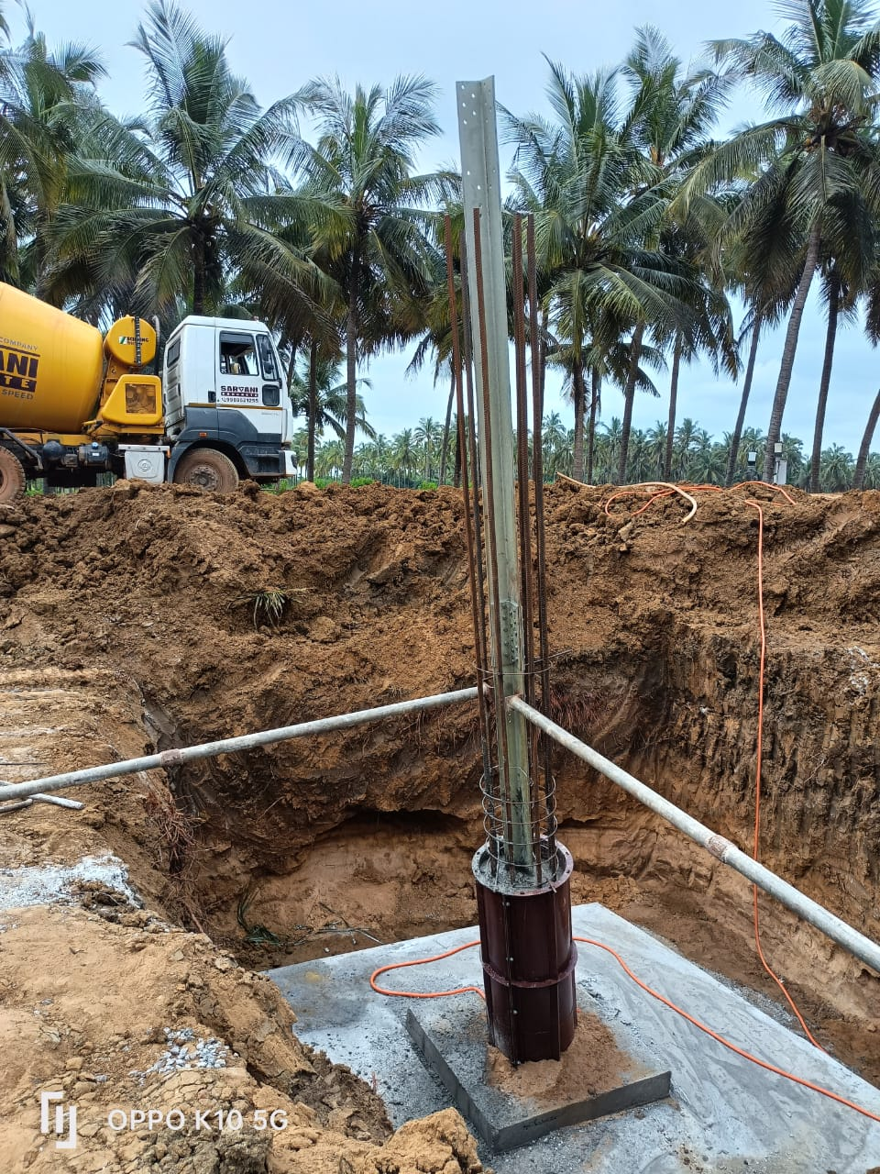
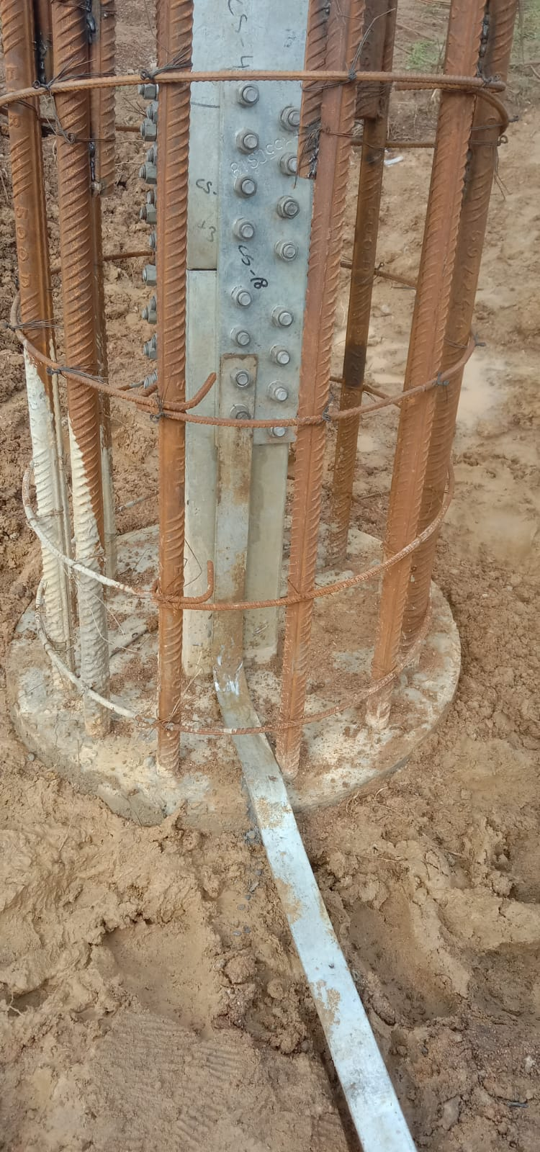

Slide 43
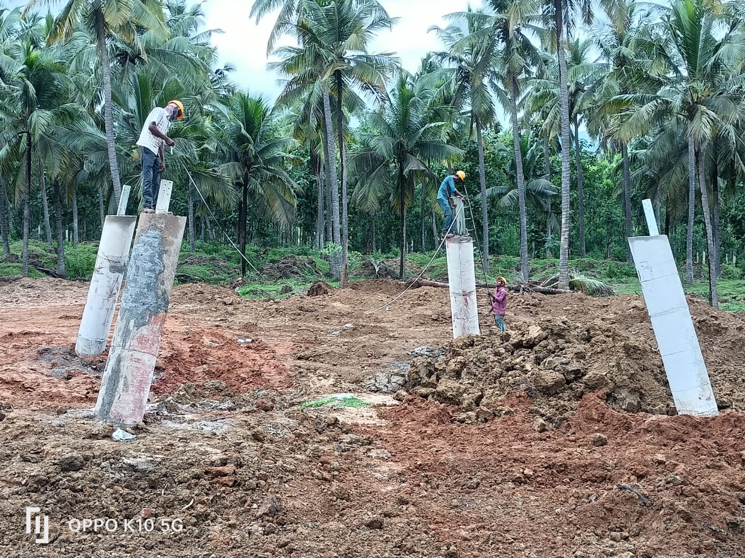

Slide 44
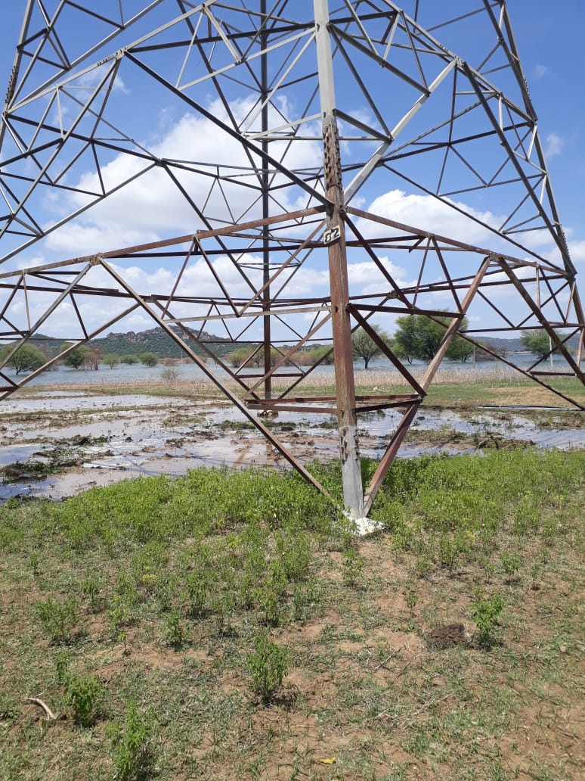
STRENGTHENING OF EXISTING STUB/CHIMNEY OF TOWER

Slide 45
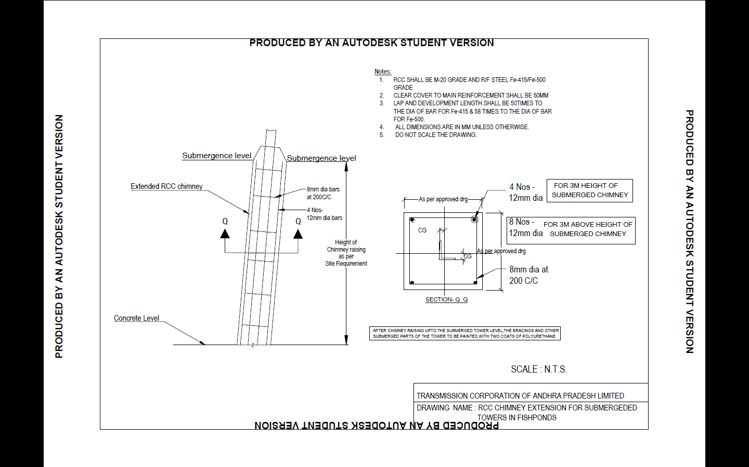

Slide 46


Slide 47


Slide 48


Slide 49


Slide 50


Slide 51


Slide 52



Slide 53



Slide 54



Slide 55


Slide 56


Slide 57


Slide 58


Slide 59


Slide 60


Slide 61



Slide 62


Slide 63


CABLE DUCT

Slide 64


Slide 66


Slide 67


Slide 68


Slide 69

SHALLOW FOUNDATIONS @220kV SS DUVVA

Slide 70


Slide 71



Slide 72


Slide 73

Construction of Roads

Slide 74


Slide 75


Slide 76


Slide 77


Slide 78


Slide 79


Slide 80


Slide 81

RETAINING WALLS

Slide 82


Slide 83


Slide 84


Slide 85


Slide 86


Slide 87


Slide 88

220kV railway line at Makthal in Telangana State

Slide 89


Slide 90


Slide 91


Slide 92


Slide 93


Slide 94


Slide 95


Slide 96


Slide 97


Slide 98


Slide 99


Slide 100


Slide 101


Slide 102


Slide 103

PILE LOAD TEST

Slide 104


Slide 105


Slide 106


Slide 107


Slide 108

PRECAST COMPOUND WALL

Slide 109


Slide 110


Slide 111


Slide 112


Slide 113


Slide 114


