Slide 1
FINANCIAL RATIOS “Your "I CAN" is more important than your IQ.”
BY
DIVYA DIVAKAR
SENIOR MANAGER
CANARA BANK
CLDC VIJAYAWADA

Slide 2
Components of Financial Statements
Section 2(40) of the new Companies act recognizes a set of following statements as Financial Statements in respect of a Company:
Balance Sheet at the end of FY
Profit & Loss Account for the FY
Cash Flow Statement for the FY
A statement in change in Equity/TNW during FY(If applicable)
Any explanatory Note annexed to or forming part thereof above.
Director’s Report for the FY

Slide 3
As per latest Companies Act 2013, Financial Year of any Company will end as on 31st March only(to match with ITR) as against any quarter end earlier as allowed as per Old Co. Act 1956

Slide 4
Lender’s Perspective
Meaningful & critical analysis of Financial statements helps to
Assess the prospects of the Enterprise both from short term & long term Lender’s Perspective
Concerned about short term liquidity as well as Debt Equity structure/ long term Solvency & long term Debt servicing capability of the Enterprise
More importantly looking upon safety of their Exposure(Existing or Proposed)
Banks earnings expected out of this Exposure by way of interest/ Commission/ charges

Slide 5
WHY ANALYSIS?
To know the Profit or Loss
To know Net Worth
To know the Source of Funds & their Deployment as Assets
To know the True & Fair view of the affairs of the Company

Slide 6
Used by
Investors /Management –To know ROI/Market Behaviour /Dividends
Employees- Profit Sharing
Customers- Reputation/Strength/Growth
Government – Tax Compliance/Regulatory Filings
General Public
Lenders – Safety of Credit Exposure/Earnings

Slide 7
Working /Operating Cycle
Schedule –III of modified Companies Act 2013 prescribes any Operating or Working Cycle as:
“A Time between the acquisition of assets for further Processing & their realization in Cash or Cash Equivalents.
Time Taken to convert any Asset into realization of Cash

Slide 8
Lower the period indicates more rotation of working capital and vice versa.
The working capital cycle helps in determining the realistic working capital requirement of entity

Slide 9

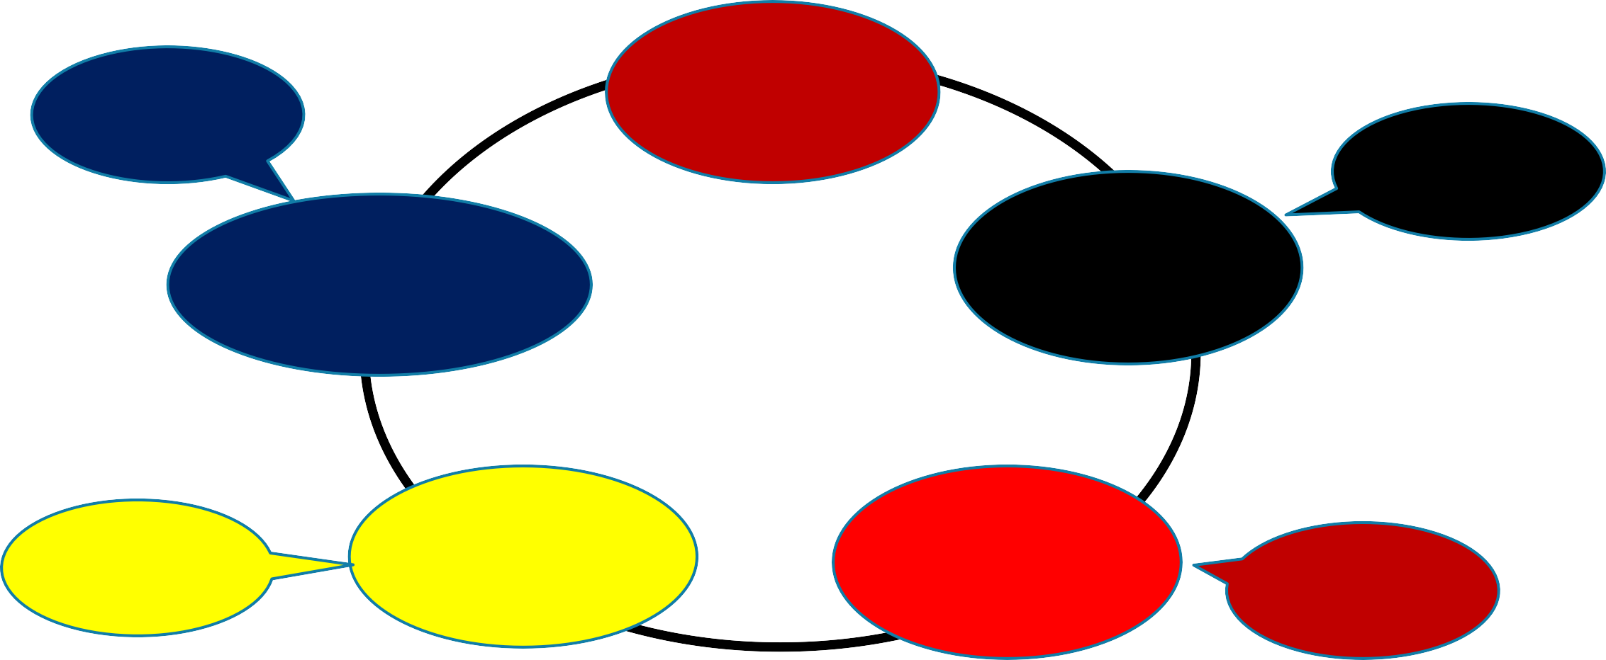
30
Days
Cash
30
Days
Bills Receivable
Raw Material
OPERATING CYCLE
20
Days
Finished
Goods
Stock in
Process
10
Days
Length of Operating Cycle = 30+10+20+30 = 90 days
i.e. 4 Cycles in a year (365 / 90)

Slide 10
Definition and importance of financial ratios
Ratios are a useful way of expressing these relationships.
Ratios express one quantity in relation to another
Several aspects of ratio analysis are important to understand. First, the computed ratio is not “the answer.”
The ratio is an indicator of some aspect of a company’s performance, telling what happened but not why it happened.

Slide 11
Company size sometimes confers economies of scale, so the absolute amounts of net income and revenue are useful in financial analysis. However, ratios control for the effect of size, which enhances comparisons between companies and over time.

Slide 12
A second important aspect of ratio analysis is that differences in accounting policies (across companies and across time) can distort ratios, and a meaningful comparison may, therefore, involve adjustments to the financial data.
Third, not all ratios are necessarily relevant to a particular analysis. The ability to select a relevant ratio or ratios to answer the research question is an analytical skill.

Slide 13
Differences in ratios across time and across companies can be subtle, and interpretation is situation specific

Slide 14
Value, Purposes, and Limitations of Ratio Analysis
Value :It enables a financial analyst to evaluate past performance, assess the current financial position of the company, and gain insights useful for projecting future results.
ratio is not “the answer” but is an indicator of some aspect of a company’s performance

Slide 15
a company’s financial flexibility, or ability to obtain the cash required to grow and meet its obligations, even if unexpected circumstances develop;
management’s ability;
changes in the company and/or industry over time; and
comparability with peer companies or the relevant industry(ies)

Slide 16
Limitations to ratio analysis
Companies may have divisions operating in many different industries. This can make it difficult to find comparable industry ratios to use for comparison purposes.
The need to determine whether the results of the ratio analysis are consistent. One set of ratios may indicate a problem, whereas another set may indicate that the potential problem is only short term in nature.
The need to use judgment.
The use of alternative accounting methods. eg inventory valuation methods Eg Straight line or accelerated methods of depreciation

Slide 17
Cross-sectional analysis
Cross-sectional analysis (sometimes called “relative analysis”) compares a specific metric for one company with the same metric for another company or group of companies, allowing comparisons even though the companies might be of significantly different sizes and/or operate in different currencies.

Slide 18
Trend Analysis
Trend analysis provides important information regarding historical performance and growth and, given a sufficiently long history of accurate seasonal information, can be of great assistance as a planning and forecasting tool for management and analysts.

Slide 19
Categories of Financial Ratios
Activity | Activity ratios measure how efficiently a company performs day-to-day tasks, such as the collection of receivables and management of inventory.
Liquidity | Liquidity ratios measure the company’s ability to meet its short-term obligations.
Solvency | Solvency ratios measure a company’s ability to meet long-term obligations. Subsets of these ratios are also known as “leverage” and “long-term debt” ratios.
Profitability | Profitability ratios measure the company’s ability to generate profits from its resources (assets).
Valuation | Valuation ratios measure the quantity of an asset or flow (e.g., earnings) associated with ownership of a specified claim (e.g., a share or ownership of the enterprise).

Slide 20
An analyst should evaluate financial ratios based on the following:
Company goals and strategy
Industry norms (cross-sectional analysis).
Economic conditions.

Slide 21
ACTIVITY RATIOS
Activity ratios are also known as asset utilization ratios or operating efficiency ratios.
This category is intended to measure how well a company manages various activities, particularly how efficiently it manages its various assets.

Slide 22
Activity ratios are analyzed as indicators of ongoing operational performance how effectively assets are used by a company.
These ratios reflect the efficient management of both working capital and longer term assets.
As noted, efficiency has a direct impact on liquidity (the ability of a company to meet its short-term obligations), so some activity ratios are also useful in assessing liquidity.

Slide 23
Activity Ratios | Numerator | Denominator
Inventory turnover | Cost of sales or cost of goods sold / | Average inventory
Days of inventory on hand (DOH) | Number of days in period / | Inventory turnover
Receivables turnover | Revenue / | Average receivables
Days of sales outstanding (DSO) | Number of days in period / | Receivables turnover

Slide 24
Payables turnover | Purchases / | Average trade payables
Number of days of payables | Number of days in period / | Payables turnover
Working capital turnover | Revenue / | Average working capital
Fixed asset turnover | Revenue / | Average net fixed assets
Total asset turnover | Revenue / | Average total assets

Slide 25
Activity ratios measure how efficiently the company utilizes assets. They generally combine information from the income statement in the numerator with balance sheet items in the denominator.

Slide 26
Inventory turnover lies at the heart of operations for many entities. It indicates the resources tied up in inventory (i.e., the carrying costs) and can, therefore, be used to indicate inventory management effectiveness.
A higher inventory turnover ratio implies a shorter period that inventory is held, and thus a lower DOH. In general, inventory turnover and DOH should be benchmarked against industry norms.

Slide 27
A high inventory turnover ratio relative to industry norms might indicate highly effective inventory management.
Alternatively, a high inventory turnover ratio (and commensurately low DOH) could possibly indicate the company does not carry adequate inventory, so shortages could potentially hurt revenue.

Slide 28
To assess which explanation is more likely, the analyst can compare the company’s revenue growth with that of the industry.
Slower growth combined with higher inventory turnover could indicate inadequate inventory levels.
Revenue growth at or above the industry’s growth supports the interpretation that the higher turnover reflects greater inventory management efficiency.

Slide 29
A low inventory turnover ratio (and commensurately high DOH) relative to the rest of the industry could be an indicator of slow-moving inventory, perhaps due to technological obsolescence or a change in fashion. Again, comparing the company’s sales growth with the industry can offer insight.

Slide 30
Receivables Turnover and DSO
The number of DSO represents the elapsed time between a sale and cash collection, reflecting how fast the company collects cash from customers to whom it offers credit.

Slide 31
A relatively high receivables turnover ratio (and commensurately low DSO) might indicate highly efficient credit and collection.
Alternatively, a high receivables turnover ratio could indicate that the company’s credit or collection policies are too stringent, suggesting the possibility of sales being lost to competitors offering more lenient terms.

Slide 32
A relatively low receivables turnover ratio would typically raise questions about the efficiency of the company’s credit and collections procedures.
As with inventory management, comparison of the company’s sales growth relative to the industry can help the analyst assess whether sales are being lost due to stringent credit policies.
In addition, comparing the company’s estimates of uncollectible accounts receivable and actual credit losses with past experience and with peer companies can help assess whether low turnover reflects credit management issues. Companies often provide details of receivables aging (how much receivables have been outstanding by age).

Slide 33
Payables Turnover and the Number of Days of Payables
The number of days of payables reflects the average number of days the company takes to pay its suppliers, and the payables turnover ratio measures how many times per year the company theoretically pays off all its creditors.

Slide 34
A payables turnover ratio that is high (low days payable) relative to the industry could indicate that the company is not making full use of available credit facilities; alternatively, it could result from a company taking advantage of early payment discounts.

Slide 35
An excessively low turnover ratio (high days payable) could indicate trouble making payments on time, or alternatively, exploitation of lenient supplier terms.
This is another example where it is useful to look simultaneously at other ratios.
If liquidity ratios indicate that the company has sufficient cash and other short-term assets to pay obligations and yet the days payable ratio is relatively high, the analyst would favor the lenient supplier credit and collection policies as an explanation

Slide 36
Working Capital Turnover
Working capital is defined as current assets minus current liabilities. Working capital turnover indicates how efficiently the company generates revenue with its working capital.
For example, a working capital turnover ratio of 4.0 indicates that the company generates €4 of revenue for every €1 of working capital.

Slide 37
A high working capital turnover ratio indicates greater efficiency (i.e., the company is generating a high level of revenues relative to working capital). For some companies, working capital can be near zero or negative, rendering this ratio incapable of being interpreted. The following two ratios are more useful in those circumstances.

Slide 38
Fixed Asset Turnover
This ratio measures how efficiently the company generates revenues from its investments in fixed assets.
Generally, a higher fixed asset turnover ratio indicates more efficient use of fixed assets in generating revenue.

Slide 39
A low ratio can indicate inefficiency, a capital-intensive business environment, or a new business not yet operating at full capacity—in which case the analyst will not be able to link the ratio directly to efficiency. In addition, asset turnover can be affected by factors other than a company’s efficiency.

Slide 40
The fixed asset turnover ratio would be lower for a company whose assets are newer (and, therefore, less depreciated and so reflected in the financial statements at a higher carrying value) than the ratio for a company with older assets (that are thus more depreciated and so reflected at a lower carrying value).
The fixed asset ratio can be erratic because, although revenue may have a steady growth rate, increases in fixed assets may not follow a smooth pattern; so, every year-to-year change in the ratio does not necessarily indicate important changes in the company’s efficiency.

Slide 41
Total Asset Turnover
The total asset turnover ratio measures the company’s overall ability to generate revenues with a given level of assets.
A ratio of 1.20 would indicate that the company is generating €1.20 of revenues for every €1 of average assets. A higher ratio indicates greater efficiency.
Because this ratio includes both fixed and current assets, inefficient working capital management can distort overall interpretations. It is therefore helpful to analyze working capital and fixed asset turnover ratios separately.

Slide 42
A low asset turnover ratio can be an indicator of inefficiency or of relative capital intensity of the business. The ratio also reflects strategic decisions by management—for example, the decision whether to use a more labor-intensive (and less capital-intensive) approach to its business or a more capital-intensive (and less labor-intensive) approach.

Slide 43
LIQUIDITY RATIOS
Liquidity analysis, which focuses on cash flows, measures a company’s ability to meet its short-term obligations.
Liquidity measures how quickly assets are converted into cash. Liquidity ratios also measure the ability to pay off short-term obligations.
In day-to-day operations, liquidity management is typically achieved through efficient use of assets. In the medium term, liquidity in the non-financial sector is also addressed by managing the structure of liabilities.

Slide 44
The level of liquidity needed differs from one industry to another. A particular company’s liquidity position may vary according to the anticipated need for funds at any given time.
Judging whether a company has adequate liquidity requires analysis of its historical funding requirements, current liquidity position, anticipated future funding needs, and options for reducing funding needs or attracting additional funds

Slide 45
These liquidity ratios reflect a company’s position at a point in time
The current, quick, and cash ratios reflect three measures of a company’s ability to pay current liabilities.
Each uses a progressively stricter definition of liquid assets.

Slide 46
The defensive interval ratio measures how long a company can pay its daily cash expenditures using only its existing liquid assets, without additional cash flow coming in.

Slide 47
The cash conversion cycle, a financial metric not in ratio form, measures the length of time required for a company to go from cash paid (used in its operations) to cash received (as a result of its operations).

Slide 48
Liquidity Ratios | Numerator | Denominator
Current ratio | Current assets | Current liabilities
Quick ratio | Cash + Short-term marketable investments + Receivables | Current liabilities
Cash ratio | Cash + Short-term marketable investments | Current liabilities
Defensive interval ratio | Cash + Short-term marketable investments + Receivables | Daily cash expenditures

Slide 49
Current Ratio
This ratio expresses current assets in relation to current liabilities. A higher ratio indicates a higher level of liquidity (i.e., a greater ability to meet short-term obligations). A current ratio of 1.0 would indicate that the book value of its current assets exactly equals the book value of its current liabilities.
A lower ratio indicates less liquidity, implying a greater reliance on operating cash flow and outside financing to meet short-term obligations. Liquidity affects the company’s capacity to take on debt. The current ratio implicitly assumes that inventories and accounts receivable are indeed liquid (which is presumably not the case when related turnover ratios are low).

Slide 50
Quick Ratio
The quick ratio is more conservative than the current ratio because it includes only the more liquid current assets (sometimes referred to as “quick assets”) in relation to current liabilities. Like the current ratio, a higher quick ratio indicates greater liquidity.
The quick ratio reflects the fact that certain current assets—such as prepaid expenses, some taxes, and employee-related prepayments—represent costs of the current period that have been paid in advance and cannot usually be converted back into cash. This ratio also reflects the fact that inventory might not be easily and quickly converted into cash, and furthermore, that a company would probably not be able to sell all of its inventory for an amount equal to its carrying value, especially if it were required to sell the inventory quickly. In situations where inventories are illiquid (as indicated, for example, by low inventory turnover ratios), the quick ratio may be a better indicator of liquidity than is the current ratio.

Slide 51
Cash Ratio
The cash ratio normally represents a reliable measure of an entity’s liquidity in a crisis situation. Only highly marketable short-term investments and cash are included. In a general market crisis, the fair value of marketable securities could decrease significantly as a result of market factors, in which case even this ratio might not provide reliable information.

Slide 52
Defensive Interval Ratio
This ratio measures how long the company can continue to pay its expenses from its existing liquid assets without receiving any additional cash inflow. A defensive interval ratio of 50 would indicate that the company can continue to pay its operating expenses for 50 days before running out of quick assets, assuming no additional cash inflows. A higher defensive interval ratio indicates greater liquidity. If a company’s defensive interval ratio is very low relative to peer companies or to the company’s own history, the analyst would want to ascertain whether there is sufficient cash inflow expected to mitigate the low defensive interval ratio.

Slide 53
Cash Conversion Cycle (Net Operating Cycle)
This metric indicates the amount of time that elapses from the point when a company invests in working capital until the point at which the company collects cash.

Slide 54
In the typical course of events, a merchandising company acquires inventory on credit, incurring accounts payable. The company then sells that inventory on credit, increasing accounts receivable. Afterwards, it pays out cash to settle its accounts payable, and it collects cash in settlement of its accounts receivable.
The time between the outlay of cash and the collection of cash is called the “cash conversion cycle.”

Slide 55
A shorter cash conversion cycle indicates greater liquidity. A short cash conversion cycle implies that the company only needs to finance its inventory and accounts receivable for a short period of time. A longer cash conversion cycle indicates lower liquidity; it implies that the company must finance its inventory and accounts receivable for a longer period of time, possibly indicating a need for a higher level of capital to fund current assets.

Slide 56
SOLVENCY RATIOS
Solvency refers to a company’s ability to fulfill its long-term debt obligations. Assessment of a company’s ability to pay its long-term obligations (i.e., to make interest and principal payments) generally includes an in-depth analysis of the components of its financial structure.
Solvency ratios provide information regarding the relative amount of debt in the company’s capital structure and the adequacy of earnings and cash flow to cover interest expenses and other fixed charges (such as lease or rental payments) as they come due.

Slide 57
A company’s relative solvency is fundamental to valuation of its debt securities and its creditworthiness. Finally, understanding a company’s use of debt can provide analysts with insight into the company’s future business prospects because management’s decisions about financing may signal their beliefs about a company’s future.

Slide 58
Solvency ratios are primarily of two types.
Debt ratios, the first type, focus on the balance sheet and measure the amount of debt capital relative to equity capital.
Coverage ratios, the second type, focus on the income statement and measure the ability of a company to cover its debt payments.

Slide 59
Solvency Ratios | Numerator | Denominator
Debt Ratios
Debt-to-assets ratio | Total debt^{b} | Total assets
Debt-to-capital ratio | Total debt^{b} | Total debt^{b} + Total shareholders’ equity
Debt-to-equity ratio | Total debt^{b} | Total shareholders’ equity
Financial leverage ratio^{c} | Average total assets | Average total equity
Debt-to-EBITDA | Total debt | EBITDA

Slide 60
Coverage Ratios
Interest coverage | EBIT | Interest payments
Fixed charge coverage | EBIT + Lease payments | Interest payments + Lease payments

Slide 61
The first three of the debt ratios presented use total debt in the numerator.
The definition of total debt used in these ratios varies among informed analysts and financial data vendors, with some using the total of interest-bearing short-term and long-term debt, excluding liabilities such as accrued expenses and accounts payable.
Other analysts use definitions that are more inclusive (e.g., all liabilities) or restrictive (e.g., long-term debt only, in which case the ratio is sometimes qualified as “long-term,” as in “long-term debt-to-equity ratio”).
If using different definitions of total debt materially changes conclusions about a company’s solvency, the reasons for the discrepancies warrant further investigation.

Slide 62
Debt-to-Assets Ratio
This ratio measures the percentage of total assets financed with debt. For example, a debt-to-assets ratio of 0.40 or 40 percent indicates that 40 percent of the company’s assets are financed with debt.
Generally, higher debt means higher financial risk and thus weaker solvency.

Slide 63
Debt-to-Capital Ratio
The debt-to-capital ratio measures the percentage of a company’s capital (debt plus equity) represented by debt. As with the previous ratio, a higher ratio generally means higher financial risk and thus indicates weaker solvency.

Slide 64
Debt-to-Equity Ratio
The debt-to-equity ratio measures the amount of debt capital relative to equity capital. Interpretation is similar to the preceding two ratios (i.e., a higher ratio indicates weaker solvency). A ratio of 1.0 would indicate equal amounts of debt and equity, which is equivalent to a debt-to-capital ratio of 50 percent. Alternative definitions of this ratio use the market value of stockholders’ equity rather than its book value (or use the market values of both stockholders’ equity and debt).

Slide 65
Financial Leverage Ratio
This ratio (often called simply the “leverage ratio”) measures the amount of total assets supported for each one money unit of equity. For example, a value of 3 for this ratio means that each €1 of equity supports €3 of total assets. The higher the financial leverage ratio, the more leveraged the company is in the sense of using debt and other liabilities to finance assets.
This ratio is often defined in terms of average total assets and average total equity

Slide 66
Debt-to-EBITDA Ratio
This ratio estimates how many years it would take to repay total debt based on earnings before income taxes, depreciation and amortization (an approximation of operating cash flow).

Slide 67
Interest Coverage
This ratio measures the number of times a company’s EBIT could cover its interest payments. Thus, it is sometimes referred to as “times interest earned.”
A higher interest coverage ratio indicates stronger solvency, offering greater assurance that the company can service its debt (i.e., bank debt, bonds, notes) from operating earnings.

Slide 68
Fixed Charge Coverage
This ratio relates fixed charges, or obligations, to the cash flow generated by the company. It measures the number of times a company’s earnings (before interest, taxes, and lease payments) can cover the company’s interest and lease payments.
Similar to the interest coverage ratio, a higher fixed charge coverage ratio implies stronger solvency, offering greater assurance that the company can service its debt (i.e., bank debt, bonds, notes, and leases) from normal earnings.
The ratio is sometimes used as an indication of the quality of the preferred dividend, with a higher ratio indicating a more secure preferred dividend

Slide 69
PROFITABILITY RATIOS
Profitability reflects a company’s competitive position in the market, and by extension, the quality of its management.
The income statement reveals the sources of earnings and the components of revenue and expenses.
Earnings can be distributed to shareholders or reinvested in the company. Reinvested earnings enhance solvency and provide a cushion against short-term problems

Slide 70
Profitability Ratios | Numerator | Denominator
Return on Sales
Gross profit margin | Gross profit | Revenue
Operating profit margin | Operating income | Revenue
Pretax margin | EBT (earnings before tax but after interest) | Revenue
Net profit margin | Net income | Revenue

Slide 71
Return on Investment
Operating ROA | Operating income | Average total assets
ROA | Net income | Average total assets
Return on total capital | EBIT | Average short- and long-term debt and equity
ROE | Net income | Average total equity
Return on common equity | Net income – Preferred dividends | Average common equity

Slide 72
Gross Profit Margin
Gross profit margin indicates the percentage of revenue available to cover operating and other expenses and to generate profit. Higher gross profit margin indicates some combination of higher product pricing and lower product costs. The ability to charge a higher price is constrained by competition, so gross profits are affected by (and usually inversely related to) competition. If a product has a competitive advantage (e.g., superior branding, better quality, or exclusive technology), the company is better able to charge more for it. On the cost side, higher gross profit margin can also indicate that a company has a competitive advantage in product costs.

Slide 73
Operating Profit Margin
Operating profit is calculated as gross profit minus operating costs. So, an operating profit margin increasing faster than the gross profit margin can indicate improvements in controlling operating costs, such as administrative overheads. In contrast, a declining operating profit margin could be an indicator of deteriorating control over operating costs.

Slide 74
Pretax Margin
Pretax income (also called “earnings before tax” or “EBT”) is calculated as operating profit minus interest, and the pretax margin is the ratio of pretax income to revenue. The pretax margin reflects the effects on profitability of leverage and other (non-operating) income and expenses. If a company’s pretax margin is increasing primarily as a result of increasing amounts of non-operating income, the analyst should evaluate whether this increase reflects a deliberate change in a company’s business focus and, therefore, the likelihood that the increase will continue.

Slide 75
Net Profit Margin
Net profit, or net income, is calculated as revenue minus all expenses. Net income includes both recurring and non-recurring components. Generally, the net income used in calculating the net profit margin is adjusted for non-recurring items to offer a better view of a company’s potential future profitability.

Slide 76
Return on Total Capital
Return on total capital measures the profits a company earns on all of the capital that it employs (short-term debt, long-term debt, and equity). As with operating ROA, returns are measured prior to deducting interest on debt capital (i.e., as operating income or EBIT).

Slide 77
ROE
ROE measures the return earned by a company on its equity capital, including minority equity, preferred equity, and common equity. As noted, return is measured as net income (i.e., interest on debt capital is not included in the return on equity capital). A variation of ROE is return on common equity, which measures the return earned by a company only on its common equity.

Slide 78
Financial performance
BY
DIVYA DIVAKAR
SENIOR MANAGER
CANARA BANK
CLDC VIJAYAWADA

Slide 79
“Investing in yourself is the best investment you will ever make. it will not only improve your life, it will improve the lives of all those around you.”

Slide 80
Financial performance
Financial performance is a subjective measure of how well a firm can use assets from its primary mode of business and generate revenues.
The term is also used as a general measure of a firm's overall financial health over a given period.

Slide 81
Financial performance is a complete evaluation of a company’s overall standing in categories such as assets, liabilities, equity, expenses, revenue, and overall profitability. It is measured through various business-related formulas that allow users to calculate exact details regarding a company’s potential effectiveness.

Slide 82
Financial statements used in evaluating overall financial performance include the balance sheet, the income statement, and the statement of cash flows.
Financial performance indicators are quantifiable metrics used to measure how well a company is doing.
No single measure should be used to define the financial performance of a firm.

Slide 83
Why Is Financial Performance Important?
A company's financial performance tells investors about its general well-being.
It's a snapshot of its economic health and the job its management is doing providing insight into the future: whether its operations and profits are on track to grow and the outlook for its stock.

Slide 84
The financial performance of a company is based on numbers. But in the end, it imparts an impression about the company and its soundness.
A financial analysis of a company's financial statements, summarized in annual reports and Forms is essential for any serious investor seeking to understand and value a company properly.

Slide 85
However, it's also important to realize that financial performance reflects the past, and is never an exact indicator of the future. Nor does it exist in a vacuum. Those evaluating a company's financial performance should always consider it in light of other, comparable businesses; the overall industry; and the company's history.

Slide 86
What Are Financial Performance Indicators?
Financial performance indicators, also known as key performance indicators (KPIs), are quantifiable measurements used to determine, track, and project the economic well-being of a business.
They act as tools for both corporate insiders (like management and board members) and outsiders (like research analysts and investors) to analyze how well the company is doing—especially regarding competitors—and identify where strengths and weaknesses lie.

Slide 87
The most widely used financial performance indicators include:
Gross profit /gross profit margin: the amount of revenue made from sales after subtracting production costs, and the percentage amount a company earns per dollar of sales
Net profit/net profit margin: the amount of revenue from sales after subtracting all related business expenses and taxes, and the related ratio of earnings per dollar of sales
Working capital: immediately available or highly liquid funds, used to finance day-to-day operations

Slide 88
Working capital is a Measure Of Company’s Efficiency And Short-term
Financial Health
Working Capital
Gap(WCG)
Gross working capital
Net working capital (Liquid surplus)
Total Current Assets - Other Current Liabilities
(Excl. Bank Borrowings)
Total investment in current assets
Current assets – Current liabilities

Slide 89
Net worth
100
FIXED ASSETS
105
LTU
LTS
Long Term Liabilities 50
----------------------------
NON CURRENT ASSETS
15
-----
NWC
SHORT TERM BANK
------------------------------------------
BORROWINGS 30
CURRENT ASSETS
110
--------
STU
STS
CURRENT LIABILITIES
OTHER CURRENT LIABILITIES 50
INDIANINDIAN
NKINGNG && FFINANCINANCE

Slide 90
Operating cash flow: the amount of money being generated by regular business operations
Current ratio
Debt-to-equity ratio: a company’s total liabilities divided by its shareholder equity

Slide 91
Quick ratio: that calculates the percentage of very liquid current assets (cash, securities, accounts receivables) against total current liabilities
Inventory turnover: how much inventory is sold within a certain period, and how often the entire inventory was sold
Return on equity: net income divided by shareholder equity (a company’s assets minus its debts)

Slide 92
What Are the Types of Financial Performance Analysis?
Working capital analysis
Working capital refers to the organization’s ability to complete its short-term liabilities with the help of current assets. Often, working capital is used to determine the liquidity of the organization. Furthermore, working capital or net working capital helps determine the company’s financial health and operational efficiency.
Analyzing working capital helps in understanding the complete operational potential of the business besides helping managers to foresee financial difficulties that may arise. It is also used to show stakeholders the organization’s financial picture through challenging periods.

Slide 93
Financial structure analysis
The financial structure comprises debt and equity that businesses use to finance their assets. Private and public companies use different financial structures to record their debt and equity-related transactions. Financial structure analysis helps in finding the right capital opportunities for your business. Interestingly, in some cases, financial structure analysis can help you decide which organization type to choose – public or private.

Slide 94
Activity analysis
Activity analysis is summarized as evaluating different processes like costing, pricing, distribution, etc. It is a systematic evaluation that determines the suitability and performance of a business function or activity. In addition, activity analysis is focused on determining whether the activity will achieve its goals.

Slide 95
Probability analysis
Probability analysis is used to forecast the future events of the market. They help foresee business losses and uncertain market conditions way ahead of others. Therefore, probability analysis is an effective technique for companies with few current assets. It is sometimes used for analyzing past losses and more.

Slide 96
Cash Flow Statement
Although the income statement and balance sheet provide measures of a company’s success in terms of performance and financial position, cash flow is also vital to a company’s long-term success.
Disclosing the sources and uses of cash helps creditors, investors, and other statement users evaluate the company’s liquidity, solvency, and financial flexibility. Financial flexibility is the ability of the company to react and adapt to financial adversity and opportunities.

Slide 97
The cash flow statement classifies all cash flows of the company into three categories: operating, investing, and financing.
Cash flows from operating activities generally involve the cash effects of transactions involved in the determination of net income and, hence, comprise the day-to-day operations of the company.
Cash flows from investing activities are associated with the acquisition and disposal of long-term assets, such as property and equipment.
Cash flows from financing activities relate to obtaining or repaying capital to be used in the business.

Slide 98
Debt Financing vs. Equity Financing
Debt financing is common for assets, such as equipment, buildings, land, or machinery, when the assets to be purchased are used as security or collateral for the loan. The main advantage of debt financing over equity financing is that the business owner doesn't have to give up partial ownership of the business and thus can retain full control. For short-term cash flow shortages, many small business owners make use of credit or lines of credit.

Slide 99
Equity financing involves raising money from angel investors or venture capitalists. Equity financing is much less risky because money invested doesn't have to be repaid if the business doesn't succeed. However, in exchange for financing, the investor becomes a part owner and, as such, takes a share of the profits and has a say in how the business is run.

Slide 100
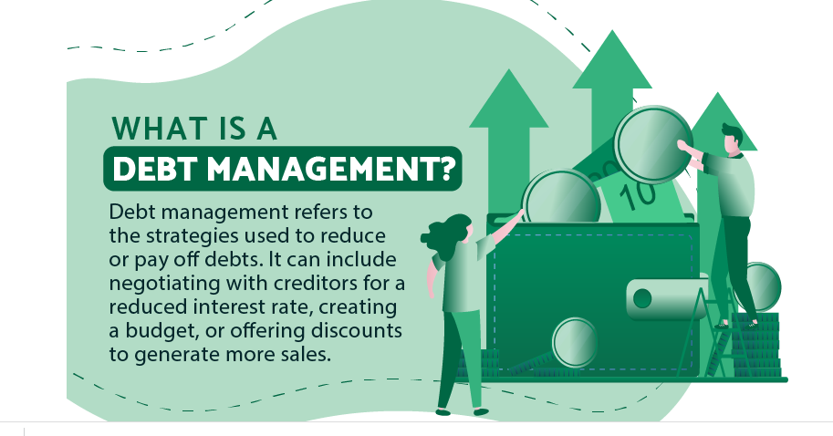
Debt Management

Slide 101
Consolidate and reduce servicing costs to a more favorable loan
Manage accounts receivable

Slide 102
Find creative options with your vendors and suppliers
Where your company debt is being directed to support expansion, inventory or services from suppliers, consider finding deferred payment arrangements with these entities. These models can include risk-sharing arrangements with payments based on downstream conclusion of the service or product sales. This is something that is rarely considered when suggested to my clients, but rethinking and evolving business relationships from one of simply supplier to that of partner or investor can be transformative, often in times of threat. Entering into such arrangements should be done with a clear understanding of risk and reward, and as much objective legal and financial expertise as is required to assure mutually beneficial outcomes to both parties.

Slide 103
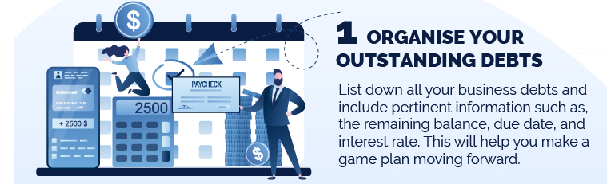

Slide 104


Slide 105
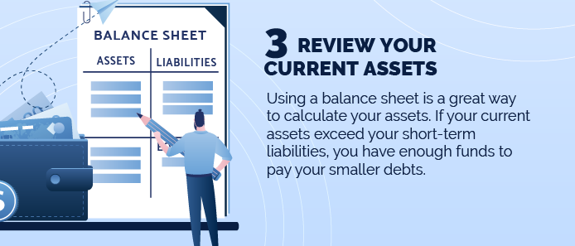

Slide 106
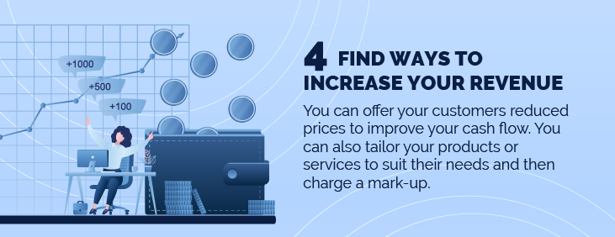

Slide 107


Slide 108


Slide 109
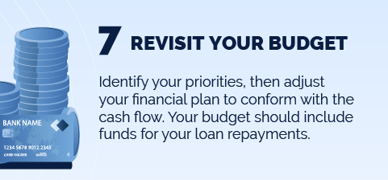

Slide 110
What Is Optimal Capital Structure?
The optimal capital structure of a firm is the best mix of debt and equity financing that maximizes a company’s market value while minimizing its cost of capital. In theory, debt financing offers the lowest cost of capital due to its tax deductibility.

Slide 111
However, too much debt increases the financial risk to shareholders and the return on equity that they require. Thus, companies have to find the optimal point at which the marginal benefit of debt equals the marginal cost.

Slide 112
An optimal capital structure is the best mix of debt and equity financing that maximizes a company’s market value while minimizing its cost of capital.
Minimizing the weighted average cost of capital (WACC) is one way to optimize for the lowest cost mix of financing.
According to some economists, in the absence of taxes, bankruptcy costs, agency costs, and asymmetric information, in an efficient market, the value of a firm is unaffected by its capital structure.

Slide 113
The cost of capital is the rate of return that the suppliers of capital—lenders and owners—require as compensation for their contribution of capital.
Another way of looking at the cost of capital is that it is the opportunity cost of funds for the suppliers of capital: A potential supplier of capital will not voluntarily invest in a company unless its return meets or exceeds what the supplier could earn elsewhere in an investment of comparable risk.
In other words, to raise new capital, the issuer must price the security to offer a level of expected return that is competitive with the expected returns being offered by similarly risky securities.

Slide 114
The most common way to estimate this required rate of return is to calculate the marginal cost of each of the various sources of capital and then calculate a weighted average of these costs. You will notice that the debt and equity costs of capital and the tax rate are all understood to be “marginal” rates: the cost or tax rate for additional capital.
The weighted average is referred to as the weighted average cost of capital (WACC). The WACC is also referred to as the marginal cost of capital (MCC) because it is the cost that a company incurs for additional capital.

Slide 115
the expression for WACC isWACC = w_{d}r_{d}(1 – t) + w_{p}r_{p} + w_{e}r_{e}, 1where
w_{d} = the target proportion of debt in the capital structure when the company raises new funds
r_{d} = the before-tax marginal cost of debt
t = the company’s marginal tax rate
w_{p} = the target proportion of preferred stock in the capital structure when the company raises new funds
r_{p} = the marginal cost of preferred stock
w_{e} = the target proportion of common stock in the capital structure when the company raises new funds
r_{e} = the marginal cost of common stock
Note that preferred stock is also referred to as preferred equity, and common stock is also referred to as common equity, or equity.

Slide 116
Benchmarking and key ratios and its importance
BY
DIVYA DIVAKAR
SENIOR MANAGER
CANARA BANK
CLDC VIJAYAWADA

Slide 117
Total Assets ₹22,00,000; Fixed Assets ₹10,00,000; Capital Employed ₹20,00,000. There were no Long-term Investments. Calculate Current Ratio.

Slide 118

Current Assets = Total Assets − Fixed Assets
Fixed Assets = 10,00,000
Total Assets = 22,00,000
∴ Current Assets = 22,00,000 − 10,00,000 = 12,00,000
Current Liabilities = Total Assets − Capital Employed
= 22,00,000 − 20,00,000 = 2,00,000

Slide 119
Capital Employed ₹10,00,000; Fixed Assets ₹7,00,000; Current Liablities ₹1,00,000. There are no Long-term Investments. Calculate Current Ratio.

Slide 120
Capital Employed = 10,00,000
Fixed Assets = 7,00,000
Current Assets = Capital Employed + Current Liabilities − Fixed Assets
= 10,00,000 + 1,00,000 − 7,00,000 = 4,00,000
CR =4/1

Slide 121
From the following informations, calculate Return on Investment (or Return on Capital Employed):
Particulars |  | ₹
Share Capital |  | 5,00,000
Reserves and Surplus |  | 2,50,000
Net Fixed Assets |  | 22,50,000
Non-current Trade Investments |  | 2,50,000
Current Assets |  | 11,00,000
10% Long-term Borrowings |  | 20,00,000
Current Liabilities |  | 8,50,000
Long-term Provision |  | NIL

Slide 122
Net Profit before tax = 6,00,000
Net Profit before interest, tax and dividend = Net Profit before tax + Interest on long-term borrowings
= 6,00,000 + 10% of 20,00,000 = 6,00,000 + 2,00,000 = 8,00,000
Capital Employed = Share Capital + Reserves and Surplus + Long-term borrowings
= 5,00,000 + 2,50,000 + 20,00,000 = 27,50,000

Slide 124
Financial ratios are of little use without benchmarks to compare them against.
Benchmarks are guidelines or general rules of thumb related to a specific industry or business segment.
As benchmarking and ratio analysis continue to grow in popularity, the availability of such data will also improve

Slide 125
While a particular ratio can provide insight into financial performance, trends in the ratios are even more useful.
A trend is a direction or tendency a ratio exhibits for two or more years. Positive or negative trends for three to five years are considered significant.
A lack of trends, or erratic financial performance, should also be watched, especially in repayment and profitability analyses.

Slide 126
Financial ratios and benchmarks are useful for persons both inside and outside a business.
Management can use the information to assist in decision-making and goal setting and to compare their business performance to that of similar operations.

Slide 127
Financial ratios and benchmarks are useful for persons both inside and outside a business.
Management can use the information to assist in decision-making and goal setting and to compare their business performance to that of similar operations.

Slide 128
Any credit facility in whatever form extended by the bank to power sector (other than captive power plant) shall form part of the infrastructure lending as defined by RBI. Infrastructure lending, as defined by RBI, is furnished in Credit Risk Management Policy of the Bank and other Circulars issued by Head Office

Slide 129
Any infrastructure facility that is a project or a facility of a similar nature in any of the following subsectors under Energy Sector shall be lending to Infrastructure-Power Sector lending :
(i) Electricity Generation
(ii) Electricity Transmission
(iii) Electricity Distribution

Slide 130
Moratorium Period
The moratorium period shall be as per implementation schedule accepted at the time of sanction and shall generally end with the commercial operation date.
However, the period shall not go beyond 6 months from the date of commercial operation date / project completion date as envisaged at the time of financial closure.

Slide 131
Crystallization of Date of Commencement of Commercial operation (DCCO) at the time of financial closure
The date of completion of project loan should be clearly spelt out at the time of financial closure of the project.
Project Loan means any term loan which has been extended for the purpose of setting up of an economic venture. While appraising project loans, Date of Commencement of Commercial Operations (DCCO) has to be realistically fixed for all project loans at the time of sanction of the loan/ financial closure

Slide 132
TEV Study of the Greenfield / Brownfield Projects
While granting any credit facilities to Infrastructure projects, the Bank generally conducts an independent techno economic appraisal of the project through the in house Project appraisal set up before placing the proposal to the concerned sanctioning authority for decision.
Project Appraisal shall be carried out as per extant guidelines. Extant guidelines as per the Credit Risk Management Policy of the bank regarding conducting of project appraisal shall be adhered to

Slide 133
Financial Benchmarks

Slide 134
Debt/Equity Ratio
Normally 2.33:1.
In exceptional cases, sanctioning authorities, DER can be accepted at 4:1 duly justifying the reasons.

Slide 135
Overall Promoters contribution
Minimum 30% of the Project Cost In exceptional cases, sanctioning authorities, can accept upto 20%.
Suitable Upfront Promoter Contribution on case to case basis may be stipulated at the time of appraisal.

Slide 136
Minimum Equity Contribution by the Promoters
15% of the project Cost; However, sanctioning authorities can accept upto 11% of Project Cost.
Equity for the purpose shall comprise of Ordinary Share Capital plus Reserve & Surplus less Revaluation Reserve (if any) less Accumulated Losses (if any) plus Preferential Capital with maturity of 12 years & above.

Slide 137
TOL /TNW (Applicable for WC FacilityBoth Fund Based and NonFund Based Facility)
TOL/TNW up to 5:1.

Slide 138
Fixed Assets Coverage Ratio
Not less than 1.25.
However Sanctioning Authorities can accept FACR upto 1.11, in exception cases

Slide 139
Repayment period
Not exceeding 15 years excluding moratorium. In exceptional cases where the project calls for longer repayment tenure due to inherent nature of project the appropriate repayment period can be accepted upto 25 years only by CAC of the Board/MC.
However, The tenor of the Amortization Schedule should not be more than 80% (leaving a tail of 20%) of the initial concession period under public private partnership (PPP) model; or 80% of the initial economic life envisaged at the time of project appraisal for determining the user charges / tariff in case of non-PPP projects

Slide 140
Overall DSCR / Minimum DSCR
Overall (Average) DSCR of not less than 1.50. In exceptional cases sanctioning authorities, can accept upto 1.25.
Minimum DSCR of 1.05 for initial period of two year period from DCCO and 1.10 from third year onwards covering balance loan tenure.

