Slide 1
33kv, 132kv & 220kv circuit breaker mechanism related problems and troubleshooting with practical approach relevant to EHT Sub-stations of APTRANSCO
By
B KameswaraRao
Executive Engineer
MRT & Tr Division, Srikakulam

Slide 2
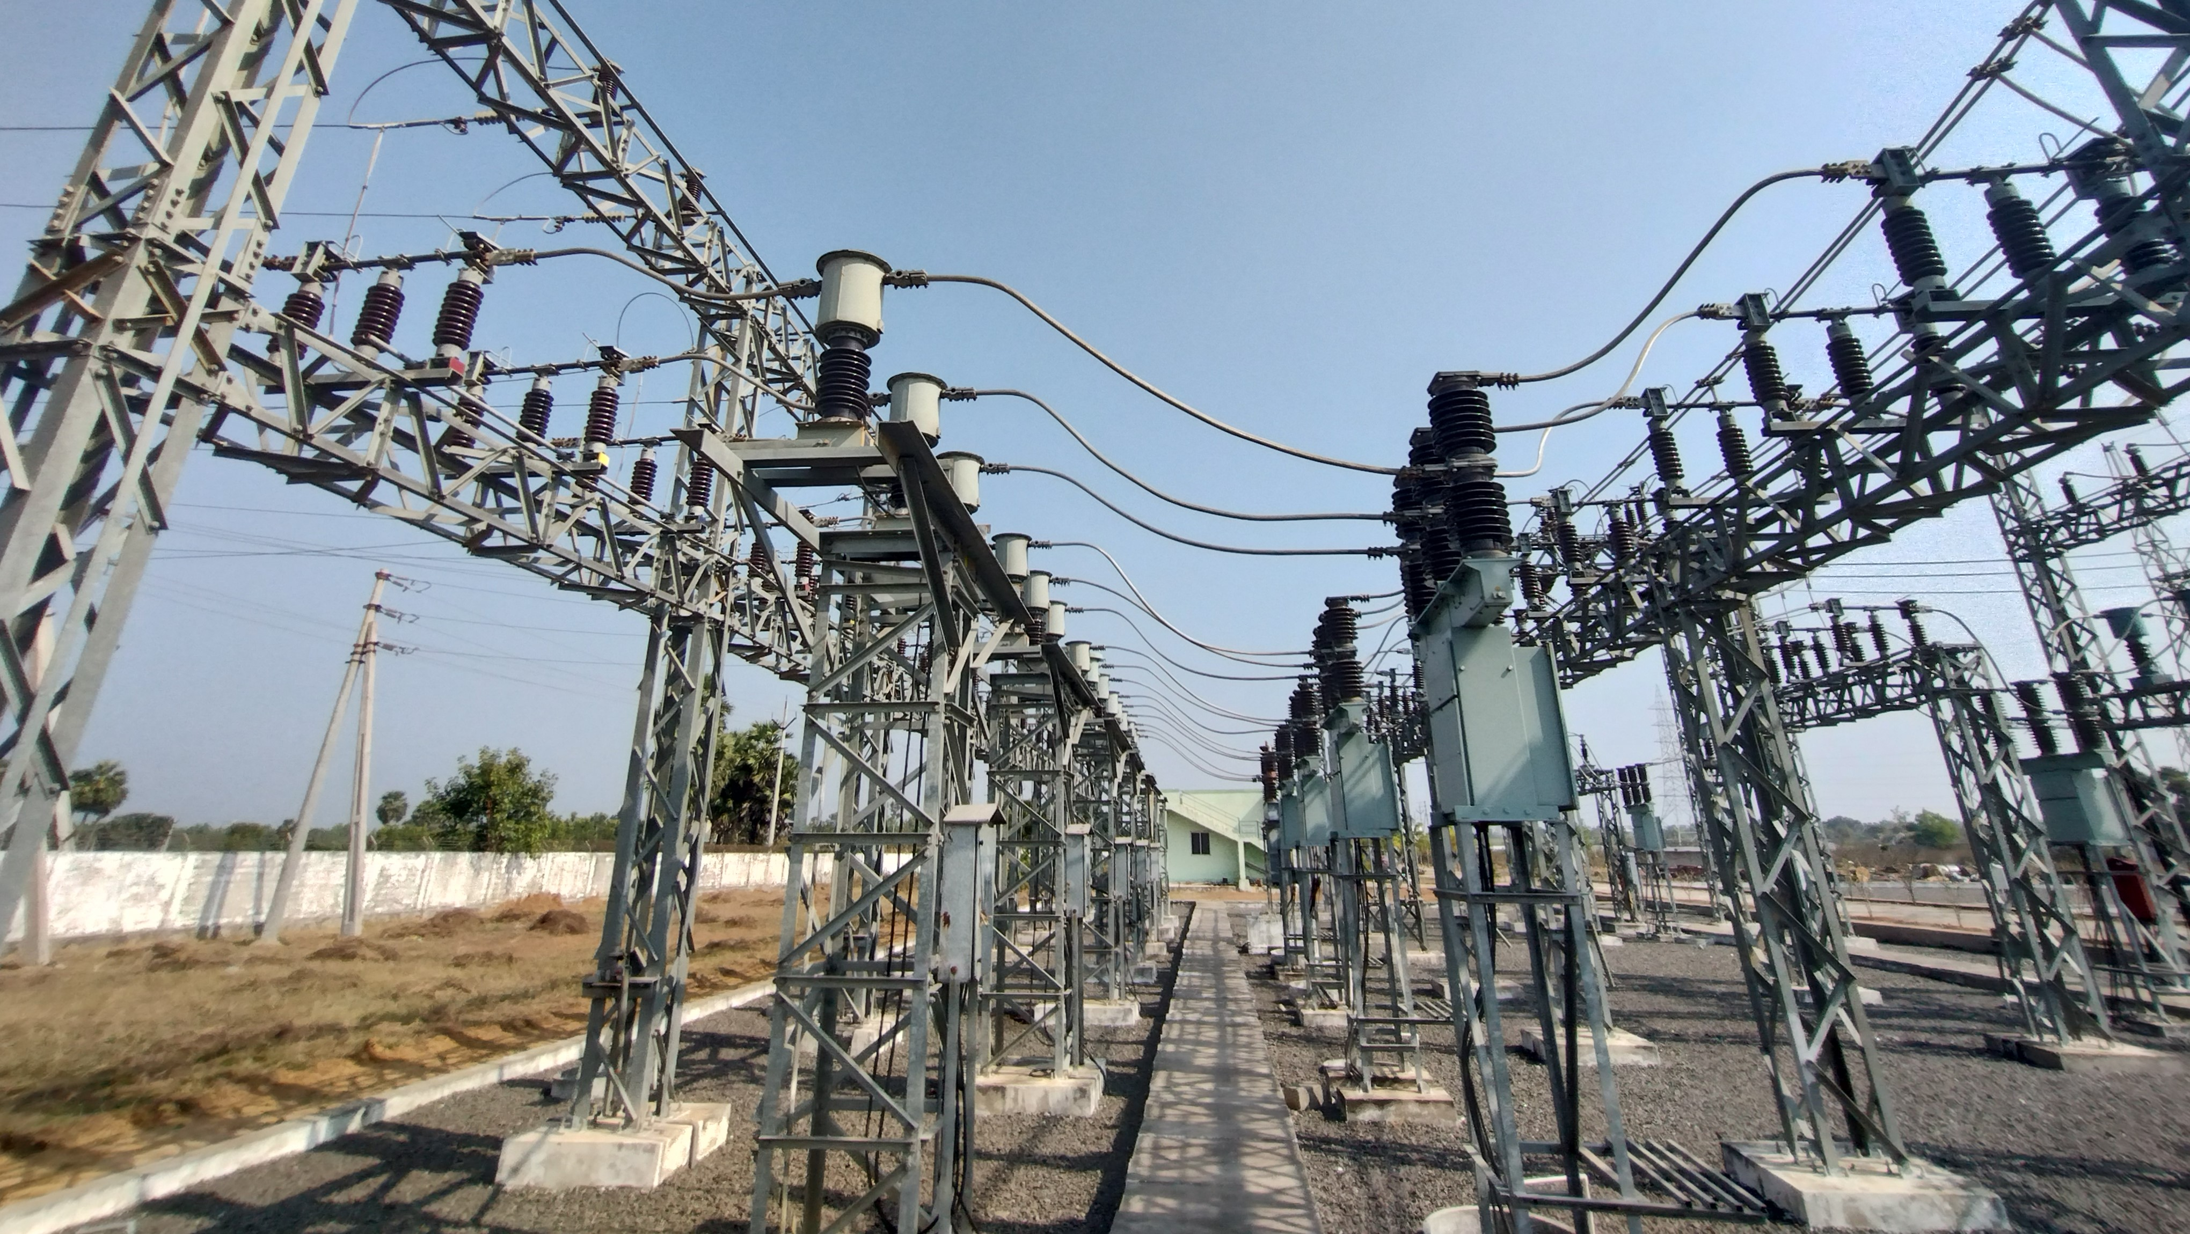
Introduction: In a typical 132/33kv sub-station, the 33kv feeder bay or Power Transformer HV/LV bays consists of Isolators (Iso), Circuit Breaker (CB), Current Transformers (CTs) and lightening arrestors (Las) and control & protective relaying system (C&R panel). This arrangement is for switching operations and to protect the electrical system from damage during high magnitude fault current conditions.

Slide 3
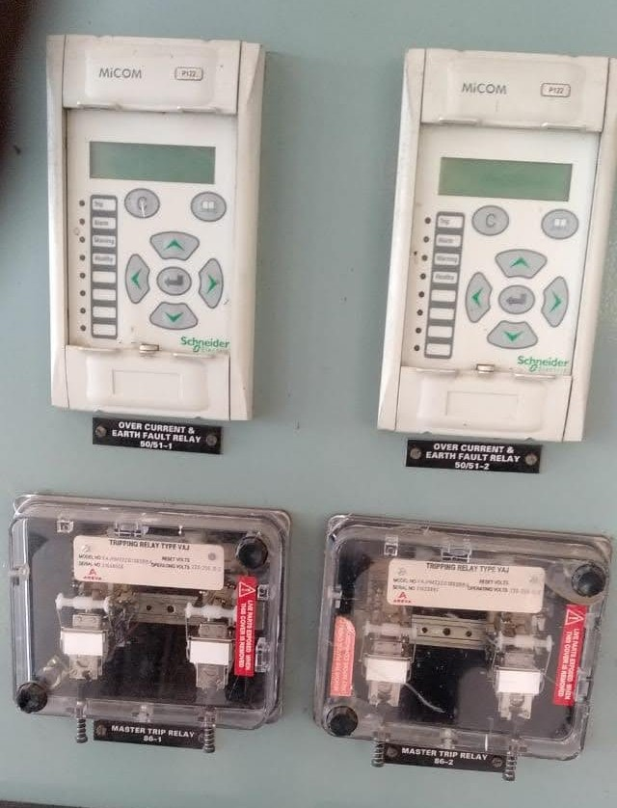
Protective relaying system:
Under abnormal or fault current flow condition, the protective relaying system will receive feedback from Current Transformers of concerned feeder and will send a 220V DC signal to trip the Circuit Breaker of that feeder to interrupt the circuit.

Slide 4
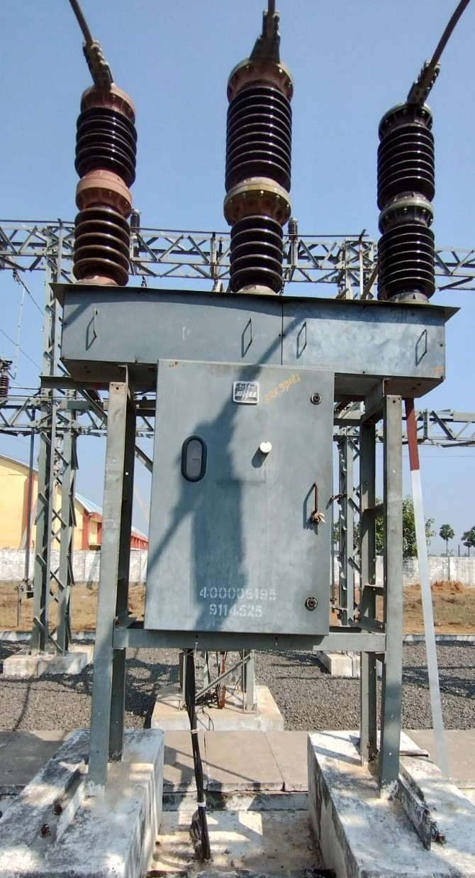
33kv Circuit breaker
Here the role of a Circuit Breaker is very important. It is a mechanical device which breaks the electrical circuit.
A circuit breaker is defined as a switching device that can be operated manually or automatically for controlling and protecting an electrical power system. It is a mechanical device that interrupts the high magnitude (fault) current and performs the function of a switch thus protects the electrical system from damage.

Slide 5
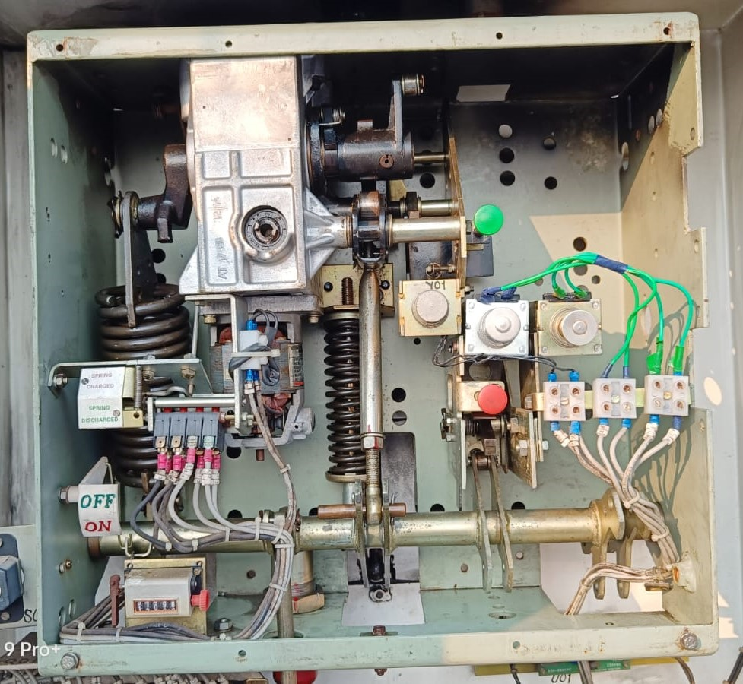
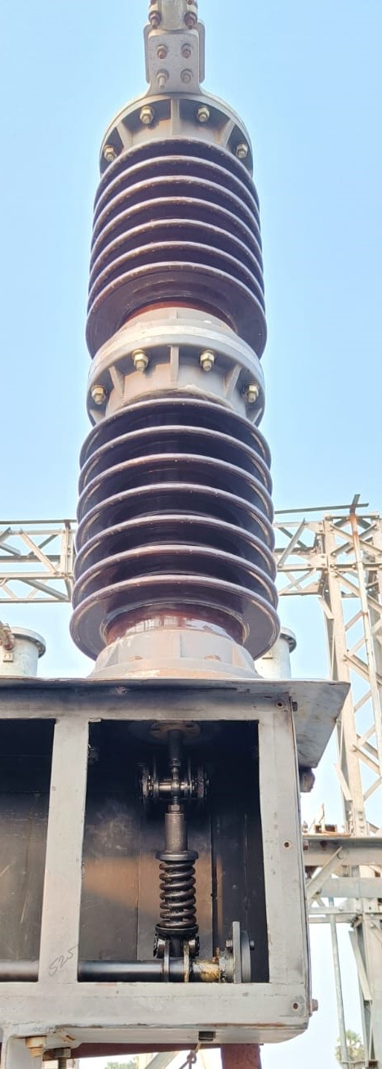
33kv, BHEL make, PVN36 type Circuit breaker: Operating mechanism Pole and base mechanism

Slide 6
The main parts of operating mechanism of a circuit breaker:
1) Close spring with charging mechanism.
2) Eccentric wheel with cam-roller mechanism with
closing latch and close coil assembly. 3) Common operating shaft
4) Trip spring.
5) Tripping latch mechanism with Trip coil assembly.
6) Pole base mechanism

Slide 7
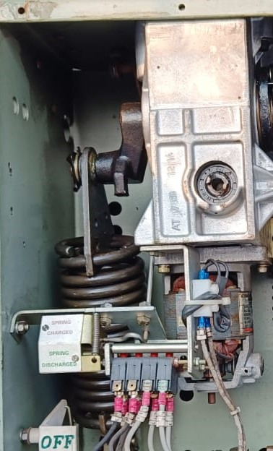
1. Close spring charging mechanism
A single phase AC/DC series motor is connected to operate the mechanism in auto mode to charge (expand) the close spring. This mechanism can also be operated manually. When close spring fully charged, the state of limit switch will be changed.

Slide 8
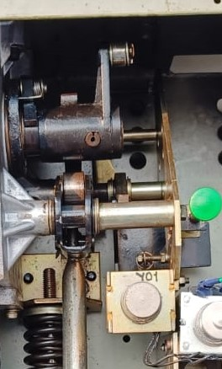
2. Eccentric cam-roller mechanism with closing latch and close coil assembly.
This arrangement will hold the close spring in charged condition. When close coil operates, the close spring will be discharged and due to eccentric cam-roller operation the common operating shaft will rotate in pro direction to close the CB.

Slide 9
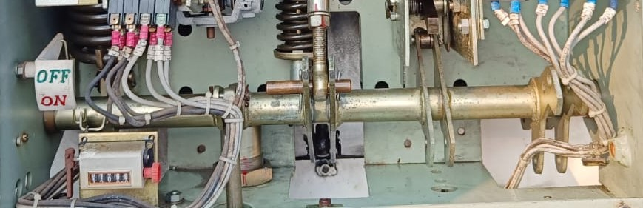
3.Common operating shaft. When common operating shaft rotates in pro direction, the following mechanical operations will be done: a) Circuit breaker will be closed. b) Trip spring will be charged and trip latch roller will gets engaged with trip catch. c) The status of Auxiliary switch will be changed.

Slide 10
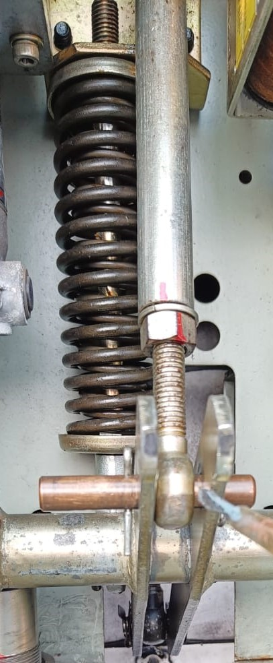
4. Tripping spring.
The trip spring is connected to common operating shaft. When common operating shaft rotates in pro direction, the trip spring will be charged and latched.

Slide 11
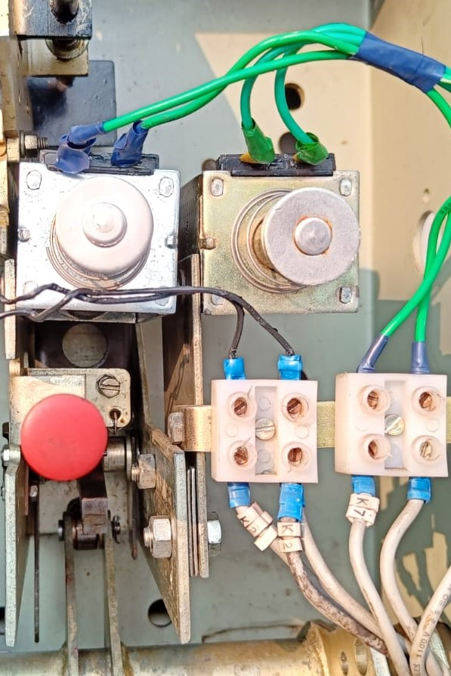
5. Tripping latch mechanism with Trip coil assembly.
This arrangement will hold the Trip spring in charged (compressed) condition. When trip coils operates, the trip spring will be released and will rotate the common operating shaft in reverse direction which will open the CB.

Slide 12
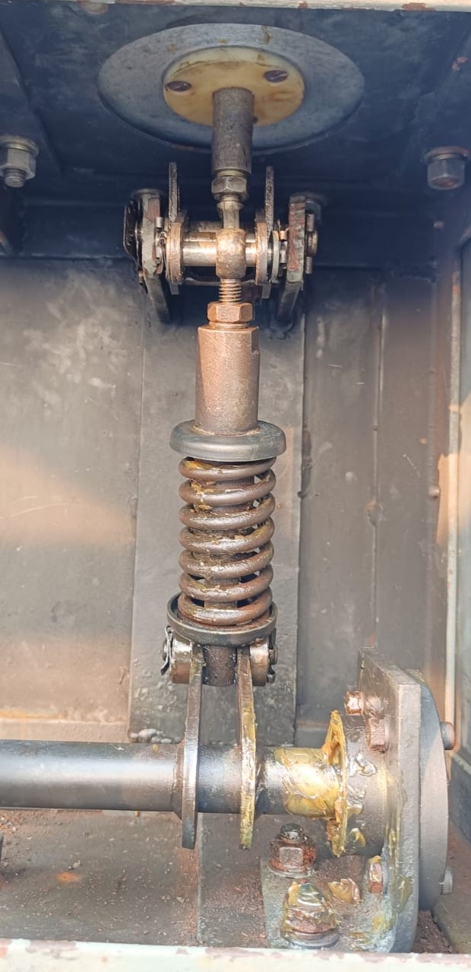
6.Pole base mechanism.
The pole base mechanism is connected to common operating shaft in the main mechanism through an operating rod to perform closing and opening operations of CB.
During closing of CB, the moving contact in the vacuum bottle will hit the fixed contact and may bounce back due to repulsive force which is not at all desirable. Here in pole base mechanism the function of spring is to supply sufficient mechanical energy to overcome repulsive force.

Slide 13
Circuit Breaker maintenance
A typical circuit breaker mechanism consists of 40 to 50 nos. moving parts. For each operation all parts will move or rotate. As an average calculation, a 33kv circuit breaker operates 180 times per year in our sub-stations (15 times per month).
As the circuit breaker is a mechanical device with more number of moving parts and more number of operations, it needs periodical lubrication of moving parts and periodical inspection for any dislocated or damaged parts.
Hence periodical physical verification of circuit breaker is very much essential.
Now we discuss about the maintenance of 33kv BHEL make, PVN36 type Vacuum circuit breaker

Slide 14
Physical verification of main operating mechanism
Check for lubrication of all hinges, roller bearings, roller pins and all moving parts.
Check for greasing of closing spring and tripping spring to avoid rusting.
Check for dislocation of any mechanism parts and rectify it.
Check for electrical loose connections and rectify it.
Check for plunger free movement for close & trip coil assemblies. If the movement is sluggish, remove the plunger from assembly, clean both surfaces, apply sewing machine oil lightly and refix the plunger. Also check the travel of plunger. If it is insufficient to push the latch plate adjust the gap between coil assembly and latch plate.

Slide 15
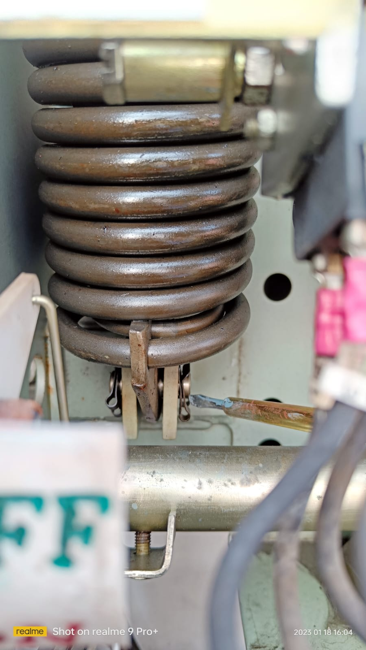
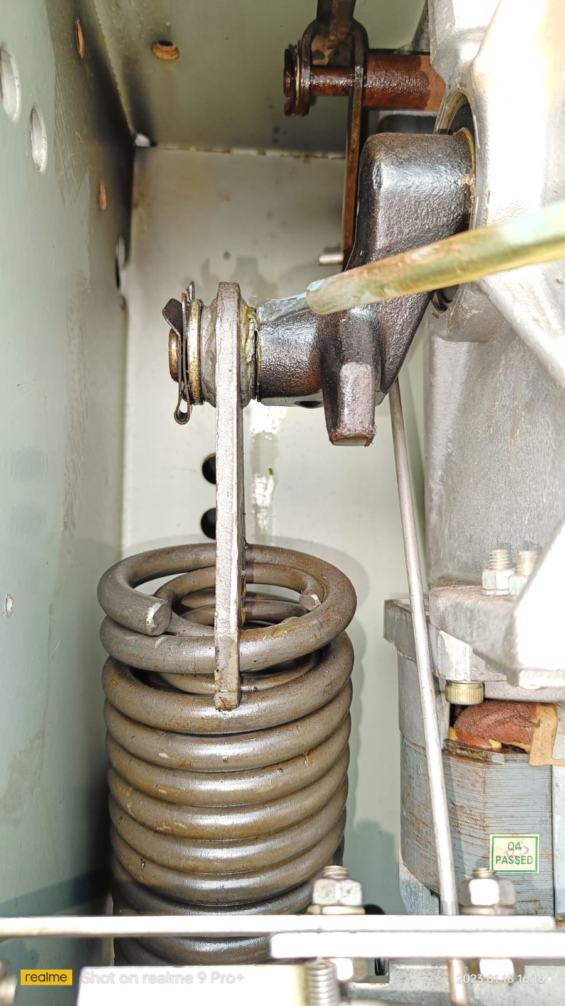
Closing spring: Lubricate the hinges and apply grease on closing spring to avoid rusting.

Slide 16
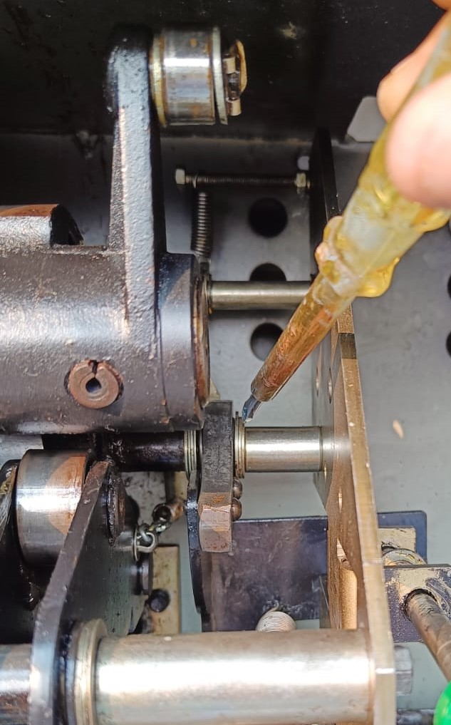
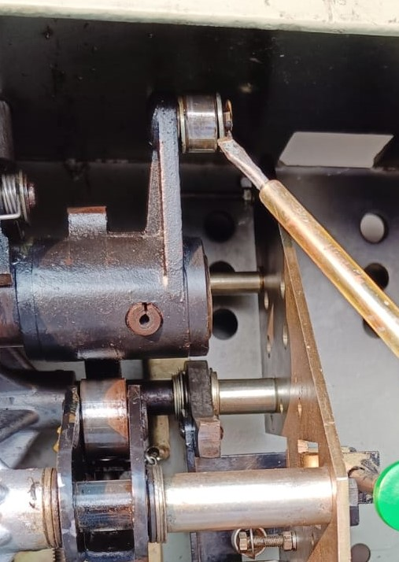
Close latch lubrication

Slide 17
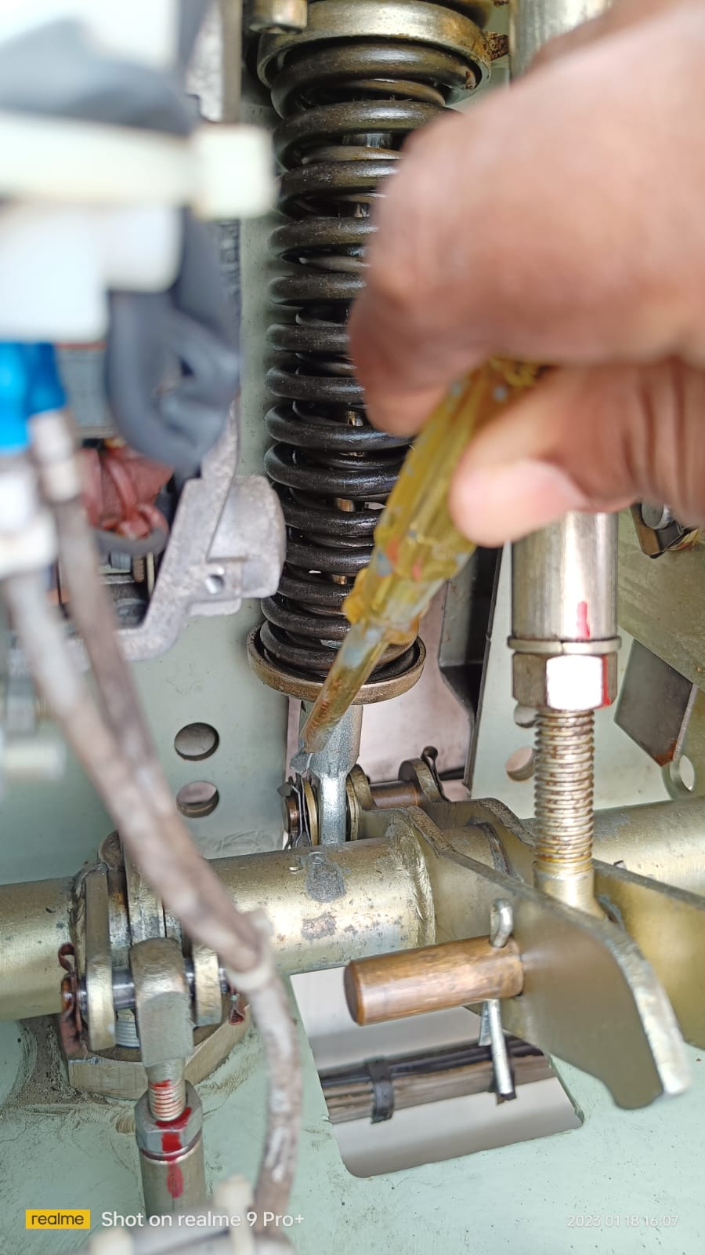
Tripping spring:
Lubricate the hinges and apply grease on tripping spring to avoid rusting.

Slide 18
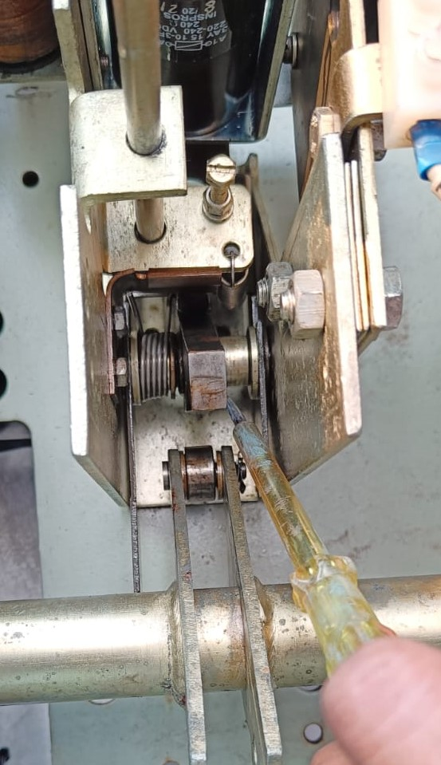
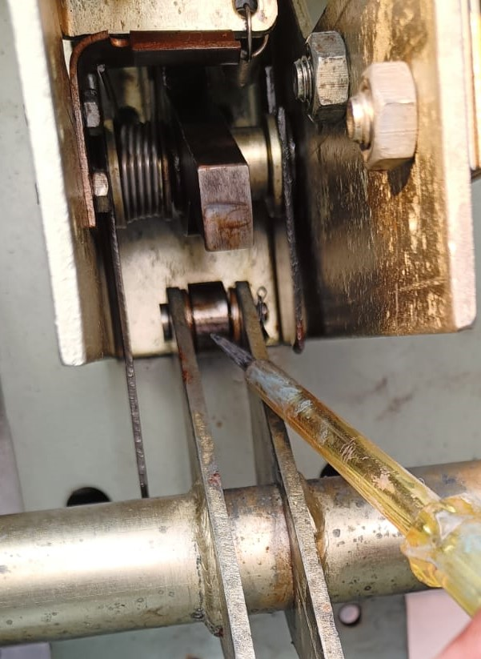
Trip latch lubrication

Slide 19
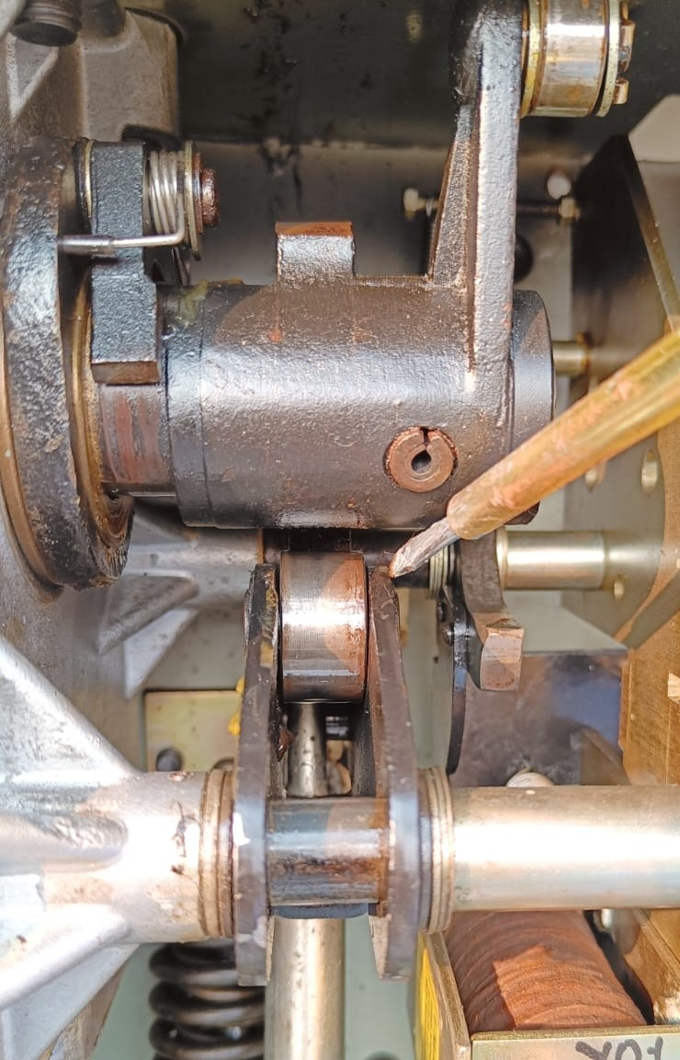
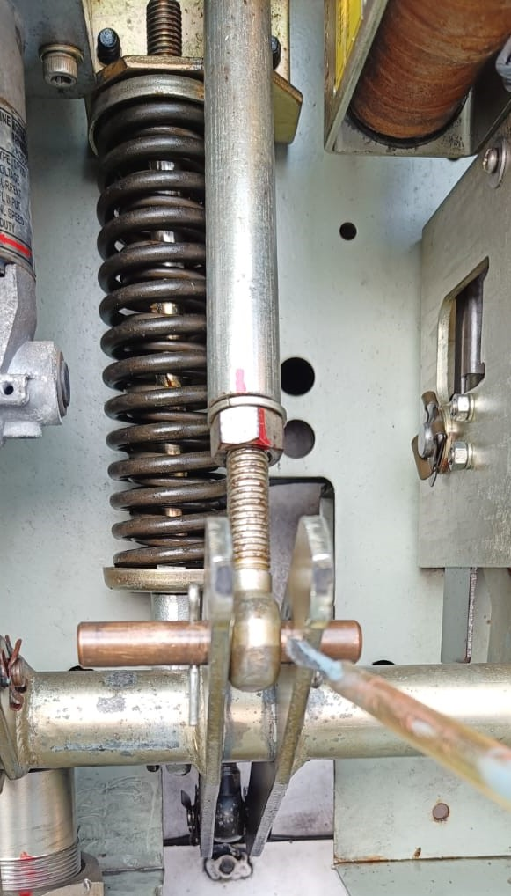
Eccentric cam-roller operating mechanism lubrication

Slide 20
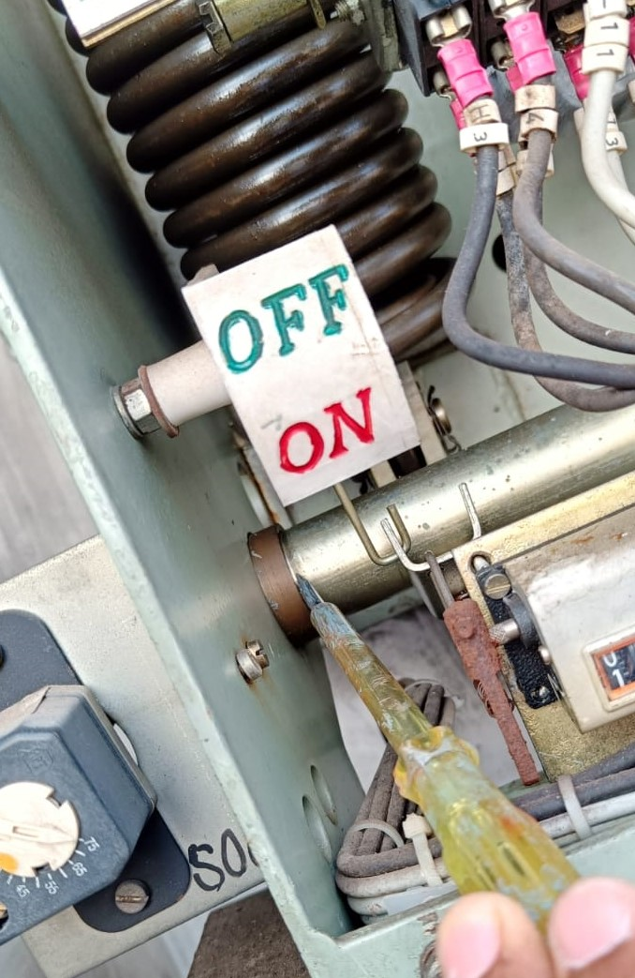
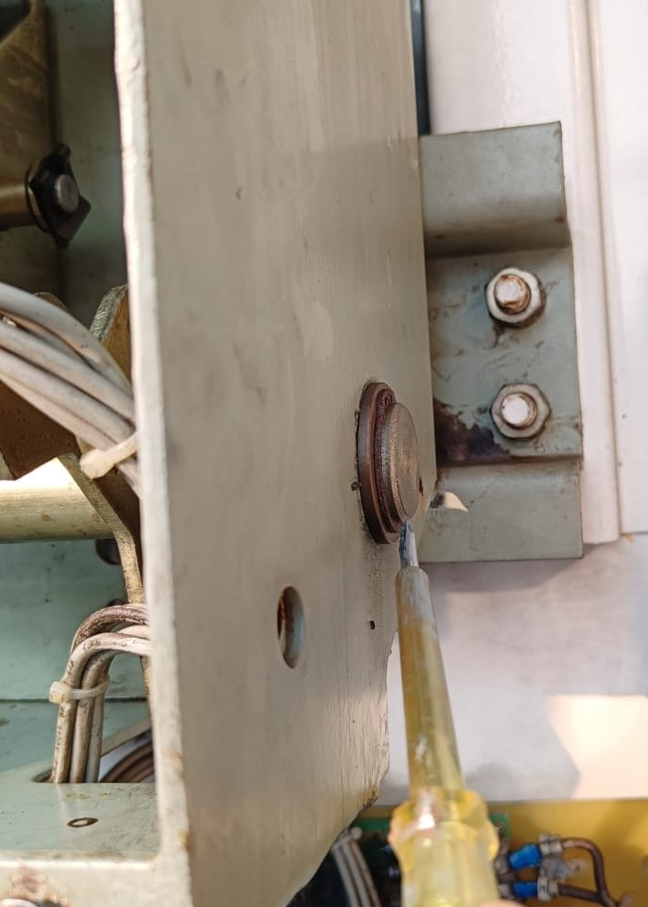
Common operating shaft lubrication

Slide 21
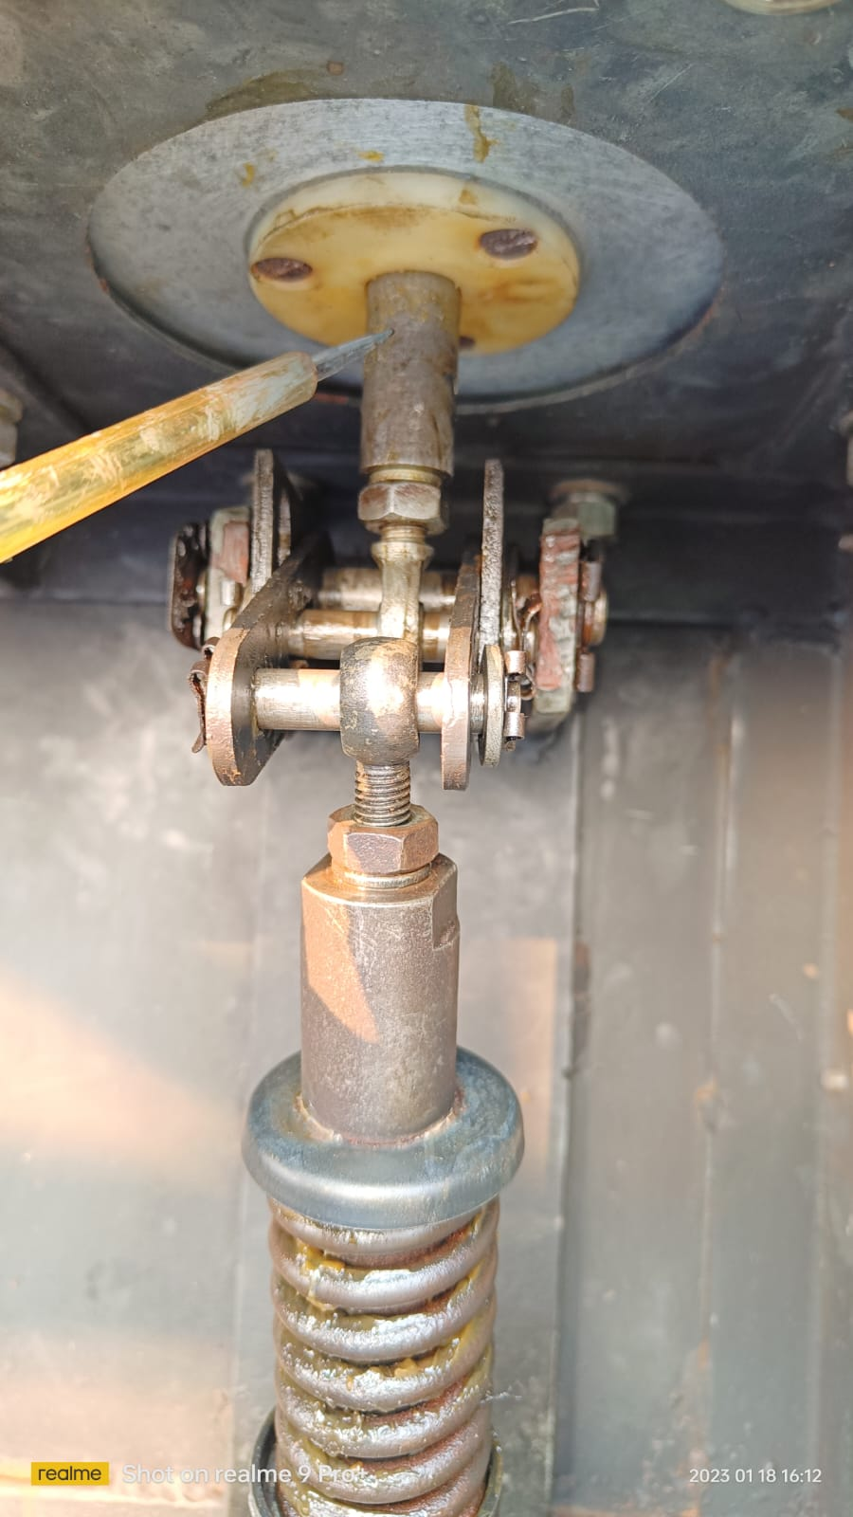
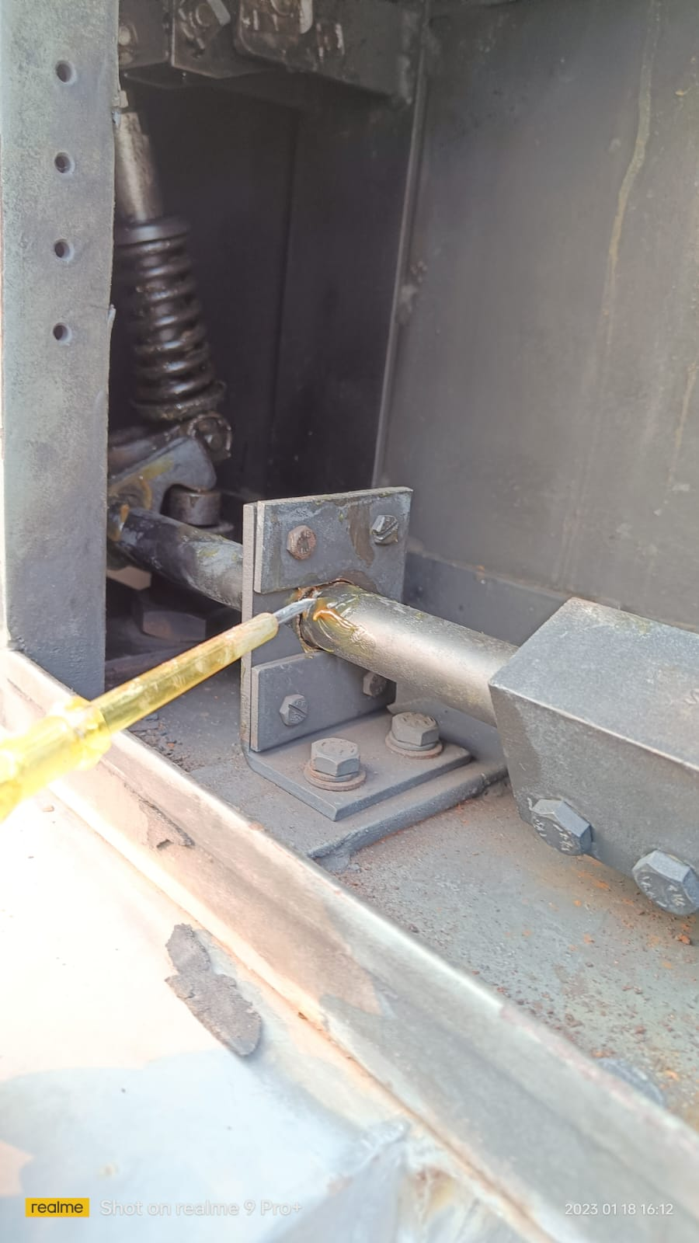
Lubrication of pole base mechanism

Slide 22
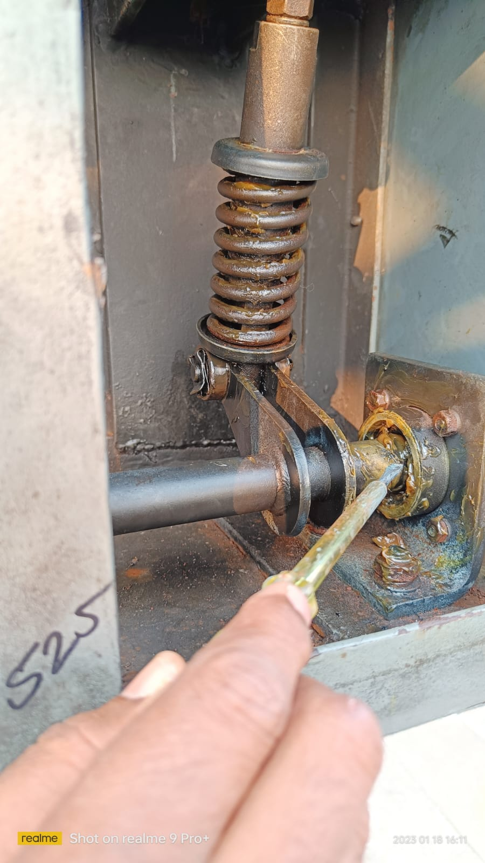
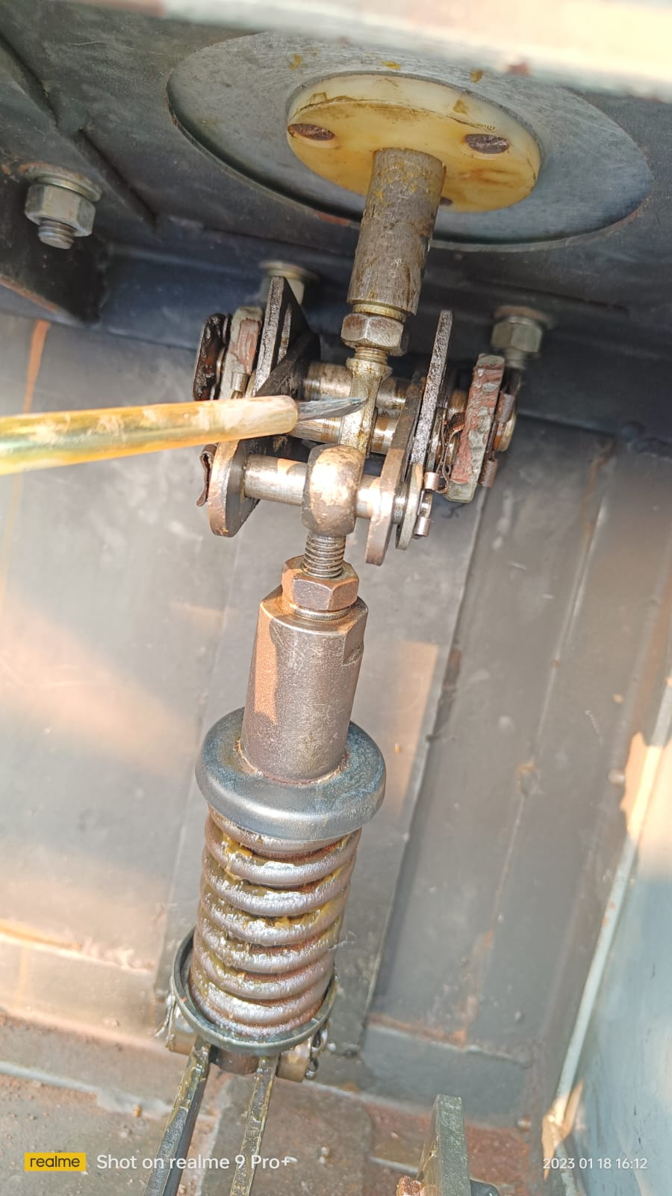
Lubrication of pole base mechanism

Slide 23
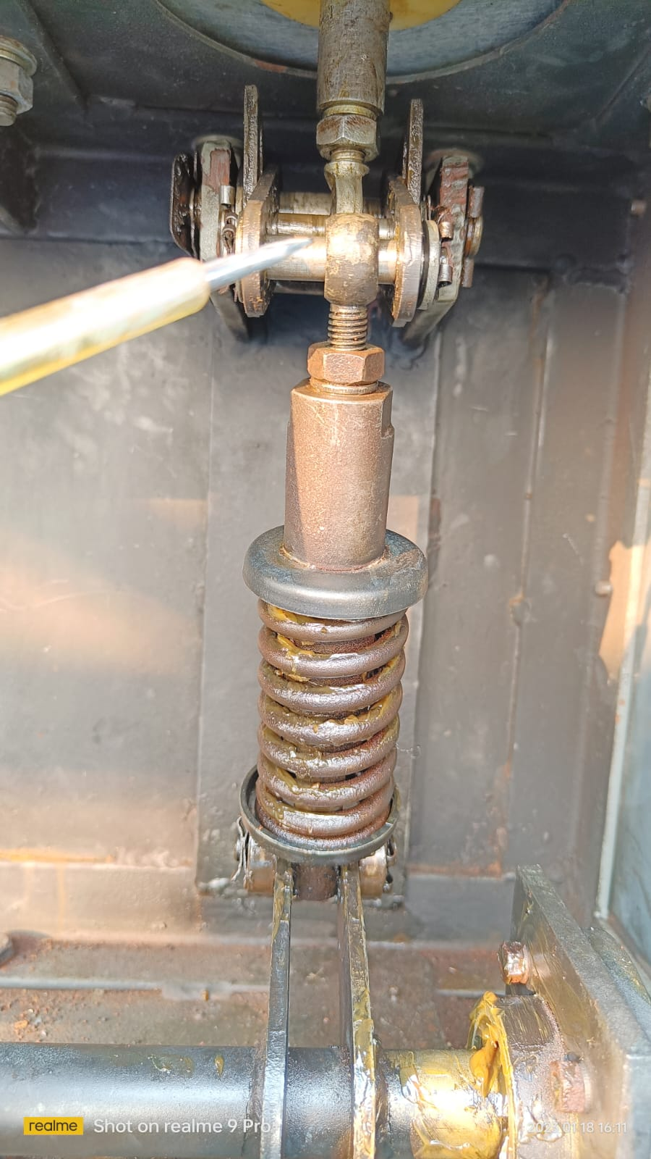
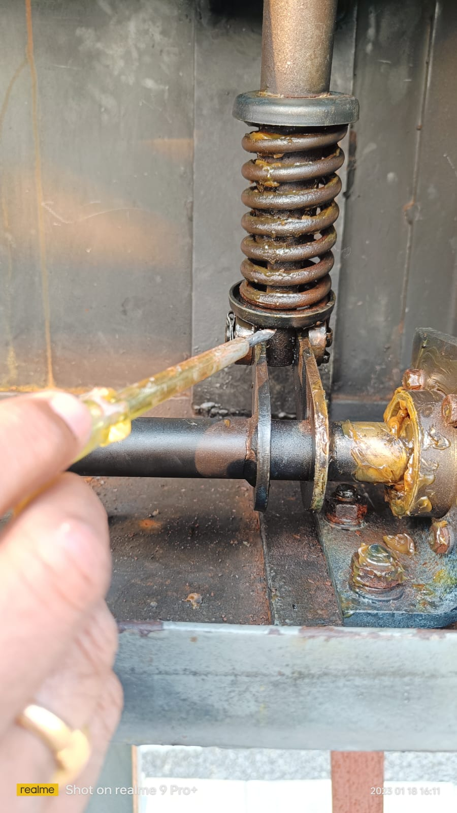
Lubrication of pole base mechanism

Slide 24
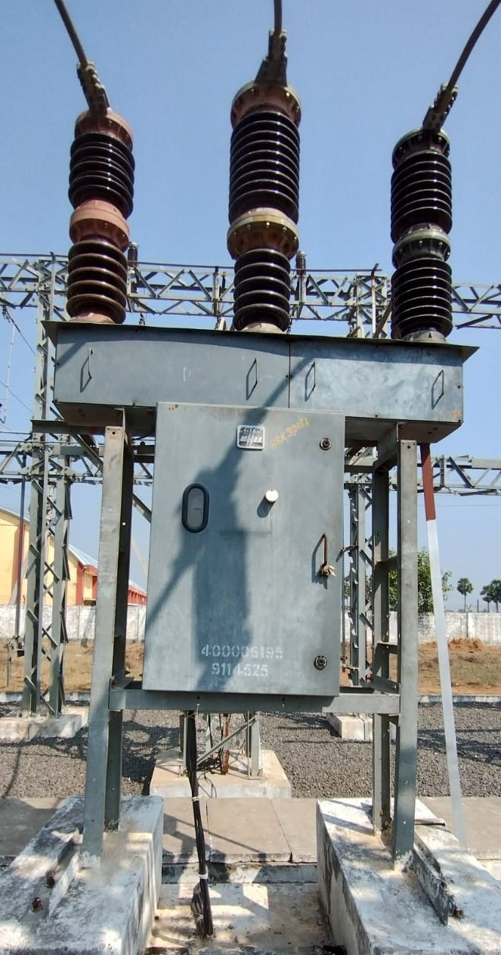
33kv BHEL make, PVN36 type Vacuum Circuit Breaker
A 33kv Circuit breaker consists of operating mechanism with 3 nos. poles (3 phase).

Slide 25
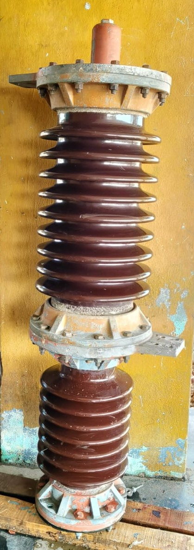
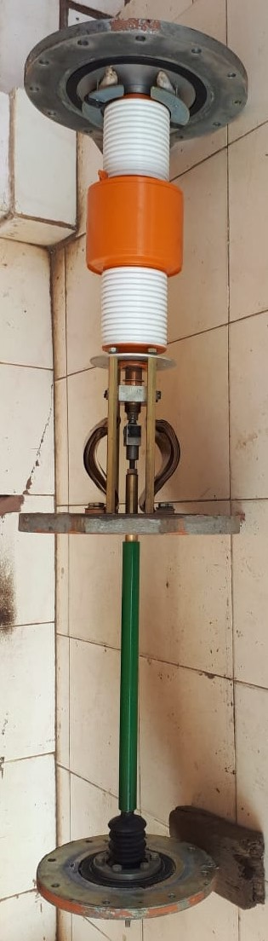
Each pole consists of 2 nos. porcelain insulators. Top one is interrupter unit consists vacuum bottle inside and bottom one is support insulator consists insulated pull rod inside. The support insulator along with insulated pull rod provides proper isolation to live contacts from earth.

Slide 26
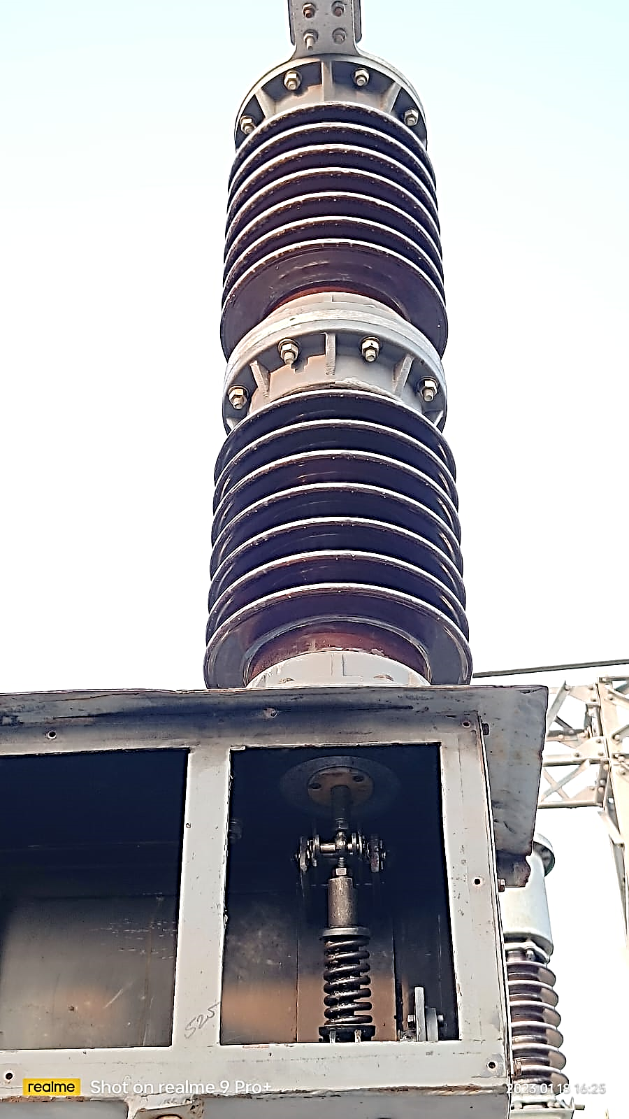
Physical verification of pole
Check porcelain insulators for any cracks and clean insulators periodically.
Check for abnormal temperatures at top interrupter unit by sensing with hand from top pad to middle pad. If more than ambient temperature is sensed at pad clamp joints rectify it by refixing the joints. If abnormal temperature is sensed across interrupter unit, it may be due to internal loose connection. It may lead to failure of vacuum interrupter. Then open the pole, refix the joints and replace the vacuum interrupter if necessary.

Slide 27
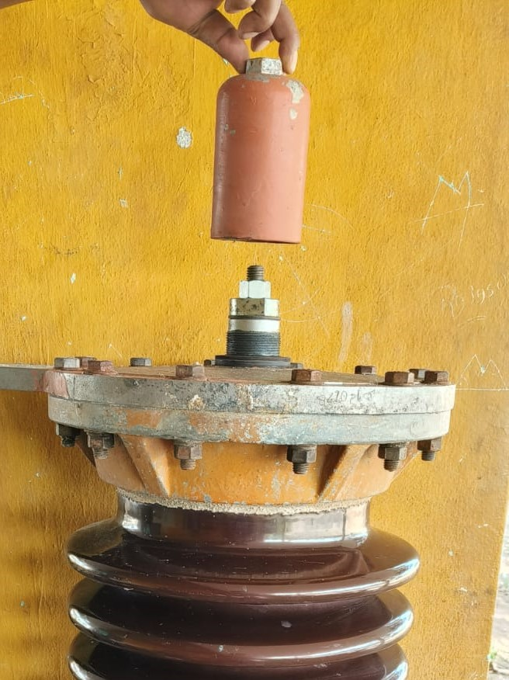
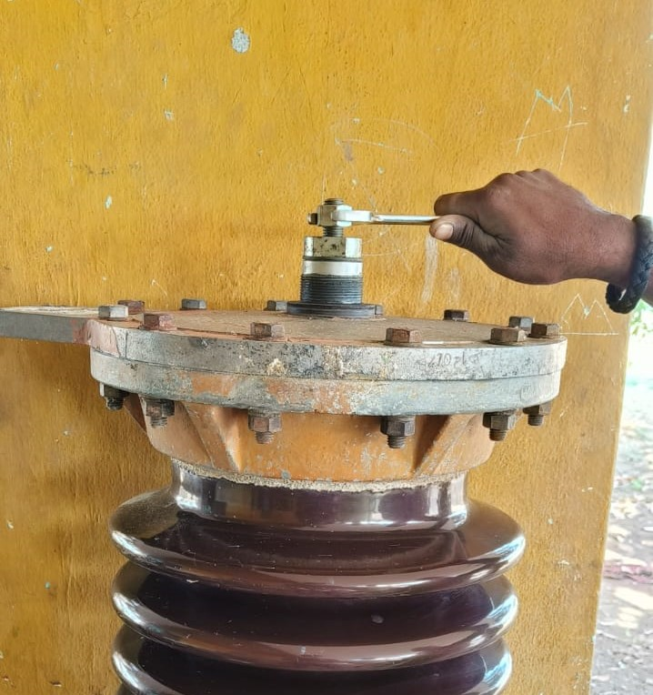
If abnormal temperature is sensed across interrupter unit, it may be due to internal loose connection. Then try this method.
1. Remove top cap of pole
2. Lock the support pin then remove the check nut

Slide 28
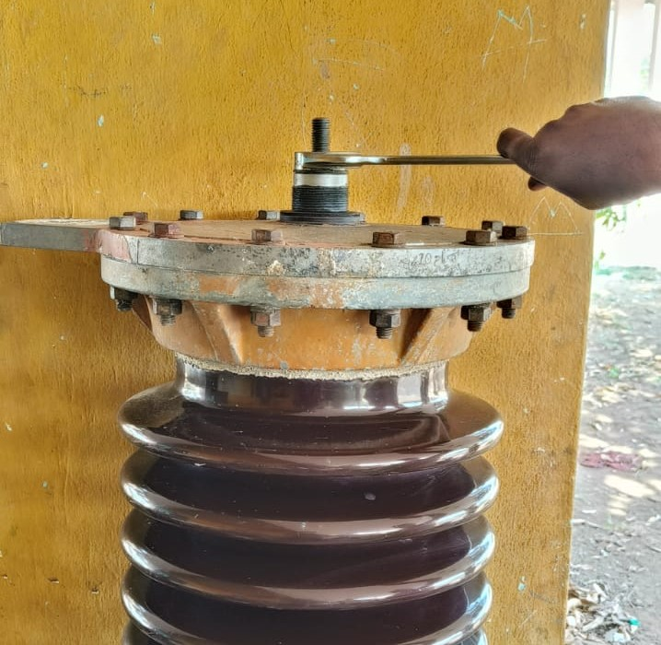
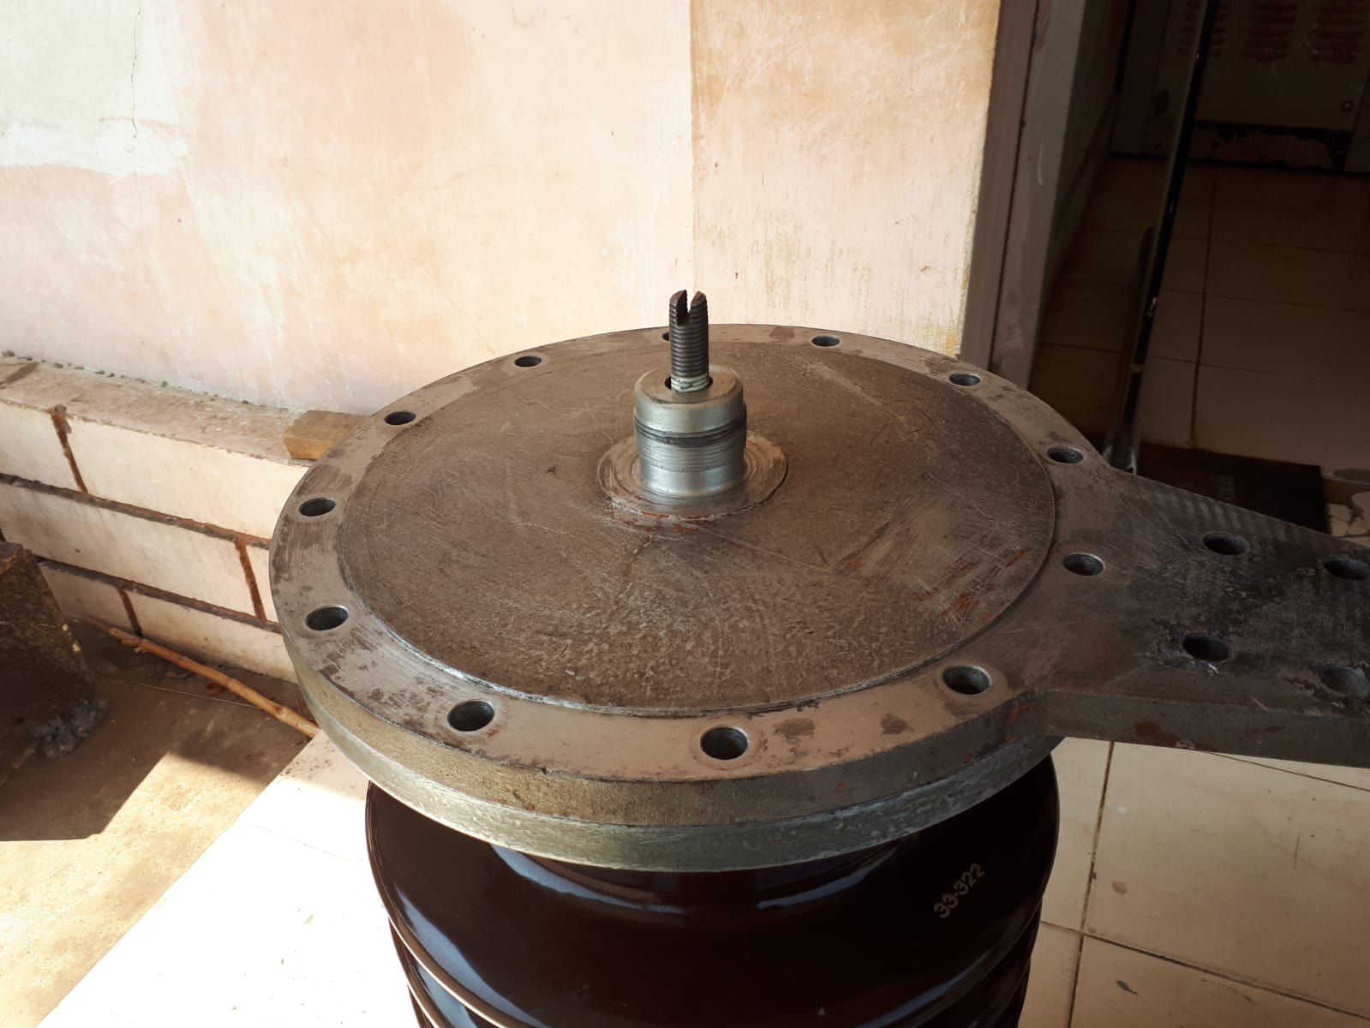
3.Lock the support pin then 4. Remove top plate bolt & Nuts remove the main nut

Slide 29
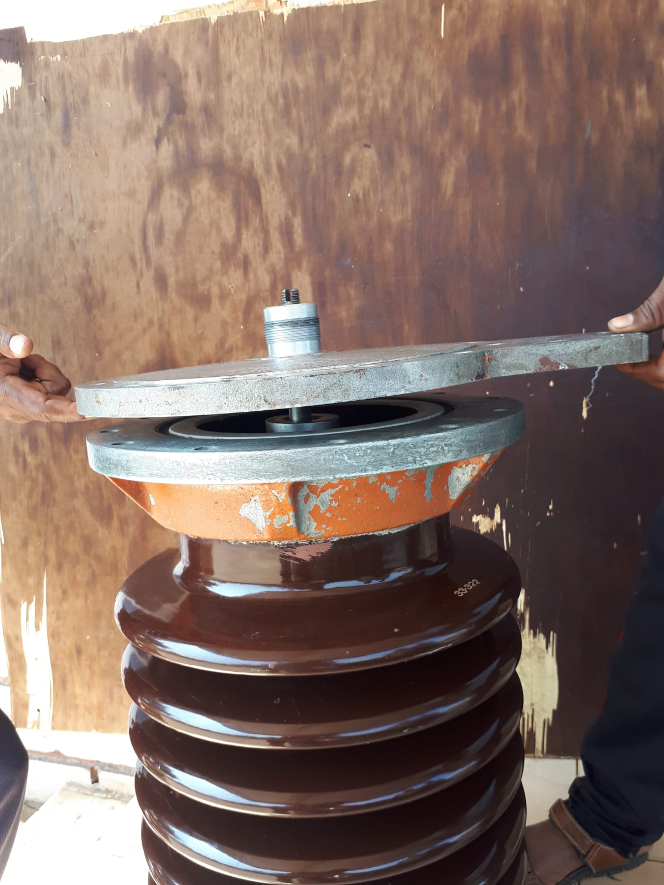
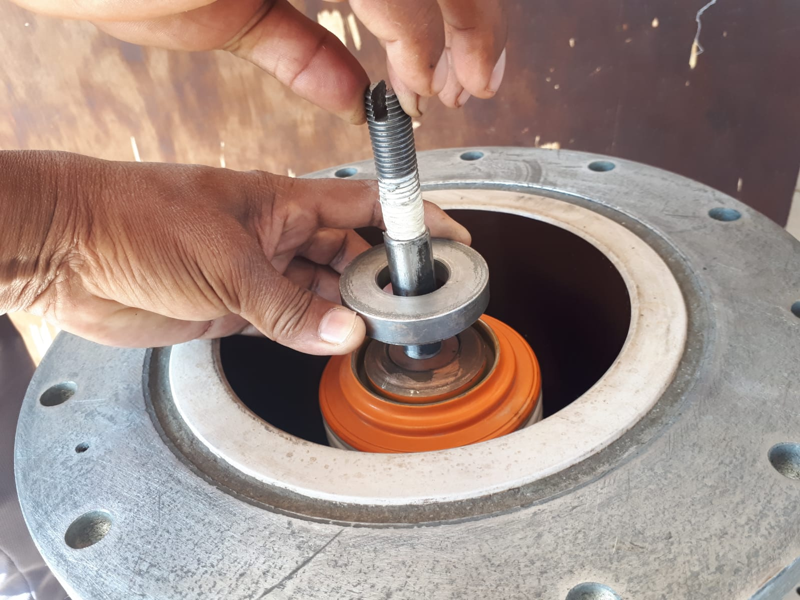
5. Open the top plate 6.clean vacuum bottle top contact and clean the copper bush then refix. Apply Teflon tape on main support pin to avoid entry of moisture

Slide 30
7. Rejoin the top plate with proper gasket arrangement then fix the main nut and tighten properly then fix the check nut and tighten properly. Finally close the top cap. Note: Don’t try to open top plate during low ambient temperature condition.

Slide 31
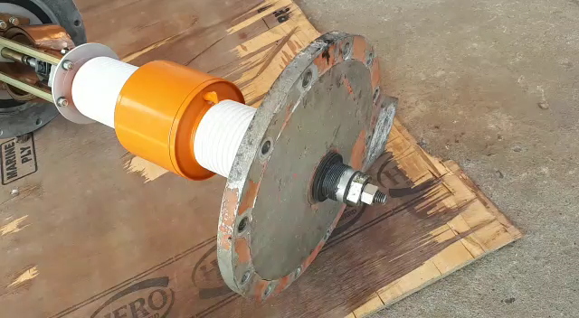
If the problem continues, then open the pole. The detailed view of internal arrangement of a 33kv pole of BHEL make, PVN36 type VCB

Slide 32
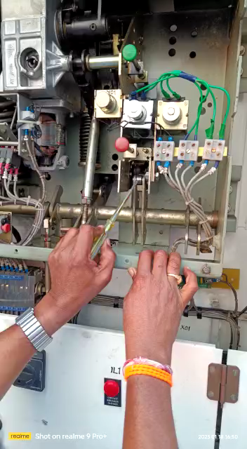
Trouble shooting: 1

Slide 33
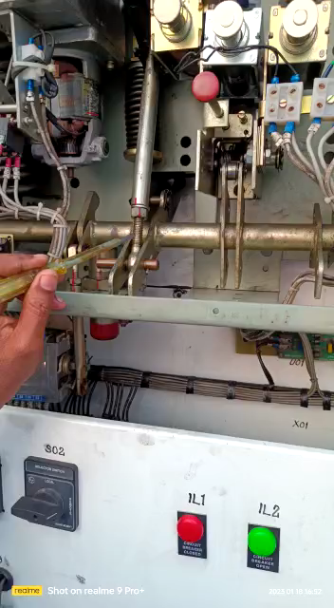
Trouble shooting: 2

Slide 34
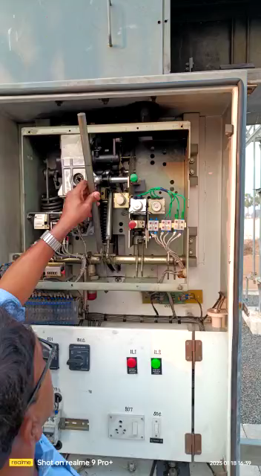
Checking of alignment of CB:1

Slide 35
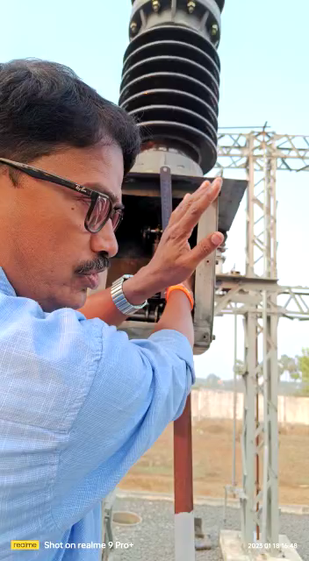
Checking of alignment of CB: 2

Slide 36
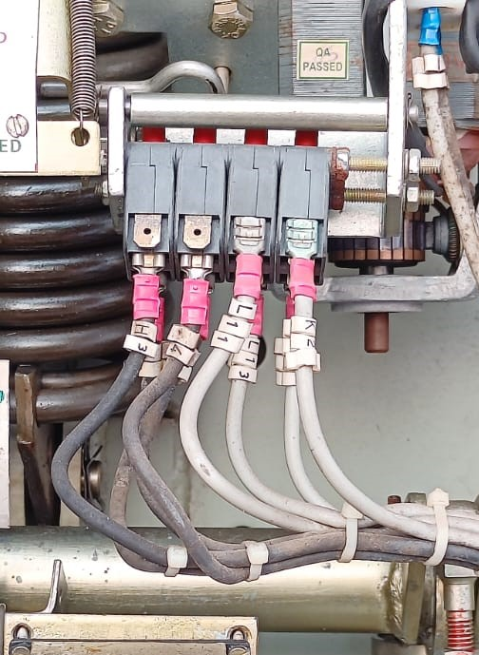
Limit switch
The main functions of limit switch in a Circuit Breaker are:
a) Extends AC supply to spring charge motor when close
spring is discharged and disconnects AC supply once
close spring fully charged.
b) Extends DC positive signal for spring charge indication
when closing spring fully charged.
c) Allows electrical close pulse to close coil when close
spring is fully charge.

Slide 37
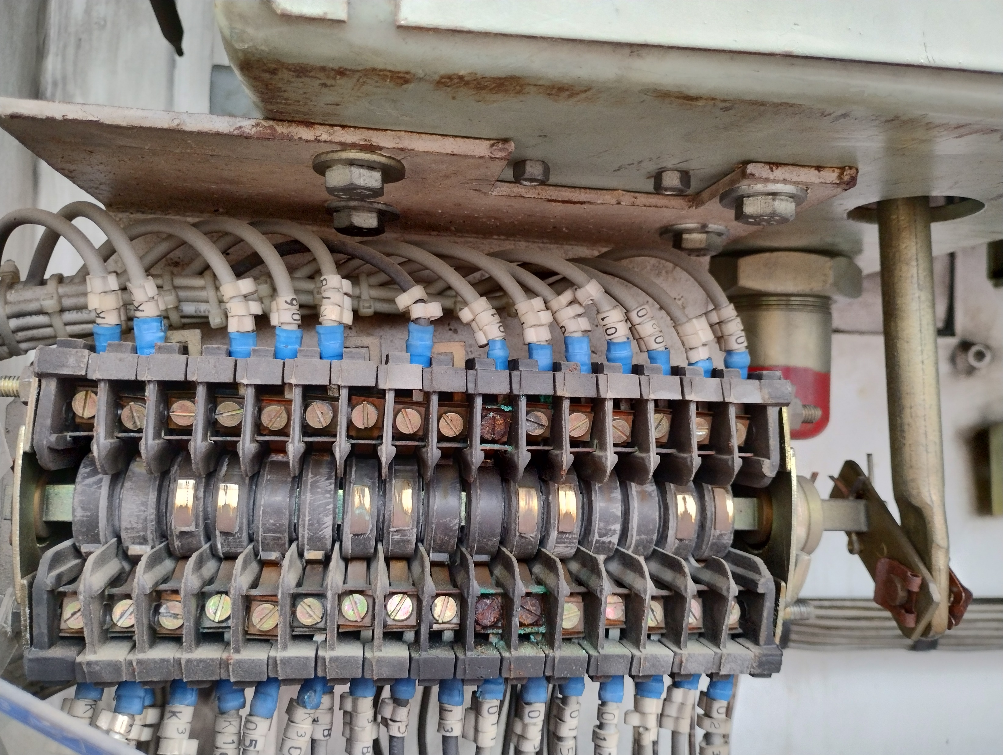
Auxiliary switch.
Auxiliary switch indicates the position (Breaker ON/OFF) of main contacts of the Circuit Breaker. Auxiliary switch is mechanically interlocked with the Circuit Breaker Operating Mechanism. When we Switch ON/OFF the Breaker, the Moving Contact changes its Position, and at the same time, Auxiliary Switch changes it state, when a predefined Distance is reached between the fixed and moving Contacts.
When, Auxiliary Switch changes its state, its contacts called as Auxiliary Contacts also change its state, i.e. NO (52a) Contacts become Close and NC (52b) contacts become open.

Slide 38
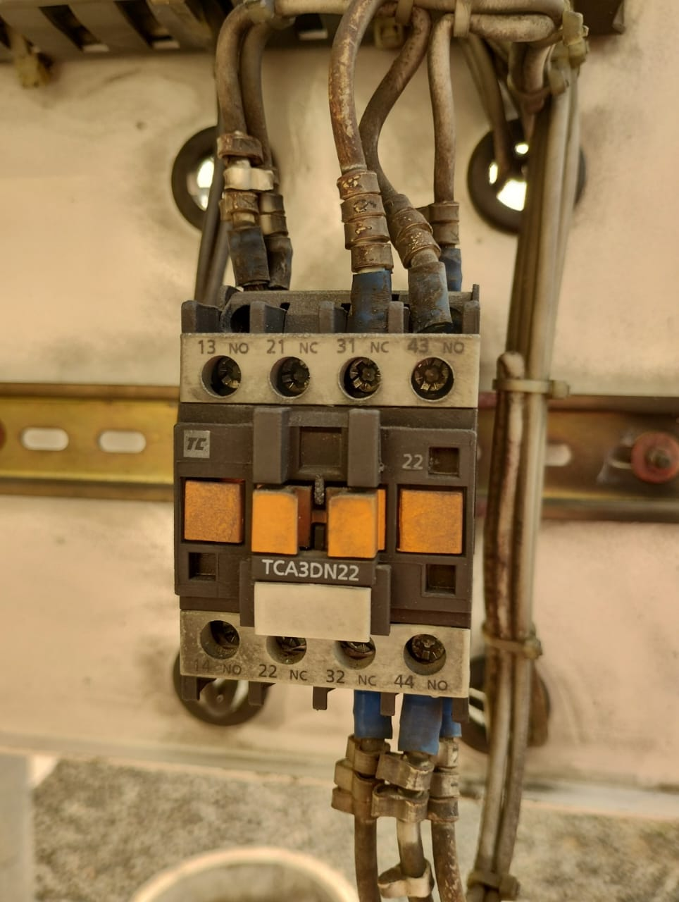
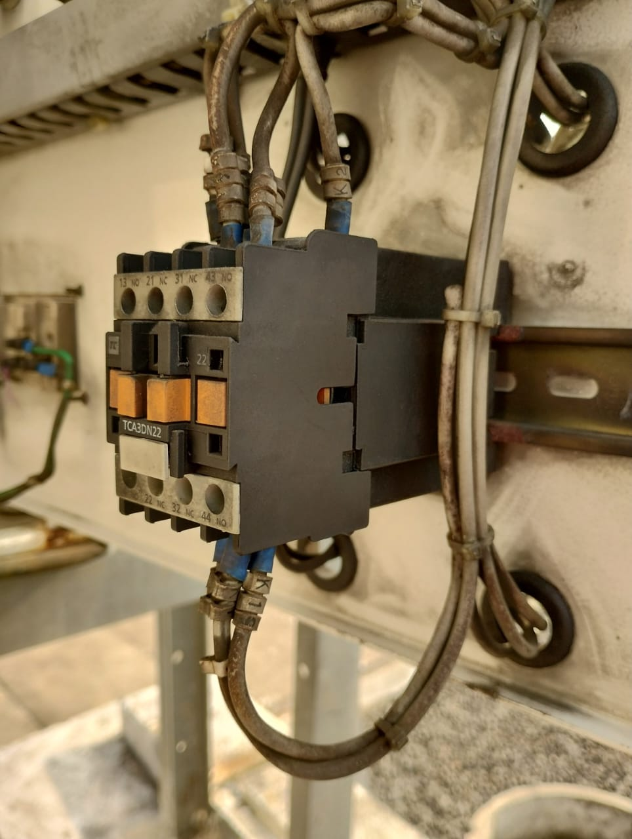
Anti-pumping relay: The anti-pumping relay or anti-hunting relay is a device in circuit-breaker whose function is to prevent multiple closing operations of breaker during SOTF condition, which can damage the closing mechanism of the breaker. Anti-Pump relay also provides protection from repeated closing operations in the event breaker TNC switch gets jammed in the close position. The effect of continuous closing of circuit breaker is called breaker hunting effect.

Slide 39
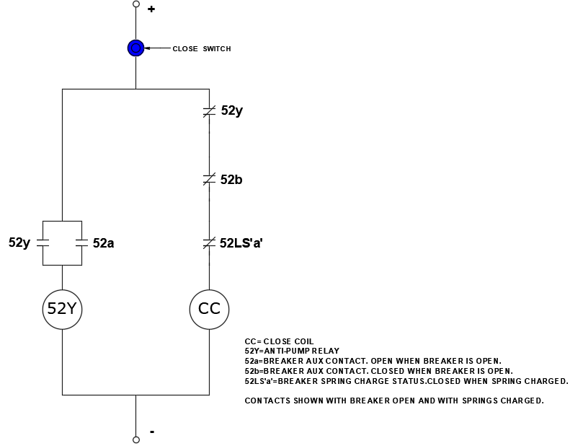
Schematic diagram of Anti-pumping relay in closing circuit of Circuit Breaker

Slide 40
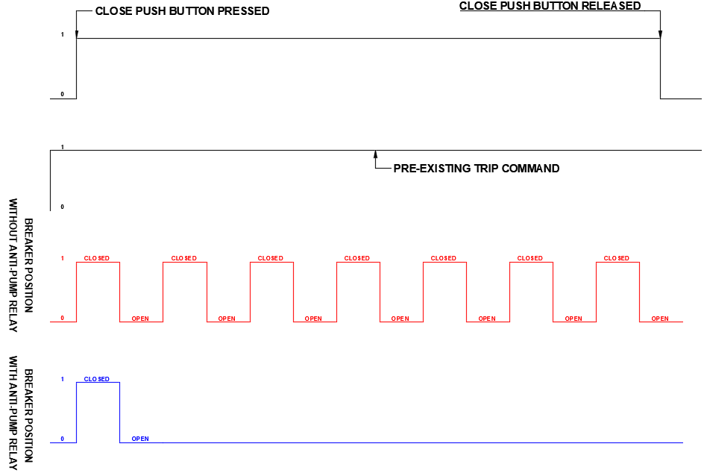
Comparison of Circuit breaker performance with and without Anti-pumping relay

Slide 41
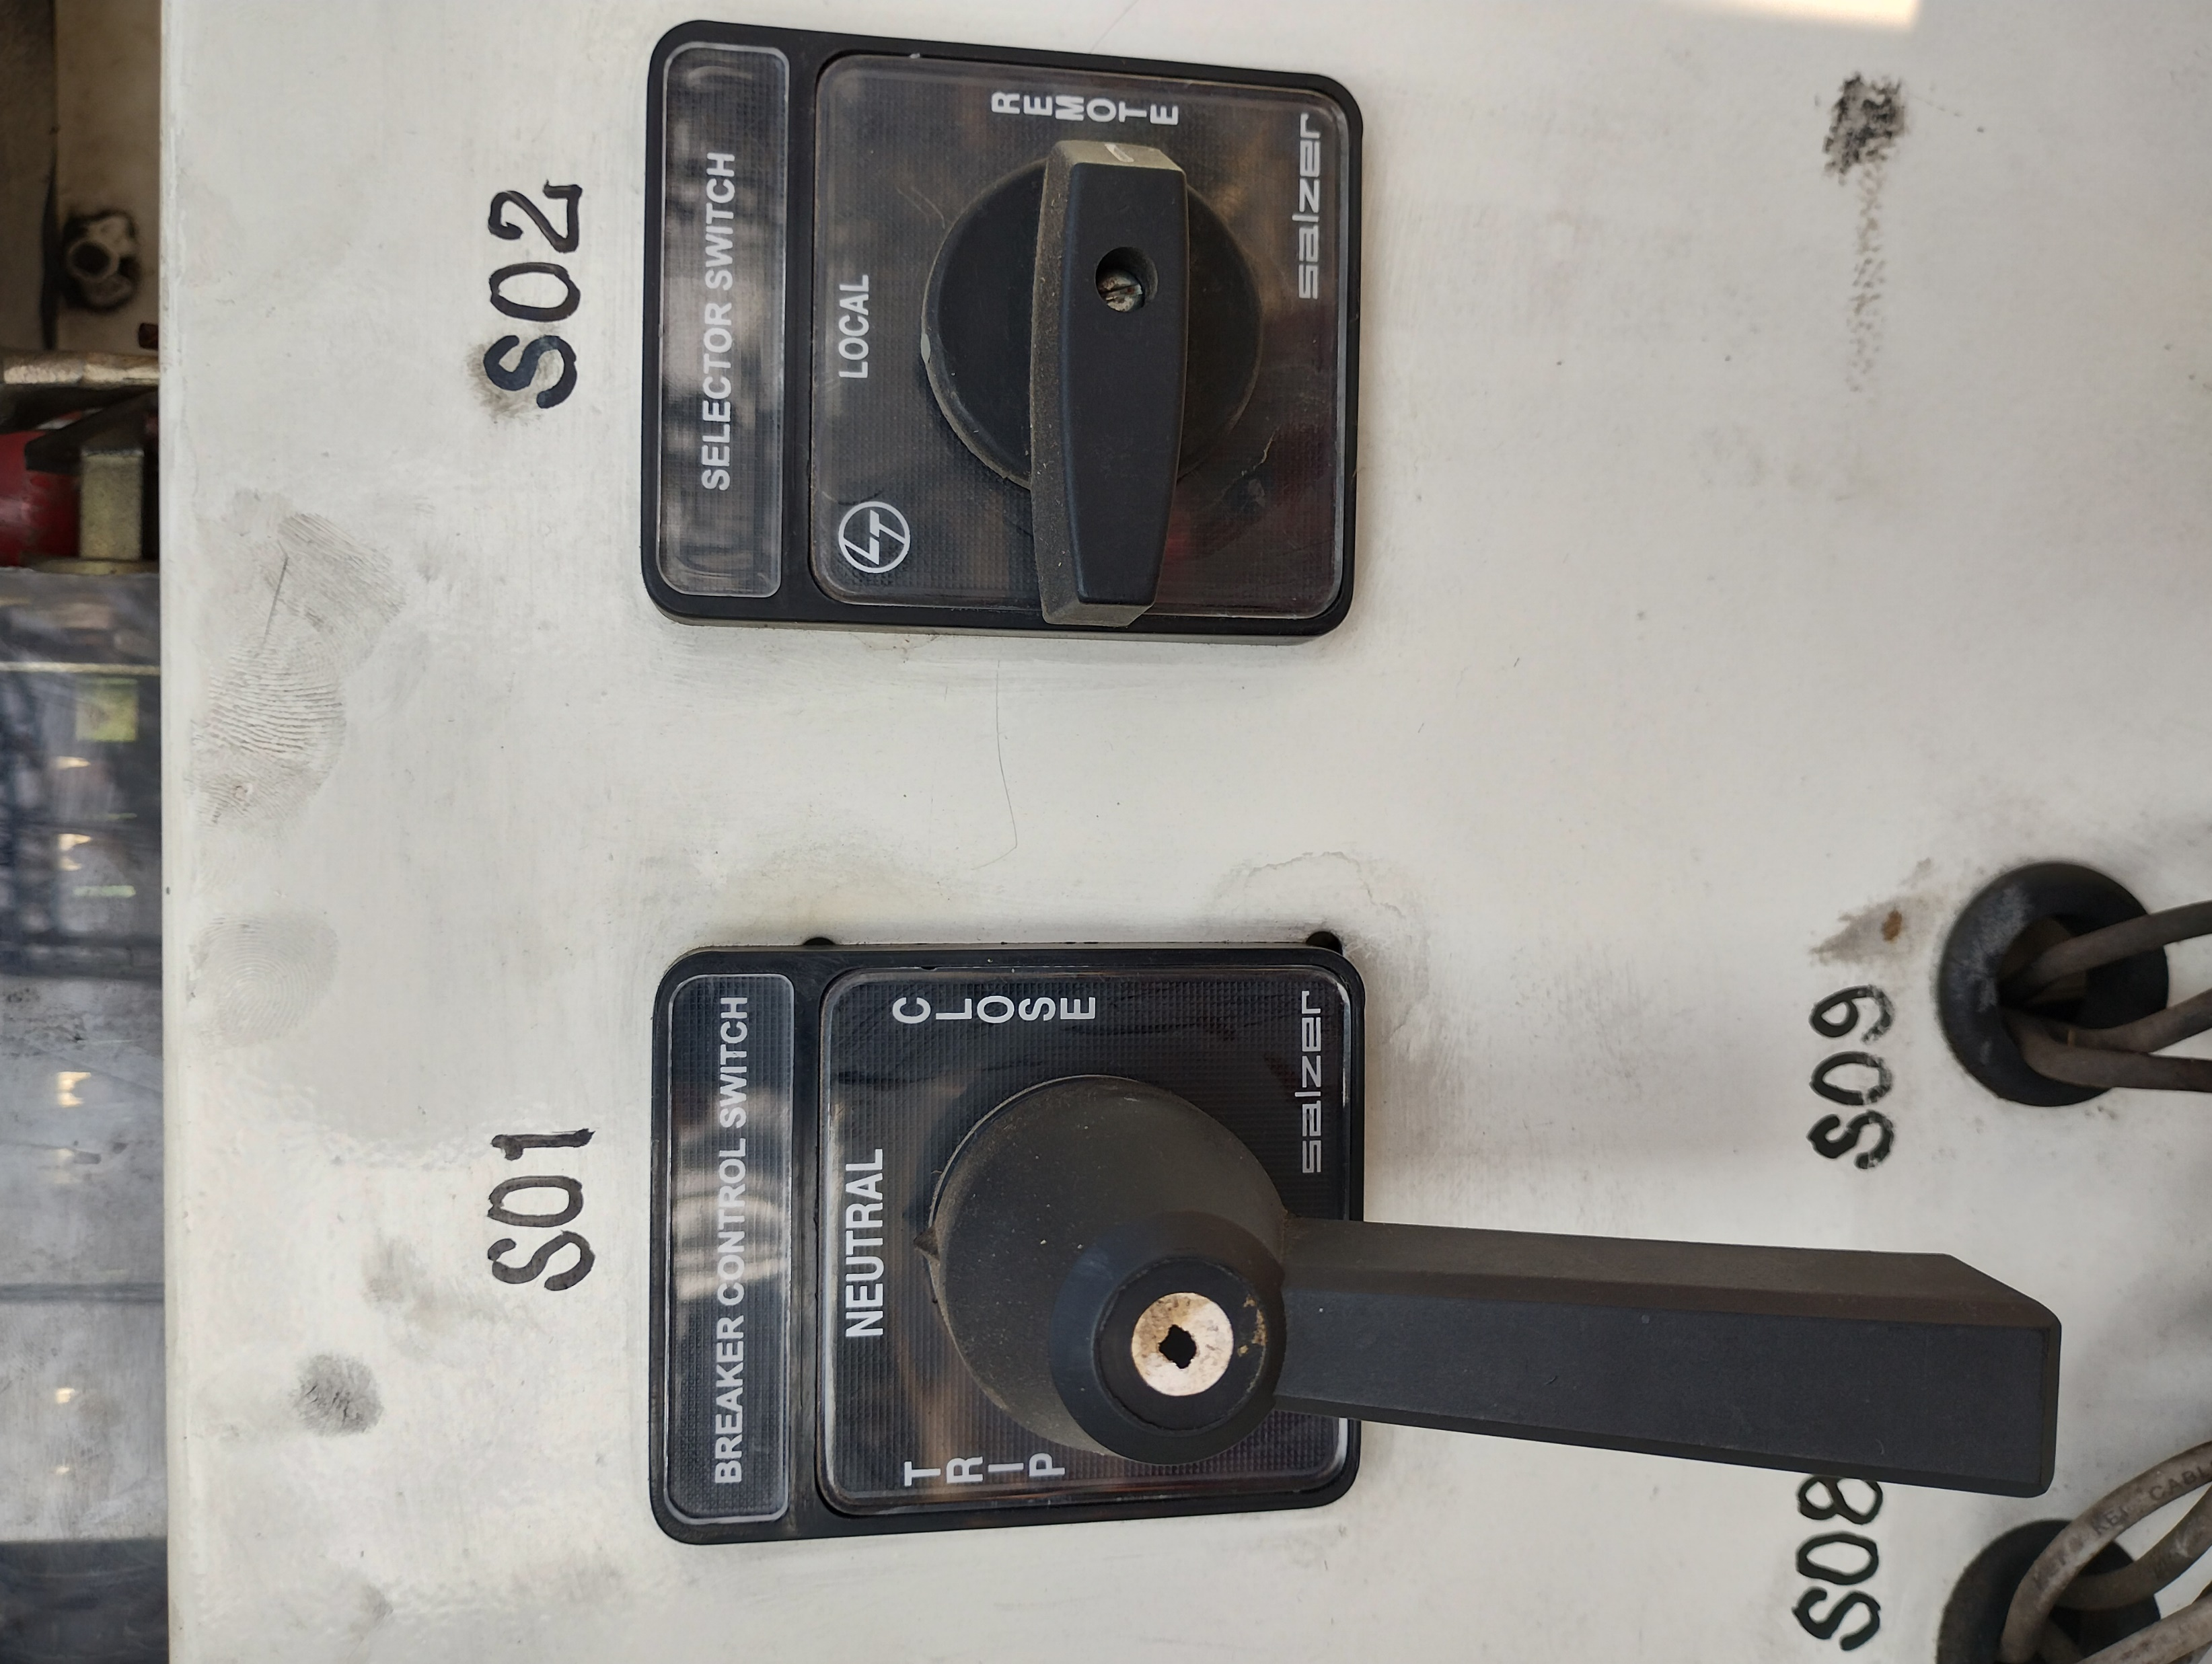
TNC switch and Local Remote switch

Slide 42


Study of electrical close circuit of 33kv Vacuum Circuit Breaker
The close coil is triggered manually to close the breaker. Closing coil should create mechanical stroke of plunger sufficient enough to operate closing mechanism of breaker. Each breaker manufacturer will calculate the plunger stroke force to operate the mechanism accordingly closing coils are designed and these close coils are not of continuous rating.
Hence the close coil will be interlocked with various safety systems to not permit the breaker to close if an abnormal or unsafe condition exists.
The following are the safety interlocks existing in closing circuit of a typical 33kv VCB.

Slide 43

Study of electrical close circuit of 33kv Vacuum Circuit Breaker
1. Auxiliary switch (52 a/b) is mechanically interlocked with the Circuit Breaker Operating Mechanism. When circuit breaker operates, the auxiliary switch contacts also changes their state, i.e. open contacts become close and close contacts become open.
Here the NC (52b) contact is introduced in the circuit to disconnect the DC positive pulse to close coil when the CB is closed. Hence protects the close coil from continuous DC positive pulse.

Slide 44

Study of electrical close circuit of 33kv Vacuum Circuit Breaker
2. Limit Switch (LS) is mechanically interlocked with the close spring charging mechanism. It consists NO / NC contacts. When close spring is fully charged, the contacts will change their state.
Hence an NO contact of Limit switch is introduced in the circuit to protect the close coil when close spring is not charged. It allows electrical close pulse to close coil when close spring is fully charge.

Slide 45

Study of electrical close circuit of 33kv Vacuum Circuit Breaker
3.Anti-pumping relay: The anti-pumping relay or anti-hunting relay is a device in circuit-breaker whose function is to prevent multiple closing operations of breaker during SOTF condition, which can damage the closing mechanism of the breaker.
Anti-Pump relay also provides protection from repeated closing operations in the event breaker close push button gets jammed in the close position.
Hence an anti-pumping relay is introduced in the circuit to prevent continuous closing of circuit breaker.

Slide 46

Study of electrical close circuit of 33kv Vacuum Circuit Breaker
4. Electrical interlock is introduced in the circuit to interlock with the associated equipment in the bay or other equipment in the sub-station for conditional operations.
Normally this interlock is shorted when no interlocking is needed.

Slide 47

Study of electrical close circuit of 33kv Vacuum Circuit Breaker
5.Local-Remote selector switch is introduced in the circuit to operate the Circuit breaker locally or from C&R panel in the control room.
For local testing operations the LR switch can be kept in Local mode. To keep the circuit breaker in service, the LR switch should be kept in Remote mode and operate the CB from C&R panel.
Note:
Don’t operate the CB locally while in service.

Slide 48
Study of electrical close circuit of 33kv Vacuum Circuit Breaker
6.Master Trip Relay is a trip relay in C&R panel which receives command from protective relaying system and extends trip pulses to circuit breaker to trip under abnormal or fault current flow condition.
In addition to trip (NO) contacts, the Master Trip Relay contains one NC contact which is connected in the close circuit of CB.
The main function of this NC contact is to block the close pulse when master trip relay operates and till reset of relay. As long as the master trip relay is not done reset, the trip pulse will be present and the CB will get tripped immediately after closing.
Note:
Before closing the CB, reset the master trip relay

Slide 49
Study of electrical trip circuit of 33kv Vacuum Circuit Breaker
Trip coil should create mechanical stroke of plunger sufficient enough to operate the trip mechanism of breaker. Each breaker manufacturer calculate the plunger stroke force to operate the mechanisms and accordingly trip coil is designed.

Slide 50
Study of electrical trip circuit of 33kv Vacuum Circuit Breaker
1. Auxiliary switch (52 a/b) is mechanically interlocked with the Circuit Breaker Operating Mechanism. When circuit breaker operates, the auxiliary switch contacts also changes their state, i.e. open contacts become close and close contacts become open.
Here the NO (52a) contact is introduced in the circuit to disconnect the DC positive pulse to trip coil when the CB is opened. Hence protects the trip coil from continuous DC positive pulse as the trip coil is not of continuous rating type.

Slide 51
Study of electrical trip circuit of 33kv Vacuum Circuit Breaker
2. Local-Remote selector switch and Master trip relay is introduced in the circuit to operate the Circuit breaker locally or from C&R panel in the control room and to trip the CB under abnormal or fault current flow condition.
For local testing operations the LR switch can be kept in Local mode. To keep the circuit breaker in service, the LR switch should be kept in Remote mode and operate the CB from C&R panel.
Basically the Trip coil is connected to a sensitive circuit (protective relaying system) directly to disconnect power line under abnormal or fault current flow condition. Hence no other interlocks connected in the circuit.
Note:
Don’t operate the CB locally while in service.

Slide 52


Study of electrical trip circuit of 33kv Vacuum Circuit Breaker
3. Trip circuit supervision is introduced in the circuit to monitor the healthiness of trip coil continuously.

Slide 53
Study of electrical trip circuit of 33kv Vacuum Circuit Breaker
Instead of loop, a push button is connected in pre-close supervision circuit to avoid coil failures.

Slide 54
Important
The 33kv circuit breaker mechanism is designed to close the circuit with in 60-70 m Sec of time when it receives close command and to open the circuit with in 30-40 m Sec of time when it receives trip command from protective relaying system.
The operating sequence of a 33kv circuit breaker is O-0.3s-CO-3min-CO. It indicates that after 1st opening operation, the CB mechanism will be ready for close operation with in 300 m sec time and immediately after 2nd opening the mechanism requires 3 min time for close operation.
Lack of lubrication is one of the cause for sluggish operations of CB. Hence it is mandatory to keep the CB mechanism in perfect lubricated condition periodically to avoid sluggish operations of CB and to maintain closing time and tripping time with in the limits.
Note:
Too much lubrication may be avoided.
Don’t use removed engine oil for lubrication.

Slide 55
Thank you one and all
B KameswaraRao
Executive Engineer
MRT & Tr, Srikakulam

