Slide 2



CASE STUDY-23……
Replacement of 50MVA PTR LV Circuit Breakers at 132KV SS Chilakaluripet duly bypassing the existing LV VCB by forming the LV Auxiliary Bus
Action taken
We have taken our own time for new foundation for new BHEL make VCB.
After complete curing, LC was taken for few hours and Aux. Bus was removed. New VCB was erected and wiring completed.
After conducting the pre-commissioning tests and restoring the Normalcy in protection, new LV VCB was taken into service.
In the same manner, LV VCB of the other PTR was also replaced.
2

Slide 3
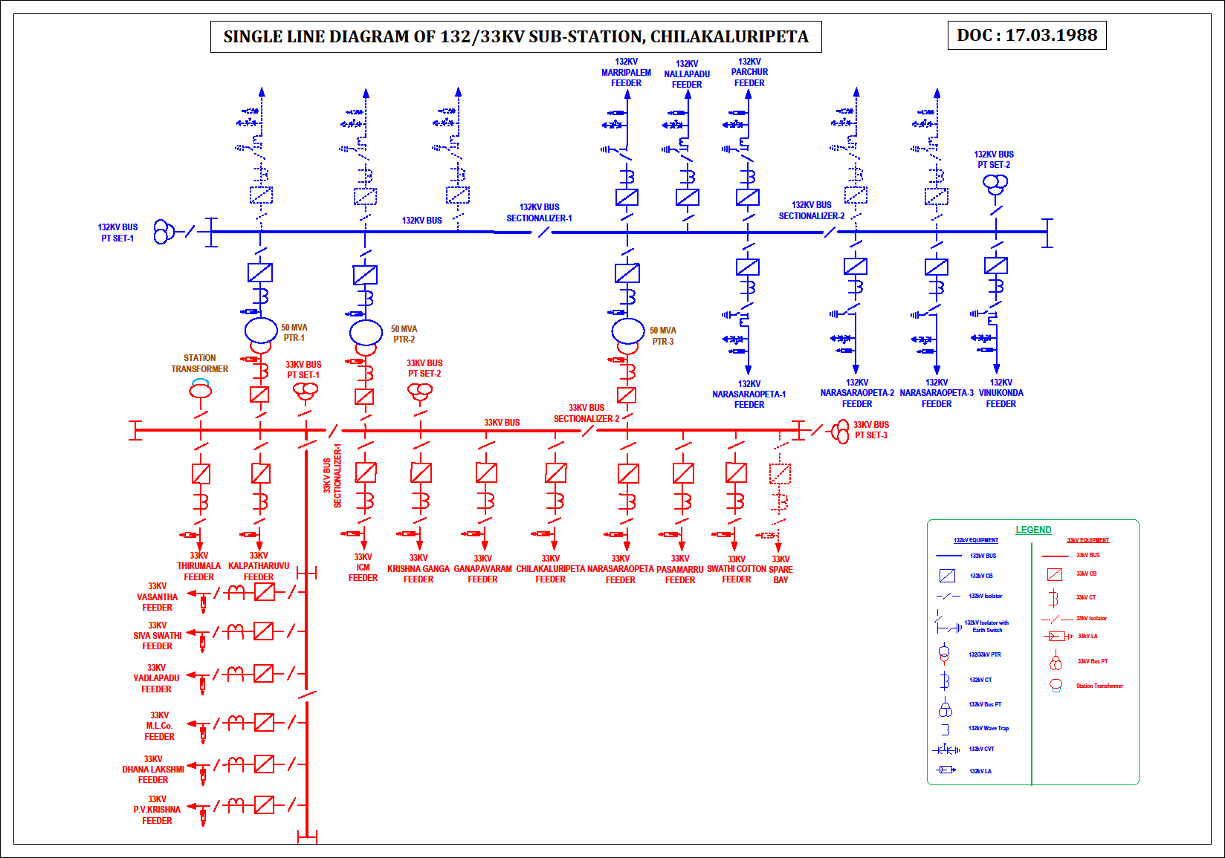

Slide 4
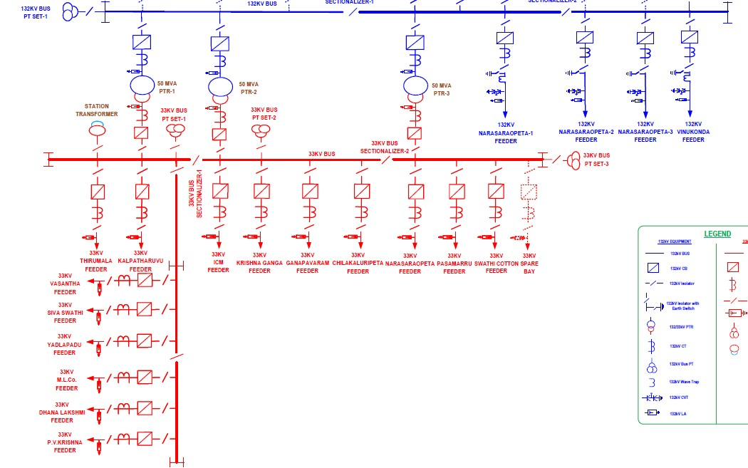

Slide 5
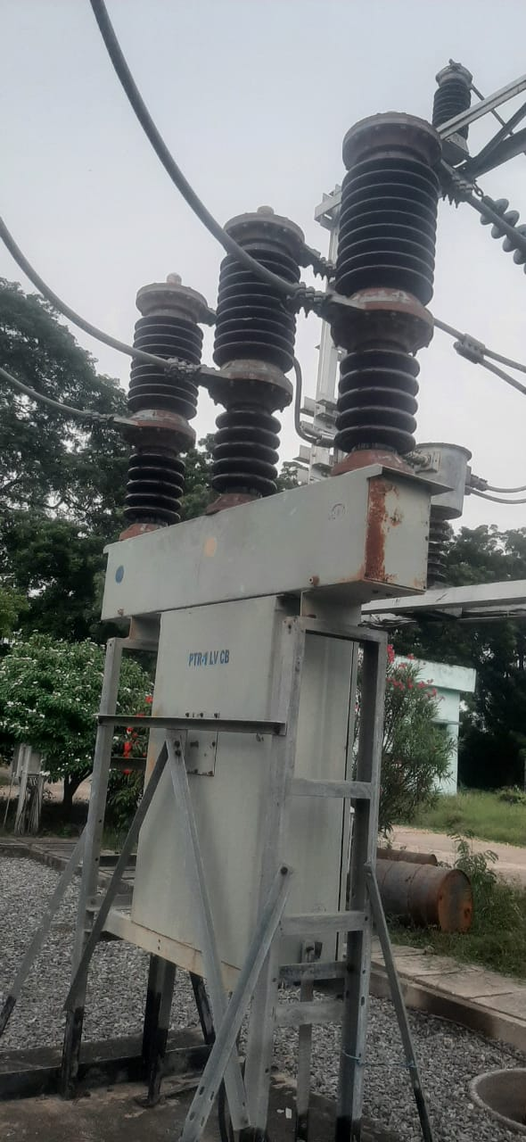
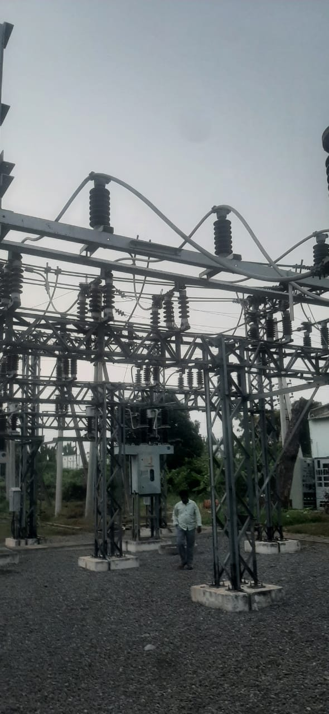

Slide 6
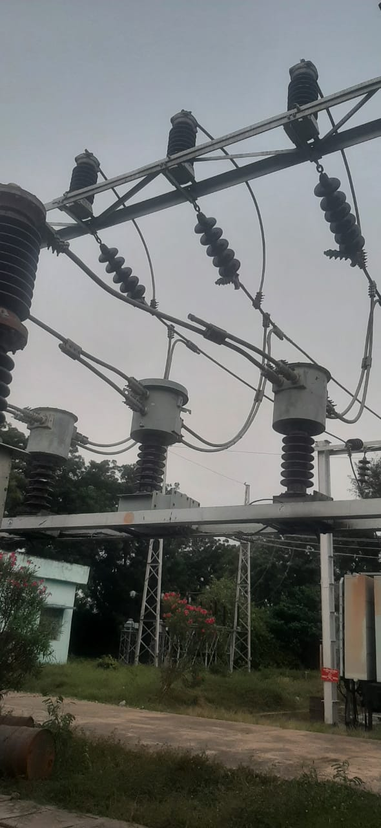
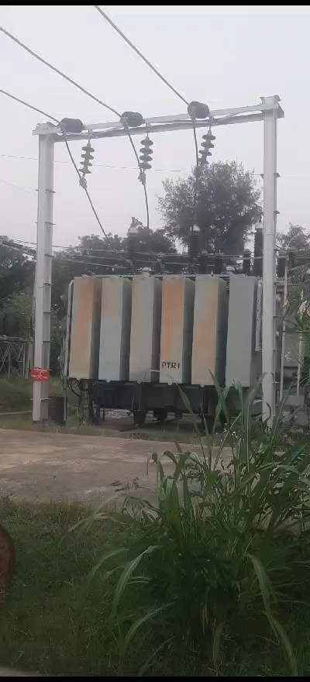

Slide 7
